Slide 1


Tutorial Series on Sequential Decision Analytics
Warren B Powell
Professor Emeritus, Princeton University
Recorded: August 12, 2026
Module: Choosing policies – The process of choosing the type of policy is very dependent on the specific characteristics of a problem.
Predecessor module(s): Designing policies (overview)
Technical level: Nontechnical

Slide 2


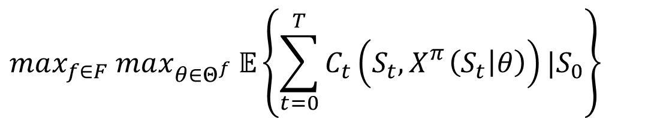

Choosing policies
Searching over policies $X_{}^{π}\left(S_{t} | θ\right)$, $π=(f,θ)$:
$$max_{f∈F} max_{θ∈Θ^{f}} 𝔼\left\{\sum_{t=0}^{T}{C_{t}\left(S_{t},X_{}^{π}\left(S_{t} | θ\right)\right)}|S_{0}\right\}$$
Hybrids
CFAs with PFAs
DLA with VFA
DLA with CFA
VFA with PFA
VFA with CFA
PFA, CFA, DLA
PFA, DLA, VFA
PFA, CFA, VFA, DLA
The four classes of policies:
Policy function approximations
Cost function approximations
Value function approximations
Direct lookahead approximations
$$θ^{n+1}=θ^{n}+α_{n}∇_{θ}F(θ^{n},W^{n+1})$$

Slide 3
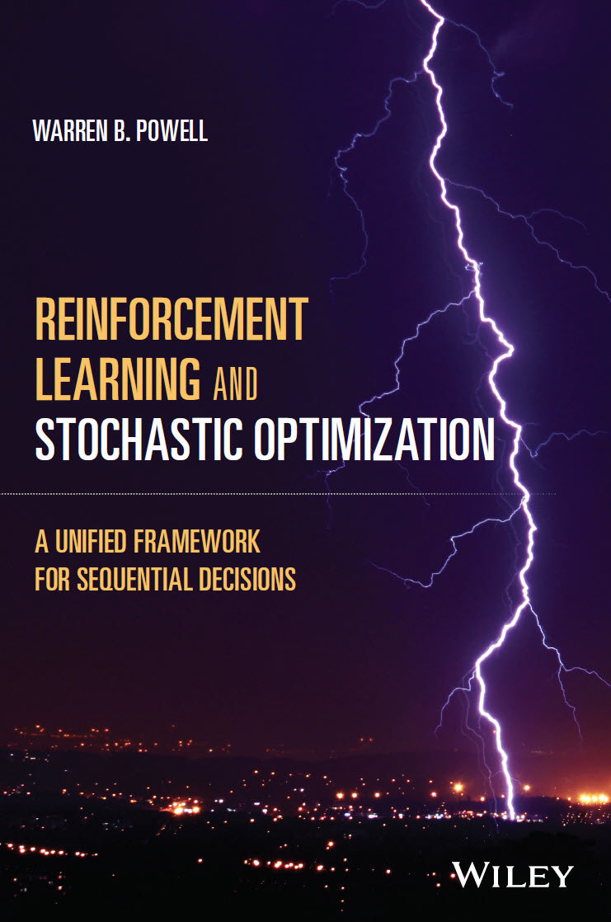
Choosing policies
How do we go about choosing policies?
Start by asking some basic questions:
Does the problem suggest an obvious rule or relationship (buy low, sell high; order-up-to inventory replenishment), which suggest a PFA.
Does a greedy policy (ignoring the future) make sense?
Is the problem fairly stationary? This might lend itself to a policy that does not need to directly plan into the future (PFAs or CFAs)
Does the problem seem to require planning into the future? (e.g. planning a path to the destination). DLAs (and possibly VFAs) are probably needed.
Does the value of being in a state suggest structure (e.g. convexity, monotonicity, linearity) that can be exploited?
Chapter 10
Section 10.7?

Slide 4
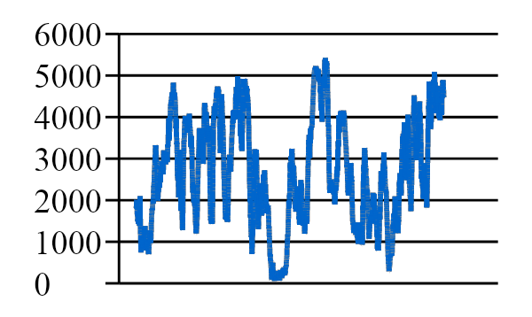
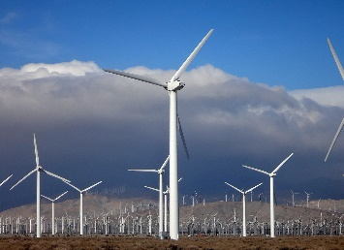

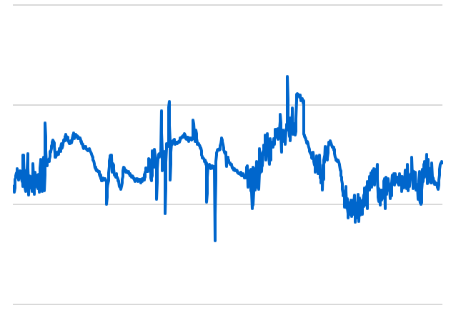
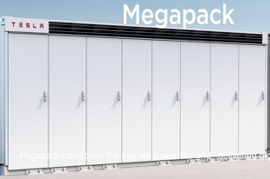
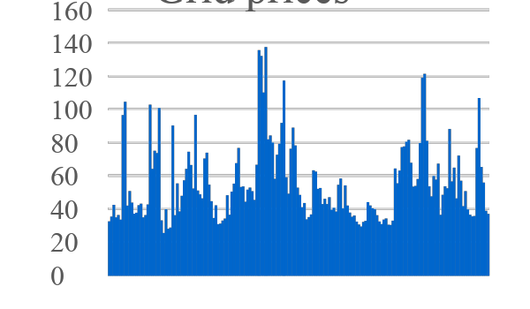
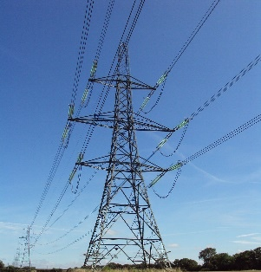
Choosing policies
Consider a basic energy storage problem
Wind energy
Demand (load)
Battery
storage
Grid Prices

Slide 5
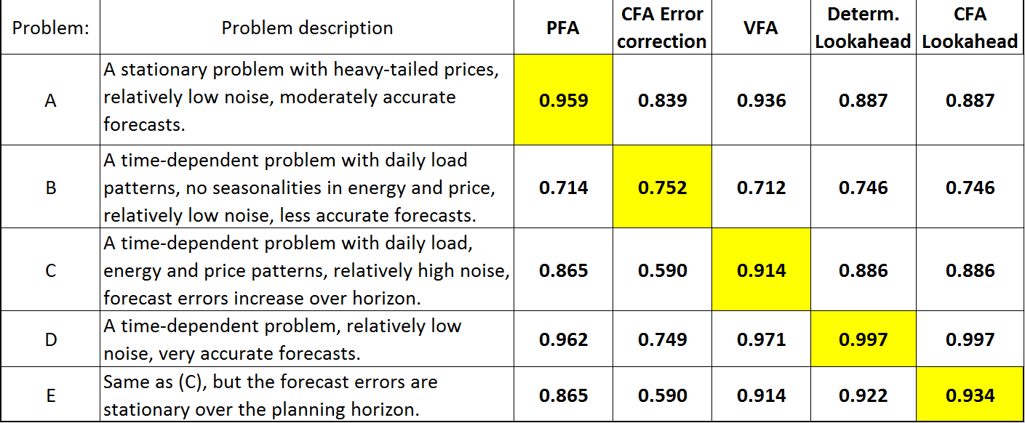

Choosing policies
Each policy is best on certain problems
PFA
CFA
VFA
DLA
DLA/CFA
Joint research with Prof. Stephan Meisel, University of Twente, Netherlands.

Slide 6
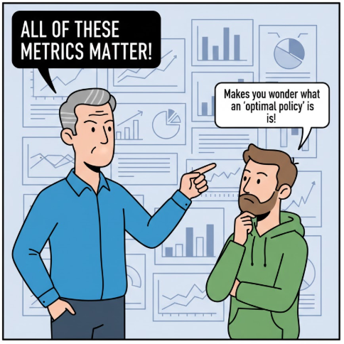
Choosing policies
We have to evaluate policies along multiple dimensions:
1) Solution quality
On average
Risk metrics
2) Computational
Average solution times
Worst case performance
3) Transparency
4) Robustness to data errors
5) Tuning requirements
6) Flexibility/adaptability
7) Complexity/ease of development
8) Data requirements

Slide 7
Choosing policies
It helps to identify six types of policies:
1) Policy function approximations (PFAs) – Simple rules, analytical functions.
2) Cost function approximations (CFAs) – Parameterized deterministic optimization models (typically static)
3) Policies based on value function approximations (VFAs) – Policies that use an approximation of the value of landing in a downstream state
4) Policies based on direct lookahead approximations (DLAs) – These should be divided into two subclasses:
4a) DLAs using deterministic lookaheads (Det-DLA) – These may be parameterized.
4b) DLAs using stochastic lookaheads (Stoch-DLA)
4b.i) Stochastic DLAs with discrete, scalar decisions.
4b.ii) Stochastic DLAs with vector decisions.
So, which are the most useful?

Slide 8




Choosing policies
We can divide the six types of policies into three categories from most to least popular:
Category 1 – This category consists of:
1) PFAs – Rules/analytical functions
2) CFAs – Parameterized det. optimization
4a) Det-DLAs – Deterministic lookaheads
Category 2 – Stoch. lookahead with discrete actions:
4b.i) Decision trees, value-of-information policies
Category 3 – Stoch. lookahead using Bellman:
3) Policies based on VFAs (approx. dynamic programming)
Category 4 – Stoch. lookahead with vectors:
4b.ii) 2-stage stochastic programming
By far the most widely used in practice. The choice among the three tends to be obvious from the structure of the problem.
Popular in the decision analysis and Bayesian optimization communities.
A very powerful strategy for a very small number of specialized problems.
This is how deterministic optimizers handle uncertainty. Almost no-one uses it in practice.

Slide 9
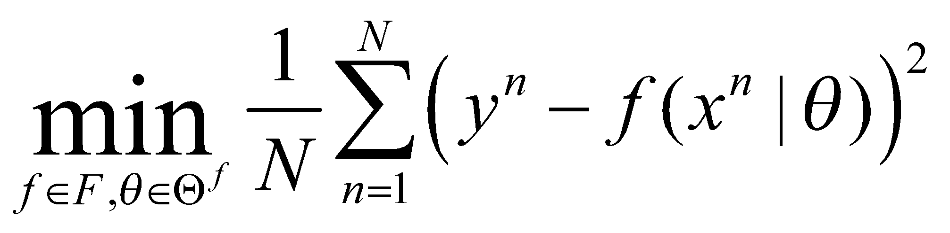
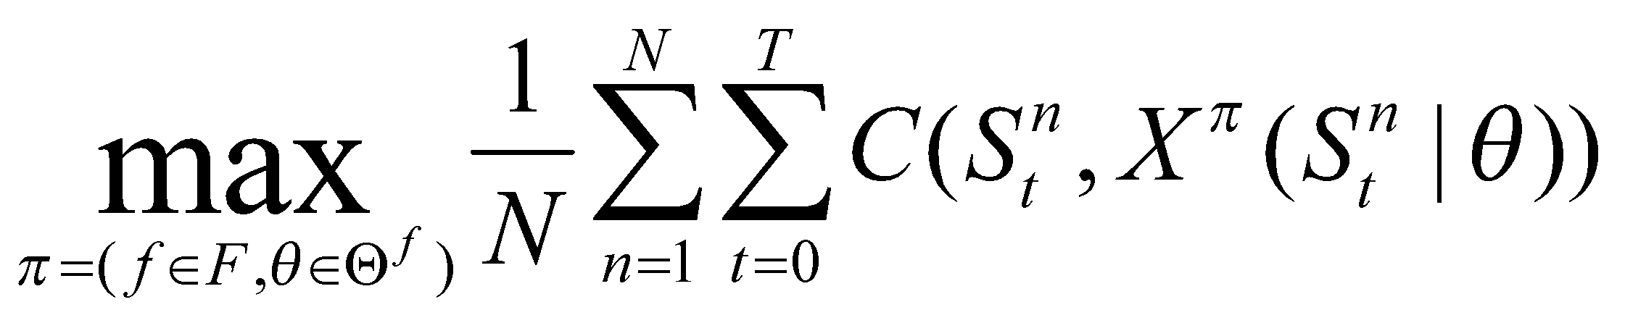
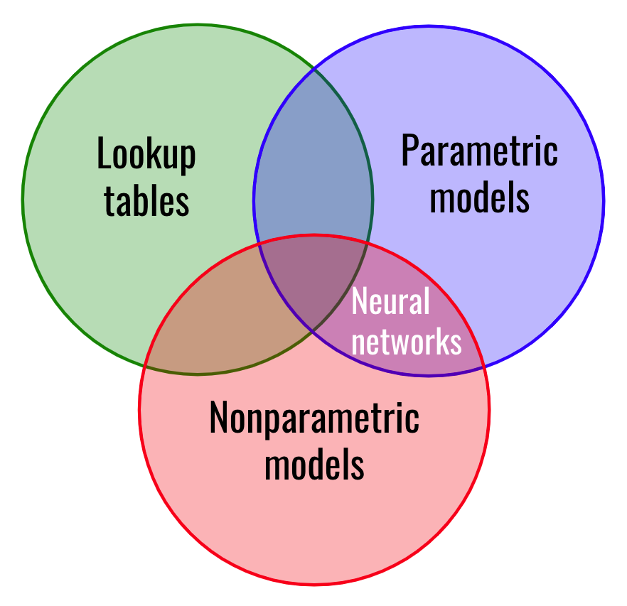


Choosing policies
Machine learning
Sequential decisions
$$S_{t+1}=S^{M}(S_{t},x_{t},W_{t+1})$$
Searching over functions
“Big dataset”
Searching over policies
System model
Policy function approximations
Analytical functions
Cost function approximations
Optimization problem
Value function approximations
Optimization problem
Direct lookahead approximations
Optimization problem

Slide 10
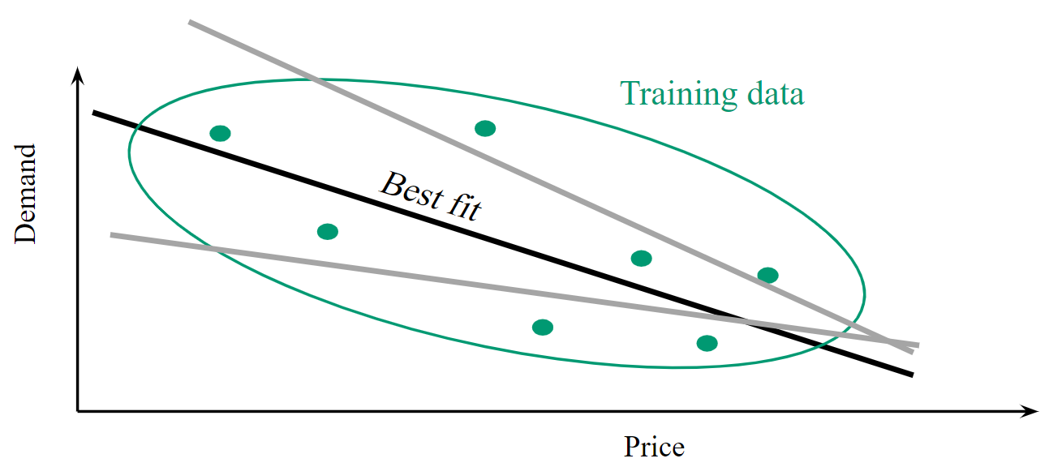
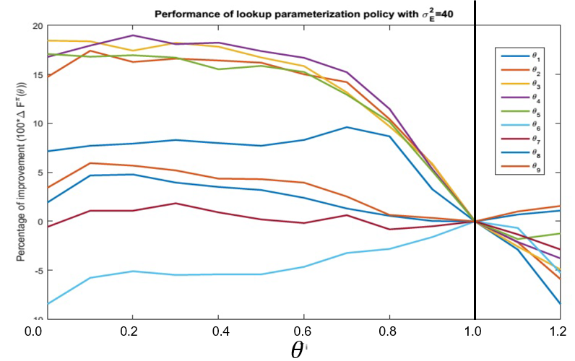
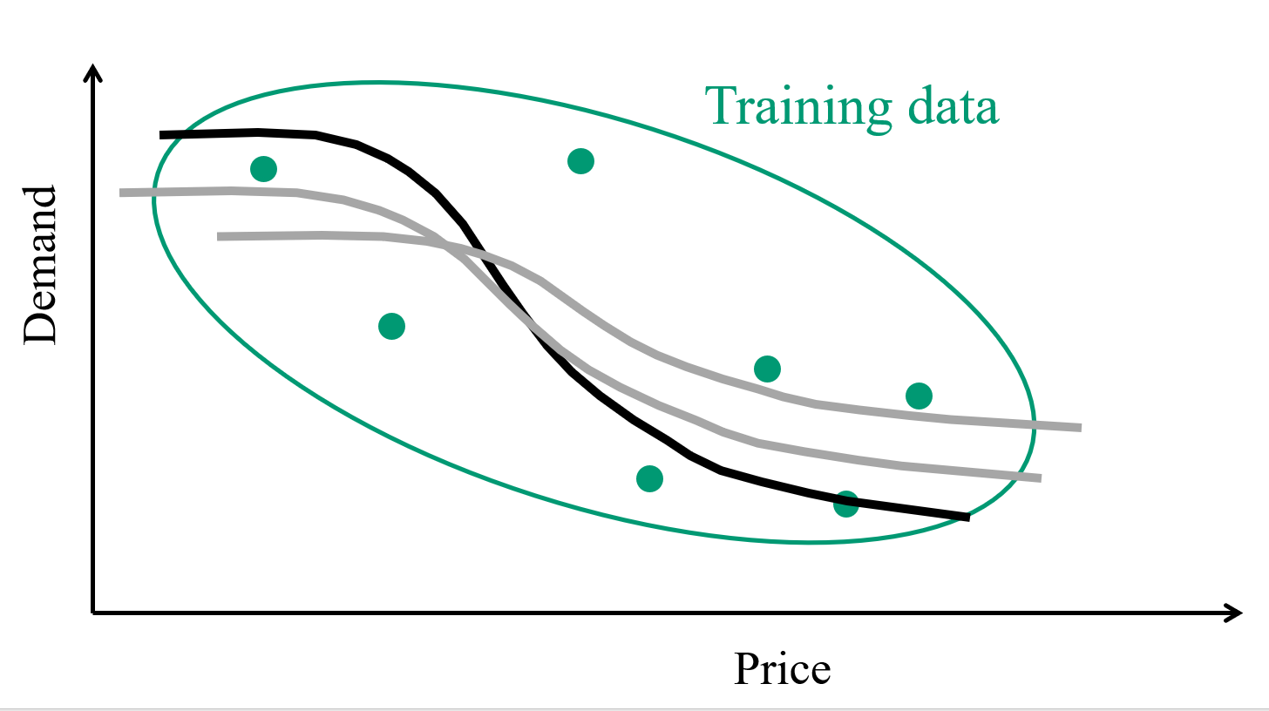

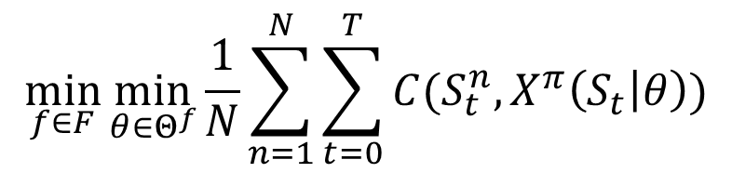
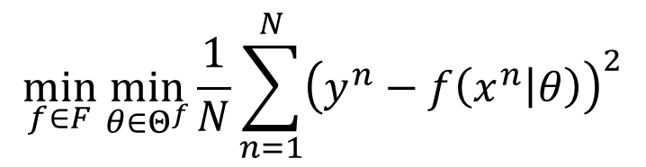
Choosing policies
Machine learning
Parameterized policies
$$\min_{f∈F}{\min_{θ∈Θ^{f}}{\frac{1}{N}\sum_{n=1}^{N}{{\left(y^{n}−f\left(x^{n} | θ\right)\right)}^{2}}}}$$
$$\min_{f∈F}{\min_{θ∈Θ^{f}}{\frac{1}{N}\sum_{n=1}^{N}{\sum_{t=0}^{T}{C(S_{t}^{n},X^{π}\left(S_{t} | θ\right))}}}}$$
$$S_{t+1}=S^{M}(S_{t},x_{t},W_{t+1})$$
Searching over functions
Parameter tuning
Searching over functions
Parameter tuning
PFAs
CFAs
Determ. DLAs

Slide 11

Choosing policies
The decision-making policy
Model realism
Complex
Simple

Slide 12


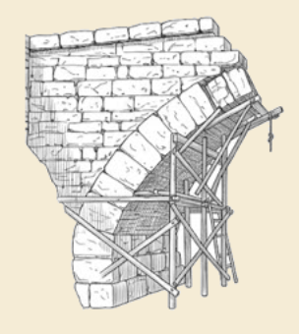
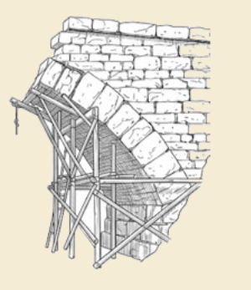
Thank you!
For more information see the Sequential Decision Analytics website at
warrenpowell.org
For more on policies go to:
warrenpowell.org → Policies → Choosing policies

