Slide 1


Tutorial Series on Sequential Decision Analytics
Warren B Powell
Professor Emeritus, Princeton University
Recorded: August 12, 2026
Module: Policy function approximations:
Introduction to the use of parametric models as policies
Policy evaluation
Predecessor module(s):
Universal modeling framework (detailed)
Technical level: Mathematical description of policy function approximations.

Slide 2

OUTLINE
Policy function approximations
Examples of PFAs
From machine learning to PFAs
Policy evaluation

Slide 3
Policy function approximations
What is a “policy function approximation”?
It is any analytical function that translates information in the state variable to a decision.
It is the only one of the four classes that does not involve an imbedded optimization problem.
It may include lookup tables, linear or nonlinear functions, nonparametric functions, and deep neural networks – any function that might be used in machine learning.

Slide 4

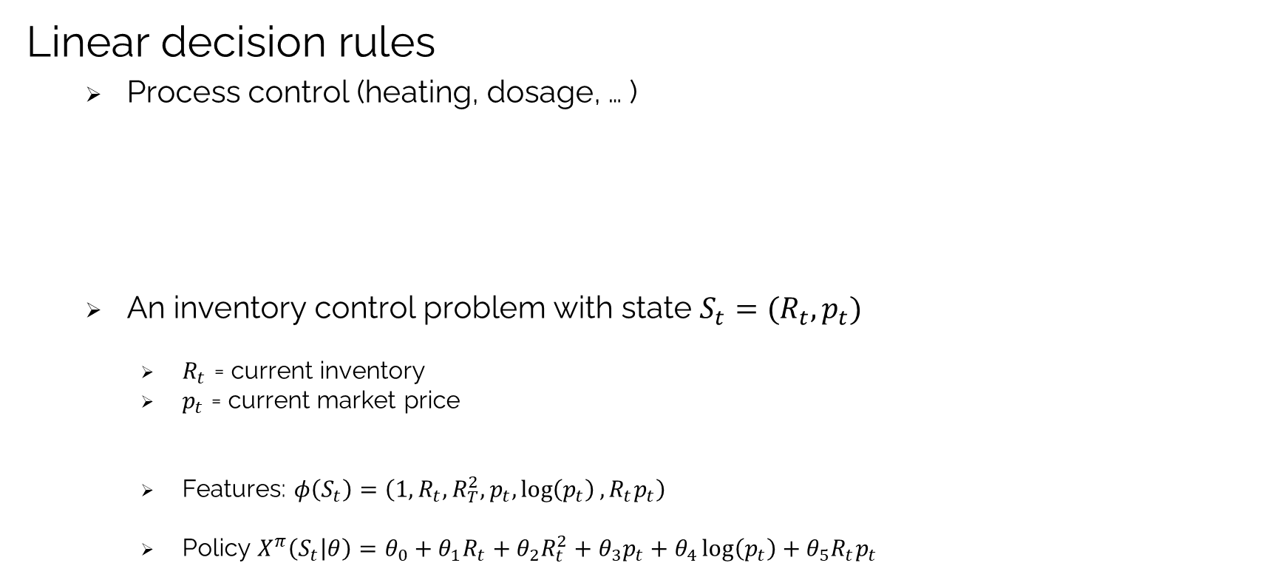
Policy function approximations
Linear decision rules
Process control (heating, dosage, … )
An inventory control problem with state $S_{t}=(R_{t},p_{t})$
$R_{t}$ = current inventory
$p_{t}$ = current market price
Features: $φ\left(S_{t}\right)=\left(1, R_{t},R_{T}^{2},p_{t},\log\left(p_{t}\right), R_{t}p_{t}\right)$
Policy $X^{π}\left(S_{t} | θ\right)=θ_{0}+θ_{1}R_{t}+θ_{2}R_{t}^{2}+θ_{3}p_{t}+θ_{4}\log\left(p_{t}\right)+θ_{5}R_{t}p_{t}$
$$X^{π}\left(S_{t} | θ\right)=\sum_{f∈ℱ}{θ_{f}φ_{f}(S_{t})}$$

Slide 5
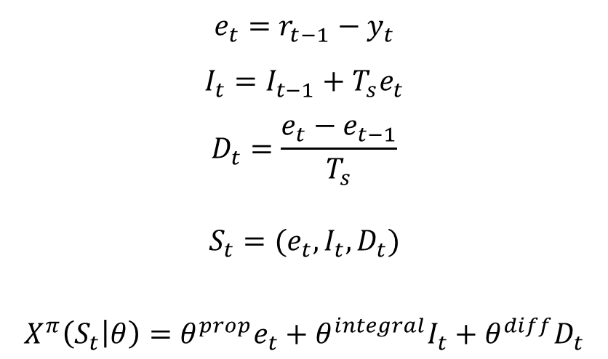
Policy function approximations
PID controllers (proportional-integral-derivative)
Temperature control (furnaces, reactors, ovens)
Flow control (liquids, gases)
Level control (tanks, reservoirs)
Administering drugs (insulin)
Target value (what we want to achieve)
What we observe
$$e_{t}=r_{t−1}−y_{t}$$
$$I_{t}=I_{t−1}+T_{s}e_{t}$$
$$D_{t}=\frac{e_{t}−e_{t−1}}{T_{s}}$$
$$S_{t}=(e_{t},I_{t},D_{t})$$
$$X^{π}\left(S_{t} | θ\right)=θ^{prop}e_{t}+θ^{integral}I_{t}+θ^{diff}D_{t}$$
Error
Sum of errors (integral)
Derivative (change)
State variable
Policy

Slide 6

Policy function approximations
Randomized policies:
Epsilon-greedy
$$X^{π}\left(S_{t} | θ\right)=\left\{\begin{matrix}argmax_{x}\left({\overline{μ}}_{x}\right) & with probability θ \\ Choose x at random & with probability 1−θ\end{matrix}\right.$$
Boltzman policy
$A\left(S_{t} | θ\right)=action a with prob.∼\frac{e^{θC(S_{t},a)}}{\sum_{a^{′}∈𝒜}{e^{θC(S_{t},a′)}}}$.

Slide 7
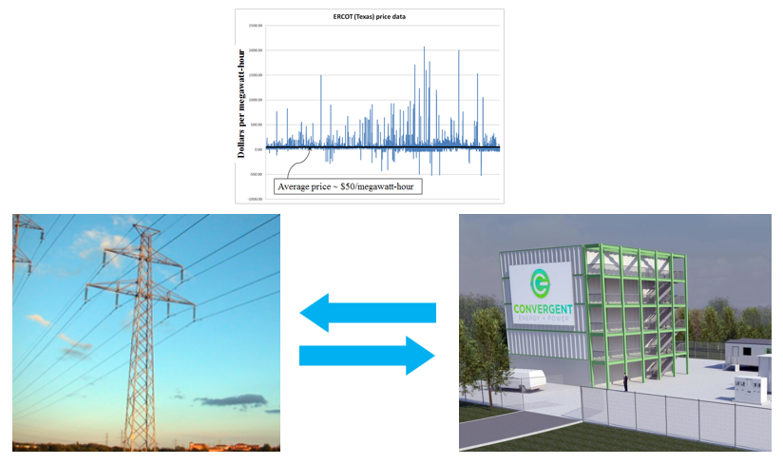
Policy function approximations
Battery arbitrage – When to charge, when to discharge

Slide 8
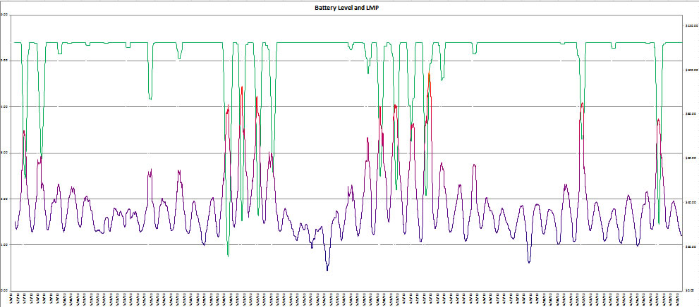
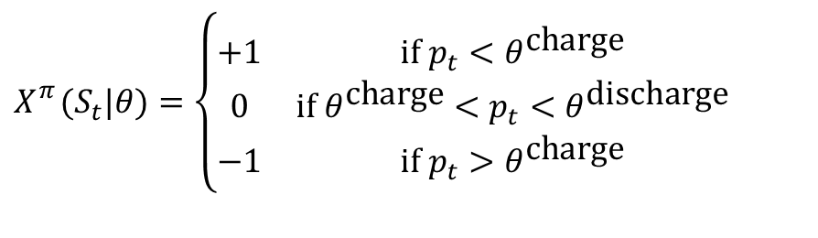
Policy function approximations
A buy low, sell high policy:
$$X_{}^{π}(S_{t}|θ)=\left\{\begin{matrix}+1 & \text{if }p_{t}<θ^{\text{charge}} \\ 0 & \text{if }θ^{\text{charge}}<p_{t}<θ^{\text{discharge}} \\ −1 & \text{if }p_{t}>θ^{\text{charge}}\end{matrix}\right.$$
Energy in storage:
Price of electricity:

Slide 9
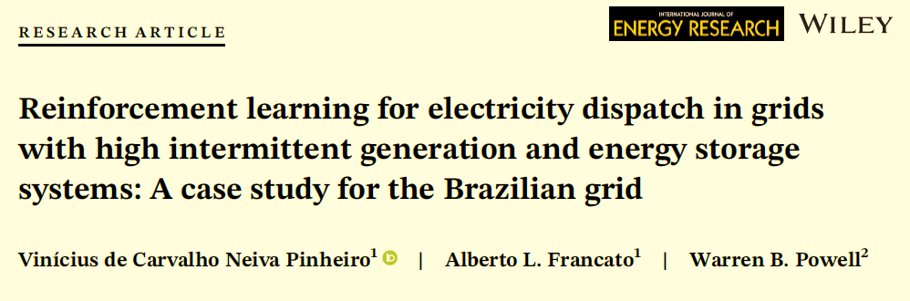
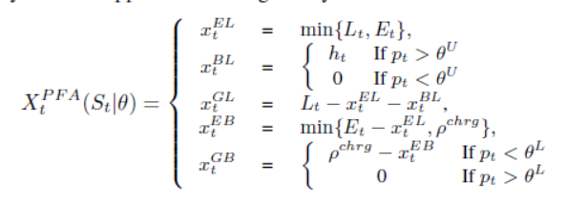
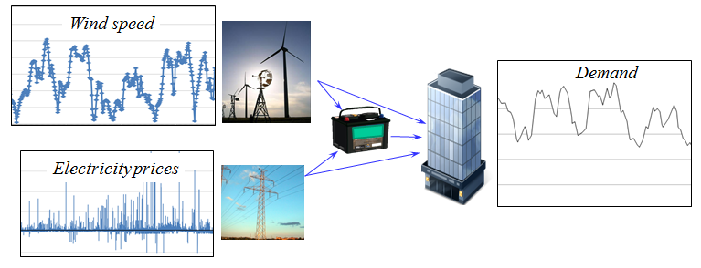

Policy function approximations
Policy
Energy control problem
$$θ=(θ^{U},θ^{L})$$

Slide 10
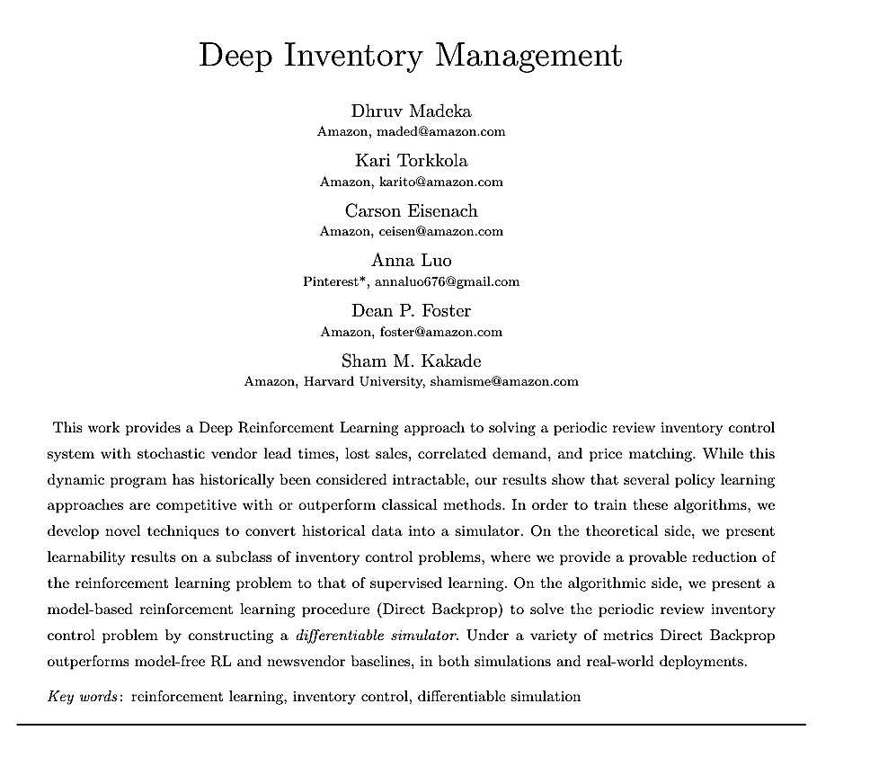
Policy function approximations
Inventory ordering policy at Amazon
Uses deep neural network to place orders.
The neural network is trained using history, which means it is incorporating the information that would typically be reflected in forecasts.

Slide 11

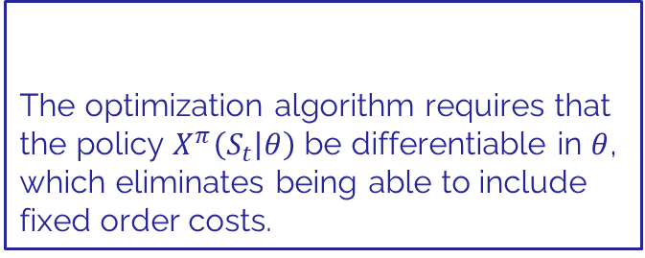

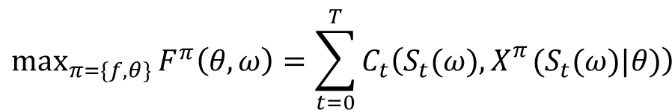




Policy function approximations
Goal is to train a neural network to manage thousands of inventories using a single deep neural network:
$$\max_{π=\{f,θ\}}{F^{π}\left(θ,ω\right)=\sum_{t=0}^{T}{C_{t}\left(S_{t}(ω),X_{}^{π}(S_{t}(ω)|θ)\right)}}$$
Simulate following historical sample path $ω$
Inventories, market data, along with historical information that might contribute to forecasts.
Weights on the neural network (~10-100 million)
$$x_{t1}$$
The optimization algorithm requires that the policy $X^{π}\left(S_{t} | θ\right)$ be differentiable in $θ$, which eliminates being able to include fixed order costs.
$$S_{t}→$$
$$x_{t2}$$
$$θ^{n+1}=θ^{n}+α_{n}∇_{θ}F^{π}(θ,ω)$$
$$x_{t3}$$

Slide 12
OUTLINE
Policy function approximations
Examples of PFAs
From machine learning to PFAs
Policy evaluation

Slide 13
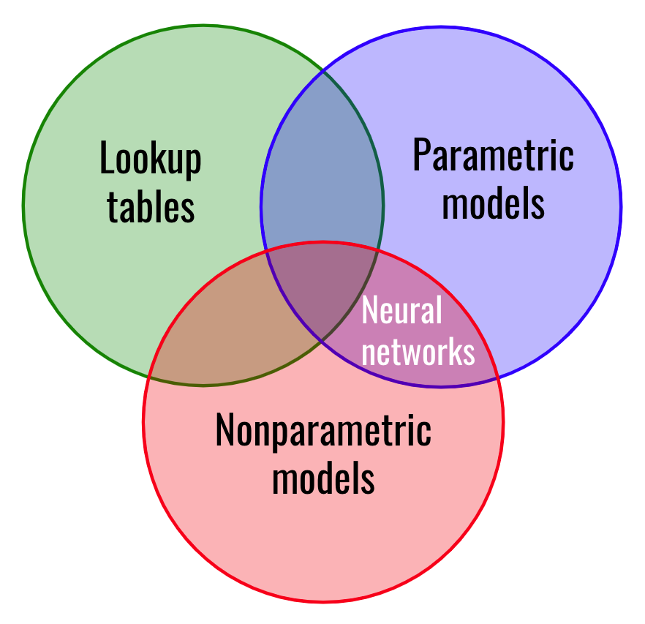
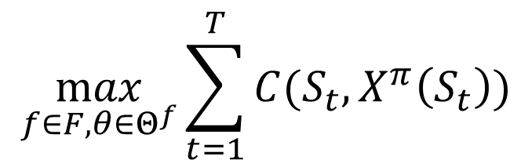
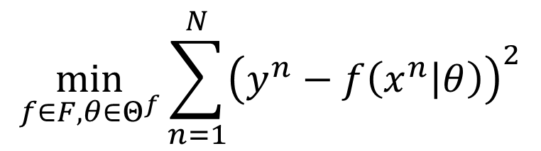


Bridging Machine Learning and Sequential Decision Problems
Machine learning
Sequential decisions
$$\max_{f∈F,θ∈Θ^{f}}{\sum_{t=1}^{T}{C(S_{t},X^{π}\left(S_{t}\right))}}$$
$$\min_{f∈F,θ∈Θ^{f}}{\sum_{n=1}^{N}{{\left(y^{n}−f\left(x^{n} | θ\right)\right)}^{2}}}$$
$$S_{t+1}=S^{M}(S_{t},x_{t},W_{t+1})$$
Searching over functions
training dataset
Searching over policies
Model of problem
Policy function approximations
Analytical functions
PFAs represent the entire class of functions used in machine learning. The only difference is:
Machine learning uses a training dataset
PFAs require a model of the underlying decision problem.

Slide 14
OUTLINE
Policy function approximations
Examples of PFAs
From machine learning to PFAs
Policy evaluation

Slide 15
Policy evaluation
Ways to evaluate a policy
Back testing using historical data
Widely used in finance, where prices are not affected by decisions
Learning in the field
“Learning while doing” or “online learning”
Requires no modeling assumptions
Very slow
Simulations using manufactured samples
Requires creating mathematical models of stochastic processes
Very easy for toy problems, but can become quite sophisticated
Major issues is capturing different forms of correlations

Slide 16
Policy evaluation
Evaluating policies is hard:
Online policy evaluation is very slow. I call this “learning while doing” and illustrate it at https://tinyurl.com/learningwhiledoing/ using the context of optimizing the policy for holding cash for a mutual fund.
This is being developed as a game at
warrenpowell.org → Teaching materials → Games
Offline simulations can be very noisy, and may be computationally demanding.

Slide 17




Thank you!
For more information see the Sequential Decision Analytics website at
warrenpowell.org
For more on policy function approximations go to:
warrenpowell.org → Policies → Policy function approximations

