Slide 1


Tutorial Series on Sequential Decision Analytics
Warren B Powell
Professor Emeritus, Princeton University
Recorded: August 12, 2026
Module: Cost function approximations (CFAs)_ – Introduces the use of parameterized deterministic optimization models, which opens the door to handling both discrete and vector-valued decisions.
Predecessor module(s):
Universal modeling framework (detailed)
Technical level: Mathematical description of policy function approximations.

Slide 2

OUTLINE
2) Cost function approximations
Discrete choices
Continuous vectors

Slide 3
OUTLINE
2) Cost function approximations
Discrete choices
Continuous vectors

Slide 4
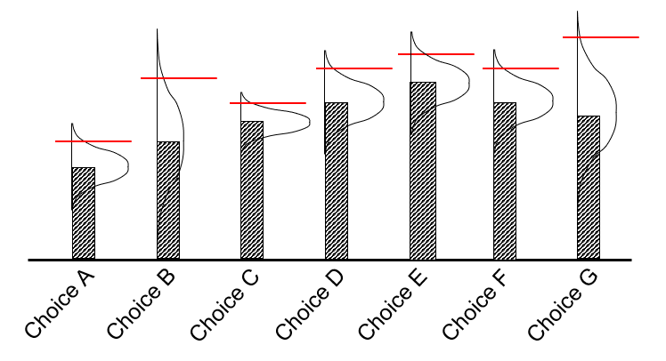
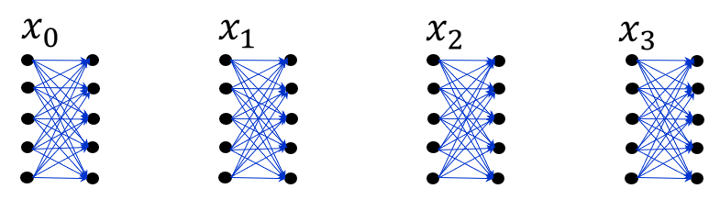
Cost function approximations: Discrete choices
Discrete decisions
Best drug?
Best price?
Best supplier
Vector-valued decisions
Allocating funds to investments
Assigning machines to tasks
Leasing warehouses

Slide 5
Cost function approximations: Discrete choices
The most common decision problem that we all face involves finding the best of a discrete set of choices:
Application settings:
Type of drug
Supplier
Trading policy (finance)
Product design
Battery technology
Price (discretized)
Web page design
Product to advertise
Location for a clinic
Diameter of silicon wafer
Financial trading policy
Advertising channel
Choice of manager
1
2
3
4
4
5
Choice A
Choice B
2nm Fe
Choice D
2nm Ni
Choice G
Choice C
Choice E
Ni 0.6 nm
1.4 nm Fe
1 nm Fe
Choice F
10nm ALD AI+1.2 nm 1BSFe
10nm ALD AI203+1 nm Ni
What are my choices?
Notes:
22

Slide 6
Cost function approximations: Discrete choices
Finding the best of a set of discrete alternatives is known as the “multiarmed bandit problem.” I like to call it an “optimal learning problem.”
1
2
3
4
4
5
Choice A
1 nm Fe
2nm Fe
2nm Ni
Ni 0.6 nm
1.4 nm Fe
Choice B
Choice C
Choice D
Choice E
Choice F
Choice G
10nm ALD AI+1.2 nm 1BSFe
10nm ALD AI203+1 nm Ni
Notes:
23

Slide 7
Cost function approximations: Discrete choices
Correlated beliefs: Testing one product teaches us about other products (known as “correlated beliefs”)
1
2
3
4
4
5
Choice A
1 nm Fe
2nm Fe
2nm Ni
Ni 0.6 nm
1.4 nm Fe
Choice B
Choice C
Choice D
Choice E
Choice F
Choice G
10nm ALD AI+1.2 nm 1BSFe
10nm ALD AI203+1 nm Ni
Notes:
24

Slide 8
Cost function approximations: Discrete choices
Policies for choosing which product to promote:
Upper confidence bounding
Interval estimation
Thompson sampling
$x^{n}=argmax_{x}{\hat{μ}}_{x}^{n}$ ${\hat{μ}}_{x}^{n}∼N({\overline{μ}}_{x}^{n},{θ^{TS}\overline{σ}}_{x}^{2,n})$

Slide 9

Cost function approximations: Discrete choices
Picking $θ^{IE}=0$ means we are evaluating each choice at the mean.
1
2
3
4
4
5
Choice A
Choice B
Choice C
Choice D
Choice E
Choice G
2nm Fe
2nm Ni
Choice F
1.4 nm Fe
1 nm Fe
Ni 0.6 nm
10nm ALD AI+1.2 nm 1BSFe
10nm ALD AI203+1 nm Ni
26
Notes:
26

Slide 10

Cost function approximations: Discrete choices
Picking $θ^{IE}=2$ means we are evaluating each choice at the 95th percentile.
1
2
3
4
4
5
Choice A
Choice B
Choice C
Choice D
Choice E
Choice G
2nm Fe
2nm Ni
Choice F
1.4 nm Fe
1 nm Fe
Ni 0.6 nm
10nm ALD AI+1.2 nm 1BSFe
10nm ALD AI203+1 nm Ni
27
Notes:
27

Slide 11
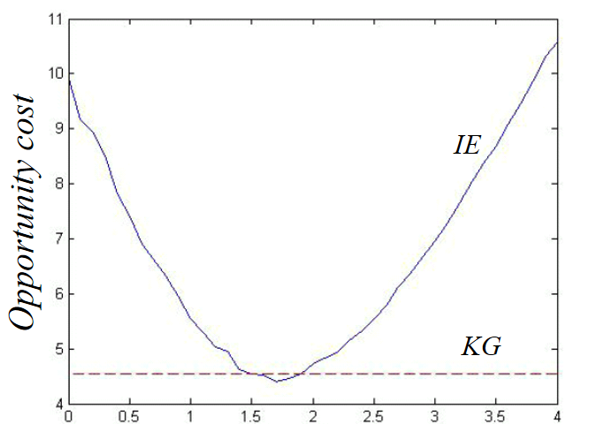

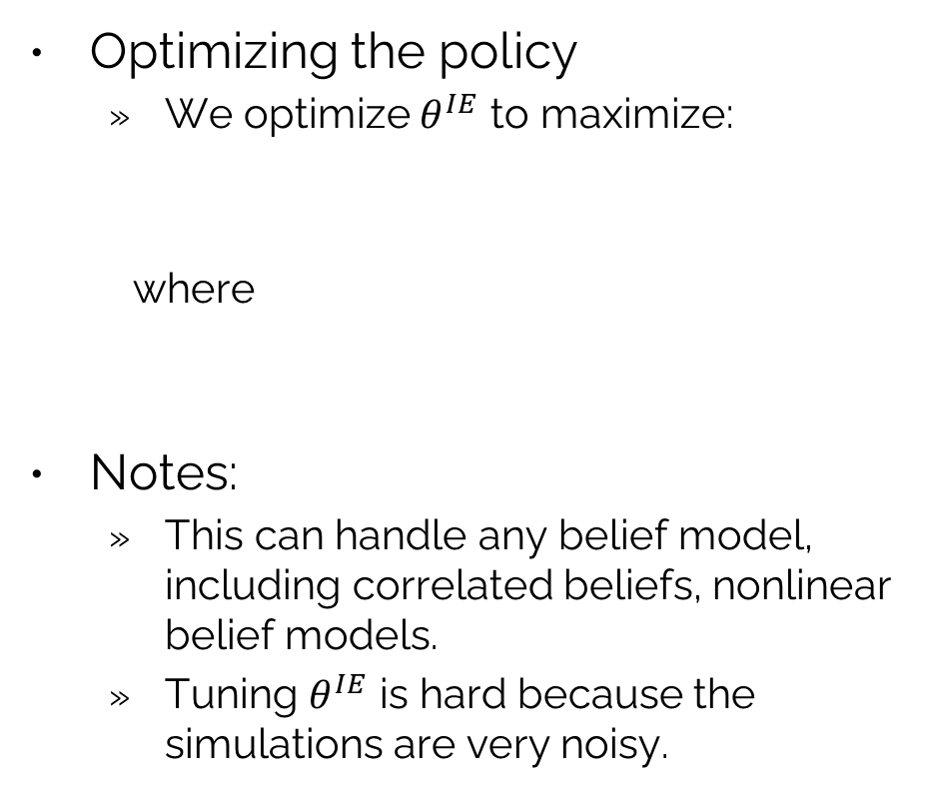
Cost function approximations: Discrete choices
Optimizing the policy
We optimize $θ^{IE}$ to maximize:
where
Notes:
This can handle any belief model, including correlated beliefs, nonlinear belief models.
Tuning $θ^{IE}$ is hard because the simulations are very noisy.
If we just use the point estimate.
Interval
estimation
Optimized
$$x^{n}=X_{}^{IE}(S^{n}|θ^{IE})={argmax}_{x}\left({\bar{μ}}_{x}^{n}+θ^{IE}{\bar{σ}}_{x}^{n}\right)$$
Opportunity cost
Knowledge
gradient
IE parameter $θ^{IE}$
See https://tinyurl.com/LearningWhileDoing/ for a video on learning a policy.

Slide 12
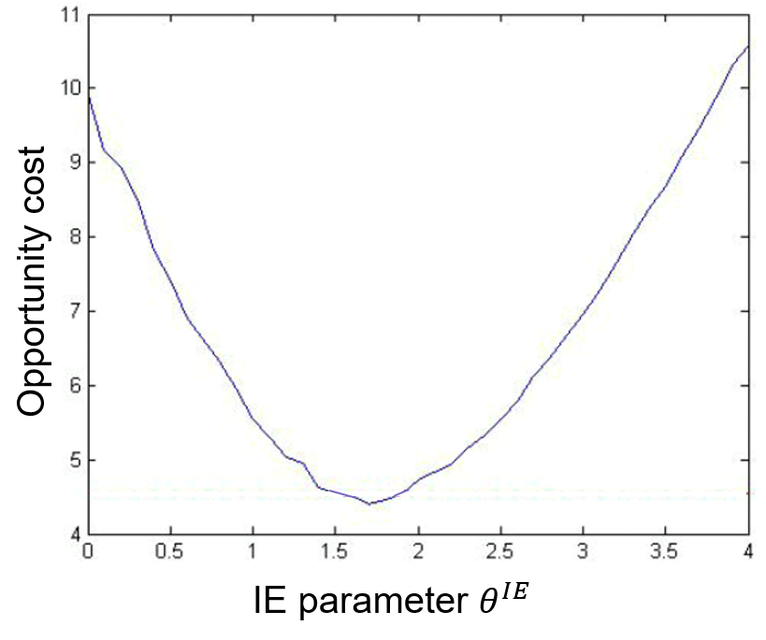
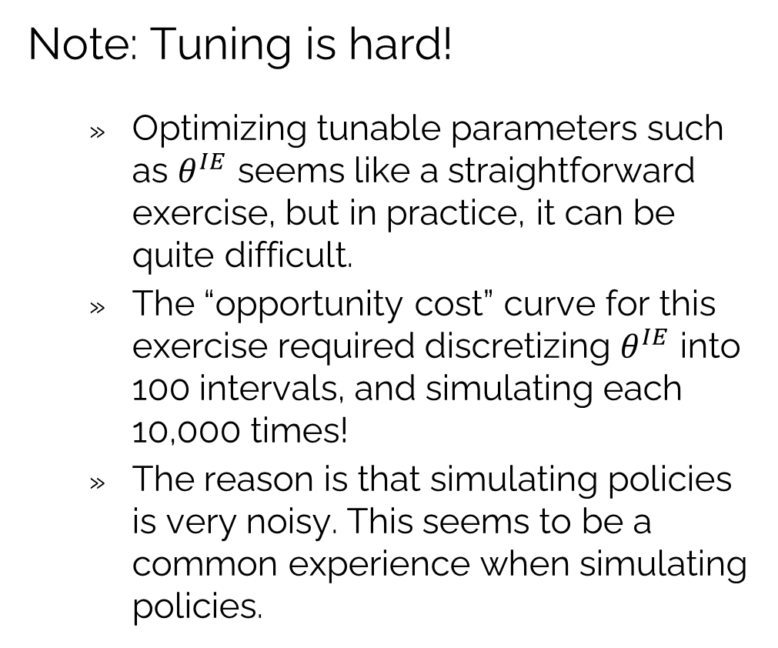
Cost function approximations: Discrete choices
Note: Tuning is hard!
Optimizing tunable parameters such as $θ^{IE}$ seems like a straightforward exercise, but in practice, it can be quite difficult.
The “opportunity cost” curve for this exercise required discretizing $θ^{IE}$ into 100 intervals, and simulating each 10,000 times!
The reason is that simulating policies is very noisy. This seems to be a common experience when simulating policies.

Slide 13
OUTLINE
2) Cost function approximations
Discrete choices
Continuous vectors

Slide 14
Cost function approximations
Discrete decisions
Best drug?
Best price?
Best supplier
Vector-valued decisions
Allocating funds to investments
Assigning machines to tasks
Leasing warehouses

Slide 15
Cost function approximations: Continuous vectors
Portfolio optimization:
We are going to describe a portfolio optimization strategy used by one of the largest hedge funds on Wall St.
It involves solving a series of static nonlinear portfolio optimization problems:
$$X_{t}^{π}\left(S_{t} | θ\right)=argmax_{x_{t}}\left(\sum_{i=1}^{M}{\left((R_{ti}+x_{ti})({\overline{f}}_{ti}\left(θ\right)+p_{ti})−c^{trans}\left|x_{ti}\right|p_{ti}\right)}−{η\left(R_{t}+x_{t}\right)}^{T}Σ_{t}(R_{t}+x_{t})\right)$$

Slide 16
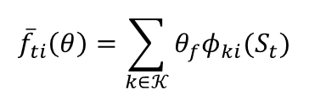
Cost function approximations: Continuous vectors
Portfolio optimization:
Current and bought/sold assets
M assets
Current price
Transaction costs
Covariance matrix
$$X_{t}^{π}\left(S_{t} | θ\right)=argmax_{x_{t}}\left(\sum_{i=1}^{M}{\left((R_{ti}+x_{ti})({\overline{f}}_{ti}\left(θ\right)+p_{ti})−c^{trans}\left|x_{ti}\right|p_{ti}\right)}−{η\left(R_{t}+x_{t}\right)}^{T}Σ_{t}(R_{t}+x_{t})\right)$$
$${\overline{f}}_{ti}\left(θ\right)=\sum_{k∈𝒦}{θ_{f}φ_{ki}(S_{t})}$$
Variance of portfolio returns
Adjustment based on assorted features of the economy

Slide 17
Cost function approximations: Continuous vectors
Portfolio optimization:
$$X_{t}^{π}\left(S_{t} | θ\right)=argmax_{x_{t}}\left(\sum_{i=1}^{M}{\left((R_{ti}+x_{ti})({\overline{f}}_{ti}\left(θ\right)+p_{ti})−c^{trans}\left|x_{ti}\right|p_{ti}\right)}−{η\left(R_{t}+x_{t}\right)}^{T}Σ_{t}(R_{t}+x_{t})\right)$$
Tunable parameters

Slide 18


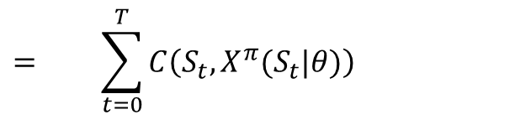














Cost function approximations: Continuous vectors
Evaluating performance over time:
$$S_{0}$$
$$S_{t}$$
$$S_{T}$$
$$x_{0}=X^{π}(S_{0}|θ)$$
$$x_{t}=X^{π}(S_{t}|θ)$$
$$x_{T}=X^{π}(S_{T}|θ)$$
$$W_{1}$$
$$W_{t+1}$$
$$⋯$$
$$⋯$$
Time
$$C(S_{0},x_{0})$$
$$C(S_{t},x_{t})$$
$$C(S_{T},x_{T})$$
$$F^{π}\left(θ\right)= + ⋯ + + ⋯ +$$
$$= \sum_{t=0}^{T}{C\left(S_{t},X^{π}(S_{t}|θ)\right)}$$
$=$performance of policy $π$ over time

Slide 19
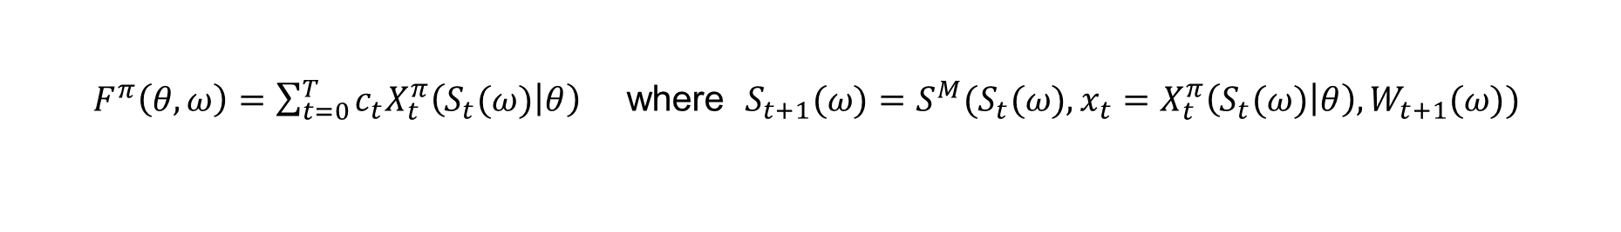
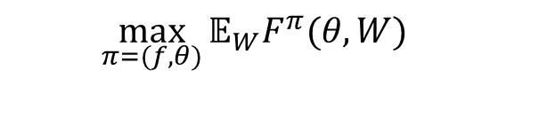

Cost function approximations: Continuous vectors
The policy (deterministic nonlinear program)
The objective function (evaluated using simulation)
Stochastic optimization problem
Stochastic gradient algorithm
$$X_{t}^{π}\left(S_{t} | θ\right)=argmax_{x_{t}}\left(\sum_{i=1}^{M}{\left((R_{ti}+x_{ti})({\overline{f}}_{ti}\left(θ\right)+p_{ti})−c^{trans}\left|x_{ti}\right|p_{ti}\right)}−{η\left(R_{t}+x_{t}\right)}^{T}Σ_{t}(R_{t}+x_{t})\right)$$
$F^{π}\left(θ,ω\right)=\sum_{t=0}^{T}{c_{t}{X_{t}^{π}\left(S_{t}(ω) | θ\right)}_{}}$ where $S_{t+1}(ω)=S^{M}(S_{t}(ω),x_{t}=X_{t}^{π}\left(S_{t}(ω) | θ\right),W_{t+1}(ω))$
Historical prices
$$\max_{π=(f,θ)}{𝔼_{W}F^{π}(θ,W)}$$
$$θ^{n+1}=θ^{n}+α_{n}∇F^{π}(θ^{n},ω^{n+1})$$

Slide 20


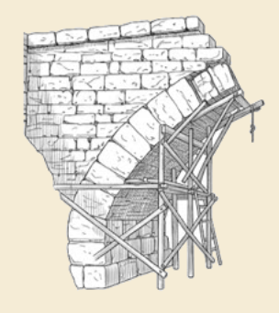
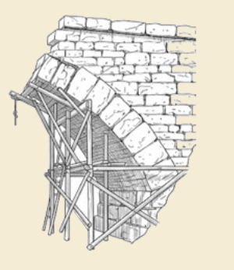
Thank you!
For more information see the Sequential Decision Analytics website at
warrenpowell.org
For more on cost function approximations go to:
warrenpowell.org → Policies → Cost function approximations

Slide 21


OUTLINE
3) VFA I – Introduction to Dynamic Programming
Exact dynamic programming
Backward MDP and the curses of dimensionality
VFA II – VFA-based policies
Value iteration
The nomadic trucker
The exploration vs. exploitation problem
Backward ADP
Basic steps
African resource allocation demonstration
VFA III - “Reinforcement learning” in the style of computer science
Temporal-difference learning
Q-learning/SARSA
The deadly triad
VFA IV - Forward ADP and linear VFAs
VFA V - Applications of ADP
Truckload fleet management
A financial application
15

