Slide 1


Tutorial Series on Sequential Decision Analytics
Warren B Powell
Professor Emeritus, Princeton University
Recorded: August 12, 2026
Module: Value function approximations I – Introduction to dynamic programming
Exact dynamic programming
Backward MDP and the curses of dimensionality
Predecessor module(s):
Universal modeling framework (detailed)
Technical level: Advanced. The presentation depends heavily on the mathematics of Bellman’s equation.

Slide 2

OUTLINE
Value function approximations:
VFA I – Introduction to Dynamic Programming
VFA II – VFA-based policies
VFA III - “Reinforcement learning” in the style of computer science
VFA IV - Forward ADP and linear VFAs
VFA V - Applications of ADP
15

Slide 3
OUTLINE
Value function approximations:
VFA I – Introduction to Dynamic Programming
VFA II – VFA-based policies
VFA III - “Reinforcement learning” in the style of computer science
VFA IV - Forward ADP and linear VFAs
VFA V - Applications of ADP
15

Slide 4
OUTLINE
VFA I – Introduction to Dynamic Programming
Exact dynamic programming
The three curses of dimensionality
Value iteration for infinite horizon problems
15

Slide 5

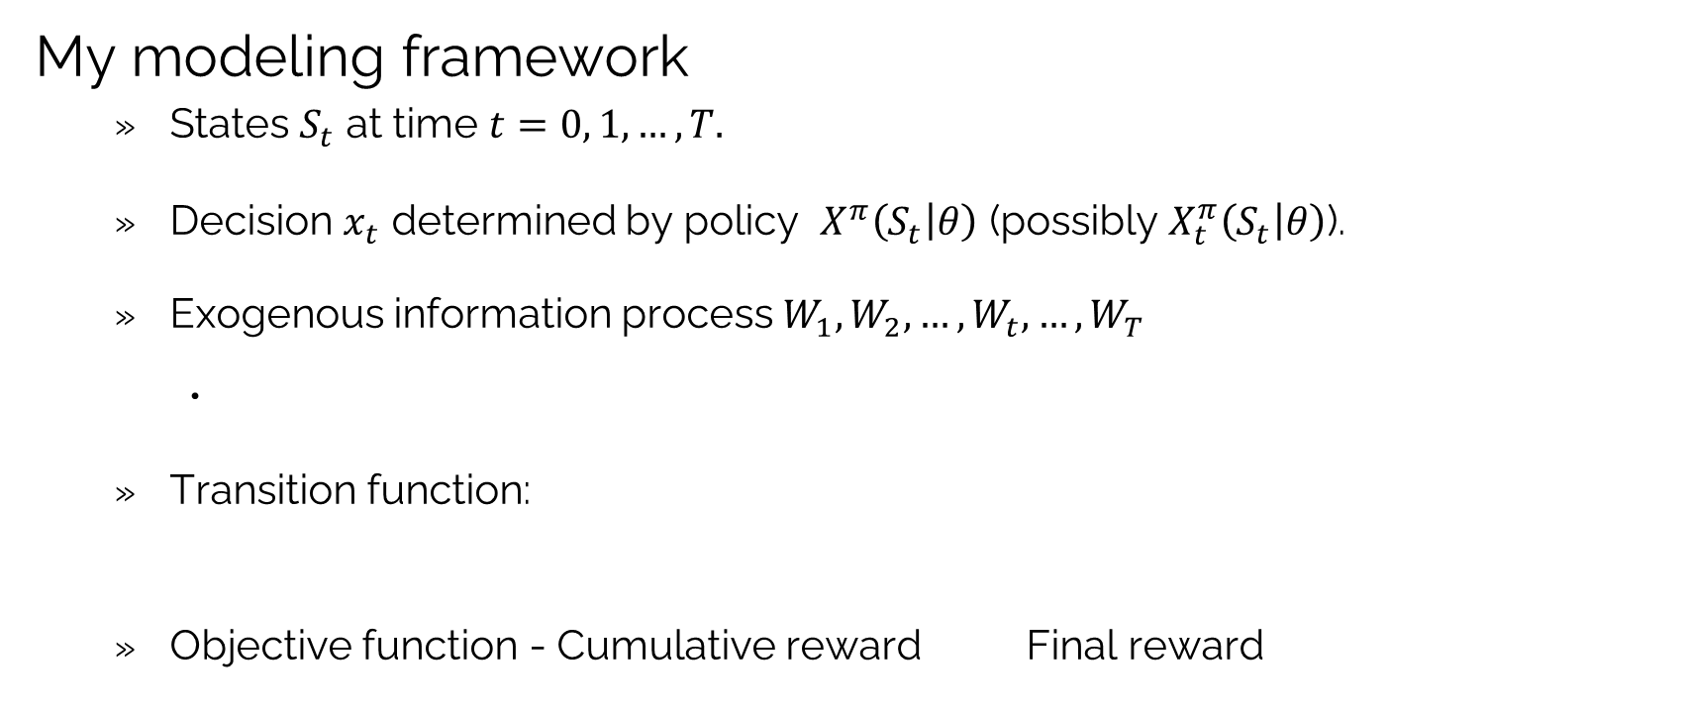

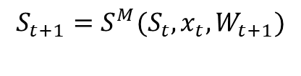
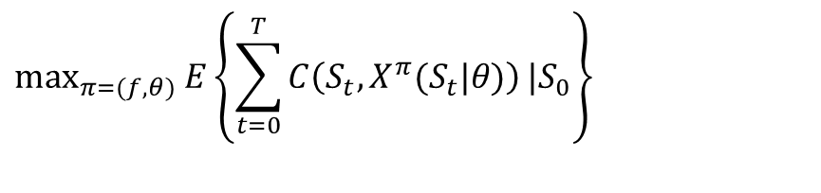
VFA policies: Exact dynamic programming
My modeling framework
States $S_{t}$ at time $t=0, 1, …, T.$
Decision $x_{t}$ determined by policy $X^{π}\left(S_{t} | θ\right)$ (possibly $X_{t}^{π}\left(S_{t} | θ\right)$).
Exogenous information process $W_{1},W_{2},…, W_{t}, …,W_{T}$
Transition function:
Objective function - Cumulative reward Final reward
Remember: $W_{t}=\left(W_{ti}\left(S_{t},x_{t}\right)\right) i∈ℐ^{information}$
$$S_{t+1}=S^{M}(S_{t},x_{t},W_{t+1})$$
$$\max_{π=(f,θ)}{E}\left\{\sum_{t=0}^{T}{C\left(S_{t},X^{π}(S_{t}|θ)\right)}|S_{0}\right\}$$
$$\max_{π}{E\left\{F\left(x_{T}^{π}\right)|S_{0}\right\}}$$
where $x_{T}^{π}$ is the final design after $T$ experiments following policy (algorithm) $π$.

Slide 6





VFA policies: Exact dynamic programming
$$W_{2}$$
$$x_{2}$$
$$x_{1}$$
$$W_{1}$$
$$x_{0}$$
Even small sequential decision problems explode dramatically as we plan into the future
What we
know now

Slide 7


Decision Outcome Decision Outcome Decision Outcome
Dynamic program with discrete pre-decision states repeatedly return to one of the set of discrete states.
Pre-decision state
Post-decision state
$$S$$
$$S$$
$$S$$

Slide 8
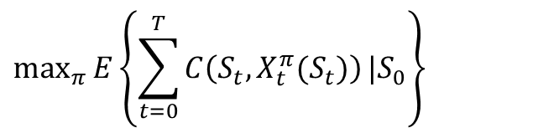
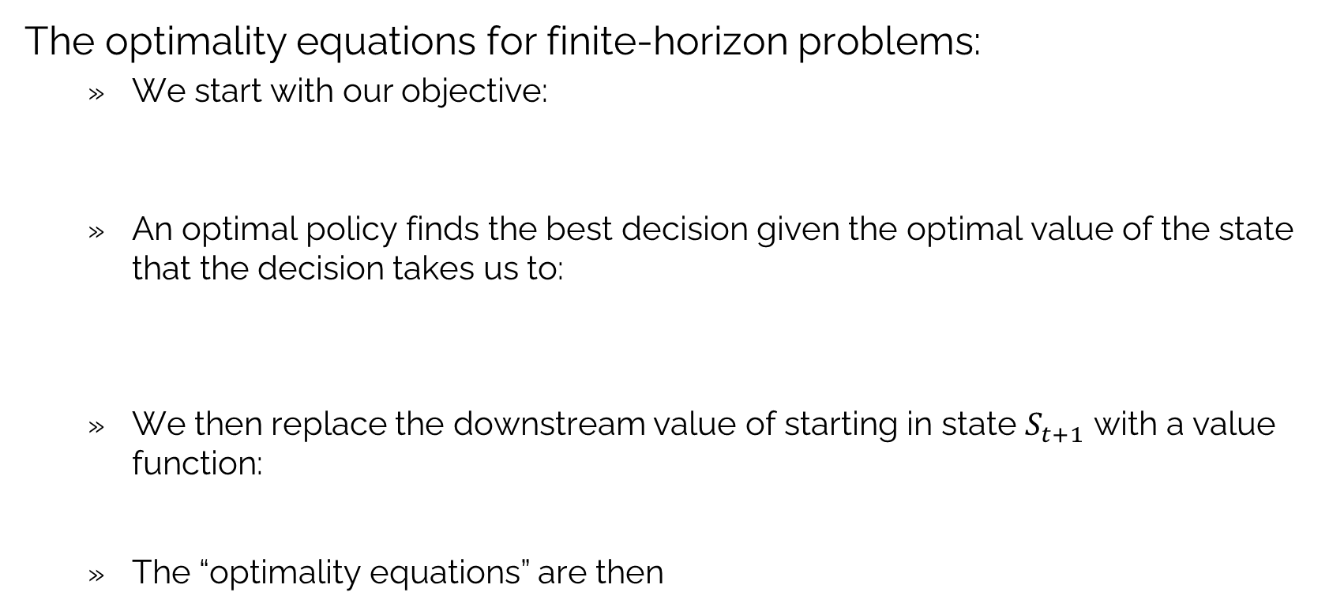
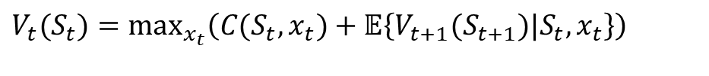
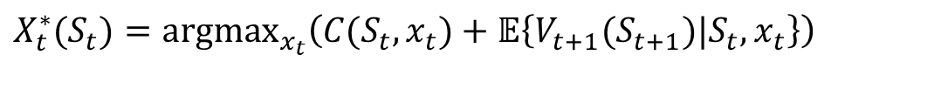
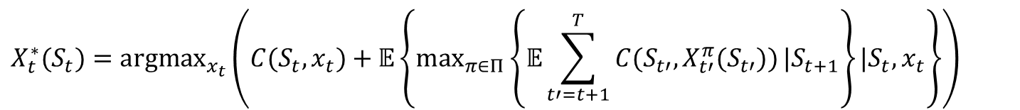
VFA policies: Exact dynamic programming
The optimality equations for finite-horizon problems:
We start with our objective:
An optimal policy finds the best decision given the optimal value of the state that the decision takes us to:
We then replace the downstream value of starting in state $S_{t+1}$ with a value function:
The “optimality equations” are then
$$\max_{π}{E}\left\{\sum_{t=0}^{T}{C\left(S_{t},X_{t}^{π}(S_{t})\right)}|S_{0}\right\}$$
$$X_{t}^{∗}(S_{t})={argmax}_{x_{t}}\left(C(S_{t},x_{t})+𝔼\left\{\max_{π∈Π}\left\{𝔼\sum_{t′=t+1}^{T}{C(S_{t′},X_{t′}^{π}(S_{t′}))}|S_{t+1}\right\}|S_{t},x_{t}\right\}\right)$$
$$X_{t}^{∗}(S_{t})={argmax}_{x_{t}}\left(C(S_{t},x_{t})+𝔼\left\{V_{t+1}(S_{t+1})|S_{t},x_{t}\right\}\right)$$
$$V_{t}(S_{t})=\max_{x_{t}}\left(C(S_{t},x_{t})+𝔼\left\{V_{t+1}(S_{t+1})|S_{t},x_{t}\right\}\right)$$

Slide 9
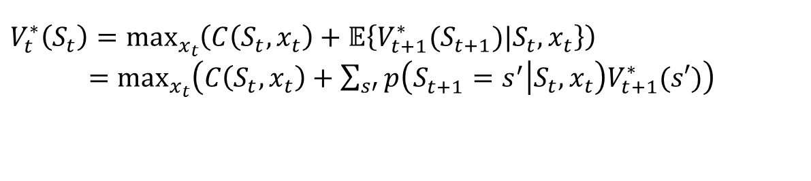
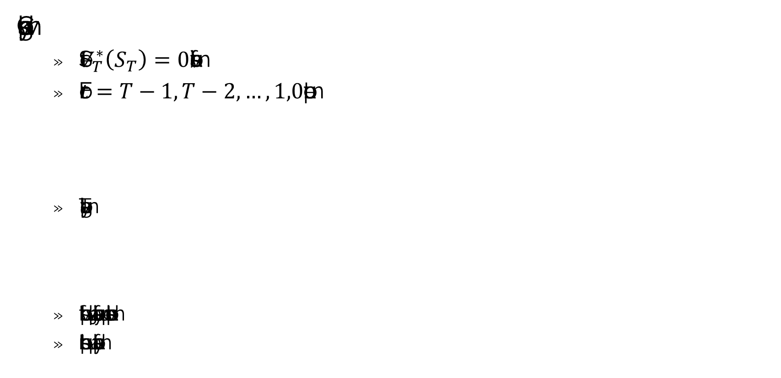
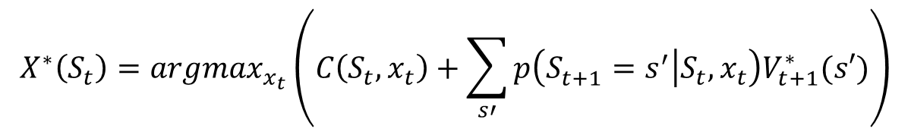
VFA policies: Exact dynamic programming
Classical backward dynamic programming
Set $V_{T}^{∗}\left(S_{T}\right)=0$ (or some final value).
For $t=T−1, T−2, …,1,0$ compute:
The optimal policy is then given by:
If we could compute this equation, the vast majority of sequential decision problems could be solved.
In practice, this equation is limited to the smallest of toy problems.
$$V_{t}^{∗}\left(S_{t}\right)=\max_{x_{t}}\left(C\left(S_{t},x_{t}\right)+𝔼\left\{V_{t+1}^{∗}(S_{t+1})|S_{t},x_{t}\right\}\right)$$
$=\max_{x_{t}}\left(C\left(S_{t},x_{t}\right)+\sum_{s′}{p\left({S_{t+1}^{}=s}^{′} | S_{t},x_{t}\right)V_{t+1}^{∗}(s′})\right)$
$$X^{∗}\left(S_{t}\right)=argmax_{x_{t}}\left(C\left(S_{t},x_{t}\right)+\sum_{s′}{p\left({S_{t+1}^{}=s}^{′} | S_{t},x_{t}\right)V_{t+1}^{∗}(s′})\right)$$

Slide 10
VFA policies: Exact dynamic programming
Dynamic programs that can be solved exactly
Problems with computable one-step transition matrix:
Discrete states that are not too large.
Discrete “action spaces” (decisions) where the number of actions is not too large.
Ability to compute the expectation over the random process.
Special cases (see section 14.4 of RLSO):
The gambling problem
The continuous budgeting problem
Linear quadratic regulation problems (see section 14.11 of RLSO)

Slide 11
OUTLINE
VFA I – Introduction to Dynamic Programming
Exact dynamic programming
The three curses of dimensionality
Value iteration for infinite horizon problems
15

Slide 12
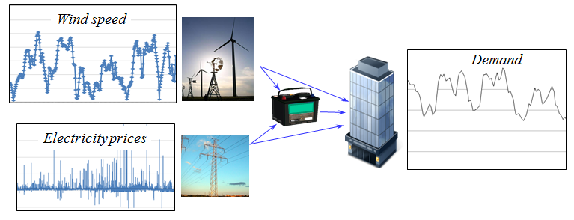








VFA policies: Backward MDP and curses of dimensionality
Energy storage with stochastic prices, supplies and demands.
$$E_{t}^{wind}$$
$$D_{t}$$
$$P_{t}^{grid}$$
$$R_{t}^{battery}$$
$E_{t+1}^{wind}=E_{t}^{wind} +{\hat{E}}_{t+1}^{wind}$ $$P_{t+1}^{grid} =P_{t}^{grid} +{\hat{P}}_{t+1}^{grid}$$ $D_{t+1}^{load} =D_{t}^{load} +{\hat{D}}_{t+1}^{load}$
$R_{t+1}^{bat}=R_{t}^{bat} +Ax_{t}$
$$W_{t+1}=\text{Exogenous inputs}$$
$$S_{t}=\text{State variable}$$
$$x_{t}=\text{Controllable inputs}$$

Slide 13
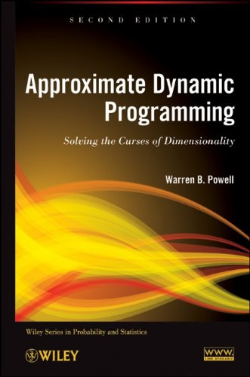



VFA policies: Backward MDP and curses of dimensionality
Bellman’s optimality equation
$$V(S_{t})=\min_{x_{t}∈X}\left(C(S_{t},x_{t})+γ𝔼\left\{V(S_{t+1}(S_{t},x_{t},W_{t+1})|S_{t}\right\}\right)$$
$$\left[\begin{aligned}E_{t}^{wind} \\ P_{t}^{grid} \\ D_{t}^{load} \\ R_{t}^{battery}\end{aligned}\right]$$
$$\left[\begin{aligned}x_{t}^{wind−battery} \\ x_{t}^{wind−load} \\ x_{t}^{grid−battery} \\ x_{t}^{grid−load} \\ x_{t}^{battery−load}\end{aligned}\right]$$
$$\left[\begin{aligned}{\hat{E}}_{t+1}^{wind} \\ {\hat{P}}_{t+1}^{grid} \\ {\hat{D}}_{t+1}^{load}\end{aligned}\right]$$
These are the “three curses of dimensionality.”

Slide 14

VFA policies: Backward MDP and curses of dimensionality
Backward dynamic programming in one dimension
$$\text{Step 0: Initialize }V_{T+1}(R_{T+1})=0\text{ for }R_{T+1}=0,1,...,100 \\ \text{Step 1: Step backward }t=T,T−1,T−2,…. 0 \\ \text{ Step 2: Loop over }R_{t}=0,1,...,100 \\ \text{ Step 3: Loop over all decisions} x_{t}=0,…,(R^{max}−R_{t}) \\ \text{ Step 4: Take the expectation over exogenous information:} \\ \text{ Compute }Q(R_{t},x_{t})=\left(C(R_{t},x_{t})+\sum_{w=0}^{100}{{ V}_{t+1}\left(S_{t+1}\left(S_{t},x_{t},w\right)\right)p(w)}\right) \\ \text{ End step 4;} \\ \text{ End Step 3;} \\ \text{ Find }V_{t}^{∗}(R_{t})=\max_{x_{t}}{Q}(R_{t},x_{t}) \\ \text{ Store }X_{t}^{π^{∗}}(R_{t})={argmax}_{x_{t}}{Q}(R_{t},x_{t}). (\text{This is our policy}) \\ \text{ End Step 2;} \\ \text{End Step 1;}$$

Slide 15

VFA policies: Backward MDP and curses of dimensionality
Dynamic programming in multiple dimensions
$$\text{Step 0: Initialize }V_{T+1}(S_{T+1})=0\text{ for all states.} \\ \text{Step 1: Step backward }t=T,T−1,T−2,... \\ \text{ Step 2: Loop over }S_{t}=\left(R_{t},D_{t},p_{t},E_{t}\right) (\text{four} \text{nested loops}) \\ \text{ Step 3: Loop over all decisions }x_{t} (\text{five }\text{nested loops}) \\ \text{ Step 4: Take the expectation over each random dimension }\left({\hat{D}}_{t},{\hat{p}}_{t},{\hat{E}}_{t}\right) \\ \text{ Compute }Q(S_{t},x_{t})=C(S_{t},x_{t})+ \\ \sum_{w_{1}=0}^{100}{\sum_{w_{2}=0}^{100}{\sum_{w_{3}=0}^{100}{V_{t+1}\left(S_{}^{M}\left(S_{t},x_{t},W_{t+1}=(w_{1},w_{2},w_{3})\right)\right)P^{W}(w_{1},w_{2},w_{3})}}}$$
$$\text{ End step 4;} \\ \text{ End Step 3;} \\ \text{ Find }V_{t}^{∗}(S_{t})=\max_{x_{t}}{Q}(S_{t},x_{t}) \\ \text{ Store }X_{t}^{π^{∗}}(S_{t})={argmax}_{x_{t}}{Q}(S_{t},x_{t}). (\text{This is our policy}) \\ \text{ End Step 2;} \\ \text{End Step 1;}$$

Slide 16
OUTLINE
VFA I – Introduction to Dynamic Programming
Exact dynamic programming
The three curses of dimensionality
Value iteration for infinite horizon problems
15

Slide 17
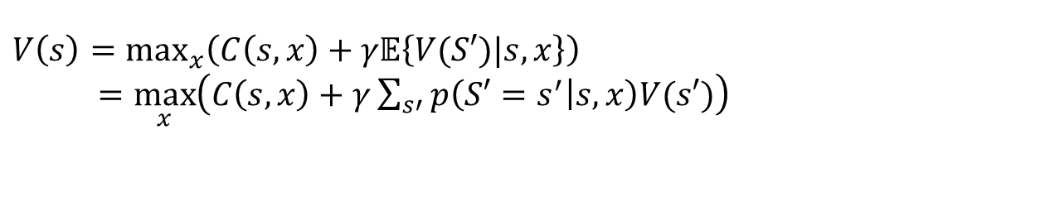

VFA policies: Exact dynamic programming
Steady state version of Bellman
Starting with Bellman, the academic community transitioned to the steady state version of Bellman’s equation for infinite horizon problems:
This can be represented as finding a fixed point $V\left(s\right)$ which can be written in operator form as:
Requires design of algorithms (such as value iteration) to find the fixed point $V(s)$. Elegant mathematical properties.
$$V\left(s\right)=\max_{x}\left(C\left(s,x\right)+γ𝔼\left\{V(S′)|s,x\right\}\right)$$
$=\max_{x}\left(C\left(s,x\right)+γ\sum_{s′}{p\left({S′=s}^{′} | s,x\right)V(s′})\right)$
$V=ℳV$

Slide 18
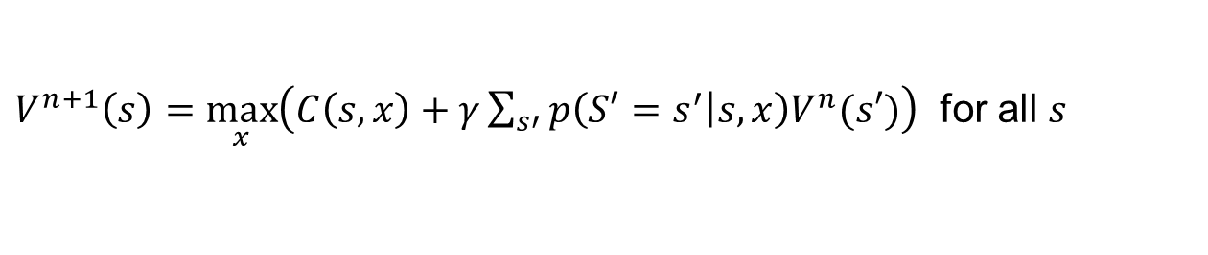


VFA policies: Exact dynamic programming
Value iteration for infinite horizon problems
Initialize $V^{0}(s)$ for all $s$ (e.g. $V^{0}\left(s\right)=0$).
Solve for $n=0, 1, 2, …$
This is known as “value iteration” and enjoys the property:
$V^{n+1}\left(s\right)=\max_{x}\left(C\left(s,x\right)+γ\sum_{s′}{p\left({S′=s}^{′} | s,x\right)V^{n}(s′})\right)$ for all $s$
$$\lim_{n→∞}{V^{n}\left(s\right)→V(s)}$$

Slide 19
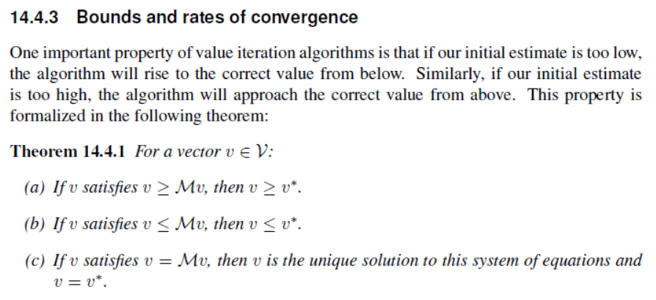
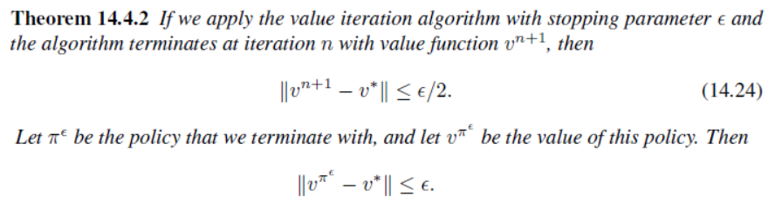
VFA policies: Exact dynamic programming
A sample of the elegant theory:
Tight bounds on the rate of convergence to an optimal policy.
This theory is beautifully presented in Puterman’s Markov Decision Processes.
Elegant theory, but not computable for real applications.

Slide 20
VFA policies: Exact dynamic programming
Steady state DP and reinforcement learning
As early as the 1950s, the Markov decision process community adopted the steady state model as the default model for dynamic programming.
It is this model that was picked up by the reinforcement learning community. It explains why they do not model time when representing states and actions.

Slide 21


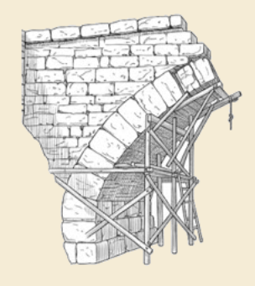
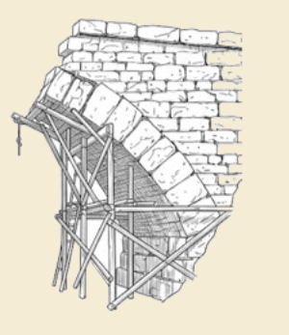
Thank you!
For more information see the Sequential Decision Analytics website at
warrenpowell.org
For more on value function approximations go to:
warrenpowell.org → Policies → Value function approximations

