Slide 1

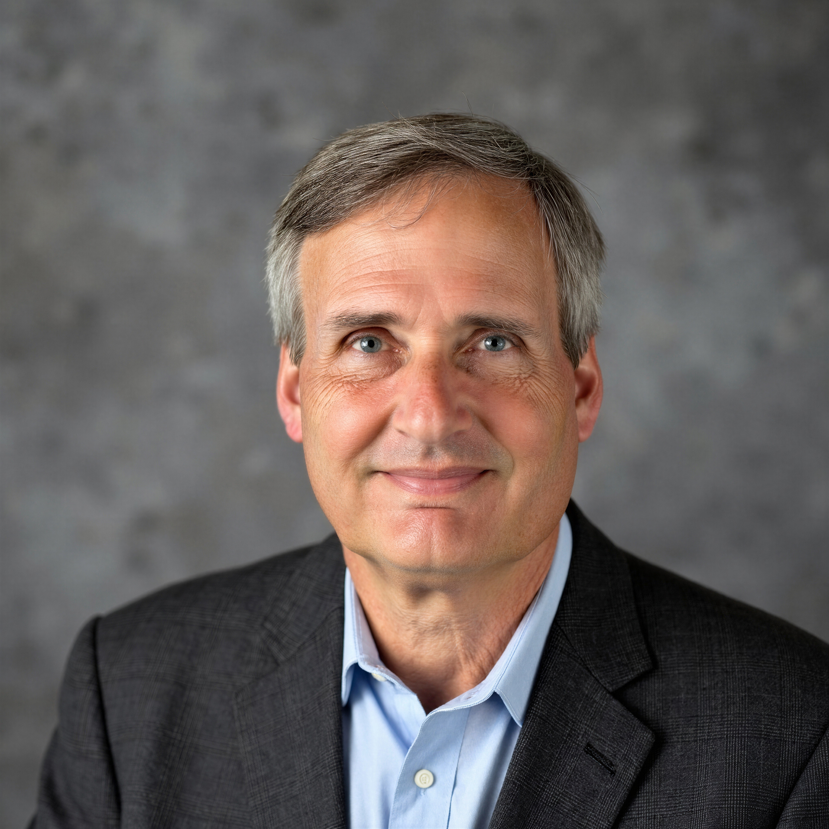
Tutorial Series on Sequential Decision Analytics
Warren B Powell
Professor Emeritus, Princeton University
Recorded: August 12, 2026
Module: Value function approximations II – VFA-based policies
Value iteration
Backward approximate dynamic programming
Predecessor module(s):
Universal modeling framework (detailed)
Value function approximations I
Technical level: Advanced. The presentation depends heavily on the mathematics of Bellman’s equation.

Slide 2

OUTLINE
Value function approximations:
VFA I – Introduction to Dynamic Programming
VFA II – VFA-based policies
VFA III - “Reinforcement learning” in the style of computer science
VFA IV - Forward ADP and linear VFAs
VFA V - Applications of ADP
15

Slide 3
OUTLINE
VFA II – VFA-based policies
Bellman’s equation and approximate dynamic programming
The nomadic trucker
The exploration vs. exploitation problem
Backward ADP
15

Slide 4
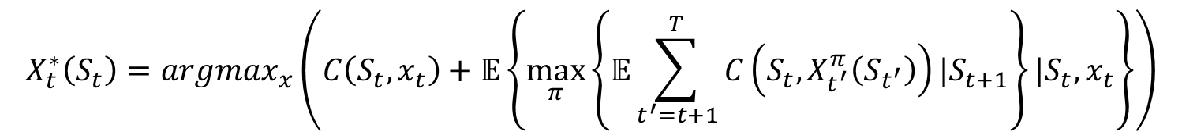
VFA policies
A formal statement of a “lookahead policy”
$$X_{t}^{∗}\left(S_{t}\right)=argmax_{x}\left(C\left(S_{t},x_{t}\right)+𝔼\left\{\max_{π}\left\{𝔼\sum_{t^{′}=t+1}^{T}{C\left(S_{t},X_{t^{′}}^{π}\left(S_{t^{′}}\right)\right)|S_{t+1}}\right\}|S_{t},x_{t}\right\}\right)$$
Contribution we receive now
Future contributions
This policy simply states that we want to make the best decision to optimize over the horizon, assuming that we also use optimal policies in the future.
We would be done if we could compute this.

Slide 5
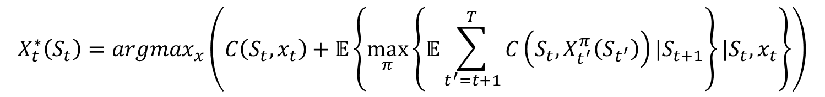
VFA policies
Lookahead policies are based on solving
$$X_{t}^{∗}\left(S_{t}\right)=argmax_{x}\left(C\left(S_{t},x_{t}\right)+𝔼\left\{\max_{π}\left\{𝔼\sum_{t^{′}=t+1}^{T}{C\left(S_{t},X_{t^{′}}^{π}\left(S_{t^{′}}\right)\right)|S_{t+1}}\right\}|S_{t},x_{t}\right\}\right)$$

Slide 6
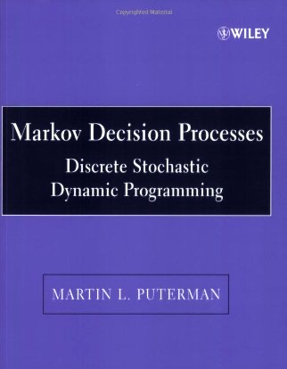
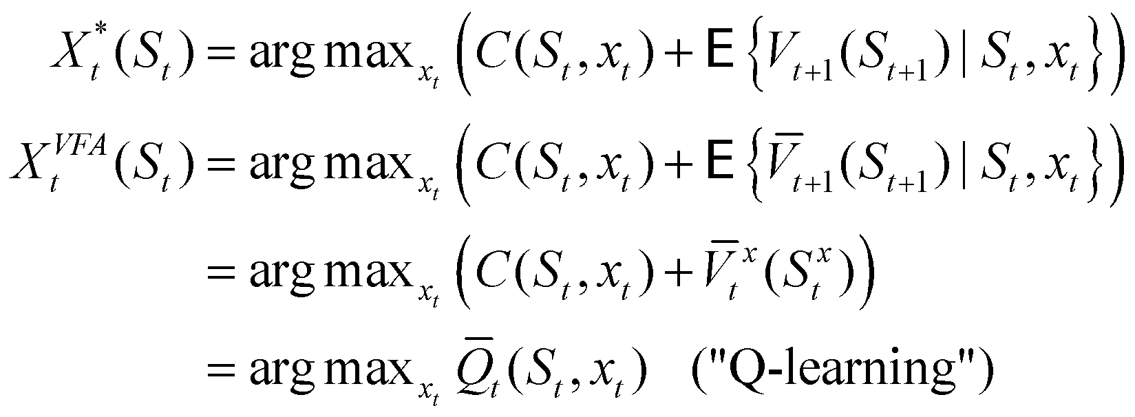
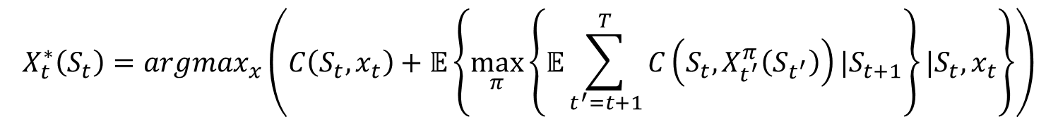
VFA policies
Lookahead approximations Approximate the impact of a decision now on the future
$$X_{t}^{∗}\left(S_{t}\right)=argmax_{x}\left(C\left(S_{t},x_{t}\right)+𝔼\left\{\max_{π}\left\{𝔼\sum_{t^{′}=t+1}^{T}{C\left(S_{t},X_{t^{′}}^{π}\left(S_{t^{′}}\right)\right)|S_{t+1}}\right\}|S_{t},x_{t}\right\}\right)$$

Slide 7
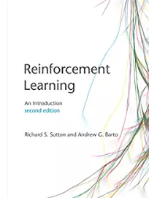
VFA policies
Lookahead approximations Approximate the impact of a decision now on the future
$$X_{t}^{∗}\left(S_{t}\right)=argmax_{x}\left(C\left(S_{t},x_{t}\right)+𝔼\left\{\max_{π}\left\{𝔼\sum_{t^{′}=t+1}^{T}{C\left(S_{t},X_{t^{′}}^{π}\left(S_{t^{′}}\right)\right)|S_{t+1}}\right\}|S_{t},x_{t}\right\}\right)$$

Slide 8
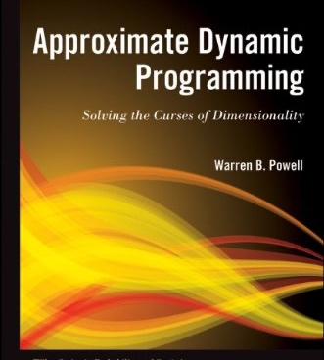
VFA policies
Lookahead approximations Approximate the impact of a decision now on the future
$$X_{t}^{∗}\left(S_{t}\right)=argmax_{x}\left(C\left(S_{t},x_{t}\right)+𝔼\left\{\max_{π}\left\{𝔼\sum_{t^{′}=t+1}^{T}{C\left(S_{t},X_{t^{′}}^{π}\left(S_{t^{′}}\right)\right)|S_{t+1}}\right\}|S_{t},x_{t}\right\}\right)$$

Slide 9
OUTLINE
VFA II – VFA-based policies
Bellman’s equation and approximate dynamic programming
The nomadic trucker
The exploration vs. exploitation problem
Backward ADP
15

Slide 10
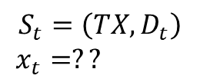
Value iteration: The nomadic trucker
The pre-decision state
$350
$150
$450
$300
Pre-decision state
$$S_{t}=\left({TX,D}_{t}\right)$$
$$x_{t}=??$$

Slide 11
Value iteration: The nomadic trucker
We use initial value function approximations…
$350
$150
$450
$300
Pre-decision state
$$S_{t}=\left({TX,D}_{t}\right)$$
$$x_{t}=??$$

Slide 12

Value iteration: The nomadic trucker
Making the decision:
$350
$150
$450
$300
Pre-decision state
$$S_{t}=\left({TX,D}_{t}\right)$$
$$x_{t}=$$
“Go to NY”

Slide 13

Value iteration: The nomadic trucker
The post-decision state
$450
Post-decision state
$$S_{t}^{x}=\left(NY\right)$$

Slide 14
Value iteration: The nomadic trucker
Update the value of being in TX:
$350
$150
$450
$300

Slide 15

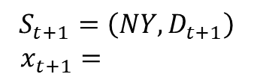
Value iteration: The nomadic trucker
Advance time to $t+1$, now in NY:
$180
$400
$600
$125
Pre-decision state
$$S_{t+1}=\left({NY,D}_{t+1}\right)$$
$$x_{t+1}=$$
“Go to CA”

Slide 16
Value iteration: The nomadic trucker
Update value of being in NY:
$180
$400
$600
$125

Slide 17
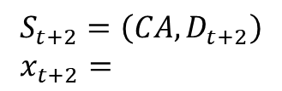

Value iteration: The nomadic trucker
Advance time to $t+2$, now in CA:
$400
$200
$150
$350
Pre-decision state
$$S_{t+2}=\left({CA,D}_{t+2}\right)$$
$$x_{t+2}=$$
??

Slide 18
Value iteration: The nomadic trucker
Make decision to go to CA
$400
$200
$150
$350
Pre-decision state
$$S_{t+2}=\left({CA,D}_{t+2}\right)$$
$$x_{t+2}=$$
Go to TX

Slide 19
Value iteration: The nomadic trucker
Update value of being in CA:
$400
$200
$150
$350
Pre-decision state
$$S_{t+2}=\left({CA,D}_{t+2}\right)$$
$$x_{t+2}=$$
Go to TX

Slide 20
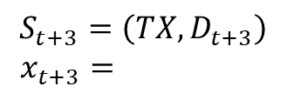
Value iteration: The nomadic trucker
Now in TX with new loads, best choice is CO
$385
$1200
$125
$275
Pre-decision state
$$S_{t+3}=\left({TX,D}_{t+3}\right)$$
$$x_{t+3}=$$
Go to CO

Slide 21
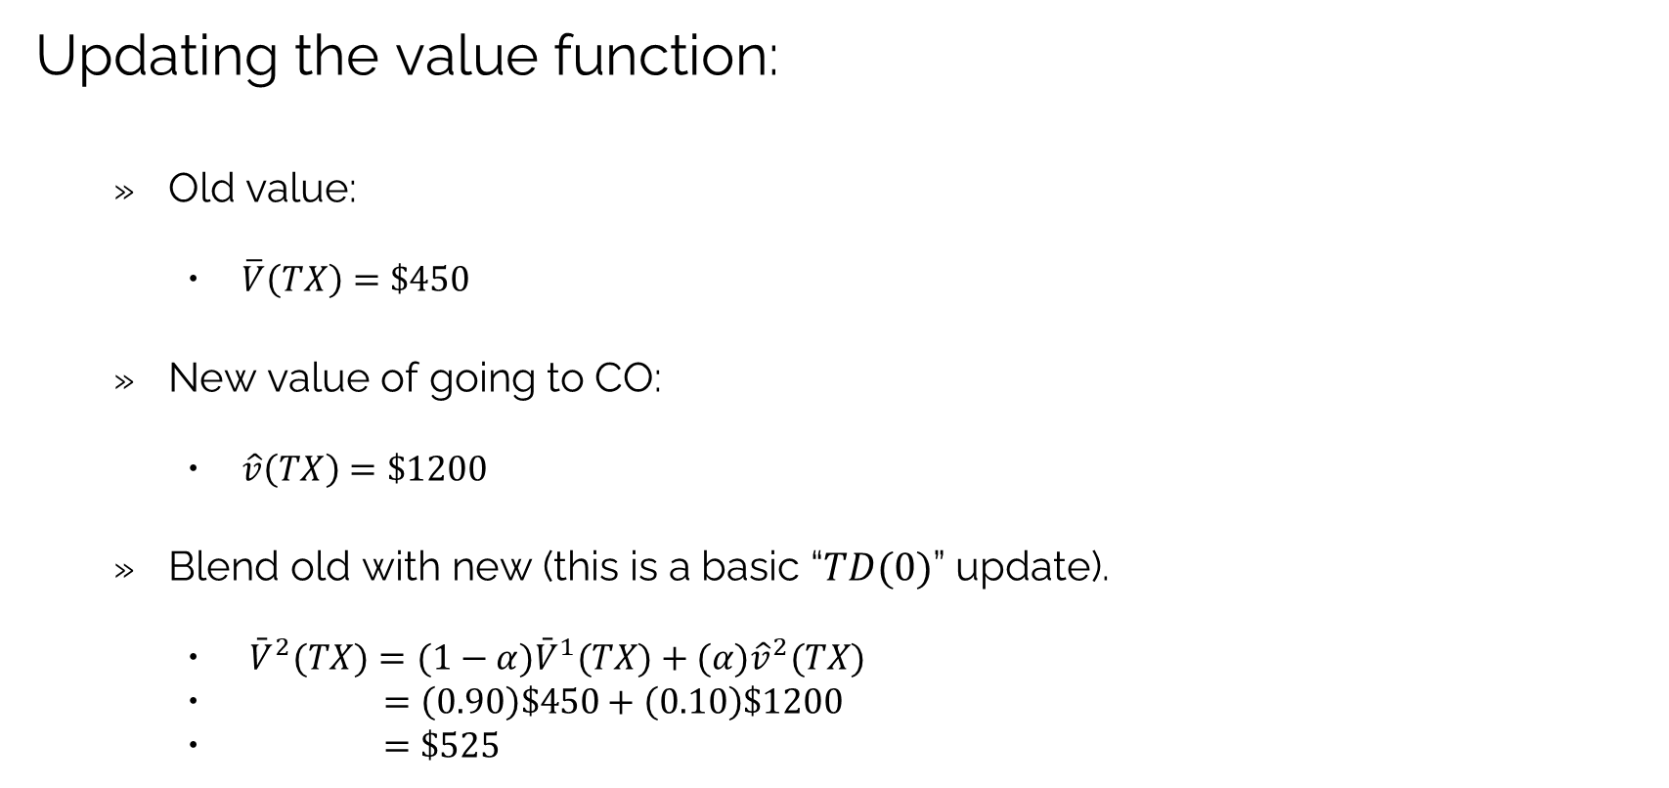
Value iteration: The nomadic trucker
Updating the value function:
Old value:
$\overline{V}\left(TX\right)=\$450$
New value of going to CO:
$\hat{v}\left(TX\right)=\$1200$
Blend old with new (this is a basic “$TD(0)$” update).
${\bar{V}}^{2}(TX)=(1−α){\bar{V}}^{1}(TX)+(α){\hat{v}}^{2}(TX)$
$=\left(0.90\right)\$450+\left(0.10\right)\$1200$
$=\$525$

Slide 22

Value iteration: The nomadic trucker
Now in TX with new loads, best choice is CO
$385
$1200
$125
$275
$${\bar{V}}^{1}(TX)=525$$
Pre-decision state
$$S_{t+3}=\left({TX,D}_{t+3}\right)$$
$$x_{t+3}=$$
Go to CO

Slide 23
Value iteration: The nomadic trucker
Challenge question:
I have used this simple example for many years.
I have (knowingly) ignored an important element of the state variable.
Can you name the information missing from the state variable?
Hint: The RL community has been making this mistake over its entire history.
The answer will be made available at a later time.

Slide 24
Value iteration: The nomadic trucker
Notes:
This example illustrates the most basic approximate dynamic programming / reinforcement learning algorithm.
This algorithm will not converge to the optimal solution.
In fact, the final solution of this algorithm is likely to be quite poor.
We are going to show how to fix this algorithm next.

Slide 25
OUTLINE
VFA II – VFA-based policies
Bellman’s equation and approximate dynamic programming
The nomadic trucker
The exploration vs. exploitation problem
Backward ADP
15

Slide 26
Value iteration: The nomadic trucker
What load to choose?
$400
$200
$150
$350
Return to TX because of the $450 value?
Or try MN just to learn its value?

Slide 27
Value iteration: Exploration vs. exploitation
What decision do we make?
The one we think is best?
Exploitation
Or do we make a decision just to try something and learn more about the result?
Exploration
This is the reason that the “exploration vs. exploitation” problem is so well known in ADP/RL.

Slide 28
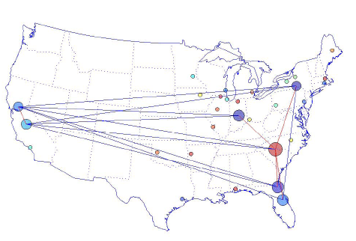
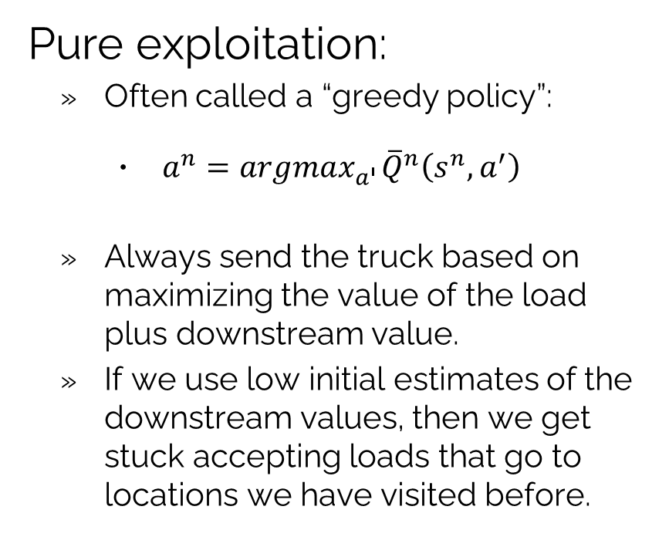
Value iteration: Exploration vs. exploitation
Pure exploitation:
Often called a “greedy policy”:
$a^{n}=argmax_{a^{′}}{\overline{Q}}^{n}\left(s^{n},a^{′}\right)$
Always send the truck based on maximizing the value of the load plus downstream value.
If we use low initial estimates of the downstream values, then we get stuck accepting loads that go to locations we have visited before.

Slide 29
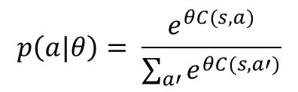
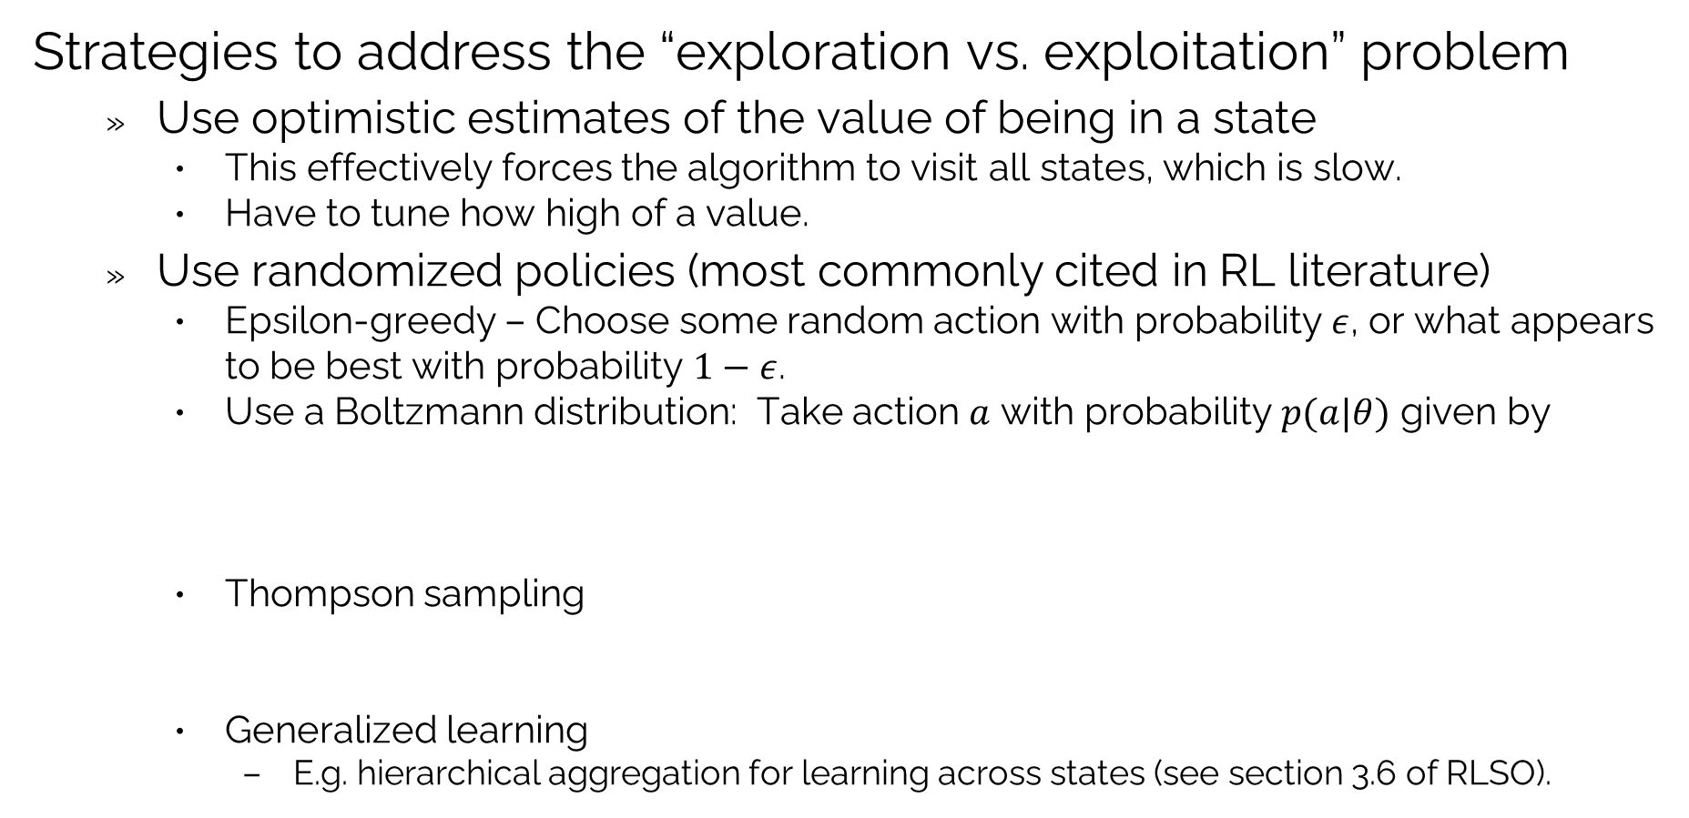
Value iteration: Exploration vs. exploitation
Strategies to address the “exploration vs. exploitation” problem
Use optimistic estimates of the value of being in a state
This effectively forces the algorithm to visit all states, which is slow.
Have to tune how high of a value.
Use randomized policies (most commonly cited in RL literature)
Epsilon-greedy – Choose some random action with probability $ε$, or what appears to be best with probability $1−ε$.
Use a Boltzmann distribution: Take action $a$ with probability $p(a|θ)$ given by
Thompson sampling
Generalized learning
E.g. hierarchical aggregation for learning across states (see section 3.6 of RLSO).
$$p\left(a|θ\right)= \frac{e^{θC(s,a)}}{\sum_{a′}{e^{θC(s,a′)}}}$$
$a=argmax_{a′}\left(C\left(s,a\right)+ε\right)$ where $ε∼N(0,{θσ}^{2})$

Slide 30
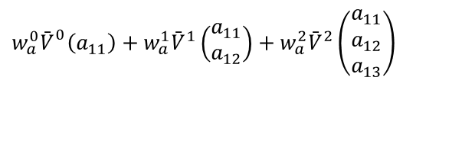

Value iteration: Exploration vs. exploitation
Aggregate
Disaggregate
$$w_{a}^{0}{\bar{V}}_{}^{0}\left(a_{11}\right)+w_{a}^{1}{\bar{V}}^{1}\left(\begin{matrix}a_{11} \\ a_{12}\end{matrix}\right)+w_{a}^{2}{\bar{V}}^{2}\left(\begin{matrix}a_{11} \\ a_{12} \\ a_{13}\end{matrix}\right)$$
$$\left[\begin{matrix}a_{1} \\ a_{2} \\ ⋮ \\ a_{n}\end{matrix}\right]$$

Slide 31
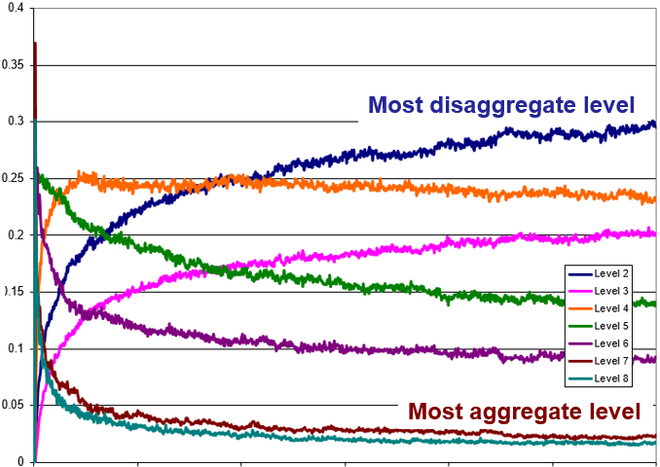
Value iteration: Exploration vs. exploitation
Average value of weights for each aggregation
$$w_{a}^{0}{\bar{V}}_{}^{0}\left(a_{11}\right)+w_{a}^{1}{\bar{V}}^{1}\left(\begin{matrix}a_{11} \\ a_{12}\end{matrix}\right)+w_{a}^{2}{\bar{V}}^{2}\left(\begin{matrix}a_{11} \\ a_{12} \\ a_{13}\end{matrix}\right)$$
$$\left[\begin{matrix}a_{1} \\ a_{2} \\ ⋮ \\ a_{n}\end{matrix}\right]$$
See section 3.6 of RLSO on lookup tables and hierarchical aggregation.

Slide 32
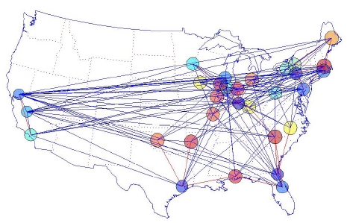
Value iteration: Exploration vs. exploitation
Generalized learning:
Uses the structure of the problem to generalize learning from each sample.
Avoids the need for pure exploration steps. We are using a deterministic policy here.
This means using an on-policy search strategy, which avoids the errors of off-policy.

Slide 33
OUTLINE
VFA II – VFA-based policies
Bellman’s equation and approximate dynamic programming
The nomadic trucker
The exploration vs. exploitation problem
Backward ADP
15

Slide 34
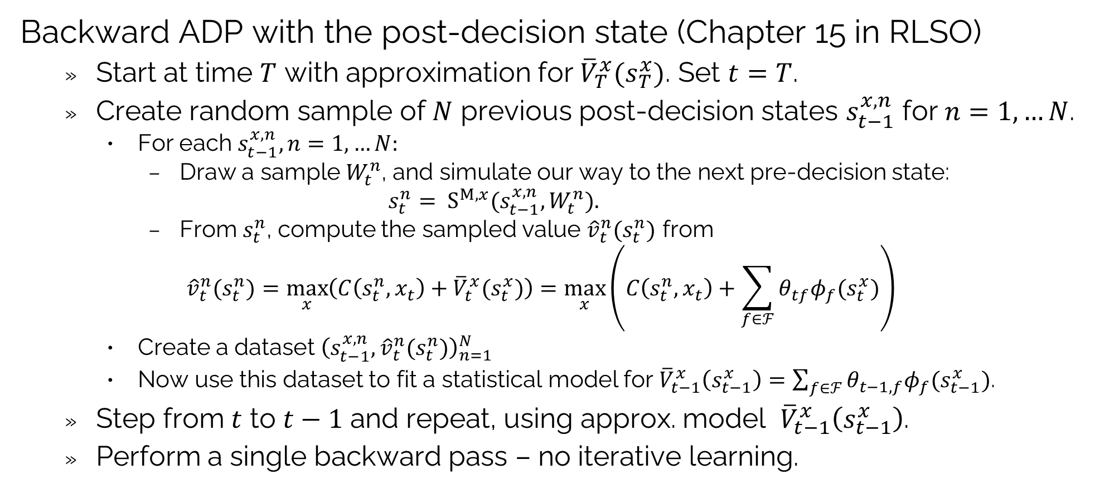
Backward approximate dynamic programming
Backward ADP with the post-decision state (Chapter 15 in RLSO)
Start at time $T$ with approximation for ${\overline{V}}_{T}^{x}(s_{T}^{x})$. Set $t=T$.
Create random sample of $N$ previous post-decision states $s_{t−1}^{x,n}$ for $n=1,…N$.
For each $s_{t−1}^{x,n},n=1,…N:$
Draw a sample $W_{t}^{n}$, and simulate our way to the next pre-decision state:
$$s_{t}^{n}= S^{M,x}(s_{t−1}^{x,n},W_{t}^{n}).$$
From $s_{t}^{n}$, compute the sampled value ${\hat{v}}_{t}^{n}(s_{t}^{n})$ from
$${\hat{v}}_{t}^{n}(s_{t}^{n})=\max_{x}\left(C\left(s_{t}^{n},x_{t}\right)+{\overline{V}}_{t}^{x}(s_{t}^{x})\right)=\max_{x}\left(C\left(s_{t}^{n},x_{t}\right)+\sum_{f∈ℱ}{θ_{tf}φ_{f}(s_{t}^{x})}\right)$$
Create a dataset ${\left(s_{t−1}^{x,n},{\hat{v}}_{t}^{n}(s_{t}^{n})\right)}_{n=1}^{N}$
Now use this dataset to fit a statistical model for ${\overline{V}}_{t−1}^{x}\left(s_{t−1}^{x}\right)=\sum_{f∈ℱ}{θ_{t−1,f}φ_{f}(s_{t−1}^{x})}$.
Step from $t$ to $t−1$ and repeat, using approx. model ${\overline{V}}_{t−1}^{x}\left(s_{t−1}^{x}\right)$.
Perform a single backward pass – no iterative learning.

Slide 35
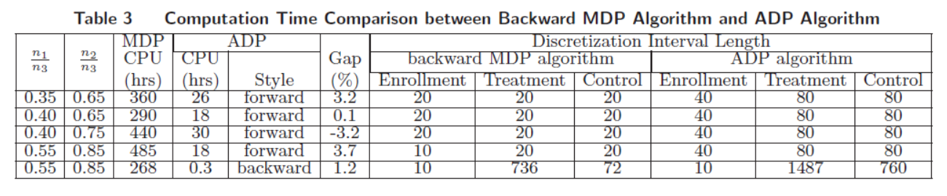
Backward approximate dynamic programming
Backward ADP for a clinical trial problem
Problem is to learn the value of a new drug within a budget of patients to be tested.
Backward MDP required 268-485 hours.
Forward ADP exploiting monotonicity required 18-30 hours.
Backward ADP required 20 minutes, with a solution that was 1.2 percent within optimal.
Backward ADP

Slide 36
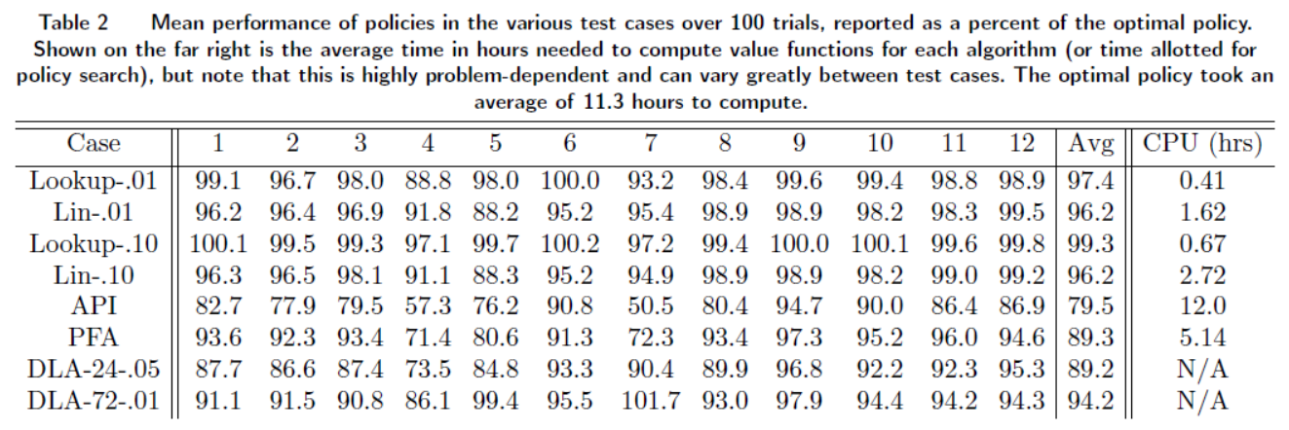
Backward approximate dynamic programming
Energy storage problem
Exact MDP 11.3 hours.
Backward ADP – 99.3 percent of optimal, .67 hours.
Backward ADP

Slide 37
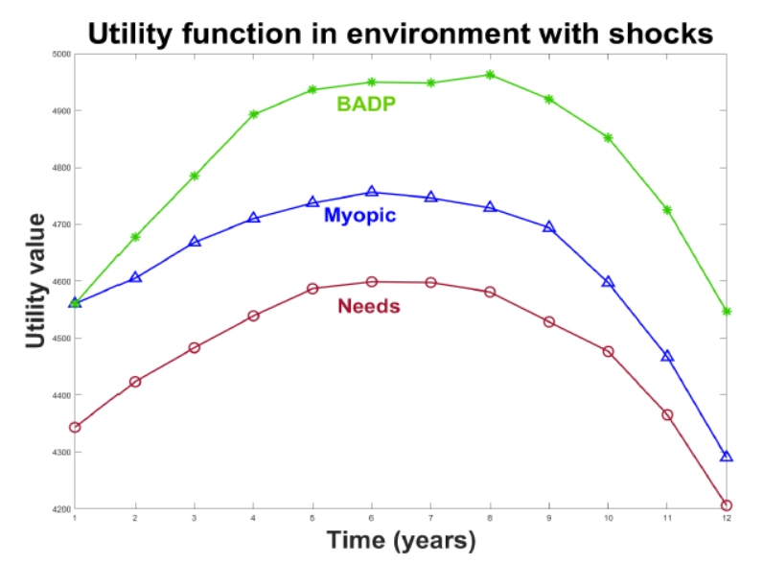
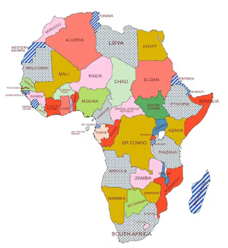
Backward approximate dynamic programming
Resource allocation in Africa
Popular policy involved solving myopic LP, ignoring the future
Solve LP using marginal values of resources in the future, computed using backward ADP.
Backward ADP
Solve LP to optimally allocate resources each year, ignoring the value of projects over multiple years.
This is the standard way that funds are allocated by the IMF (International Monetary Fund).

Slide 38


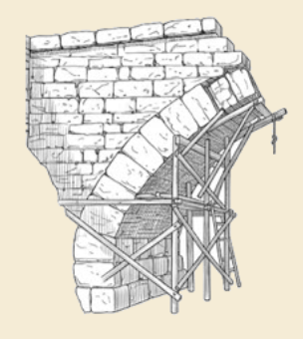
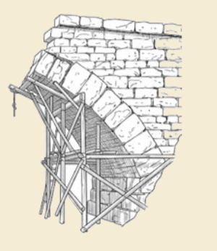
Thank you!
For more information see the Sequential Decision Analytics website at
warrenpowell.org
For more on value function approximations go to:
warrenpowell.org → Policies → Value function approximations

