Slide 1


Tutorial Series on Sequential Decision Analytics
Warren B Powell
Professor Emeritus, Princeton University
Recorded: August 12, 2026
Module: Value function approximations III – “Reinforcement learning”
Temporal difference learning
Q-learning
The deadly triad
Predecessor module(s):
Universal modeling framework (detailed)
Value function approximations I and II
Technical level: Advanced. The presentation depends heavily on the mathematics of Bellman’s equation.

Slide 2

OUTLINE
Value function approximations:
VFA I – Introduction to Dynamic Programming
VFA II – VFA-based policies
VFA III - “Reinforcement learning” in the style of computer science
VFA IV - Forward ADP and linear VFAs
VFA V - Applications of ADP
15

Slide 3
OUTLINE
VFA III - “Reinforcement learning” in the style of computer science
Temporal-difference learning
Q-learning/SARSA
The deadly triad
15

Slide 4

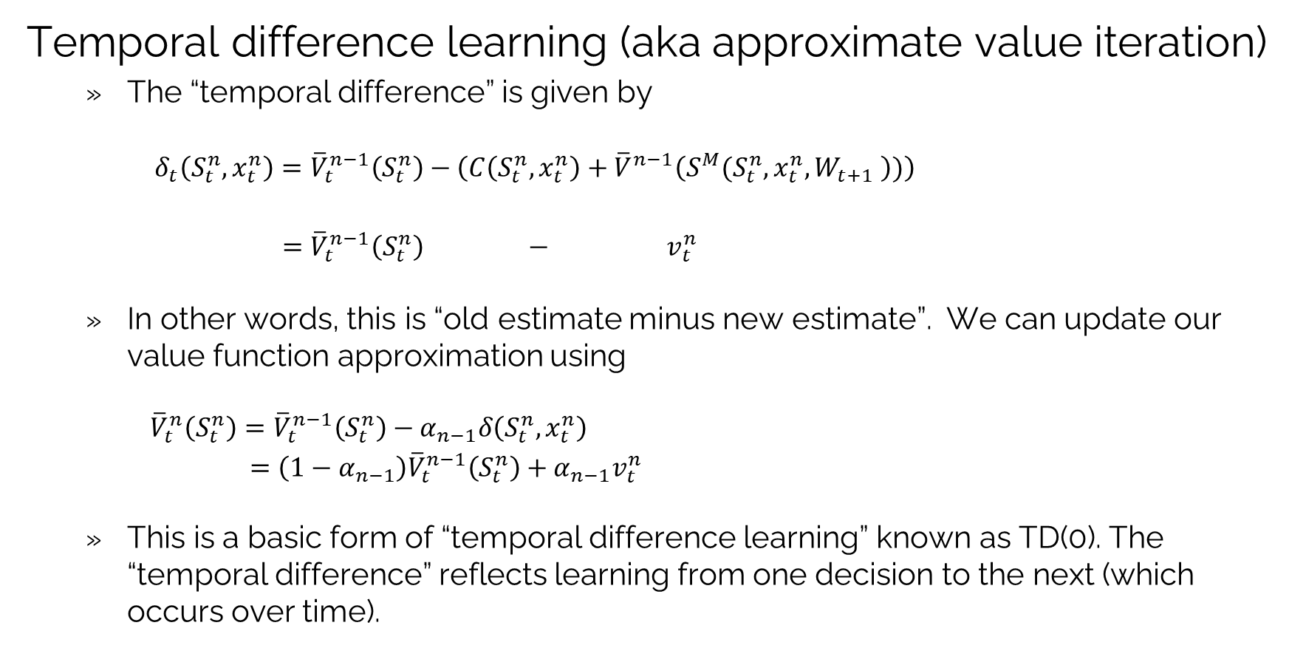
Reinforcement learning: TD learning
Temporal difference learning (aka approximate value iteration)
The “temporal difference” is given by
$$δ_{t}\left(S_{t}^{n},x_{t}^{n}\right)={\overline{V}}_{t}^{n−1}\left(S_{t}^{n}\right)−\left(C\left(S_{t}^{n},x_{t}^{n}\right)+{\overline{V}}^{n−1}\left(S^{M}(S_{t}^{n},x_{t}^{n},W_{t+1} \right))\right)$$
$={\overline{V}}_{t}^{n−1}\left(S_{t}^{n}\right) − v_{t}^{n}$
In other words, this is “old estimate minus new estimate”. We can update our value function approximation using
${\overline{V}}_{t}^{n}\left(S_{t}^{n}\right)={\overline{V}}_{t}^{n−1}\left(S_{t}^{n}\right)−α_{n−1}δ\left(S_{t}^{n},x_{t}^{n}\right)$
$=\left(1−α_{n−1}\right){\overline{V}}_{t}^{n−1}\left(S_{t}^{n}\right)+α_{n−1}v_{t}^{n}$
This is a basic form of “temporal difference learning” known as TD(0). The “temporal difference” reflects learning from one decision to the next (which occurs over time).

Slide 5

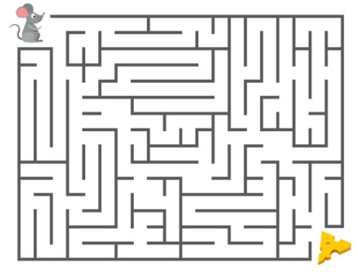

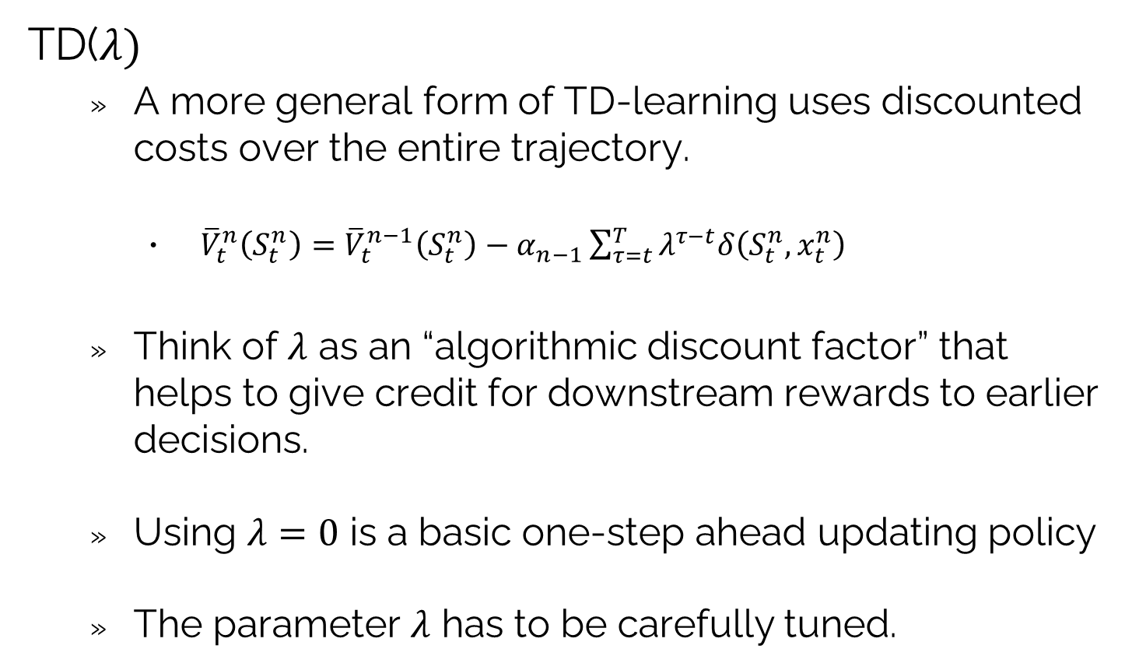
Reinforcement learning: TD learning
TD($λ)$
A more general form of TD-learning uses discounted costs over the entire trajectory.
${\overline{V}}_{t}^{n}\left(S_{t}^{n}\right)={\overline{V}}_{t}^{n−1}\left(S_{t}^{n}\right)−α_{n−1}\sum_{τ=t}^{T}{λ^{τ−t}δ\left(S_{t}^{n},x_{t}^{n}\right)}$
Think of $λ$ as an “algorithmic discount factor” that helps to give credit for downstream rewards to earlier decisions.
Using $λ=0$ is a basic one-step ahead updating policy
The parameter $λ$ has to be carefully tuned.
Executed by doing a forward simulation following some policy.

Slide 6
Reinforcement learning: TD learning
Approximating the value function
Temporal difference updates can be paired with any recursive estimation algorithm for a linear or locally linear model:
Lookup tables
Independent beliefs
Correlated beliefs
Hierarchical beliefs
Linear parametric models
Nonparametric models
Kernel regression
Locally linear
Nonlinear models for VFAs require specialized algorithms for doing incremental updates.

Slide 7
OUTLINE
VFA III - “Reinforcement learning” in the style of computer science
Temporal-difference learning
Q-learning/SARSA
The deadly triad
15

Slide 8
Reinforcement learning: Q-learning
Mouse in a maze problem
Original motivating application for Sutton and Barto:
Important element is a mouse whose behavior is unknown to us.

Slide 9
Reinforcement learning: Q-learning
Some terms from Sutton and Barto:
“Behavior policy” is the policy used to choose actions
E.g. these are actions observed by a real system
“Target policy” is the policy that we are trying to learn, which is to say the policy we want to implement.
When the target policy is different from the behavior policy, then this is termed “off policy learning”
My vocabulary:
The “learning policy” is the policy (often called an algorithm) that learns the value functions (or Q-factors)
The “implementation policy” is the policy determined by the value functions (or Q-factors).

Slide 10
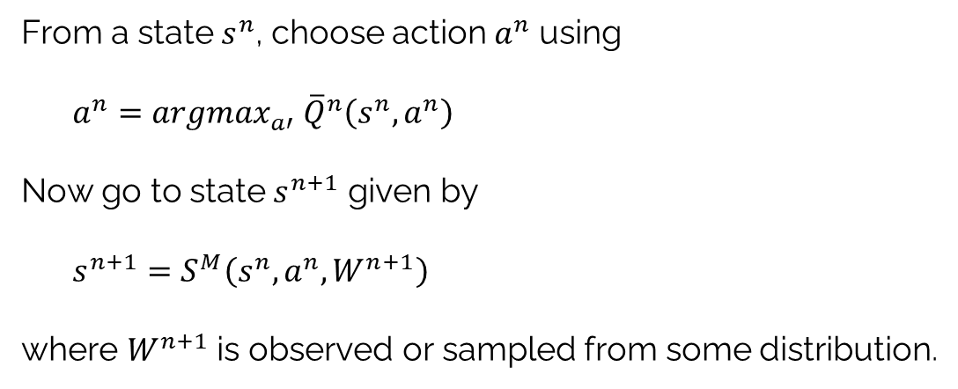
Reinforcement learning: Q-learning
On- vs off-policy learning:
On-policy learning – Learning the value of the implementation (target) policy:
Off-policy learning:
Sample actions according to a learning policy (called “behavior policy” in Sutton & Barto). This is the policy used for learning the implementation policy (called the “target policy” in Sutton & Barto).
Needs to be combined with a state sampling policy.
From a state $s^{n}$, choose action $a^{n}$ using
$a^{n}=argmax_{a′} {\overline{Q}}^{n}\left(s^{n},a^{n}\right)$
Now go to state $s^{n+1}$ given by
$s^{n+1}=S^{M}\left(s^{n},a^{n},W^{n+1}\right)$
where $W^{n+1}$ is observed or sampled from some distribution.

Slide 11
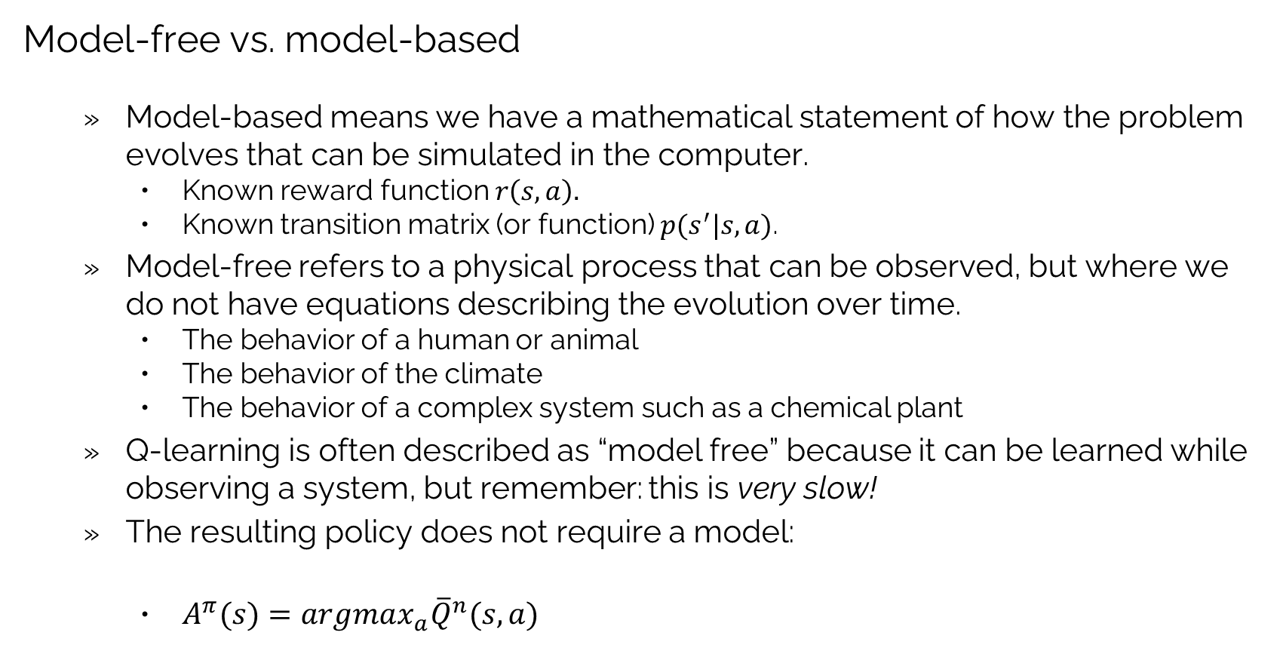
Reinforcement learning: Q-learning
Model-free vs. model-based
Model-based means we have a mathematical statement of how the problem evolves that can be simulated in the computer.
Known reward function $r\left(s,a\right).$
Known transition matrix (or function) $p(s^{′}|s,a)$.
Model-free refers to a physical process that can be observed, but where we do not have equations describing the evolution over time.
The behavior of a human or animal
The behavior of the climate
The behavior of a complex system such as a chemical plant
Q-learning is often described as “model free” because it can be learned while observing a system, but remember: this is very slow!
The resulting policy does not require a model:
$A^{π}(s)=argmax_{a}{\overline{Q}}^{n}(s,a)$

Slide 12
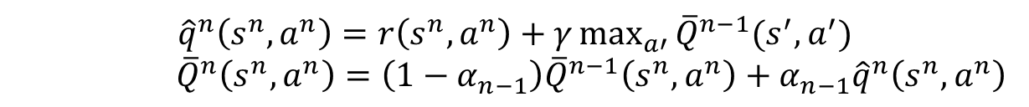
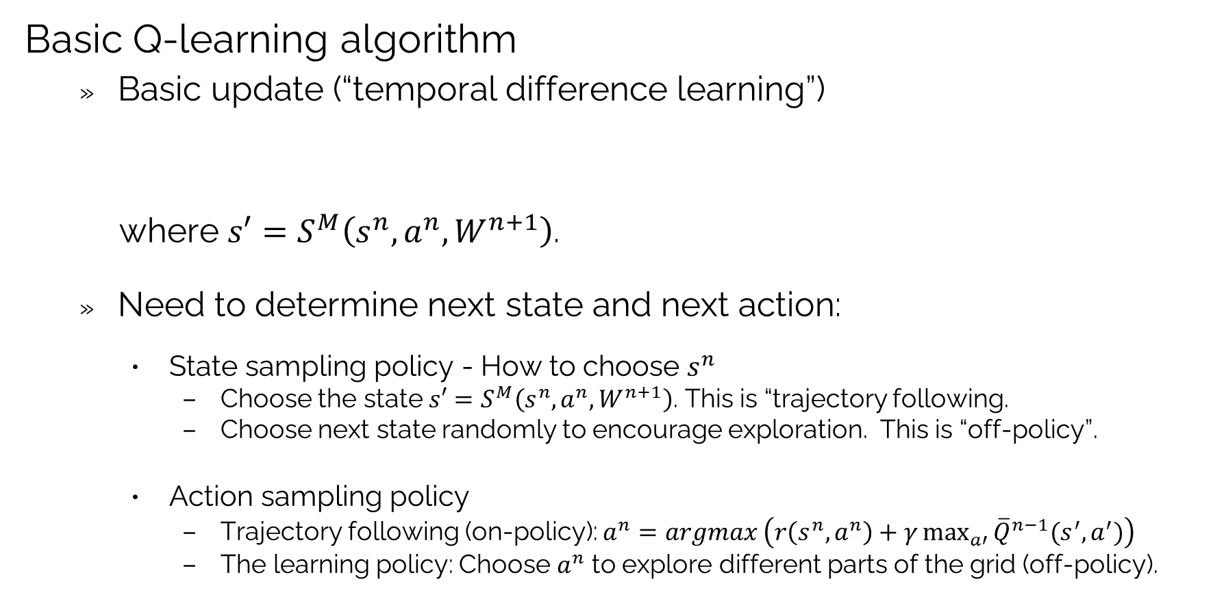
Reinforcement learning: Q-learning
Basic Q-learning algorithm
Basic update (“temporal difference learning”)
where $s′=S^{M}\left(s^{n},a^{n},W^{n+1}\right)$.
Need to determine next state and next action:
State sampling policy - How to choose $s^{n}$
Choose the state $s′=S^{M}\left(s^{n},a^{n},W^{n+1}\right)$. This is “trajectory following.
Choose next state randomly to encourage exploration. This is “off-policy”.
Action sampling policy
Trajectory following (on-policy): $a^{n}=argmax \left(r\left(s^{n},a^{n}\right)+γ\max_{a′}^{}{{\overline{Q}}^{n−1}(s^{′},a^{′})}\right)$
The learning policy: Choose $a^{n}$ to explore different parts of the grid (off-policy).
$${\hat{q}}^{n}\left(s^{n},a^{n}\right)=r\left(s^{n},a^{n}\right)+γ\max_{a′}^{}{{\overline{Q}}^{n−1}(s^{′},a^{′})}$$
${\overline{Q}}^{n}\left(s^{n},a^{n}\right)=\left(1−α_{n−1}\right){\overline{Q}}^{n−1}\left(s^{n},a^{n}\right)+α_{n−1}{\hat{q}}^{n}\left(s^{n},a^{n}\right)$

Slide 13
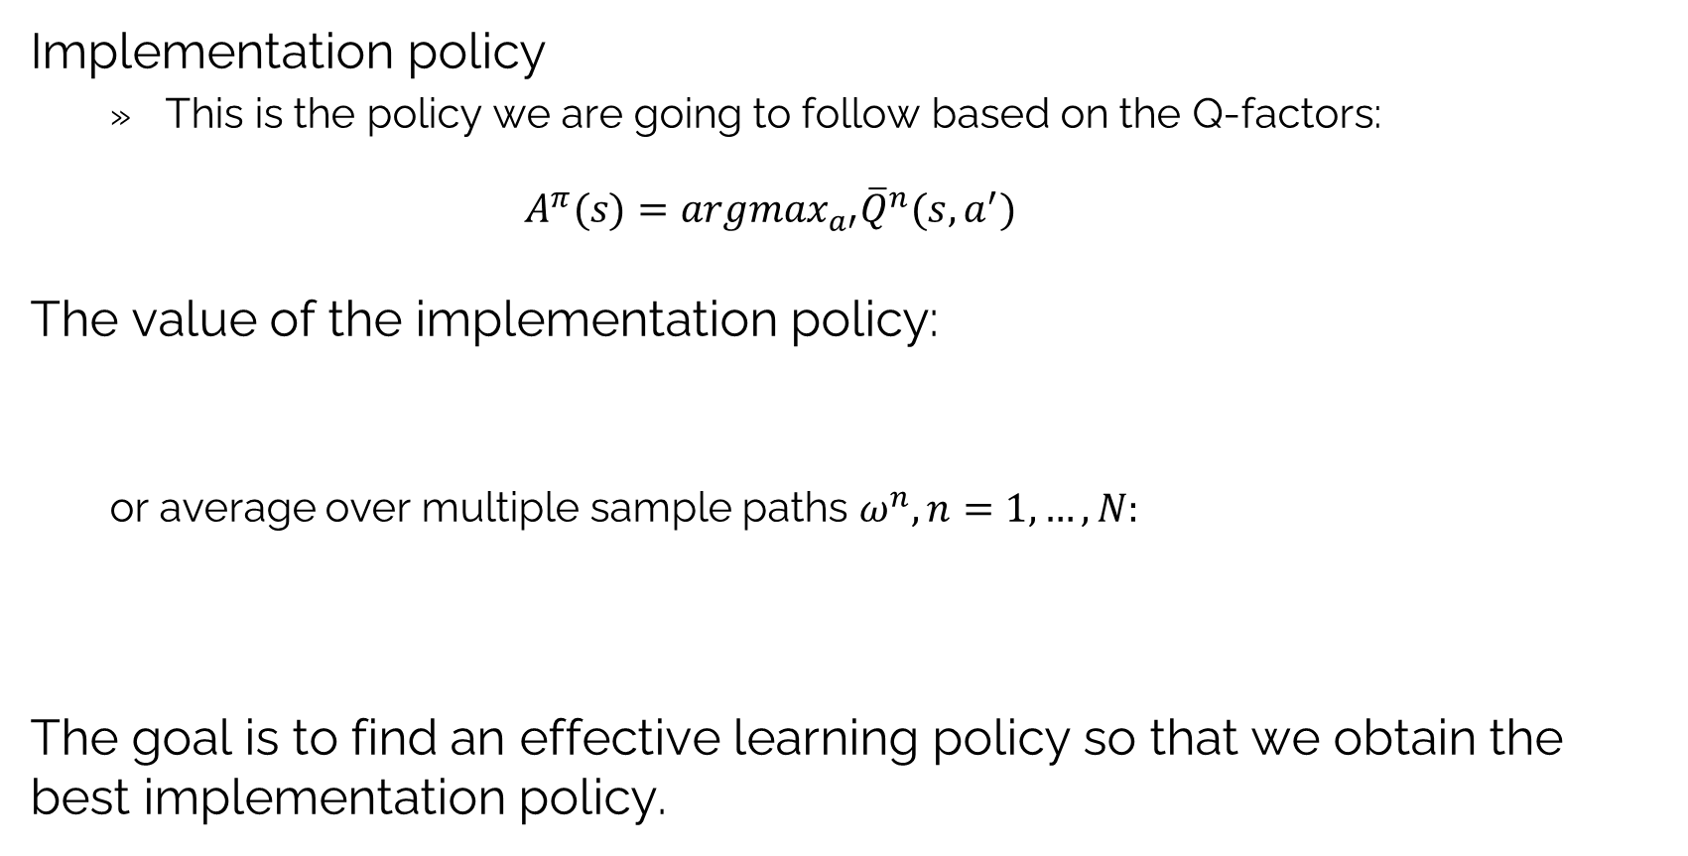
Reinforcement learning: Q-learning
Implementation policy
This is the policy we are going to follow based on the Q-factors:
$$A^{π}(s)=argmax_{a′}{\overline{Q}}^{n}(s,a^{′})$$
The value of the implementation policy:
or average over multiple sample paths $ω^{n}, n=1,…,N:$
The goal is to find an effective learning policy so that we obtain the best implementation policy.
$${\bar{F}}^{π}(ω)=\sum_{t=0}^{T}{C(S_{t},A^{π}(S_{t}))\text{ where }S_{t+1}=S^{M}(S_{t},}A^{π}(S_{t}),W_{t+1}(ω))$$
$${\bar{F}}^{π}=\frac{1}{N}\sum_{n=1}^{N−1}{\sum_{t=0}^{T}{C(S_{t},A^{π}(S_{t})) }}\text{where }S_{t+1}=S^{M}(S_{t},A^{π}(S_{t}),W_{t+1}(ω^{n})))$$

Slide 14
OUTLINE
VFA III - “Reinforcement learning” in the style of computer science
Temporal-difference learning
Q-learning/SARSA
The deadly triad
15

Slide 15
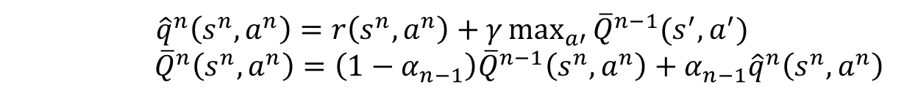
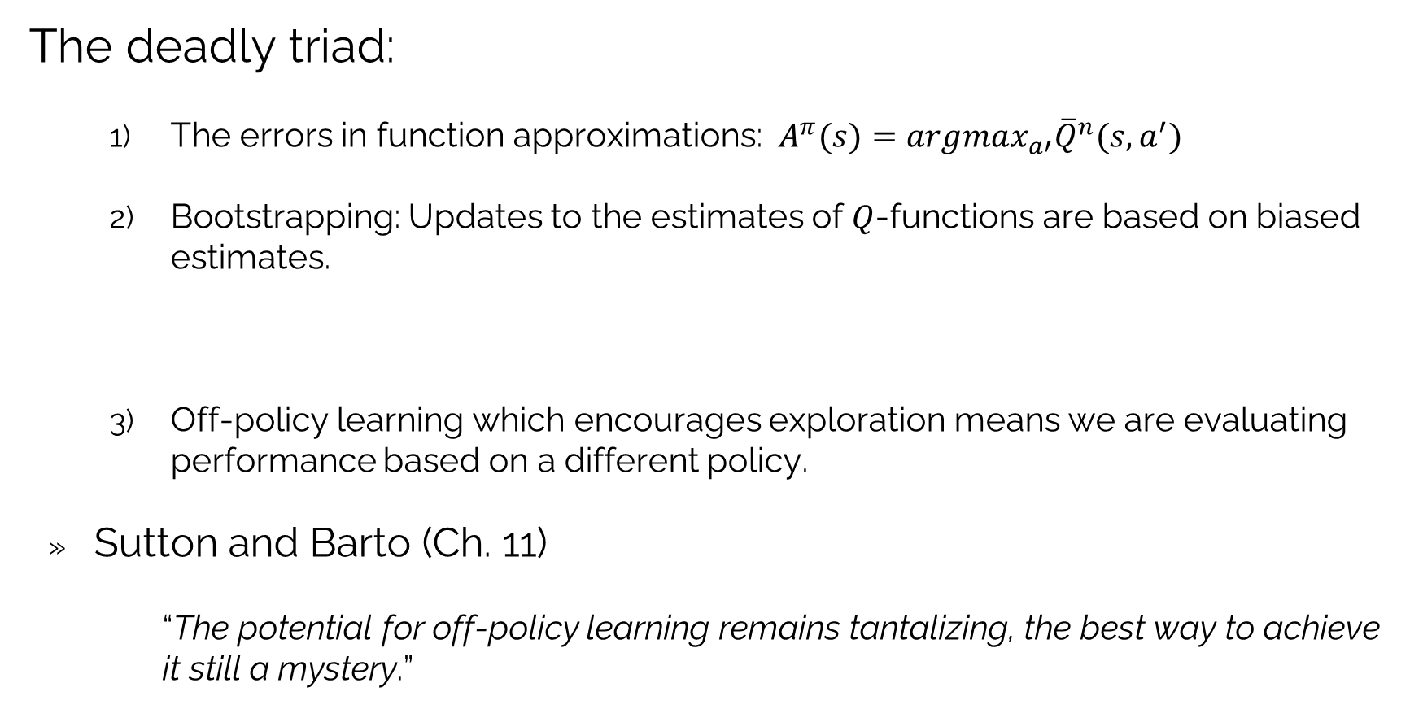
VFA: The deadly triad
The deadly triad:
The errors in function approximations: $A^{π}(s)=argmax_{a′}{\overline{Q}}^{n}(s,a^{′})$
Bootstrapping: Updates to the estimates of $Q$-functions are based on biased estimates.
Off-policy learning which encourages exploration means we are evaluating performance based on a different policy.
Sutton and Barto (Ch. 11)
“The potential for off-policy learning remains tantalizing, the best way to achieve it still a mystery.”
$${\hat{q}}^{n}\left(s^{n},a^{n}\right)=r\left(s^{n},a^{n}\right)+γ\max_{a′}^{}{{\overline{Q}}^{n−1}(s^{′},a^{′})}$$
${\overline{Q}}^{n}\left(s^{n},a^{n}\right)=\left(1−α_{n−1}\right){\overline{Q}}^{n−1}\left(s^{n},a^{n}\right)+α_{n−1}{\hat{q}}^{n}\left(s^{n},a^{n}\right)$

Slide 16
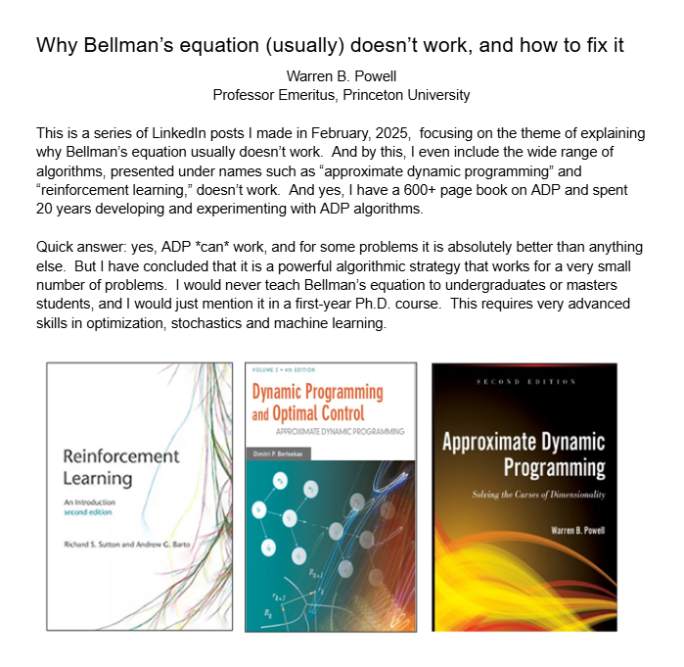
VFA: The deadly triad
Why Bellman does not work
The thousands of papers “demonstrating” various forms of ADP or reinforcement learning all use problems chosen by the developers of the algorithm.
The deadly triad helps explain algorithms for learning VFAs do not work.
Even if a VFA-based algorithm seems to work, it has to be easier to use than any of the other classes of policies.
I have summarized my thoughts on this at:
https://tinyurl.com/WhyBellmanDoesNotWork

Slide 17


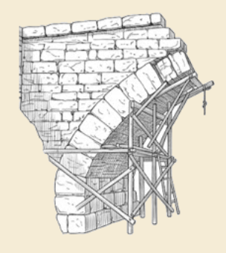
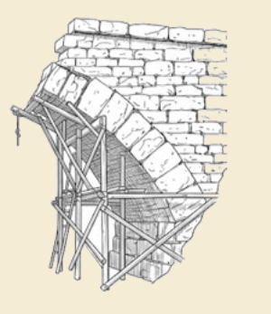
Thank you!
For more information see the Sequential Decision Analytics website at
warrenpowell.org
For more on value function approximations go to:
warrenpowell.org → Policies → Value function approximations

