Slide 1


Tutorial Series on Sequential Decision Analytics
Warren B Powell
Professor Emeritus, Princeton University
Recorded: August 12, 2026
Module: Value function approximations IV – Forward ADP and linear value functions
Learning linear VFAs
A financial trading application
The projection problem
Predecessor module(s):
Universal modeling framework (detailed)
Value function approximations I, II and III
Technical level: Advanced. The presentation depends heavily on the mathematics of Bellman’s equation.

Slide 2

OUTLINE
Value function approximations:
VFA I – Introduction to Dynamic Programming
VFA II – VFA-based policies
VFA III - “Reinforcement learning” in the style of computer science
VFA IV - Forward ADP and linear VFAs
VFA V - Applications of ADP
15

Slide 3
OUTLINE
VFA IV - Forward ADP and linear VFAs
Algorithms
Stepsizes
A financial application
15

Slide 4
OUTLINE
VFA IV - Forward ADP and linear VFAs
Algorithms
Stepsizes
A financial application
15

Slide 5
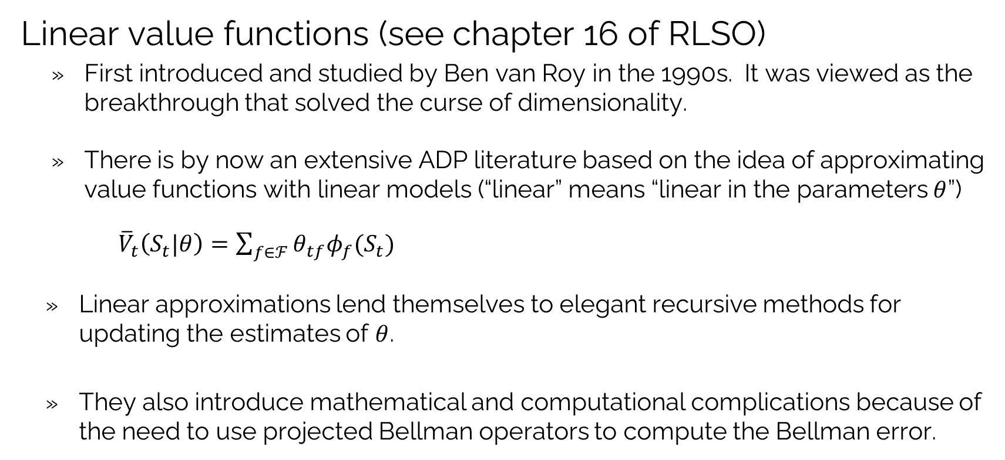
VFAs: Linear value function approximations
Linear value functions (see chapter 16 of RLSO)
First introduced and studied by Ben van Roy in the 1990s. It was viewed as the breakthrough that solved the curse of dimensionality.
There is by now an extensive ADP literature based on the idea of approximating value functions with linear models (“linear” means “linear in the parameters $θ$”)
${\overline{V}}_{t}\left(S_{t}|θ\right)=\sum_{f∈ℱ}{θ_{tf}φ_{f}(S_{t})}$
Linear approximations lend themselves to elegant recursive methods for updating the estimates of $θ$.
They also introduce mathematical and computational complications because of the need to use projected Bellman operators to compute the Bellman error.

Slide 6
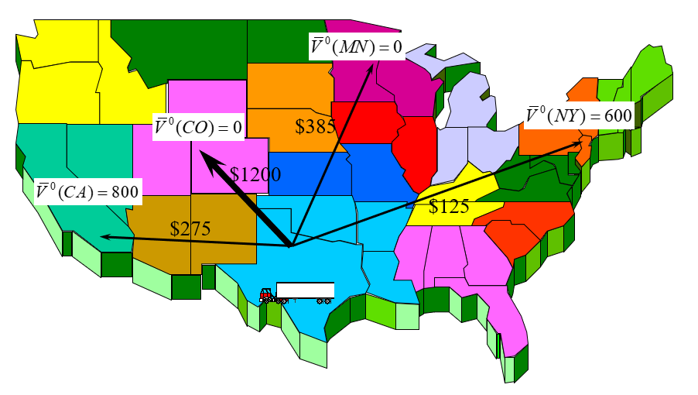

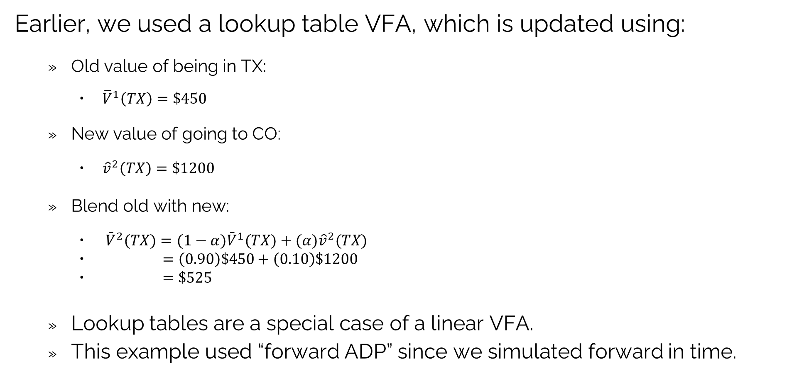
VFAs: Linear value function approximations
Earlier, we used a lookup table VFA, which is updated using:
Old value of being in TX:
${\overline{V}}^{1}\left(TX\right)=\$450$
New value of going to CO:
${\hat{v}}^{2}\left(TX\right)=\$1200$
Blend old with new:
${\bar{V}}^{2}(TX)=(1−α){\bar{V}}^{1}(TX)+(α){\hat{v}}^{2}(TX)$
$=\left(0.90\right)\$450+\left(0.10\right)\$1200$
$=\$525$
Lookup tables are a special case of a linear VFA.
This example used “forward ADP” since we simulated forward in time.
$${\overline{V}}^{1}\left(TX\right)=\$450$$

Slide 7
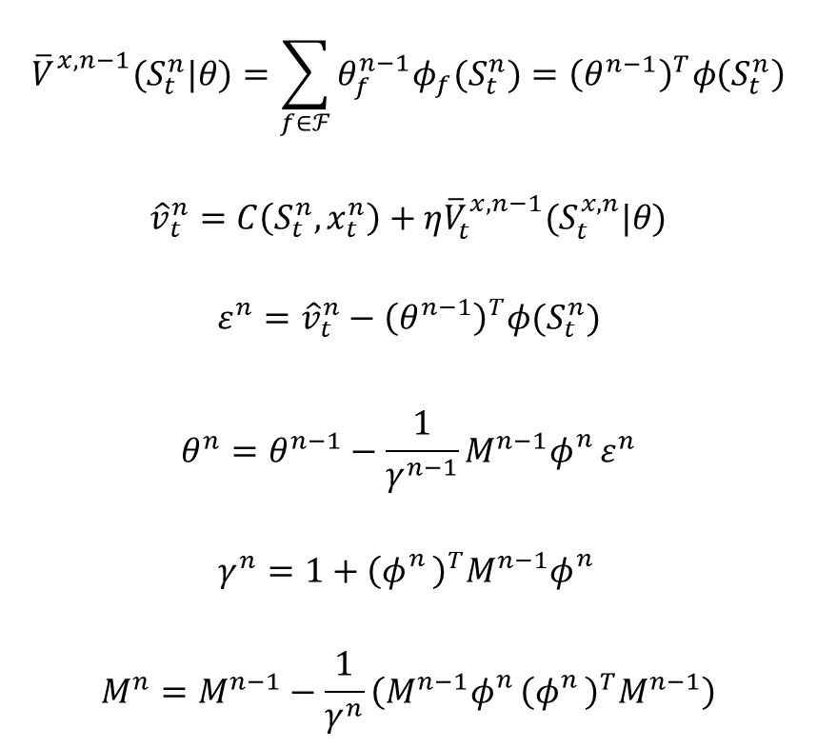
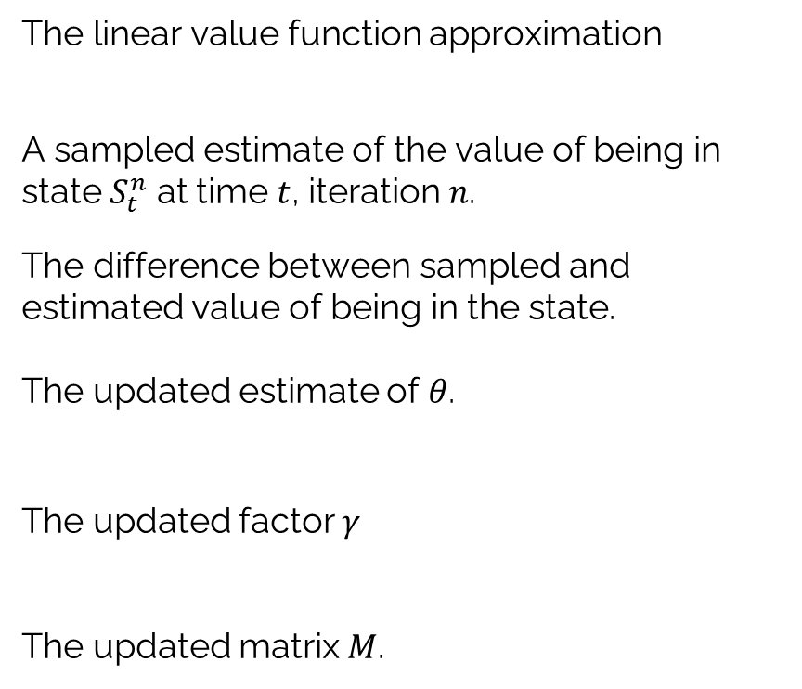
VFAs: Linear value function approximations
More general linear models are a bit more complicated:
$${\overline{V}}_{}^{x,n−1}(S_{t}^{n}|θ)=\sum_{f∈ℱ}{θ_{f}^{n−1}φ_{f}(S_{t}^{n})}={\left(θ^{n−1}\right)}^{T}φ\left(S_{t}^{n}\right)$$
$${\hat{v}}_{t}^{n}=C\left(S_{t}^{n},x_{t}^{n}\right)+η{\overline{V}}_{t}^{x,n−1}(S_{t}^{x,n}|θ)$$
$$ε^{n}={\hat{v}}_{t}^{n}−{\left(θ^{n−1}\right)}^{T}φ(S_{t}^{n})$$
$$θ^{n}=θ^{n−1}−\frac{1}{γ^{n−1}}M^{n−1}φ_{}^{n}ε^{n}$$
$$γ^{n}=1+{\left(φ_{}^{n}\right)}^{T}M^{n−1}φ_{}^{n}$$
$$M^{n}=M^{n−1}−\frac{1}{γ^{n}}\left(M^{n−1}φ_{}^{n}{\left(φ_{}^{n}\right)}^{T}M^{n−1}\right)$$
The linear value function approximation
A sampled estimate of the value of being in state $S_{t}^{n}$ at time $t$, iteration $n$.
The difference between sampled and estimated value of being in the state.
The updated estimate of $θ$.
The updated factor $γ$
The updated matrix $M$.

Slide 8
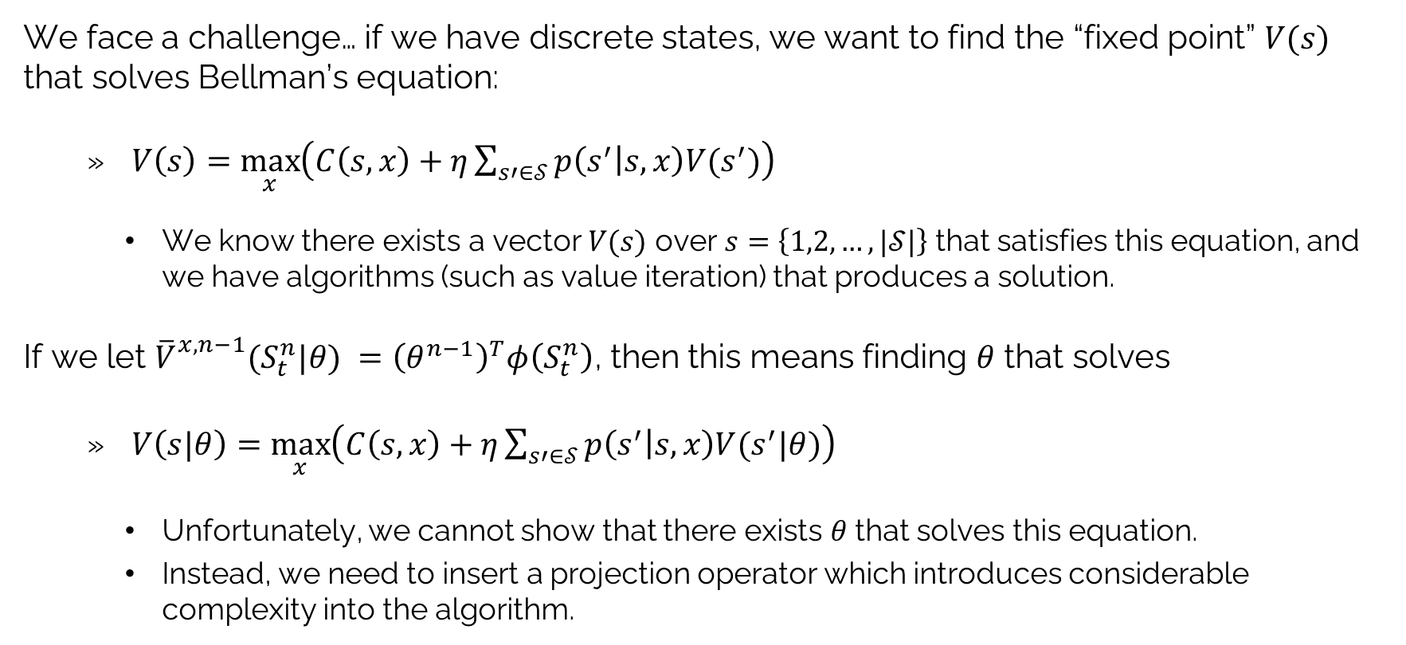
VFAs: Linear value function approximations
We face a challenge… if we have discrete states, we want to find the “fixed point” $V(s)$ that solves Bellman’s equation:
$V\left(s\right)=\max_{x}\left(C\left(s,x\right)+η\sum_{s′∈𝒮}{p\left(s^{′} | s,x\right)V(s^{′})}\right)$
We know there exists a vector $V(s)$ over $s=\left\{1,2,…,|𝒮|\right\}$ that satisfies this equation, and we have algorithms (such as value iteration) that produces a solution.
If we let ${\overline{V}}_{}^{x,n−1}(S_{t}^{n}|θ) ={\left(θ^{n−1}\right)}^{T}φ\left(S_{t}^{n}\right)$, then this means finding $θ$ that solves
$V\left(s|θ\right)=\max_{x}\left(C\left(s,x\right)+η\sum_{s′∈𝒮}{p\left(s^{′} | s,x\right)V(s^{′}|θ)}\right)$
Unfortunately, we cannot show that there exists $θ$ that solves this equation.
Instead, we need to insert a projection operator which introduces considerable complexity into the algorithm.

Slide 9
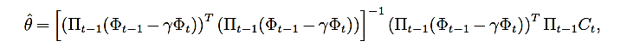
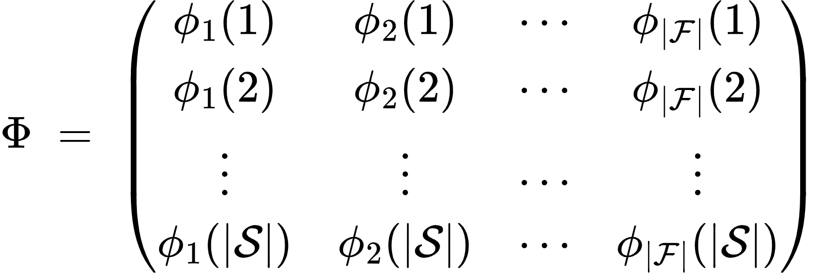
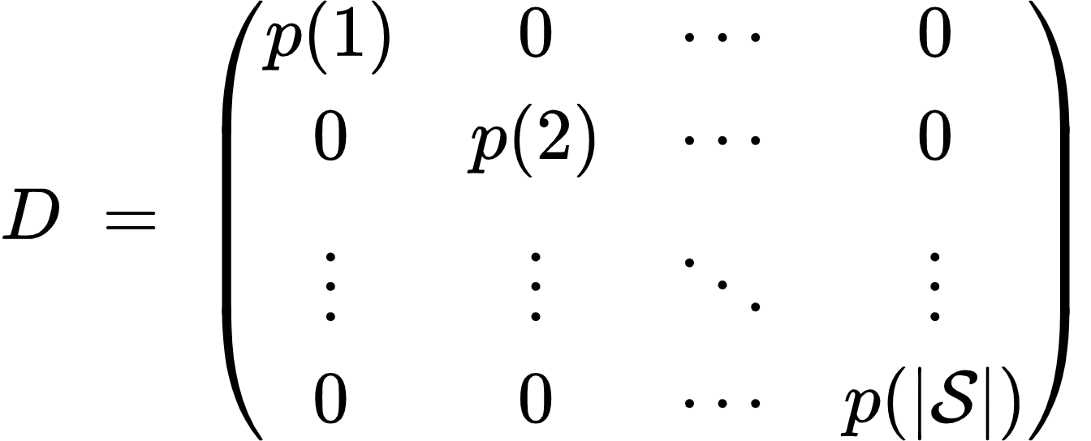

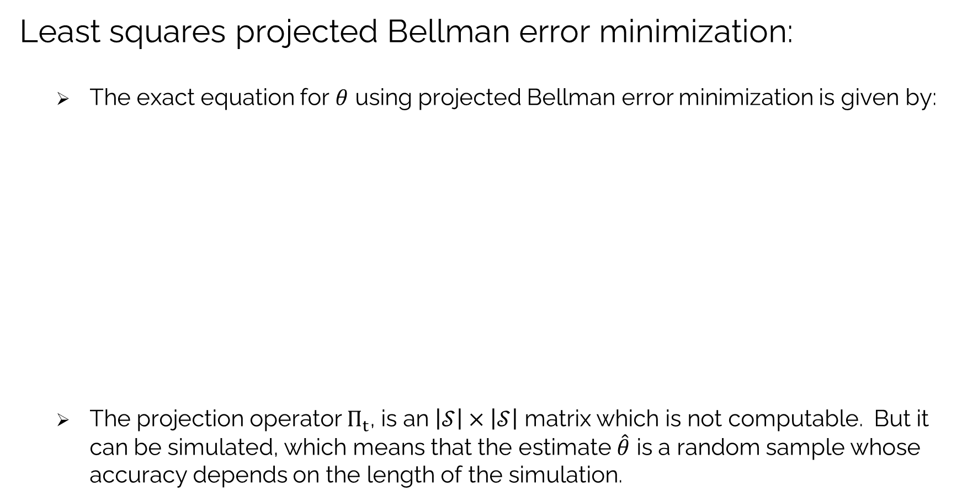
VFAs: Linear value function approximations
Least squares projected Bellman error minimization:
The exact equation for $θ$ using projected Bellman error minimization is given by:
The projection operator $Π_{t}$, is an $\left|𝒮\right|×\left|𝒮\right|$ matrix which is not computable. But it can be simulated, which means that the estimate $\hat{θ}$ is a random sample whose accuracy depends on the length of the simulation.
$$Π=Φ{\left(Φ^{T}DΦ\right)}^{−1}Φ^{T}D$$

Slide 10
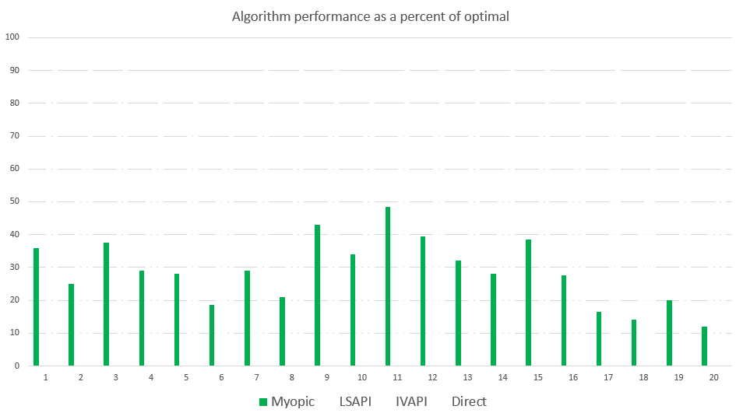
VFAs: Linear value function approximations
Myopic policy
Percent of optimal

Slide 11
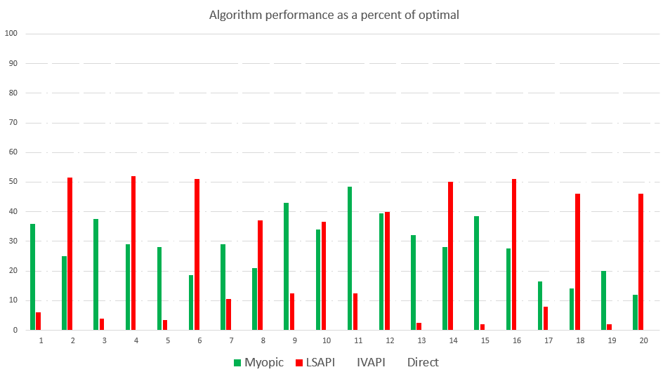
VFAs: Linear value function approximations
Myopic policy
LSAPI
Percent of optimal

Slide 12
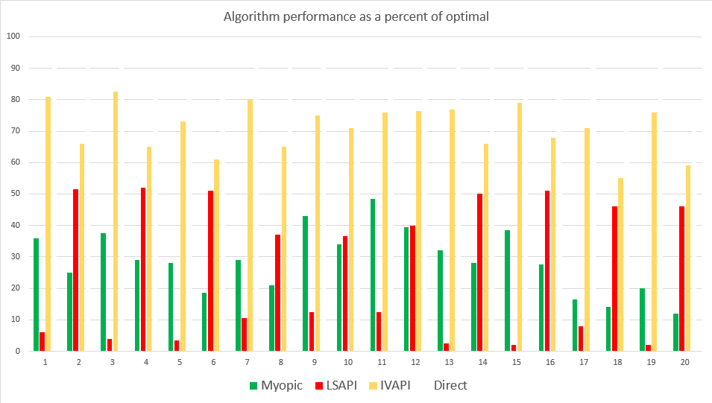
VFAs: Linear value function approximations
Myopic policy
LSAPI
LSAPI-Proj. Bellman
Percent of optimal

Slide 13
VFAs: Linear value function approximations
Notes:
Projected Bellman minimization is a fairly complex algorithmic strategy.
It is necessary to implement simulation-based approximations to overcome the size of the state space.
Despite this success, linear VFAs have proven to be problematic. They simply do not work as a general methodology.
The problem is that local approximations (that is, accurate for a local region of the state space) is not enough. It has to be accurate over all the states that might be visited.

Slide 14
OUTLINE
VFA IV - Forward ADP and linear VFAs
Algorithms
Stepsizes
A financial application
15

Slide 15
VFAs: Stepsizes
$$V_{t−1}^{n}(S_{t−1}^{x})=(1−α_{n−1})V_{t−1}^{n−1}(S_{t−1}^{x})+α_{n−1}{\hat{v}}_{t}^{n}$$
Updated estimate
Old estimate
New observation
Stepsizes:
Approximate value iteration requires updates of the form:

Slide 16
VFAs: Stepsizes
$$V_{t−1}^{n}(S_{t−1}^{x})=(1−α_{n−1})V_{t−1}^{n−1}(S_{t−1}^{x})+α_{n−1}{\hat{v}}_{t}^{n}$$
The stepsize
“Learning rate”
“Smoothing factor”
Stepsizes:
Approximate value iteration requires updates of the form:

Slide 17
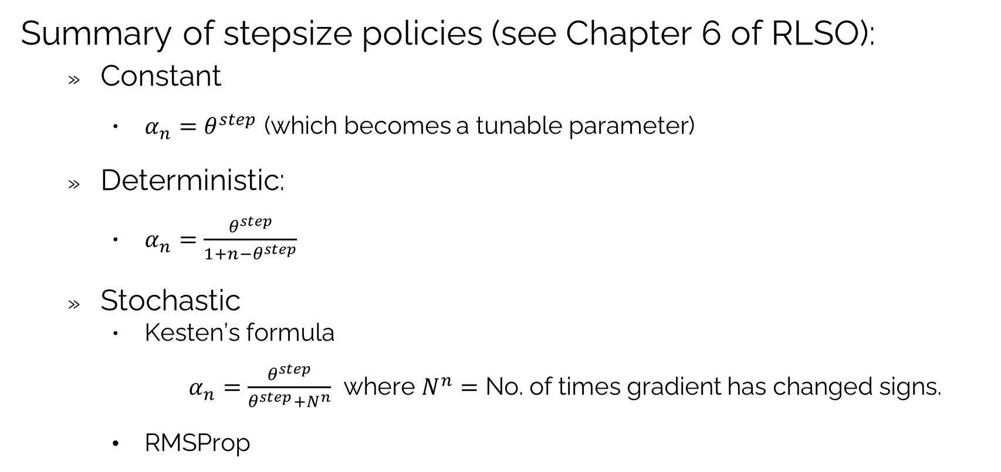
VFAs: Stepsizes
Summary of stepsize policies (see Chapter 6 of RLSO):
Constant
$α_{n}=θ^{step}$ (which becomes a tunable parameter)
Deterministic:
$α_{n}=\frac{θ^{step}}{1+n−θ^{step}}$
Stochastic
Kesten’s formula
$α_{n}=\frac{θ^{step}}{θ^{step}+N^{n}}$ where $N^{n}=$ No. of times gradient has changed signs.
RMSProp
$α_{n}=\frac{θ^{scale}}{\sqrt{{\overline{g}}^{n}}}$ where ${\overline{g}}^{n}=\left(1−θ^{smooth}\right){\overline{g}}_{n−1}+θ^{smooth}{\left\|∇_{θ}F\left(θ^{n−1},W^{n}\right)\right\|}^{2}$

Slide 18
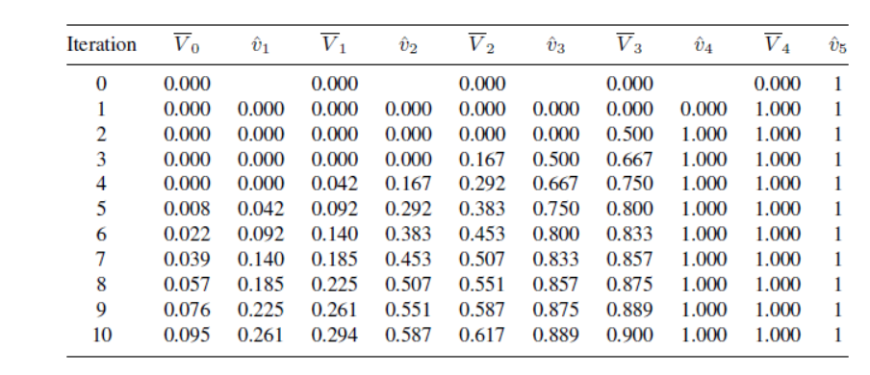
VFAs: Stepsizes
Single state, single action Markov chain
Updating – receives reward=1 at last node. All other rewards = 0.
Same as adding up random rewards with mean of 1. Noise may be zero, or quite high.
0
0
0
0
0
1
0
1
2
3
4
5
Very slow backward communication of rewards when using forward ADP, with a 1/n stepsize.

Slide 19
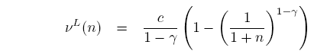
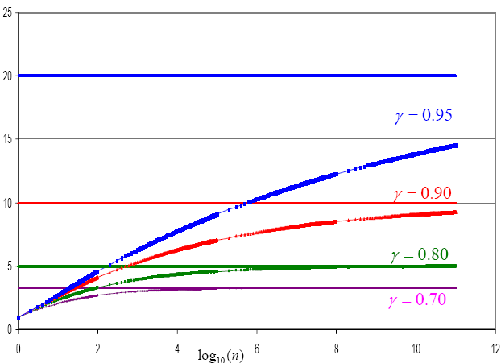

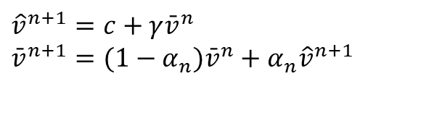








VFAs: Stepsizes
Bound on rate of convergence using ADP:
Single state, single action problem
Discounted sum of costs over infinite horizon:
Computed the infinite discounted sum using approximate DP:
Lower bound on ${\bar{v}}^{n+1}:$
$$c$$
$$V=\sum_{n=0}^{∞}{γ^{n}c=\frac{c}{1−γ}}$$
$${\hat{v}}^{n+1}=c+γ{\bar{v}}^{n} \\ {\bar{v}}^{n+1}=(1−α_{n}){\bar{v}}^{n}+α_{n}{\hat{v}}^{n+1}$$
$$10^{2}$$
$$10^{4}$$
$$10^{6}$$
$$10^{8}$$
$$10^{10}$$
$$10^{12}$$

Slide 20
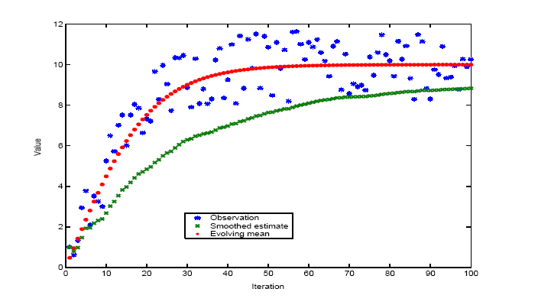
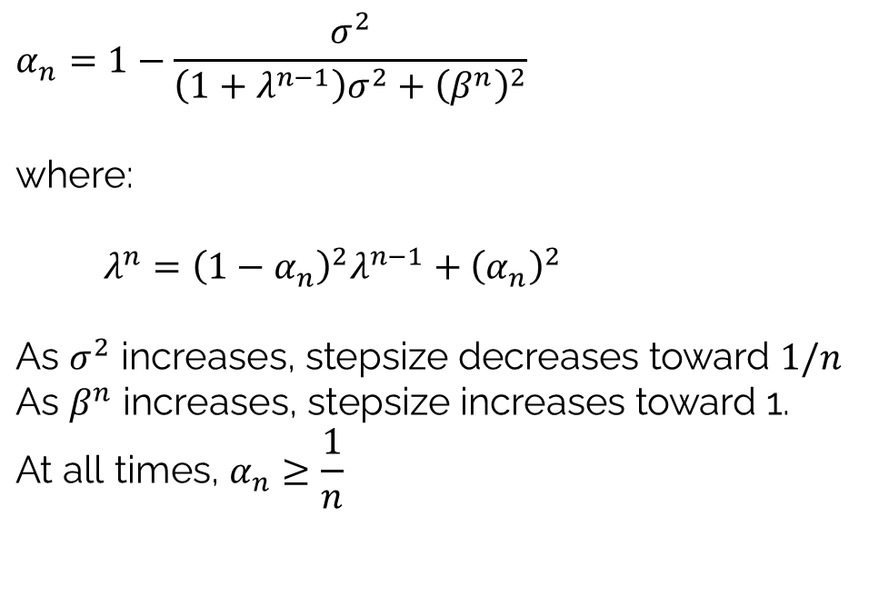
VFAs: Stepsizes
Bias-adjusted Kalman filter (BAKF)
Estimate of the variance
$$α_{n}=1−\frac{σ^{2}}{\left(1+λ^{n−1}\right)σ^{2}+{\left(β^{n}\right)}^{2}}$$ $$\text{where:}$$
$$λ^{n}={\left(1−α_{n}\right)}^{2}λ^{n−1}+{\left(α_{n}\right)}^{2}$$
$$\text{As }σ^{2}\text{ increases, stepsize decreases toward }1/n \\ \text{As }β^{n}\text{ increases, stepsize increases toward 1.} \\ \text{At all times, }α_{n}≥\frac{1}{n}$$
Noise
Estimate of the bias
Bias

Slide 21
VFAs: Stepsizes
Observed values
BAKF stepsize rule
1/n stepsize rule
The bias-adjusted Kalman filter – low noise case

Slide 22
VFAs: Stepsizes
The bias-adjusted Kalman filter – high noise case
Observed values
BAKF stepsize rule

Slide 23
OUTLINE
VFA IV - Forward ADP and linear VFAs
Algorithms
Stepsizes
A financial application
15

Slide 24
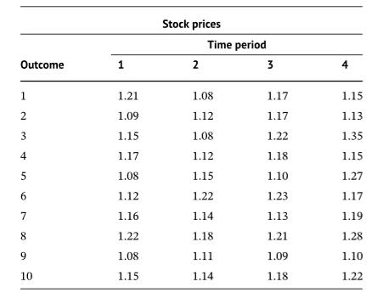
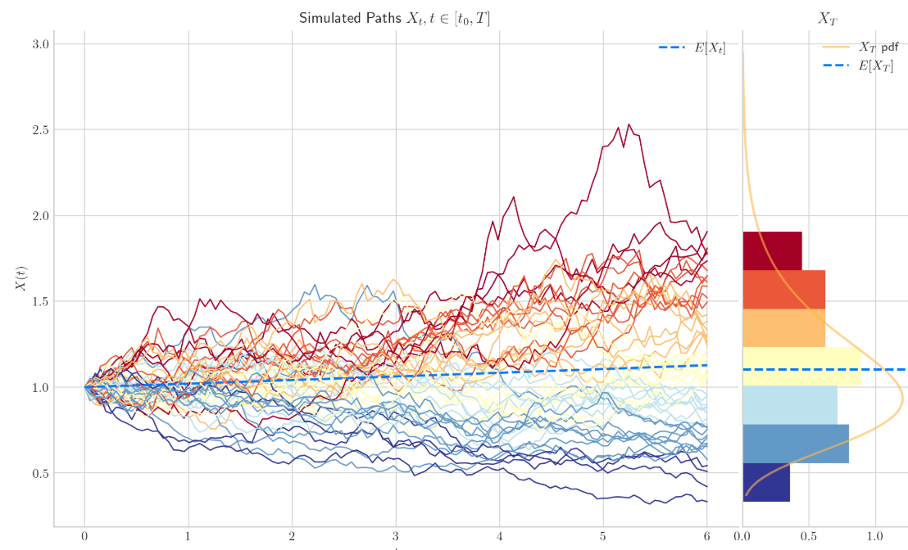
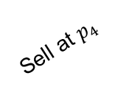
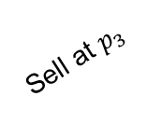
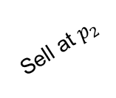
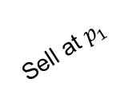
Value iteration: Financial application
Longstaff and Schwartz - Pricing an American option
Sell at $p_{1}$
Sell at $p_{2}$
Sell at $p_{3}$
Sell at $p_{4}$
1
Hold
2
Hold
3
Hold
4
Hold
Sell prices

Slide 25
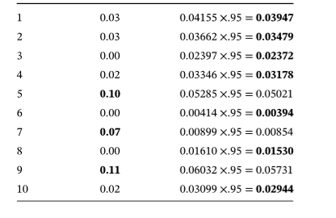

Value iteration: Financial application
Longstaff and Schwartz - Pricing an American option
Sell at $p_{1}$
Sell at $p_{2}$
Sell at $p_{3}$
Sell at $p_{4}$
1
Hold
2
Hold
3
Hold
4
Hold
Decision
Outcome Sell Hold
Prices at time 2
State $=S_{t}=\left(R_{t},I_{t}\right)=(R_{t},\left(p_{t},p_{t−1},p_{t−2}\right))$

Slide 26
Value iteration: Financial application
Longstaff and Schwartz - Pricing an American option
Sell at $p_{1}$
Sell at $p_{2}$
Sell at $p_{3}$
Sell at $p_{4}$
1
Hold
2
Hold
3
Hold
4
Hold
Decision
Outcome Sell Hold
Expected value of holding the asset ($R_{t}=1$):
$${\overline{V}}_{3}(S_{t})=θ_{t0}p_{t−2}+θ_{t1}p_{t−1}+θ_{t2}p_{t}+θ_{t3}{\left(p_{t}\right)}^{2}$$
$=0.0056−0.1234p_{1}+0.6011p_{2}−0.3903{\left(p_{2}\right)}^{2}$

Slide 27

Value iteration: Financial application
Longstaff and Schwartz - Pricing an American option
Sell at $p_{1}$
Sell at $p_{2}$
Sell at $p_{3}$
Sell at $p_{4}$
1
Hold
2
Hold
3
Hold
4
Hold
Decision
Outcome Sell Hold
${\overline{V}}_{2}=$ average of max value for each sample path

Slide 28
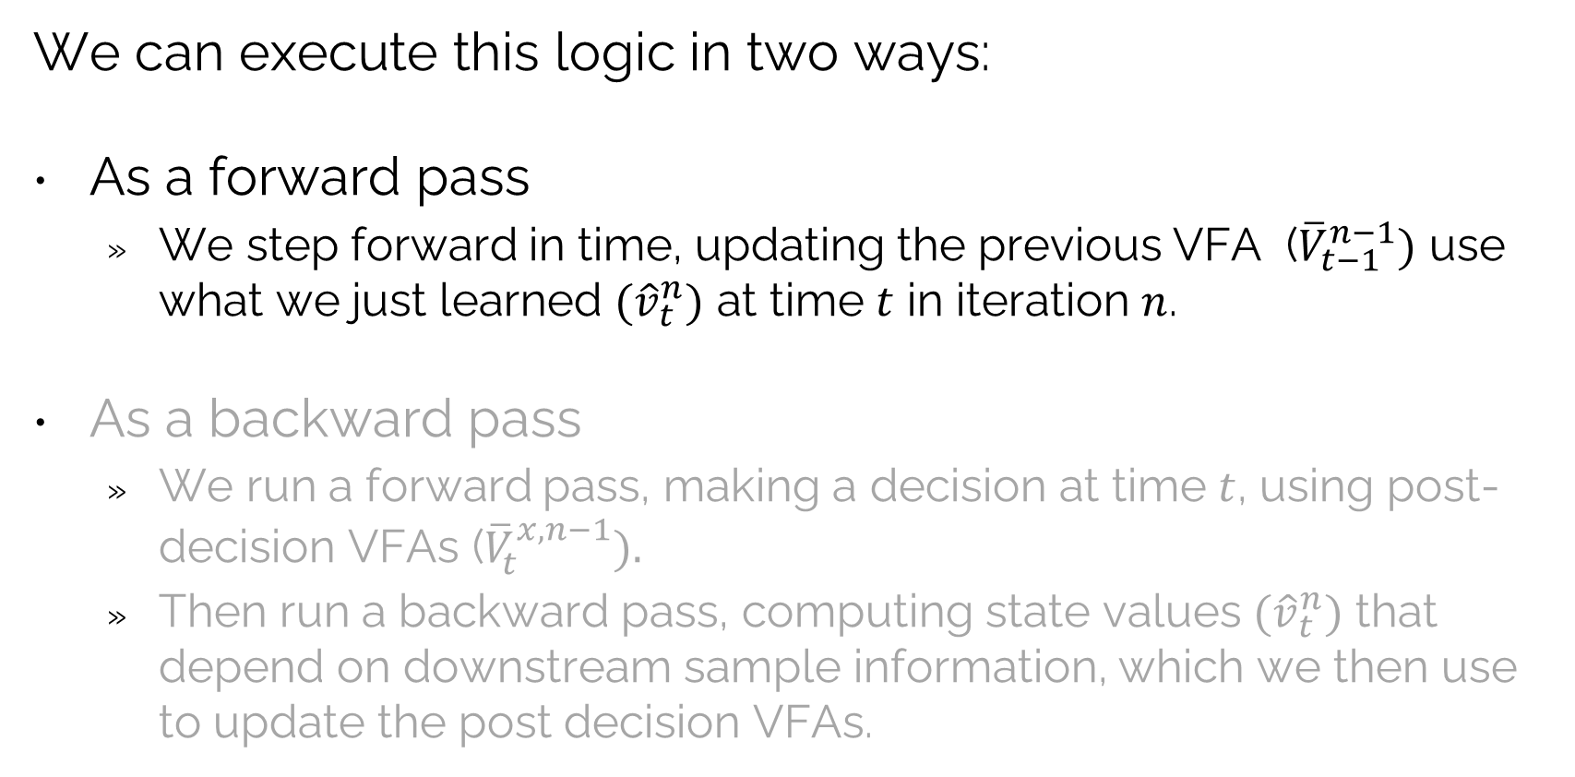
Value iteration: Financial application
We can execute this logic in two ways:
As a forward pass
We step forward in time, updating the previous VFA (${\overline{V}}_{t−1}^{n−1})$ use what we just learned ${(\hat{v}}_{t}^{n})$ at time $t$ in iteration $n$.
As a backward pass
We run a forward pass, making a decision at time $t$, using post-decision VFAs (${\overline{V}}_{t}^{x,n−1}).$
Then run a backward pass, computing state values ${(\hat{v}}_{t}^{n})$ that depend on downstream sample information, which we then use to update the post decision VFAs.

Slide 29
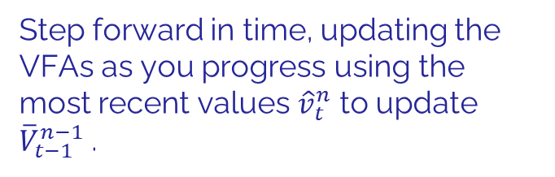
Value iteration: Financial application
Longstaff and Schwartz - Pricing an American option
Sell at $p_{1}$
Sell at $p_{2}$
Sell at $p_{3}$
Sell at $p_{4}$
1
Hold
2
Hold
3
Hold
4
Hold
Decision
Outcome Sell Hold
Step forward in time, updating the VFAs as you progress using the most recent values ${\hat{v}}_{t}^{n}$ to update ${\overline{V}}_{t−1}^{n−1}$.

Slide 30
Value iteration: Financial application
Longstaff and Schwartz - Pricing an American option
Sell at $p_{1}$
Sell at $p_{2}$
Sell at $p_{3}$
Sell at $p_{4}$
1
Hold
2
Hold
3
Hold
4
Hold
Decision
Outcome Sell Hold

Slide 31
Value iteration: Financial application
Longstaff and Schwartz - Pricing an American option
Sell at $p_{1}$
Sell at $p_{2}$
Sell at $p_{3}$
Sell at $p_{4}$
1
Hold
2
Hold
3
Hold
4
Hold
Decision
Outcome Sell Hold

Slide 32
Value iteration: Financial application
Longstaff and Schwartz - Pricing an American option
Sell at $p_{1}$
Sell at $p_{2}$
Sell at $p_{3}$
Sell at $p_{4}$
1
Hold
2
Hold
3
Hold
4
Hold
Decision
Outcome Sell Hold

Slide 33
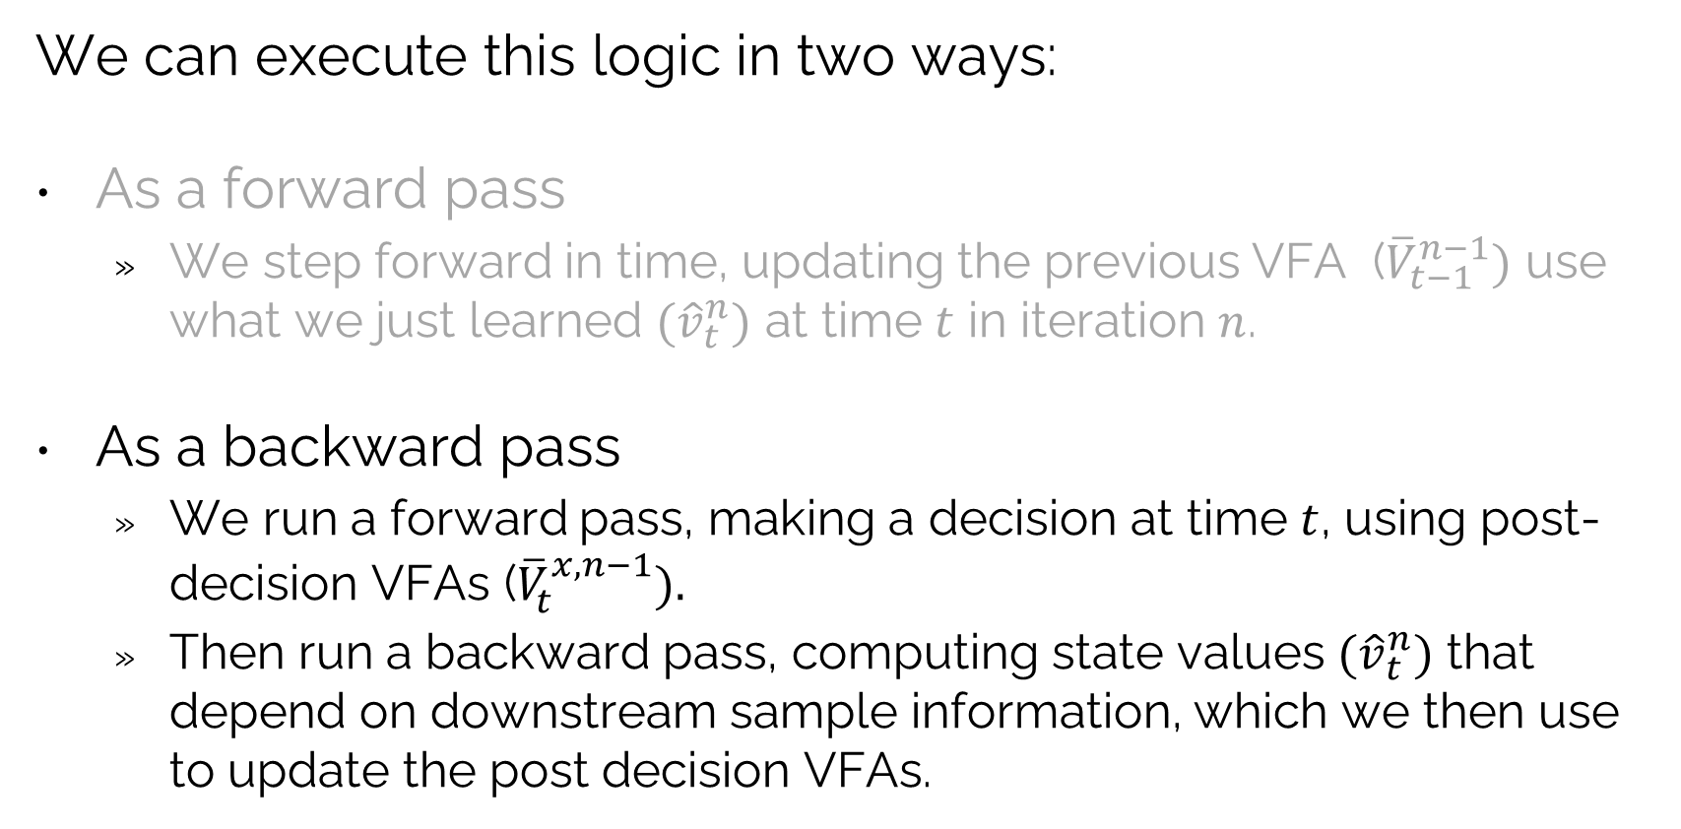
Value iteration: Financial application
We can execute this logic in two ways:
As a forward pass
We step forward in time, updating the previous VFA (${\overline{V}}_{t−1}^{n−1})$ use what we just learned ${(\hat{v}}_{t}^{n})$ at time $t$ in iteration $n$.
As a backward pass
We run a forward pass, making a decision at time $t$, using post-decision VFAs (${\overline{V}}_{t}^{x,n−1}).$
Then run a backward pass, computing state values ${(\hat{v}}_{t}^{n})$ that depend on downstream sample information, which we then use to update the post decision VFAs.

Slide 34
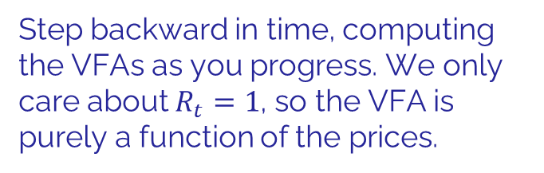
Value iteration: Financial application
Longstaff and Schwartz - Pricing an American option
Sell at $p_{1}$
Sell at $p_{2}$
Sell at $p_{3}$
Sell at $p_{4}$
1
Hold
2
Hold
3
Hold
4
Hold
Decision
Outcome Sell Hold
Step backward in time, computing the VFAs as you progress. We only care about $R_{t}=1$, so the VFA is purely a function of the prices.

Slide 35
Value iteration: Financial application
Longstaff and Schwartz - Pricing an American option
Sell at $p_{1}$
Sell at $p_{2}$
Sell at $p_{3}$
Sell at $p_{4}$
1
Hold
2
Hold
3
Hold
4
Hold
Decision
Outcome Sell Hold

Slide 36
Value iteration: Financial application
Longstaff and Schwartz - Pricing an American option
Sell at $p_{1}$
Sell at $p_{2}$
Sell at $p_{3}$
Sell at $p_{4}$
1
Hold
2
Hold
3
Hold
4
Hold
Decision
Outcome Sell Hold

Slide 37
Value iteration: Financial application
Longstaff and Schwartz - Pricing an American option
Sell at $p_{1}$
Sell at $p_{2}$
Sell at $p_{3}$
Sell at $p_{4}$
1
Hold
2
Hold
3
Hold
4
Hold
Decision
Outcome Sell Hold

Slide 38
Value iteration: Financial application
Longstaff and Schwartz - Pricing an American option
Longstaff-Schwartz is widely used in practice for pricing and valuation, but not real-time trading.
The success in the use of linear approximations is largely because the state variable is the past history of prices, which does not depend on past decisions.
Sell at $p_{1}$
Sell at $p_{2}$
Sell at $p_{3}$
Sell at $p_{4}$
1
Hold
2
Hold
3
Hold
4
Hold

Slide 39


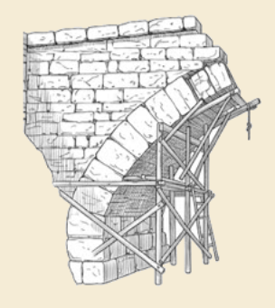
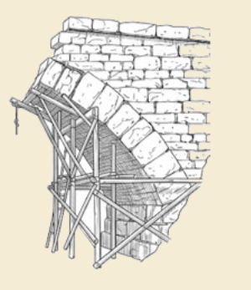
Thank you!
For more information see the Sequential Decision Analytics website at
warrenpowell.org
For more on value function approximations go to:
warrenpowell.org → Policies → Value function approximations

