Slide 1

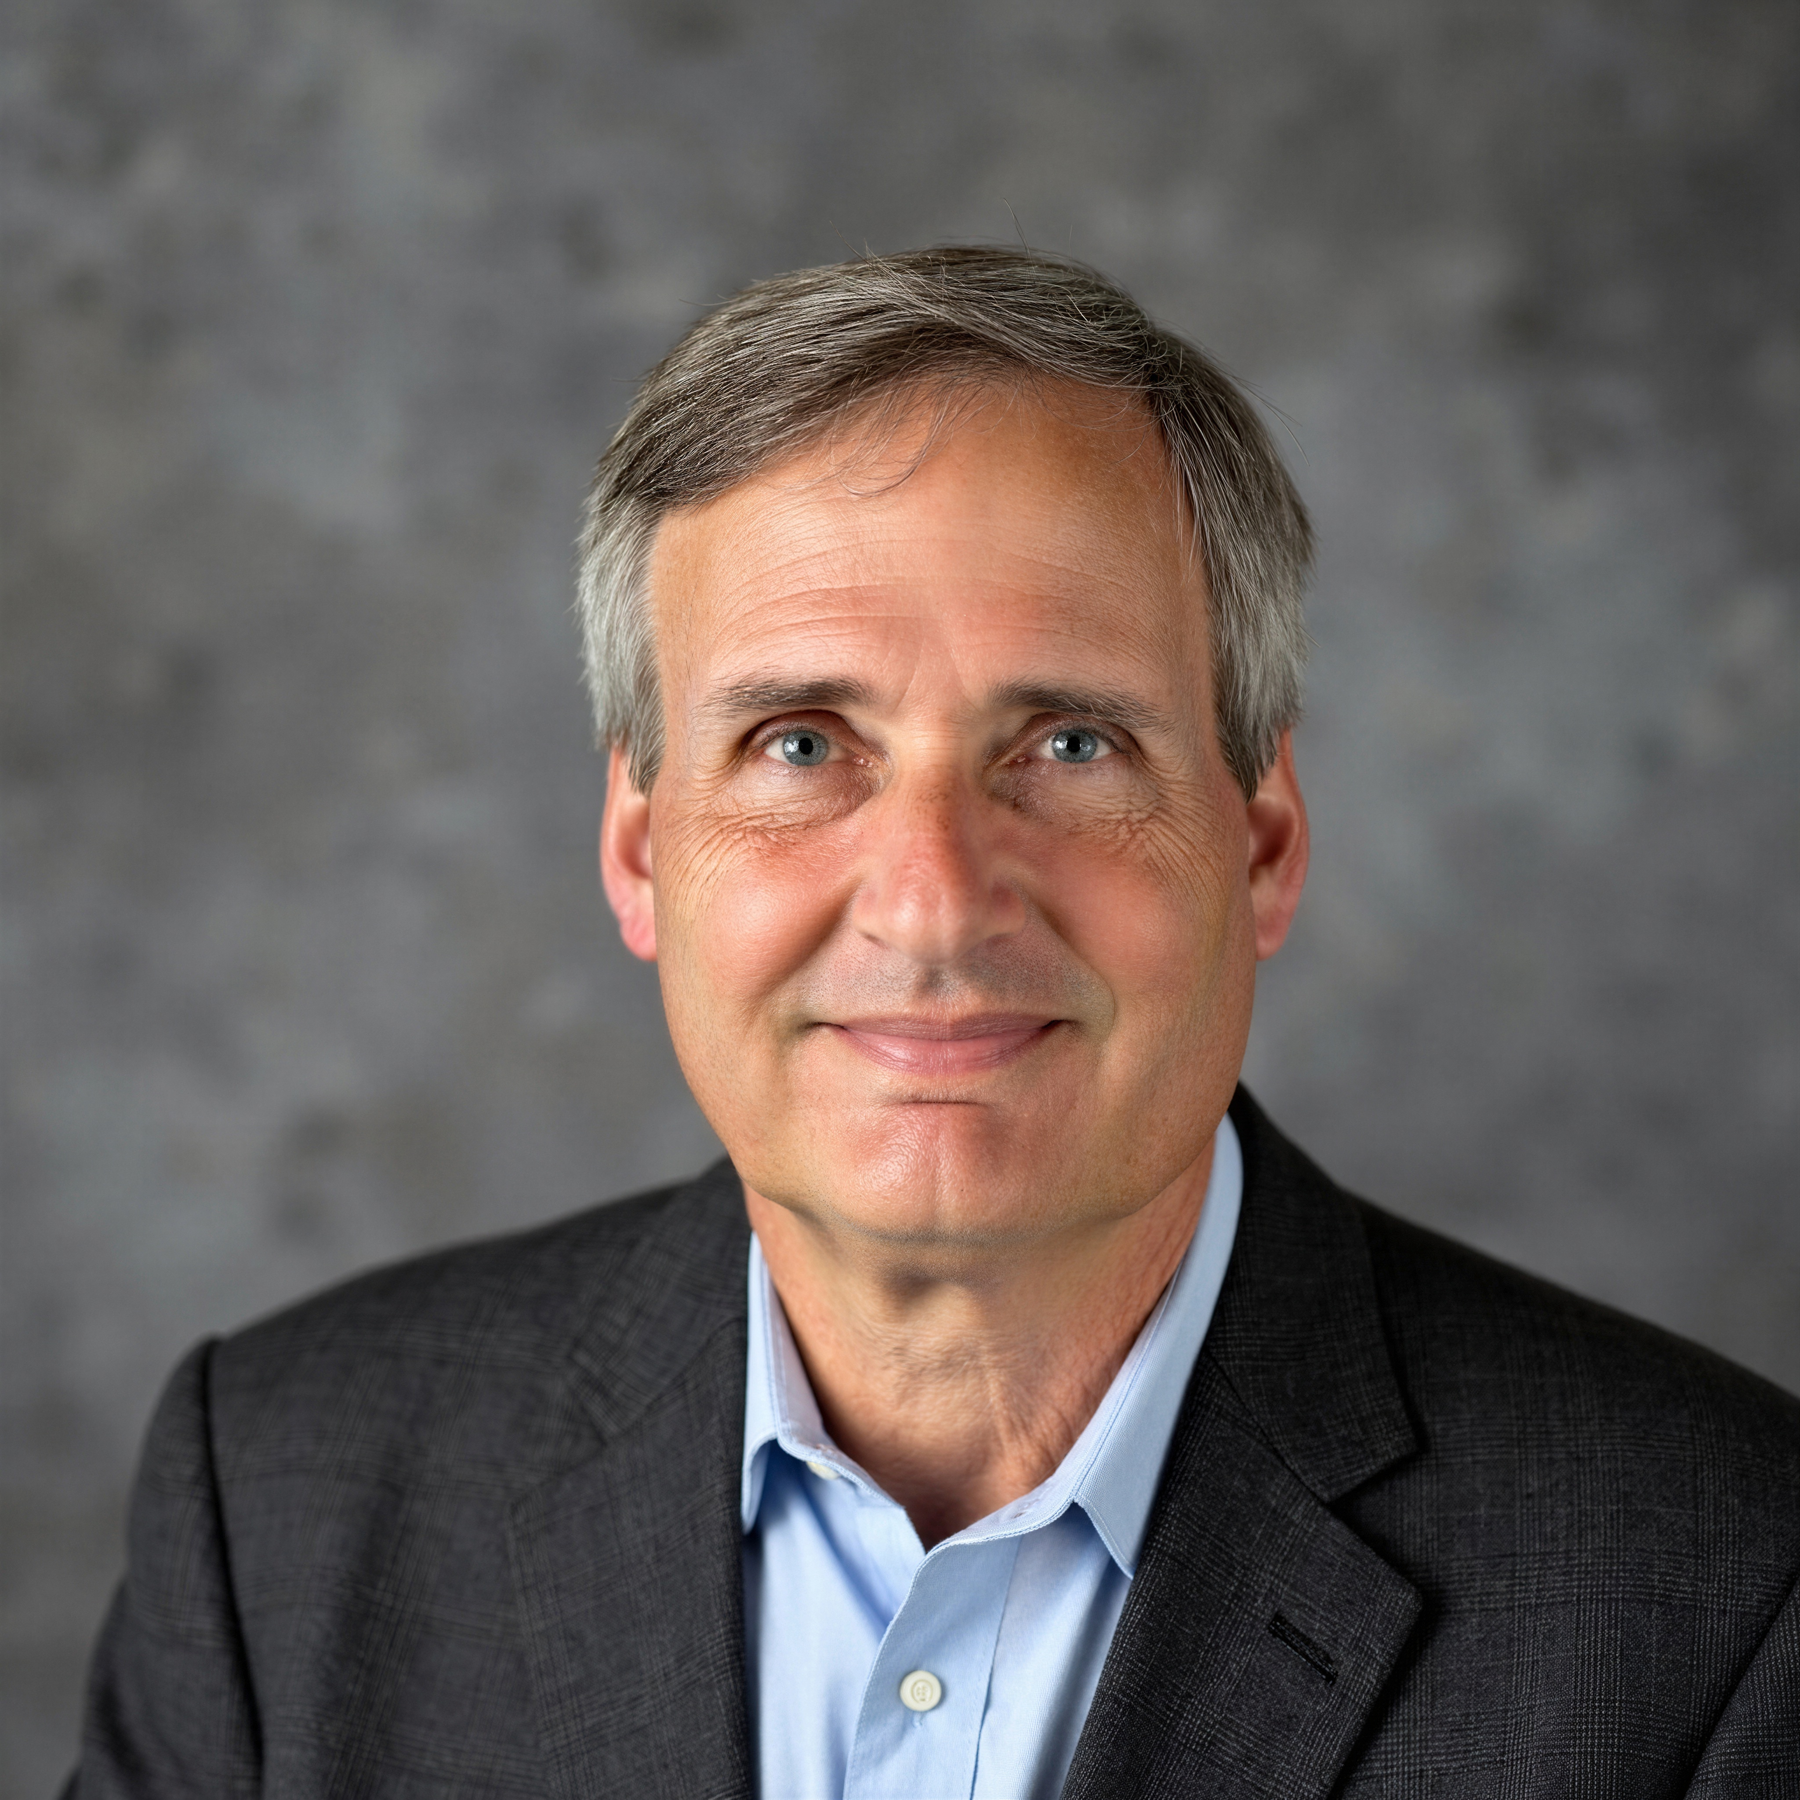
Tutorial Series on Sequential Decision Analytics
Warren B Powell
Professor Emeritus, Princeton University
Recorded: August 12, 2026
Module: Value function approximations V – Applications
Predecessor module(s):
Universal modeling framework (detailed)
Technical level: Low

Slide 2

OUTLINE
Value function approximations:
VFA I – Introduction to Dynamic Programming
VFA II – VFA-based policies
VFA III - “Reinforcement learning” in the style of computer science
VFA IV - Forward ADP and linear VFAs
VFA V - Applications of ADP
15

Slide 3
OUTLINE
VFA V - Applications of ADP
Blood management
Grid-level energy storage
Truckload fleet planning at Schneider National
Locomotive planning at Norfolk Southern
15

Slide 4
OUTLINE
VFA V - Applications of ADP
Blood management
Grid-level energy storage
Truckload fleet planning at Schneider National
Locomotive planning at Norfolk Southern
15

Slide 5
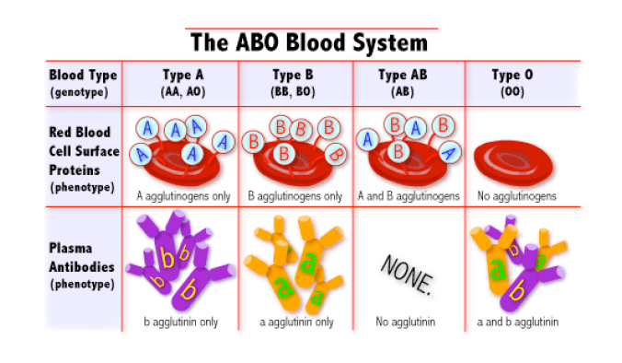
Blood management
Blood types:
A and B antigens
Produces A, B, AB and O
The Rh antigen
Present (+)
Not present (-)

Slide 6
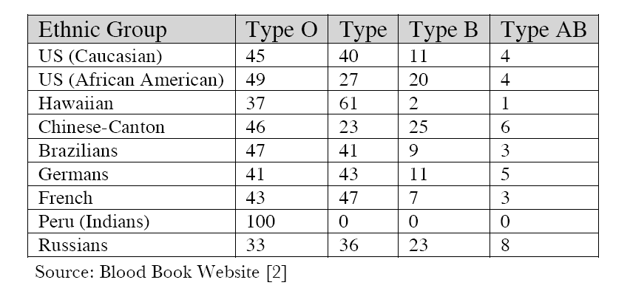


Blood management
Blood type by ethnic group

Slide 7
Blood management
Supply and demand distributions
Donation depend on age, race, income and geography

Slide 8
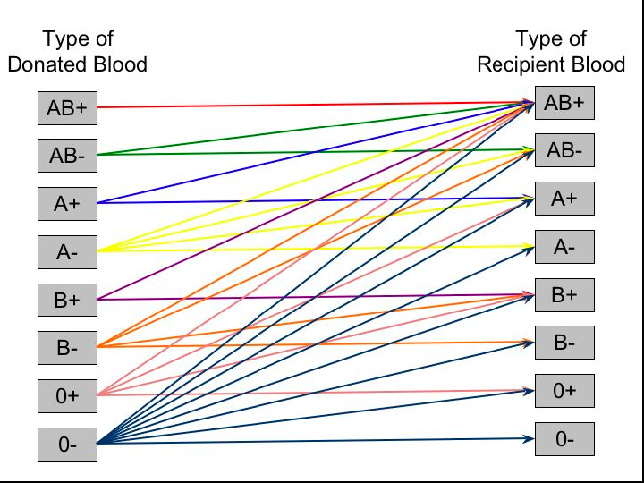
Blood management
Blood substitution by type:
Universal recipient
Universal donor

Slide 9
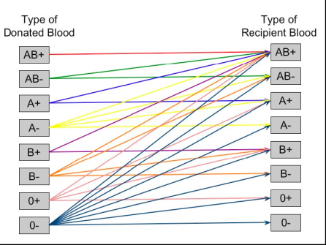









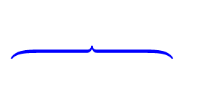






Blood management
Managing blood inventories over time
Week 0
Week 1
Week 2
Week 3
$$x_{0}$$
$$x_{1}$$
$$x_{2}$$
$$x_{3}$$
$$S_{0}$$
$$S_{1}$$
$$S_{2}$$
$$S_{2}^{x}$$
$$S_{3}$$
$$S_{3}^{x}$$
$${\hat{R}}_{1},{\hat{D}}_{1}$$
$${\hat{R}}_{2},{\hat{D}}_{2}$$
$${\hat{R}}_{3},{\hat{D}}_{3}$$
t=0
t=1
t=2
t=3
Slide 162
Notes:
162

Slide 10


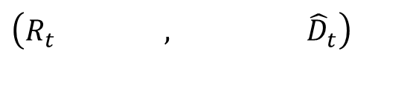













$$S_{t}=$$
$$\left(R_{t} \text{ , } {\hat{D}}_{t}\right)$$
$$R_{t}^{x}$$
AB+
$${\hat{D}}_{t,AB+}$$
AB+,0
$$R_{t,(AB+,0)}$$
AB+,0
$${\hat{D}}_{t,AB−}$$
AB+,1
AB-
$$R_{t,(AB+,1)}$$
AB+,1
AB+,2
$${\hat{D}}_{t,A+}$$
A+
$$R_{t,(AB+,2)}$$
AB+,2
AB+,3
$${\hat{D}}_{t,AB+}$$
$$⋮$$
$$⋮$$
A-
$$⋮$$
$${\hat{D}}_{t,AB+}$$
$$R_{t,(O−,0)}$$
O-,0
O-,0
B+
$${\hat{D}}_{t,AB+}$$
$$R_{t,(O−,1)}$$
O-,1
O-,1
B-
$$R_{t,(O−,2)}$$
O-,2
$${\hat{D}}_{t,AB+}$$
O-,2
$$⋮$$
O+
O-,3
$$⋮$$
$${\hat{D}}_{t,AB+}$$
O-
Satisfy a demand
Hold
Notes:
bloodnetworkdemands

Slide 11


















$$R_{t}$$
$$R_{t}^{x}$$
$$R_{t+1}$$
$$R_{t,(AB+,0)}$$
AB+,0
AB+,0
$${\hat{R}}_{t+1,AB+}$$
AB+,0
$$R_{t,(AB+,1)}$$
AB+,1
AB+,1
AB+,1
$$R_{t,(AB+,2)}$$
AB+,2
AB+,2
AB+,2
$$⋮$$
AB+,3
AB+,3
$$R_{t,(O−,0)}$$
O-,0
$$⋮$$
$$⋮$$
$$R_{t,(O−,1)}$$
O-,1
O-,0
$${\hat{R}}_{t+1,O−}$$
O-,0
$$R_{t,(O−,2)}$$
O-,2
O-,1
O-,1
$$⋮$$
O-,2
O-,2
O-,3
O-,3
$$⋮$$
$$⋮$$
$${\hat{D}}_{t}$$
Notes:
bloodnetworkhold

Slide 12








$$R_{t}$$
$$R_{t}^{x}$$
$$R_{t,(AB+,0)}$$
AB+,0
AB+,0
$$R_{t,(AB+,1)}$$
AB+,1
AB+,1
$$R_{t,(AB+,2)}$$
AB+,2
AB+,2
$$⋮$$
AB+,3
$$R_{t,(O−,0)}$$
O-,0
$$⋮$$
$$R_{t,(O−,1)}$$
O-,1
O-,0
$$R_{t,(O−,2)}$$
O-,2
O-,1
$$⋮$$
O-,2
O-,3
$$⋮$$
$${\hat{D}}_{t}$$
Notes:
bloodadpnetwork

Slide 13

$$R_{t}$$
$$R_{t}^{x}$$
$$F(R_{t})$$
$$R_{t,(AB+,0)}$$
AB+,0
AB+,0
$$R_{t,(AB+,1)}$$
AB+,1
AB+,1
$$R_{t,(AB+,2)}$$
AB+,2
AB+,2
$$⋮$$
AB+,3
$$R_{t,(O−,0)}$$
O-,0
$$⋮$$
$$R_{t,(O−,1)}$$
O-,1
O-,0
$$R_{t,(O−,2)}$$
O-,2
O-,1
$$⋮$$
O-,2
O-,3
Solve this as a linear program.
$$⋮$$
$${\hat{D}}_{t}$$
Notes:
bloodadpnetwork

Slide 14






Duals
$$R_{t}$$
$$R_{t}^{x}$$
$$F(R_{t})$$
$${\hat{ν}}_{t,(AB+,0)}$$
AB+,0
AB+,0
$${\hat{ν}}_{t,(AB+,1)}$$
AB+,1
AB+,1
$${\hat{ν}}_{t,(AB+,2)}$$
AB+,2
AB+,2
$$⋮$$
AB+,3
$${\hat{ν}}_{t,(O−,0)}$$
O-,0
$$⋮$$
$${\hat{ν}}_{t,(O−,1)}$$
O-,1
O-,0
$${\hat{ν}}_{t,(O−,2)}$$
O-,2
O-,1
$$⋮$$
O-,2
O-,3
Dual variables give value additional unit of blood..
$$⋮$$
$${\hat{D}}_{t}$$
Notes:
bloodadpnetwork

Slide 15




Blood management
Estimate the gradient at
$$R_{t}^{n}$$
$${\hat{ν}}_{t,(AB+,2)}^{n}$$
$$F(R_{t})$$
$$R_{t,(AB+,2)}^{n}$$

Slide 16


Blood management
Update the value function at
$${\bar{V}}_{t−1}^{n−1}(R_{t−1}^{x})$$
$${\hat{ν}}_{t,(AB+,2)}^{n}$$
$$F(R_{t})$$
$$R_{t−1}^{x,n}$$
$$R_{t,(AB+,2)}^{n}$$

Slide 17

Blood management
Update the value function at
$${\bar{V}}_{t−1}^{n−1}(R_{t−1}^{x})$$
$${\hat{ν}}_{t,(AB+,2)}^{n}$$
$$R_{t−1}^{x,n}$$

Slide 18

Blood management
Update the value function at
$${\bar{V}}_{t−1}^{n−1}(R_{t−1}^{x})$$
$${\bar{V}}_{t−1}^{n}(R_{t−1}^{x})$$
$$R_{t−1}^{x,n}$$

Slide 19
Blood management
Notes:
We get a marginal value for each supply node.
These are provided automatically by linear programming solvers.
Be careful when the supply at the node is zero. While we would like to have the marginal value of one more, if we use the marginal values produced by the linear programming code, it might be the slope to the left (where the “supply” would be negative).

Slide 20


Blood management
Derivatives are used to estimate a piecewise linear approximation
$${\bar{V}}_{t}(R_{t})$$
$$R_{t}$$

Slide 21
Blood management
t

Slide 22
Blood management

Slide 23
Blood management

Slide 24
Blood management

Slide 25
OUTLINE
VFA V - Applications of ADP
Blood management
Grid-level energy storage
Truckload fleet planning at Schneider National
Locomotive planning at Norfolk Southern
15

Slide 26
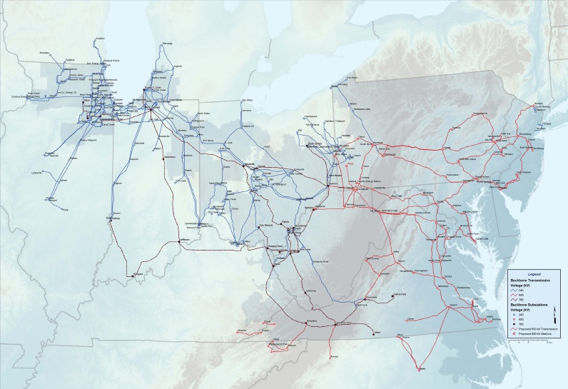
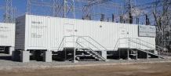
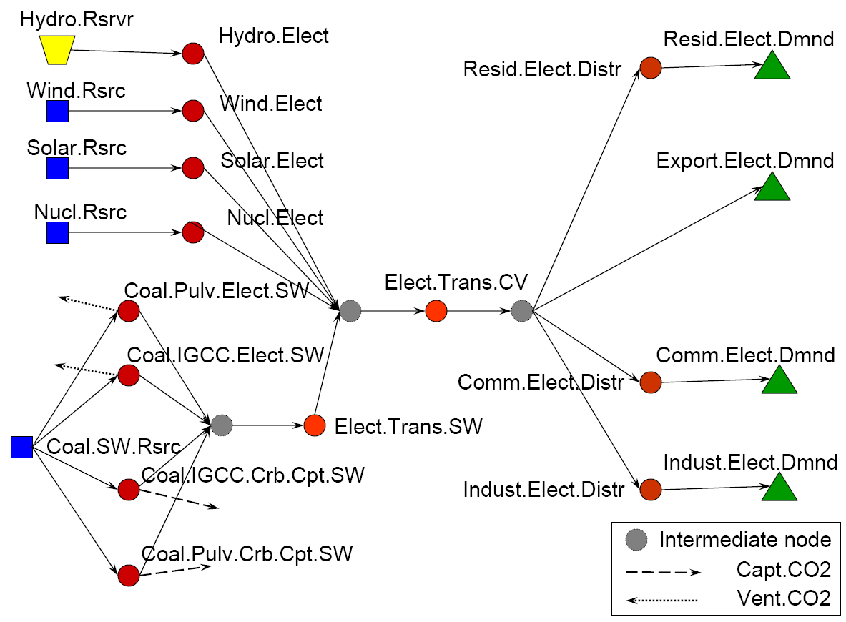
Grid level storage
Imagine 25 large storage devices spread around the PJM grid:
Slide 179
Notes:
179
This slide is animated to show how we are graphically depicting the hourly dispatch problem. Transition to next slide.

Slide 27
Grid level energy storage
Slide 180
Notes:
180
This slide is animated to show how we are graphically depicting the hourly dispatch problem. Transition to next slide.

Slide 28
Grid level energy storage
Slide 181
Notes:
181
This slide is animated to show how we are graphically depicting the hourly dispatch problem. Transition to next slide.

Slide 29

Grid level energy storage
Monday
Time
:05
:10
:15
:20
$$…$$
Slide 182
Notes:
182
This slide and next illustrate how we solve this for every hour, in sequence, so we also properly handle storage.

Slide 30
Grid level energy storage
Monday
Time
:05
:10
:15
:20
$$…$$
Slide 183
Notes:
183
This slide and next illustrate how we solve this for every hour, in sequence, so we also properly handle storage.

Slide 31
Grid level energy storage
Monday
Time
:05
:10
:15
:20
$$…$$
Slide 184
Notes:
184
This slide and next illustrate how we solve this for every hour, in sequence, so we also properly handle storage.

Slide 32


Grid level energy storage
Derivatives are used to estimate a piecewise linear approximation
$${\bar{V}}_{t}(R_{t})$$
$$R_{t}$$

Slide 33
Grid level energy storage
… a typical performance graph.

Slide 34
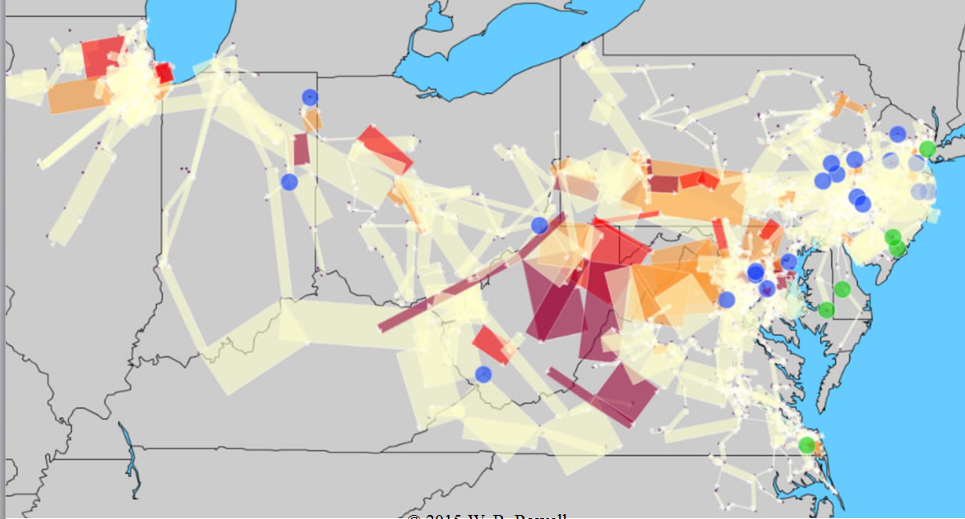
Grid level energy storage
Without storage

Slide 35
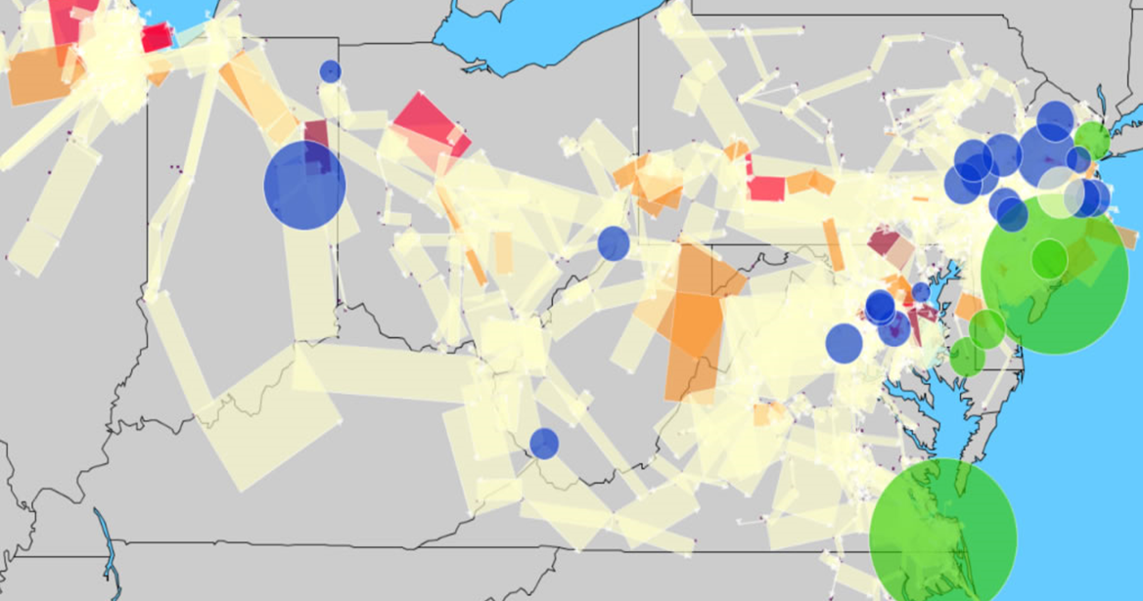
Grid level energy storage
With storage

Slide 36
OUTLINE
VFA V - Applications of ADP
Blood management
Grid-level energy storage
Truckload fleet planning at Schneider National
Locomotive planning at Norfolk Southern
15

Slide 37
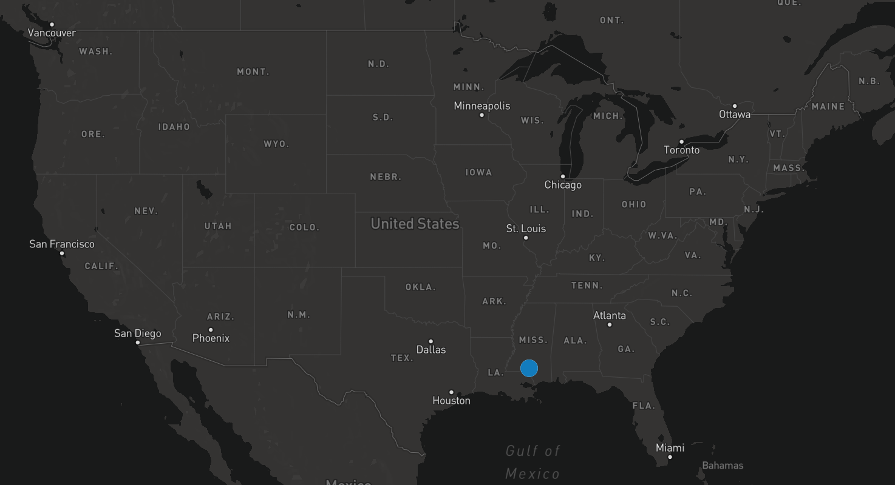
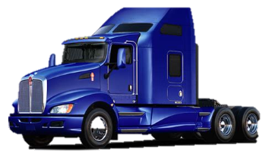


Monday

Slide 38
Truckload fleet planning at Schneider National
Monday
Tuesday

Slide 39
Truckload fleet planning at Schneider National
Monday
Tuesday
Wednesday

Slide 40
Truckload fleet planning at Schneider National
Monday
The value of drivers in the future

Slide 41
Truckload fleet planning at Schneider National
Time
Space
Network model used at Schneider National since 1980

Slide 42
Truckload fleet planning at Schneider National
Monday
Solved to optimality
At Optimal Dynamics we solve over
5 million (deterministic) IPs each day.

Slide 43
Truckload fleet planning at Schneider National
Monday

Slide 44
Truckload fleet planning at Schneider National
Monday

Slide 45
Truckload fleet planning at Schneider National
Monday

Slide 46
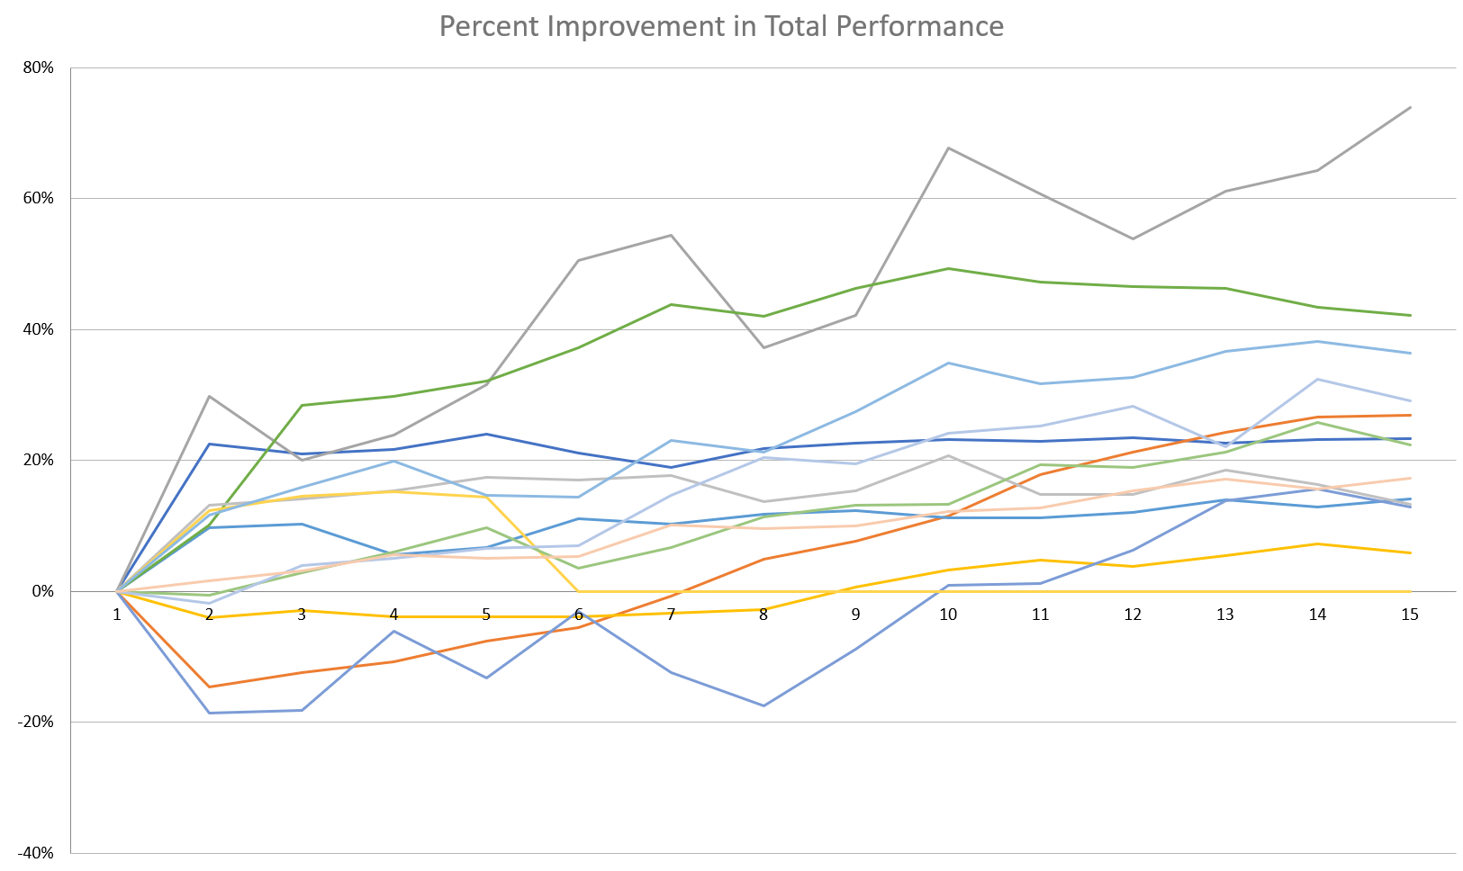


Truckload fleet planning at Schneider National
Percent improvement due to value function training
Optimized VFAs
VFAs = 0
$$F^{π}\left(S_{0}\right)={\sum_{n=1}^{N}{C(S^{n},X^{π}\left(S^{n} | θ\right))}}$$
10-50% improvement
Training iterations
Actual results for 11 different carriers analyzed by Optimal Dynamics

Slide 47
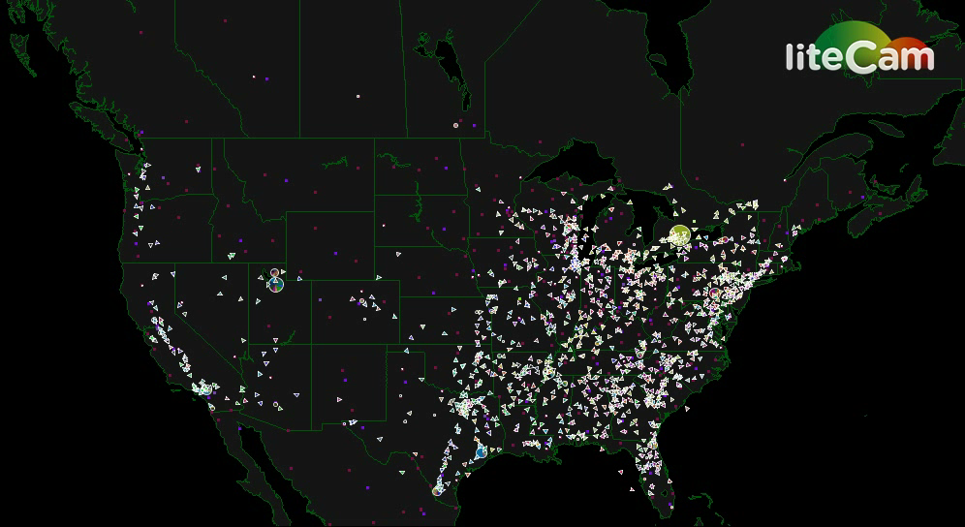
Truckload fleet planning at Schneider National

Slide 48
Truckload fleet planning at Schneider National
Historical min and max
Calibrated model
Utilization
Revenue per WU
We were able to calibrate our ADP model very closely to the behavior of the company, which helped to build confidence.
Notes:
201
With ADP, we were able to closely match their historical performance.

Slide 49
Truckload fleet planning at Schneider National
Notes:
We can use the value functions to estimate the marginal value of drivers whose home is in a particular region.
In the next slides, we are going to show two ways to estimate these values:
In the first, we are going to run a series of (very expensive) simulations where we hire an increasing number of drivers in a region. Each time, we have to reoptimize the entire fleet over many iterations. We would have to repeat this for each possible home location.
In the second, we are going to estimate the marginal value by using the value function approximations to estimate the value of drivers in each region, from one run of the model.

Slide 50
Truckload fleet planning at Schneider National
Notes:
Now we want to know the marginal value of addiing drivers whose home is in a particular location (e.g. Texas). Here, we simply ran many simulations as we increased the number of drivers. The blue line shows the average value of more drivers in Texas. This is very expensive to do.

Slide 51

Truckload fleet planning at Schneider National
$${\bar{v}}_{a}$$
Notes:
The red line is directly from the value function. We get the slope of this line for every type of driver just from the base case. We do not have to do all those simulations to get the marginal value of additional drivers.

Slide 52
Truckload fleet planning at Schneider National
Purple bars: Value of drivers from value function approximations
Error bars: Statistical estimate from rerunning the simulation.
This shows that the value functions provide reasonable approximations of the
Notes:
Here we compared the value function to the brute force for 20 different types of drivers. We show confidence intervals from the brute force simulation. 18 out of 20 times we are within the confidence interval.

Slide 53
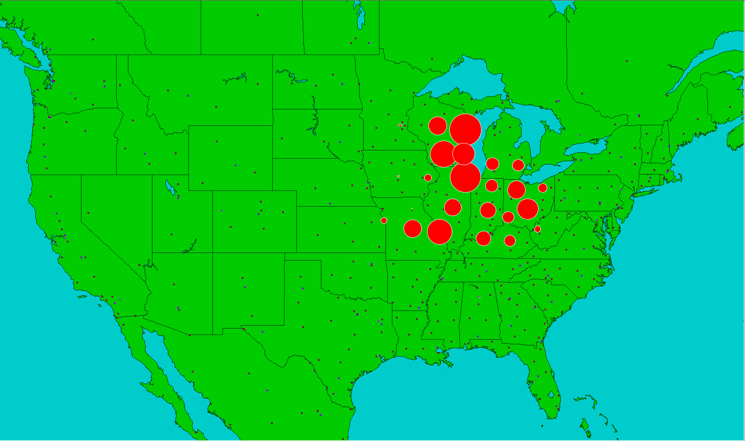
Truckload fleet planning at Schneider National
Where to add drivers:

Slide 54
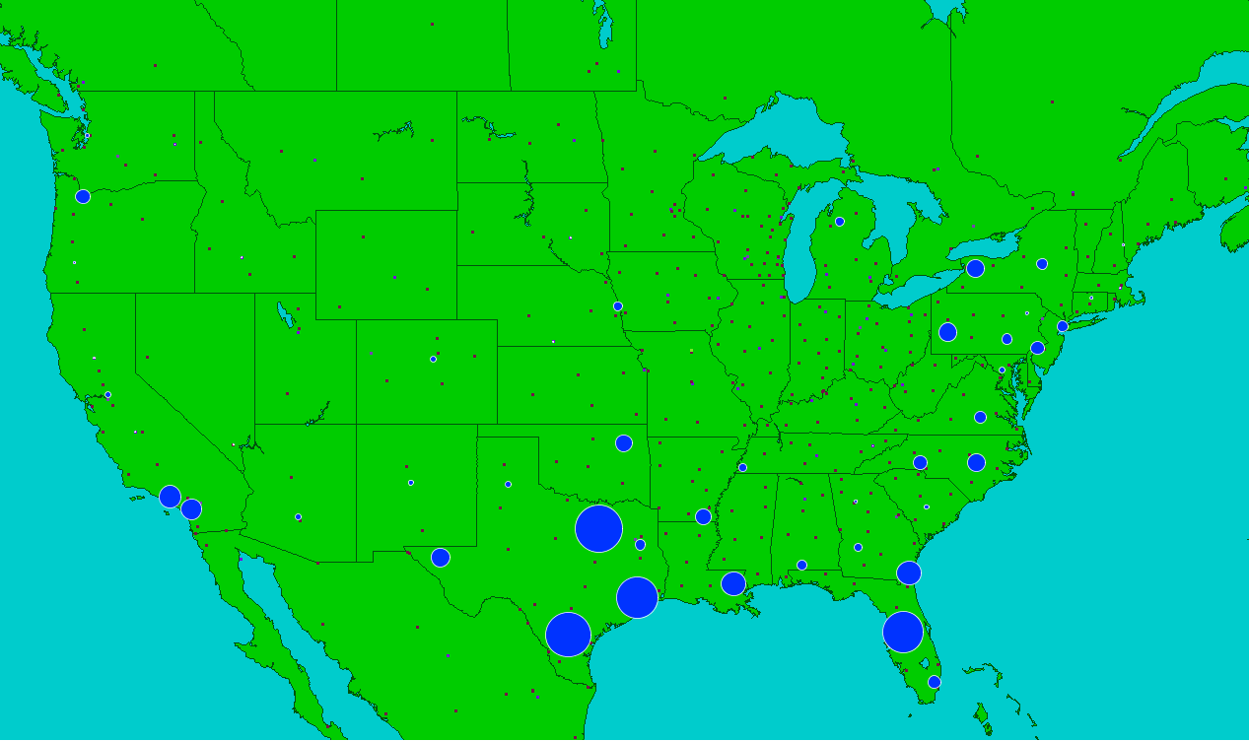
Truckload fleet planning at Schneider National
Where to reduce drivers:

Slide 55
OUTLINE
VFA V - Applications of ADP
Blood management
Grid-level energy storage
Truckload fleet planning at Schneider National
Locomotive planning at Norfolk Southern
15

Slide 56
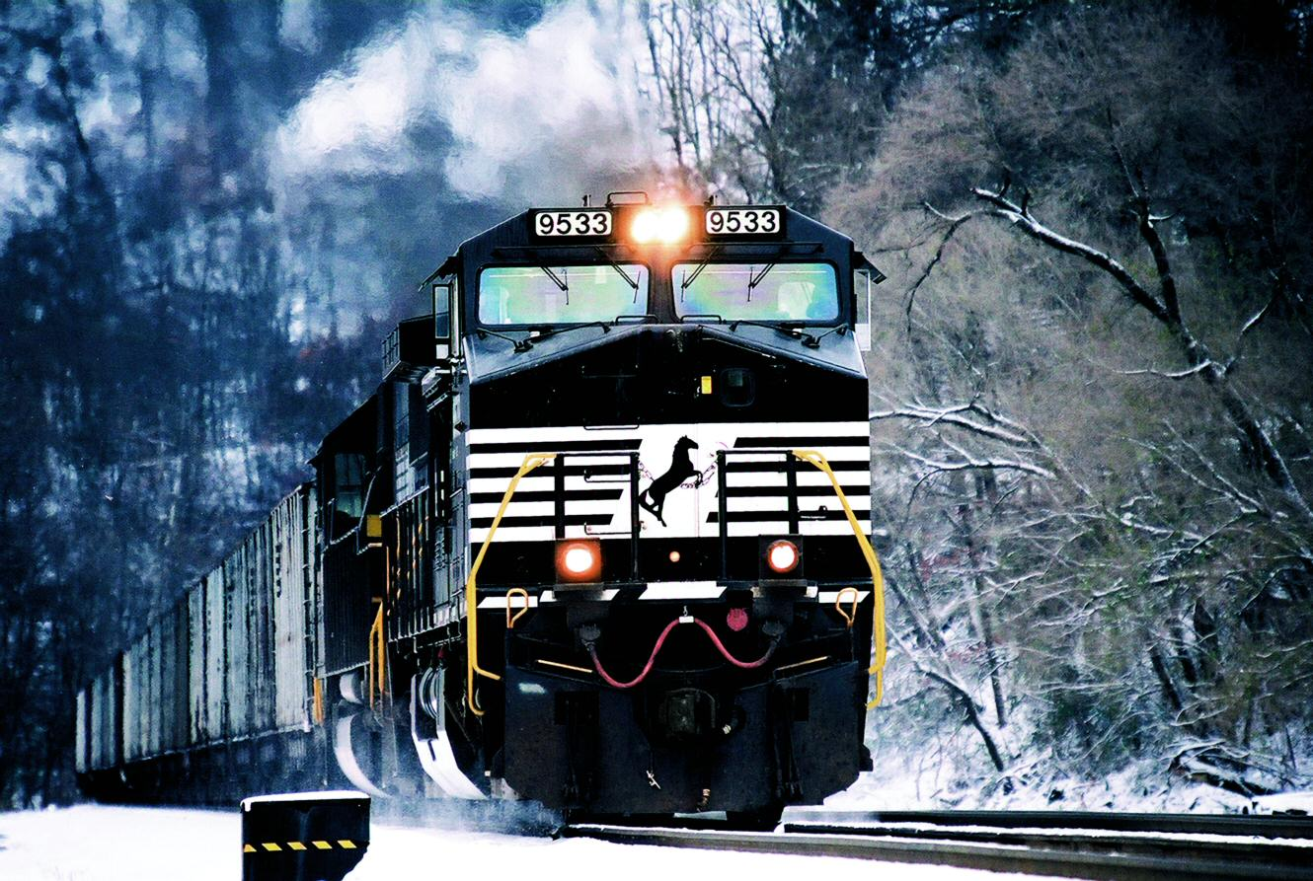


Locomotive planning at Norfolk Southern

Slide 57
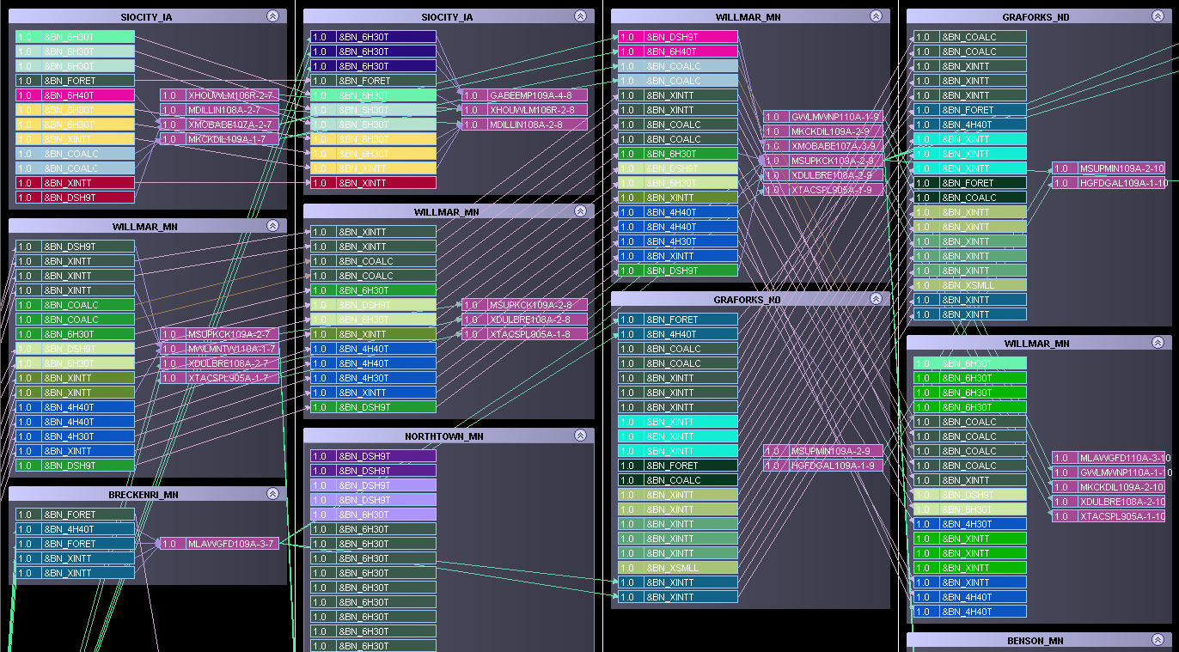
Notes:
These slides are from an industrial example (locomotives, but could be drivers or jets or box cars).

Slide 60
© 2008 Warren B. Powell
Slide 213
Notes:
213

Slide 61
Locomotive planning at Norfolk Southern
Atlanta
Locomotives
Trains
Yards
Baltimore
Jacksonville

Slide 62
Locomotive planning at Norfolk Southern
Horsepower
Locomotives
4400
4400
6000
4400
5700
4600
6200
Consist-breakup costs
Shop routing bonuses/ penalties
Leader logic

Slide 63
Locomotive planning at Norfolk Southern
Horsepower
Locomotives
Locomotives coming in on same train
4400
4400
6000
4400
5700
4600
6200

Slide 64
Locomotive planning at Norfolk Southern
Train reward function
Horsepower
Locomotives
4400
4400
6000
4400
5700
4600
6200

Slide 65
Locomotive planning at Norfolk Southern
The train reward function
Train reward
Repositioning
Power
Goal
Minimum

Slide 66
Locomotive planning at Norfolk Southern
Horsepower
Locomotives
4400
4400
6000
4400
5700
4600
Train may need 12,130 horsepower. Solutions:
4400 + 4400 + 6000 = 14,400
4400+4400+4400 = 13,200
6000+6200 = 12,200
6200

Slide 67
Locomotive planning at Norfolk Southern
Horsepower
Locomotives
4400
4400
6000
4400
5700
4600
Train may need 12,130 horsepower. Solutions:
4400 + 4400 + 6000 = 14,400
4400+4400+4400 = 13,200
6000+6200 = 12,200
6200

Slide 68
Locomotive planning at Norfolk Southern
Locomotive
buckets
Horsepower
Locomotives
4400
4400
6000
4400
5700
4600
6200
The value of locomotives in the future is captured through nonlinear approximations.

Slide 69
Locomotive planning at Norfolk Southern
4400
4400
6000
4400
5700
4600
6200
Locomotive subproblem can be solved quickly using Cplex

Slide 70
Locomotive planning at Norfolk Southern
Initial inventories

Slide 71
Locomotive planning at Norfolk Southern
Initial inventories

Slide 72
Locomotive planning at Norfolk Southern
Operational forecasting system
Initial inventories

Slide 73
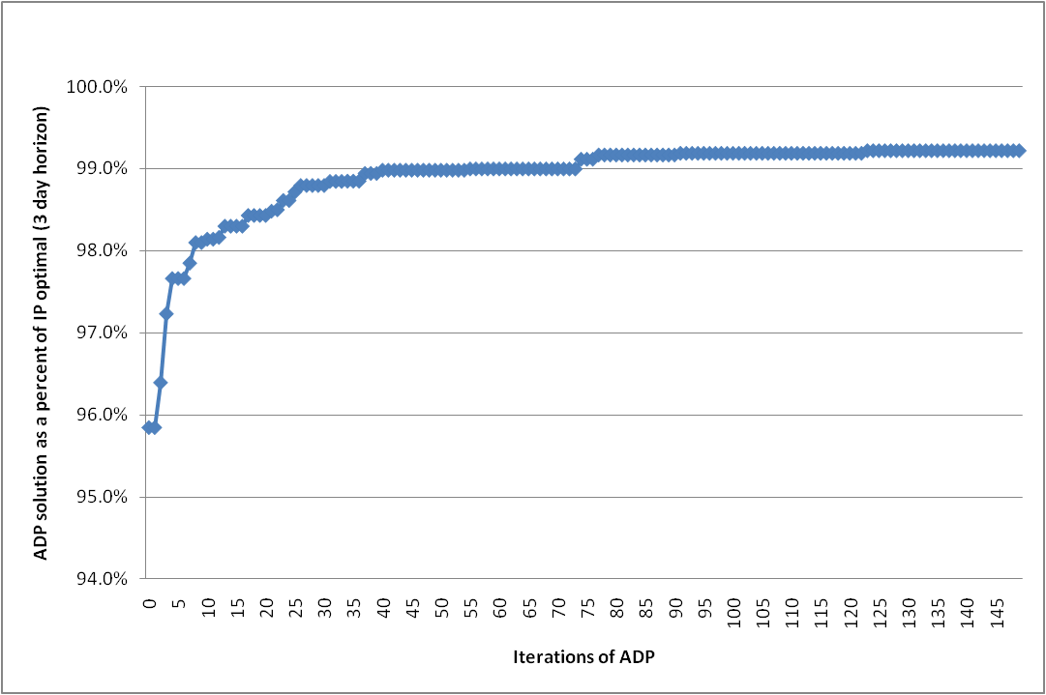
Locomotive planning at Norfolk Southern
ADP as a percent of IP optimal
3 day horizon
Five locomotive types

Slide 74
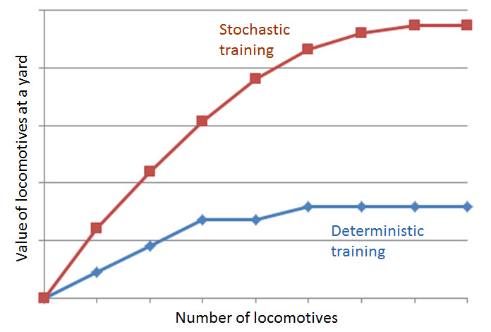
Locomotive planning at Norfolk Southern
Deterministic training
Run each forward pass on the same sample path
Stochastic training
Run each forward pass on a different sample path

Slide 75
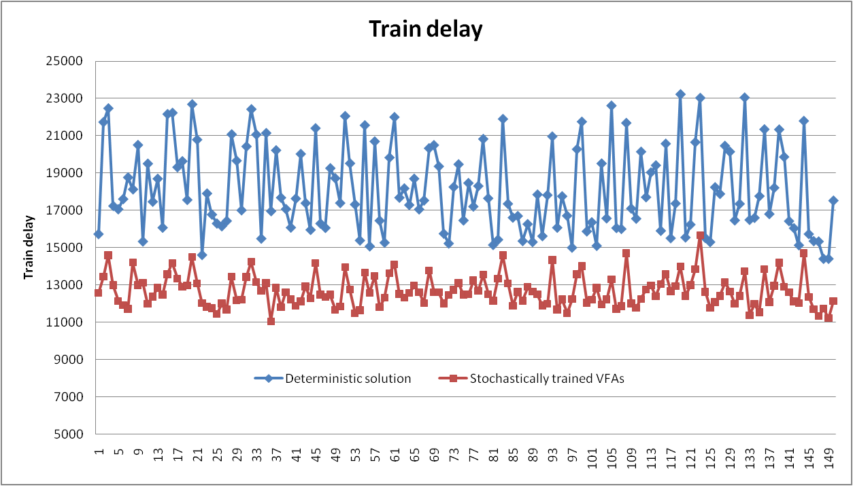
Locomotive planning at Norfolk Southern
Train delay with uncertain transit times and yard delays
Train delay using deterministically trained VFAs
Train delay
Train delay using stochastically trained VFAs

Slide 76
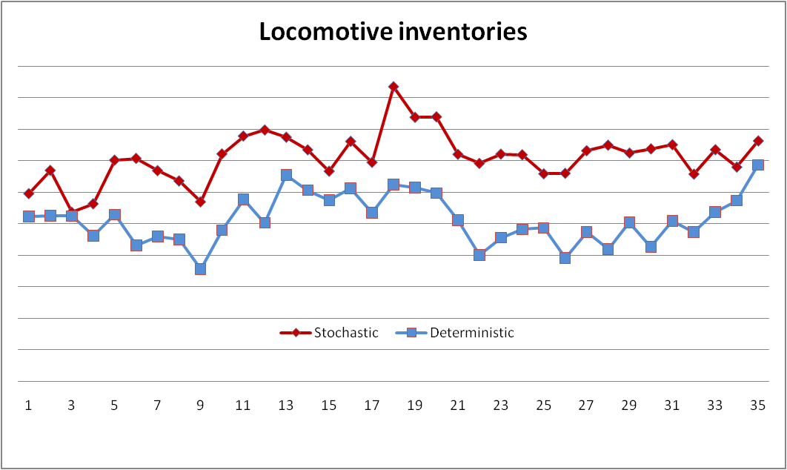
Locomotive planning at Norfolk Southern
How do we do it?
The stochastic model keeps more power in inventory. The challenge is knowing when and where.
Stochastic training
Deterministic training
Time period within simulation

Slide 77
Locomotive planning at Norfolk Southern
PLASMA has been running at Nortfolk Southern Railway since 2008.
It is used for both strategic fleet planning…
… and operational dispatch, primarily to handle the complex problem of getting locomotives to their shop appointments.

Slide 78


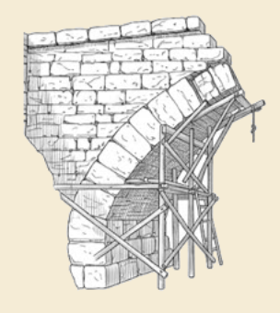
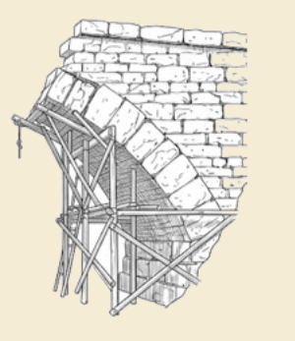
Thank you!
For more information see the Sequential Decision Analytics website at
warrenpowell.org
For more on value function approximations go to:
warrenpowell.org → Policies → Value function approximations

Slide 79
OUTLINE
4) DLA I – Overview of direct lookahead approximations
Types of lookahead approximations
The policy-within-a-policy
DLA II - Deterministic lookaheads
Parameterized deterministic approximation (CFA)
DLA III - Stochastic lookaheads using PFAs, CFAs and VFAs
PFA-based:
Illustrate using inventory lookahead
CFA-based:
VFA-based:
A load acceptance problem for truckload trucking
DLA IV – Stochastic lookaheads using DLAs – Discrete actions
DLA V – Stochastic lookaheads using DLAs – Vector actions
50

