Slide 1


Tutorial Series on Sequential Decision Analytics
Warren B Powell
Professor Emeritus, Princeton University
Recorded: August 12, 2026
Module: Direct lookahead approximations I – Overview
The direct lookahead model
Types of approximations
Predecessor module(s):
Universal modeling framework (detailed)
Technical level: Moderate.

Slide 2

OUTLINE
Direct lookahead approximations:
DLA I – Overview of direct lookahead approximations
DLA II - Deterministic lookaheads
DLA III - Stochastic lookaheads using PFAs, CFAs and VFAs
DLA IV – Stochastic lookaheads using DLAs – Discrete actions
DLA V – Stochastic lookaheads using DLAs – Vector actions
15

Slide 3
OUTLINE
Direct lookahead approximations:
DLA I – Overview of direct lookahead approximations
DLA II - Deterministic lookaheads
DLA III - Stochastic lookaheads using PFAs, CFAs and VFAs
DLA IV – Stochastic lookaheads using DLAs – Discrete actions
DLA V – Stochastic lookaheads using DLAs – Vector actions
15

Slide 4
OUTLINE
DLA I – Overview of direct lookahead approximations
Types of lookahead approximations
The policy-within-a-policy
15

Slide 5
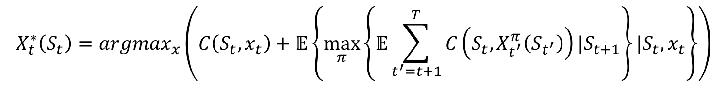
Base models vs. lookahead models
Optimal lookahead policies require solving
$$X_{t}^{∗}\left(S_{t}\right)=argmax_{x}\left(C\left(S_{t},x_{t}\right)+𝔼\left\{\max_{π}\left\{𝔼\sum_{t^{′}=t+1}^{T}{C\left(S_{t},X_{t^{′}}^{π}\left(S_{t^{′}}\right)\right)|S_{t+1}}\right\}|S_{t},x_{t}\right\}\right)$$
Contribution we receive now
Future contributions
We cannot compute the future contributions, so the challenge is designing appropriate approximations.

Slide 6
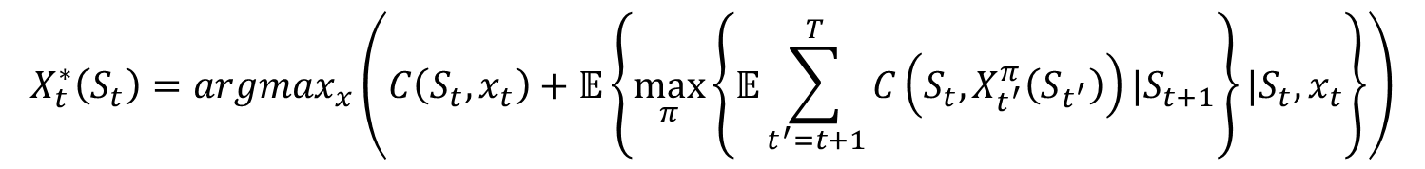
Base models vs. lookahead models
Lookahead policies are based on solving
$$X_{t}^{∗}\left(S_{t}\right)=argmax_{x}\left(C\left(S_{t},x_{t}\right)+𝔼\left\{\max_{π}\left\{𝔼\sum_{t^{′}=t+1}^{T}{C\left(S_{t},X_{t^{′}}^{π}\left(S_{t^{′}}\right)\right)|S_{t+1}}\right\}|S_{t},x_{t}\right\}\right)$$

Slide 7





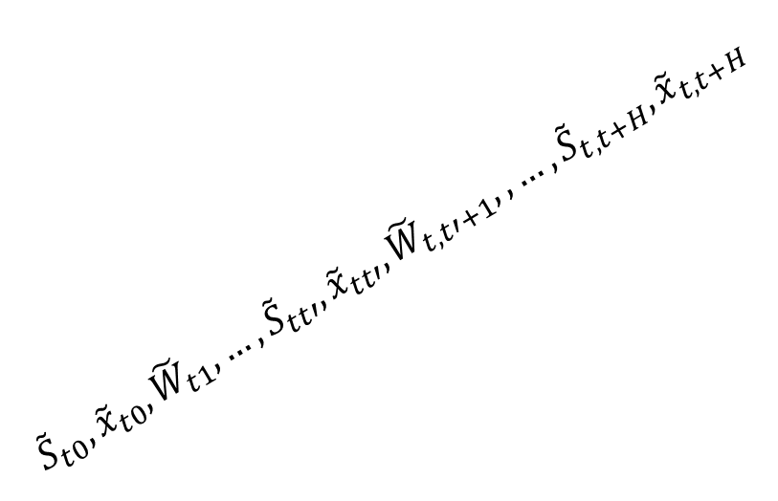

Base models vs. lookahead models
We create an approximation called the approximate lookahead model:
The lookahead model
$${\tilde{S}}_{t0},{\tilde{x}}_{t0},{\tilde{W}}_{t1},…,{\tilde{S}}_{tt′},{\tilde{x}}_{tt′},{\tilde{W}}_{t,t′+1},,…,{\tilde{S}}_{t,t+H},{\tilde{x}}_{t,t+H}$$
. . . .
$$t−1$$
$$t$$
$$t+1$$
$$t+2$$
$$t+3$$
$$S_{0},x_{0},W_{1},…,S_{t},x_{t},W_{t+1},…,S_{T},x_{T}$$
The base model (or real world)

Slide 8
Base models vs. lookahead models
Methods for approximating lookahead models:
Deterministic vs. stochastic future
Horizon truncation
Discretization (time, states, decisions)
Policy approximation (“policy within a policy”)
Latent variables (holding dynamic variables constant)
Outcome aggregation and sampling
Stage aggregation

Slide 9
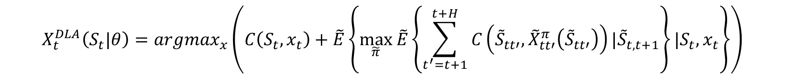
Base models vs. lookahead models
4) Direct lookahead policies (DLAs) – Here we create an approximation called the approximate lookahead model:
There are six classes of approximations we can introduce.
Our direct lookahead policy now requires solving:
$$({\tilde{S}}_{tt},{\tilde{x}}_{tt},{\tilde{W}}_{t,t+1},{\tilde{S}}_{t,t+1},{\tilde{x}}_{t,t+1},{\tilde{W}}_{t,t+2},…,{\tilde{S}}_{tt^{′}},{\tilde{x}}_{tt^{′}},{\tilde{W}}_{t,t^{′}+1},…)$$
$$X_{t}^{DLA}\left(S_{t}|θ\right)=argmax_{x}\left(C\left(S_{t},x_{t}\right)+\tilde{E}\left\{\max_{\tilde{π}} \tilde{E}\left\{\sum_{t^{′}=t+1}^{t+H}{C\left({\tilde{S}}_{tt′},{\tilde{X}}_{tt′}^{π}\left({\tilde{S}}_{tt′}\right)\right)|{\tilde{S}}_{t,t+1}}\right\}{|S_{t},x_{t}}\right\}\right)$$
Sampled information process
Restricted horizon
Limited decisions
The lookahead policy
Reduced state space

Slide 10

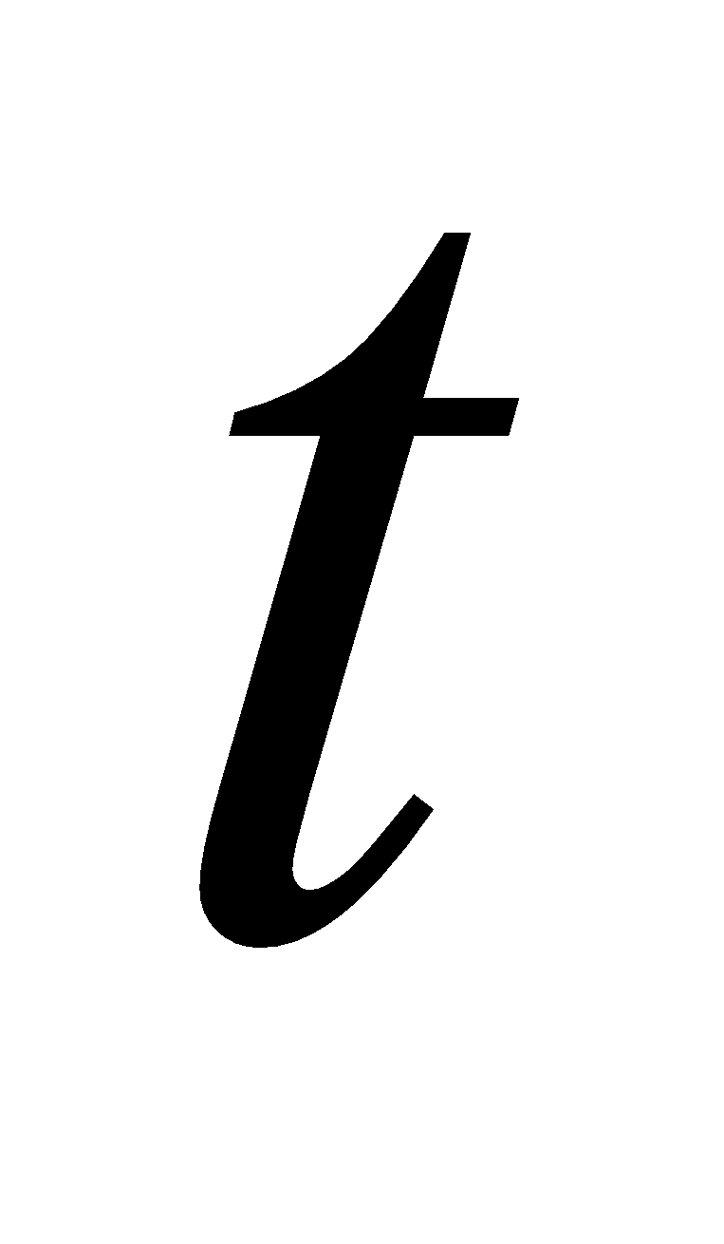
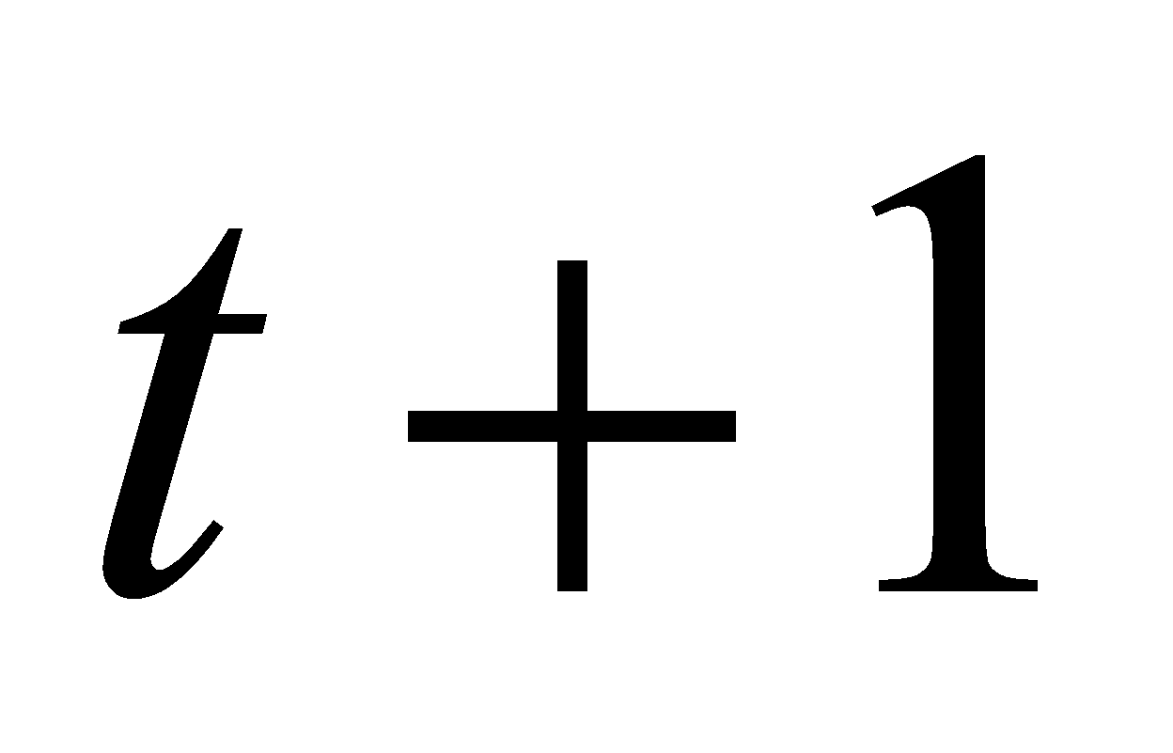
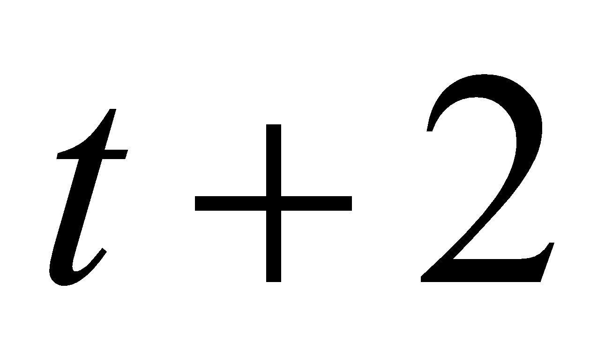
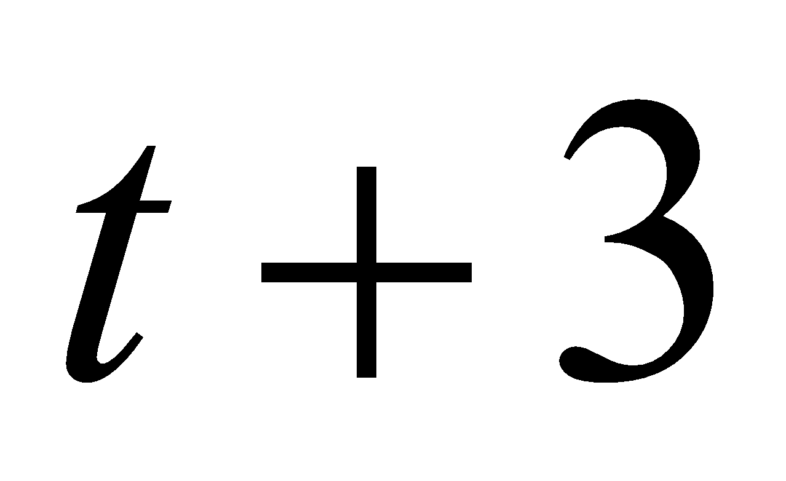
Base models vs. lookahead models
Direct Lookahead Policies (DLAs)
Tilde variables are used to model approximate lookahead
The lookahead model
. . . .
The base model

Slide 11
Base models vs. lookahead models
Direct Lookahead Policies (DLAs)
Tilde variables are used to model approximate lookahead
The lookahead model
. . . .
The base model

Slide 12
Base models vs. lookahead models
Direct Lookahead Policies (DLAs)
Tilde variables are used to model approximate lookahead
The lookahead model
. . . .
The base model

Slide 13
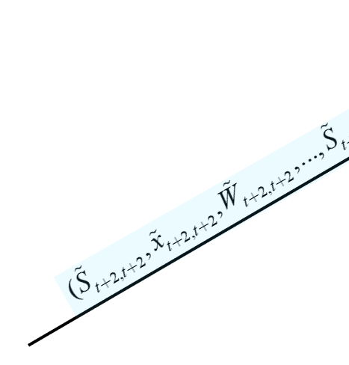


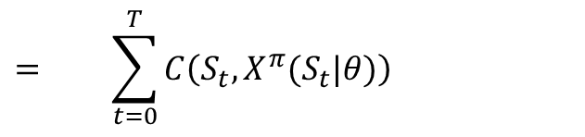













Base models vs. lookahead models
Evaluating policies:
$$S_{0}$$
$$S_{t}$$
$$S_{T}$$
$$x_{0}=X^{π}(S_{0}|θ)$$
$$x_{t}=X^{π}(S_{t}|θ)$$
$$x_{T}=X^{π}(S_{T}|θ)$$
$$W_{1}$$
$$W_{t+1}$$
$$⋯$$
$$⋯$$
Time
$$C(S_{0},x_{0})$$
$$C(S_{t},x_{t})$$
$$C(S_{T},x_{T})$$
$$F^{π}\left(θ\right)= + ⋯ + + ⋯ +$$
$$= \sum_{t=0}^{T}{C\left(S_{t},X^{π}(S_{t}|θ)\right)}$$

Slide 14
Base models vs. lookahead models
DLA policies are widely used under different names
Rolling horizon procedure (operations research and others)
Receding horizon procedure (computer science)
Model predictive control (control theory, but becoming more widely adopted).
I use “direct lookahead approximation” because it is more descriptive.

Slide 15
OUTLINE
DLA I – Overview of direct lookahead approximations
Types of lookahead approximations
The policy-within-a-policy
15

Slide 16
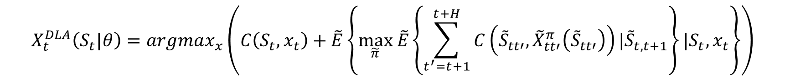
The policy-within-a-policy
We have to design the policy within the lookahead model:
$$X_{t}^{DLA}\left(S_{t}|θ\right)=argmax_{x}\left(C\left(S_{t},x_{t}\right)+\tilde{E}\left\{\max_{\tilde{π}} \tilde{E}\left\{\sum_{t^{′}=t+1}^{t+H}{C\left({\tilde{S}}_{tt′},{\tilde{X}}_{tt′}^{π}\left({\tilde{S}}_{tt′}\right)\right)|{\tilde{S}}_{t,t+1}}\right\}{|S_{t},x_{t}}\right\}\right)$$

Slide 17
The policy-within-a-policy
How do we design this policy? We start with our four classes of policies:
Policy function approximations (PFAs)
Cost function approximations (CFAs)
Value function approximations (VFAs)
Direct lookahead approximations (DLAs)
Deterministic DLAs
Stochastic DLAs
Remember: We are designing these policies for an approximate lookahead model, not the original base model.

Slide 18
The policy-within-a-policy
If we have already decided that we need a direct lookahead approximation for our problem, why don’t we just use a DLA?
Often it is too expensive.
We put a higher emphasis on quality over computation when choosing the base policy…
… but when choosing a policy for a lookahead model, we put a high emphasis on computation, and we are willing to sacrifice quality.
The effect of suboptimal policies in the lookahead on the quality of decisions in the lookahead policy remains an open research question.

Slide 19


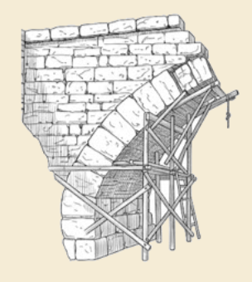
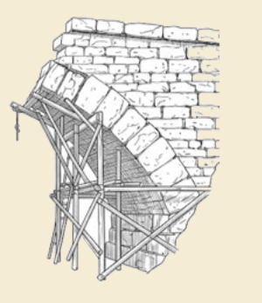
Thank you!
For more information see the Sequential Decision Analytics website at
warrenpowell.org
For more on direct lookahead approximations go to:
warrenpowell.org → Policies → Direct lookahead approximations

