Slide 1


Tutorial Series on Sequential Decision Analytics
Warren B Powell
Professor Emeritus, Princeton University
Recorded: August 12, 2026
Module: Direct lookahead approximations II – Deterministic lookaheads
Parameterized deterministic lookaheads
Predecessor module(s):
Universal modeling framework (detailed)
Technical level: Moderate.

Slide 2

OUTLINE
Direct lookahead approximations:
DLA I – Overview of direct lookahead approximations
DLA II - Deterministic lookaheads
DLA III - Stochastic lookaheads using PFAs, CFAs and VFAs
DLA IV – Stochastic lookaheads using DLAs – Discrete actions
DLA V – Stochastic lookaheads using DLAs – Vector actions
15

Slide 3
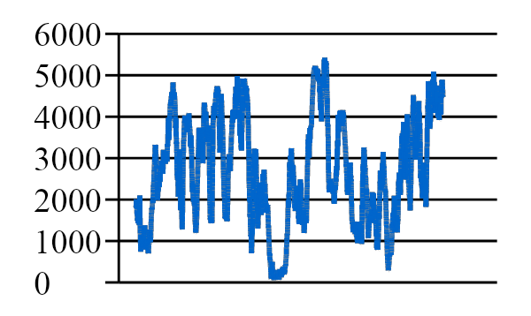
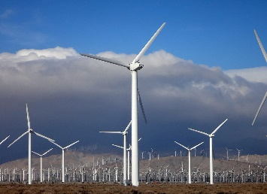

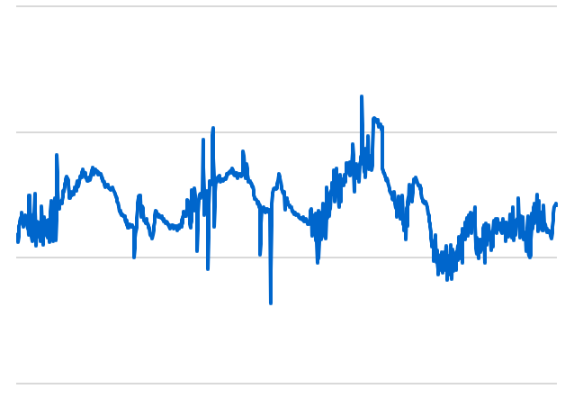

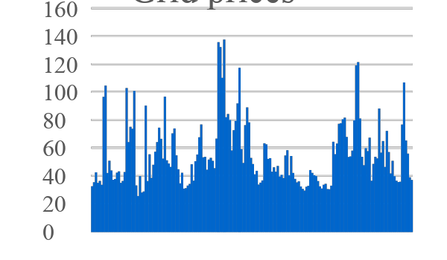
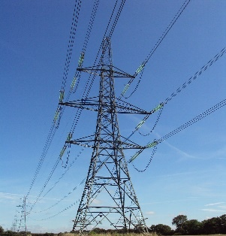
Deterministic lookahead: Parameterized LP
Consider a basic energy storage problem
Wind energy
Demand (load)
Battery
storage
Grid Prices

Slide 4
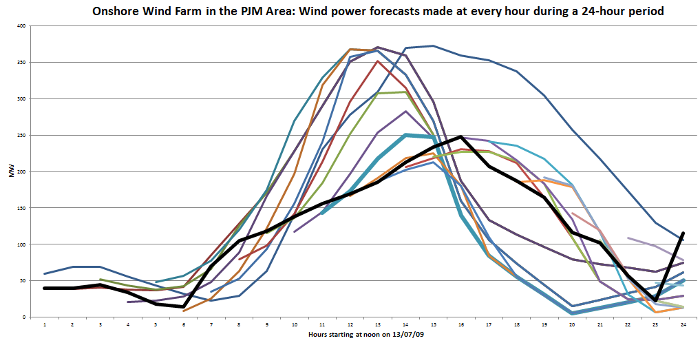
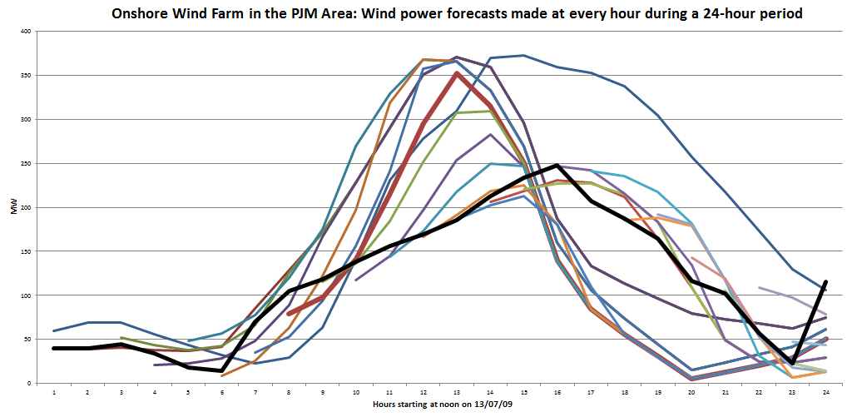
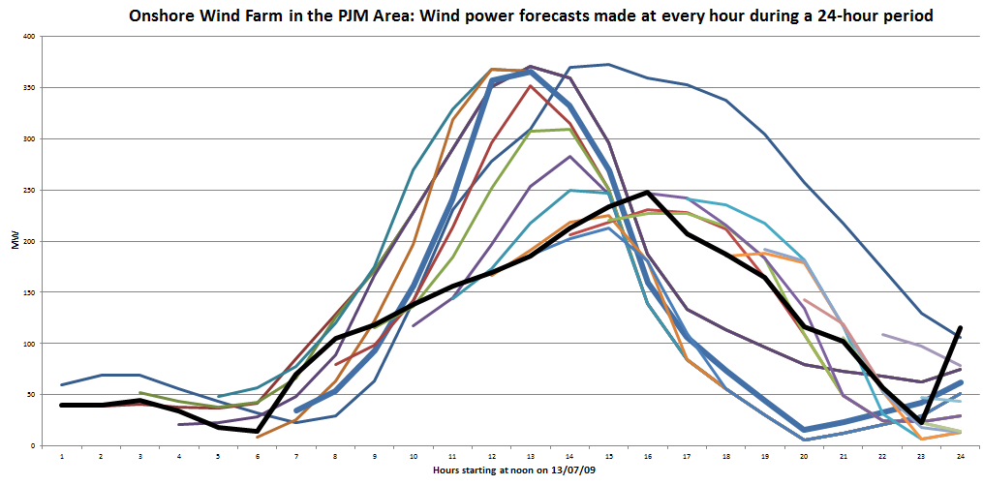
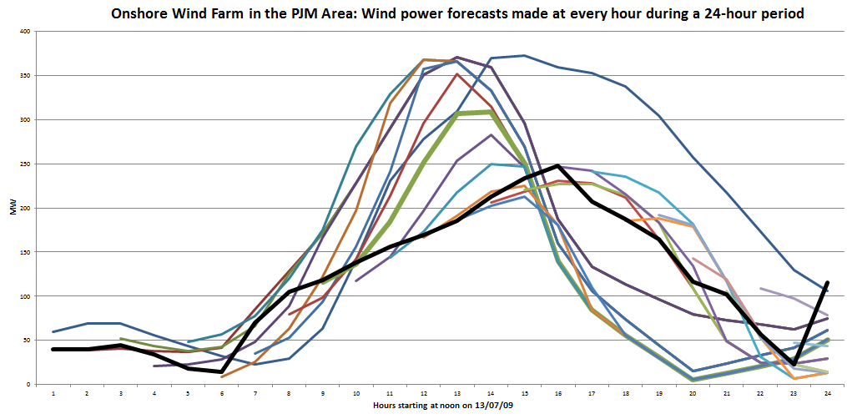
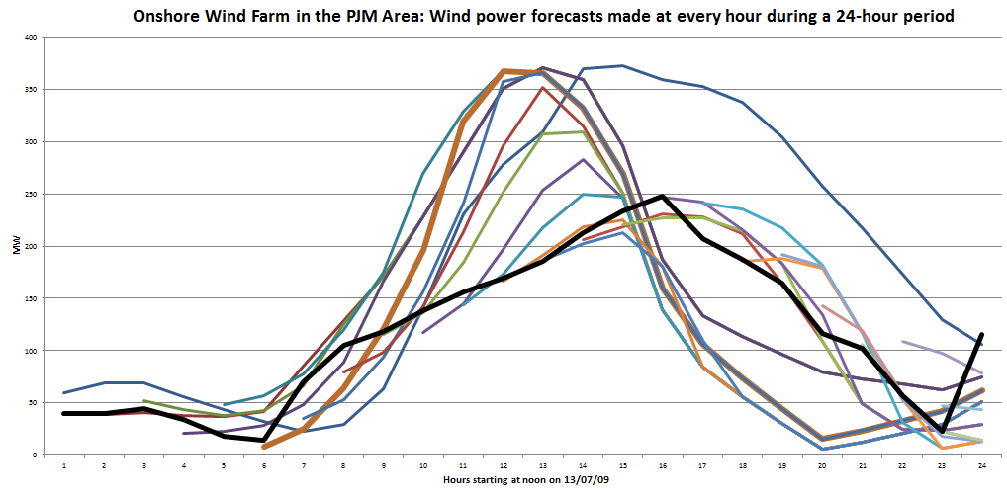
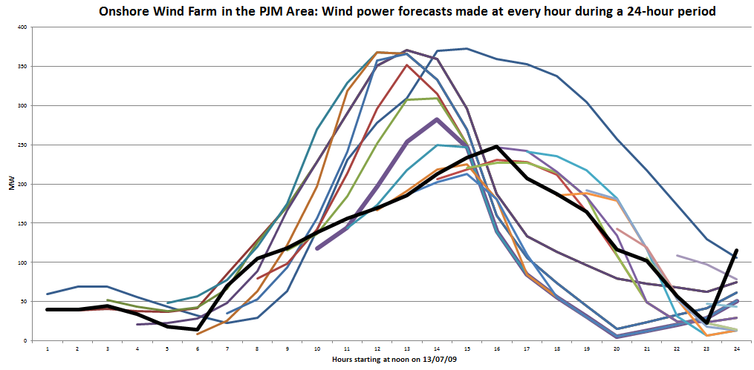
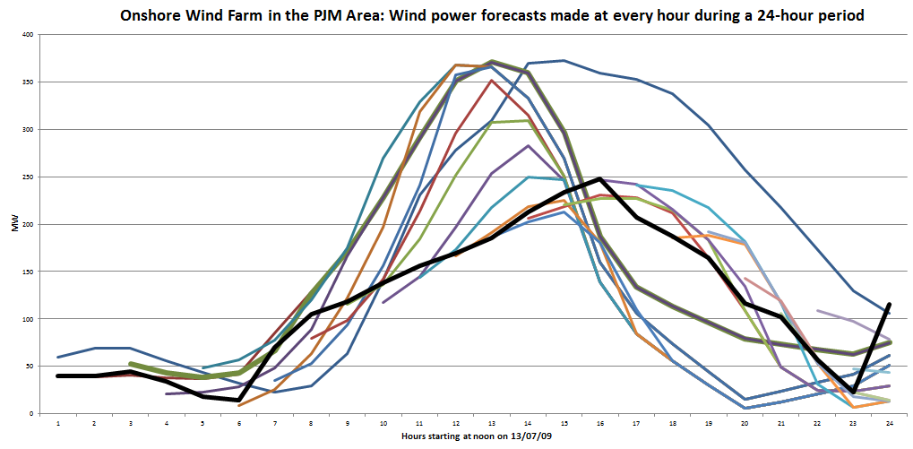
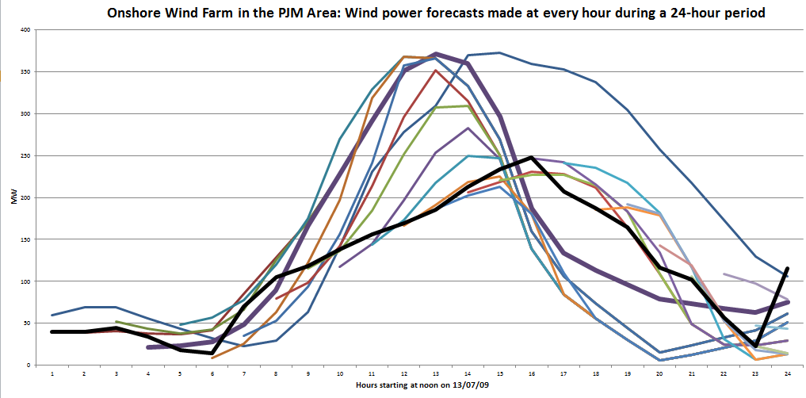
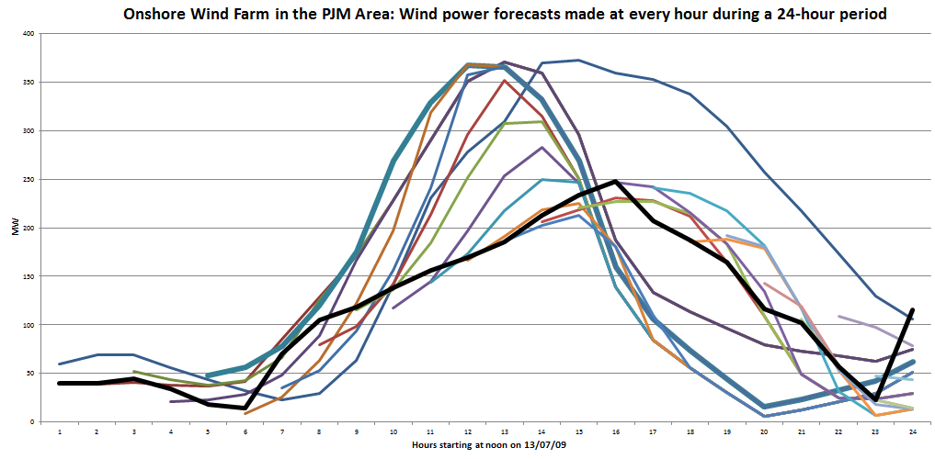
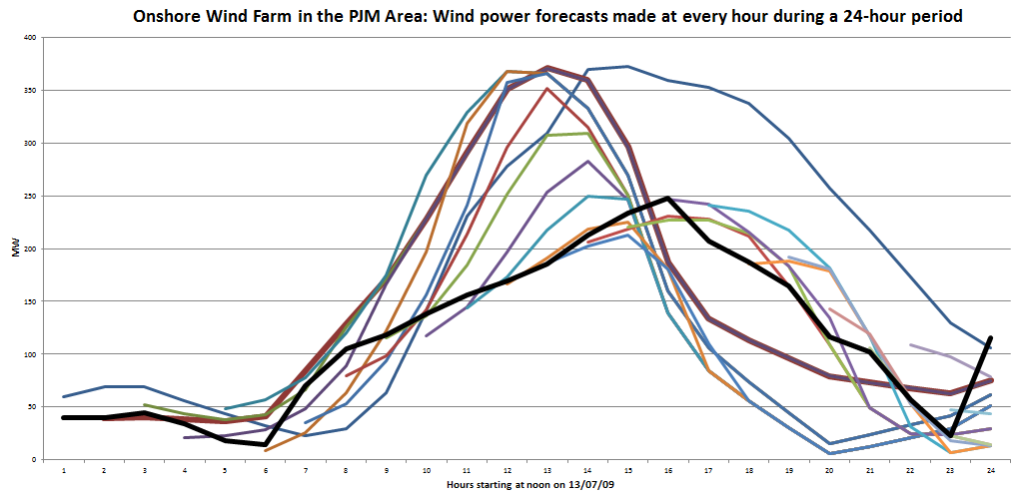
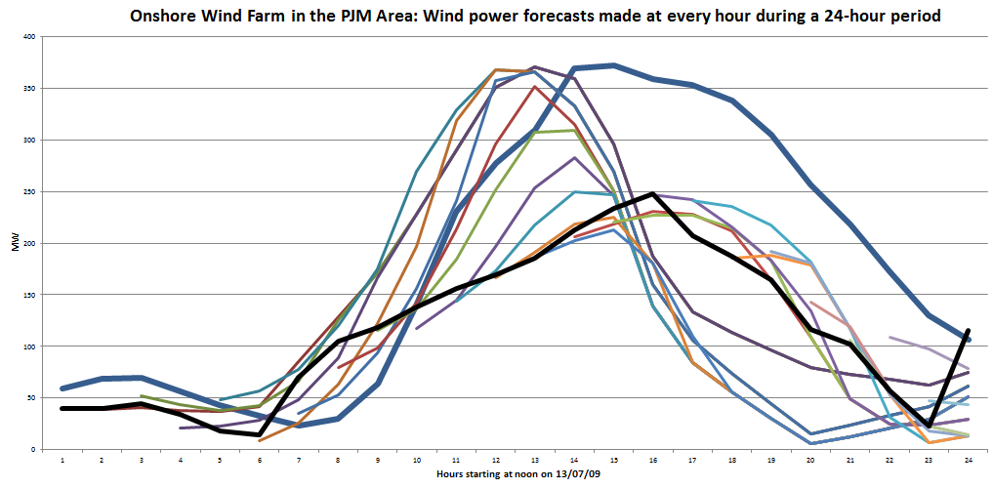
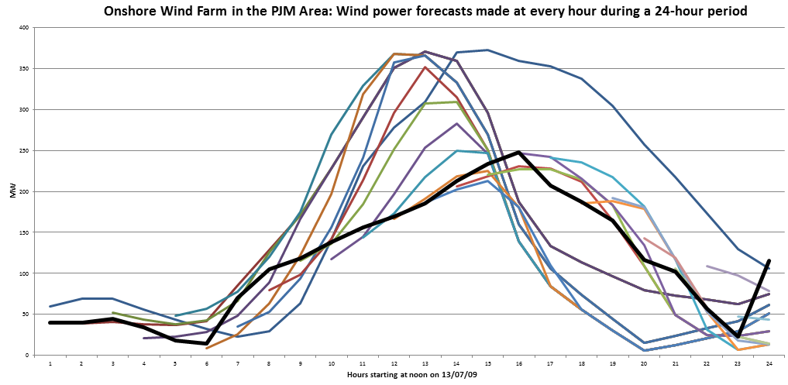
Deterministic lookahead: Parameterized LP
Wind forecasts evolve over time as new information arrives:
24 hours
Rolling forecasts, updated each hour.
Forecast made at midnight:
Actual

Slide 5
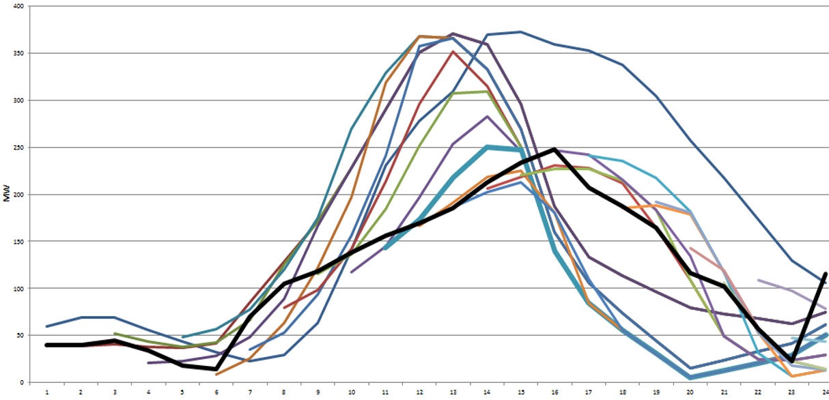

Deterministic lookahead: Parameterized LP
Benchmark policy – Deterministic lookahead
$${\tilde{x}}_{tt′}^{wd}+β{\tilde{x}}_{tt′}^{rd}+{\tilde{x}}_{tt′}^{gd}≤f_{tt′}^{D} \\ {\tilde{x}}_{tt′}^{gd}+{\tilde{x}}_{tt′}^{gr}≤f_{tt′}^{G} \\ {\tilde{x}}_{tt′}^{rd}+{\tilde{x}}_{tt′}^{rg}≤{\tilde{R}}_{tt′} \\ {\tilde{x}}_{tt′}^{wr}+{\tilde{x}}_{tt′}^{gr}≤R_{tt′}^{max} \\ {\tilde{x}}_{tt′}^{wr}+{\tilde{x}}_{tt′}^{wd}≤f_{tt′}^{E} \\ {\tilde{x}}_{tt′}^{wr}+{\tilde{x}}_{tt′}^{gr}≤γ^{charge} \\ {\tilde{x}}_{tt′}^{rd}+{\tilde{x}}_{tt′}^{rg}≤γ^{discharge}$$
(joint with Saeed Ghadimi)

Slide 6
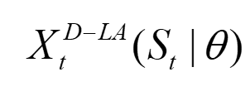
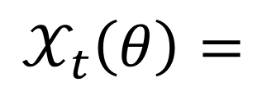


Deterministic lookahead: Parameterized LP
Benchmark policy – Deterministic lookahead
$${\tilde{x}}_{tt′}^{wd}+β{\tilde{x}}_{tt′}^{rd}+{\tilde{x}}_{tt′}^{gd}≤f_{tt′}^{D} \\ {\tilde{x}}_{tt′}^{gd}+{\tilde{x}}_{tt′}^{gr}≤f_{tt′}^{G} \\ {\tilde{x}}_{tt′}^{rd}+{\tilde{x}}_{tt′}^{rg}≤{\tilde{R}}_{tt′} \\ {\tilde{x}}_{tt′}^{wr}+{\tilde{x}}_{tt′}^{gr}≤R_{tt′}^{max} \\ {\tilde{x}}_{tt′}^{wr}+{\tilde{x}}_{tt′}^{wd}≤θ_{t′−t}f_{tt′}^{E} \\ {\tilde{x}}_{tt′}^{wr}+{\tilde{x}}_{tt′}^{gr}≤γ^{charge} \\ {\tilde{x}}_{tt′}^{rd}+{\tilde{x}}_{tt′}^{rg}≤γ^{discharge}$$
$$𝒳_{t}\left(θ\right)=$$
(joint with Saeed Ghadimi)

Slide 7

Deterministic lookahead: Parameterized LP
Lookahead policies peek into the future
Optimize over deterministic lookahead model
The lookahead model
. . . .
The real process

Slide 8

Deterministic lookahead: Parameterized LP
Lookahead policies peek into the future
Optimize over deterministic lookahead model
The lookahead model
. . . .
The real process

Slide 9

Deterministic lookahead: Parameterized LP
Lookahead policies peek into the future
Optimize over deterministic lookahead model
The lookahead model
. . . .
The real process

Slide 10
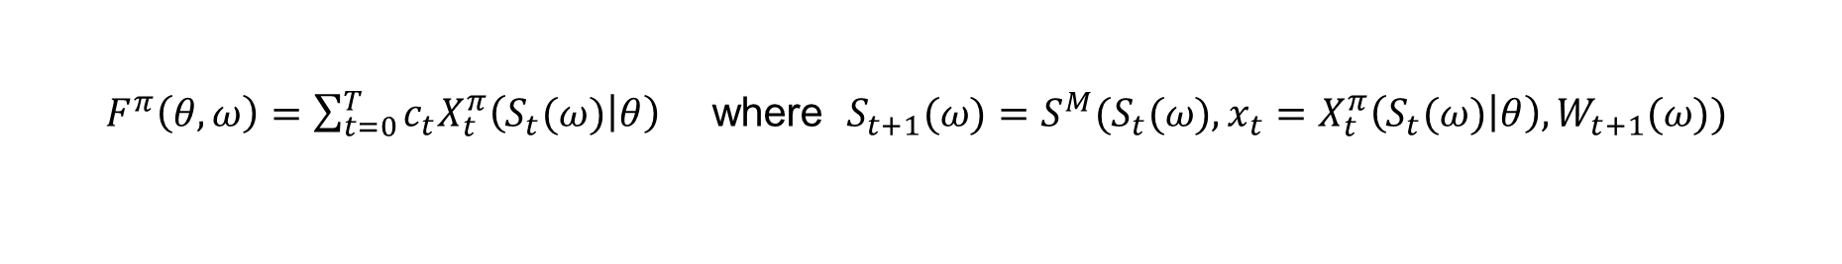
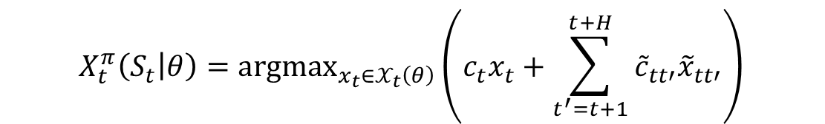
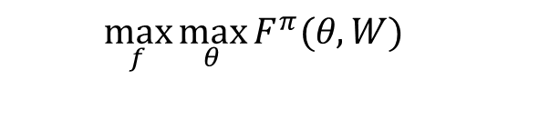

Deterministic lookahead: Parameterized LP
The policy (deterministic linear program)
The objective function (evaluated using simulation)
Stochastic optimization problem
Stochastic gradient algorithm (using Spall’s SPSA algorithm)
$$X_{t}^{π}\left(S_{t} | θ\right)={argmax}_{x_{t}∈𝒳_{t}\left(θ\right)}\left(c_{t}x_{t}+\sum_{t^{′}=t+1}^{t+H}{{\tilde{c}}_{tt′}{\tilde{x}}_{tt′}}\right)$$
$F^{π}\left(θ,ω\right)=\sum_{t=0}^{T}{c_{t}{X_{t}^{π}\left(S_{t}(ω) | θ\right)}_{}}$ where $S_{t+1}(ω)=S^{M}(S_{t}(ω),x_{t}=X_{t}^{π}\left(S_{t}(ω) | θ\right),W_{t+1}(ω))$
Testing parameterizations
Tuning parameters
$$\max_{f}{\max_{θ}{F^{π}(θ,W)}}$$
$$θ^{n+1}=θ^{n}+α_{n}∇F^{π}(θ^{n},ω^{n+1})$$
(joint with Saeed Ghadimi)

Slide 11
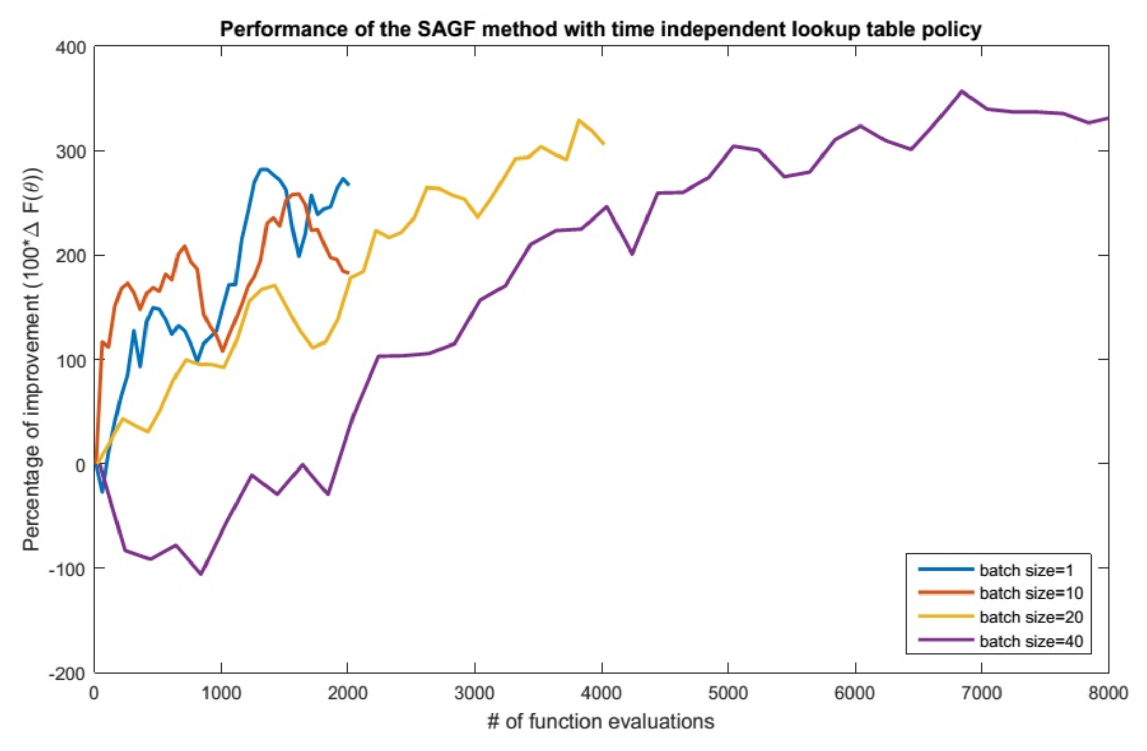
Deterministic lookahead: Parameterized LP
Mini-batch = 20
Mini-batch = 1
Mini-batch
= 10
Mini-batch = 40
“mini-batch” = number of times we simulate the function to estimate the derivative.
Each point represents the sum of optimal solutions to linear programs (but we keep changing the model).
Number of function evaluations
(joint with Saeed Ghadimi)

Slide 12
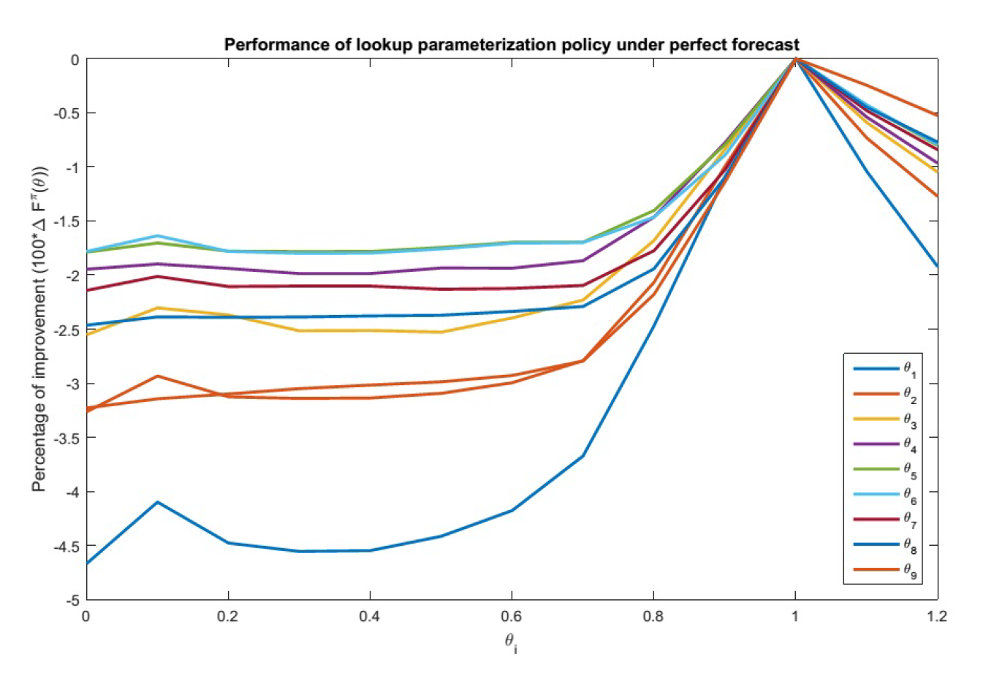


Deterministic lookahead: Parameterized LP
One-dimensional contour plots – perfect forecast
$$θ_{i}^{∗}=1\text{ for perfect forecasts.}$$
0.0 0.2 0.4 0.6 0.8 1.0 1.2
$$θ$$
(joint with Saeed Ghadimi)

Slide 13
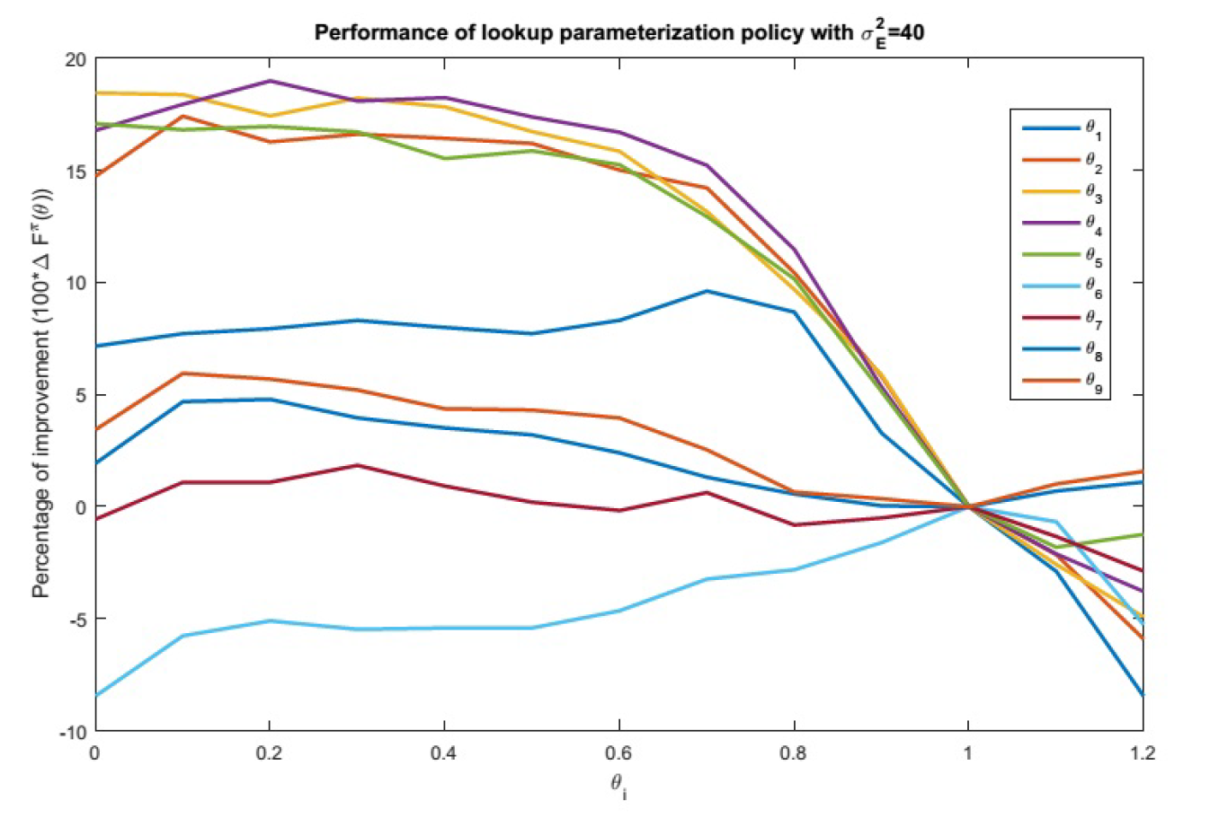




Deterministic lookahead: Parameterized LP
One-dimensional contour plots - uncertain forecast
$$θ_{2},θ_{3},θ_{4},θ_{5}$$
$$θ_{1}$$
$$θ_{6}$$
0.0 0.2 0.4 0.6 0.8 1.0 1.2
$$θ$$
(joint with Saeed Ghadimi)

Slide 14
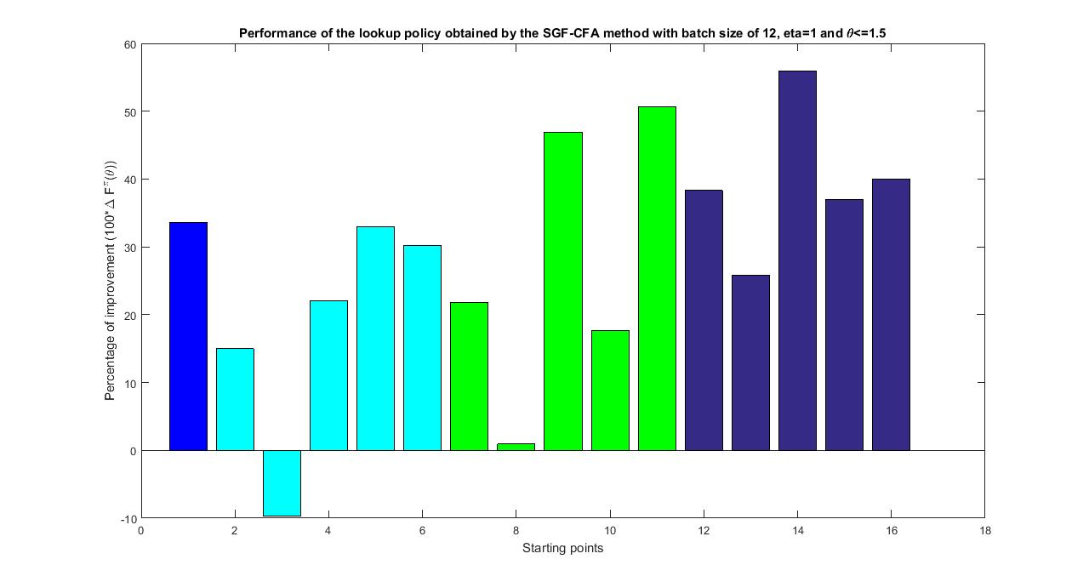







Deterministic lookahead: Parameterized LP
Tuning the parameters
$$θ_{i}=1$$
$$θ_{i}∈[0,1]$$
$$θ_{i}∈[0.5,1.5]$$
$$θ_{i}∈[1,2]$$
Optimized $θ$
30 percent improvement
Percent improvement over $θ=1$
$$θ=1$$
Starting points for stochastic search for $θ$
(joint with Saeed Ghadimi)

Slide 15
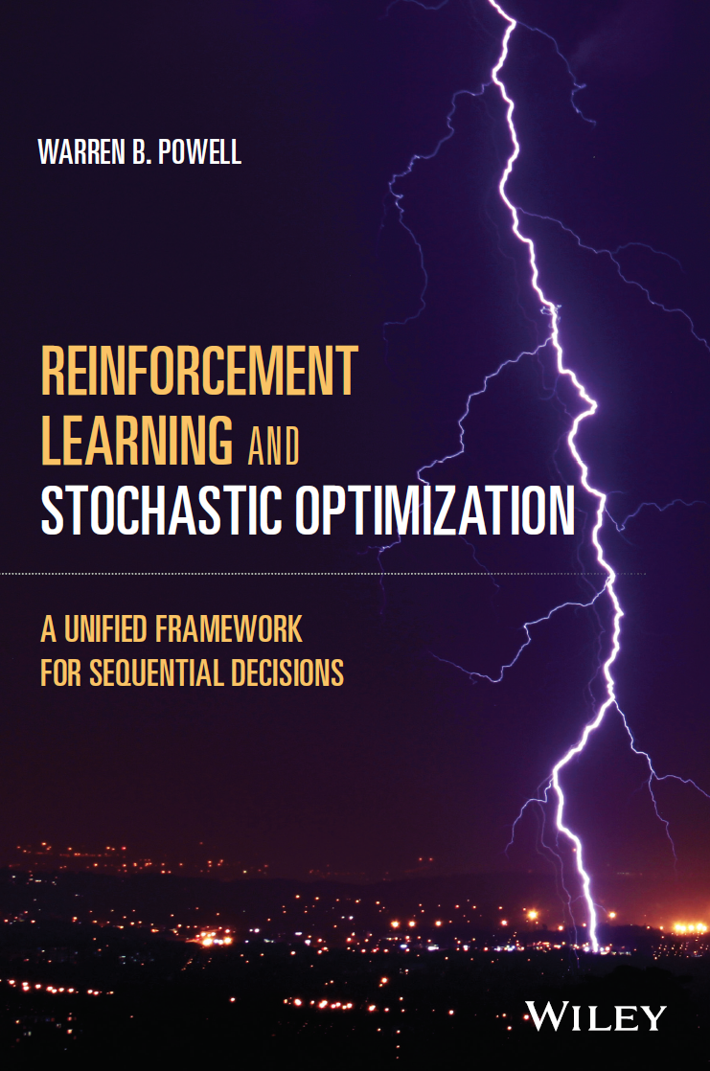
Deterministic lookahead: Parameterized LP
Cost function approximations
This approach is widely used in industry, but in an ad-hoc way.
Professionals will tweak their models so they work well in the field (and over time).
Missing is any formal recognition that this is a parameterized policy.
CFAs are covered in Chapter 13 of RLSO. This is the first book to formalize parameterizing deterministic optimization models as a way of solving stochastic optimization problems.
Chapter 13

Slide 16
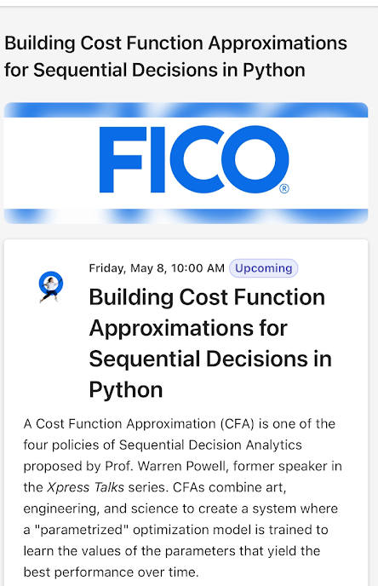
Cost function approximations: Parameterized LP
Parameterized LPs in industry
FICO is one of the major vendors of deterministic solvers (LPs, NLPs, MIPs)
They have embraced the idea of using parameterized deterministic optimization models to help a deterministic model work better over time.
Talk was given May 8, 2026.
Presentation by Carlos Zetina

Slide 17
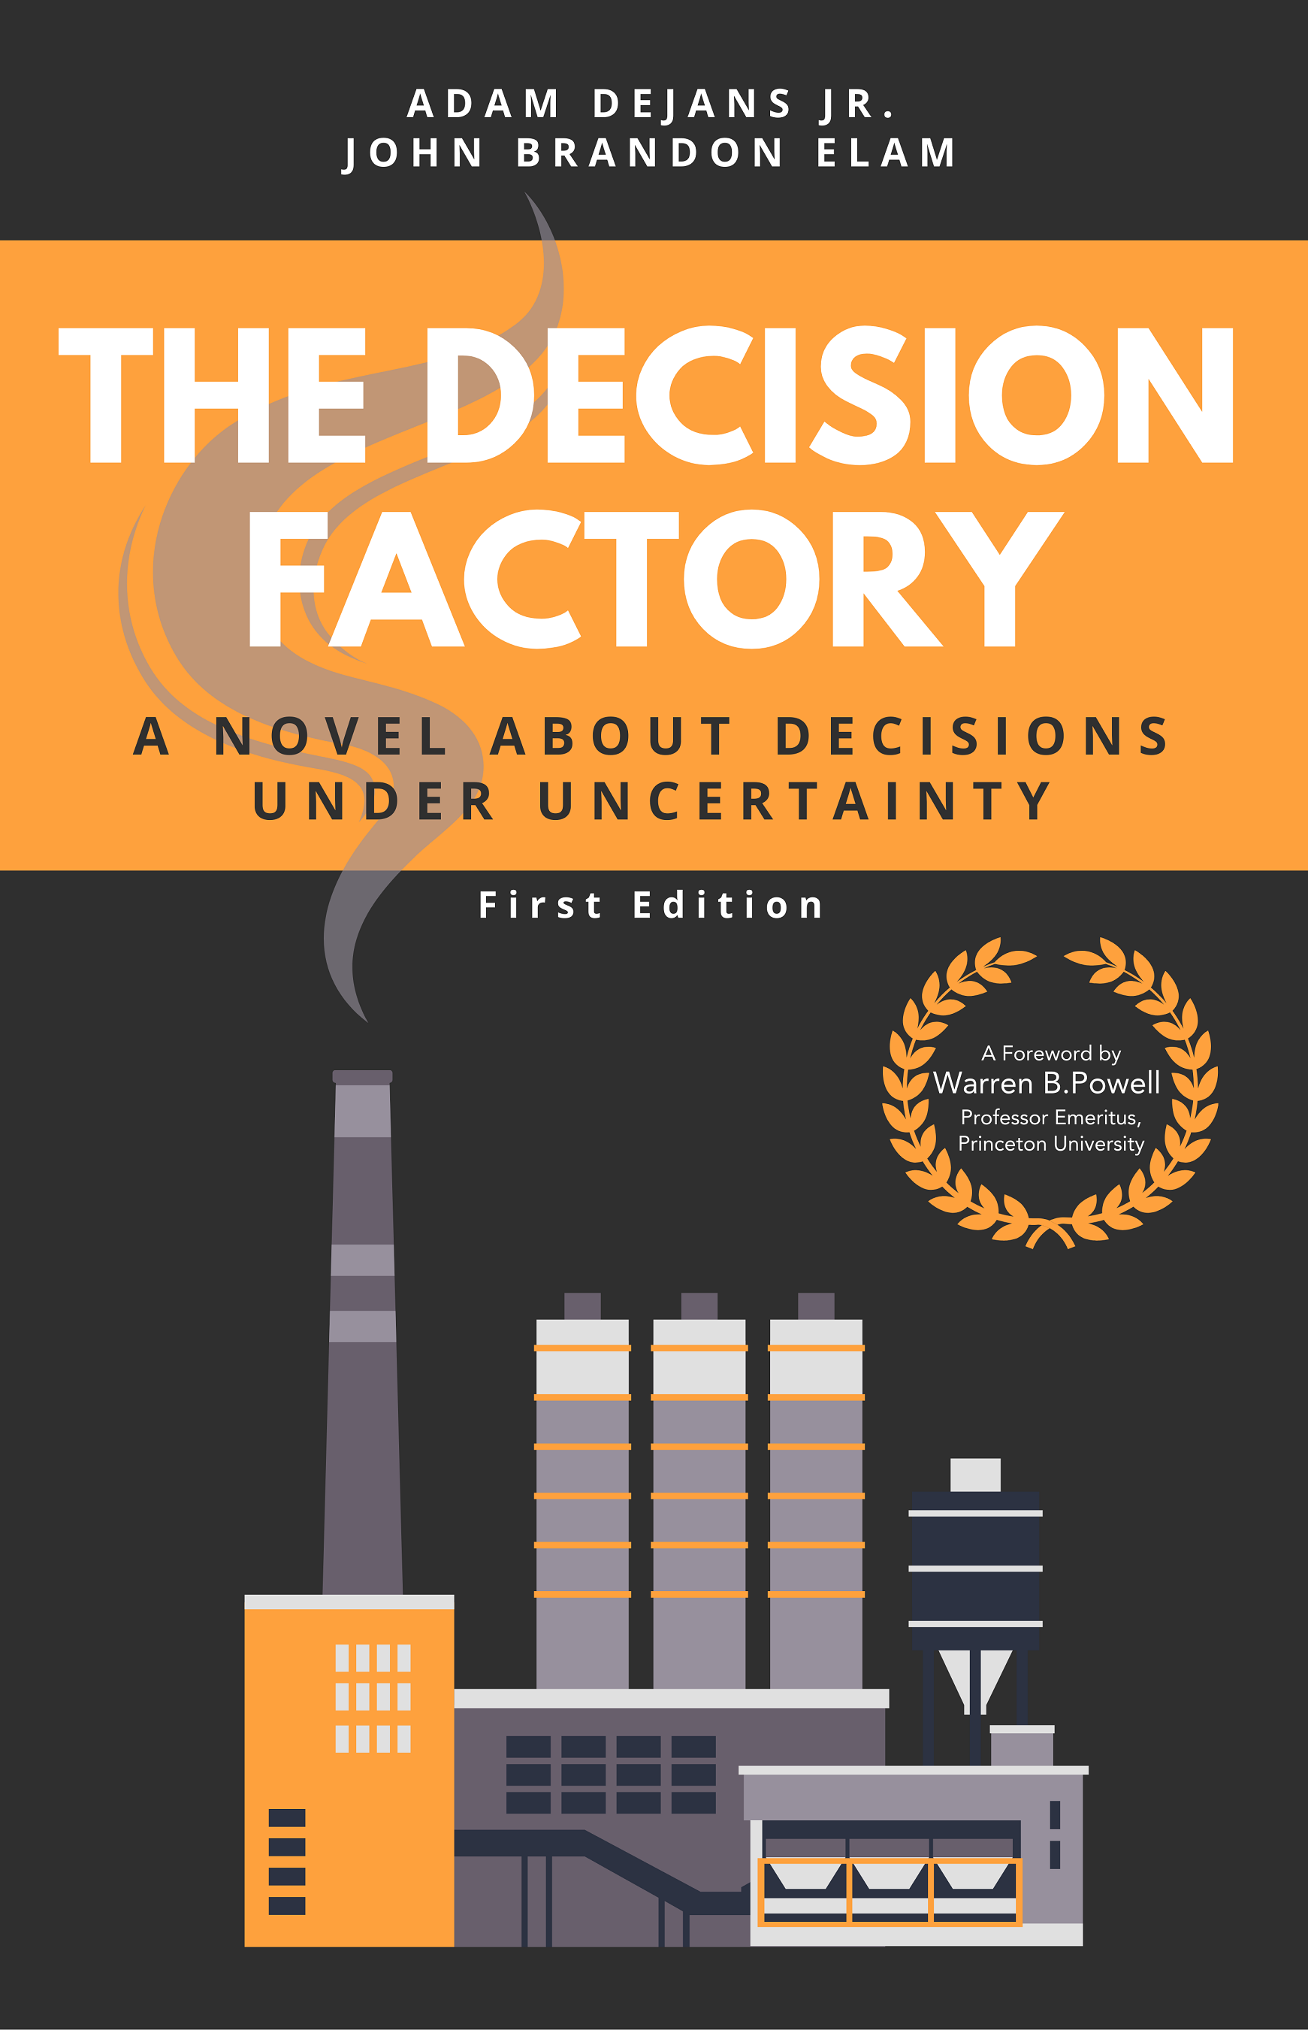
Cost function approximations: Parameterized LP
The Decision Factory
Written in the style of the popular business book “The Goal.”
Coauthored by two industry professionals (formerly at Toyota). Lead author Adam DeJans was at Gurobi when the book appeared.
It embraces my strategy of solving complex problems using “policies” which may be simple rules or functions, or parameterized integer programs.

Slide 18


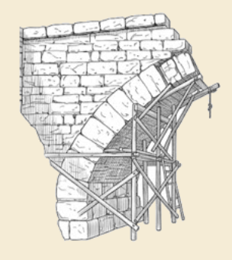
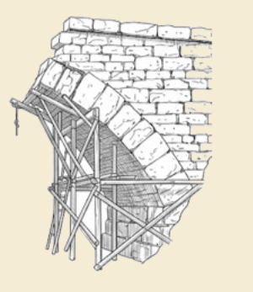
Thank you!
For more information see the Sequential Decision Analytics website at
warrenpowell.org
For more on direct lookahead approximations go to:
warrenpowell.org → Policies → Direct lookahead approximations

