Slide 1

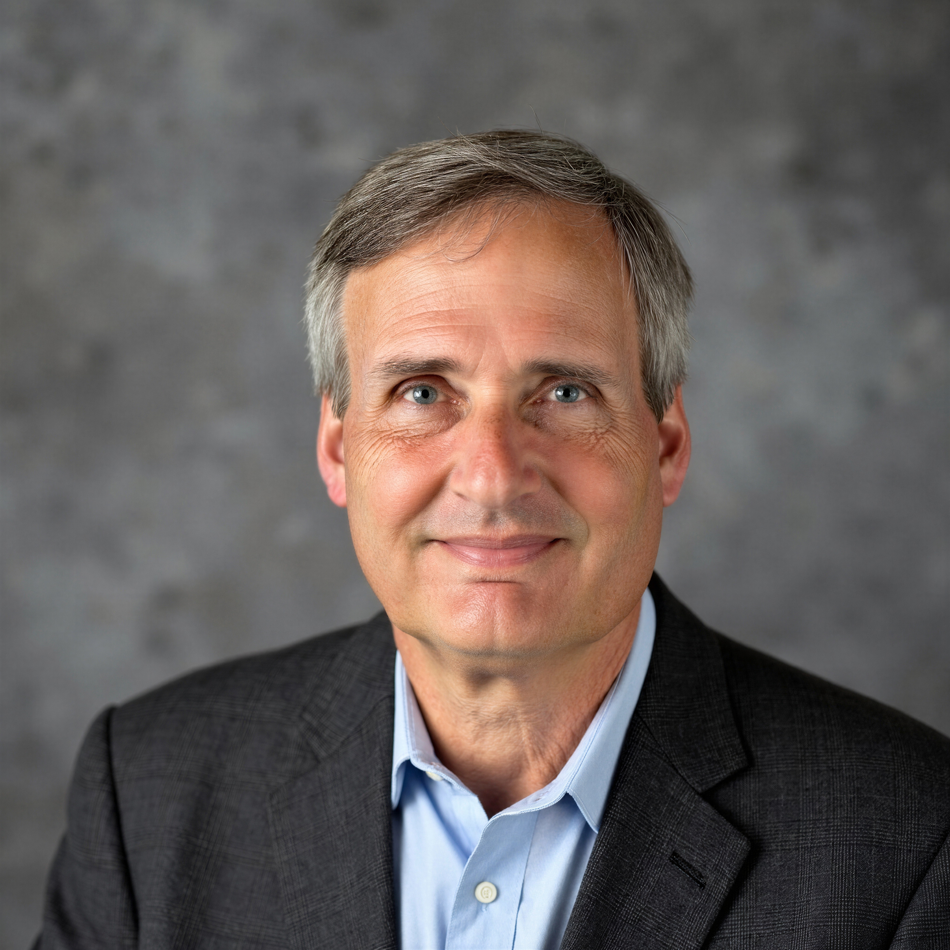
Tutorial Series on Sequential Decision Analytics
Warren B Powell
Professor Emeritus, Princeton University
Recorded: August 12, 2026
Module: Direct lookahead approximations III – Stochastic lookaheads
The “policy-within-a-policy”
PFA illustration – planning inventories
Other approximations
Predecessor module(s):
Universal modeling framework (detailed)
Technical level: Moderate.

Slide 2

OUTLINE
Direct lookahead approximations:
DLA I – Overview of direct lookahead approximations
DLA II - Deterministic lookaheads
DLA III - Stochastic lookaheads using PFAs, CFAs and VFAs
DLA IV – Stochastic lookaheads using DLAs – Discrete actions
DLA V – Stochastic lookaheads using DLAs – Vector actions
15

Slide 3
OUTLINE
DLA III - Stochastic lookaheads using PFAs, CFAs and VFAs
PFA-based
CFA-based:
VFA-based:
15

Slide 4





PFA-based lookahead policy
Textbook inventory planning uses standard “order up to” policies:
Inventory $R_{t}$
$$θ^{max}$$
$$θ^{lead}$$
$$θ^{min}$$
Time
$$t$$
1 week

Slide 5
PFA-based lookahead policy
Seasonal sales of candy facing Halloween spike
Production capacity
Sales
Jan Feb March April May June July August Sept Oct Nov Dec

Slide 6
PFA-based lookahead policy
Seasonal sales of candy facing Halloween spike
Need to plan production in the future to meet demand while respecting production capacity constraints.
Production capacity
Sales
Jan Feb March April May June July August Sept Oct Nov Dec

Slide 7
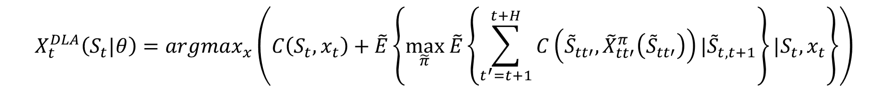
PFA-based lookahead policy
Direct lookahead policies (DLAs) – Here we create an approximation called the approximate lookahead model:
There are six classes of approximations we can introduce.
Our direct lookahead policy now requires solving:
$$({\tilde{S}}_{tt},{\tilde{x}}_{tt},{\tilde{W}}_{t,t+1},{\tilde{S}}_{t,t+1},{\tilde{x}}_{t,t+1},{\tilde{W}}_{t,t+2},…,{\tilde{S}}_{tt^{′}},{\tilde{x}}_{tt^{′}},{\tilde{W}}_{t,t^{′}+1},…)$$
$$X_{t}^{DLA}\left(S_{t}|θ\right)=argmax_{x}\left(C\left(S_{t},x_{t}\right)+\tilde{E}\left\{\max_{\tilde{π}} \tilde{E}\left\{\sum_{t^{′}=t+1}^{t+H}{C\left({\tilde{S}}_{tt′},{\tilde{X}}_{tt′}^{π}\left({\tilde{S}}_{tt′}\right)\right)|{\tilde{S}}_{t,t+1}}\right\}{|S_{t},x_{t}}\right\}\right)$$
Simplified policies
The “policy within a policy”

Slide 8





PFA-based lookahead policy
Designing the lookahead policy:
Policy function approximation
“(s,S)” inventory policy - $R_{t}$=inventory
$$X_{}^{π}(R_{t}|θ=(θ^{min},θ^{max}))=\left\{\begin{matrix}θ^{max}−R_{t} & \text{If }R_{t}<θ^{min} \\ 0 & R_{t}≥θ^{min}\end{matrix}\right.$$
Inventory $R_{t}$
$$θ^{max}$$
$$r^{lead}$$
$$θ^{min}$$
Time
$$t$$
1 week

Slide 9
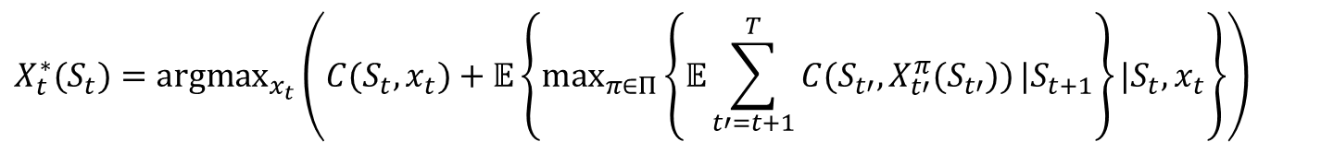
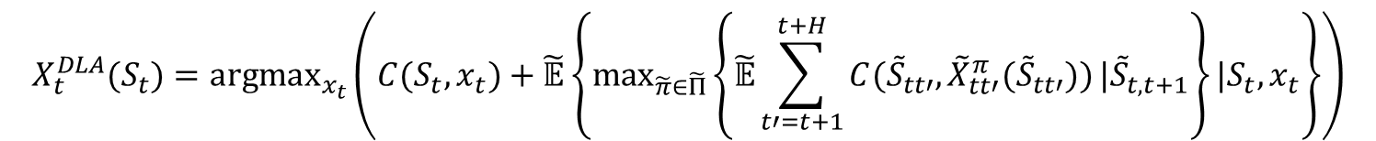
PFA-based lookahead policy
A stochastic lookahead policy
The optimal policy
We replace the full lookahead with an approximate policy:
We can replace the expectations with Monte Carlo samples
Real challenge is designing the “policy within a policy” which can be any of our four classes of policies.
$$X_{t}^{∗}(S_{t})={argmax}_{x_{t}}\left(C(S_{t},x_{t})+𝔼\left\{\max_{π∈Π}\left\{𝔼\sum_{t′=t+1}^{T}{C(S_{t′},X_{t′}^{π}(S_{t′}))}|S_{t+1}\right\}|S_{t},x_{t}\right\}\right)$$
$$X_{t}^{DLA}(S_{t})={argmax}_{x_{t}}\left(C(S_{t},x_{t})+\tilde{𝔼}\left\{\max_{\tilde{π}∈\tilde{Π}}\left\{\tilde{𝔼}\sum_{t′=t+1}^{t+H}{C({\tilde{S}}_{tt′},{\tilde{X}}_{tt′}^{π}({\tilde{S}}_{tt′}))}|{\tilde{S}}_{t,t+1}\right\}|S_{t},x_{t}\right\}\right)$$

Slide 10
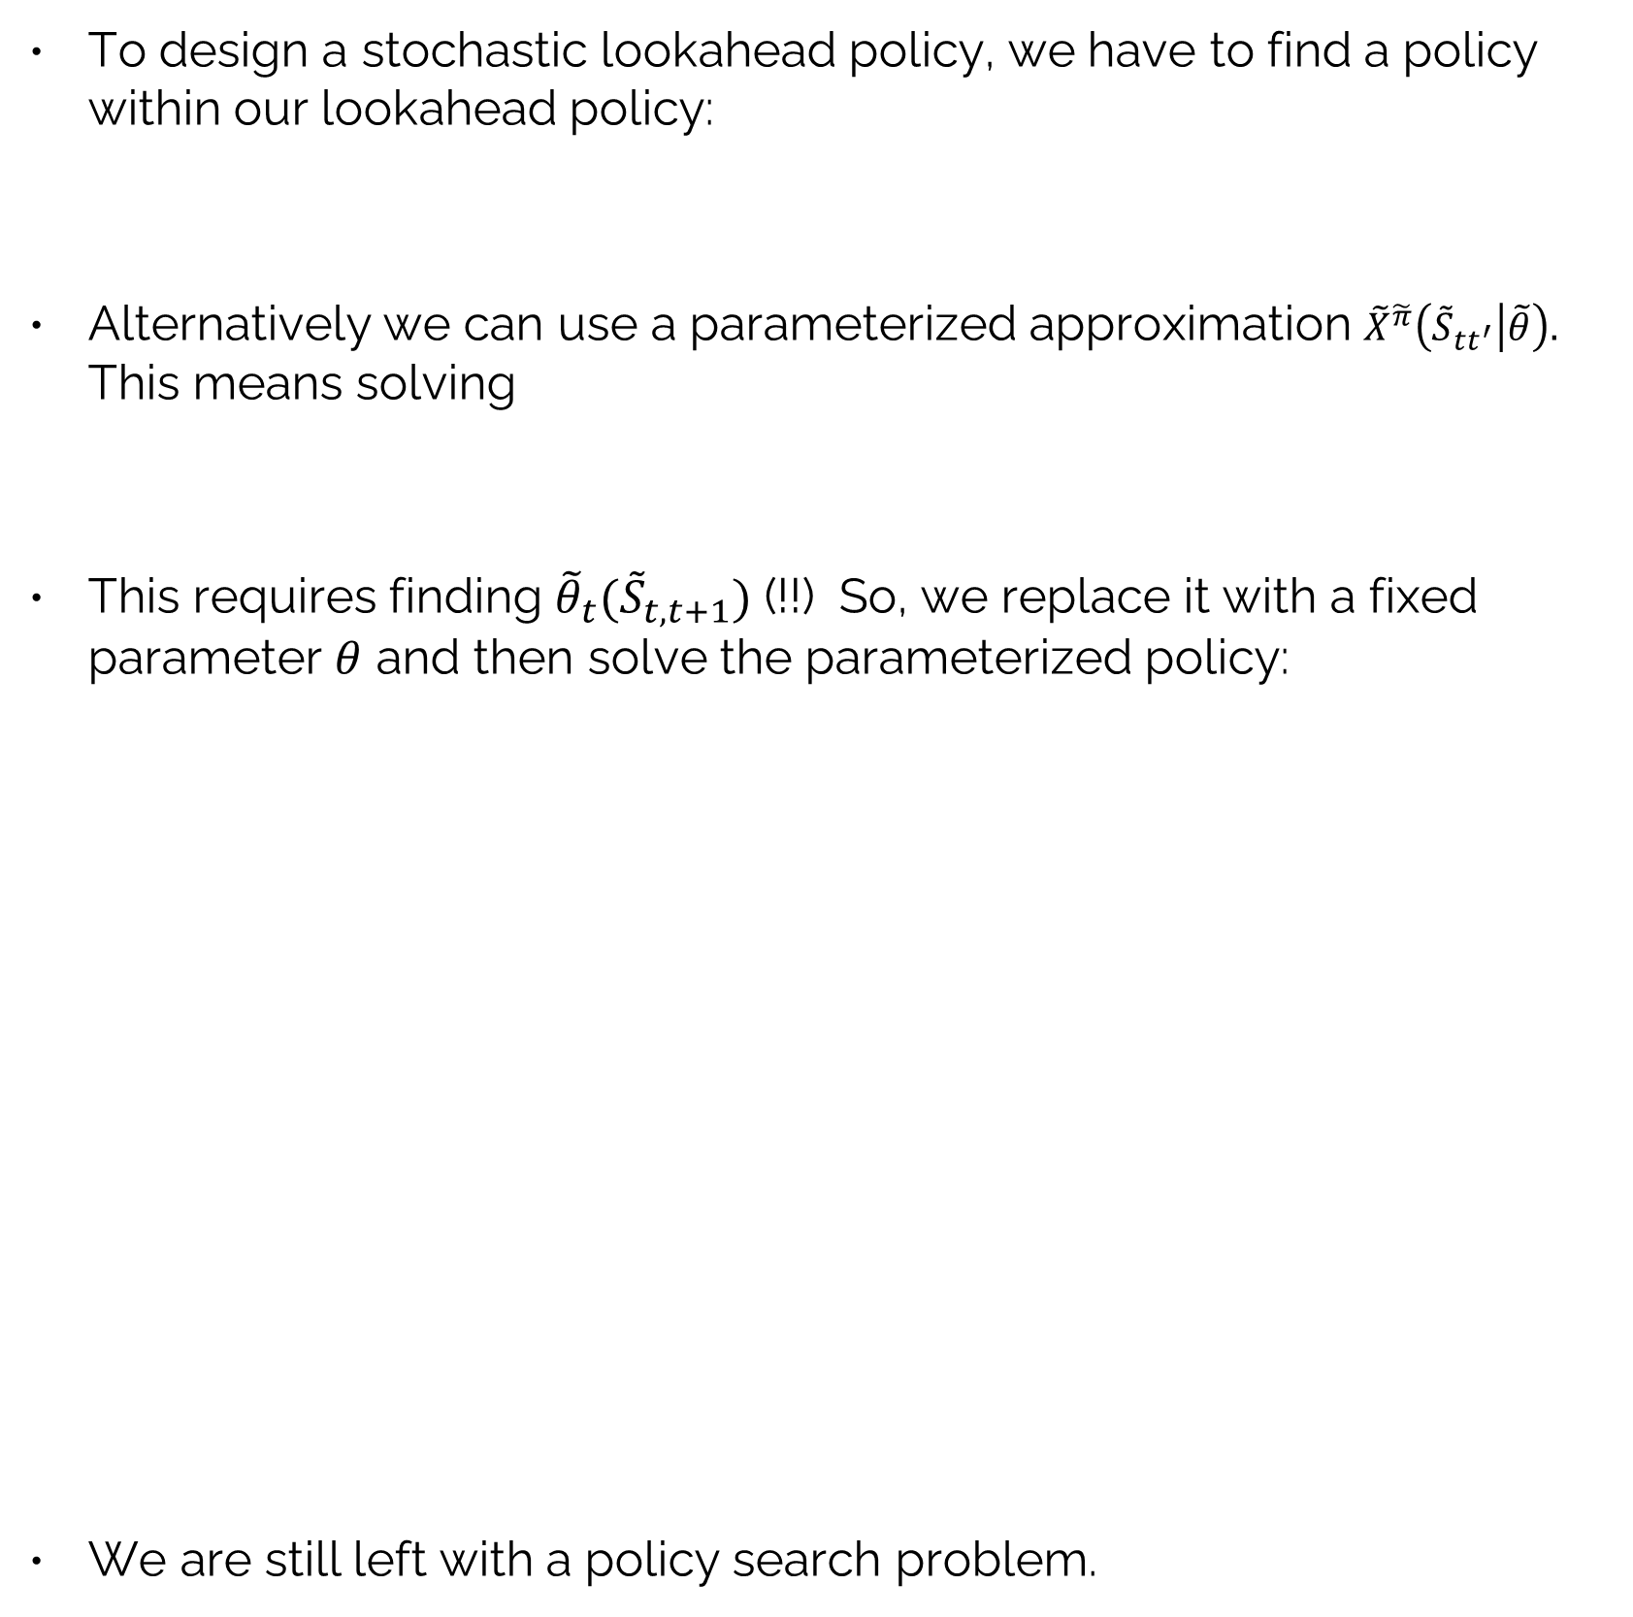
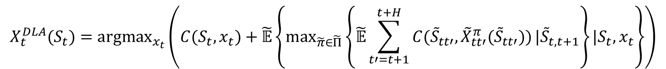
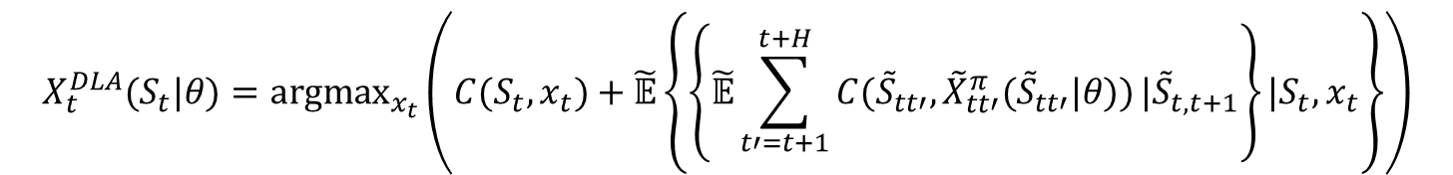
PFA-based lookahead policy
To design a stochastic lookahead policy, we have to find a policy within our lookahead policy:
Alternatively we can use a parameterized approximation ${\tilde{X}}^{\tilde{π}}\left({\tilde{S}}_{tt^{′}} | \tilde{θ}\right).$ This means solving
This requires finding ${\tilde{θ}}_{t}({\tilde{S}}_{t,t+1})$ (!!) So, we replace it with a fixed parameter $θ$ and then solve the parameterized policy:
We are still left with a policy search problem.
$$X_{t}^{DLA}(S_{t})={argmax}_{x_{t}}\left(C(S_{t},x_{t})+\tilde{𝔼}\left\{\max_{\tilde{π}∈\tilde{Π}}\left\{\tilde{𝔼}\sum_{t′=t+1}^{t+H}{C({\tilde{S}}_{tt′},{\tilde{X}}_{tt′}^{π}({\tilde{S}}_{tt′}))}|{\tilde{S}}_{t,t+1}\right\}|S_{t},x_{t}\right\}\right)$$
$$X_{t}^{DLA}(S_{t})={argmax}_{x_{t}}\left(C(S_{t},x_{t})+\tilde{𝔼}\left\{\max_{{\tilde{θ}}_{t+1}}\left\{\tilde{𝔼}\sum_{t′=t+1}^{t+H}{C({\tilde{S}}_{tt′},{\tilde{X}}_{tt′}^{π}({\tilde{S}}_{tt′}|\tilde{θ}))}|{\tilde{S}}_{t,t+1}\right\}|S_{t},x_{t}\right\}\right)$$
$$X_{t}^{DLA}(S_{t}|θ)={argmax}_{x_{t}}\left(C(S_{t},x_{t})+\tilde{𝔼}\left\{\left\{\tilde{𝔼}\sum_{t′=t+1}^{t+H}{C({\tilde{S}}_{tt′},{\tilde{X}}_{tt′}^{π}({\tilde{S}}_{tt′}|θ))}|{\tilde{S}}_{t,t+1}\right\}|S_{t},x_{t}\right\}\right)$$

Slide 11
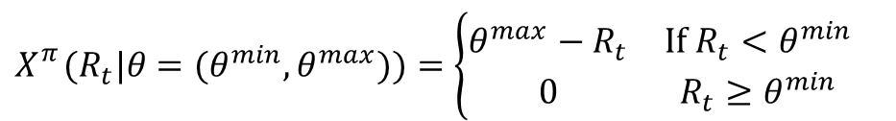
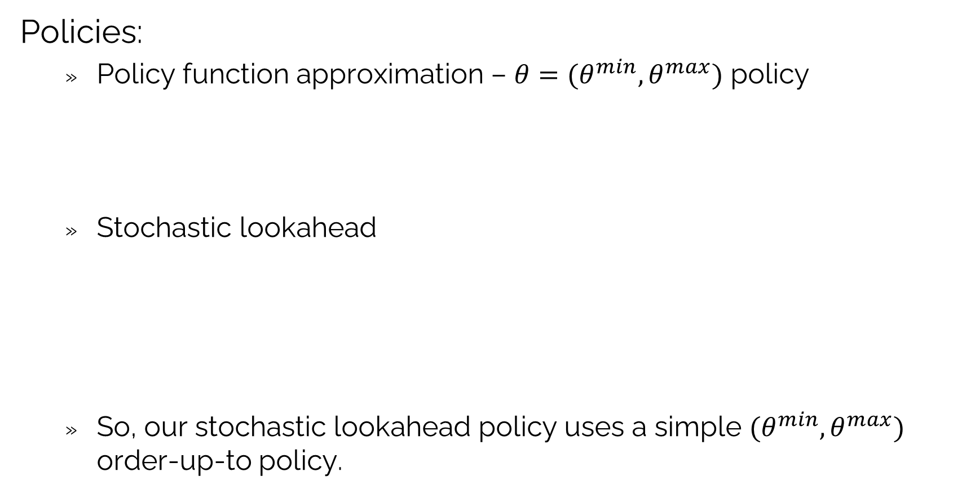


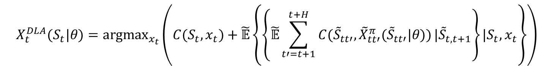
PFA-based lookahead policy
Policies:
Policy function approximation – $θ=(θ^{min},θ^{max})$ policy
Stochastic lookahead
So, our stochastic lookahead policy uses a simple $(θ^{min},θ^{max})$ order-up-to policy.
$$X_{}^{π}(R_{t}|θ=(θ^{min},θ^{max}))=\left\{\begin{matrix}θ^{max}−R_{t} & \text{If }R_{t}<θ^{min} \\ 0 & R_{t}≥θ^{min}\end{matrix}\right.$$
$$θ=(θ^{min},θ^{max})$$
$$X_{t}^{DLA}(S_{t}|θ)={argmax}_{x_{t}}\left(C(S_{t},x_{t})+\tilde{𝔼}\left\{\left\{\tilde{𝔼}\sum_{t′=t+1}^{t+H}{C({\tilde{S}}_{tt′},{\tilde{X}}_{tt′}^{π}({\tilde{S}}_{tt′}|θ))}|{\tilde{S}}_{t,t+1}\right\}|S_{t},x_{t}\right\}\right)$$
$θ$ $=(θ^{min},θ^{max})$
No max operator!

Slide 12
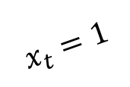


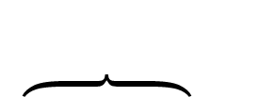
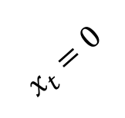




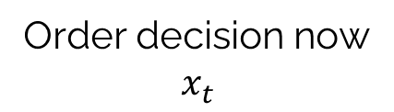

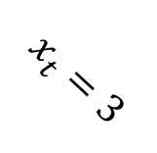

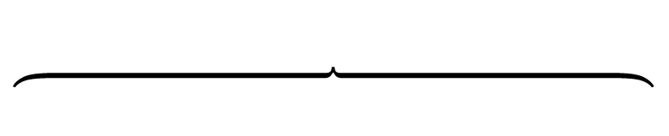
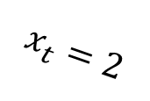

PFA-based lookahead policy
Rollout policy
Order decision now
$$x_{t}$$
Future decisions from (s,S) policy
$$x_{t+1},x_{t+2},….,x_{t+H}$$
$$θ^{max}$$
$$θ^{min}$$
$$x_{t}=0$$
$$θ^{max}$$
$$θ^{min}$$
$$x_{t}=1$$
$$x_{t}=2$$
$$θ^{max}$$
$$θ^{min}$$
$$x_{t}=3$$
$$θ^{max}$$
$$θ^{min}$$
Pick the $x_{t}$ that performs the best (using one or more forward simulations)

Slide 13
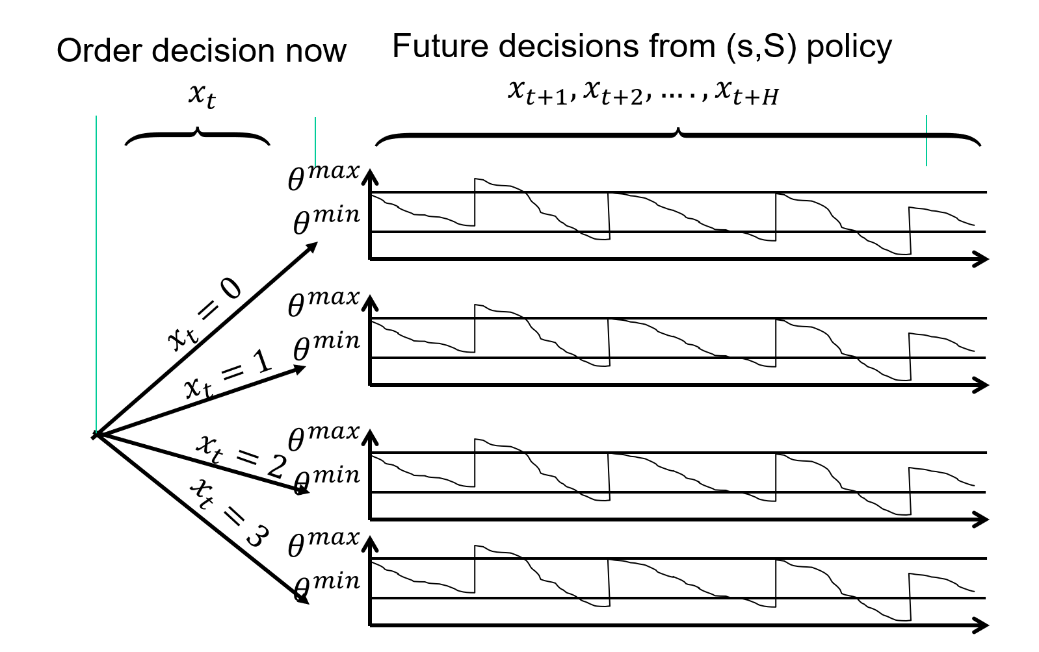




PFA-based lookahead policy
We simulate our $(θ^{min},θ^{max})$ policy for each decision now.
The lookahead model
. . . .
$$t$$
$$t+1$$
$$t+2$$
$$t+3$$
The base model

Slide 14
PFA-based lookahead policy
We simulate our $(θ^{min},θ^{max})$ policy for each decision now.
The lookahead model
. . . .
$$t$$
$$t+1$$
$$t+2$$
$$t+3$$
The base model

Slide 15
PFA-based lookahead policy
We simulate our $(θ^{min},θ^{max})$ policy for each decision now.
The lookahead model
. . . .
$$t$$
$$t+1$$
$$t+2$$
$$t+3$$
The base model

Slide 16
OUTLINE
DLA III - Stochastic lookaheads using PFAs, CFAs and VFAs
PFA-based
CFA-based:
VFA-based:
15

Slide 17
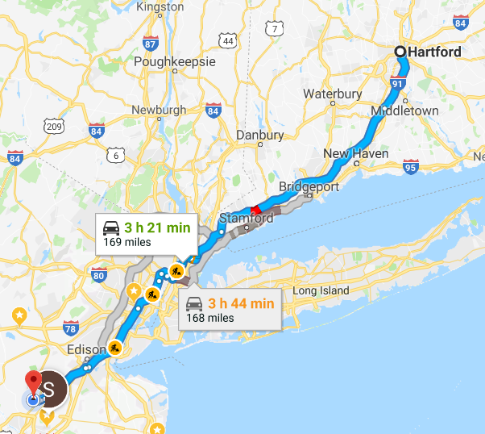
Direct lookahead policies
Google maps solves a deterministic shortest path problem to make a decision now.
As we travel, travel times are updated and Google re-optimizes the shortest path to reflect current conditions.

Slide 18




























Dynamic shortest paths
A static, deterministic network
$$17.4$$
$$15.9$$
$$2$$
$$5$$
$$8$$
$$12.6$$
$$5.7$$
$$8.1$$
$$12.7$$
$$9.6$$
$$8.4$$
$$15.9$$
$$8.9$$
$$7.3$$
$$1$$
$$3$$
$$6$$
$$9$$
$$11$$
$$9.2$$
$$2.3$$
$$3.6$$
$$13.5$$
$$4.5$$
$$4$$
$$16.5$$
$$7$$
$$20.2$$
$$10$$

Slide 19
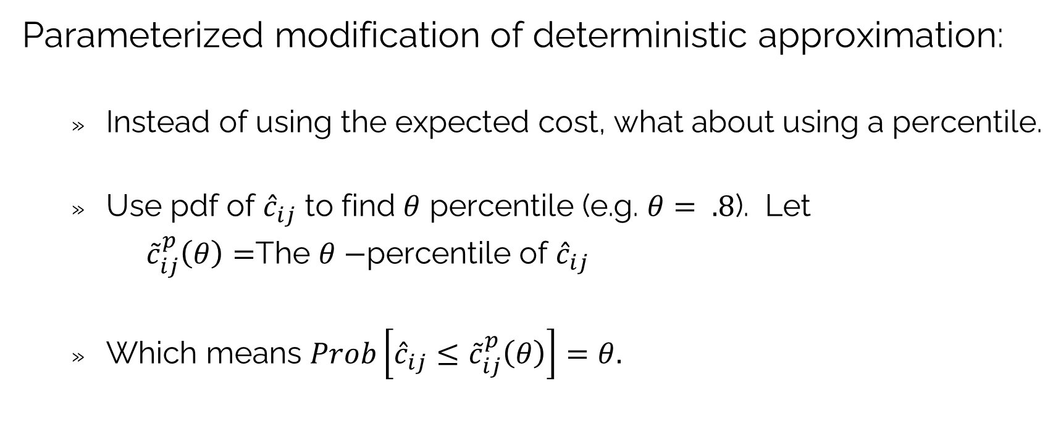
Dynamic shortest paths
Parameterized modification of deterministic approximation:
Instead of using the expected cost, what about using a percentile.
Use pdf of ${\hat{c}}_{ij}$ to find $θ$ percentile (e.g. $θ= .8$). Let
${\tilde{c}}_{ij}^{p}\left(θ\right)=$The $θ−$percentile of ${\hat{c}}_{ij}$
Which means $Prob\left[{\hat{c}}_{ij}≤{\tilde{c}}_{ij}^{p}\left(θ\right)\right]=θ.$

Slide 20
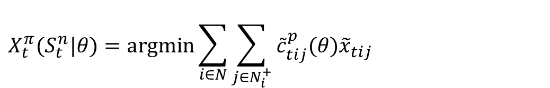

Parameterized deterministic lookahead
The $θ−$percentile policy.
Solve the linear program (shortest path problem):
subject to flow conservation constraints.
$$X_{t}^{π}(S_{t}^{n}|θ)=\operatorname{argmin}{\sum_{i∈N}{\sum_{j∈N_{i}^{+}}{{\tilde{c}}_{tij}^{p}(θ){\tilde{x}}_{tij}}}}$$

Slide 21





























Dynamic shortest paths
A static, deterministic network, but now using the $θ−$percentile travel times.
$$17.4$$
$$15.9$$
$$2$$
$$5$$
$$8$$
$$12.6$$
$$5.7$$
$$8.1$$
$$12.7$$
$$9.6$$
$$8.4$$
$$15.9$$
$$8.9$$
$$7.3$$
$$1$$
$$3$$
$$6$$
$$9$$
$$11$$
$$9.2$$
$$2.3$$
$$3.6$$
$$13.5$$
$$4.5$$
$$4$$
$$16.5$$
$$7$$
$$20.2$$
$$10$$

Slide 22
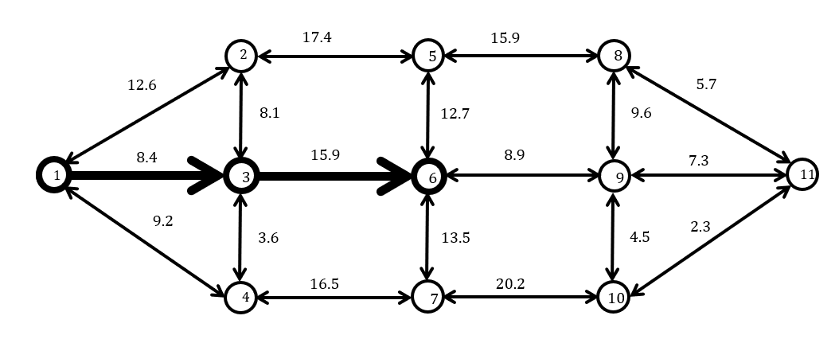








Dynamic shortest paths
Solving a shortest path over the static graph as times change:
$$t′=t+4$$
$$t′=t+3$$
$$t′=t+2$$
The lookahead model
. . . .
$$t′=t+1$$
$$t′=t$$
$$t$$
$$t+1$$
$$t+2$$
$$t+3$$
The base model

Slide 23
Dynamic shortest paths
Solving a shortest path over the static graph as times change:
$$t′=t+4$$
$$t′=t+3$$
$$t′=t+2$$
The lookahead model
. . . .
$$t′=t+1$$
$$t′=t$$
$$t$$
$$t+1$$
$$t+2$$
$$t+3$$
The base model

Slide 24
Dynamic shortest paths
Solving a shortest path over the static graph as times change:
$$t′=t+4$$
$$t′=t+3$$
$$t′=t+2$$
The lookahead model
. . . .
$$t′=t+1$$
$$t′=t$$
$$t$$
$$t+1$$
$$t+2$$
$$t+3$$
The base model

Slide 25
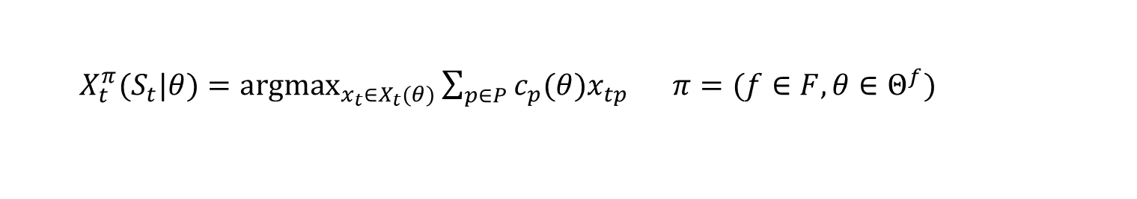
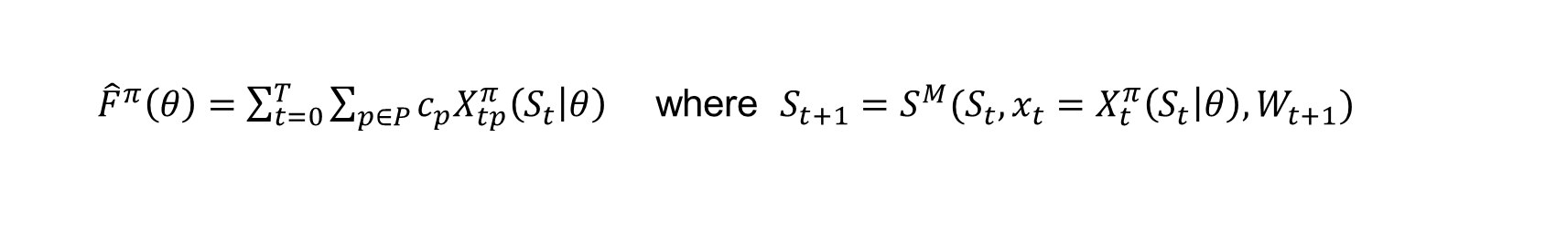
Designing policies
The policy (deterministic shortest path problem)
The objective function (simulates the policy)
The stochastic optimization problem
$X_{t}^{π}(S_{t}|θ)={argmax}_{x_{t}∈X_{t}(θ)}{\sum_{p∈P}{c_{p}(θ)x_{tp}}}$ $π=(f∈F,θ∈Θ^{f})$
${\hat{F}}^{π}\left(θ\right)=\sum_{t=0}^{T}{\sum_{p∈P}{c_{p}{X_{tp}^{π}\left(S_{t} | θ\right)}_{}}}$ where $S_{t+1}=S^{M}(S_{t},x_{t}=X_{t}^{π}\left(S_{t} | θ\right),W_{t+1})$
$$F^{∗}=\max_{f∈F}{\max_{θ}{F^{π}(θ)}}$$

Slide 26
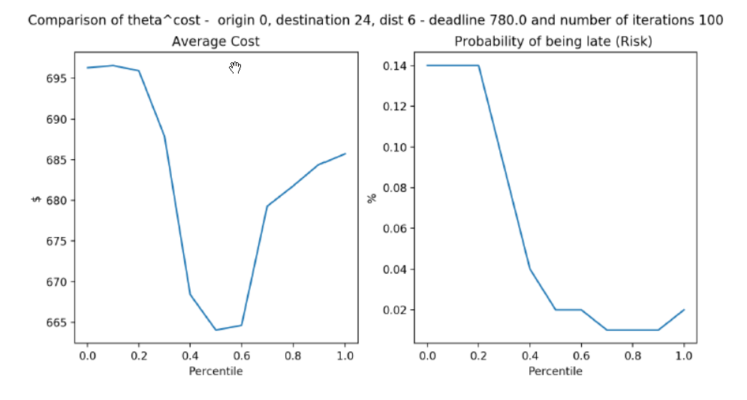


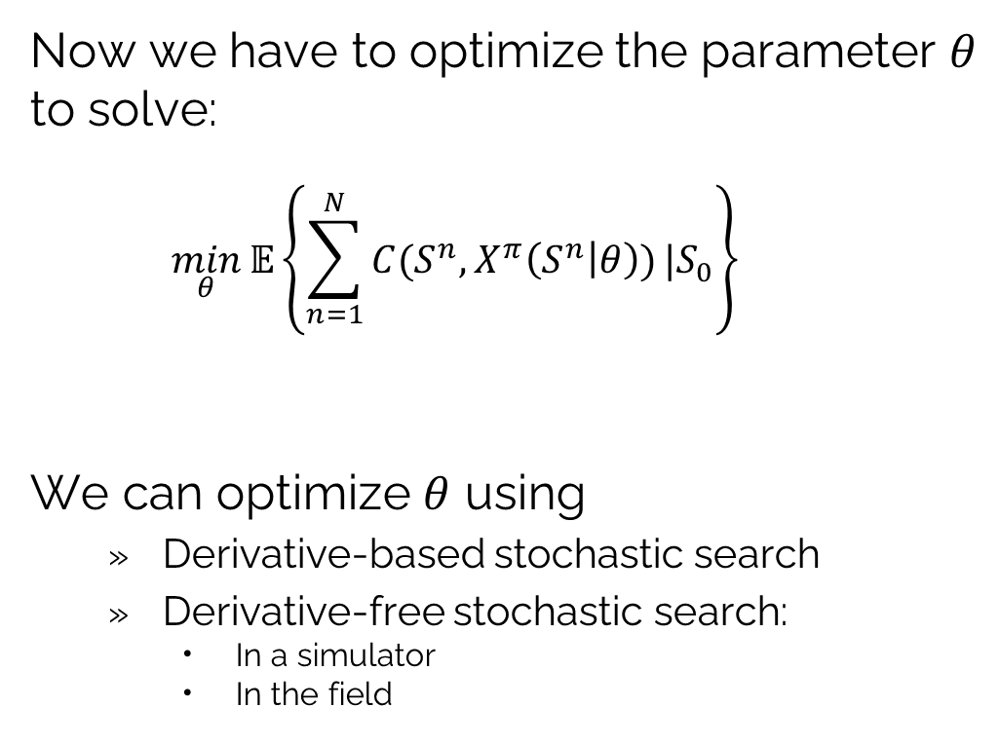
Policy search
Expected cost
Now we have to optimize the parameter $θ$ to solve:
$$\min_{θ}{𝔼\left\{\sum_{n=1}^{N}{C(S^{n},X^{π}\left(S^{n} | θ\right))}|S_{0}\right\}}$$
We can optimize $θ$ using
Derivative-based stochastic search
Derivative-free stochastic search:
In a simulator
In the field
$$θ^{∗}=0.5$$
50th percentile works best.
Probability of arriving late
$$θ^{∗}=0.8$$
80th percentile works best.

Slide 27
OUTLINE
DLA III - Stochastic lookaheads using PFAs, CFAs and VFAs
PFA-based
CFA-based:
VFA-based:
15

Slide 28
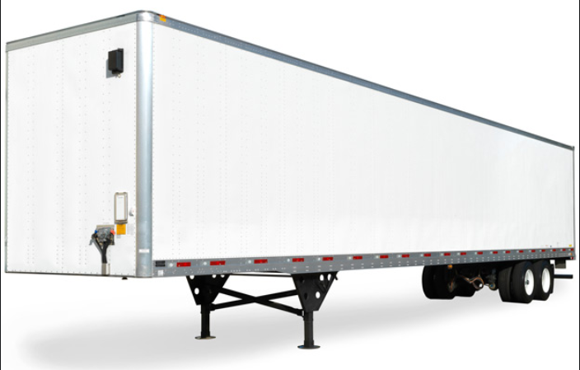
VFA-based lookahead policy
The load acceptance problem
We are offered a load today to be moved 5 days from now.
We have to consider:
Will we have a driver to cover the load?
If we do, does the load contribute to network profitability?
Does it help get a driver home?
?
Accept or reject?
Monday Tuesday Wednesday Thursday Friday

Slide 29
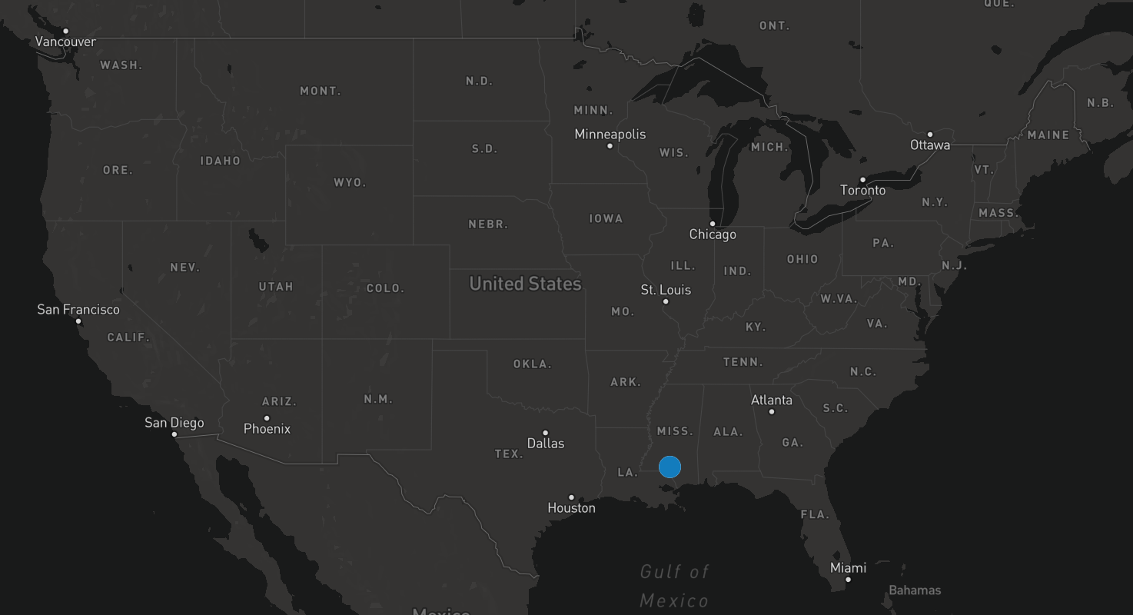


VFA-based lookahead policy

Slide 30
VFA-based lookahead policy

Slide 31
VFA-based lookahead policy

Slide 32
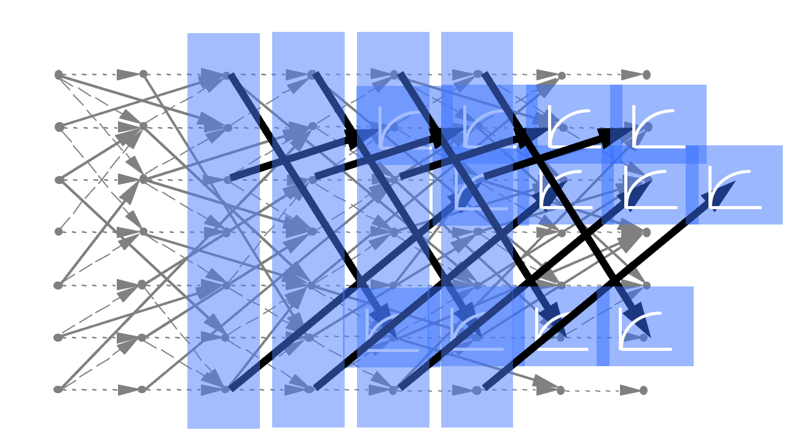
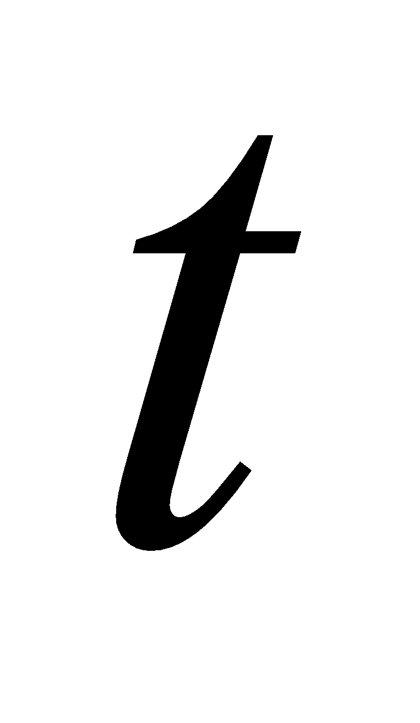
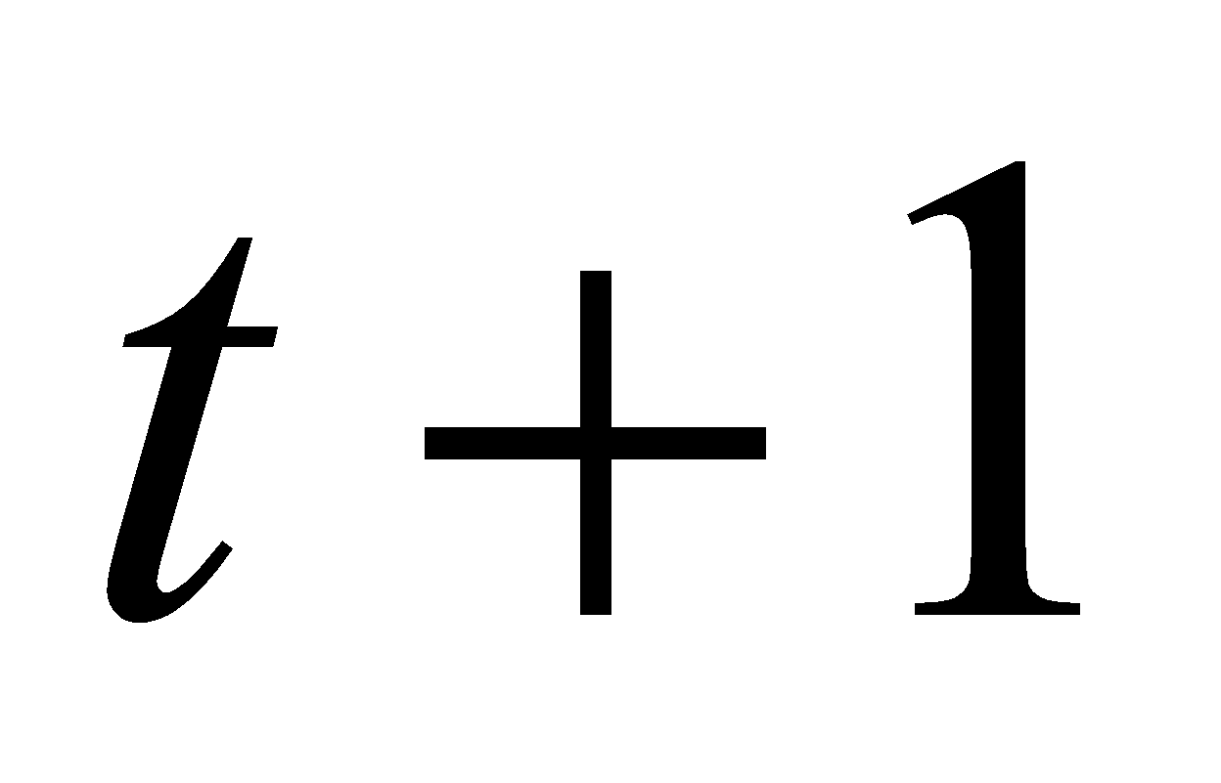
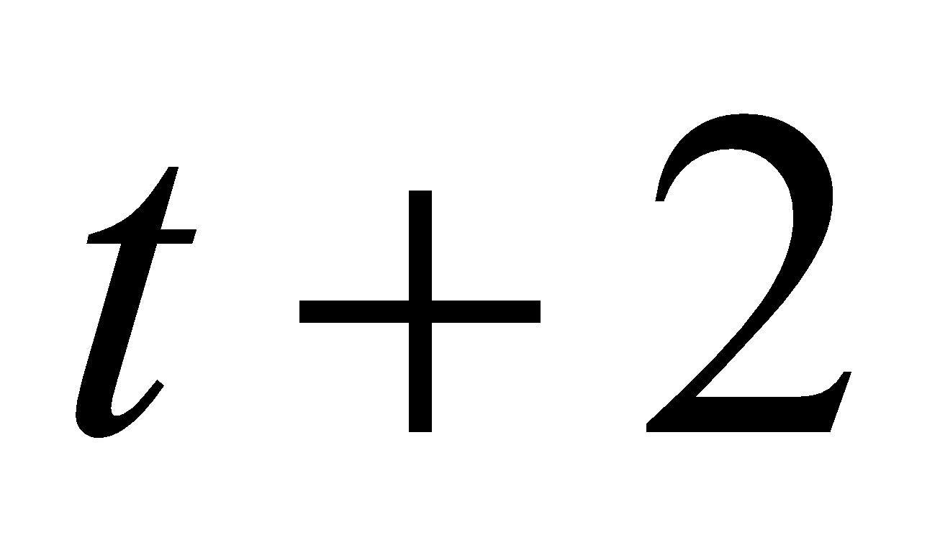
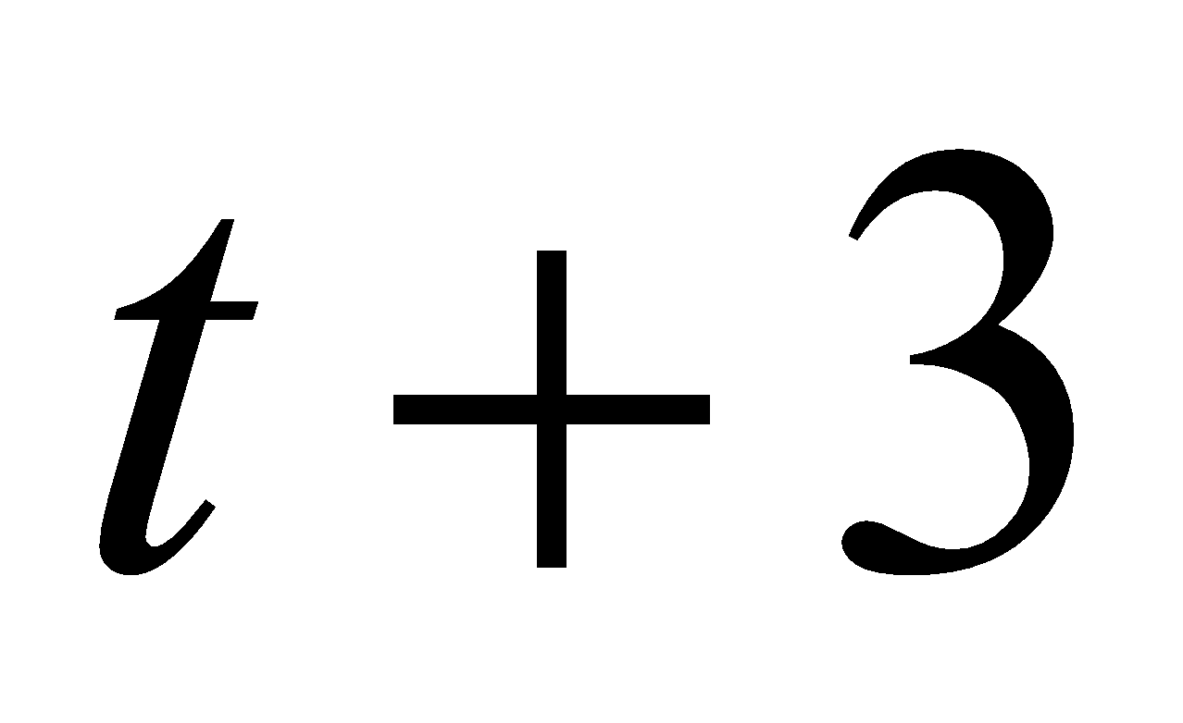
VFA-based lookahead policy
Load 001
Load 002
Load 003
Accept?
Accept?
Accept?
Sample 20
Sample 2
Sample 1
1
1
0
18
.90
1
0
0
14
.70
0
1
1
19
.95
Train the VFAs overnight.
Run 20 parallel simulations.
For each simulation, sample loads that are not known now from distributions.
Observe whether loads that are known now (time t) are covered.
Compute the probability loads known now are covered.
. . .
. . .
No. scenarios where load is accepted
Prob(accept)
The lookahead model

Slide 33
VFA-based lookahead policy
. . .
The lookahead model

Slide 34
VFA-based lookahead policy
. . .
The lookahead model

Slide 35
VFA-based lookahead policy
. . .
The lookahead model

Slide 36
VFA-based lookahead policy
. . .
The lookahead model

Slide 37
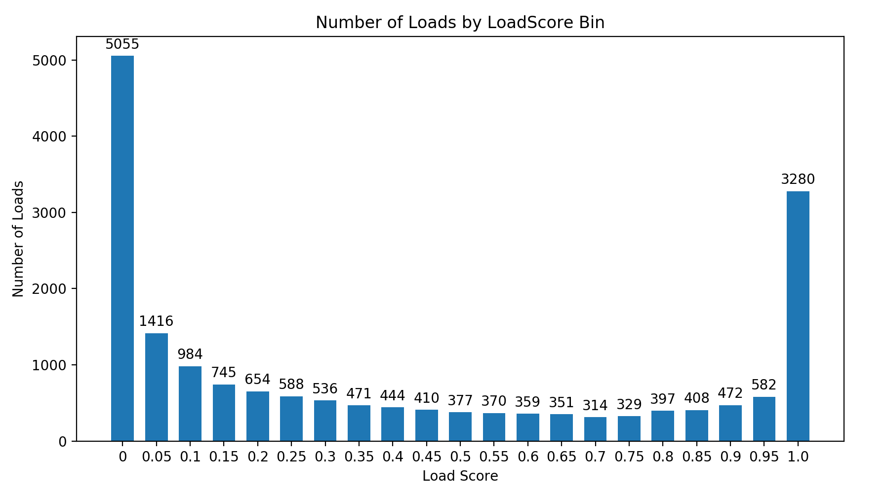
VFA-based lookahead policy
We compute the probability of covering each load.
Evaluation of loads from brokerage division
Most loads have acceptance probability of 0.0 or 1.0.
Minimum load acceptance probability:
10,200 loads
Number of loads
Probability load is accepted
Probability the load is covered

Slide 38


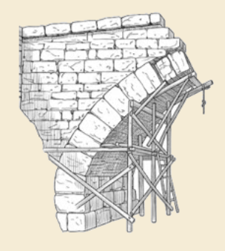
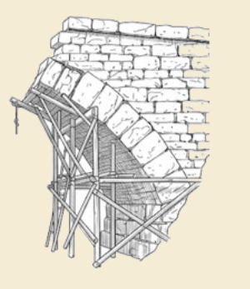
Thank you!
For more information see the Sequential Decision Analytics website at
warrenpowell.org
For more on direct lookahead approximations go to:
warrenpowell.org → Policies → Direct lookahead approximations

