Slide 1


Tutorial Series on Sequential Decision Analytics
Warren B Powell
Professor Emeritus, Princeton University
Recorded: August 12, 2026
Module: Direct lookahead approximations IV – Discrete actions
Using decision trees
Monte Carlo tree search
Predecessor module(s):
Universal modeling framework (detailed)
Technical level: Moderate.

Slide 2

OUTLINE
Direct lookahead approximations:
DLA I – Overview of direct lookahead approximations
DLA II - Deterministic lookaheads
DLA III - Stochastic lookaheads using PFAs, CFAs and VFAs
DLA IV – Stochastic lookaheads using DLAs – Discrete actions
DLA V – Stochastic lookaheads using DLAs – Vector actions
15

Slide 3
OUTLINE
DLA IV – Stochastic lookaheads using DLAs – Discrete actions
Decision trees
Monte Carlo tree search
50

Slide 4
DLA policy: Decision trees
Decision trees
Used by Ron Howard (and others) in their courses for MBAs, early 1960s.
John Magee, "How to Use Decision Trees in Capital Investments“ and “Decision Trees for Decision-Making”, Harvard Business Review, 1964.
First published use of decision trees.
Howard Raiffa, Decision Analysis: Introductory Lectures on Choices Under Uncertainty, Addison-Wesley, 1968.
This is the book that made decision trees central to the field. It documents the paradigmatic shift from statistical decision theory to decision analysis as a discipline.

Slide 5
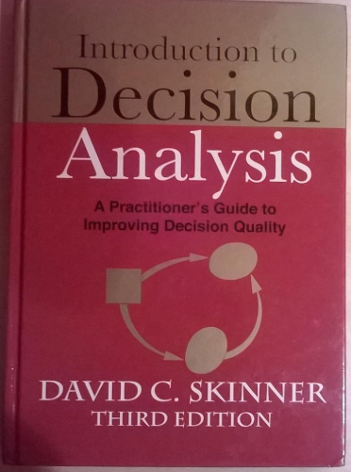


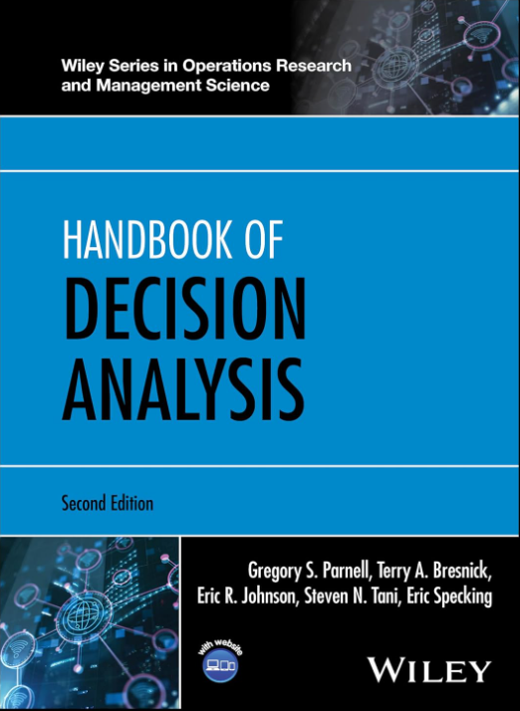

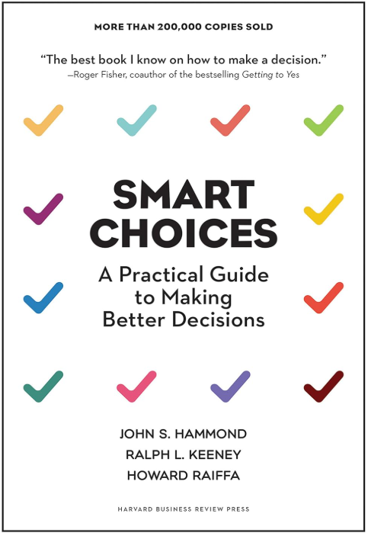
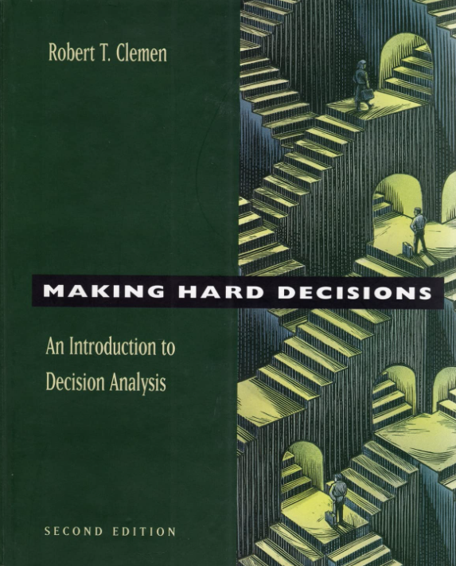
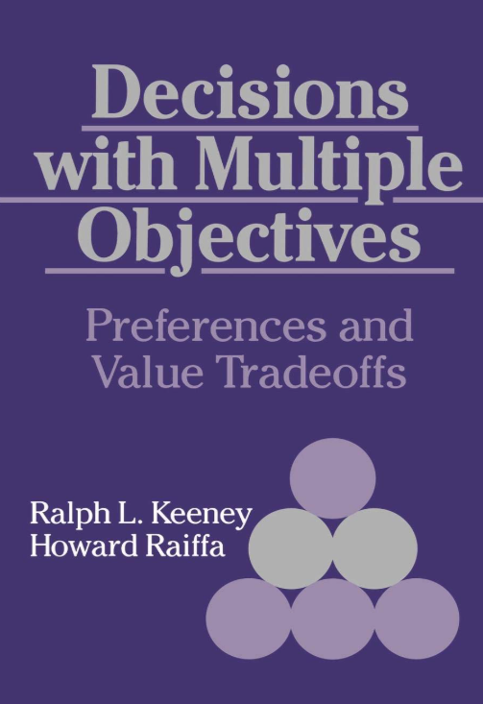
DLA policy: Decision trees
Decisions trees have become a stable of decision analysis:

Slide 6

DLA policy: Decision trees
Asset selling problem
State information
Am I holding the asset or not
Decision
Hold
Sell (we receive the price of the asset)
Exogenous information - price
Price goes up $1 with probability .3
Price stays the same w. p. .5
Price goes down $1 w. p. .2

Slide 7
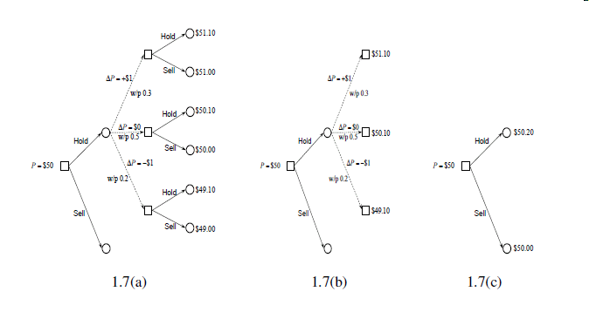
DLA policy: Decision trees
Some vocabulary:
Square nodes are:
Decision nodes – Solid links are decisions
Also represents the state of our system.
Circle nodes are:
Outcome nodes – Dotted links are outcomes
Represents the state after a decision is made.
Decision capture the information in the entire path leading up to the node.

Slide 8
DLA policy: Decision trees
Generating the tree

Slide 9
DLA policy: Decision trees
Rolling back the tree

Slide 10

DLA policy: Decision trees
Which hitter to choose
State information
We have three hitters.
We know the past history of each hitter (number of at bats, batting average).
Decision
We have to choose who to use.
Exogenous information
Whether the batter gets a hit or not.
When we observe whether the batter gets a hit or not, we update his batting average.

Slide 11
Choose hitter
Hit?
Choose hitter
Hit?
.366
.333
1
.318
.360
.356
0
.640
.333
As we observe whether or not the player gets a hit, we update our estimate of his probability of getting a hit (his batting average.)
.318
A
.360
.500
1
.318
B
.333
0
.360
.667
.250
.318
C
.360
.333
1
.348
.318
0
.360
.682
.333
.304

Slide 12
.366
.333
1
.360
.318
0
.356
.640
.333
A
.318
.360
1
.500
B
.333
.318
0
.360
.667
.250
C
.318
.360
1
.333
.318
.348
0
.360
.682
.333
.304

Slide 13
.366
1
.360
0
.640
.356
A
1
.500
B
.333
0
.667
.360
C
1
.360
.318
0
.682
.360

Slide 14
.720 =
.360(1+.366)+
.640(0+.356)
We choose player B, who does not have the highest average.
This was a player with very few at-bats, so one hit had a much bigger impact on his batting average.
A
B
.740
C
.678

Slide 15
OUTLINE
DLA IV – Stochastic lookaheads using DLAs – Discrete actions
Decision trees
Monte Carlo tree search
50

Slide 16
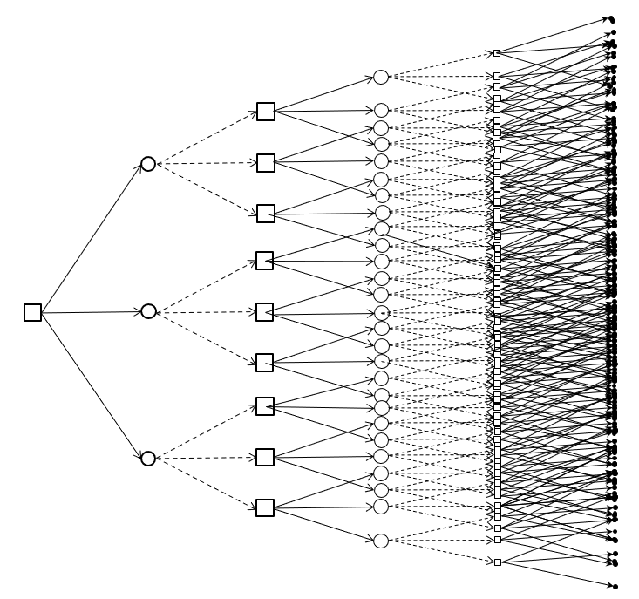
DLA policies: MCTS
Decision trees represent a full enumeration of each sequence of decisions and information.
They explode exponentially, which limits their use in most applications.
Monte Carlo tree search identifies the best decision without enumerating the tree.
Decision Outcome Decision Outcome Decision

Slide 17
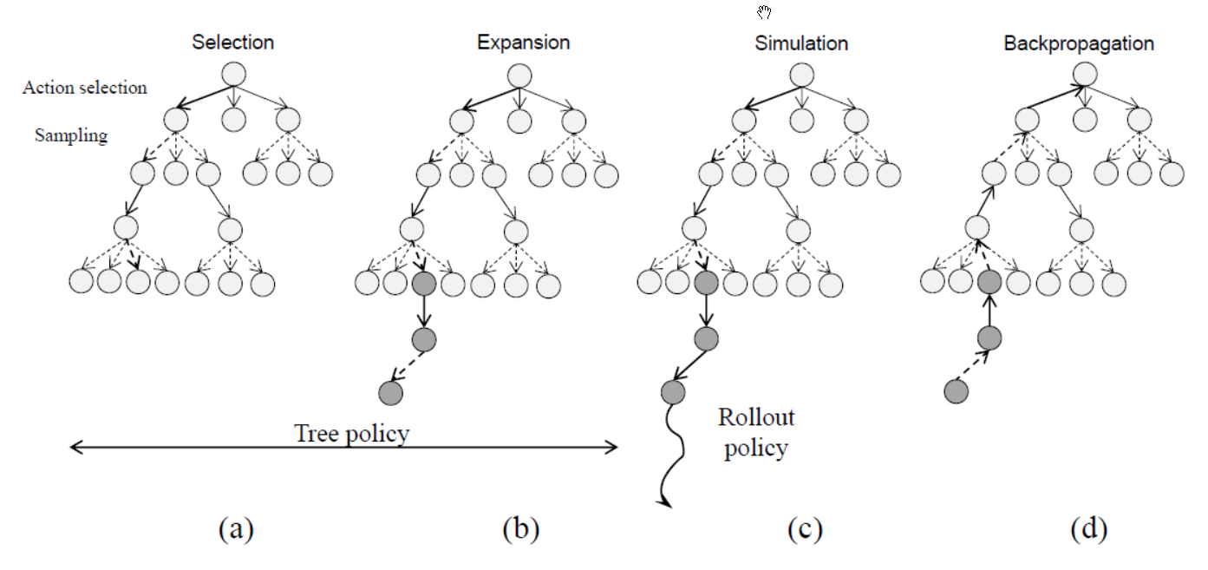
DLA policies: MCTS
Monte Carlo tree search:
Rollout policy
C. Browne, E. Powley, D. Whitehouse, S. Lucas, P. I. Cowling, P. Rohlfshagen, S. Tavener, D. Perez, S. Samothrakis and S. Colton, “A survey of Monte Carlo tree search methods,” IEEE Transactions on Computational Intelligence and AI in Games, vol. 4, no. 1, pp. 1–49, March 2012.

Slide 18
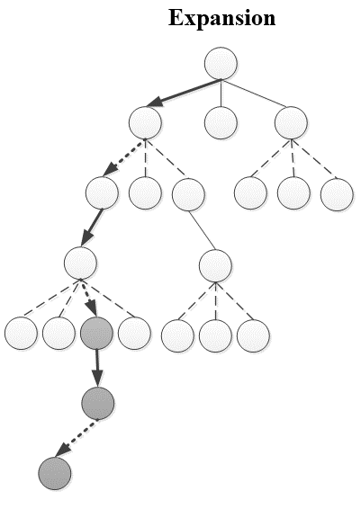






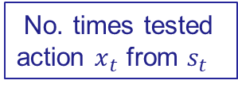



DLA policies: MCTS
Choosing an action:
Downstream value is obtained by simulating some policy (the “rollout policy”) to “peek” into the future.
No. times
visited node $s_{t}$
Downstream value
No. times tested
action $x_{t}$ from $s_{t}$
$$s_{t}$$
$$x_{t}$$
$$s_{t+1}$$
$${\hat{V}}_{t+1}(s_{t+1})$$
Rollout policy

Slide 19
DLA policies: MCTS
Elements of MCTS:
Decision – Use “upper confidence bounding for trees”, UCT, to decide which action to take
MCTS solves a stochastic lookahead using hybrid policies:
PFA – Typically used in the rollout policy
CFA –
VFA –
DLA – MCTS is a DLA, and it uses a rollout policy (a form of DLA) to get initial estimates of the value of being in a state.

Slide 20
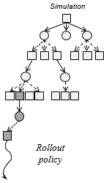
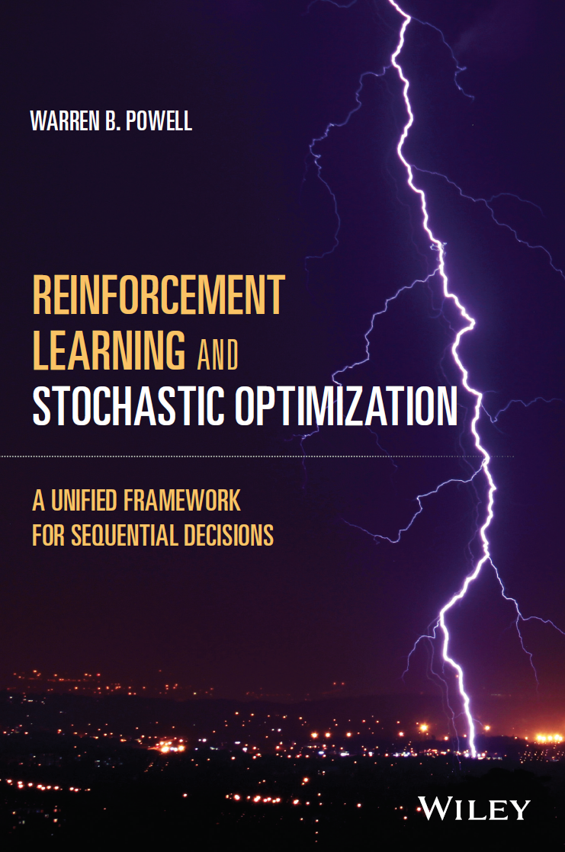

DLA policies: MCTS
From pessimistic to optimistic MCTS
Pessimistic MCTS
Optimistic MCTS
Chapter 19
Section 19.8
Deterministic
math
program

Slide 21
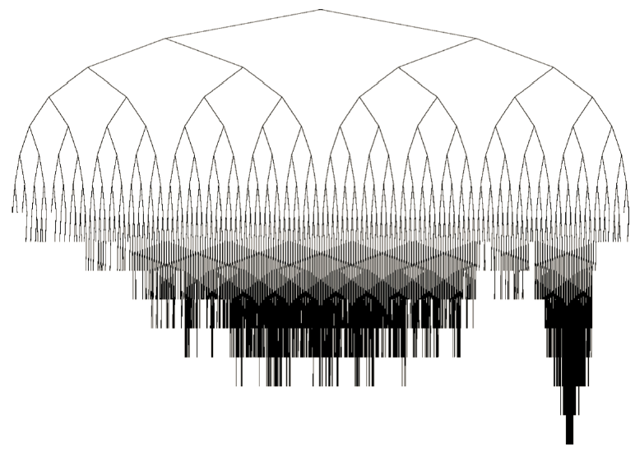
DLA policies: MCTS
Monte Carlo tree search
Explores some nodes more than others.

Slide 22




DLA policies: MCTS
We can then simulate this lookahead policy over time:
The lookahead model
. . . .
$$t$$
$$t+1$$
$$t+2$$
$$t+3$$
The base model

Slide 23
DLA policies: MCTS
We can then simulate this lookahead policy over time:
The lookahead model
. . . .
$$t$$
$$t+1$$
$$t+2$$
$$t+3$$
The base model

Slide 24
DLA policies: MCTS
We can then simulate this lookahead policy over time:
The lookahead model
. . . .
$$t$$
$$t+1$$
$$t+2$$
$$t+3$$
The base model

Slide 25
DLA policies: MCTS
Notes:
MCTS is immune to large state spaces. This means that it can easily handle a very large belief state.
MCTS is only for small, discrete action spaces.
The literature widely overlooks that MCTS is not solving a problem… it is a policy.
There are various parameters that need to be evaluated by simulating the policy over time.

Slide 26


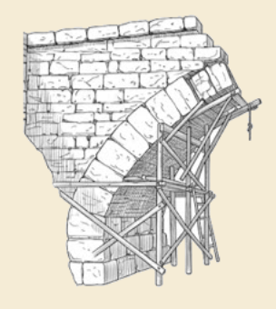
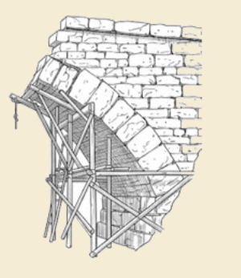
Thank you!
For more information see the Sequential Decision Analytics website at
warrenpowell.org
For more on direct lookahead approximations go to:
warrenpowell.org → Policies → Direct lookahead approximations

