Slide 1


Tutorial Series on Sequential Decision Analytics
Warren B Powell
Professor Emeritus, Princeton University
Recorded: August 12, 2026
Module: Direct lookahead approximations V – Vector decisions
Two-stage stochastic programming
Predecessor module(s):
Universal modeling framework (detailed)
DLA parts I, II and III
Technical level: Advanced.

Slide 2

OUTLINE
Direct lookahead approximations:
DLA I – Overview of direct lookahead approximations
DLA II - Deterministic lookaheads
DLA III - Stochastic lookaheads using PFAs, CFAs and VFAs
DLA IV – Stochastic lookaheads using DLAs – Discrete actions
DLA V – Stochastic lookaheads using DLAs – Vector actions
15

Slide 3
OUTLINE
DLA V – Stochastic lookaheads using DLAs – Vector actions
Two-stage stochastic programming
Stochastic search
50

Slide 4

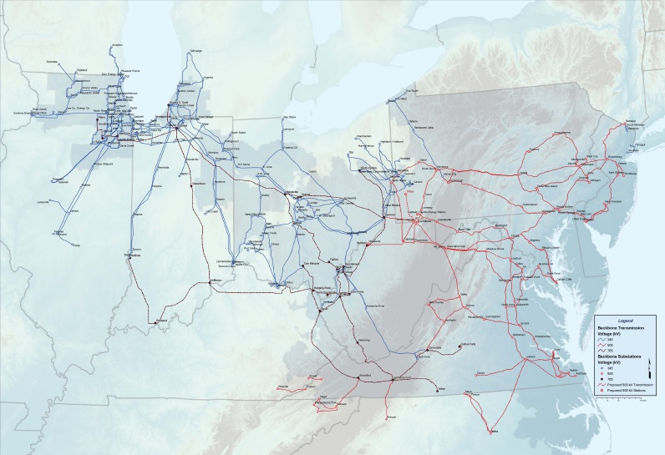
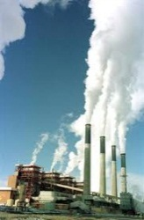
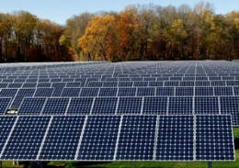
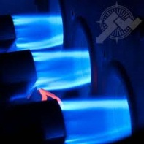
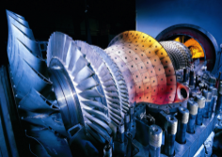
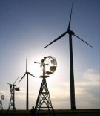
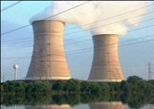


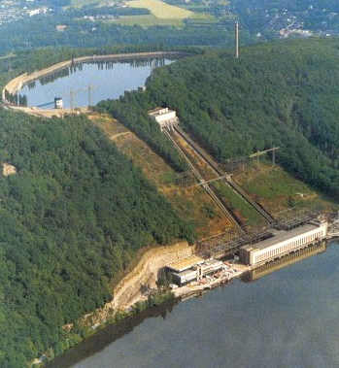

Slide 5
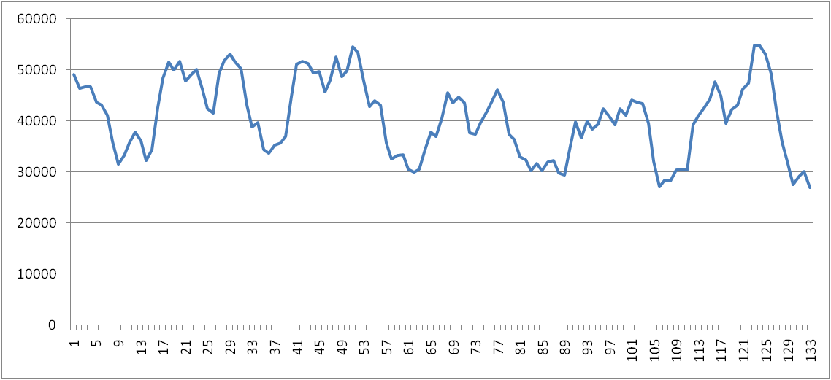
The timing of decisions
Day-ahead planning (slow – predominantly steam)
Intermediate-term planning (fast – gas turbines)
Real-time planning (economic dispatch)
Notes:
SMART-ISO is composed by three nested subsystems: a day-ahead planning model (which schedules primarily the steam generation, or the so-called “slow” generators), an intermediate-term planning model (which schedules primarily the gas turbines, or the “fast” generators), and a real-time simulation model (which corresponds to the economic dispatch).

Slide 6
The timing of decisions
The day-ahead unit commitment problem
Midnight
Midnight
Midnight
Midnight
Noon
Noon
Noon
Noon
Notes:
The day-ahead model runs at, say, noon of every day, aiming to schedule generation for the following day (midnight to midnight).

Slide 7
The timing of decisions
Intermediate-term unit commitment problem
1:00 pm
2:00 pm
3:00 pm
1:15 pm
1:45 pm
2:15 pm
2:30 pm
1:30

Slide 8
The timing of decisions
Intermediate-term unit commitment problem
1:00 pm
2:00 pm
3:00 pm
1:15 pm
1:45 pm
2:15 pm
2:30 pm
1:30

Slide 9
The unit commitment problem (for PJM)
Planning tomorrow’s schedule
Generation
Time
Generation
Generation
Generation
Time
Time
Time
Generation
Generation
Generation
Time
Time
Time
Generation
Generation
Time
Time
Notes:
… we are trying to find a robust set of schedules for the steam (or slow) generators.

Slide 10
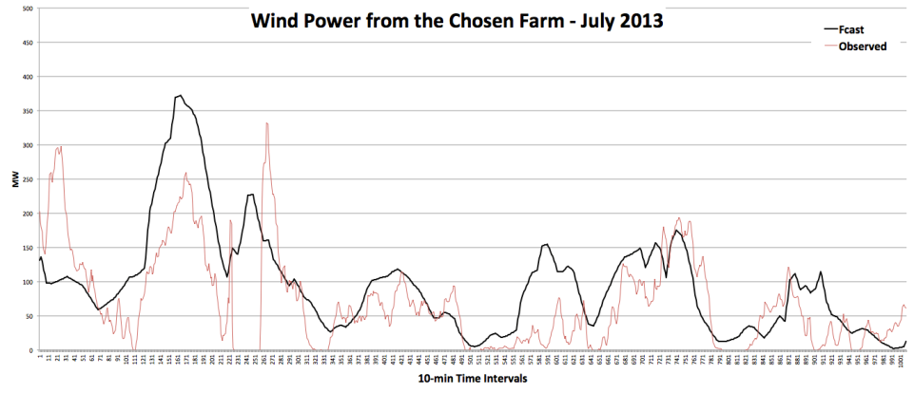
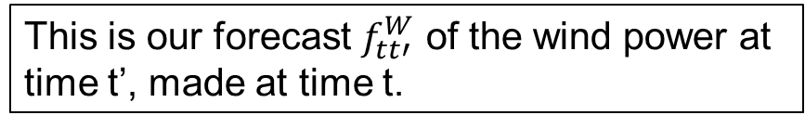


DLA-based lookahead policy: two stage
Actual vs. forecasted energy from wind
This is our forecast $f_{tt′}^{W}$ of the wind power at
time t’, made at time t.
This is the actual energy from wind, showing
the deviations from forecast.
$$t=\text{Current time}$$
$$t′=\text{Some point in the future}$$

Slide 11
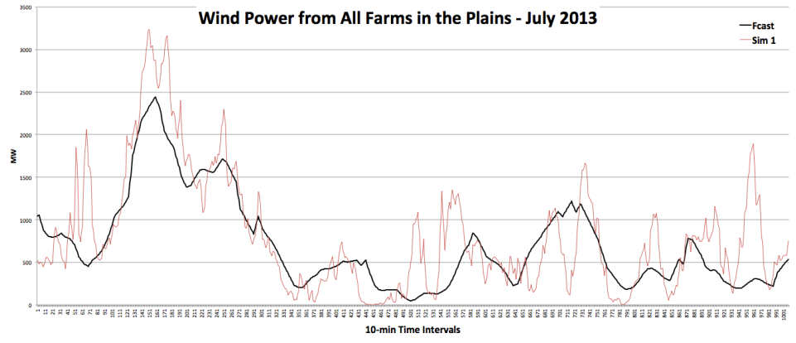
DLA-based lookahead policy: two stage
Creating wind scenarios (Scenario #1)

Slide 12
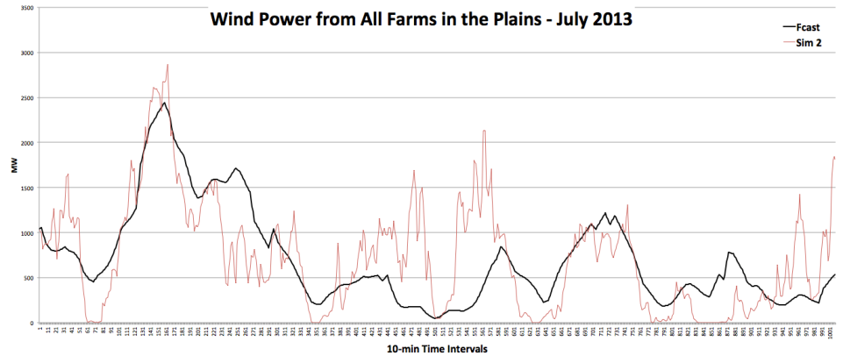
DLA-based lookahead policy: two stage
Creating wind scenarios (Scenario #2)

Slide 13
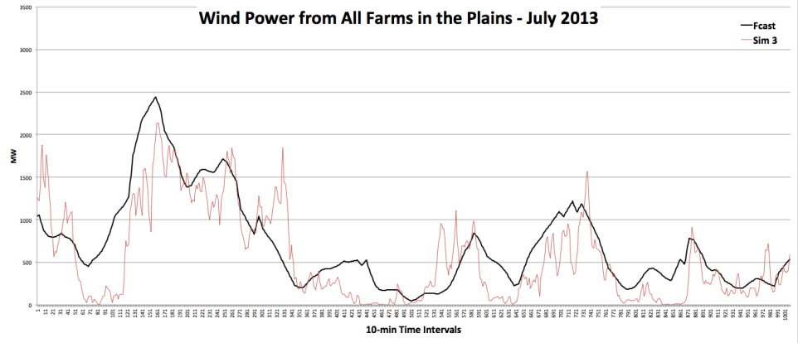
DLA-based lookahead policy: two stage
Creating wind scenarios (Scenario #3)

Slide 14
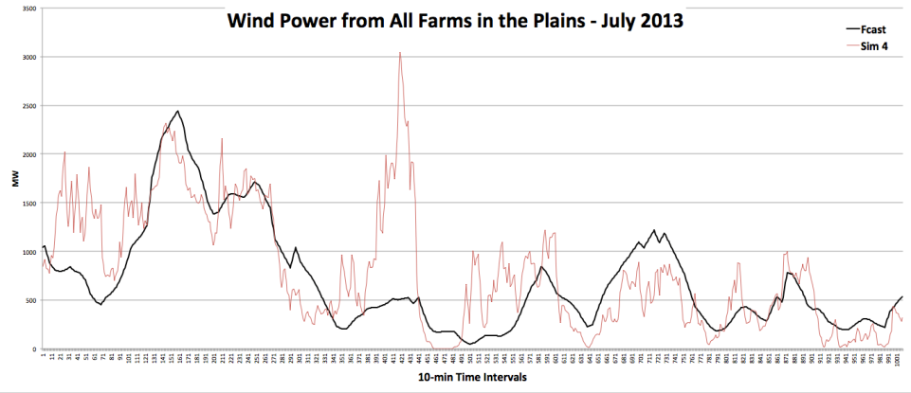
DLA-based lookahead policy: two stage
Creating wind scenarios (Scenario #4)

Slide 15
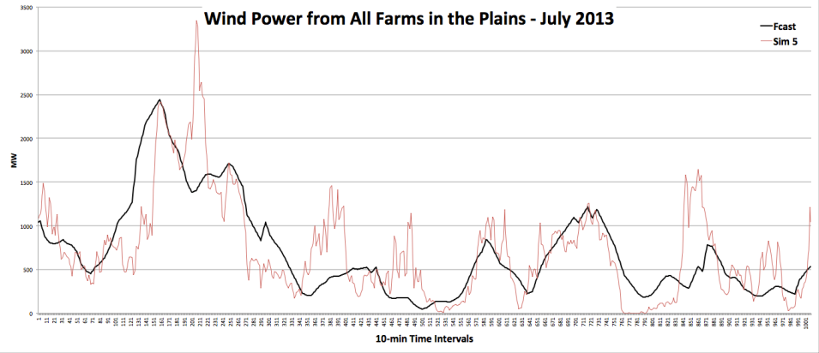
DLA-based lookahead policy: two stage
Creating wind scenarios (Scenario #5)

Slide 16
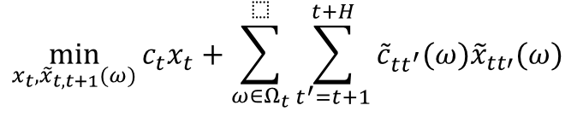
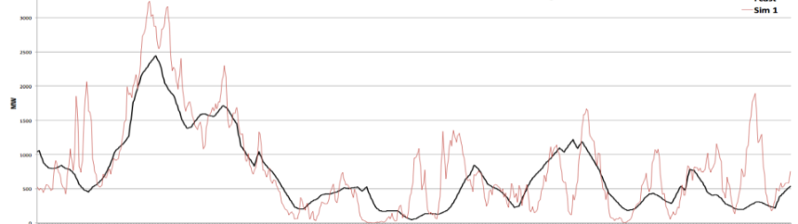
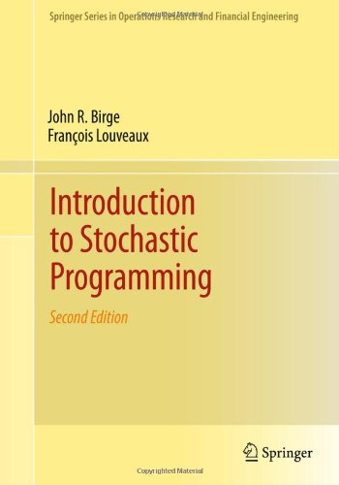
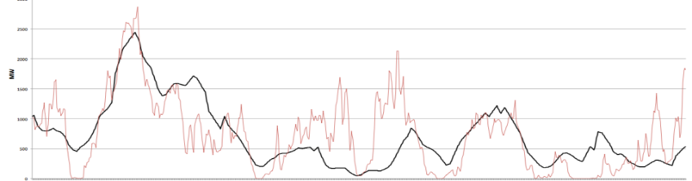
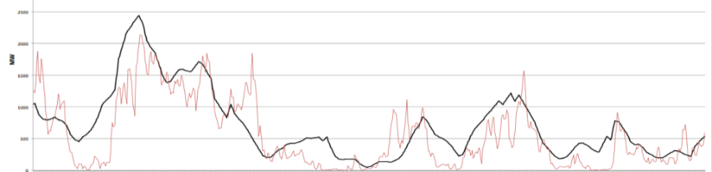
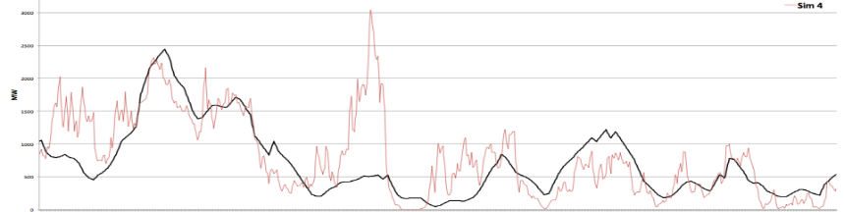
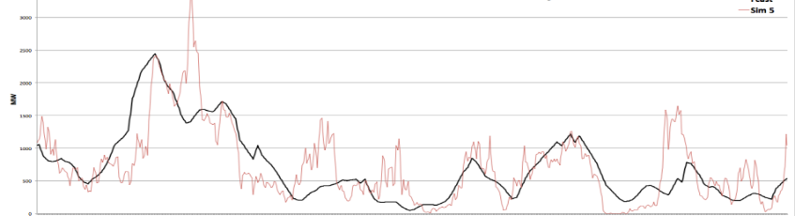




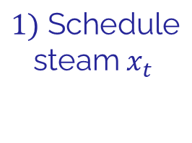





DLA-based lookahead policy: two stage
Then make future decisions:
$$x_{t+1}(ω),x_{t+2}(ω),....x_{t+H}(ω)$$
$$ω_{1}$$
$$1)\text{ Schedule} \\ \text{steam} x_{t}$$
$$ω_{2}$$
$$ω_{3}$$
$$Ω_{t}$$
$$ω_{4}$$
2) See wind $ω_{t}$:
$$ω_{5}$$
3) Schedule turbines

Slide 17
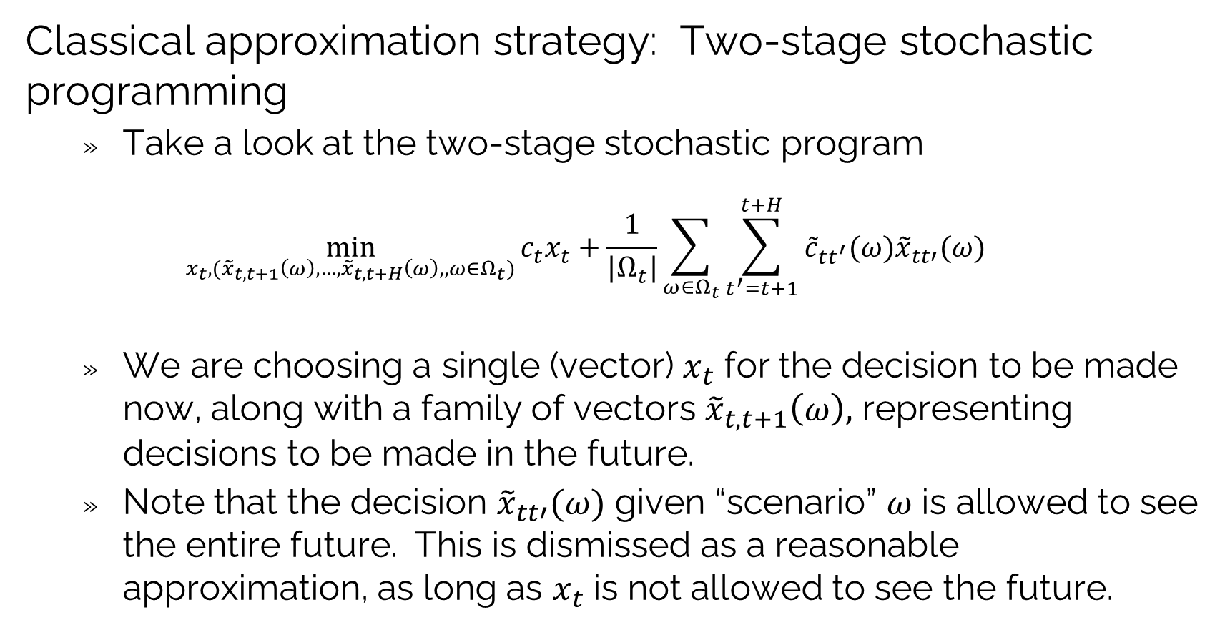
DLA-based lookahead policy: two stage
Classical approximation strategy: Two-stage stochastic programming
Take a look at the two-stage stochastic program
$$\min_{x_{t},{(\tilde{x}}_{t,t+1}\left(ω\right),…,{\tilde{x}}_{t,t+H}\left(ω\right),,ω∈Ω_{t})}{c_{t}x_{t}+\frac{1}{|Ω_{t}|}\sum_{ω∈Ω_{t}}{\sum_{t^{′}=t+1}^{t+H}{{\tilde{c}}_{tt^{′}}(ω){\tilde{x}}_{tt′}(ω)}}}$$
We are choosing a single (vector) $x_{t}$ for the decision to be made now, along with a family of vectors ${\tilde{x}}_{t,t+1}\left(ω\right),$ representing decisions to be made in the future.
Note that the decision ${\tilde{x}}_{tt′}(ω)$ given “scenario” $ω$ is allowed to see the entire future. This is dismissed as a reasonable approximation, as long as $x_{t}$ is not allowed to see the future.

Slide 18
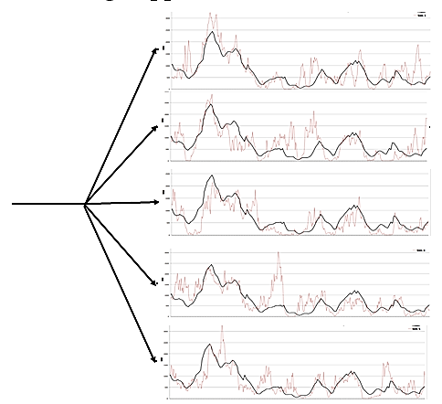




DLA-based lookahead policy: two stage
We can then simulate this lookahead policy over time:
The lookahead model
. . . .
$$t$$
$$t+1$$
$$t+2$$
$$t+3$$
The base model

Slide 19
DLA-based lookahead policy: two stage
We can then simulate this lookahead policy over time:
The lookahead model
. . . .
$$t$$
$$t+1$$
$$t+2$$
$$t+3$$
The base model

Slide 20
DLA-based lookahead policy: two stage
We can then simulate this lookahead policy over time:
The lookahead model
. . . .
$$t$$
$$t+1$$
$$t+2$$
$$t+3$$
The base model

Slide 21
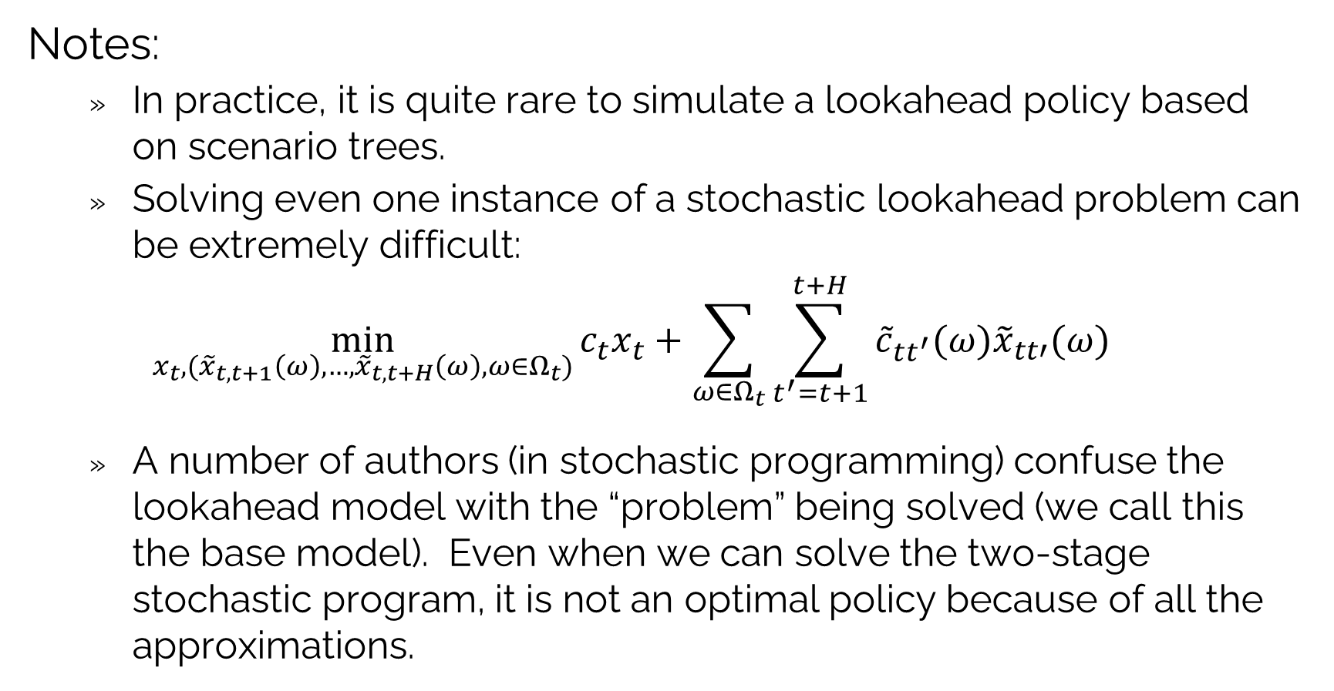
DLA-based lookahead policy: two stage
Notes:
In practice, it is quite rare to simulate a lookahead policy based on scenario trees.
Solving even one instance of a stochastic lookahead problem can be extremely difficult:
$$\min_{x_{t},{(\tilde{x}}_{t,t+1}\left(ω\right),…,{\tilde{x}}_{t,t+H}\left(ω\right),ω∈Ω_{t})}{c_{t}x_{t}+\sum_{ω∈Ω_{t}}{\sum_{t^{′}=t+1}^{t+H}{{\tilde{c}}_{tt^{′}}(ω){\tilde{x}}_{tt′}(ω)}}}$$
A number of authors (in stochastic programming) confuse the lookahead model with the “problem” being solved (we call this the base model). Even when we can solve the two-stage stochastic program, it is not an optimal policy because of all the approximations.

Slide 22
OUTLINE
DLA V – Stochastic lookaheads using DLAs – Vector actions
Two-stage stochastic programming
Stochastic search
50

Slide 23

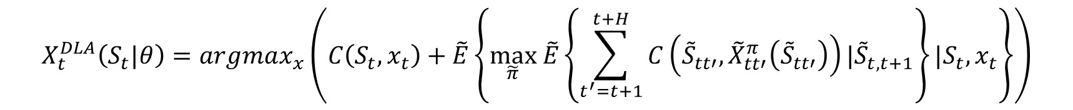
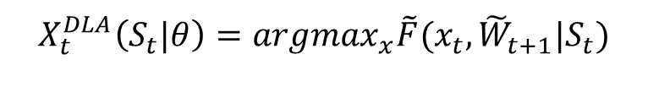
DLA-Stochastic search
We are going to return to our stochastic lookahead model using whatever approximations we have chosen:
We can now view this as a classical stochastic search problem:
$$X_{t}^{DLA}\left(S_{t}|θ\right)=argmax_{x}\left(C\left(S_{t},x_{t}\right)+\tilde{E}\left\{\max_{\tilde{π}} \tilde{E}\left\{\sum_{t^{′}=t+1}^{t+H}{C\left({\tilde{S}}_{tt′},{\tilde{X}}_{tt′}^{π}\left({\tilde{S}}_{tt′}\right)\right)|{\tilde{S}}_{t,t+1}}\right\}{|S_{t},x_{t}}\right\}\right)$$
$$\tilde{F}(x_{t},{\tilde{W}}_{t+1}|S_{t})$$
$$X_{t}^{DLA}\left(S_{t}|θ\right)=argmax_{x}\tilde{F}(x_{t},{\tilde{W}}_{t+1}|S_{t})$$

Slide 24
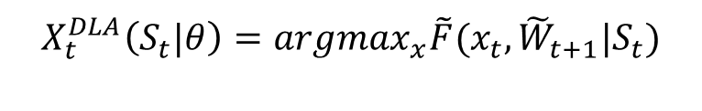
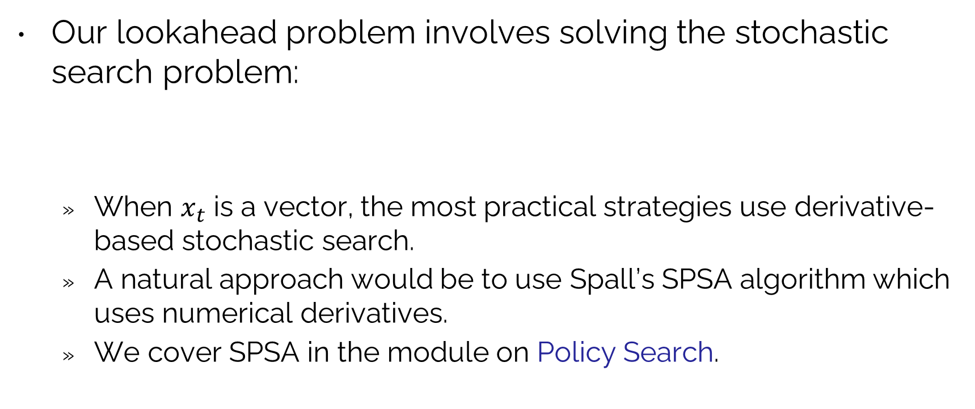
DLA-Stochastic search
Our lookahead problem involves solving the stochastic search problem:
When $x_{t}$ is a vector, the most practical strategies use derivative-based stochastic search.
A natural approach would be to use Spall’s SPSA algorithm which uses numerical derivatives.
We cover SPSA in the module on Policy Search.
$$X_{t}^{DLA}\left(S_{t}|θ\right)=argmax_{x}\tilde{F}(x_{t},{\tilde{W}}_{t+1}|S_{t})$$

Slide 25


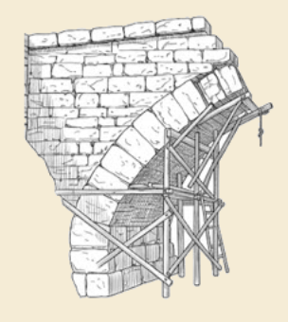
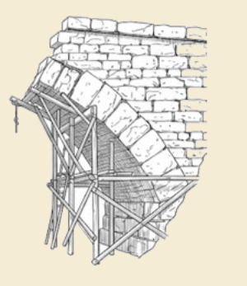
Thank you!
For more information see the Sequential Decision Analytics website at
warrenpowell.org
For more on direct lookahead approximations go to:
warrenpowell.org → Policies → Direct lookahead approximations

