Slide 1


Tutorial Series on Sequential Decision Analytics
Warren B Powell
Professor Emeritus, Princeton University
Recorded: August 12, 2026
Module: Policy search:
Evaluating policies
Derivative-based, derivative-free, offline/online
Mutual fund cash management game
Predecessor module(s):
Universal modeling framework (detailed)
Technical level: Mathematical description of policy function approximations.

Slide 2

OUTLINE
Policy search
Derivative-based stochastic search – Exact derivatives
Derivative-based stochastic search – Numerical derivatives
Derivative-free stochastic search
Stochastic search as a sequential decision problem
The mutual fund cash management game
50

Slide 3
OUTLINE
Policy search
Derivative-based stochastic search – Exact derivatives
Derivative-based stochastic search – Numerical derivatives
Derivative-free stochastic search
Stochastic search as a sequential decision problem
The mutual fund cash management game
50

Slide 4
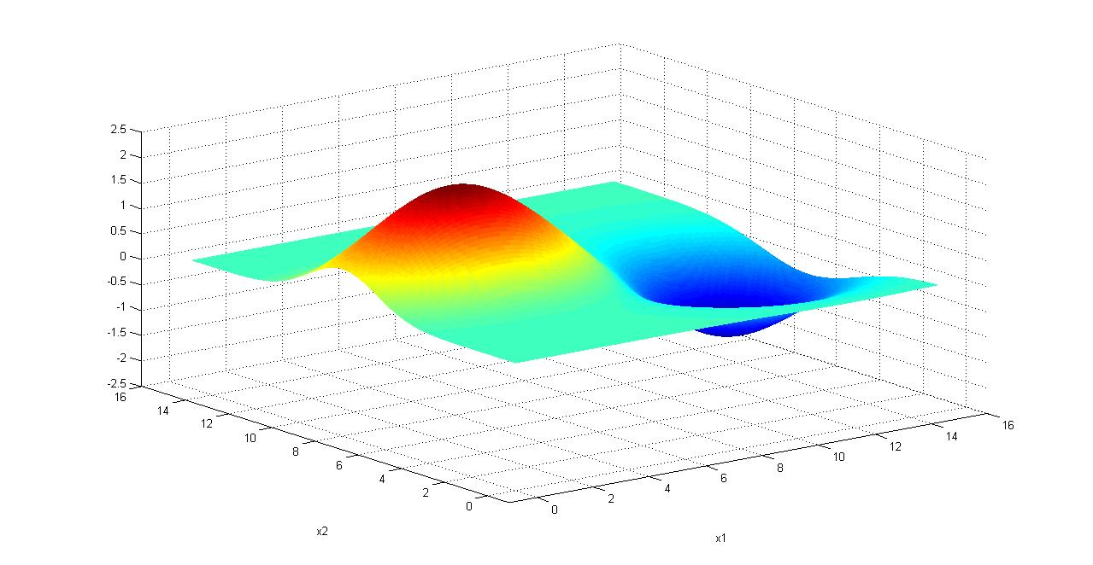
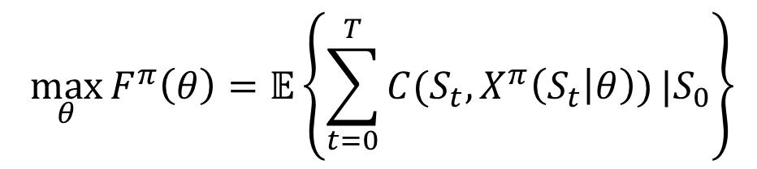

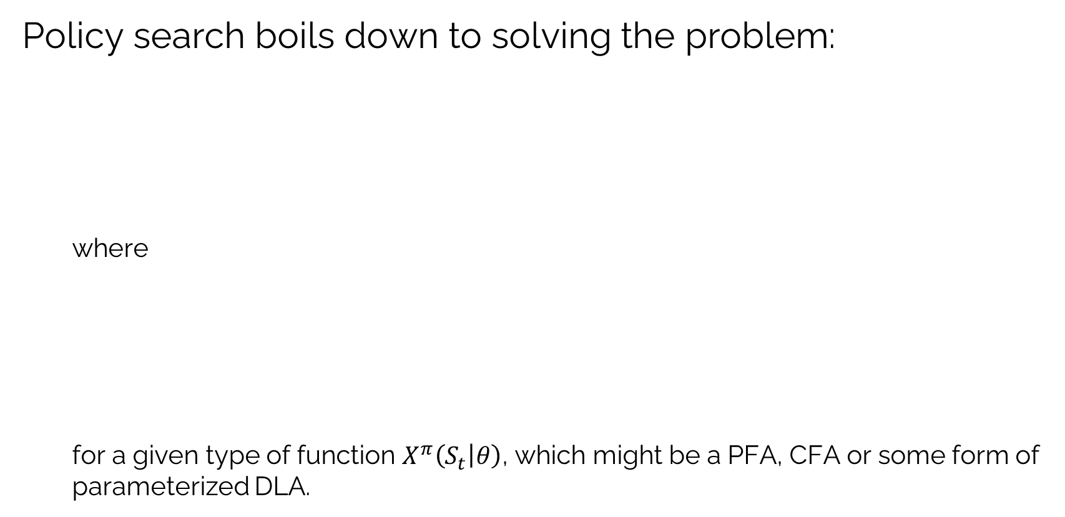


Policy search: Derivative-based
Policy search boils down to solving the problem:
where
for a given type of function $X^{π}\left(S_{t} | θ\right)$, which might be a PFA, CFA or some form of parameterized DLA.
$$\max_{θ}{F^{π}\left(θ\right)=𝔼\left\{\sum_{t=0}^{T}{C(S_{t},X^{π}\left(S_{t} | θ\right))}|S_{0}\right\}}$$
$$S_{t+1}=S^{M}(S_{t},x_{t}=X^{π}\left(S_{t} | θ\right),W_{t+1})$$
$$θ_{1}$$
$$θ_{2}$$

Slide 5
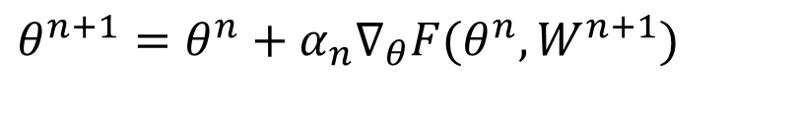
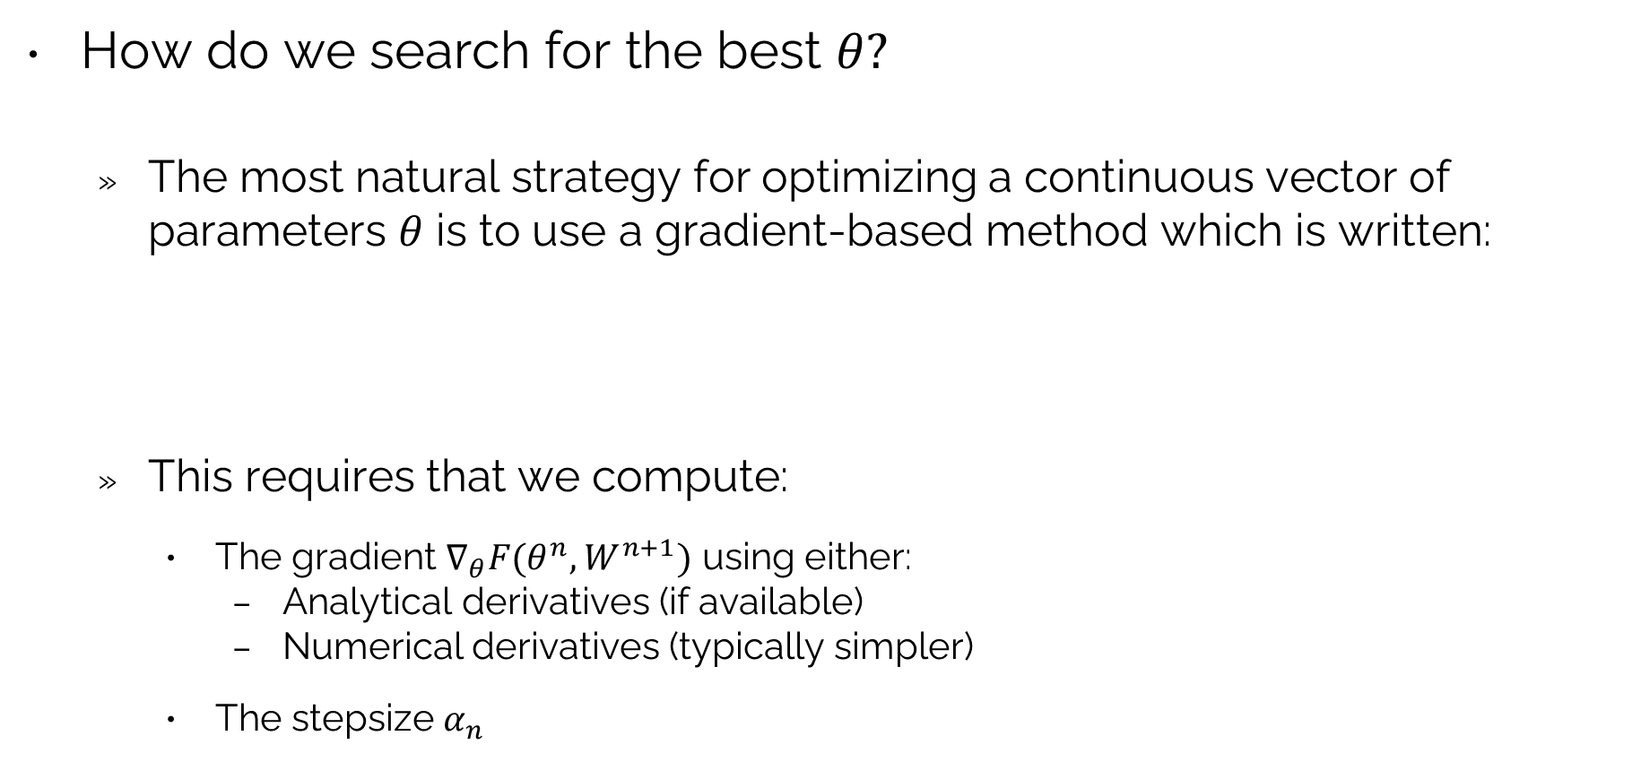
Policy search: Derivative-based
How do we search for the best $θ?$
The most natural strategy for optimizing a continuous vector of parameters $θ$ is to use a gradient-based method which is written:
This requires that we compute:
The gradient $∇_{θ}F(θ^{n},W^{n+1})$ using either:
Analytical derivatives (if available)
Numerical derivatives (typically simpler)
The stepsize $α_{n}$
$$θ^{n+1}=θ^{n}+α_{n}∇_{θ}F(θ^{n},W^{n+1})$$

Slide 6
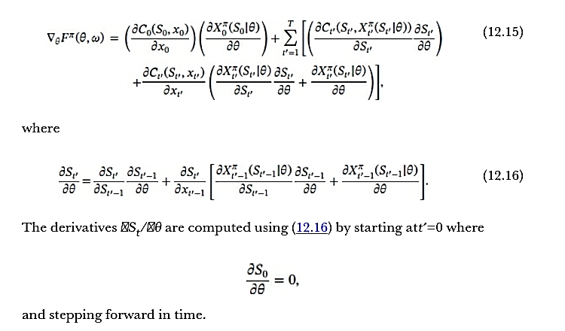
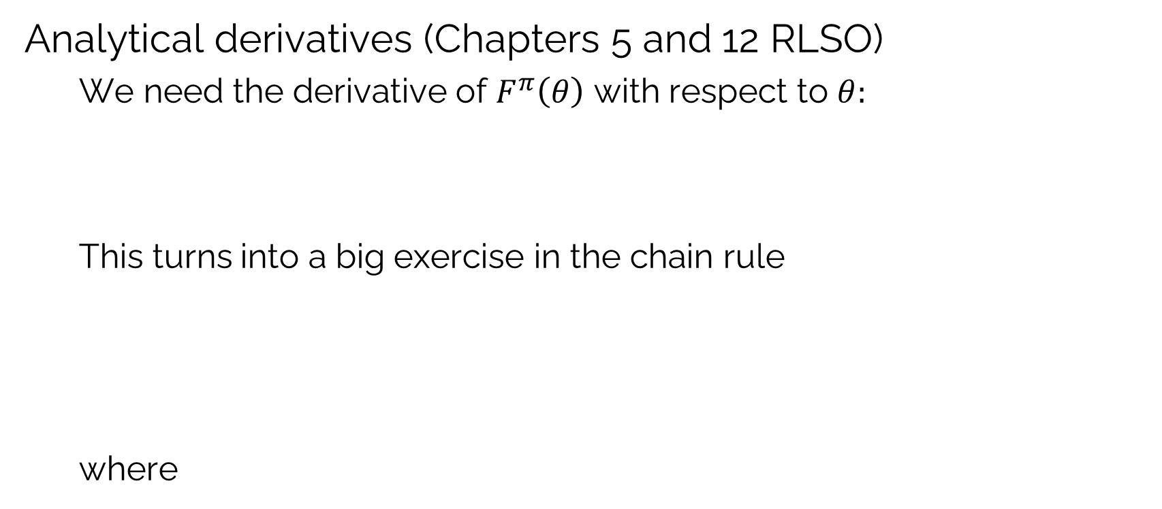
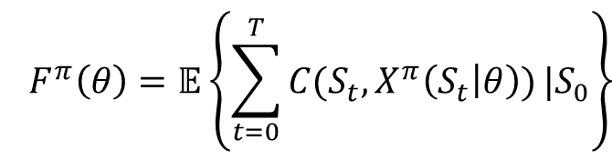
Policy search: Derivative-based
Analytical derivatives (Chapters 5 and 12 RLSO)
We need the derivative of $F^{π}\left(θ\right)$ with respect to $θ:$
This turns into a big exercise in the chain rule
where
$${F^{π}\left(θ\right)=𝔼\left\{\sum_{t=0}^{T}{C(S_{t},X^{π}\left(S_{t} | θ\right))}|S_{0}\right\}}$$

Slide 7
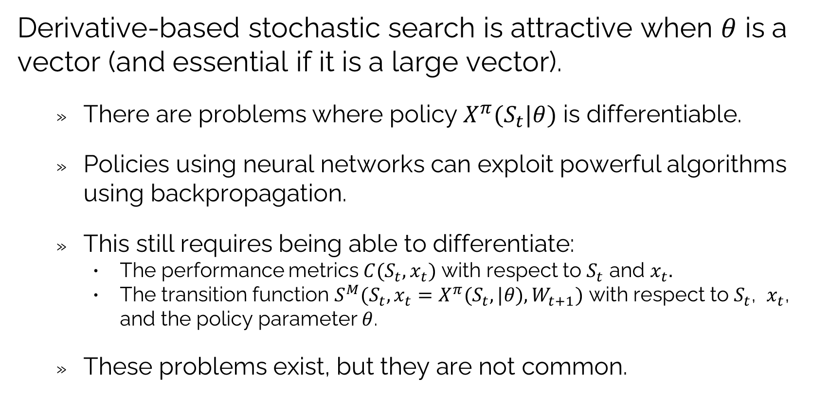
Policy search: Derivative-based
Derivative-based stochastic search is attractive when $θ$ is a vector (and essential if it is a large vector).
There are problems where policy $X^{π}(S_{t}|θ)$ is differentiable.
Policies using neural networks can exploit powerful algorithms using backpropagation.
This still requires being able to differentiate:
The performance metrics $C(S_{t}, x_{t})$ with respect to $S_{t}$ and $x_{t}.$
The transition function $S^{M}(S_{t},x_{t}=X^{π}(S_{t},|θ),W_{t+1})$ with respect to $S_{t}$, $x_{t}$, and the policy parameter $θ$.
These problems exist, but they are not common.

Slide 8
OUTLINE
Policy search
Derivative-based stochastic search – Exact derivatives
Derivative-based stochastic search – Numerical derivatives
Derivative-free stochastic search
Stochastic search as a sequential decision problem
The mutual fund cash management game
50

Slide 9

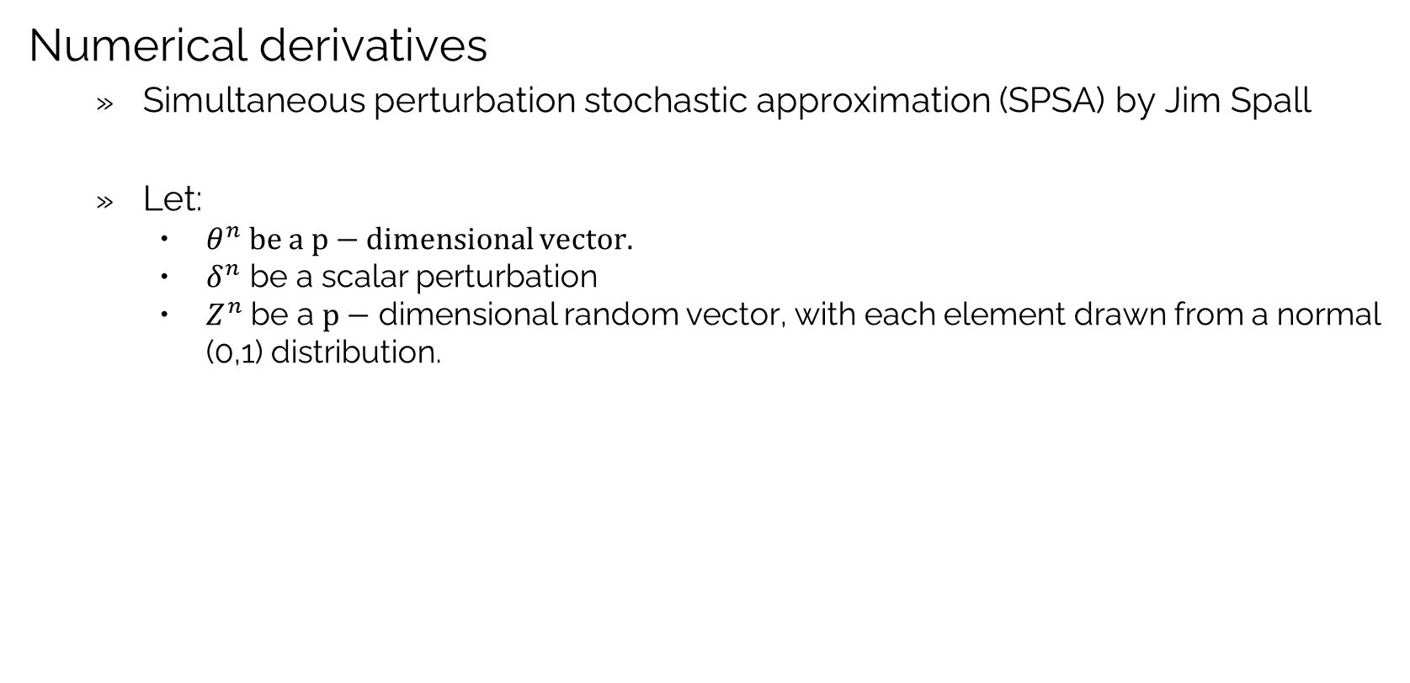
Policy search: Derivative-based
Numerical derivatives
Simultaneous perturbation stochastic approximation (SPSA) by Jim Spall
Let:
$θ^{n}$ be a $p−$ dimensional vector.
$δ^{n}$ be a scalar perturbation
$Z^{n}$ be a $p−$ dimensional random vector, with each element drawn from a normal (0,1) distribution.
$$Z^{n}=\left[\begin{matrix}Z_{1}^{n}∼N(0,1) \\ \begin{matrix}\begin{matrix} \\ \end{matrix} \\ Z_{2}^{n}∼N(0,1)\end{matrix} \\ \begin{matrix}\begin{matrix} \\ ⋮ \\ \end{matrix} \\ Z_{p}^{n}∼N(0,1)\end{matrix}\end{matrix}\right]$$

Slide 10
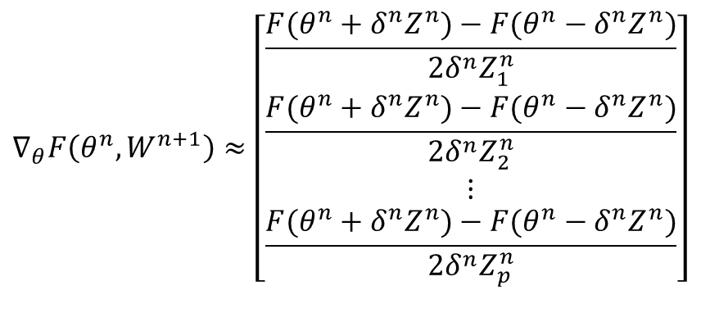

Policy search: Derivative-based
Numerical derivatives
Simultaneous perturbation stochastic approximation (SPSA)
Each function evaluation $F\left(θ^{n}+/{− δ}^{n}Z^{n}\right)$ requires simulating the policy $X^{π}\left(S_{t} | θ\right).$
We can estimate of the gradient using two simulations: $F\left(θ^{n}+δ^{n}Z^{n}\right)$ and $F\left(θ^{n}−δ^{n}Z^{n}\right)$
The simulations required to compute $F\left(θ^{n}+δ^{n}Z^{n}\right)$ and $F\left(θ^{n}−δ^{n}Z^{n}\right)$ are typically very noisy, so we do $m^{batch}$ (“mini-batch”) repetitions and take an average.
$$∇_{θ}F\left(θ^{n},W^{n+1}\right)≈\left[\begin{matrix}\frac{F(θ^{n}+δ^{n}Z^{n})−F(θ^{n}−δ^{n}Z^{n})}{2δ^{n}Z_{1}^{n}} \\ \frac{F(θ^{n}+δ^{n}Z^{n})−F(θ^{n}−δ^{n}Z^{n})}{2δ^{n}Z_{2}^{n}} \\ ⋮ \\ \frac{F(θ^{n}+δ^{n}Z^{n})−F(θ^{n}−δ^{n}Z^{n})}{2δ^{n}Z_{p}^{n}}\end{matrix}\right]$$

Slide 11

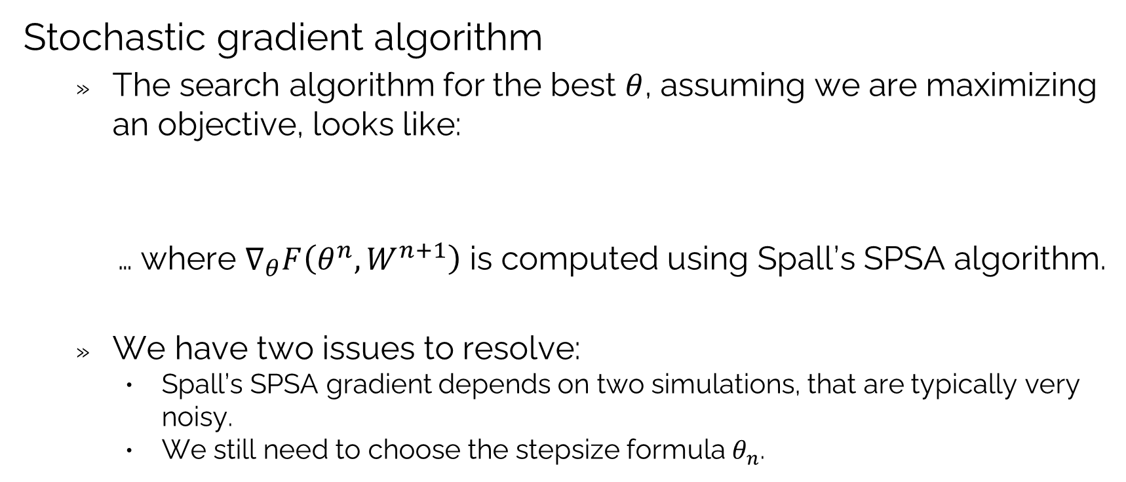
Policy search: Derivative-based
Stochastic gradient algorithm
The search algorithm for the best $θ$, assuming we are maximizing an objective, looks like:
… where $∇_{θ}F\left(θ^{n},W^{n+1}\right)$ is computed using Spall’s SPSA algorithm.
We have two issues to resolve:
Spall’s SPSA gradient depends on two simulations, that are typically very noisy.
We still need to choose the stepsize formula $θ_{n}$.
$$θ^{n+1}=θ^{n}+α_{n}∇_{θ}F\left(θ^{n},W^{n+1}\right)$$

Slide 12
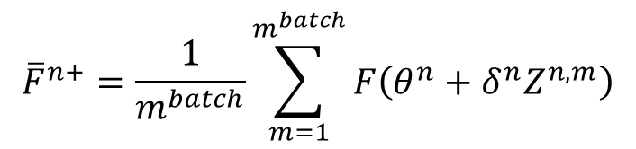
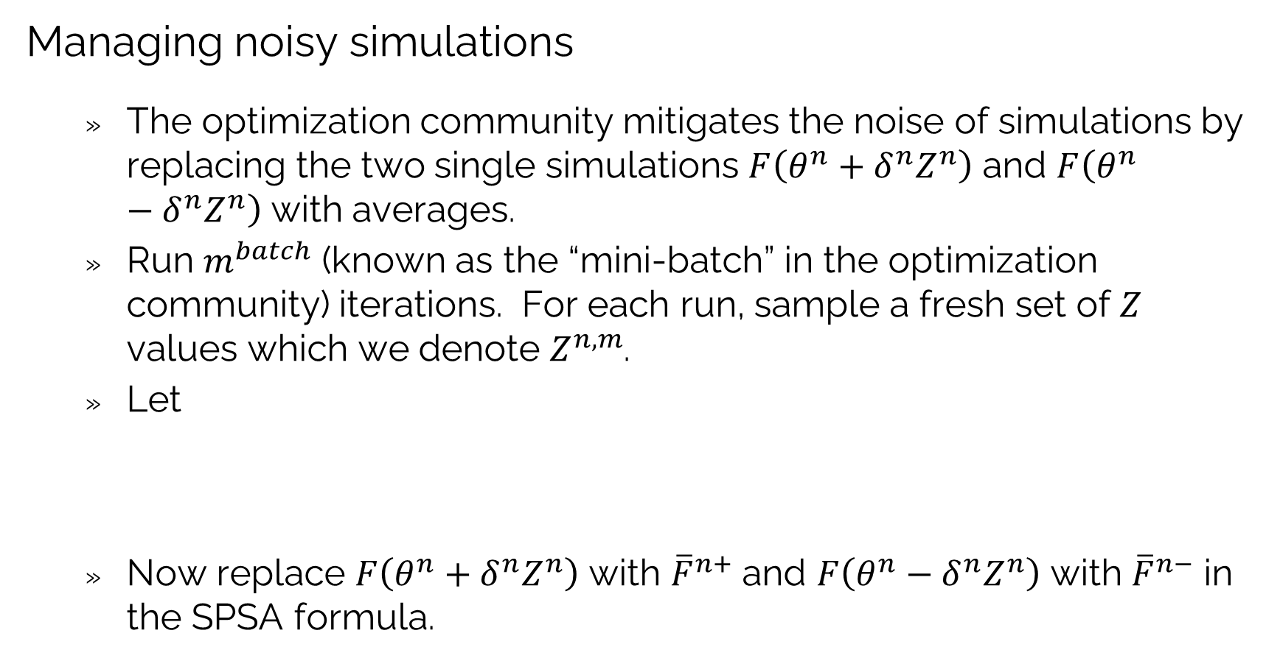
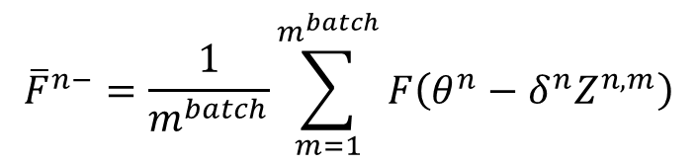
Policy search: Derivative-based
Managing noisy simulations
The optimization community mitigates the noise of simulations by replacing the two single simulations $F\left(θ^{n}+δ^{n}Z^{n}\right)$ and $F\left(θ^{n}−δ^{n}Z^{n}\right)$ with averages.
Run $m^{batch}$ (known as the “mini-batch” in the optimization community) iterations. For each run, sample a fresh set of $Z$ values which we denote $Z^{n,m}$.
Let
Now replace $F\left(θ^{n}+δ^{n}Z^{n}\right)$ with ${\overline{F}}^{n+}$ and $F\left(θ^{n}−δ^{n}Z^{n}\right)$ with ${\overline{F}}^{n−}$ in the SPSA formula.
$${\overline{F}}^{n+}=\frac{1}{m^{batch}}\sum_{m=1}^{m^{batch}}{F\left(θ^{n}+δ^{n}Z^{n,m}\right)}$$
$${\overline{F}}^{n−}=\frac{1}{m^{batch}}\sum_{m=1}^{m^{batch}}{F\left(θ^{n}−δ^{n}Z^{n,m}\right)}$$

Slide 13
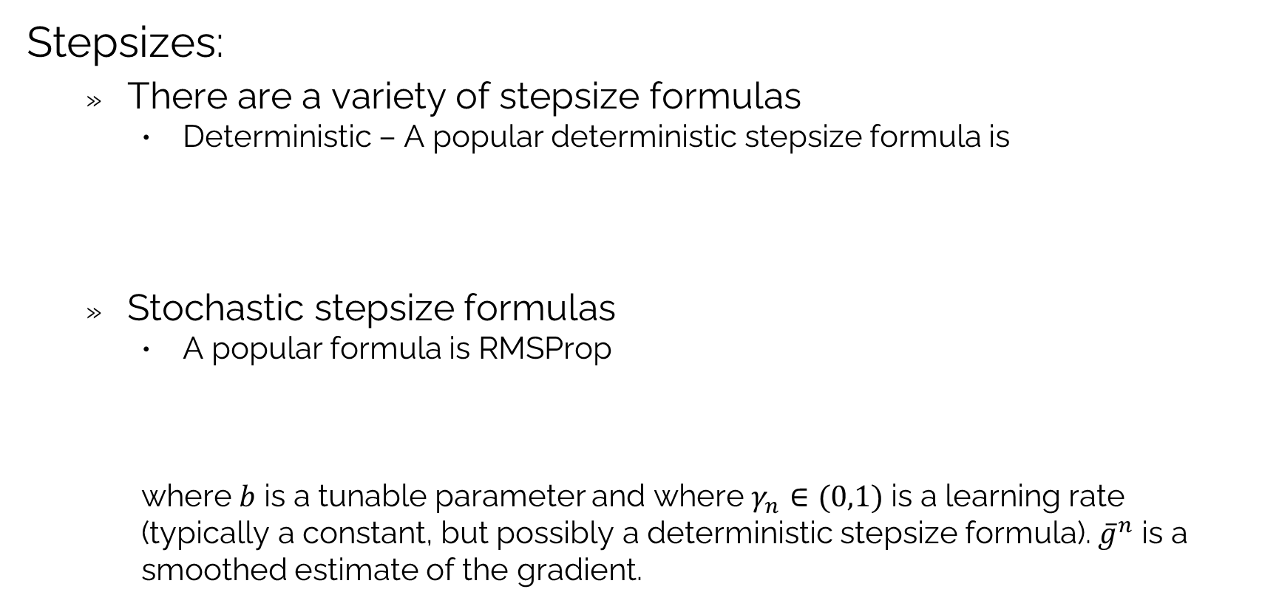
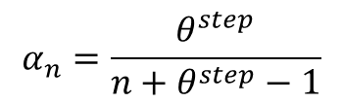
Policy search: Derivative-based
Stepsizes:
There are a variety of stepsize formulas
Deterministic – A popular deterministic stepsize formula is
Stochastic stepsize formulas
A popular formula is RMSProp
where $b$ is a tunable parameter and where $γ_{n}∈(0,1)$ is a learning rate (typically a constant, but possibly a deterministic stepsize formula). ${\overline{g}}^{n}$ is a smoothed estimate of the gradient.
$$α_{n}=\frac{θ^{step}}{n+θ^{step}−1}$$
$α_{n}=\frac{b}{\sqrt{{\overline{g}}^{n}}}$ where ${\overline{g}}^{n}=\left(1−γ_{n}\right){\overline{g}}_{n−1}+γ_{n}{\left\|∇_{θ}F\left(θ^{n−1},W^{n}\right)\right\|}^{2}$

Slide 14
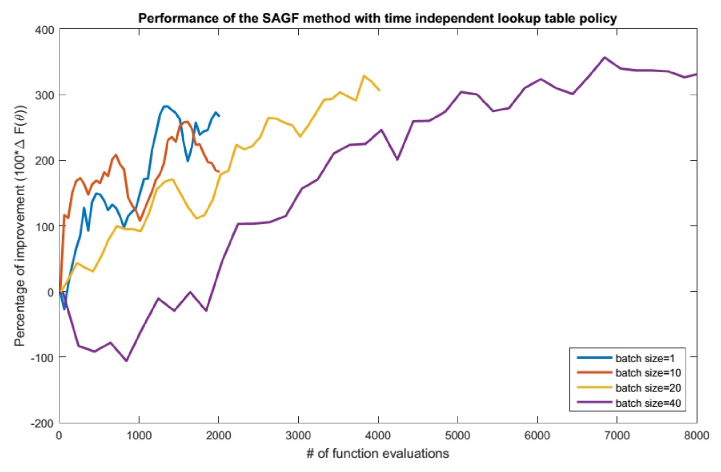





Policy search: Derivative-based
$m^{batch}$ = 20
$m^{batch}$ = 1
$m^{batch}$= 10
$m^{batch}$ = 40
$$θ^{n+1}=θ^{n}+α_{n}∇_{θ}F(θ^{n},W^{n+1})$$
Number of function evaluations
(joint with Saeed Ghadimi)

Slide 15
OUTLINE
Policy search
Derivative-based stochastic search – Exact derivatives
Derivative-based stochastic search – Numerical derivatives
Derivative-free stochastic search
Stochastic search as a sequential decision problem
The mutual fund cash management game
50

Slide 16
Policy search: Derivative-free
Derivative free stochastic search is known under a variety of names:
Intelligent trial and error
Multi-armed bandit problems
Derivative-free stochastic search
Optimal learning
Bayesian optimization
Active learning
Design of experiments
Ranking and selection/
Simulation-optimization

Slide 17
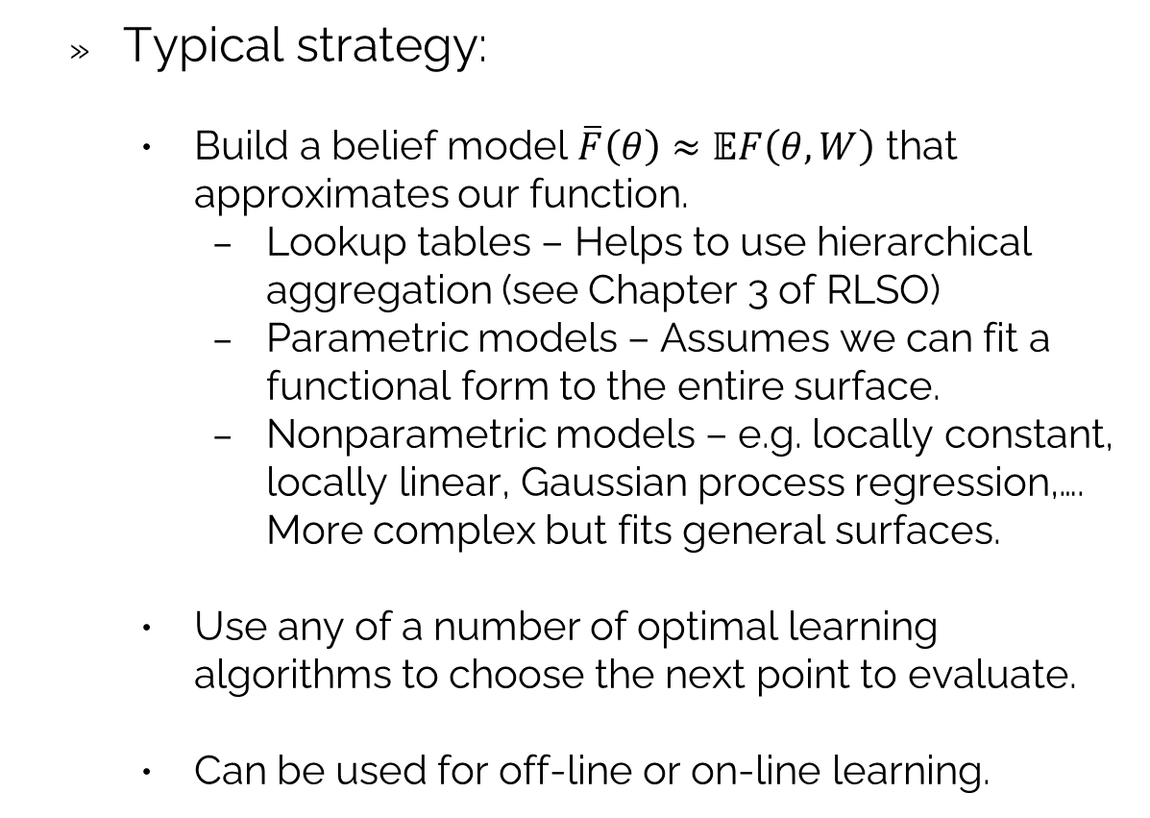
Policy search: Derivative-free
Typical strategy:
Build a belief model $\overline{F}\left(θ\right)≈𝔼F\left(θ,W\right)$ that approximates our function.
Lookup tables – Helps to use hierarchical aggregation (see Chapter 3 of RLSO)
Parametric models – Assumes we can fit a functional form to the entire surface.
Nonparametric models – e.g. locally constant, locally linear, Gaussian process regression,…. More complex but fits general surfaces.
Use any of a number of optimal learning algorithms to choose the next point to evaluate.
Can be used for off-line or on-line learning.

Slide 18
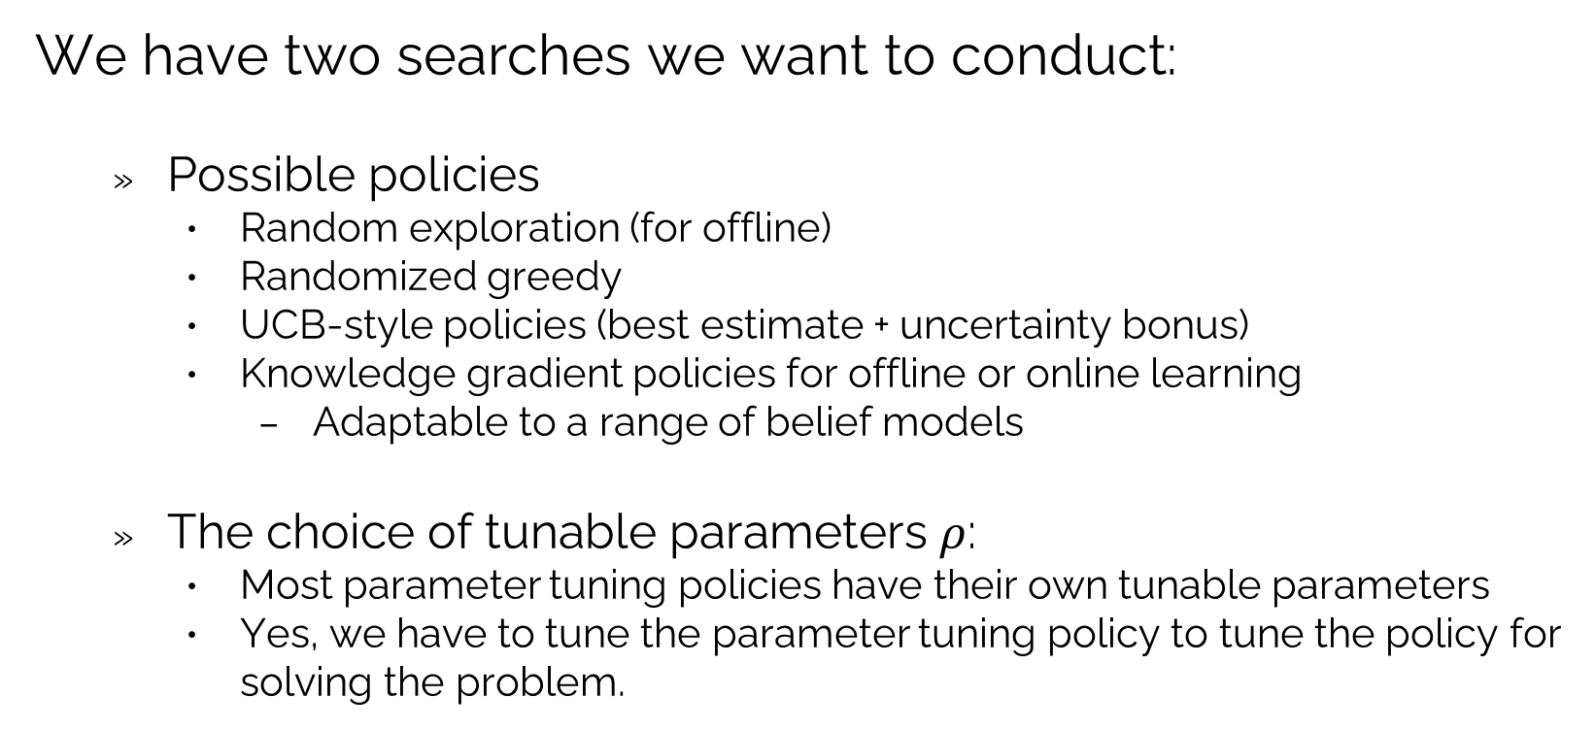
Policy search: Derivative-free
We have two searches we want to conduct:
Possible policies
Random exploration (for offline)
Randomized greedy
UCB-style policies (best estimate + uncertainty bonus)
Knowledge gradient policies for offline or online learning
Adaptable to a range of belief models
The choice of tunable parameters $ρ$:
Most parameter tuning policies have their own tunable parameters
Yes, we have to tune the parameter tuning policy to tune the policy for solving the problem.

Slide 19
OUTLINE
Policy search
Derivative-based stochastic search – Exact derivatives
Derivative-based stochastic search – Numerical derivatives
Derivative-free stochastic search
Stochastic search as a sequential decision problem
The mutual fund cash management game
50

Slide 20
Policy search: Derivative-based
Derivative-based stochastic search:
Stochastic gradient methods are easily the most widely used form of stochastic optimization:
There is an extensive literature on “stepsize rules” which are parametric functions for determining the stepsize.
Decision

Slide 21
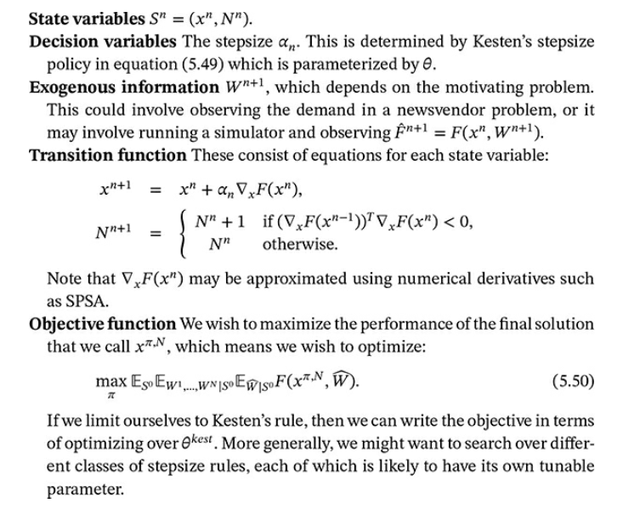
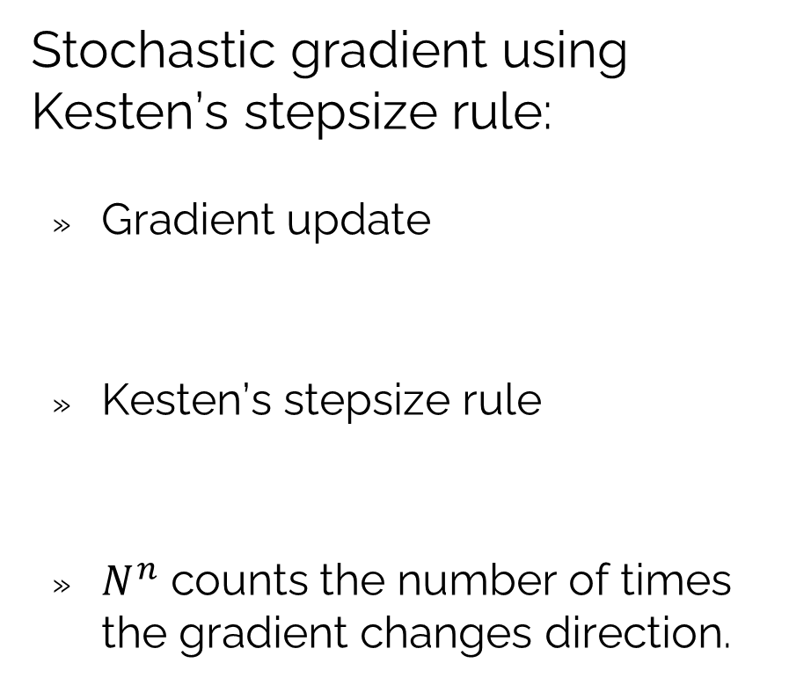


The universal modeling framework
Stochastic gradient using Kesten’s stepsize rule:
Gradient update
Kesten’s stepsize rule
$N^{n}$ counts the number of times the gradient changes direction.
1)
2)
3)
4)
$$x^{n+1}=x^{n}+α_{n}(θ^{kest})∇_{x}F(x^{n},W^{n+1})$$
$$α_{n}(θ^{kest})=\frac{θ^{kest}}{θ^{kest}+N^{n}}$$
5)
Chapter 5, section 5.6 of RLSO

Slide 22
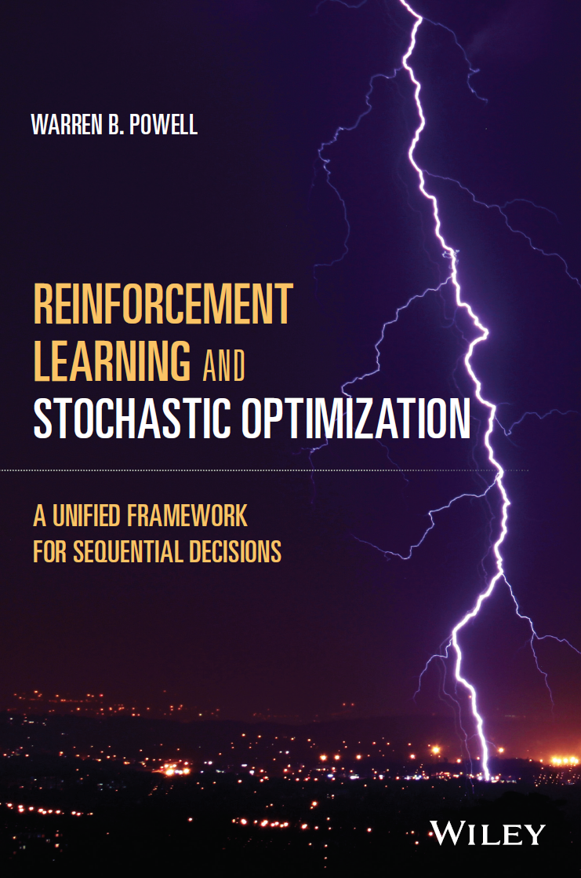
Policy search: as a SDP
Derivative-free stochastic search
Chapter 7 describes stochastic search as a sequential decision problem.
Illustrates all four classes of policies…
… but two stand out:
CFA-based policies – Typically variations of upper confidence bounding.
DLA-based policies:
Knowledge gradient
Expected improvement
Chapter 7

Slide 23
OUTLINE
Policy search
Derivative-based stochastic search – Exact derivatives
Derivative-based stochastic search – Numerical derivatives
Derivative-free stochastic search
Stochastic search as a sequential decision problem
The mutual fund cash management game
50

Slide 24
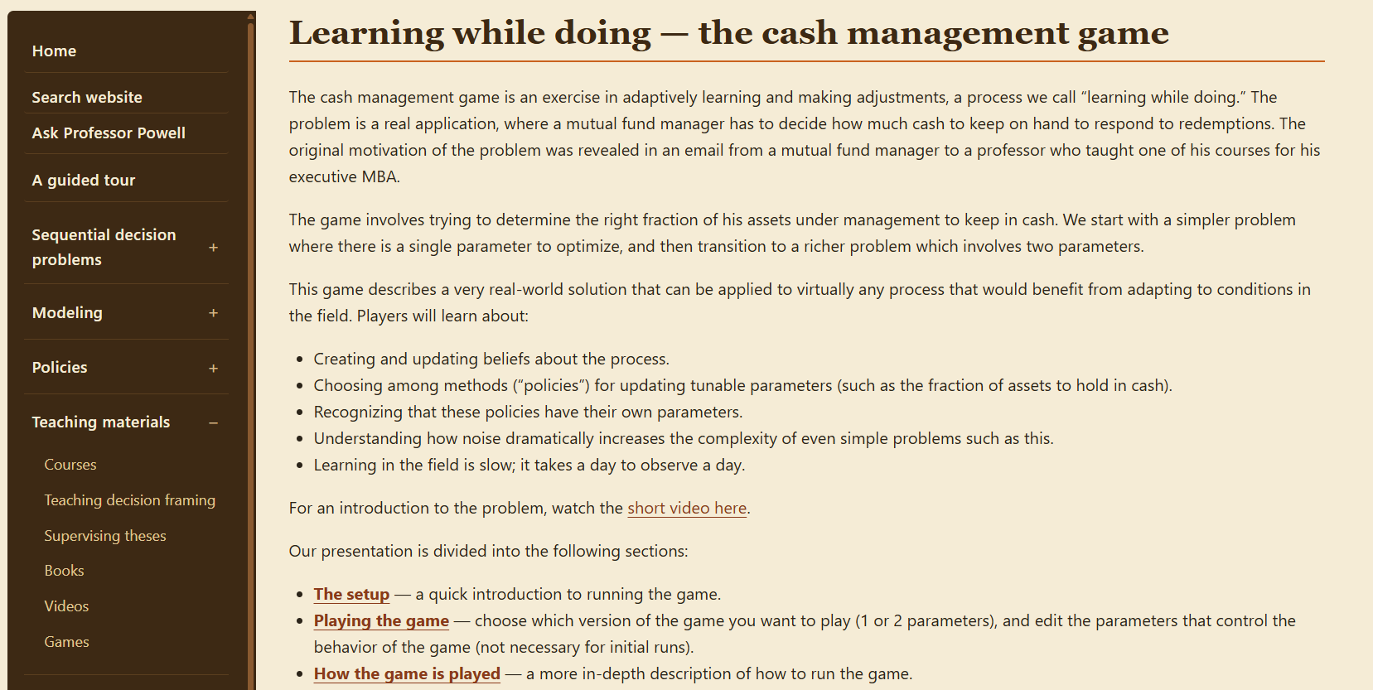

Slide 25
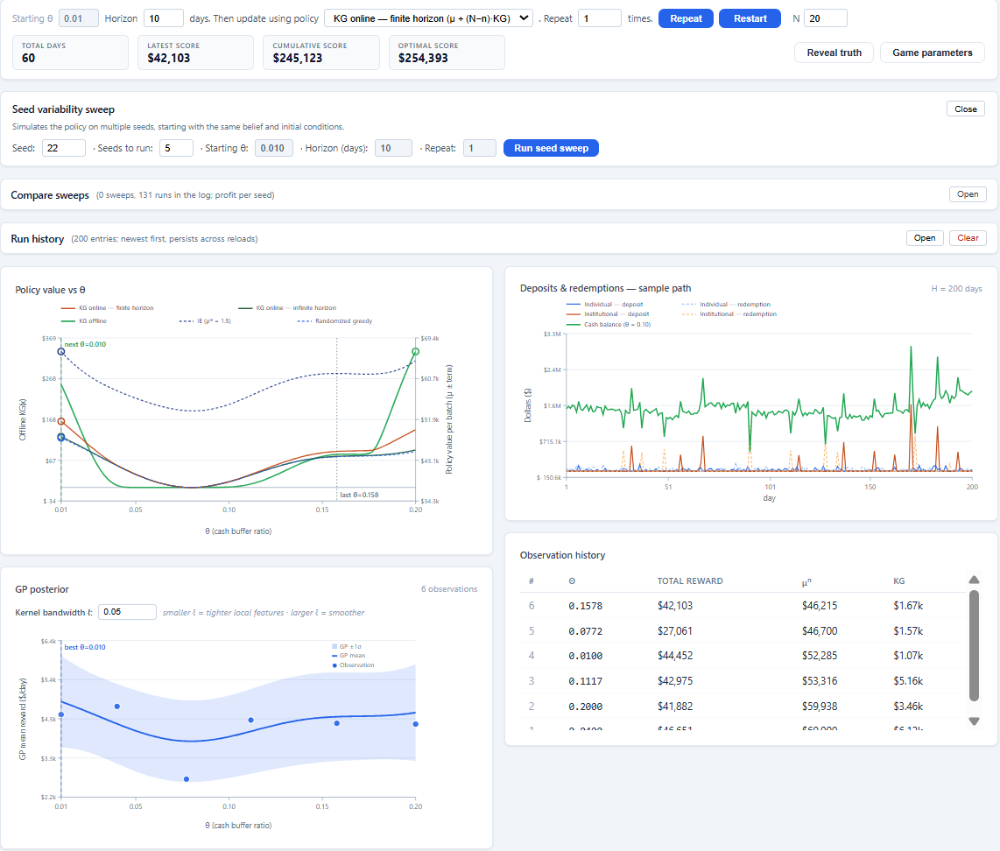

Slide 26
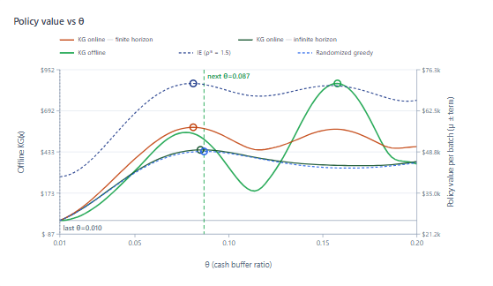
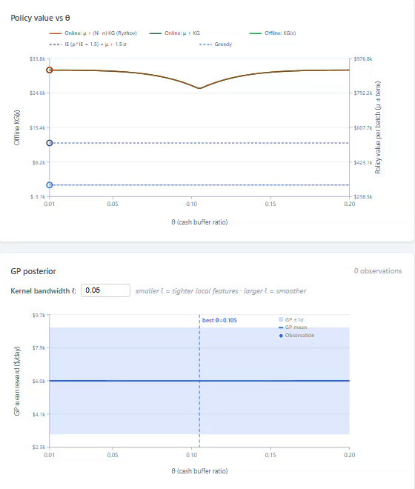
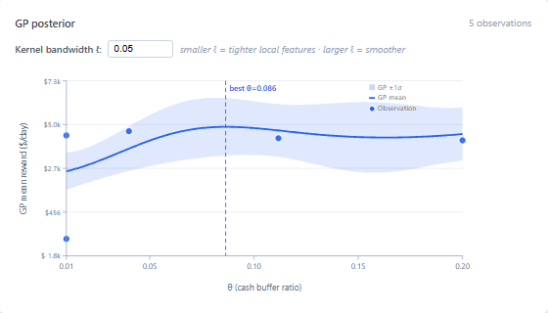

Policy search: Derivative-free
Parameter tuning
We need to find the parameters that produce the best performance.
Often, we need to do this from observations in the field.
We call this “Learning While Doing” but it could also be called intelligent trial and error.
Policies (determines what value to try)
UCB policy
Offline KG
Policy value
Online KG
Tunable parameter $θ$
Belief about policy performance
Policy performance
Tunable parameter $θ$

Slide 27
Policy search: Derivative-free
Parameter tuning
We need to find the parameters that produce the best performance.
Often, we need to do this from observations in the field.
We call this “Learning While Doing” but it could also be called intelligent trial and error.
Policies (determines what value to try)
Policy value
Tunable parameter $θ$
Belief about policy performance
Policy performance
Tunable parameter $θ$

Slide 28


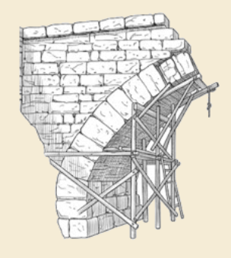
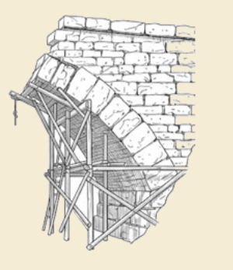
Thank you!
For more information see the Sequential Decision Analytics website at
warrenpowell.org
For more on policy function approximations go to:
warrenpowell.org → Policies → Policy function approximations

