Slide 1

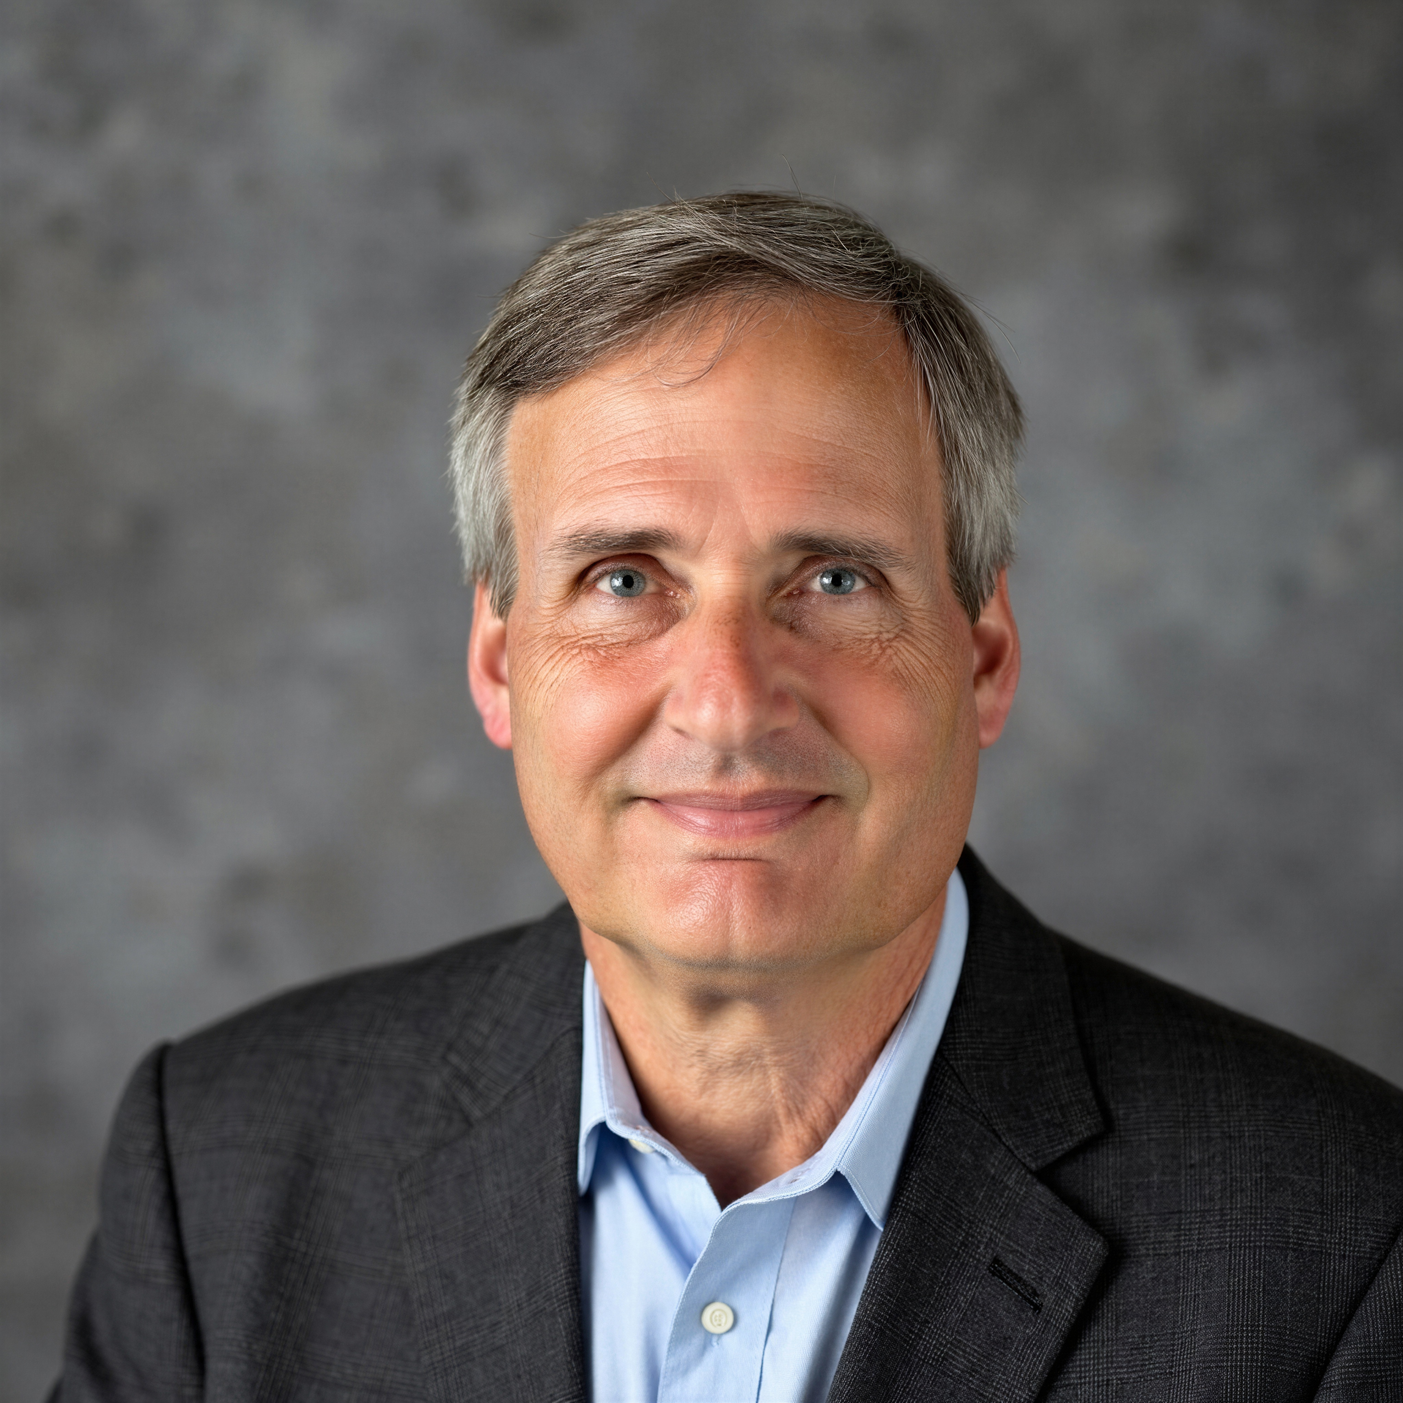
Tutorial Series on Sequential Decision Analytics
Warren B Powell
Professor Emeritus, Princeton University
Recorded: September 3, 2026
Module: Optimal learning – This module introduces the idea of learning about an unknown function by performing intelligent trial and error.
Predecessor module(s):
Universal modeling framework (high level or detailed)
Technical level: Low

Slide 2

OUTLINE
Introduction to optimal learning
A pricing example
Illustration of interval estimation
Illustration of the knowledge gradient

Slide 3
OUTLINE
Introduction to optimal learning
A pricing example
Illustration of interval estimation
Illustration of the knowledge gradient

Slide 4
Optimal learning
Every field in business, the physical and social sciences, economics, energy, health, …. requires some form of intelligent experimentation.
Intelligent trial and error
Active learning
Derivative-free stochastic search
Bayesian optimization
Multi-armed bandit problems
Design of experiments
Ranking and selection/
Simulation-optimization

Slide 5
Optimal learning
The most common decision problem that we all face involves finding the best of a discrete set of choices:
Choices:
Type of drug
Component supplier
Trading policy (finance)
Product design
Battery technology
Price (discretized)
Web page design
Product to advertise
Location for a clinic
Diameter of silicon wafer
Financial trading policy
Advertising channel
Choice of manager
1
2
3
4
4
5
Choice A
Choice B
2nm Fe
Choice D
2nm Ni
Choice G
Choice C
Choice E
Ni 0.6 nm
1.4 nm Fe
1 nm Fe
Choice F
10nm ALD AI+1.2 nm 1BSFe
10nm ALD AI203+1 nm Ni
Notes:
5

Slide 6
Optimal learning
Major problem classes
Offline learning
Online learning
Inexpensive
experiments
Optimizing computer games
Tuning policies for maximizing
ad-clicks
Bidding for ad-clicks
Ad-click maximization
Recommender systems
Microseconds to
seconds to minutes
Laboratory experimentation
Optimizing materials
Tuning expensive simulations
Tuning industrial processes
What is the best price for a product
Optimizing performance targets
Finding the best drug for a patient
Expensive
experiments
An hour to a day, week or month.
We only care about the final design.
We do not care how well we do while we are searching.
We learn as we test, and we have to live with the results while we are learning.

Slide 7
Intelligent trial and error
There is an entire spectrum of learning problems
Physical resource allocation problems
(managing drivers,
Inventories, money …)
Mixed problems: managing physical/financial resources while learning
Pure learning problems

Slide 8

Optimal learning
The “multi-armed bandit” story
N slot machines, each with a different winning probability
We can only collect information about the winning probability by playing the slot machine.
A low estimate of the winning probability may just be from bad luck.
We have to strike a balance between exploring (trying a machine with a lower probability to see if it might actually be better) and exploiting (playing the machines with the highest probability).
The goal is to optimize total rewards
1
2
3
4
5
Notes:
Personal picture (not from internet)

Slide 9
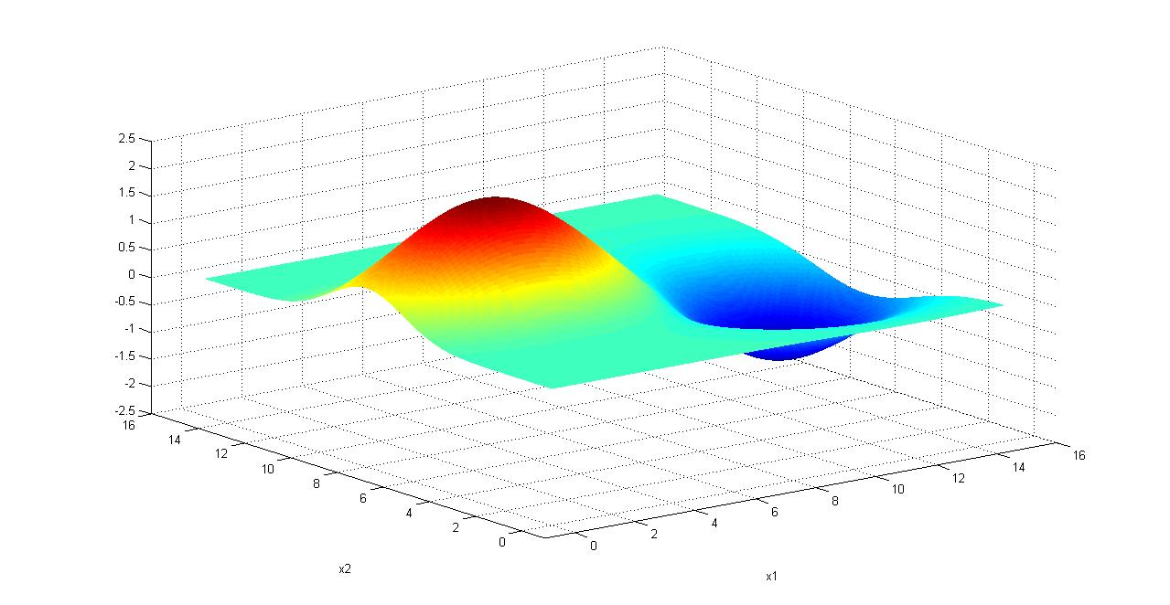
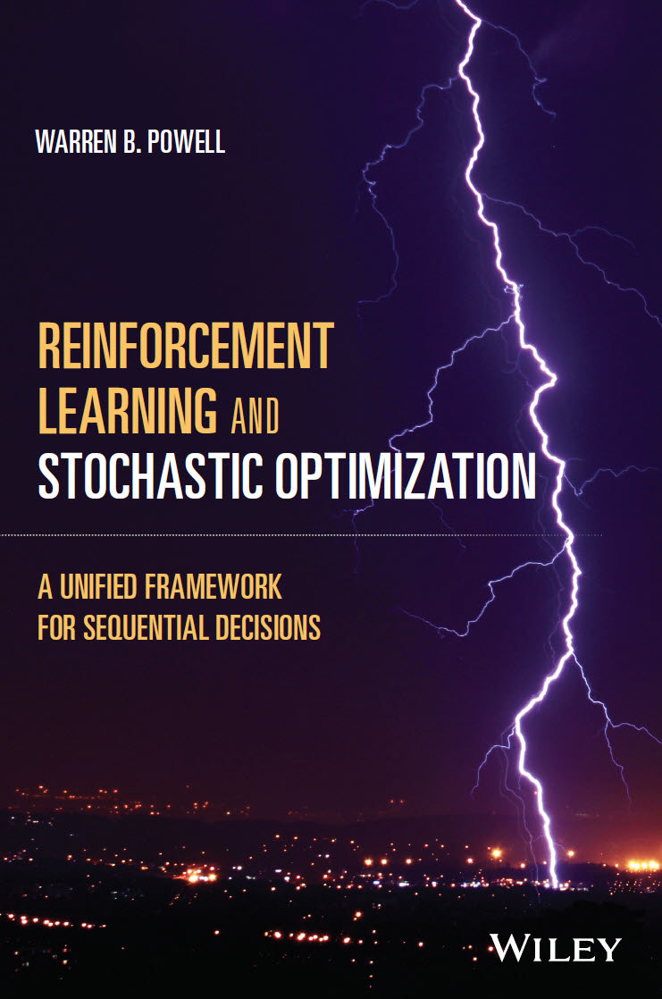
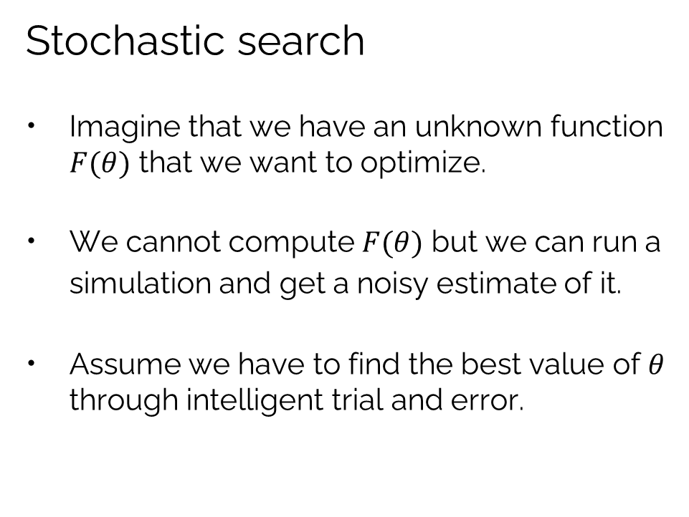


Optimal learning
Stochastic search
Imagine that we have an unknown function $F(θ)$ that we want to optimize.
We cannot compute $F(θ)$ but we can run a simulation and get a noisy estimate of it.
Assume we have to find the best value of $θ$ through intelligent trial and error.
$$θ^{min}$$
$$θ^{max}$$
Chapter 7 in my book covers this in depth

Slide 10
Optimal learning
Applications
Tuning computer simulations
Laboratory experiments
Testing materials, concentrations, temperature
Manufacturing process optimization
Semiconductor manufacturing
Internet applications:
Bidding for ad placement
Recommender systems
Webpage design optimization
Mechanical design
Tuning component dimensions, design choices,
Finance
Tuning parameters of trading policies
Trucking
Optimizing prices, fleet sizes, bids, ….
Employee management
Setting performance targets, salaries, hiring choices
Choosing educational background (school, degree) or experience
…. genuinely massive problem class.

Slide 11
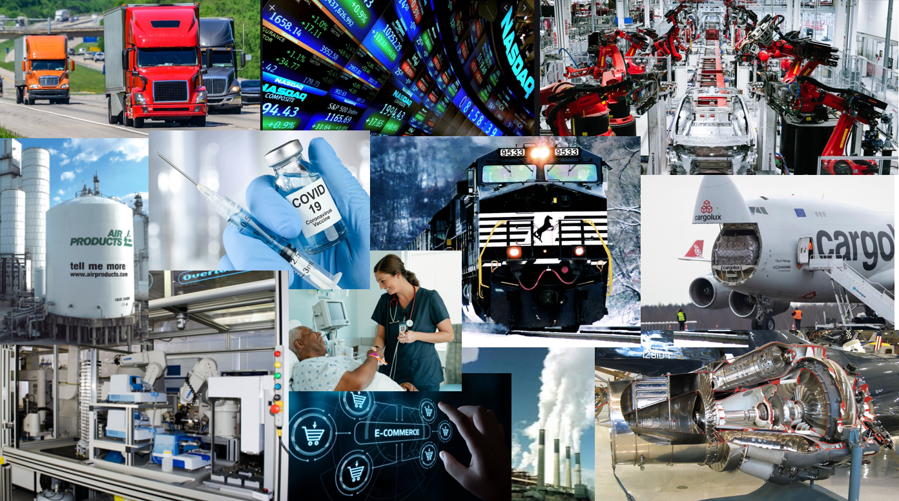
Optimal learning
Applications in supply chain management:
Tuning parameters in inventory policies such as (s,S)
Pricing, discounts and coupons
Marketing and advertising strategies
Testing new markets
Designing products
Evaluating new suppliers
Refining manufacturing processes
Managing cash flows
Setting employee performance targets

Slide 12
OUTLINE
Introduction to optimal learning
A pricing example
Illustration of interval estimation
Illustration of the knowledge gradient

Slide 13
Optimal learning
Learning the price that maximizes revenue
$$
Most likely revenue
Most likely sales response
Price
Revenue maximizing price:

Slide 14
Optimal learning
Learning the price that maximizes revenue
$$
Most likely revenue
Observations
of sales
Most likely sales response
Price
Revenue maximizing price:

Slide 15
Optimal learning
Learning the price that maximizes revenue
Possible revenue curves
$$
Most likely revenue
Possible true sales responses
Most likely sales response
Price
Revenue maximizing price:

Slide 16
Optimal learning
Learning the price that maximizes revenue
$$
Most likely revenue
Most likely sales response
Price
Revenue maximizing price:

Slide 17
Optimal learning
Learning the price that maximizes revenue
$$
Most likely revenue
Most likely sales response
Price
Revenue maximizing price:

Slide 18
OUTLINE
Introduction to optimal learning
A pricing example
Illustration of interval estimation
Illustration of the knowledge gradient

Slide 19
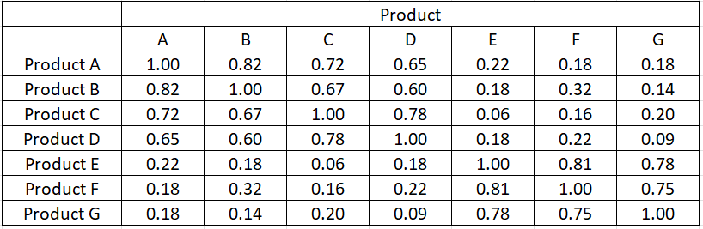



Cost function approximations
Finding the best product to sell.
The demand for different products may be correlated (similar features, complementary products).
Baby
products
Kitchen
products
Correlation coefficient $ρ$

Slide 20
Cost function approximations
1
2
3
4
4
5
Product A
1 nm Fe
2nm Fe
2nm Ni
Ni 0.6 nm
1.4 nm Fe
Product B
Product C
Product D
Product E
Product F
Product G
10nm ALD AI+1.2 nm 1BSFe
10nm ALD AI203+1 nm Ni
20
Notes:
20

Slide 21
Cost function approximations
Correlated beliefs: Testing one product teaches us about other products
1
2
3
4
4
5
Product A
1 nm Fe
2nm Fe
2nm Ni
Ni 0.6 nm
1.4 nm Fe
Product B
Product C
Product D
Product E
Product F
Product G
10nm ALD AI+1.2 nm 1BSFe
10nm ALD AI203+1 nm Ni
21
Notes:
21

Slide 22
Optimal learning
Policies for choosing which product to promote:
Upper confidence bounding
Interval estimation
Thompson sampling
$x^{n}=argmax_{x}{\hat{μ}}_{x}^{n}$ ${\hat{μ}}_{x}^{n}∼N({\overline{μ}}_{x}^{n},{θ^{TS}\overline{σ}}_{x}^{2,n})$

Slide 23
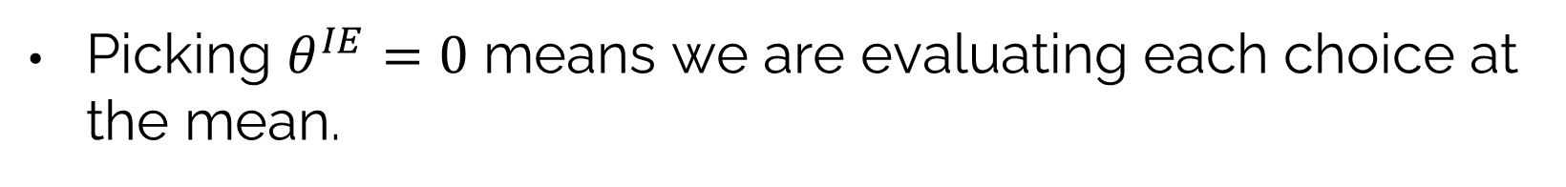
Cost function approximations
Picking $θ^{IE}=0$ means we are evaluating each choice at the mean.
1
2
3
4
4
5
Product A
Product B
Product C
Product D
Product E
Product G
2nm Fe
2nm Ni
Product F
1.4 nm Fe
1 nm Fe
Ni 0.6 nm
10nm ALD AI+1.2 nm 1BSFe
10nm ALD AI203+1 nm Ni
23
Notes:
23

Slide 24
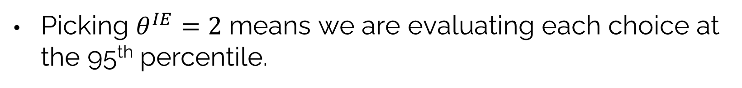
Cost function approximations
Picking $θ^{IE}=2$ means we are evaluating each choice at the 95th percentile.
1
2
3
4
4
5
Product A
Product B
Product C
Product D
Product E
Product G
2nm Fe
2nm Ni
Product F
1.4 nm Fe
1 nm Fe
Ni 0.6 nm
10nm ALD AI+1.2 nm 1BSFe
10nm ALD AI203+1 nm Ni
24
Notes:
24

Slide 25
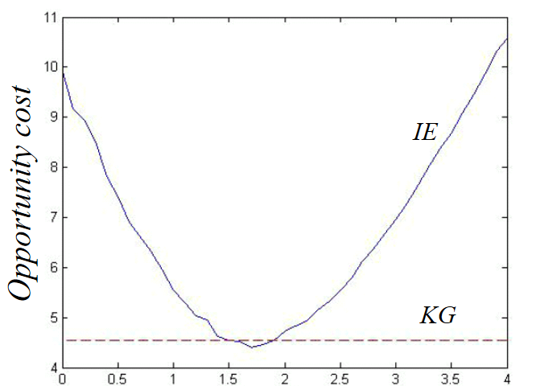

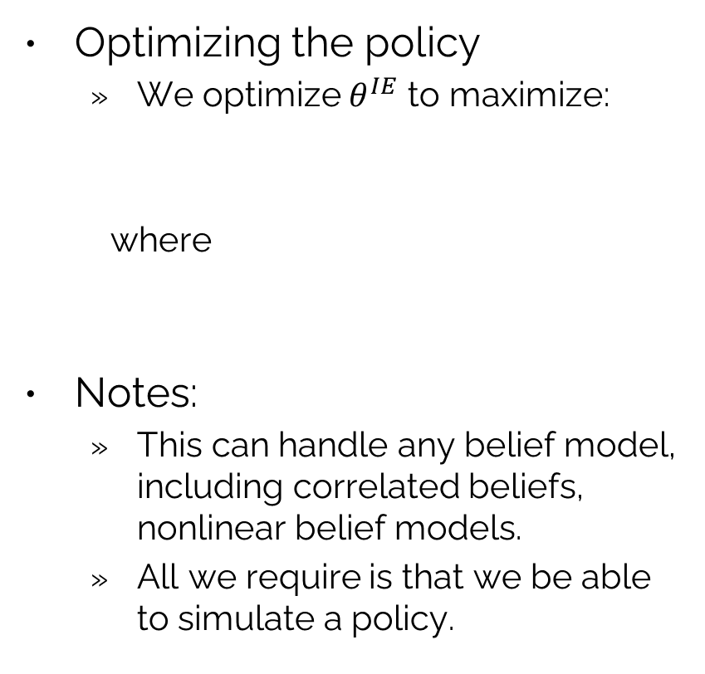
Cost function approximations
Optimizing the policy
We optimize $θ^{IE}$ to maximize:
where
Notes:
This can handle any belief model, including correlated beliefs, nonlinear belief models.
All we require is that we be able to simulate a policy.
If we just use the point estimate.
Interval
estimation
Optimized
$$x^{n}=X_{}^{IE}(S^{n}|θ^{IE})={argmax}_{x}\left({\bar{μ}}_{x}^{n}+θ^{IE}{\bar{σ}}_{x}^{n}\right)$$
Opportunity cost
Knowledge
gradient
IE parameter $θ^{IE}$

Slide 26
OUTLINE
Introduction to optimal learning
A pricing example
Illustration of interval estimation
Illustration of the knowledge gradient

Slide 27
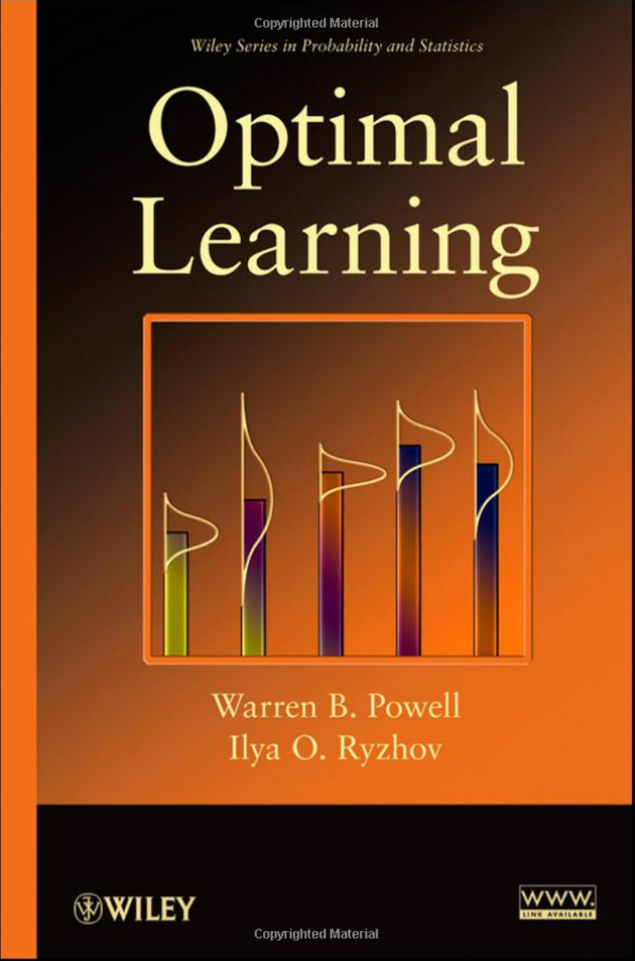
Optimal learning
The knowledge gradient
Estimates the value of information from a single experiment.
Best suited to problems where an observation is expensive.
1
2
3
4
5
Best decision

Slide 28
Optimal learning
The knowledge gradient
Estimates the value of information from a single experiment.
Best suited to problems where an observation is expensive.
No improvement
1
2
3
4
5
Best decision

Slide 29
Optimal learning
The knowledge gradient
Estimates the value of information from a single experiment.
Best suited to problems where an observation is expensive.
1
2
3
4
5
Best decision

Slide 30
Optimal learning
The knowledge gradient
Estimates the value of information from a single experiment.
Best suited to problems where an observation is expensive.
Improvement
1
2
3
4
5
Best decision

Slide 31
Optimal learning
The knowledge gradient
Estimates the value of information from a single experiment.
Best suited to problems where an observation is expensive.
1
2
3
4
5
Best decision

Slide 32
Optimal learning
The knowledge gradient
Estimates the value of information from a single experiment.
Best suited to problems where an observation is expensive.
Expected improvement = knowledge gradient
Improvement
No improvement
1
2
3
4
5
Knowledge gradient policy: compute the KG for each choice, and pick the one with the highest KG.

Slide 33
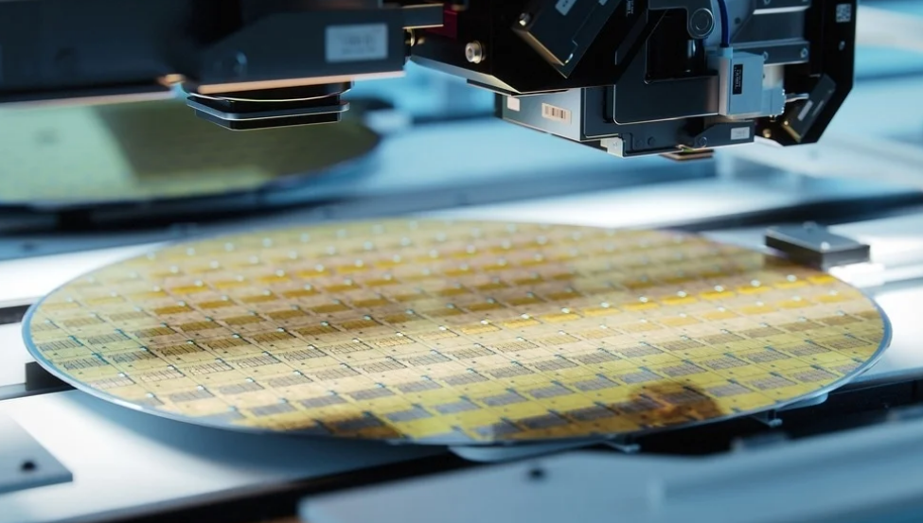
Optimal learning
Optimizing the manufacture of semiconductor wafers
We are looking for the best combination of wafer diameter and temperature of a heating process to maximize the yield of semiconductor chips.
We have divided diameter and temperature into 50 increments.
Testing each combination requires running an experiment that requires several hours.

Slide 34
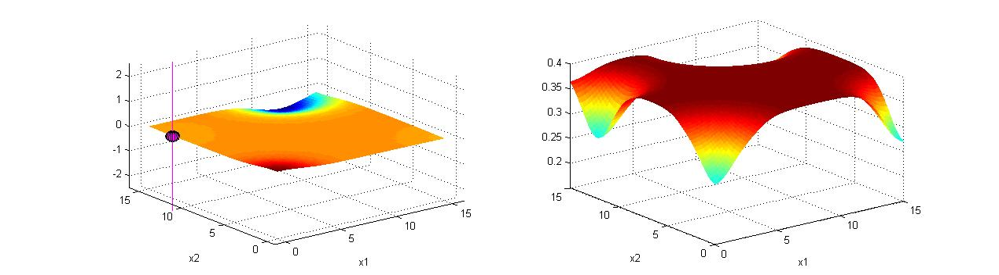
Optimal learning
After four experiments:
Estimated surface
Knowledge gradient
Value of another measurement at same location.
Measurement
New optimum
Diameter
Temperature
Diameter
Temperature
Notes:
34

Slide 35
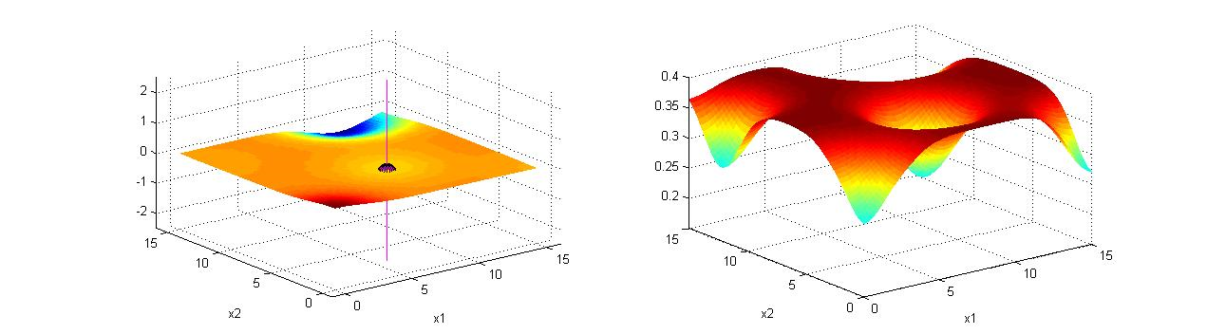
Optimal learning
After five experiments:
Estimated surface
Knowledge gradient
New optimum
Diameter
Temperature
Diameter
Temperature
Notes:
35

Slide 36
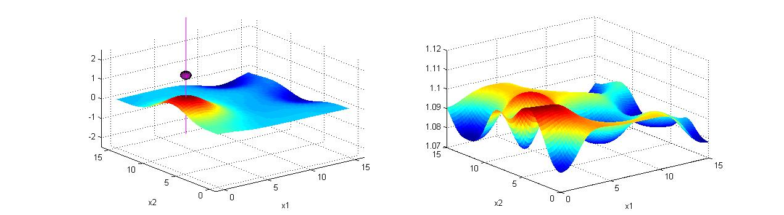
Optimal learning
After seven experiments:
Estimated surface
Knowledge gradient
New optimum
Diameter
Temperature
Diameter
Temperature
Notes:
36
Fred – remaining slides you should click through fairly quickly.

Slide 37
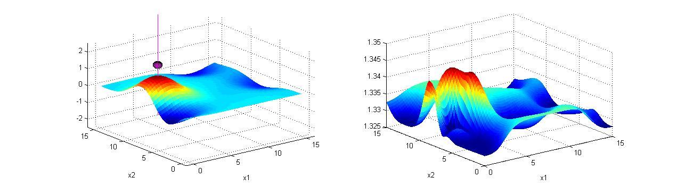
Optimal learning
After nine experiments:
Estimated surface
Knowledge gradient
Diameter
Temperature
Diameter
Temperature
After nine experiments, we can identify the best out of 2500 combinations of wafer diameter and the temperature and the heating process.
Notes:
37

Slide 38
Cost function approximations
Optimizing the policy
We optimize $θ^{IE}$ to maximize:
where
Notes:
This can handle any belief model, including correlated beliefs, nonlinear belief models.
All we require is that we be able to simulate a policy.
IE wins!
Interval
estimation
$$x^{n}=X_{}^{IE}(S^{n}|θ^{IE})={argmax}_{x}\left({\bar{μ}}_{x}^{n}+θ^{IE}{\bar{σ}}_{x}^{n}\right)$$
Opportunity cost
Knowledge
gradient
IE parameter $θ^{IE}$

Slide 39


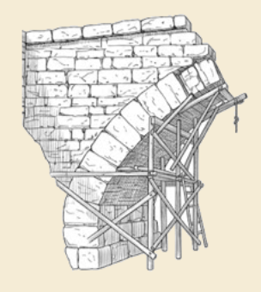
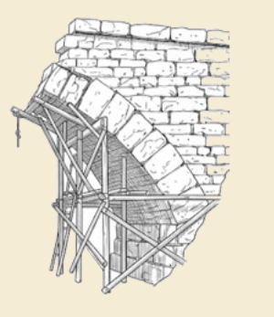
Thank you!
For more information see the Sequential Decision Analytics website at
warrenpowell.org
For more on optimal learning go to:
warrenpowell.org → Sequential decision problems → Optimal learning

