Slide 1


Tutorial Series on Sequential Decision Analytics
Warren B Powell
Professor Emeritus, Princeton University
Recorded: March 24, 2026
Module: Deterministic optimization as a sequential decision problem – We illustrate the power of using parameterized versions of deterministic optimization models as policies, known as cost function approximations.
Predecessor module(s):
Introduction to sequential decision problems
Universal modeling framework (high level or detailed)
Technical level: Assumes familiarity with linear programming

Slide 2

OUTLINE
Deterministic optimization as SDPs
From static LPs to fully sequential problems
An energy illustration

Slide 3
OUTLINE
Deterministic optimization as SDPs
From static LPs to fully sequential problems
An energy illustration

Slide 4
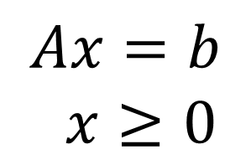
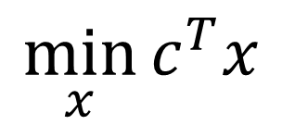
From static to sequential problems
We start with a static, deterministic optimization problem:
$$\min_{x}{c^{T}x}$$
Subject to:
$$Ax=b$$
$x≥0$

Slide 5
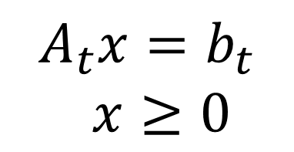
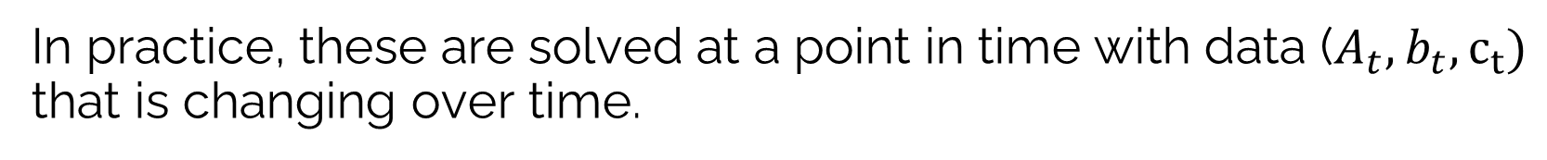
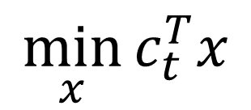
From static to sequential problems
In practice, these are solved at a point in time with data ($A_{t},b_{t},c_{t})$ that is changing over time.
$$\min_{x}{c_{t}^{T}x}$$
Subject to:
$$A_{t}x=b_{t}$$
$x≥0$

Slide 6
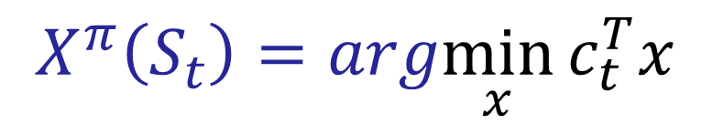

From static to sequential problems
Any method for making a decision at time $t$ can be called a policy that depends on the state $S_{t}=\left(A_{t},b_{t},c_{t}\right):$
$$X^{π}\left(S_{t}\right)=arg\min_{x}{c_{t}^{T}x}$$
Subject to:
$$A_{t}x=b_{t}$$
$x≥0$
where “argmin $f(x)$” is the value of $x$ that minimizes $f(x)$. $X^{π}(S_{t})$ is a policy that represents how we make a decision at time t.

Slide 7
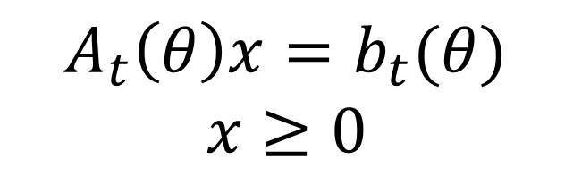
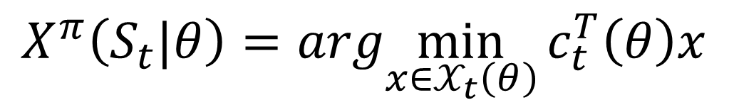


From static to sequential problems
We can modify the behavior of our linear program by introducing tunable parameters in the objective function or constraints.
$$X^{π}\left(S_{t}|θ\right)=arg\min_{x∈𝒳_{t}\left(θ\right)}{c_{t}^{T}\left(θ\right)x}$$
Subject to:
$$A_{t}\left(θ\right)x=b_{t}(θ)$$
$x≥0$
$$𝒳_{t}\left(θ\right)=$$
The policy “$π=(f,θ)$” captures how the problem is parameterized $f$, and the parameters $θ$.

Slide 8


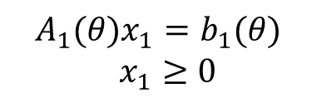
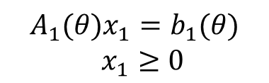




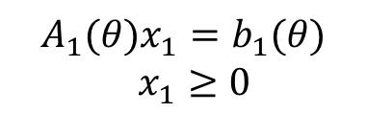
From static to sequential problems
Which parameterization is best?
Developer:
Model 1
Model 2
Model 3
$$\min_{x_{1}}{c_{1}^{T}\left(θ\right)x_{1}}$$
$$\min_{x_{1}}{c_{1}^{T}\left(θ\right)x_{1}}$$
$$\min_{x_{1}}{c_{1}^{T}\left(θ\right)x_{1}}$$
Model:
$$A_{1}(θ)x_{1}=b_{1}(θ)$$
$x_{1}≥0$
$$A_{1}(θ)x_{1}=b_{1}(θ)$$
$x_{1}≥0$
$$A_{1}(θ)x_{1}=b_{1}(θ)$$
$x_{1}≥0$
Optimal
solution:
$$x_{1}^{∗}$$
$$x_{2}^{∗}$$
$$x_{3}^{∗}$$
We need to evaluate how well each solution works in the field, over time.

Slide 9
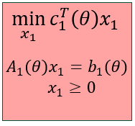





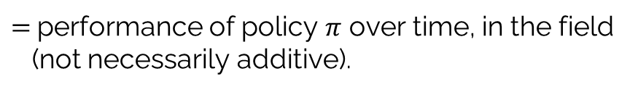



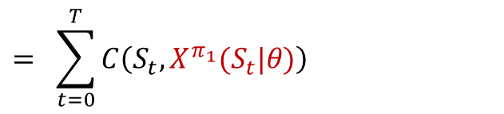







From static to sequential problems
We next simulate to evaluate the performance of our policy:
$$S_{0}$$
$$S_{t}$$
$$S_{T}$$
$$x_{0}=X^{π_{1}}(S_{0}|θ)$$
$$x_{t}=X^{π_{1}}(S_{t}|θ)$$
$$x_{T}=X^{π_{1}}(S_{T}|θ)$$
$$W_{1}$$
$$W_{t+1}$$
$$⋯$$
$$⋯$$
Time
$$C(S_{0},x_{0})$$
$$C(S_{t},x_{t})$$
$$C(S_{T},x_{T})$$
$$F^{π_{1}}\left(θ\right) = + ⋯ + + ⋯ +$$
$$= \sum_{t=0}^{T}{C\left(S_{t},X^{π_{1}}(S_{t}|θ)\right)}$$
$=$performance of policy $π$ over time, in the field
(not necessarily additive).

Slide 10

From static to sequential problems
We can modify the behavior of our linear program by introducing tunable parameters in the objective function or constraints.
$$X^{π}\left(S_{t}|θ\right)=arg\min_{x∈𝒳_{t}\left(θ\right)}{c_{t}^{T}\left(θ\right)x}$$
This is called a “cost function approximation” which is a parametrically modified deterministic optimization model, tuned to work well over time.
Subject to:
$$A_{t}\left(θ\right)x=b_{t}(θ)$$
$x≥0$
$$𝒳_{t}\left(θ\right)=$$
The policy “$π=(f,θ)$” captures how the problem is parameterized $f$, and the parameters $θ$.

Slide 11
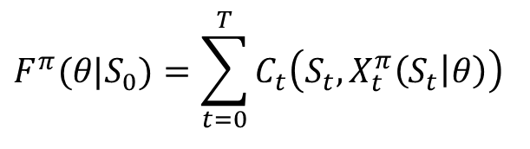




From static to sequential problems
We need to recognize two optimization problems:
An optimal solution to the surrogate optimization model is almost never an optimal policy; it may perform well, but not necessarily.
The surrogate optimization model – used for making decisions
The objective function, used for
evaluating policies.
$$F^{π}(θ|S_{0})=\sum_{t=0}^{T}{C_{t}\left(S_{t},X_{t}^{π}\left(S_{t} | θ\right)\right)}$$
$$X^{π}\left(S_{t}|θ\right)=arg\min_{x∈𝒳_{t}\left(θ\right)}{c_{t}^{T}\left(θ\right)x}$$
$$A_{t}\left(θ\right)x=b_{t}(θ)$$
$x≥0$
$$S_{t+1}=S^{M}(S_{t},x_{t},W_{t+1})$$
$$x_{t}=X^{π}(S_{t}|θ)$$
This evaluation may be done in a simulator or in the field.

Slide 12
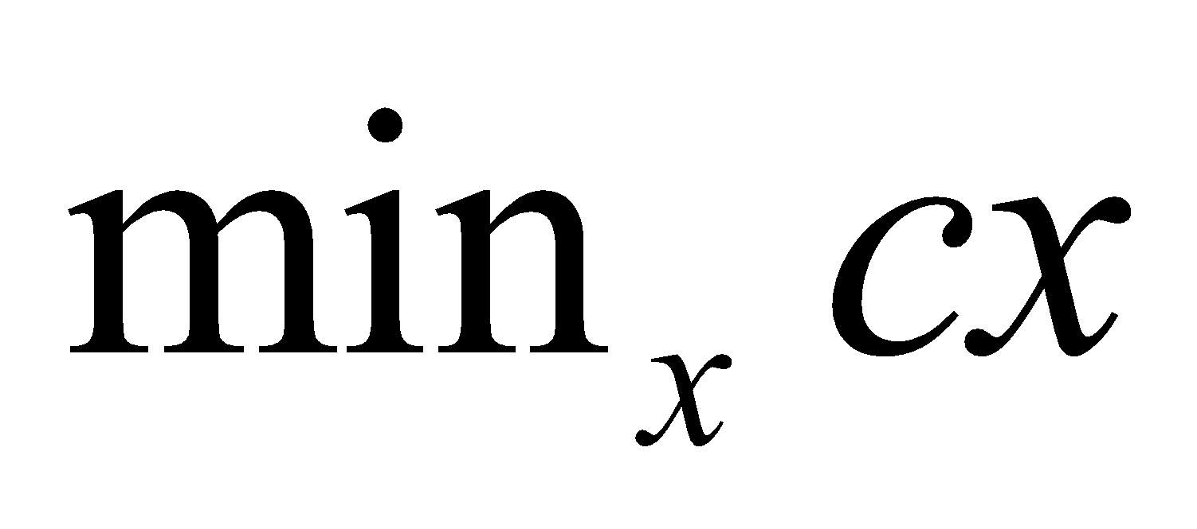
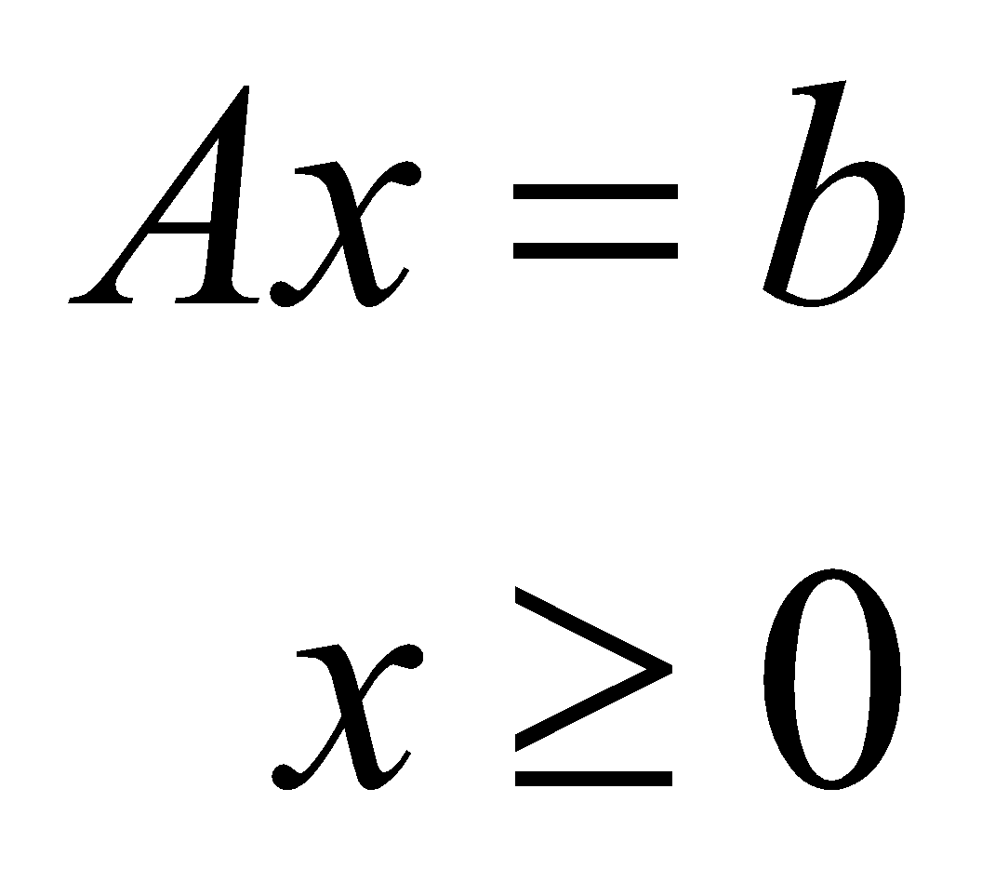
The Universal Modeling Framework
Canonical frameworks
Math programming framework
Decision variables
Objective function
Constraints

Slide 13
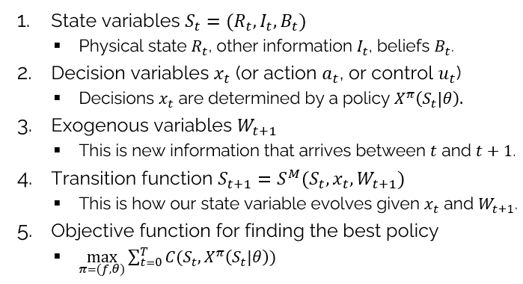


The Universal Modeling Framework
Canonical frameworks
Math programming framework
Universal Modeling Framework
… optimizes over $x$.
… optimizes over policies $π=(f,θ)$.

Slide 14
OUTLINE
Deterministic optimization as SDPs
From static LPs to fully sequential problems
An energy illustration

Slide 15
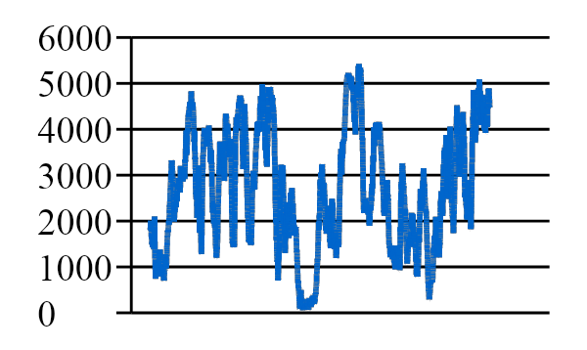
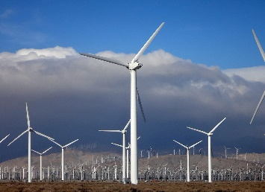

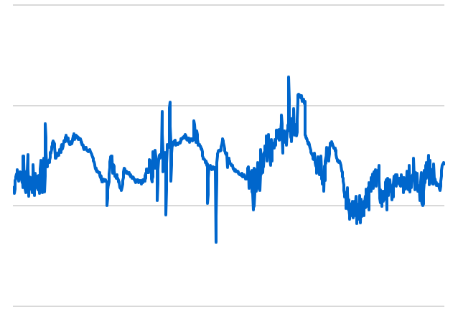

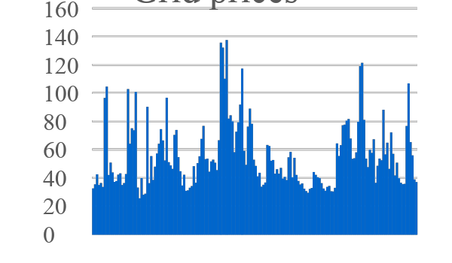
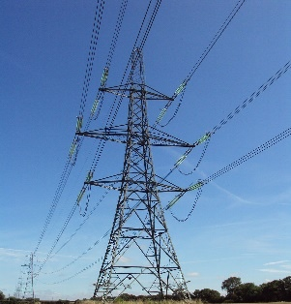
Optimizing a parameterized LP
Consider a basic energy storage problem
Wind energy
Demand (load)
Battery
storage
Grid Prices

Slide 16
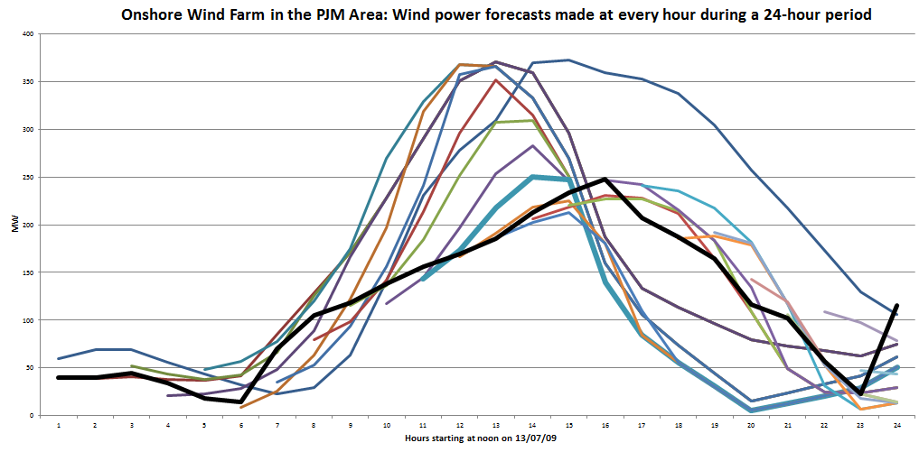
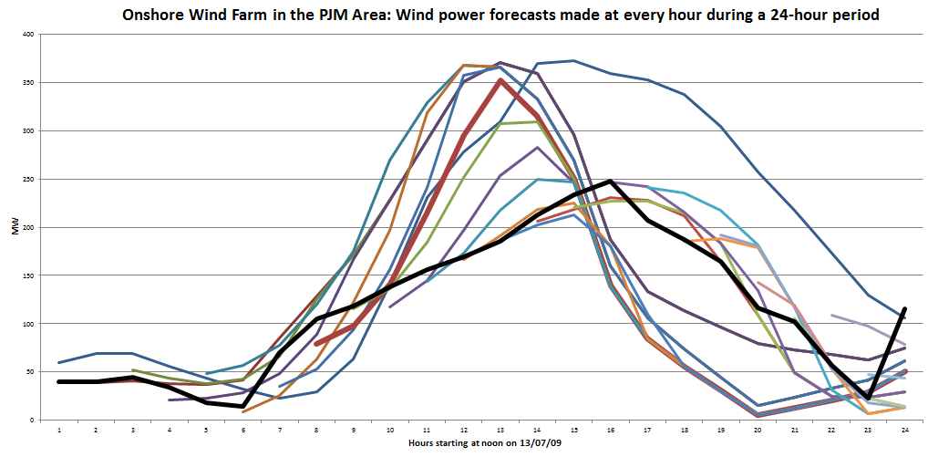
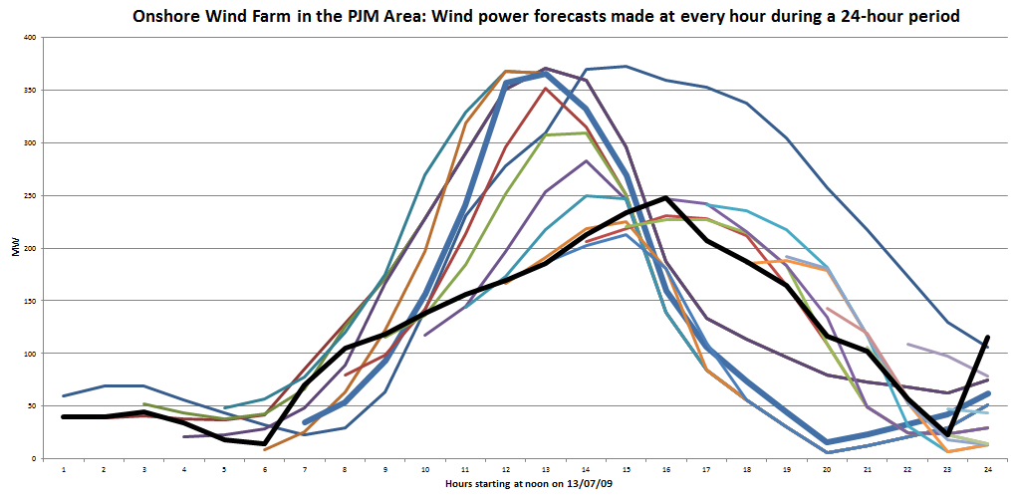
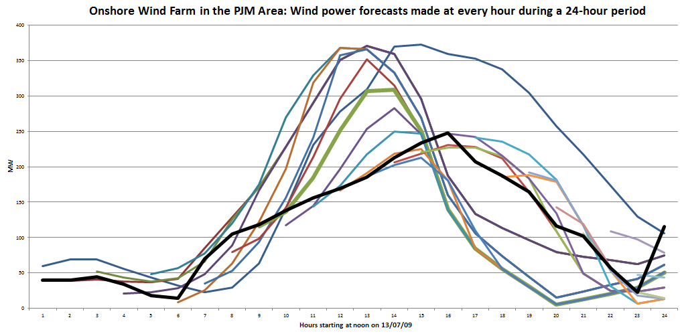
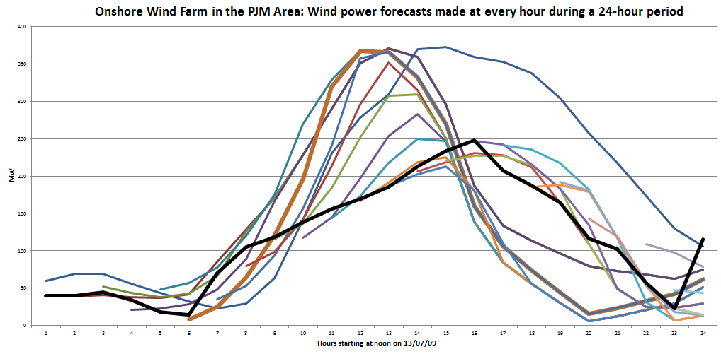
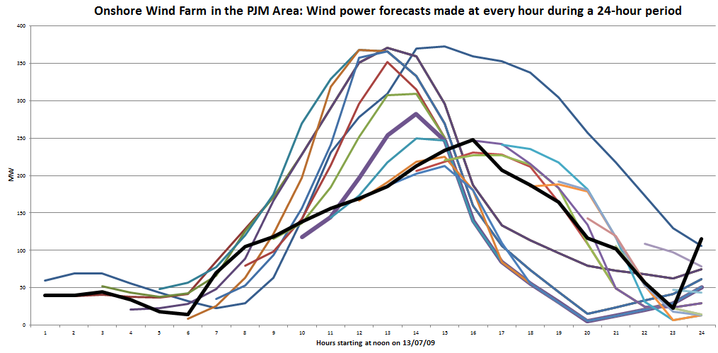
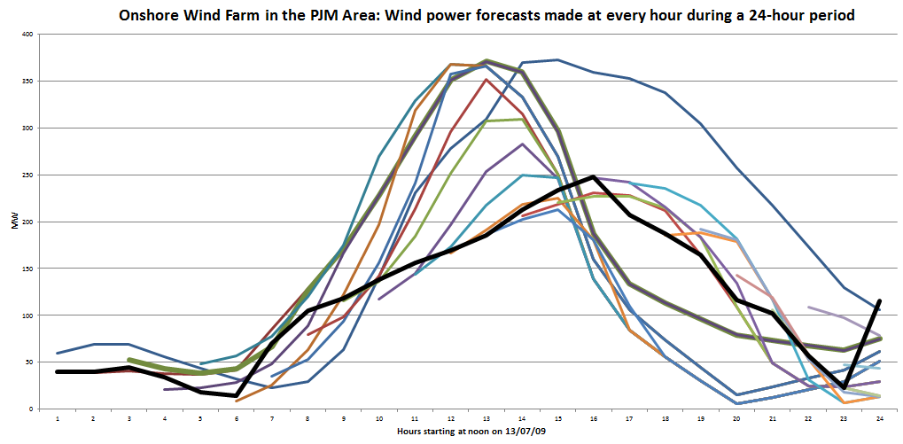
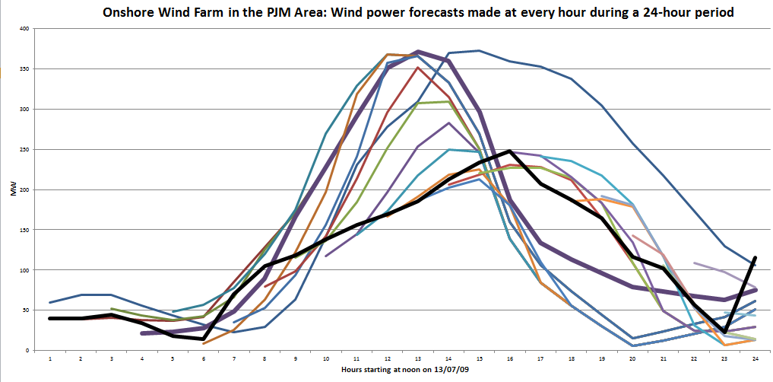
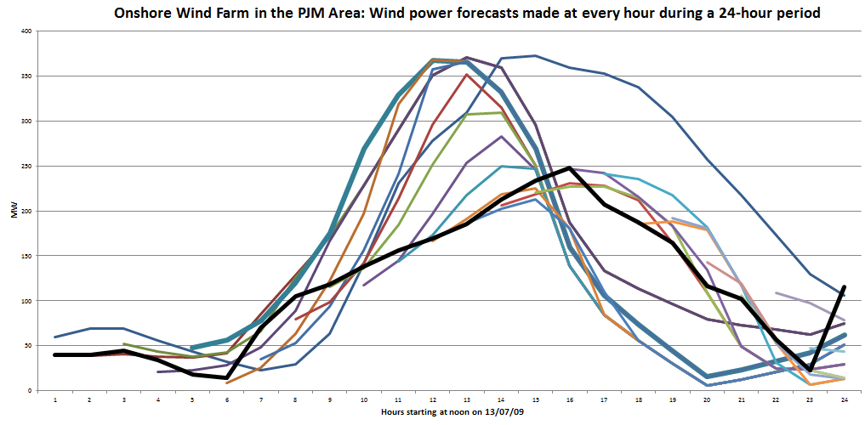
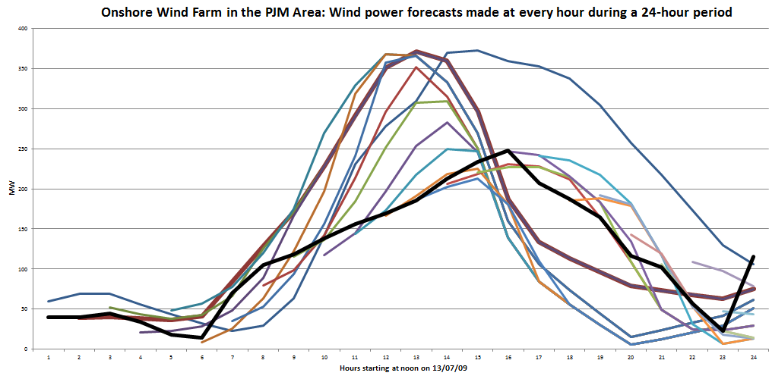
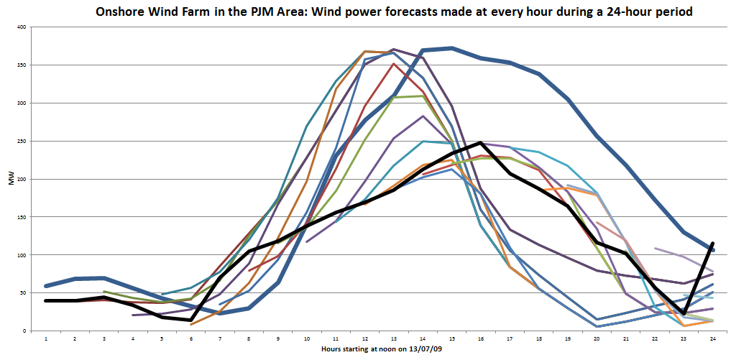
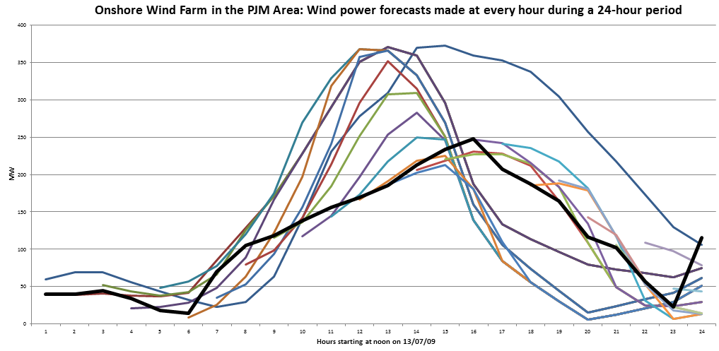
Optimizing a parameterized LP
Wind forecasts evolve over time as new information arrives:
24 hours
Rolling forecasts, updated each hour.
Forecast made at midnight:
Actual

Slide 17
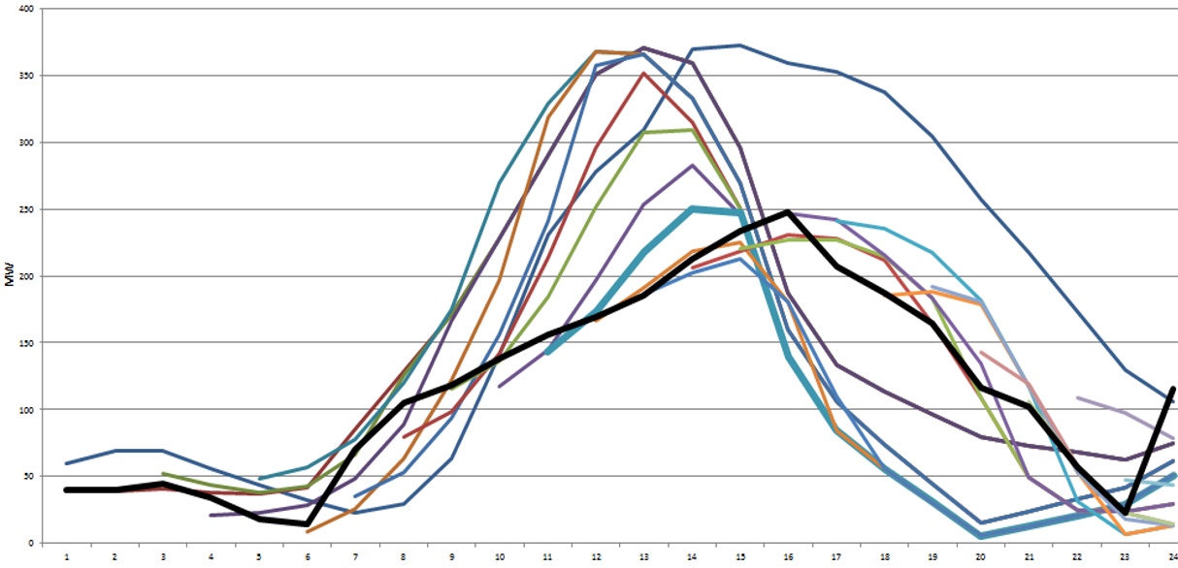

Optimizing a parameterized LP
Benchmark policy – Deterministic lookahead
$${\tilde{x}}_{tt′}^{wd}+β{\tilde{x}}_{tt′}^{rd}+{\tilde{x}}_{tt′}^{gd}≤f_{tt′}^{D} \\ {\tilde{x}}_{tt′}^{gd}+{\tilde{x}}_{tt′}^{gr}≤f_{tt′}^{G} \\ {\tilde{x}}_{tt′}^{rd}+{\tilde{x}}_{tt′}^{rg}≤{\tilde{R}}_{tt′} \\ {\tilde{x}}_{tt′}^{wr}+{\tilde{x}}_{tt′}^{gr}≤R_{tt′}^{max} \\ {\tilde{x}}_{tt′}^{wr}+{\tilde{x}}_{tt′}^{wd}≤f_{tt′}^{E} \\ {\tilde{x}}_{tt′}^{wr}+{\tilde{x}}_{tt′}^{gr}≤γ^{charge} \\ {\tilde{x}}_{tt′}^{rd}+{\tilde{x}}_{tt′}^{rg}≤γ^{discharge}$$
(joint with Saeed Ghadimi)

Slide 18
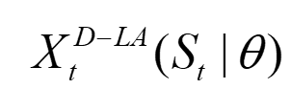
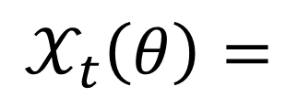


Optimizing a parameterized LP
Benchmark policy – Deterministic lookahead
$${\tilde{x}}_{tt′}^{wd}+β{\tilde{x}}_{tt′}^{rd}+{\tilde{x}}_{tt′}^{gd}≤f_{tt′}^{D} \\ {\tilde{x}}_{tt′}^{gd}+{\tilde{x}}_{tt′}^{gr}≤f_{tt′}^{G} \\ {\tilde{x}}_{tt′}^{rd}+{\tilde{x}}_{tt′}^{rg}≤{\tilde{R}}_{tt′} \\ {\tilde{x}}_{tt′}^{wr}+{\tilde{x}}_{tt′}^{gr}≤R_{tt′}^{max} \\ {\tilde{x}}_{tt′}^{wr}+{\tilde{x}}_{tt′}^{wd}≤θ_{t′−t}f_{tt′}^{E} \\ {\tilde{x}}_{tt′}^{wr}+{\tilde{x}}_{tt′}^{gr}≤γ^{charge} \\ {\tilde{x}}_{tt′}^{rd}+{\tilde{x}}_{tt′}^{rg}≤γ^{discharge}$$
$$𝒳_{t}\left(θ\right)=$$
(joint with Saeed Ghadimi)

Slide 19

Optimizing a parameterized LP
Lookahead policies peek into the future
Optimize over deterministic lookahead model
The lookahead model
. . . .
The real process

Slide 20

Optimizing a parameterized LP
Lookahead policies peek into the future
Optimize over deterministic lookahead model
The lookahead model
. . . .
The real process

Slide 21

Optimizing a parameterized LP
Lookahead policies peek into the future
Optimize over deterministic lookahead model
The lookahead model
. . . .
The real process

Slide 22
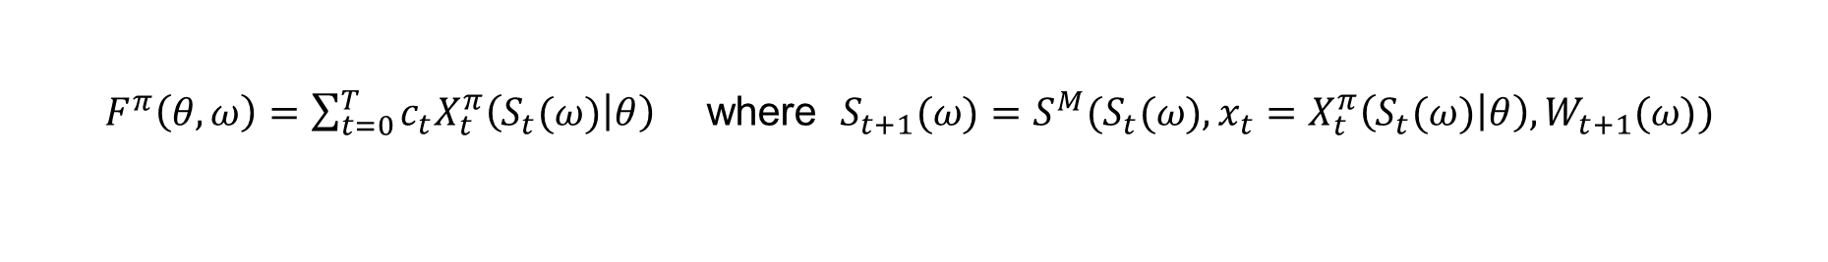
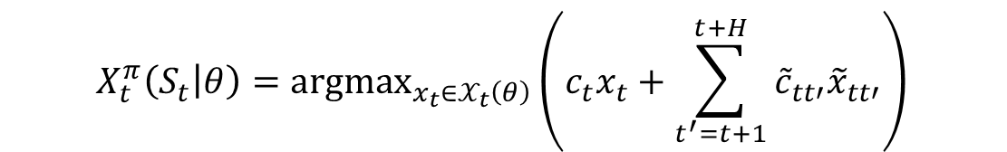
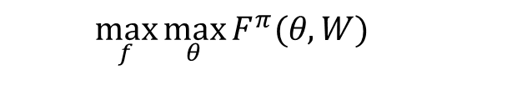

Optimizing a parameterized LP
The policy (deterministic linear program)
The objective function (evaluated using simulation)
Stochastic optimization problem
Stochastic gradient algorithm (using Spall’s SPSA algorithm)
$$X_{t}^{π}\left(S_{t} | θ\right)={argmax}_{x_{t}∈𝒳_{t}\left(θ\right)}\left(c_{t}x_{t}+\sum_{t^{′}=t+1}^{t+H}{{\tilde{c}}_{tt′}{\tilde{x}}_{tt′}}\right)$$
$F^{π}\left(θ,ω\right)=\sum_{t=0}^{T}{c_{t}{X_{t}^{π}\left(S_{t}(ω) | θ\right)}_{}}$ where $S_{t+1}(ω)=S^{M}(S_{t}(ω),x_{t}=X_{t}^{π}\left(S_{t}(ω) | θ\right),W_{t+1}(ω))$
Testing parameterizations
Tuning parameters
$$\max_{f}{\max_{θ}{F^{π}(θ,W)}}$$
$$θ^{n+1}=θ^{n}+α_{n}∇F^{π}(θ^{n},ω^{n+1})$$
(joint with Saeed Ghadimi)

Slide 23
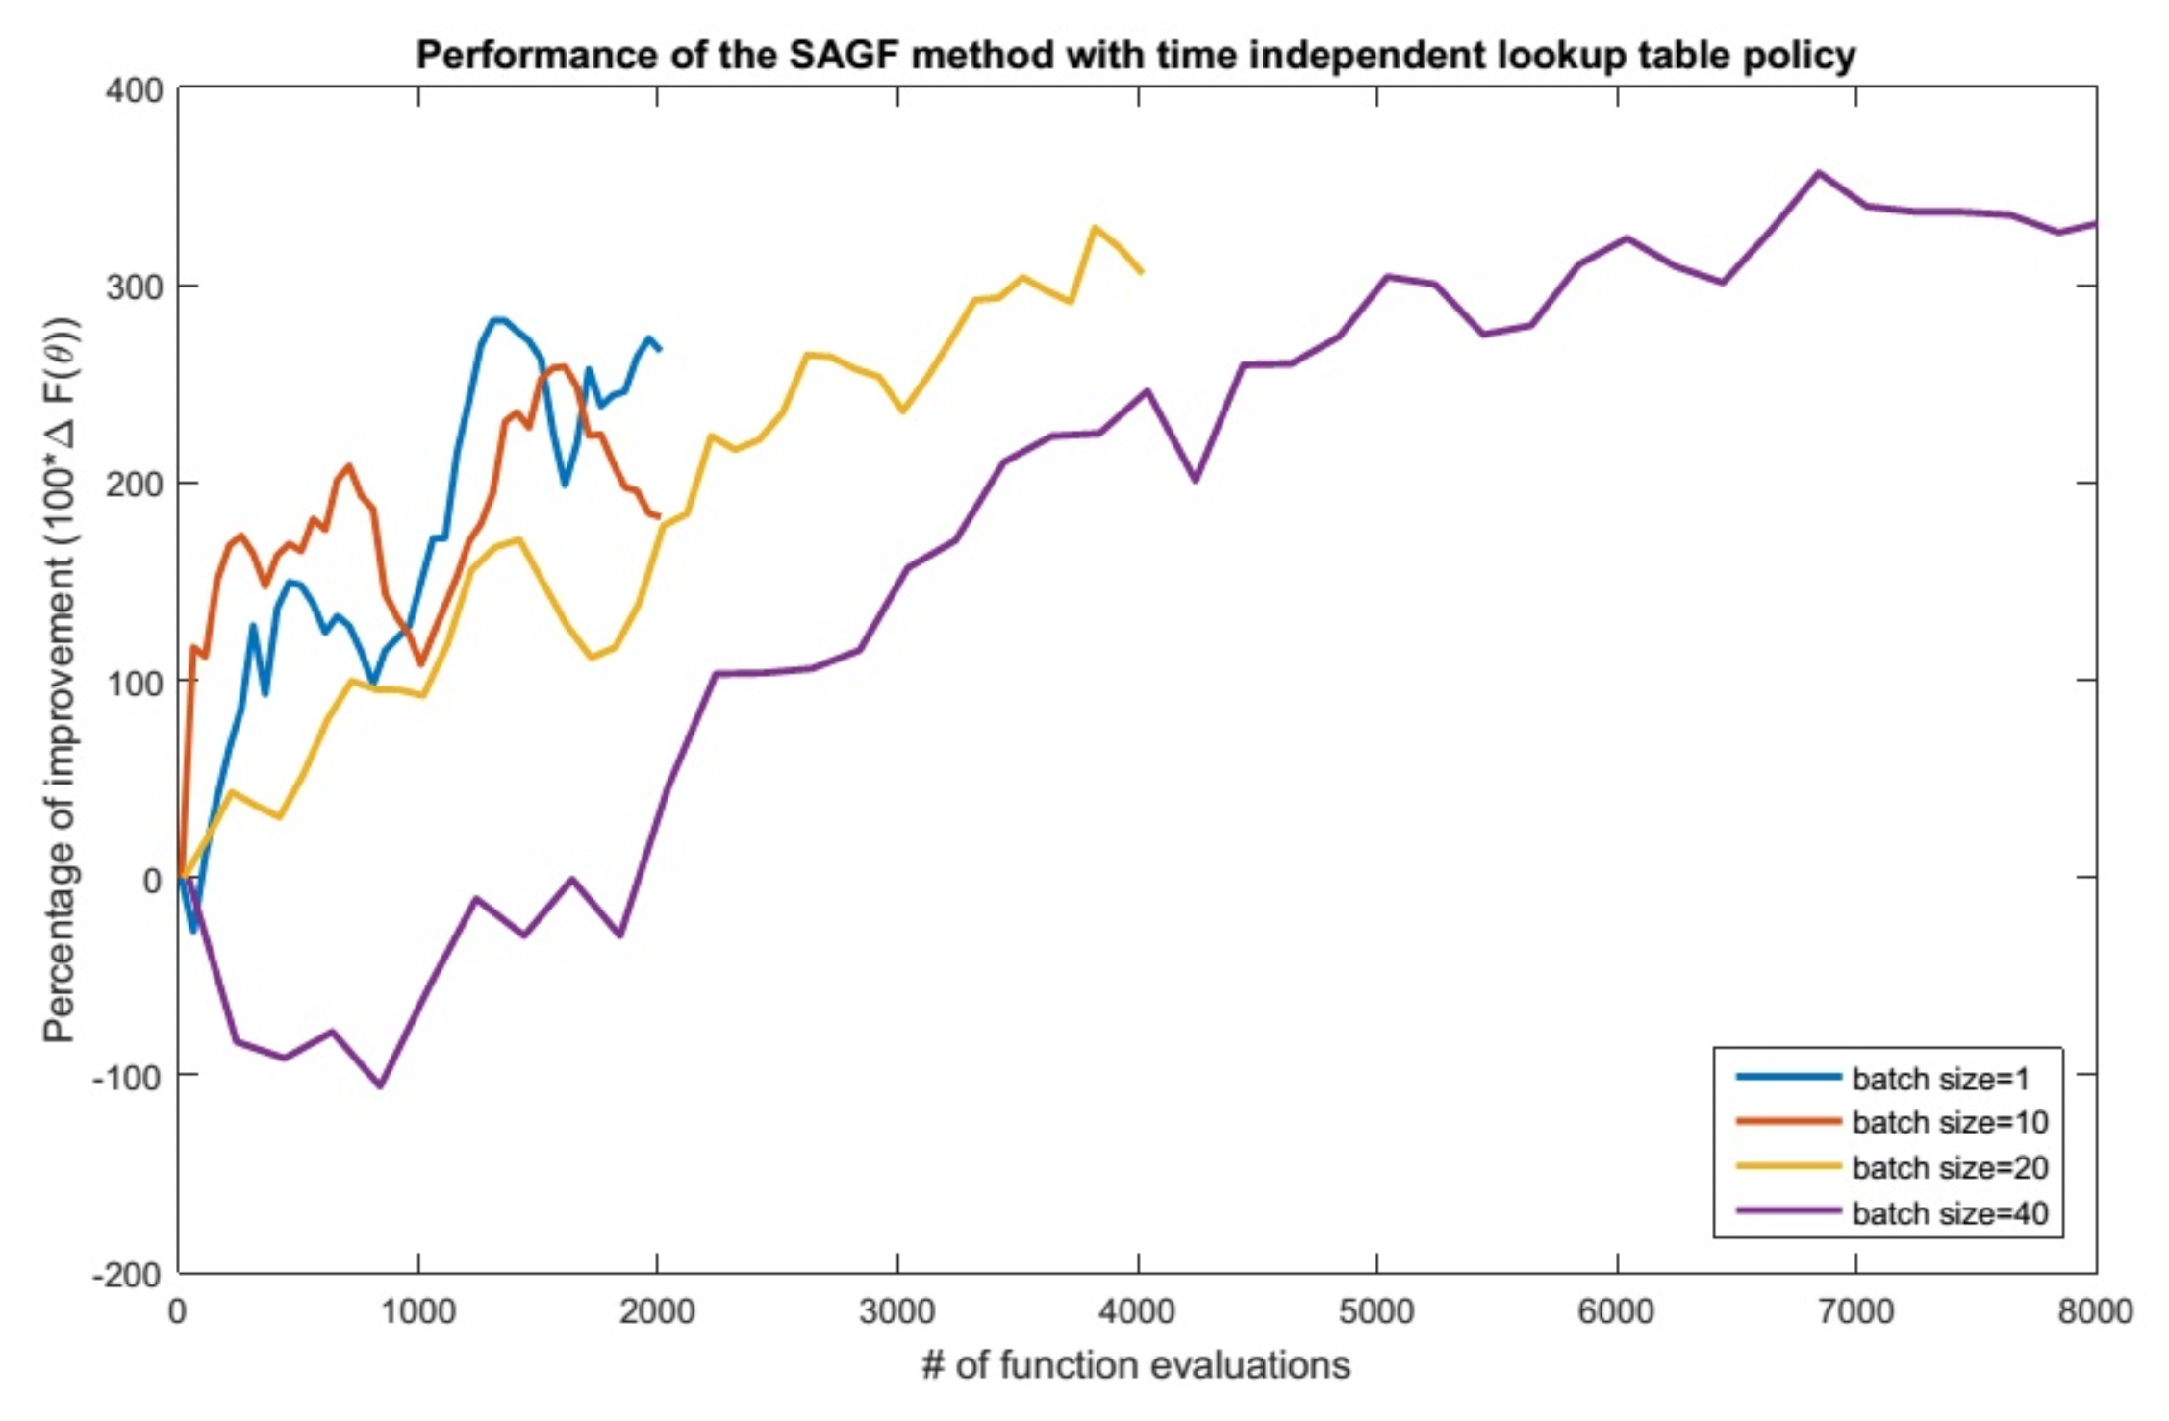
Optimizing a parameterized LP
Mini-batch = 20
Mini-batch = 1
Mini-batch
= 10
Mini-batch = 40
“mini-batch” = number of times we simulate the function to estimate the derivative.
Each point represents the sum of optimal solutions to linear programs (but we keep changing the model).
Number of function evaluations
(joint with Saeed Ghadimi)

Slide 24
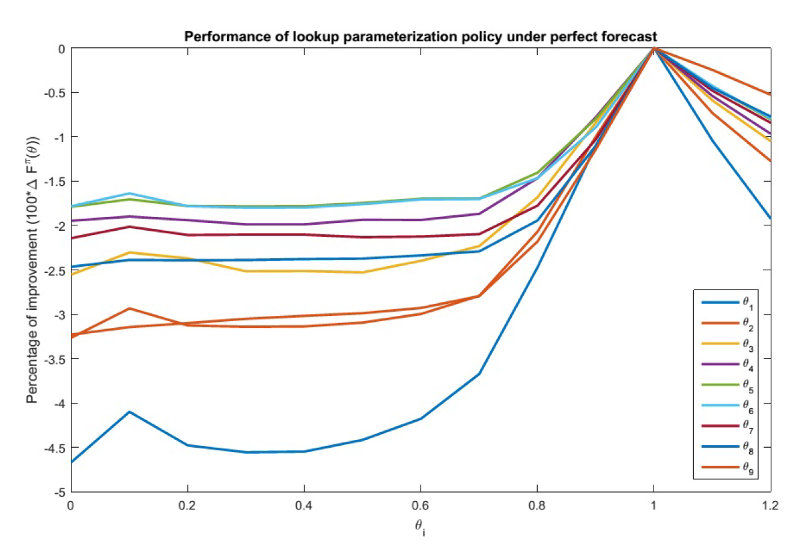


Optimizing a parameterized LP
One-dimensional contour plots – perfect forecast
$$θ_{i}^{∗}=1\text{ for perfect forecasts.}$$
0.0 0.2 0.4 0.6 0.8 1.0 1.2
$$θ$$
(joint with Saeed Ghadimi)

Slide 25
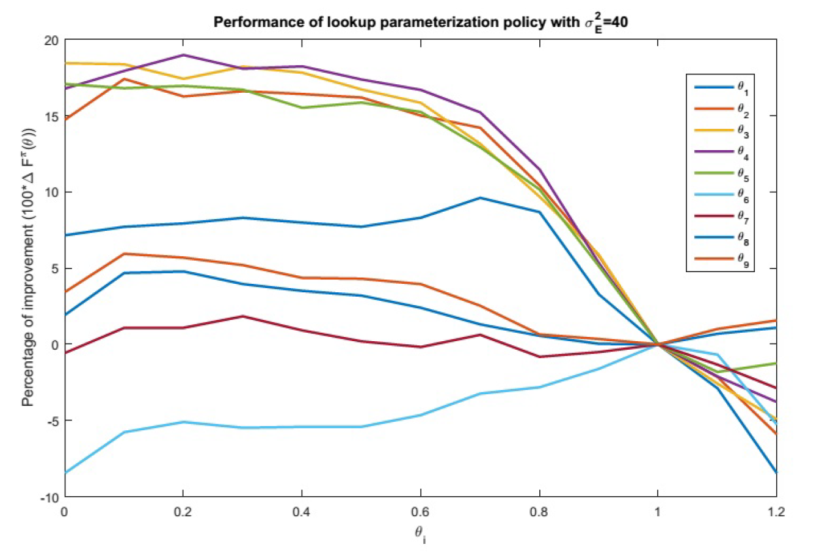




Optimizing a parameterized LP
One-dimensional contour plots - uncertain forecast
$$θ_{2},θ_{3},θ_{4},θ_{5}$$
$$θ_{1}$$
$$θ_{6}$$
0.0 0.2 0.4 0.6 0.8 1.0 1.2
$$θ$$
(joint with Saeed Ghadimi)

Slide 26








Optimizing a parameterized LP
Tuning the parameters
$$θ_{i}=1$$
$$θ_{i}∈[0,1]$$
$$θ_{i}∈[0.5,1.5]$$
$$θ_{i}∈[1,2]$$
Optimized $θ$
30 percent improvement
Percent improvement over $θ=1$
$$θ=1$$
Starting points for stochastic search for $θ$
(joint with Saeed Ghadimi)

Slide 27




Thank you!
For more information see the Sequential Decision Analytics website at
warrenpowell.org
For more on optimal learning go to:
warrenpowell.org → Policies → Cost function approximations
warrenpowell.org → Policies → Direct lookahead approximations Part III

