Slide 1


Tutorial Series on Sequential Decision Analytics
Warren B Powell
Professor Emeritus, Princeton University
Recorded: March 24, 2026
Module: Modeling matters: From model predictive control to sequential decision problems – This is a brief illustration of what can go wrong with improper modeling, using an example from optimizing an energy storage device.
Predecessor module(s):
Introduction to sequential decision problems
Universal modeling framework (high level or detailed)
Technical level: Introduces the subtlety behind the misuse of assuming you can see into the future.

Slide 2

OUTLINE
Modeling matters

Slide 3

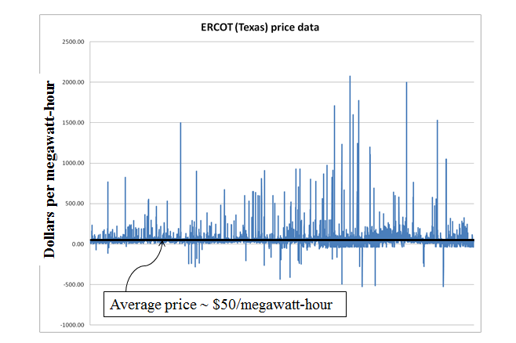
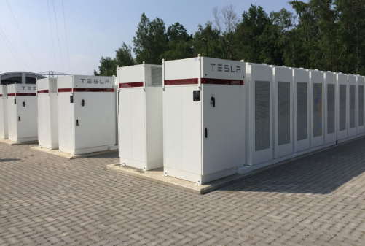
Modeling matters
Battery arbitrage – When to charge, when to discharge, given volatile grid prices

Slide 4
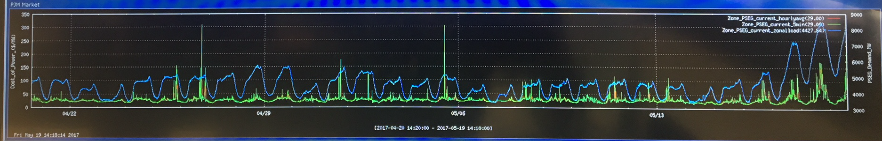
Modeling matters
Snapshot of electricity prices for New Jersey:

Slide 5
Modeling matters
A battery manufacturer proposed to buy and sell energy from and to the grid as prices vary, taking advantage of highs and lows:
Sell
Price
Sell
Sell
Sell
Sell
Sell
Buy
Buy
Buy
Buy
Buy
Buy

Slide 6

Modeling matters
Don’t gamble; take all your savings and buy some good stock and hold it till it goes up, then sell it. If it don’t go up, don’t buy it.
Will Rogers
It is not enough to mix “optimization” (intelligent decision making) and uncertainty. You have to be sure that each decision has access to the information available at the time.

Slide 7
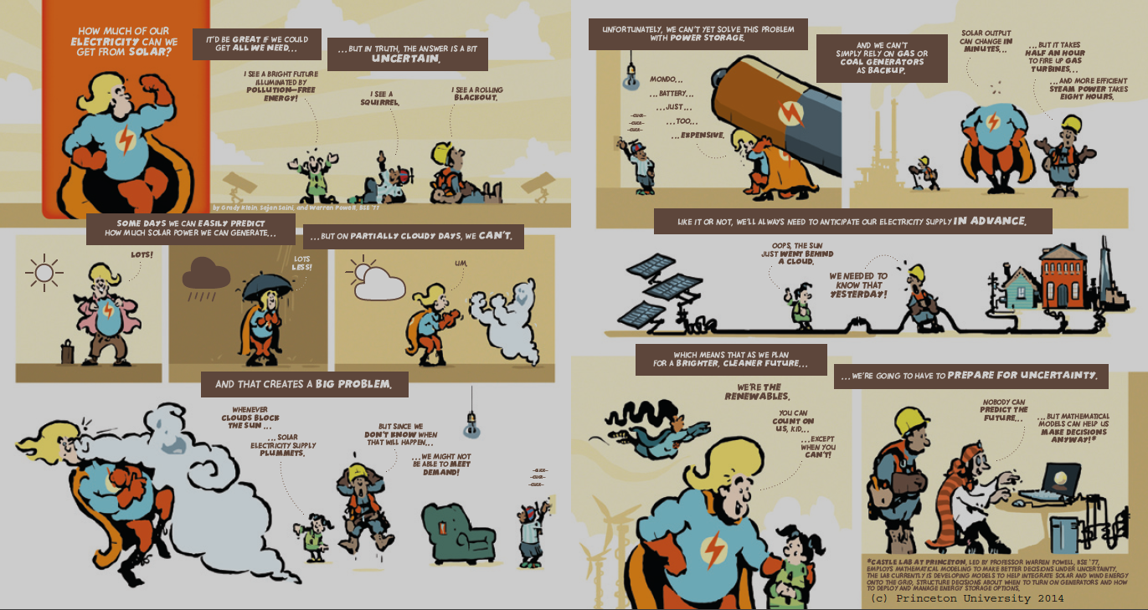


Modeling matters

Slide 8
Modeling matters
The value of knowing the future
$389,000
Cost of
battery
Will Rogers policy
Valid policy

Slide 9

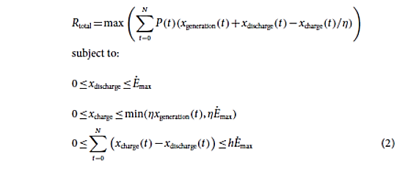
Modeling matters
Stochastic prices
Charge/discharge decisions

Slide 10

Modeling matters
Lookahead policies peek into the future
Optimize over deterministic lookahead model
The lookahead model
. . . .
The real process

Slide 11
Modeling matters
Lookahead policies peek into the future
Optimize over deterministic lookahead model
The lookahead model
. . . .
The real process

Slide 12
Modeling matters
Lookahead policies peek into the future
Optimize over deterministic lookahead model
The lookahead model
. . . .
The real process

Slide 13


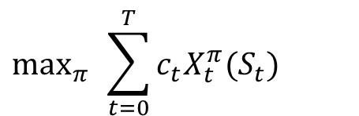
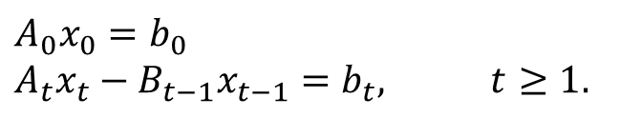

Modeling matters
Imagine that you would like to solve the time-dependent linear program:
subject to
We can fix this by replacing $x_{t}$ with $X^{π}(S_{t})$:
The dynamics are modeled in the transition function:
$$\max_{x_{0},...,x_{T}}{\sum_{t=0}^{T}{c_{t}x_{t}}}$$
$$A_{0}x_{0}=b_{0} \\ A_{t}x_{t}−B_{t−1}x_{t−1}=b_{t}, t≥1.$$
$$\max_{π}{ }\sum_{t=0}^{T}{c_{t}X_{t}^{π}(S_{t})}$$
$$S_{t+1}=S^{M}\left(S_{t},x_{t}=X^{π}(S_{t}),W_{t+1}\right)$$

Slide 14

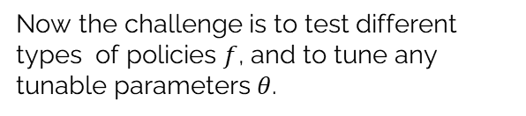
Modeling matters
Imagine that you would like to solve the time-dependent linear program:
subject to
We can fix this by replacing $x_{t}$ with $X^{π}(S_{t})$:
The dynamics are modeled in the transition function:
$$\max_{x_{0},...,x_{T}}{\sum_{t=0}^{T}{c_{t}x_{t}}}$$
$$A_{0}x_{0}=b_{0} \\ A_{t}x_{t}−B_{t−1}x_{t−1}=b_{t}, t≥1.$$
Now the challenge is to test different types of policies $f$, and to tune any tunable parameters $θ$.
$$\max_{π}{ }\sum_{t=0}^{T}{c_{t}X_{t}^{π}(S_{t})}$$
$$S_{t+1}=S^{M}\left(S_{t},x_{t}=X^{π}(S_{t}),W_{t+1}\right)$$

Slide 15


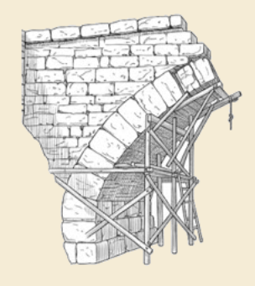

Thank you!
For more information see the Sequential Decision Analytics website at
warrenpowell.org

