Slide 1
.
Sequential decision analytics and modeling
ORF 411
Fall, 2018
Warren Powell
Princeton University
http://www.castlelab.princeton.edu
© 2017 Warren B. Powell, Princeton University

Slide 2

Week 5 – Monday
Energy storage I

Slide 3

Presentation on energy storage in Brazil

Slide 4
The Brazilian Electricity Sector
Energy mix, grid operation and challenges for integrating intermittent sources to the system

Slide 5
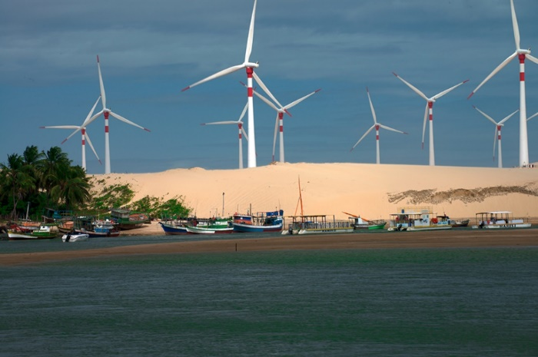
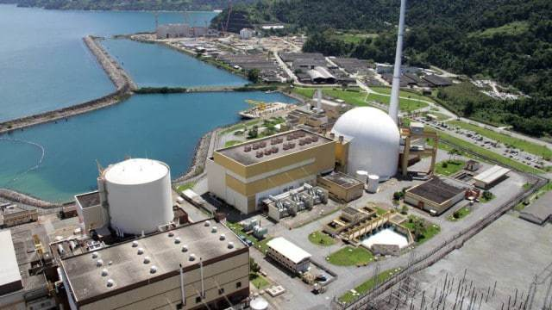


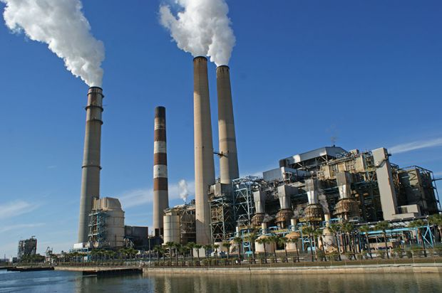
Brazilian Energy Mix

Slide 6
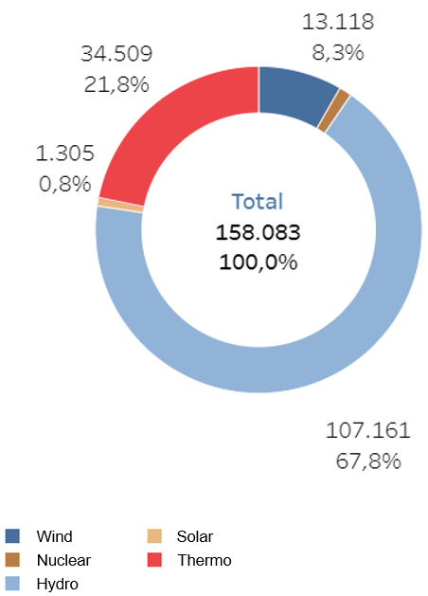
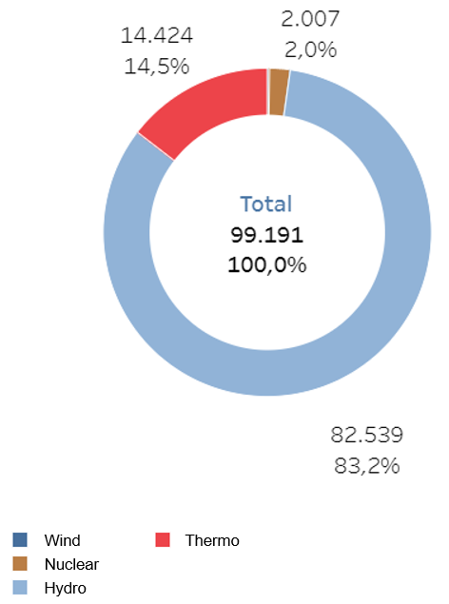
Brazilian Energy Mix
Capacity (MW) per type – August/2018
Capacity (MW) per type – August/2008
13,118
8.3%
14,424
14.5%
2,007
2.0%
34,509
21.8%
1,305
0.8%
158,083
100.0%
99,191
100.0%
107,161
67.8%
82,539
83.2%
Source: Adapted from ONS (2018).

Slide 7
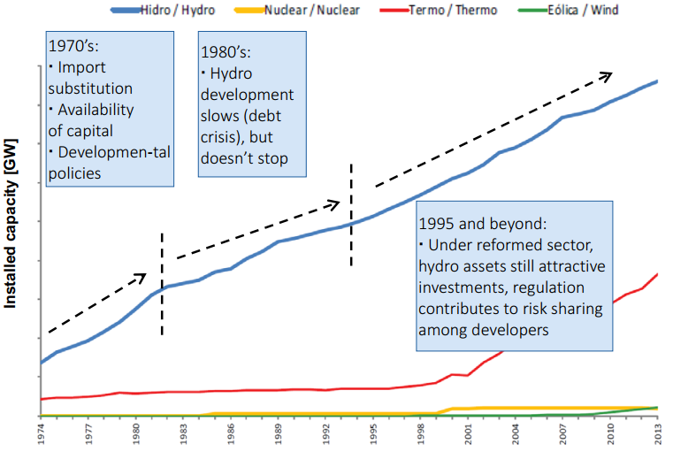
Brazilian Energy Mix
90
Source: Adapted from EPE (2018).

Slide 8
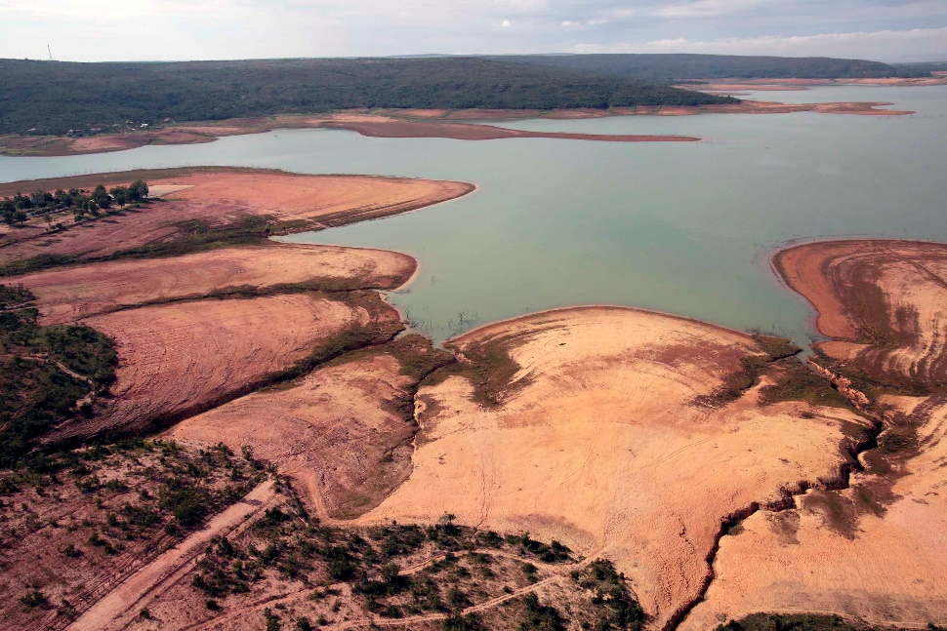
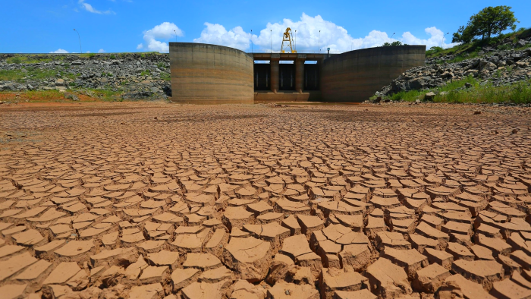
2014 Brazilian drought

Slide 9
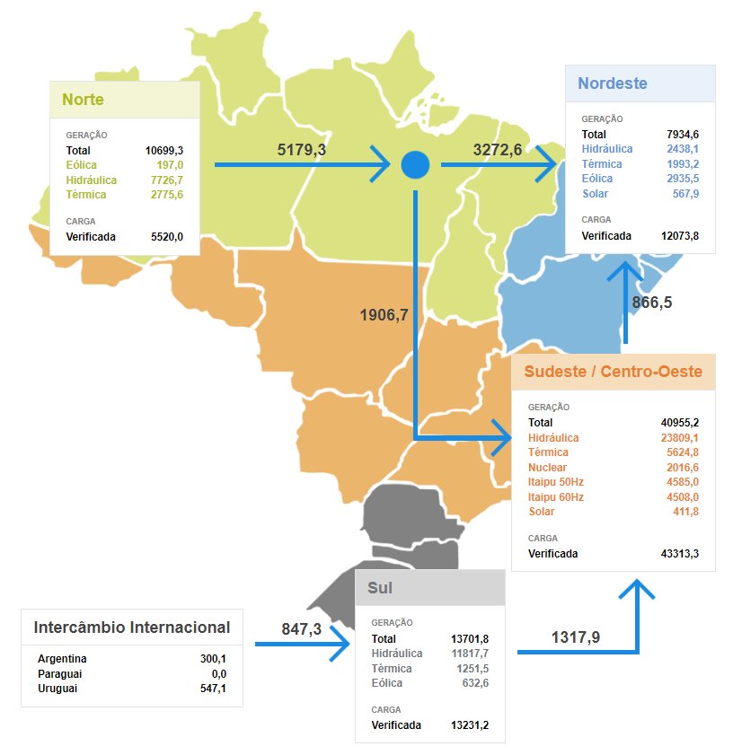

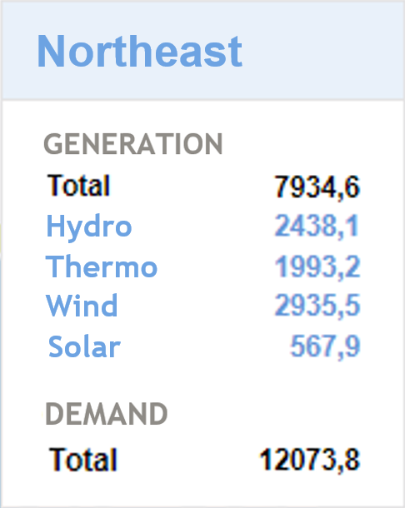
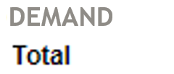
Interconnected National System
Northeast
POWER IN MW
North
Hydro
Wind
Thermo
Hydro
Wind
Thermo
Solar
Midwest/Southeast
Date and time: 10/04/18 at 14:24
Hydro
Thermo
Nuclear
Itaipu 50 Hz
Itaipu 60 Hz
Solar
South
Energy Imports
Argentina
Hydro
Source: Adapted from ONS (2018).
Paraguay
Thermo
Uruguay
Wind

Slide 10
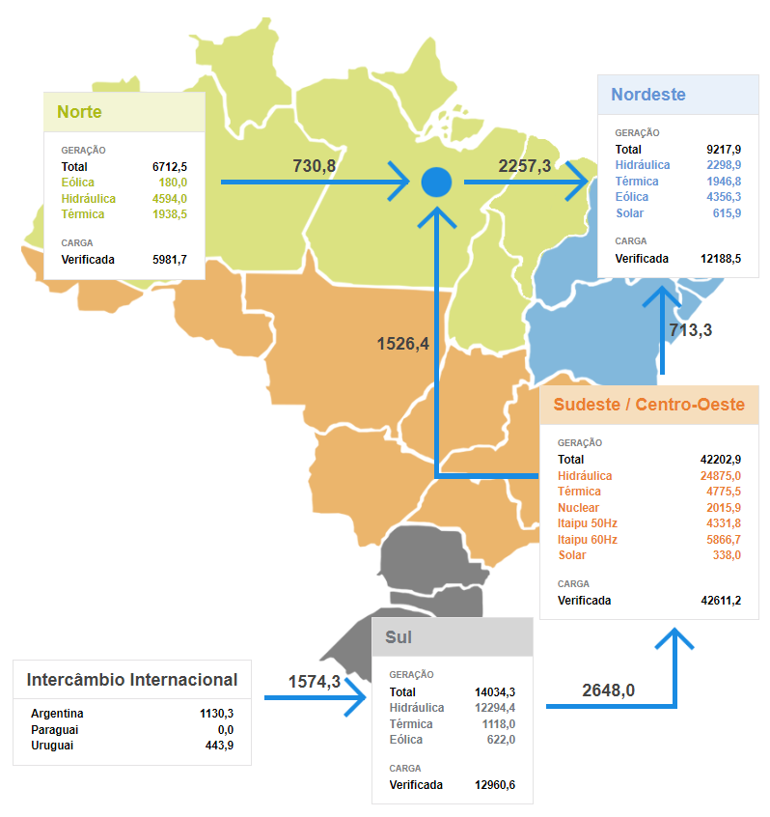
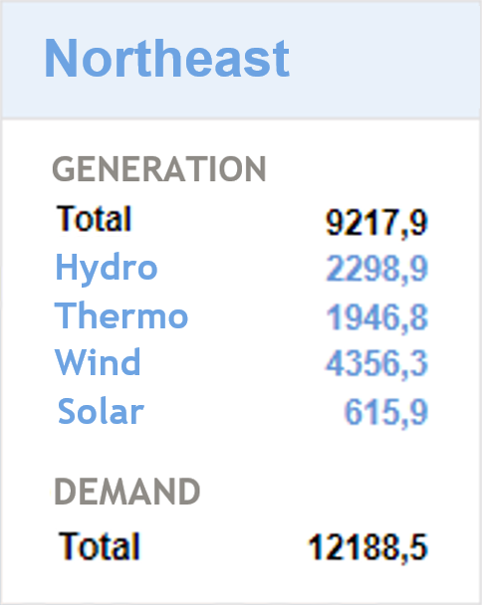
Interconnected National System
Northeast
POWER IN MW
North
Hydro
Wind
Thermo
Hydro
Wind
Thermo
Solar
Midwest/Southeast
Date and time: 10/05/18 at 13:39
Hydro
Thermo
Nuclear
Itaipu 50 Hz
Itaipu 60 Hz
Solar
South
Energy Imports
Argentina
Hydro
Source: Adapted from ONS (2018).
Paraguay
Thermo
Uruguay
Wind

Slide 11
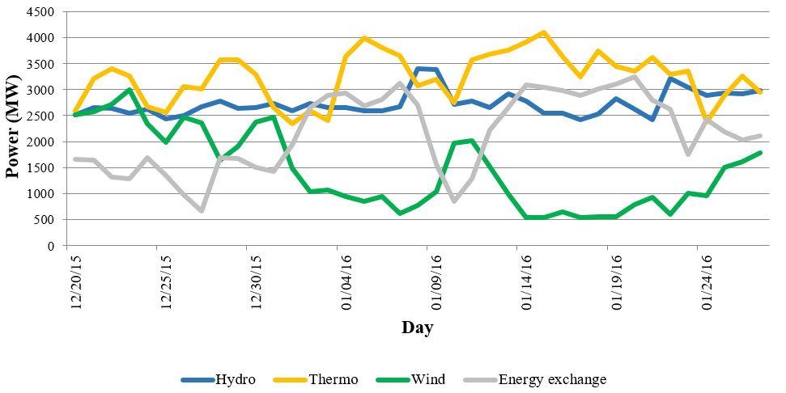
Intermittent generation
Generation in Northeastern Subsystem
Source: Adapted from EPE (2018).

Slide 12
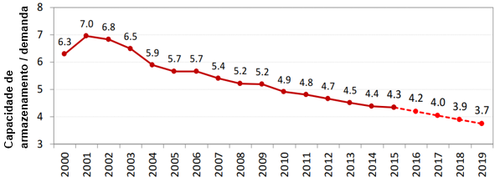
Current storage options
Hydro with reservoirs
Thermo fuel
Storage capacity / demand (%)
Source: Adapted from EPE (2018).

Slide 13
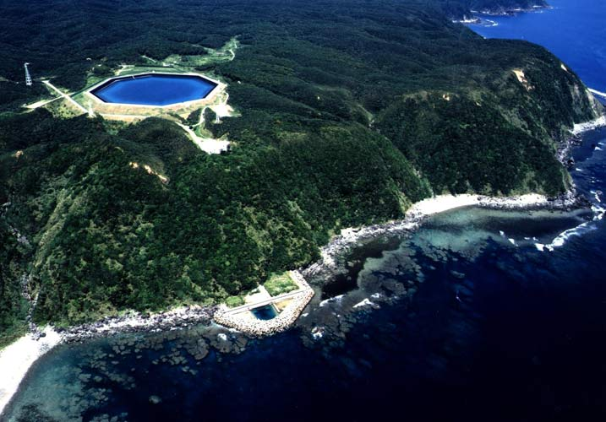
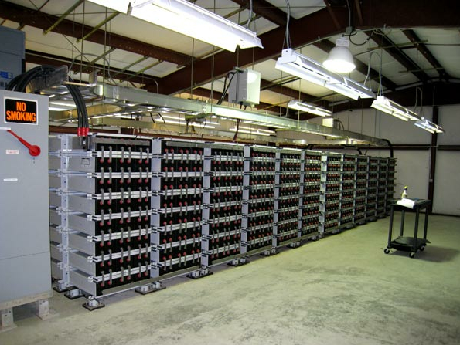
Energy Storage Systems
Energy storage systems can help mitigating wind intermittence
Source: DOE (2010).

Slide 14
Narrative

Slide 15
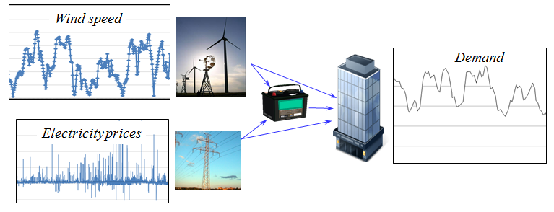
An energy storage problem
Consider a basic energy storage problem:
We are going to show that with minor variations in the characteristics of this problem, we can make each class of policy work best.

Slide 16
There are many variations of “storage problems.”
Inventory planning at Amazon (or any retailer)
How much cash to keep in a mutual fund.
How much blood to keep in a blood bank.
How many vaccines to keep in inventory

Slide 17
Basic model

Slide 18
An energy storage problem
A model of our problem
State variables
Decision variables
Exogenous information
Transition function
Objective function

Slide 19
An energy storage problem
State variables
We will present the full model, accumulating the information we need in the state variable.
We will highlight information we need as we proceed. This information will make up our state variable.
L
E
B
G

Slide 20
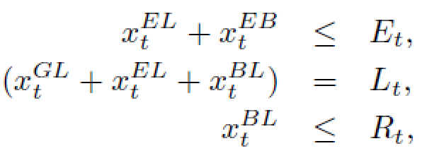
An energy storage problem
Decision variables
Constraints;
L
E
B
G

Slide 21
An energy storage problem
Exogenous information
L
E
B
G

Slide 22
An energy storage problem
Transition function
L
E
B
G

Slide 23
An energy storage problem
Objective function
L
E
B
G

Slide 24
An energy storage problem
State variables
Cost function
Decision function
Constraints:
Transition function

Slide 25
Designing policies
PFA for:
Simple battery arbitrage
More complex storage problem

Slide 26
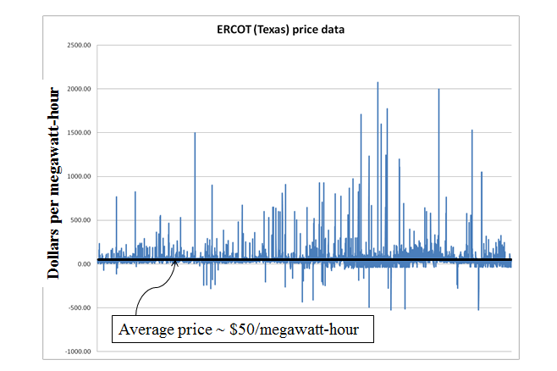
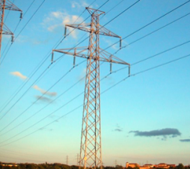
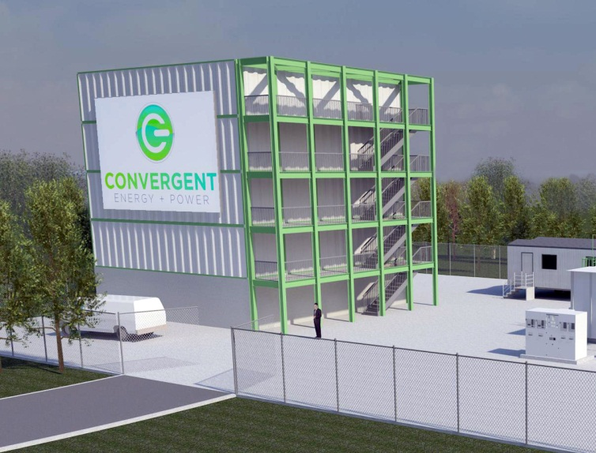
Policy function approximations
Battery arbitrage – When to charge, when to discharge, given volatile LMPs

Slide 27
Policy function approximations
Grid operators require that batteries bid charge and discharge prices, an hour in advance.
We have to search for the best values for the policy parameters

Slide 28
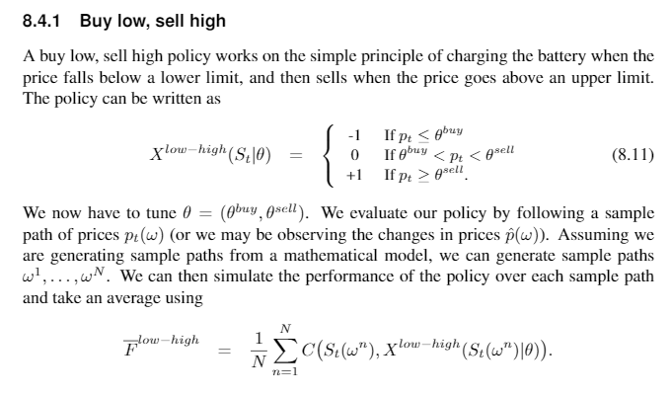
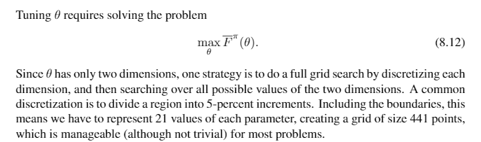

Slide 29
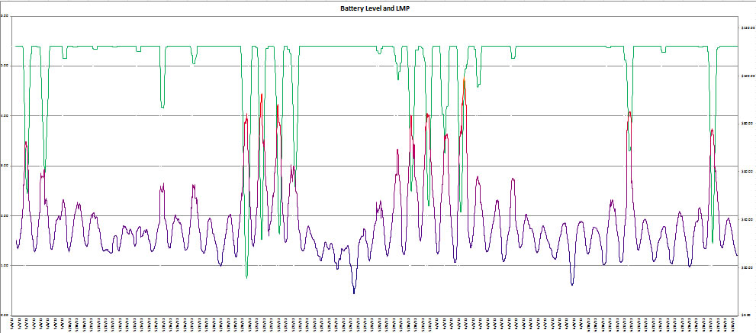
Policy function approximations
Our policy function might be the parametric model (this is nonlinear in the parameters):
Energy in storage:
Price of electricity:

Slide 30
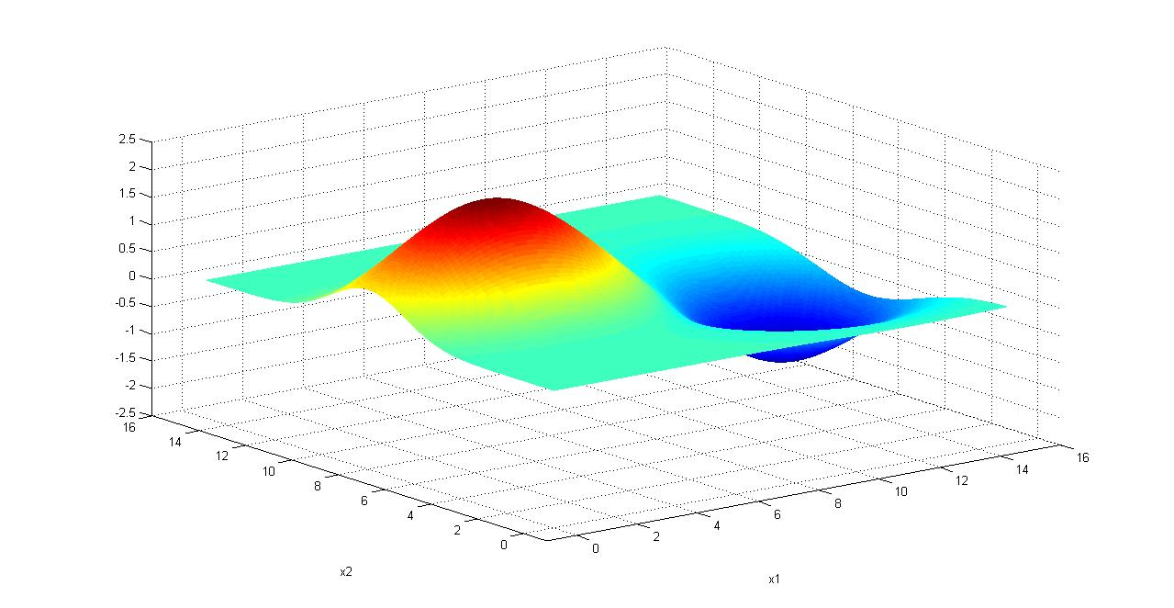
Policy function approximations
Finding the best policy
We need to maximize
We cannot compute the expectation, so we run simulations:
Notes:
30

Slide 31
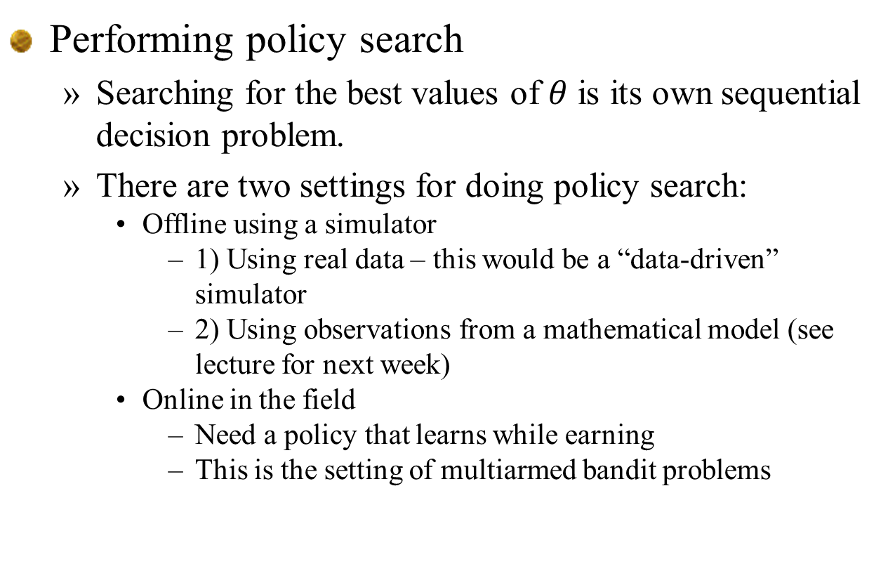
Policy function approximations
Performing policy search
Searching for the best values of $θ$ is its own sequential decision problem.
There are two settings for doing policy search:
Offline using a simulator
1) Using real data – this would be a “data-driven” simulator
2) Using observations from a mathematical model (see lecture for next week)
Online in the field
Need a policy that learns while earning
This is the setting of multiarmed bandit problems

