Slide 1
.
Sequential decision analytics and modeling
ORF 411
Fall, 2018
Warren Powell
Princeton University
http://www.castlelab.princeton.edu
© 2017 Warren B. Powell, Princeton University

Slide 2

Week 9 - Monday
Beer game discussion

Slide 3

Results of the beer game

Slide 4
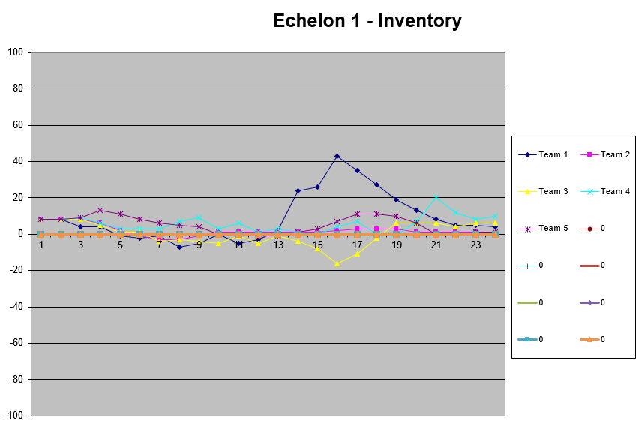

Slide 5
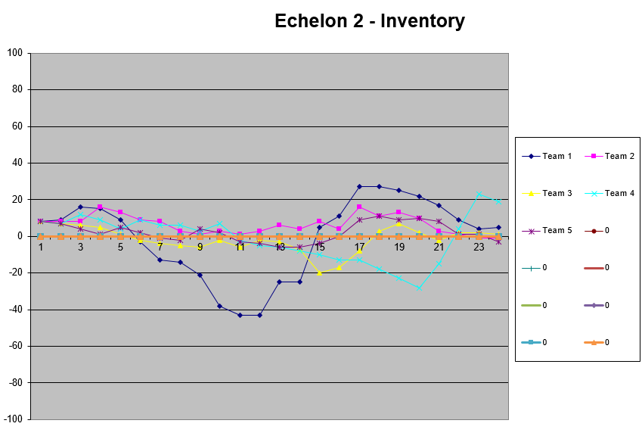

Slide 6
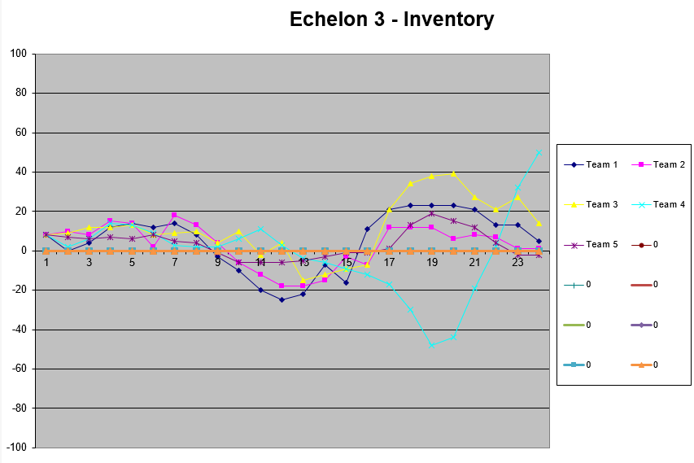

Slide 7
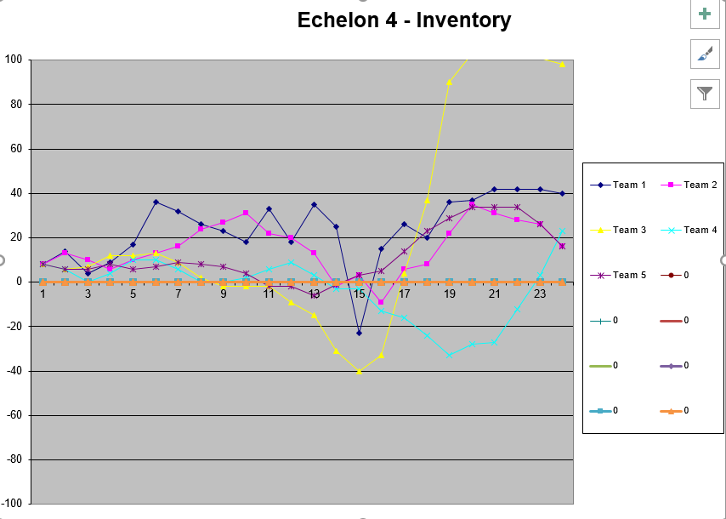

Slide 8
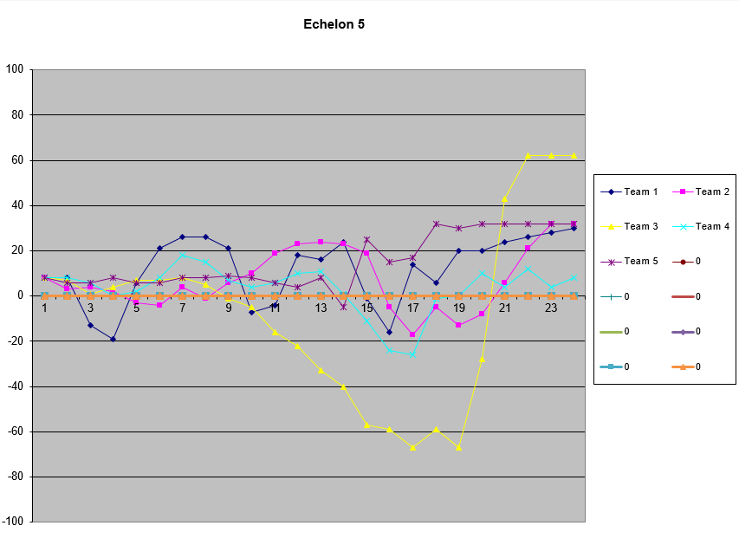

Slide 9
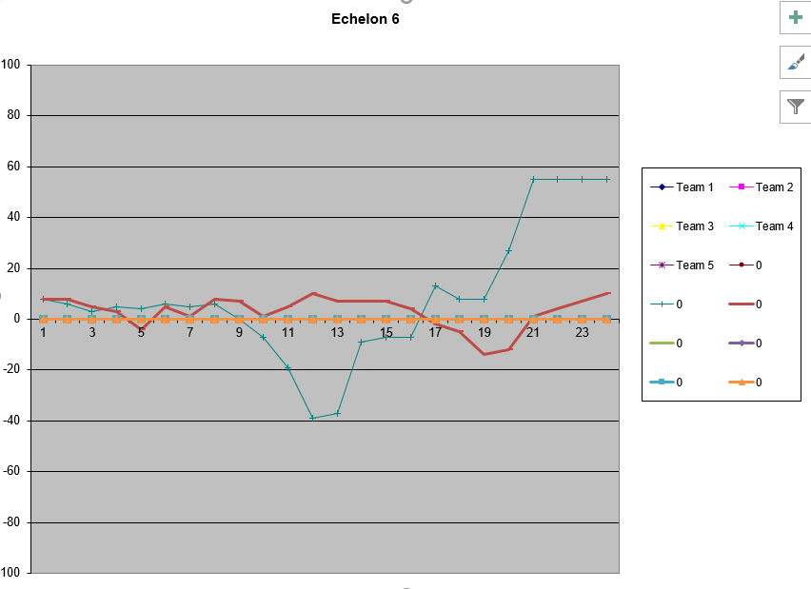

Slide 10
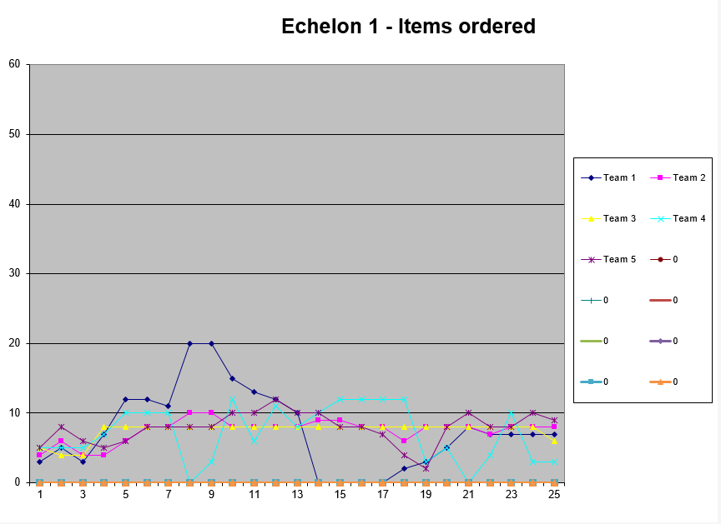

Slide 11


Slide 12
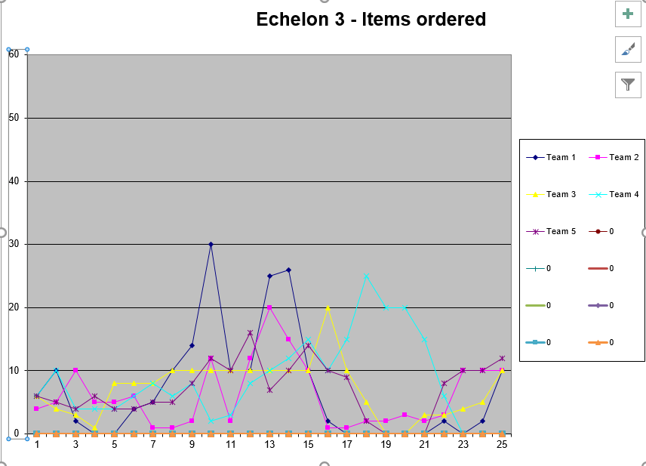

Slide 13
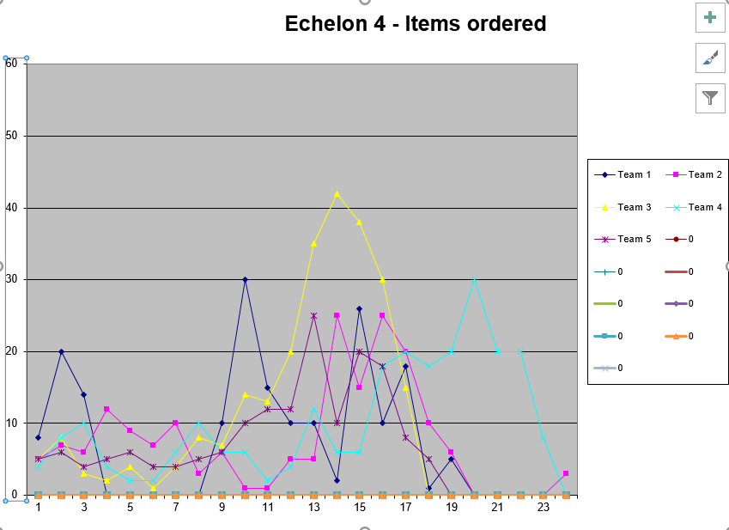

Slide 14
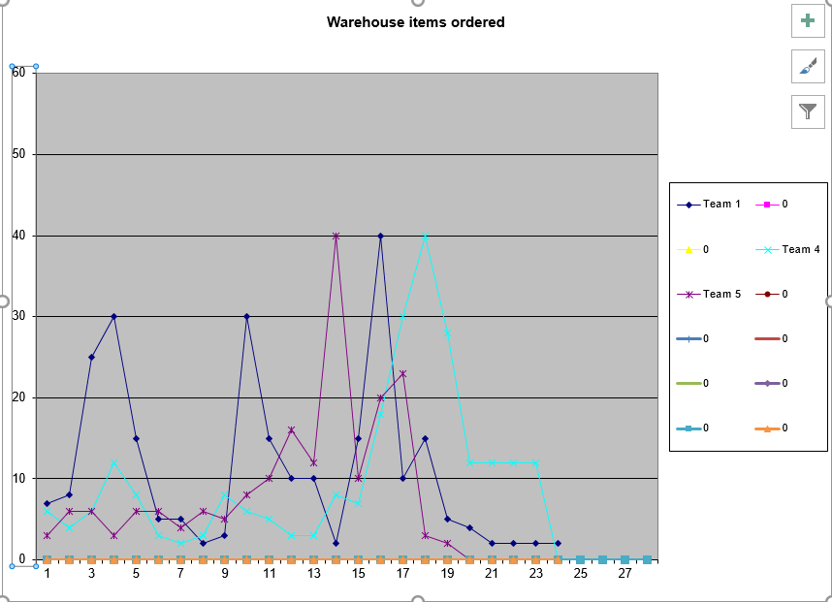

Slide 15
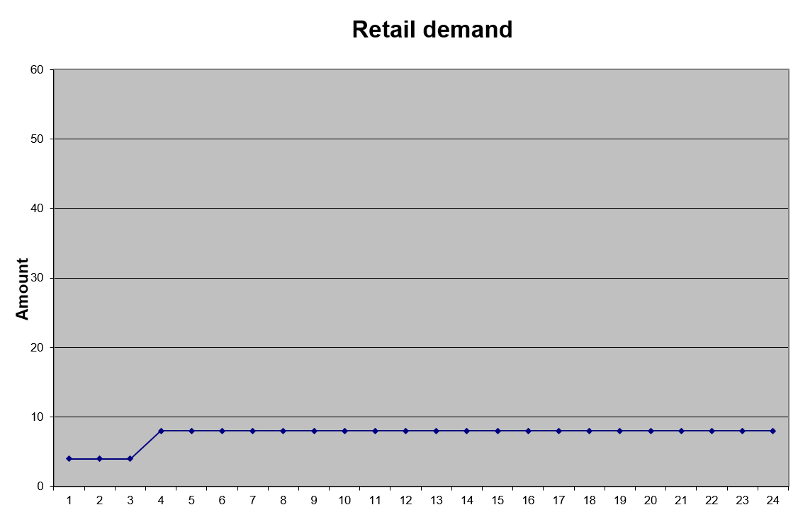

Slide 16
Information exchange problems
Communication network
Draw on board – handout copy of full diagram to students

Slide 17
Two-agent newsvendor schematic
-
-
+
average
+
-
+
average
+
-
-
+
average
Player
Noise
Filter
Positive Feedback (Set Point)
Feedback Controller
Negative Feedback
Input Weighting
Junction (or Summation)
System Input

Slide 18
Two-agent newsvendor schematic
The error with which we perceive the need, with bias and noise. We can reduce these by making investments in information technology.
The “agent” that has to think and decide how much to order.
+
-
Exogenous requirement. represents the real need which we cannot measure perfectly.
Our agent wants to solve:
Player
Noise
As in the past, he does not know exactly what is required, but does know if he requested too much or too little.
Filter
Positive Feedback (Set Point)
Feedback Controller
Negative Feedback
Input Weighting
Junction (or Summation)
System Input

Slide 19
Two-agent newsvendor schematic
Request from “field” to “command” for resources.
+
-
+
-
-
+
average
Player
Noise
Filter
Positive Feedback (Set Point)
Feedback Controller
Negative Feedback
Input Weighting
Junction (or Summation)
System Input

Slide 20
Two-agent newsvendor schematic

Slide 21
Two-agent newsvendor schematic
An independent source of information (usually with more noise).
-
+
-
+
average
+
-
-
+
average
Our central command agent q has to combine these two sources of information.

Slide 22
Two-agent newsvendor schematic

Slide 23
Two-agent newsvendor schematic

Slide 24
Two-agent newsvendor schematic
The level of noise from our exogenous source can be reduced by investing in information.
-
+
-
+
average
+
-
-
+
average
Weighting the two inputs provides the best estimate of the actual need.
But how do we get the estimates of the variances?

Slide 25
Two-agent newsvendor schematic
-
+
-
+
average
+
-
-
+
average
Resources granted by the “central command”

Slide 26
Two-agent newsvendor schematic
-
-
+
average
+
-
+
average
+
-
-
+
average
Here we “learn” what happened after the fact. We can use this information to learn about biases and variances, and use this for future calculations.

Slide 27
Two-agent newsvendor schematic

Slide 28
Two-agent newsvendor schematic
-
-
+
average
+
-
+
average
+
-
-
+
average
The central command also learns what happens after the fact, and is thus able to estimate biases, variances, etc.

Slide 29
Two-agent newsvendor schematic
There may be communication errors from the central command back to the field.
-
-
+
average
+
-
+
average
+
-
-
+
average
But we may not learn exactly what was needed, and each agent has different information channels with different levels of noise.

Slide 30
Two-agent newsvendor schematic
-
-
+
average
+
-
+
average
+
-
-
+
average
The agent looks at what was really needed (as best as he can measure it) and compare this to what the central command actually gave him. From this, he can identify biases in the behavior of the central command, and account for this in future requests.

Slide 31
Two-agent newsvendor schematic

Slide 32
Two-agent newsvendor schematic
-
-
+
average
+
-
+
average
+
-
-
+
average
Player
Noise
Filter
Positive Feedback (Set Point)
Feedback Controller
Negative Feedback
Input Weighting
Junction (or Summation)
System Input

Slide 33
Feedback loops and misinformation

Slide 34
Feedback loops and misinformation
What are sources of misinformation in resource allocation problems?
If we run out of resources, does this mean demand was too high?
If we did not run out of resources, does this mean demand was too low?
How do we estimate productivity? How do we estimate how many resources are required?

Slide 35
The forms of misinformation
Sources of misinformation in the feedback process:
Bias from information hiding:
Censoring:
Too few resources are allocated, all resources are used, and actual demand is hidden.
Inflation:
Too many resources are allocated by central command.
Field agent uses resources inefficiently to make it appear that the right amount was requested.
Spend more time finishing a project
Spend money unnecessarily – Ryder example: management bought a lot of furniture and the profits were reduced; company did not want such a large bump in profits – would set unrealistic expectations.
Hiding
The resources are there and available to be used, but the field agent does not allow them to be recorded.
Hiding people: make them appear as if they are assigned to a project
Hiding money: put it in a budget allocated to a project

Slide 36
The forms of misinformation
Sources of misinformation in the feedback process:
Bias from information hiding (cont’d)
“Shrinkage”
Resources are reduced due to theft, spoilage, breakage.
Rationing/hoarding:
Too few resources are allocated, but resources are still left over. Agent has held resources for future potential uses, even if demand is not satisfied. So, it appears we have resources, but in reality we would have run out. We were “hiding” low priority demands.
Measurement error
May be reduced through investment in information technology.
Sensors on equipment; auditing accounts; etc.
36
Notes:
36

Slide 37
Designing policies
Anchor and adjustment for the beer game

Slide 38
Behavioral dynamics
How did you make decisions?
What was your thought process?
How would you classify your decision-making progress in terms of the four types of policies introduced earlier?
Myopic policy
Lookahead
Policy function approximation (which kind?)
Policy based on value function approximation

Slide 39
Behavioral dynamics
A common policy structure is called anchor and adjustment:
Anchor: A fixed action, possibly based on a plan (a set of actions based on a particular set of future events or an expected system state).
Adjustment: Changes made to the “anchor” based on deviations from planned future events or deviation from an expected system state.

Slide 40
Behavioral dynamics
What information did we have?

Slide 41
Behavioral dynamics
Lead time
Quantity
Time

Slide 42
Behavioral dynamics
Observation:
If there was no lead time (and no fixed order cost), what would you do?
Why would you do otherwise?
Uncertainties in order lead times?
Need to build up larger buffer inventory?
Anticipation of higher demand?
Current stock under/over what you think you need?
We need to make “adjustments” to our basic model.

Slide 43
Behavioral dynamics
Refining our model:
Behavioral strategy - anchor and adjustment (Tversky)
Anchor - Create a known reference point
Adjustment - Change based on position relative to the anchor.
Let:
New behavioral model:
Since this may be negative, our new ordering model is:

Slide 44
Behavioral dynamics
Calculating the perceived loss rate:
Possible models:

Slide 45
Behavioral dynamics
Adjustments:
For current stock:
What is R* a function of?

Slide 46
Behavioral dynamics
Adjustments:
For supply line:

Slide 47
Behavioral dynamics
Observation:
Anchoring and adjustment is an exceptionally powerful model.
General method:
Find an anchor by solving a simple version of the problem
Develop adjustment mechanisms based on available information.
Examples:
What quantity to order (product, investment, energy storage)?
Anchor – based on expectation
Adjustment – over time, build up an idea of safety stock

