Slide 1
.
Sequential decision analytics and modeling
ORF 411
Fall, 2018
Warren Powell
Princeton University
http://www.castlelab.princeton.edu
© 2017 Warren B. Powell, Princeton University

Slide 2

Week 12 – Blood management

Slide 3

Narrative

Slide 4



Blood management
Blood collection organizations:
American Red Cross
36 regional centers and five testing facilities
Highly centralized
America’s Blood Centers
Started in competition to Red Cross.
Serves independent blood centers.
Each handles about half of civilian supply
Department of Defense
Runs blood bank program for the military.

Slide 5
Blood management
Community blood centers
Donation Process
Eligibility Requirements
Blood donors vary by race, which affects the distribution of blood types.
Some donated blood is lost due to contamination.
Transfusion Process
Community blood centers distribute to hospitals
Crossmatching process
CBC
HBB
HBB
CBC
HBB
HBB
Hospital blood banks
HBB

Slide 6
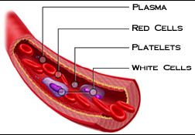
Blood management
Components of Blood
Red Blood Cells:
42 day shelf-life
8 blood types with various substitution possibilities
Different products such as frozen RBC

Slide 7
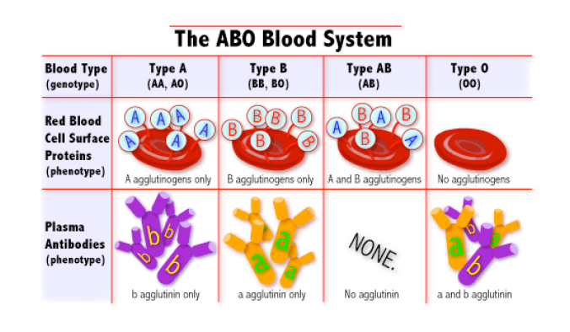
Blood management
Blood types:
A and B antigens
Produces A, B, AB and O
The Rh antigen
Present (+)
Not present (-)

Slide 8
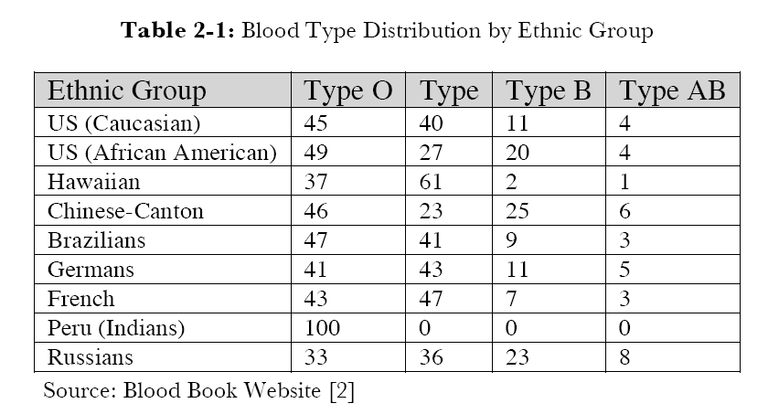


Blood management

Slide 9
Blood management
Donations by ethnicity

Slide 10
Blood management
Supply and demand distributions
Donations
Depends on age, race, income and geography

Slide 11
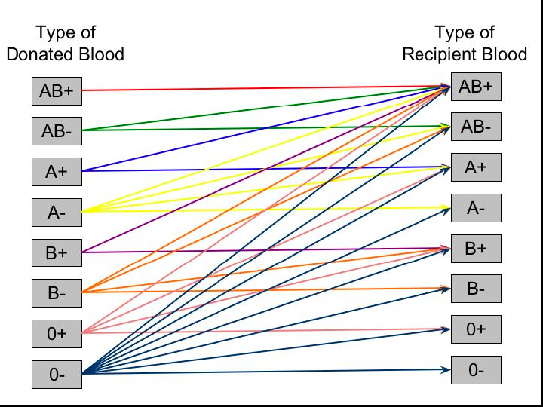
Blood management

Slide 12
Blood management
Substitution
O- is universal donor
AB+ is universal recipient
Substitution is not allowed for some operations
Mothers giving birth – infants cannot handle substitution of any type.
Preference of surgeon for some operations

Slide 13
Blood management
Storage
Red blood cells (RBC’s) require constant metabolic energy to survive.
Blood Ph has to be maintained in range of 6.4 to 7.2.
Maximum (safe) shelf life is 42 days.
Determined by requirement that 75 percent of blood cells must be alive 24 hours after transfusion.
Must be refrigerated – temperature must be maintained between 2 and 6 degrees C.
Freezing
Frozen blood may be stored indefinitely.
Requires 60 to 90 minutes to thaw.
Must be used within 24 hours after thawing.

Slide 14
Basic model

Slide 15
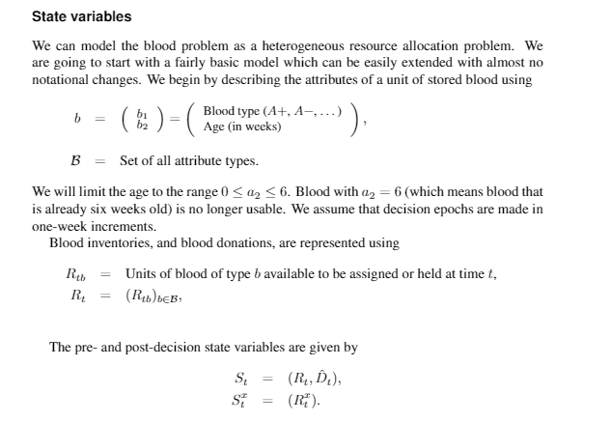
Blood management

Slide 16
Blood management
Blood types
Demand types

Slide 17
Blood management

Slide 18
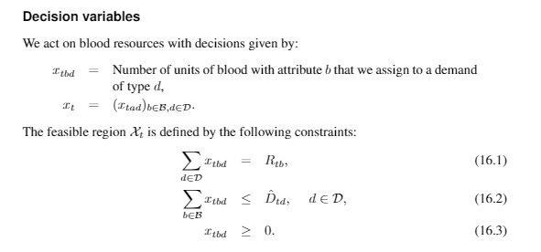
Blood management

Slide 19
Blood management
Decisions

Slide 20
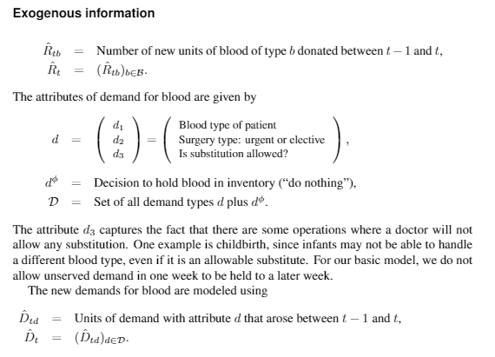
Blood management

Slide 21
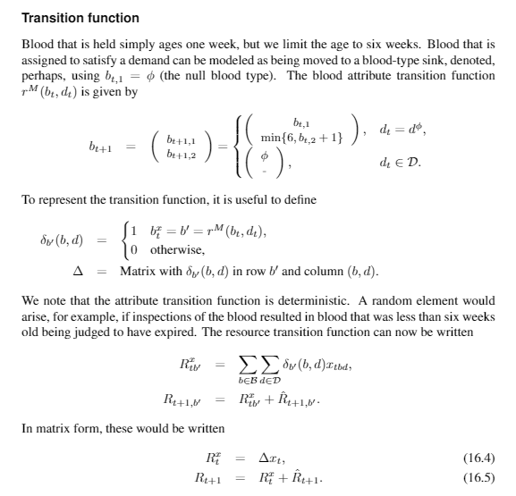
Blood management

Slide 22
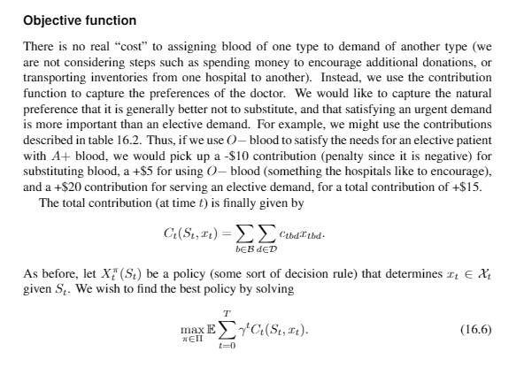
Blood management

Slide 23
Blood management
Contributions
Notes:
“contributions” express preferences.
Matching blood type to demand might produce a “contribution” of 0. Small negative contribution when types do not match.
Larger negative contributions if we hold blood longer.

Slide 24
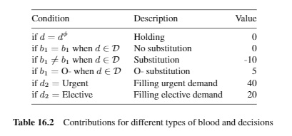
Blood management

Slide 25
Uncertainty modeling

Slide 26
Blood management

Slide 27
Blood management
Donations by ethnicity

Slide 28
Blood management
Supply and demand distributions
Donations
Depends on age, race, income and geography

Slide 29
Supplies
Might assume that donations follow a Poisson distribution with means given by historical donation rates (this is what you might learn in ORF 309).
The Poisson is generally appropriate when describing rates that come from a large population.
Potential errors:
Donations may be triggered by mass requests or highly visible events.
Capturing correlations between donations because of exogenous sources.
Correlations can come in different forms: spatial, temporal, and across ethnicities (??)
Next week we are going to see a model where we assume a Poisson distribution, but where the Poisson is not actually a good fit.

Slide 30
Demands
Same issues as donations, although the underlying stochastic model would have different elements.
E.g. bursts of demands could be due to:
Weather events (snow storms, very hot weather)
Major sports events
Notes:
Proper stochastic modeling is key if we wish to focus on the risk of outages.

Slide 31
Designing policies
Myopic policy

Slide 32
Blood management
Managing blood inventories

Slide 33
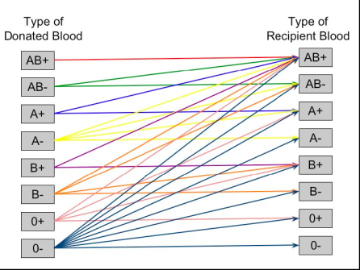
Blood management
Managing blood inventories over time
Week 0
Week 1
Week 2
Week 3
t=0
t=1
t=2
t=3
Slide 33
Notes:
33

Slide 34
Blood management
Myopic policy
We can use bonuses and penalties to encourage different behaviors.
We may wish to try to hold onto O-minus blood for the future since it can be used to meet any need.
We may wish to discourage covering elective surgery if we feel we need to hoard blood for urgent surgeries in the future.
Challenges:
Tuning these bonuses and penalties can be a real pain!
Very tricky when we are trying to optimize across different metrics (e.g. limiting the coverage of elective surgeries, holding onto O-minus).
Hard to handle time-dependent policies.

Slide 35
Designing policies
Approximate dynamic programming

Slide 36
Blood management
Managing blood inventories over time
Week 0
Week 1
Week 2
Week 3
t=0
t=1
t=2
t=3
Slide 36
Notes:
36

Slide 37
AB+
AB+,0
AB+,0
AB-
AB+,1
AB+,1
AB+,2
A+
AB+,2
AB+,3
A-
O-,0
B+
O-,0
O-,1
O-,1
B-
O-,2
O-,2
O+
O-,3
O-
Satisfy a demand
Hold
Notes:
bloodnetworkdemands

Slide 38
AB+,0
AB+,0
AB+,0
AB+,1
AB+,1
AB+,1
AB+,2
AB+,2
AB+,2
AB+,3
AB+,3
O-,0
O-,1
O-,0
O-,0
O-,2
O-,1
O-,1
O-,2
O-,2
O-,3
O-,3
Notes:
bloodnetworkhold

Slide 39
AB+,0
AB+,0
AB+,1
AB+,1
AB+,2
AB+,2
AB+,3
O-,0
O-,1
O-,0
O-,2
O-,1
O-,2
O-,3
Notes:
bloodadpnetwork

Slide 40
AB+,0
AB+,0
AB+,1
AB+,1
AB+,2
AB+,2
AB+,3
O-,0
O-,1
O-,0
O-,2
O-,1
O-,2
O-,3
Solve this as a linear program.
Notes:
bloodadpnetwork

Slide 41
Duals
AB+,0
AB+,0
AB+,1
AB+,1
AB+,2
AB+,2
AB+,3
O-,0
O-,1
O-,0
O-,2
O-,1
O-,2
O-,3
Dual variables give value additional unit of blood..
Notes:
bloodadpnetwork

Slide 42
Updating the value function approximation
Estimate the gradient at

Slide 43
Updating the value function approximation
Update the value function at

Slide 44
Updating the value function approximation
Update the value function at

Slide 45
Updating the value function approximation
Update the value function at

Slide 46
Exploiting concavity
Derivatives are used to estimate a piecewise linear approximation

Slide 47
Approximate value iteration
Step 1: Start with a pre-decision state
Step 2: Solve the deterministic optimization using
an approximate value function:
to obtain and dual variables .
Step 3: Update the value function approximation
Step 4: Obtain Monte Carlo sample of and
compute the next pre-decision state:
Step 5: Return to step 1.
Deterministic
optimization
Recursive
statistics
Simulation
Notes:
47

Slide 48
Approximate value iteration
Step 1: Start with a pre-decision state
Step 2: Solve the deterministic optimization using
an approximate value function:
to obtain and dual variables .
Step 3: Update the value function approximation
Step 4: Obtain Monte Carlo sample of and
compute the next pre-decision state:
Step 5: Return to step 1.
Deterministic
optimization
Recursive
statistics
Simulation
Slide 48
Notes:
48
This is the basic algorithmic strategy. We start with the previous state R^x_{t-1}. Now simulate our way to R_t (one Monte Carlo simulation). Now find the value of being in state R_t. Finally use this to update the value of being in state R^x_{t-1} at time t-1.
For problems in transportation and logistics, you do not implement this literally. For resource allocation, we need the marginal value of an additional driver (etc). The value function here could be Benders cuts, and the updating mechanism could be stochastic decomposition. See chapter 12 of the current version of my book.

Slide 49
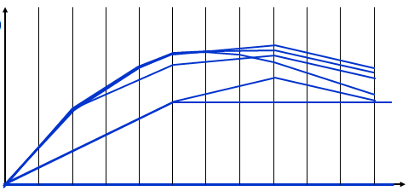
Approximate value iteration
Step 1: Start with a pre-decision state
Step 2: Solve the deterministic optimization using
an approximate value function:
to obtain and dual variables .
Step 3: Update the value function approximation
Step 4: Obtain Monte Carlo sample of and
compute the next pre-decision state:
Step 5: Return to step 1.
Deterministic
optimization
Recursive
statistics
Simulation
Notes:
This is the basic algorithmic strategy. We start with the previous state R^x_{t-1}. Now simulate our way to R_t (one Monte Carlo simulation). Now find the value of being in state R_t. Finally use this to update the value of being in state R^x_{t-1} at time t-1.
For problems in transportation and logistics, you do not implement this literally. For resource allocation, we need the marginal value of an additional driver (etc). The value function here could be Benders cuts, and the updating mechanism could be stochastic decomposition. See chapter 12 of the current version of my book.

Slide 50
Approximate value iteration
Step 1: Start with a pre-decision state
Step 2: Solve the deterministic optimization using
an approximate value function:
to obtain and dual variables .
Step 3: Update the value function approximation
Step 4: Obtain Monte Carlo sample of and
compute the next pre-decision state:
Step 5: Return to step 1.
Deterministic
optimization
Recursive
statistics
Simulation
Notes:
This is the basic algorithmic strategy. We start with the previous state R^x_{t-1}. Now simulate our way to R_t (one Monte Carlo simulation). Now find the value of being in state R_t. Finally use this to update the value of being in state R^x_{t-1} at time t-1.
For problems in transportation and logistics, you do not implement this literally. For resource allocation, we need the marginal value of an additional driver (etc). The value function here could be Benders cuts, and the updating mechanism could be stochastic decomposition. See chapter 12 of the current version of my book.

Slide 51
Iterative learning
t

Slide 52
Iterative learning

Slide 53
Iterative learning

Slide 54
Iterative learning

Slide 55
Approximate dynamic programming
… a typical performance graph.

