Slide 1
.
Sequential decision analytics and modeling
ORF 411
Fall, 2018
Warren Powell
Princeton University
http://www.castlelab.princeton.edu
© 2017 Warren B. Powell, Princeton University

Slide 2

Week 11 - Monday
Student decision problems
Booking a flight

Slide 3
This lecture was run by choosing a student with a sequential decision problem.
The idea is to choose one student as the modeler who stands at the front of the classroom. They should write out the five elements of a sequential decision problem (see next slide).
A second student, who is familiar with the problem, serves as the domain experiment. He/she sits in the audience and answers questions. This lecture focused on booking flights, which is a problem that many students are familiar with (I found that the international students were particularly skilled at this).
The modeler then fills in the elements of the problem by asking the class.

Slide 4
Elements of a dynamic model
The modeling process
I conduct a conversation with a domain expert to fill in the elements of a problem:
State
variables
Decision
variables
New
information
Transition
function
Objective
function
Performance metrics
How the state variables evolve
What we didn’t know
when we made our decision
What we control
What we need to know
(and only what we need)

Slide 5
Note:
I recall doing this twice in the first year, but I suggest trying to do this as often as you can.
This exercise involves active student involvement in the modeling process, which is key.

Slide 6

Student decision problem
Template

Slide 7
Decision problem
Narrative
State variables

Slide 8
Decision problem
Decision variables
Exogenous information

Slide 9
Decision problem
Transition function
Objective function

Slide 10
Student decision problem
Booking airline reservations

Slide 11
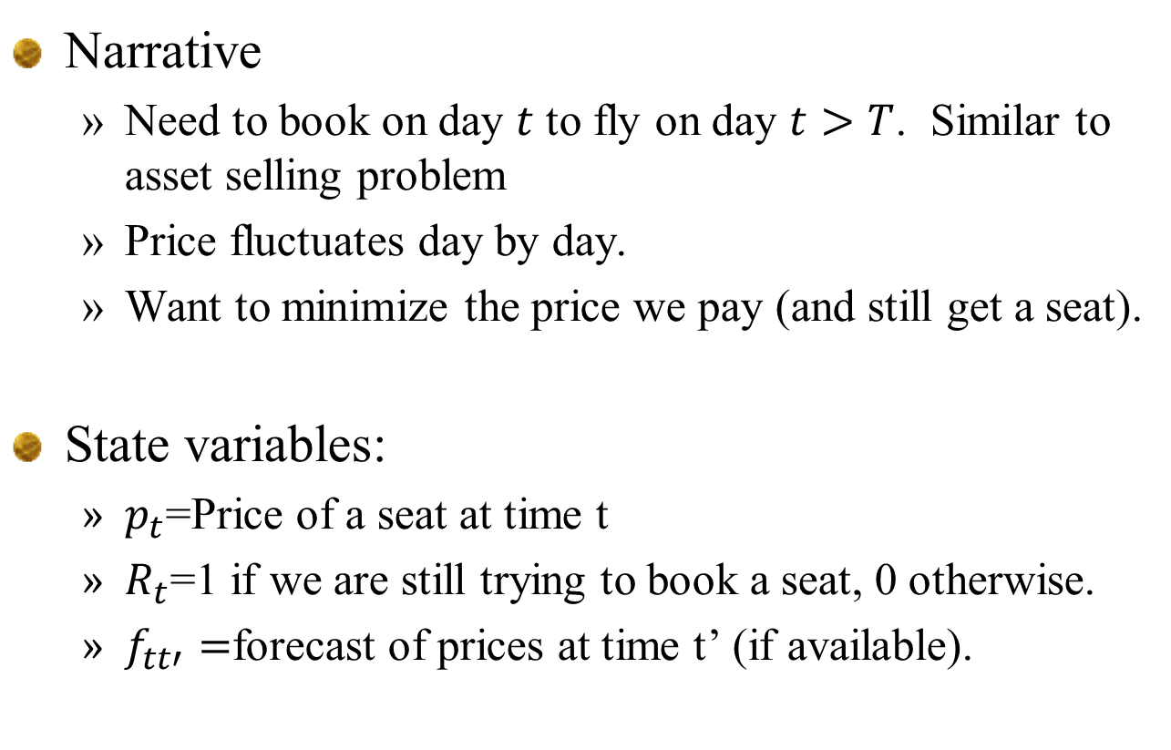
When to book a flight?
Narrative
Need to book on day $t$ to fly on day $t>T$. Similar to asset selling problem
Price fluctuates day by day.
Want to minimize the price we pay (and still get a seat).
State variables:
$p_{t}$=Price of a seat at time t
$R_{t}$=1 if we are still trying to book a seat, 0 otherwise.
$f_{tt′}=$forecast of prices at time t’ (if available).

Slide 12
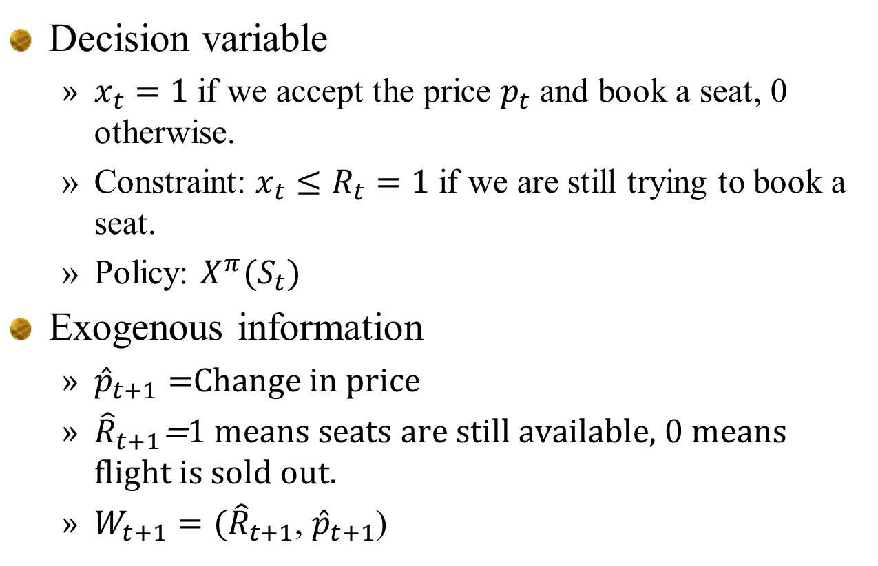
When to book a flight?
Decision variable
$x_{t}=1$ if we accept the price $p_{t}$ and book a seat, 0 otherwise.
Constraint: $x_{t}≤R_{t}=1$ if we are still trying to book a seat.
Policy: $X^{π}(S_{t})$
Exogenous information
${\hat{p}}_{t+1}=$Change in price
${\hat{R}}_{t+1}$=1 means seats are still available, 0 means flight is sold out.
$W_{t+1}=({\hat{R}}_{t+1}$, ${\hat{p}}_{t+1}$)

Slide 13
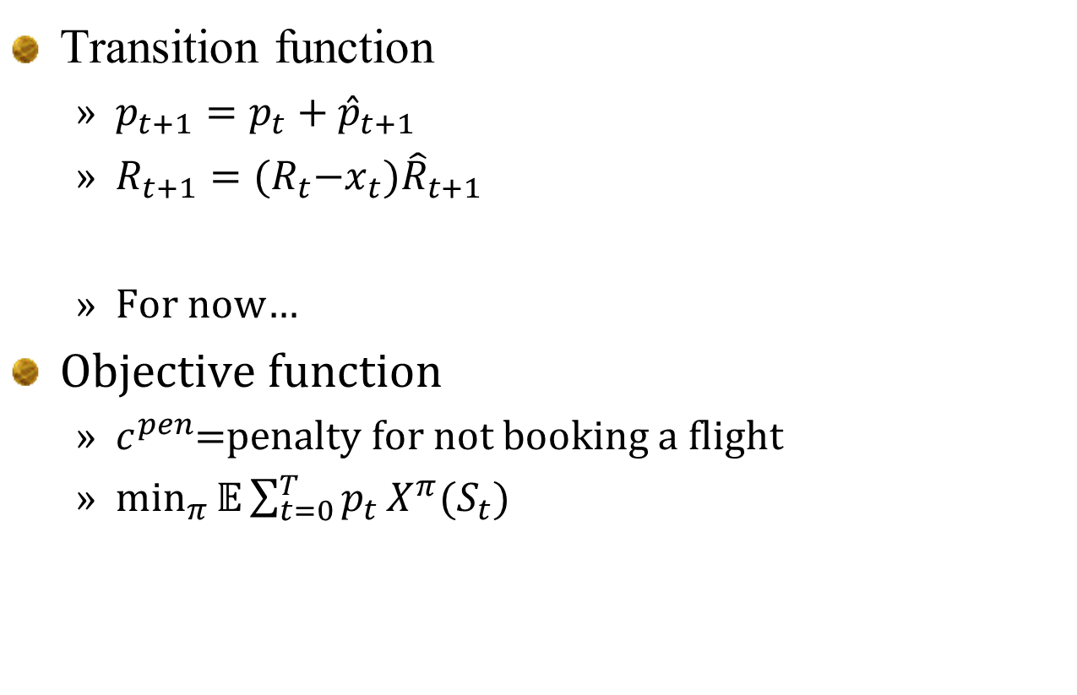
When to book a flight?
Transition function
$p_{t+1}=p_{t}+{\hat{p}}_{t+1}$
$R_{t+1}={(R}_{t}−x_{t}{){\hat{R}}_{t+1}}_{}$
For now…
Objective function
$c^{pen}$=penalty for not booking a flight
$\min_{π}{𝔼\sum_{t=0}^{T}{p_{t}}}X^{π}(S_{t})$

Slide 14
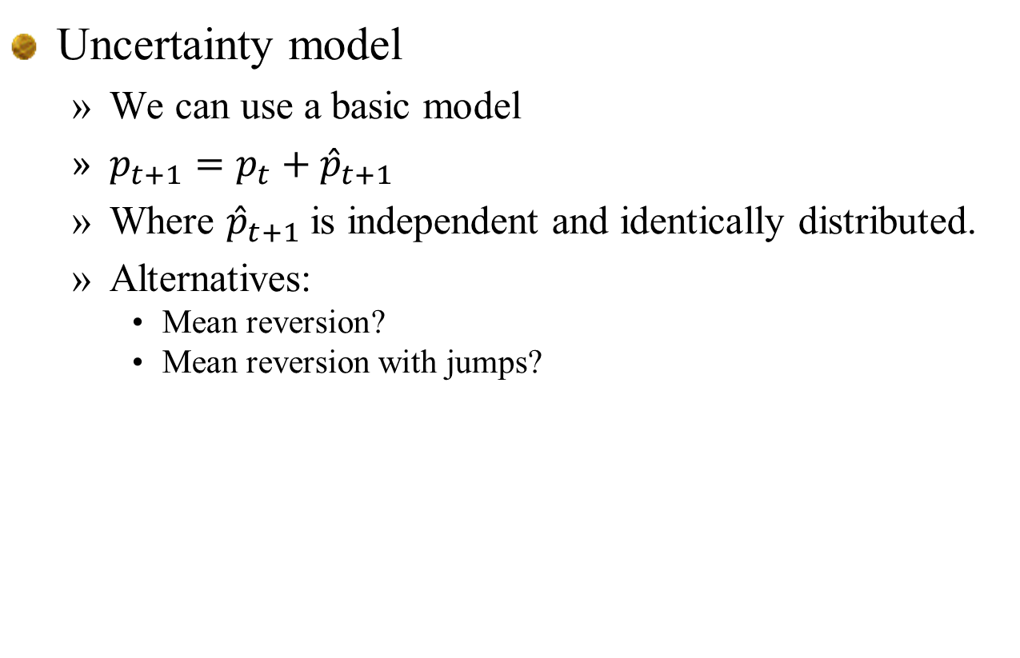
When to book a flight?
Uncertainty model
We can use a basic model
$p_{t+1}=p_{t}+{\hat{p}}_{t+1}$
Where ${\hat{p}}_{t+1}$ is independent and identically distributed.
Alternatives:
Mean reversion?
Mean reversion with jumps?

Slide 15
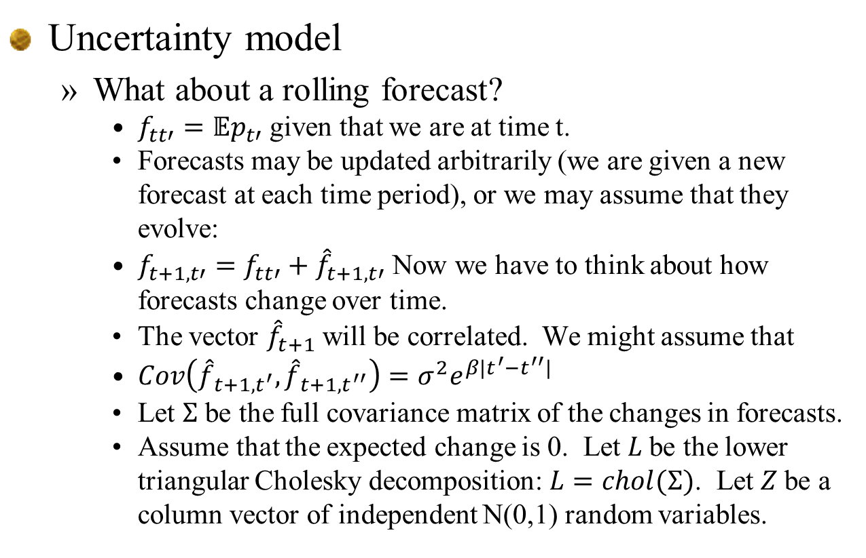
When to book a flight?
Uncertainty model
What about a rolling forecast?
$f_{tt′}=𝔼p_{t′}$ given that we are at time t.
Forecasts may be updated arbitrarily (we are given a new forecast at each time period), or we may assume that they evolve:
$f_{t+1,t′}=f_{tt′}+{\hat{f}}_{t+1,t′}$ Now we have to think about how forecasts change over time.
The vector ${\hat{f}}_{t+1}$ will be correlated. We might assume that
$Cov\left({\hat{f}}_{t+1,t^{′}},{\hat{f}}_{t+1,t^{′′}}\right)=σ^{2}e^{β|t^{′}−t^{′′}|}$
Let $Σ$ be the full covariance matrix of the changes in forecasts.
Assume that the expected change is 0. Let $L$be the lower triangular Cholesky decomposition: $L=chol(Σ)$. Let $Z$be a column vector of independent N(0,1) random variables.

Slide 16
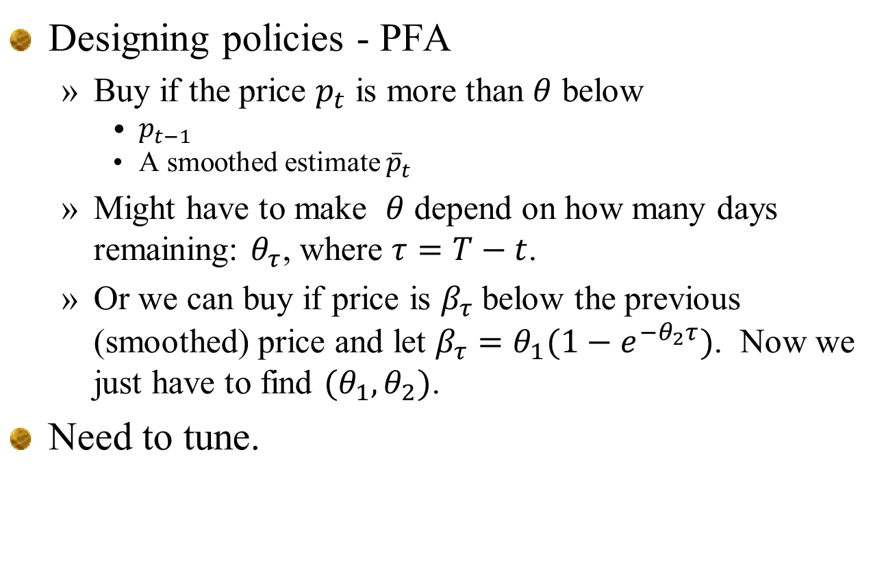
When to book a flight?
Designing policies - PFA
Buy if the price $p_{t}$ is more than $θ$ below
$p_{t−1}$
A smoothed estimate ${\overline{p}}_{t}$
Might have to make $θ$ depend on how many days remaining: $θ_{τ}$, where $τ=T−t$.
Or we can buy if price is $β_{τ}$ below the previous (smoothed) price and let $β_{τ}=θ_{1}{(1−e}^{{−θ}_{2}τ})$. Now we just have to find $(θ_{1},θ_{2})$.
Need to tune.

Slide 17
When to book a flight?
Possible CFA …
Discuss logic from diabetes example.
We could estimate the value of reserving on each day before the departure date. You can learn within a simulator, or using actual experience.
Simplify – instead of day t, use weeks.

Slide 18
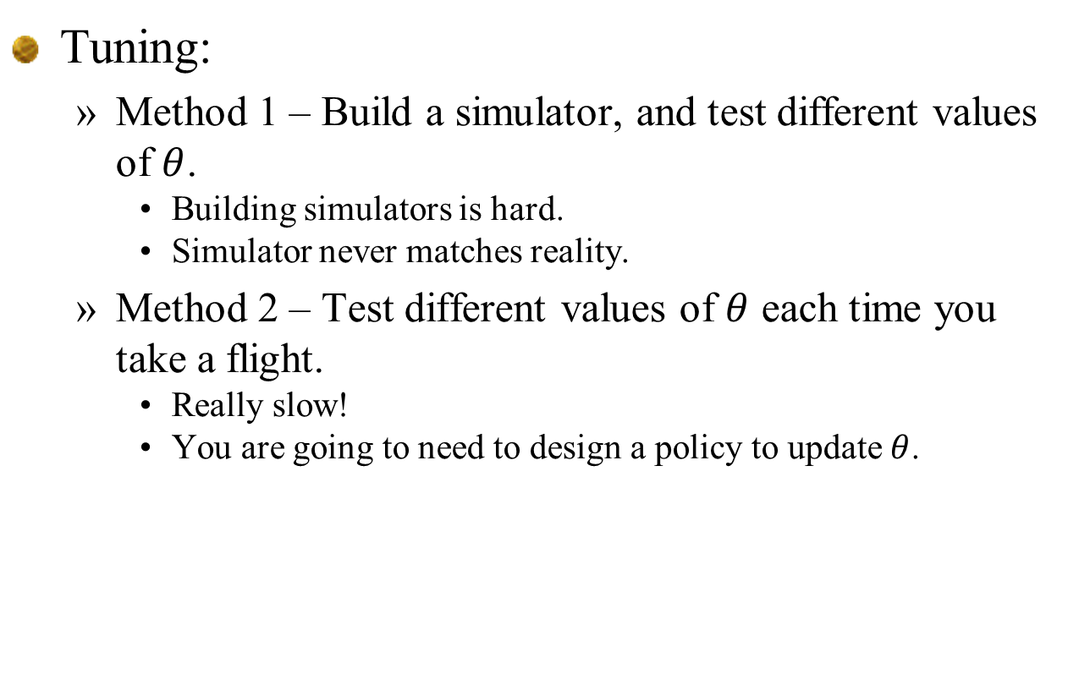
When to book a flight?
Tuning:
Method 1 – Build a simulator, and test different values of $θ$.
Building simulators is hard.
Simulator never matches reality.
Method 2 – Test different values of $θ$ each time you take a flight.
Really slow!
You are going to need to design a policy to update $θ$.

Slide 19
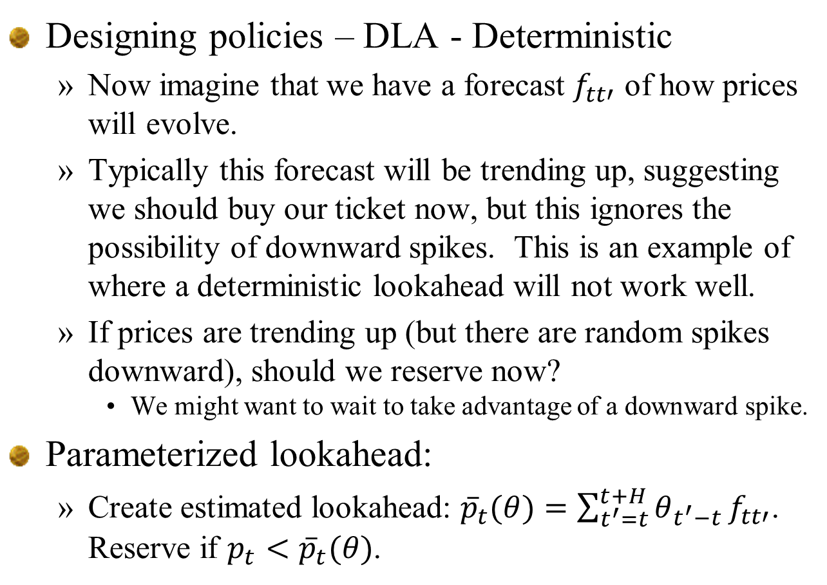
When to book a flight?
Designing policies – DLA - Deterministic
Now imagine that we have a forecast $f_{tt′}$ of how prices will evolve.
Typically this forecast will be trending up, suggesting we should buy our ticket now, but this ignores the possibility of downward spikes. This is an example of where a deterministic lookahead will not work well.
If prices are trending up (but there are random spikes downward), should we reserve now?
We might want to wait to take advantage of a downward spike.
Parameterized lookahead:
Create estimated lookahead: ${\overline{p}}_{t}(θ)=\sum_{t^{′}=t}^{t+H}{θ_{t^{′}−t }f_{tt′}}$. Reserve if $p_{t}<{\overline{p}}_{t}(θ)$.

Slide 20
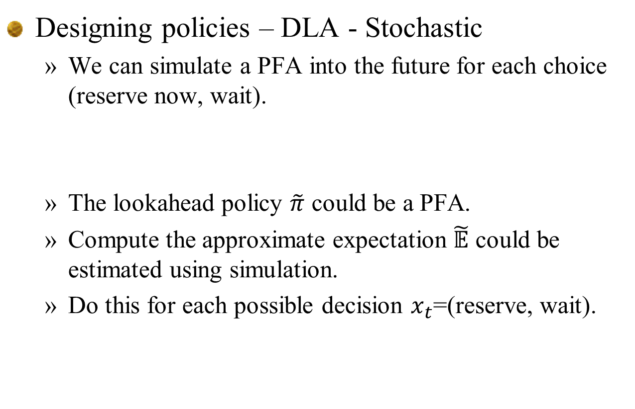
When to book a flight?
Designing policies – DLA - Stochastic
We can simulate a PFA into the future for each choice (reserve now, wait).
The lookahead policy $\tilde{π}$ could be a PFA.
Compute the approximate expectation $\tilde{𝔼}$ could be estimated using simulation.
Do this for each possible decision $x_{t}$=(reserve, wait).

Slide 21
Student decision problem
Financial trading

Slide 22
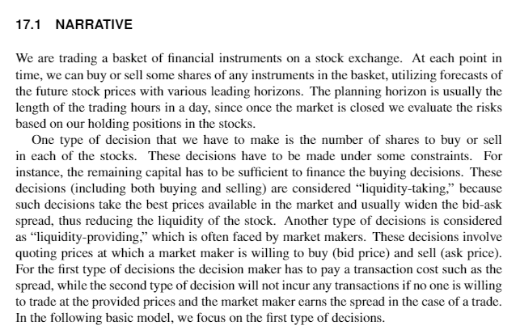
Narrative

Slide 23
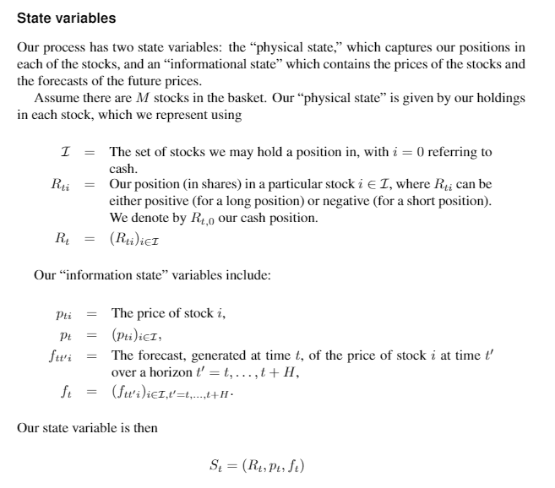
State variables

Slide 24
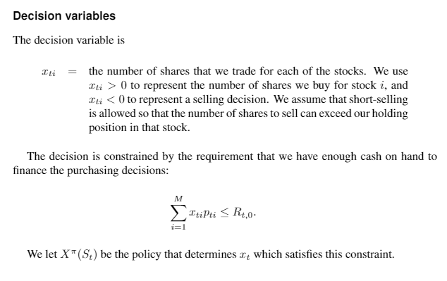
Decision variables

Slide 25
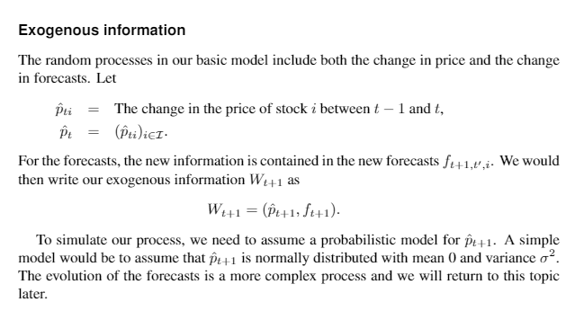
Exogenous information

Slide 26
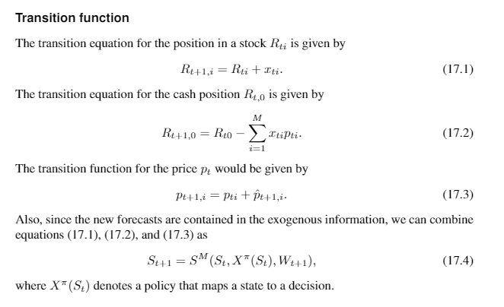
Transition function

Slide 27
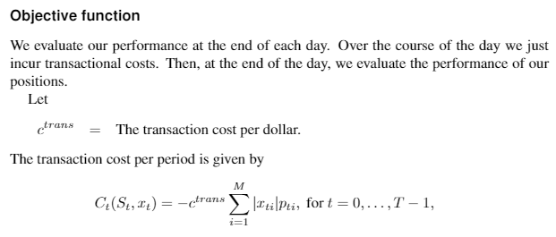
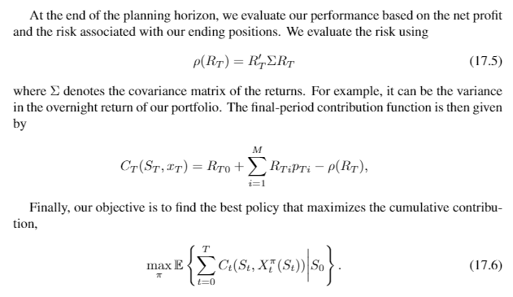
Objective function

Slide 28
Uncertainty model
The process is data-driven – no uncertainty model required. No simulator has been used, and there is no lookahead component.

Slide 29
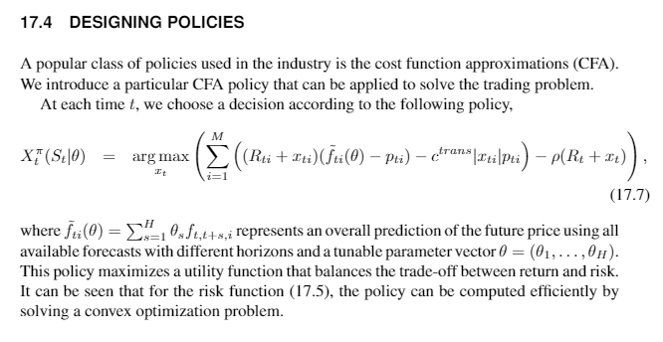
Designing policies

