Slide 1
.
Sequential decision analytics and modeling
ORF 411
Fall, 2018
Warren Powell
Princeton University
http://www.castlelab.princeton.edu
© 2017 Warren B. Powell, Princeton University

Slide 2

Week 1 - Monday
Adaptive market planning

Slide 3

Narrative

Slide 4
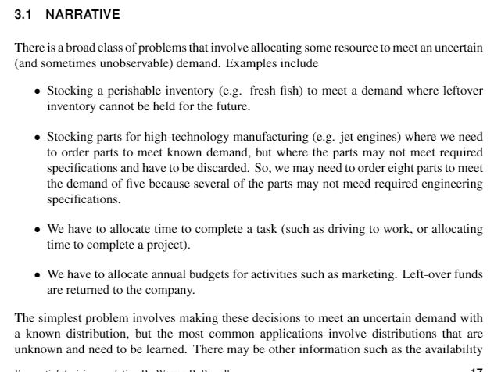
Narrative

Slide 5
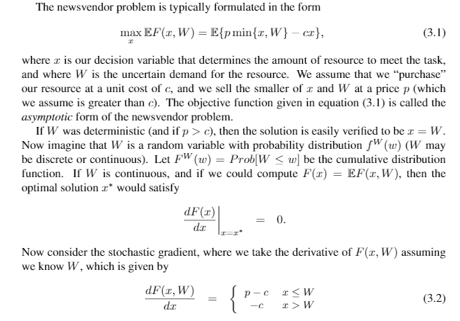
Narrative

Slide 6
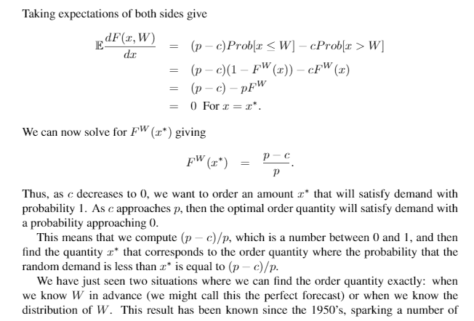
Narrative

Slide 7
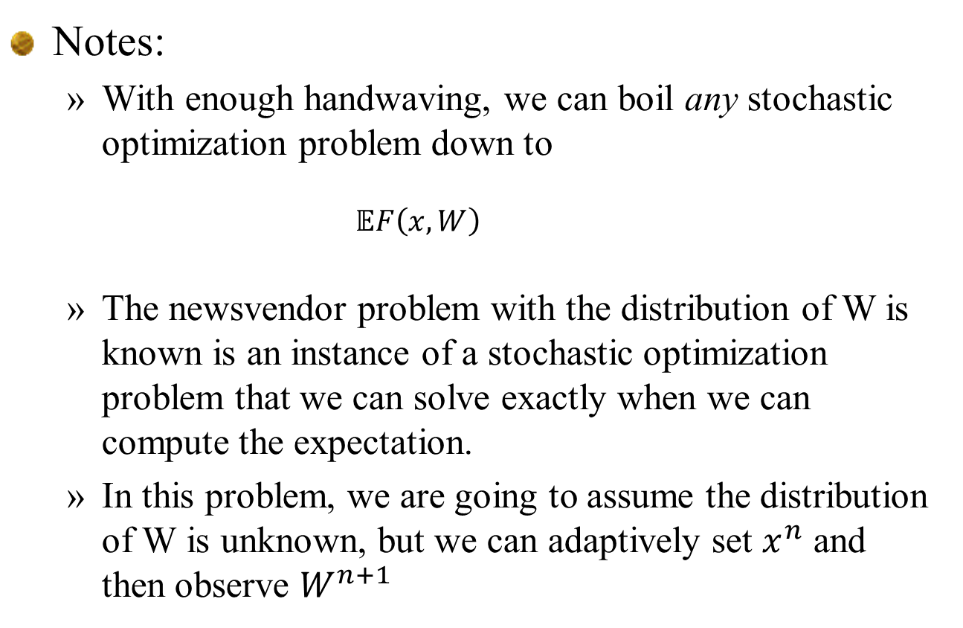
Narrative
Notes:
With enough handwaving, we can boil any stochastic optimization problem down to
$$𝔼F\left(x,W\right)$$
The newsvendor problem with the distribution of W is known is an instance of a stochastic optimization problem that we can solve exactly when we can compute the expectation.
In this problem, we are going to assume the distribution of W is unknown, but we can adaptively set $x^{n}$ and then observe $W^{n+1}$

Slide 8
Stochastic gradient algorithms

Slide 9
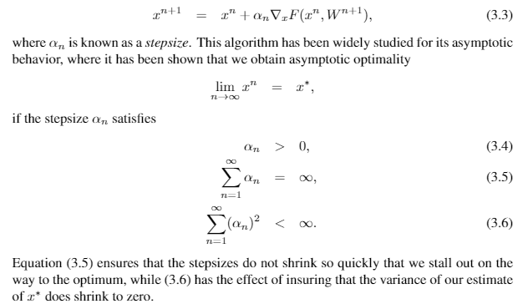
Adaptive market planning
Gradient-based stochastic search
Powerful algorithm, but it an important class of sequential decision problem

Slide 10


Adaptive market planning
Stepsize rules
Harmonic stepsize formula (deterministic
Kesten’s rule (stochastic)
Discuss:
Scaling
Handling bias (learning) vs. noise (smoothing)

Slide 11
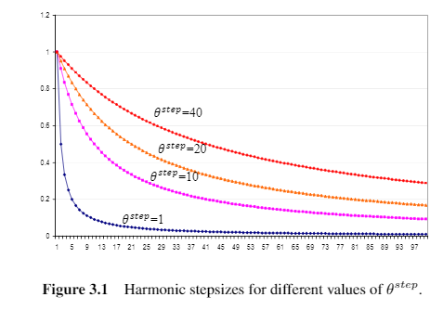
Adaptive market planning
Harmonic stepsize rules

Slide 12
Basic model
Kesten’s stepsize rule

Slide 13
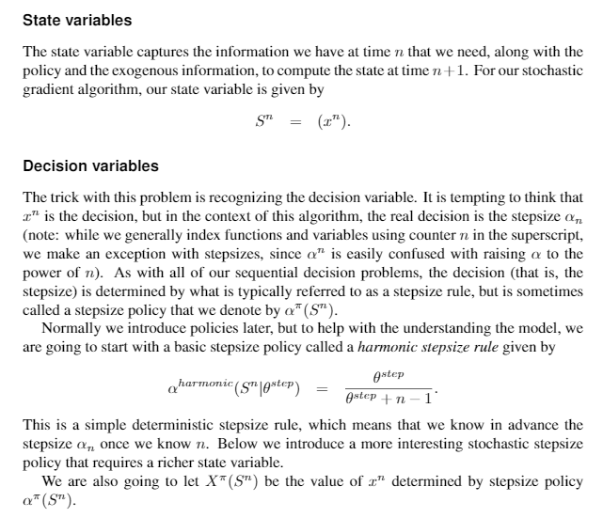
Basic model

Slide 14
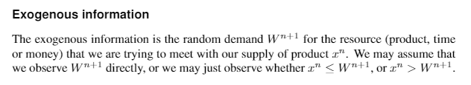
Basic model

Slide 15
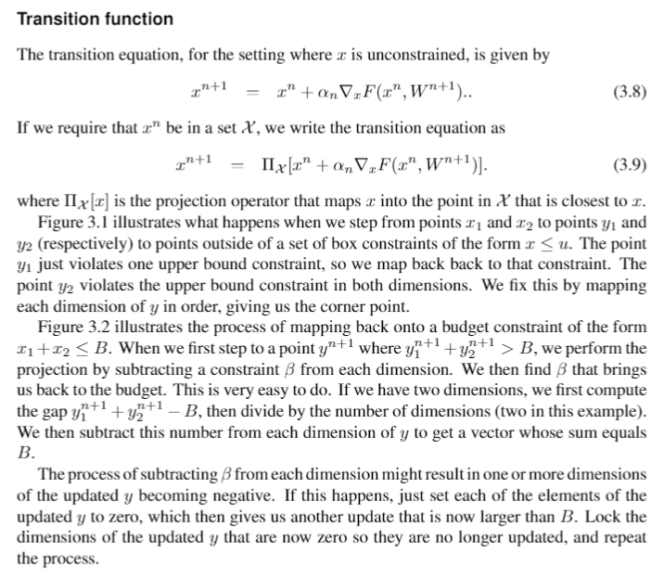

Slide 16
Derivative-based stochastic search
Mapping to $x_{1}+x_{2}≤6$

Slide 17
Derivative-based stochastic search
Mapping to box constraints

Slide 18
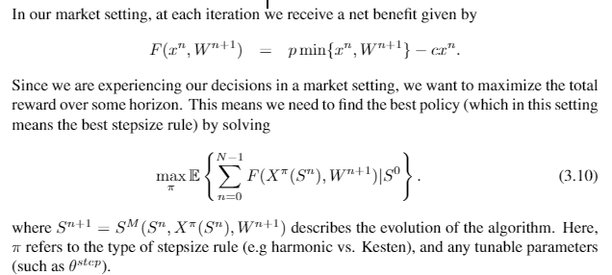
Basic model
Objective function

Slide 19
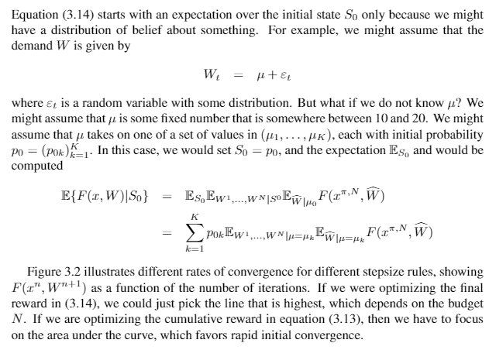
Basic model

Slide 20
Uncertainty modeling

Slide 21
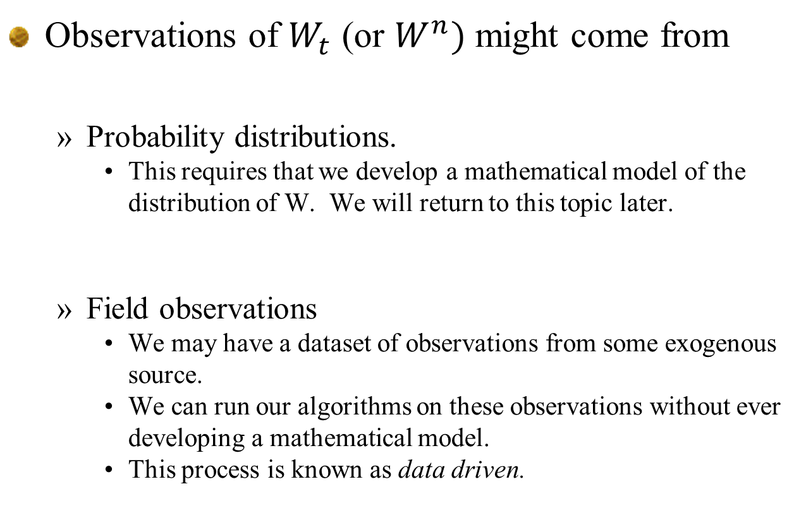
Modeling uncertainty
Observations of $W_{t}$ (or $W^{n})$ might come from
Probability distributions.
This requires that we develop a mathematical model of the distribution of W. We will return to this topic later.
Field observations
We may have a dataset of observations from some exogenous source.
We can run our algorithms on these observations without ever developing a mathematical model.
This process is known as data driven.

Slide 22
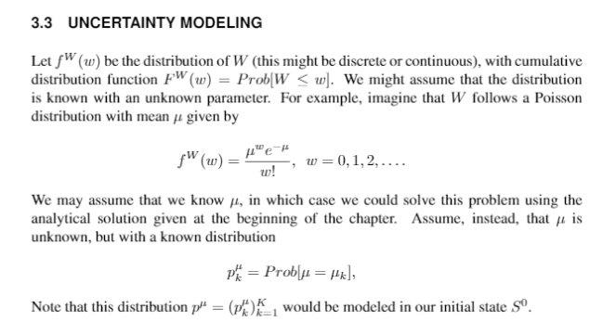

Slide 23
Designing policies

Slide 24
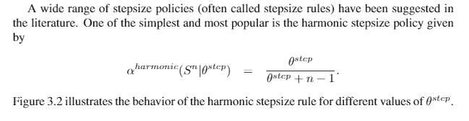
Policies
Stepsize policies
Harmonic (deterministic)

Slide 25
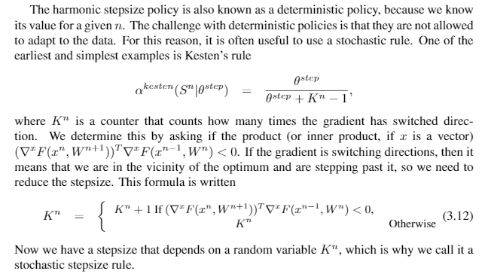
Policies
Stepsize policies
Kesten (stochastic

Slide 26
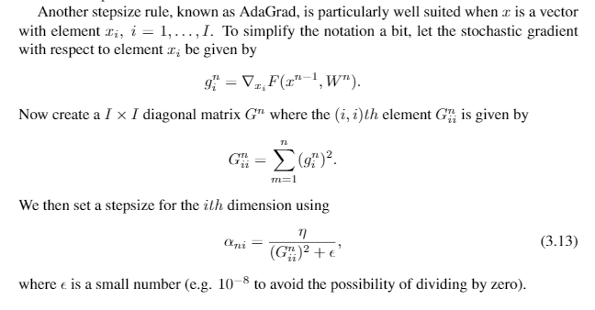
Policies
Stepsize policies
AdaGrad (stochastic)
Discuss variable scaling

Slide 27
Policy evaluation

Slide 28

Policies
Simulating a policy
Walk through steps of a simulation
Represent a sample path of realizations as $ω$

Slide 29
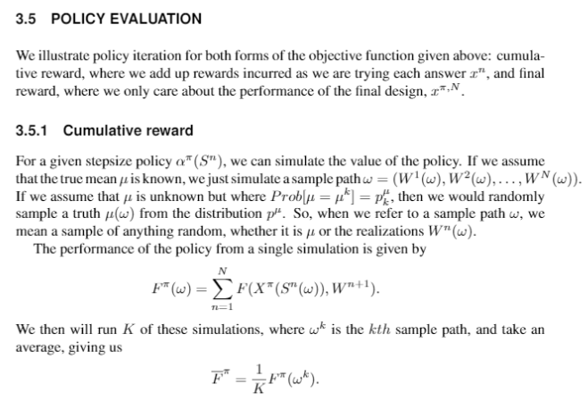

Slide 30
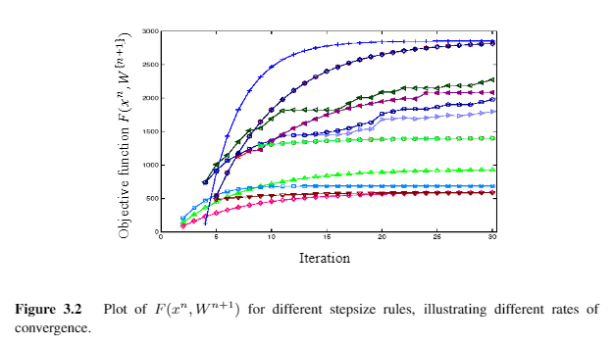

Slide 31
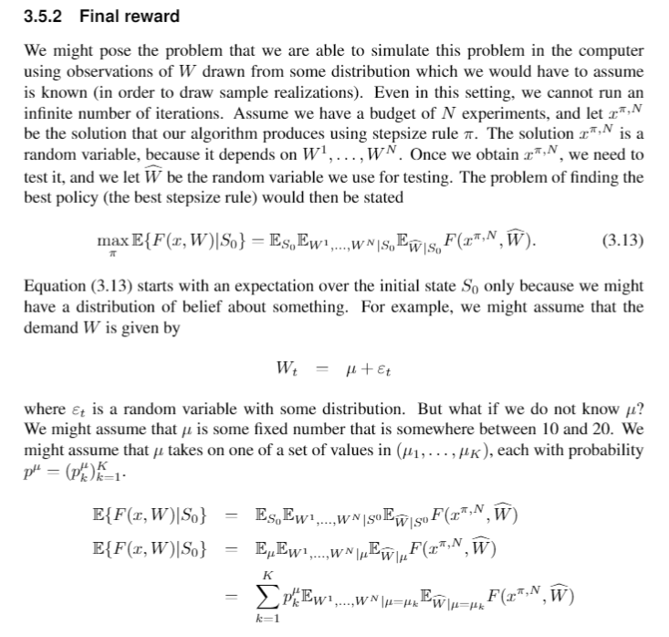

Slide 32
Extensions

Slide 33
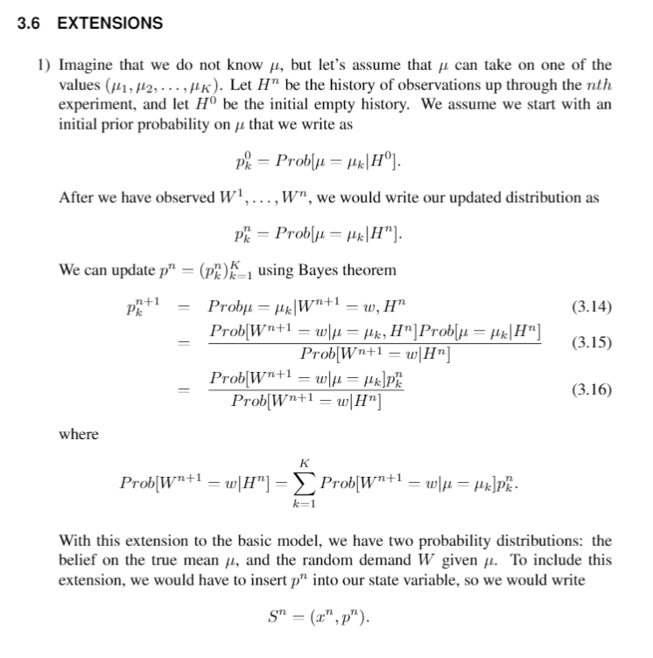
Extensions

Slide 34
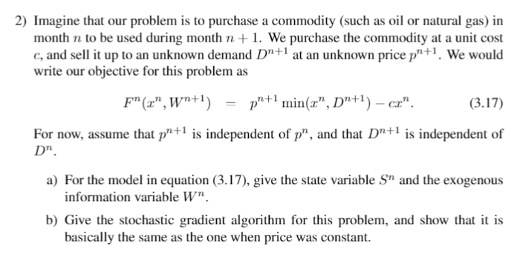
Extensions

Slide 35
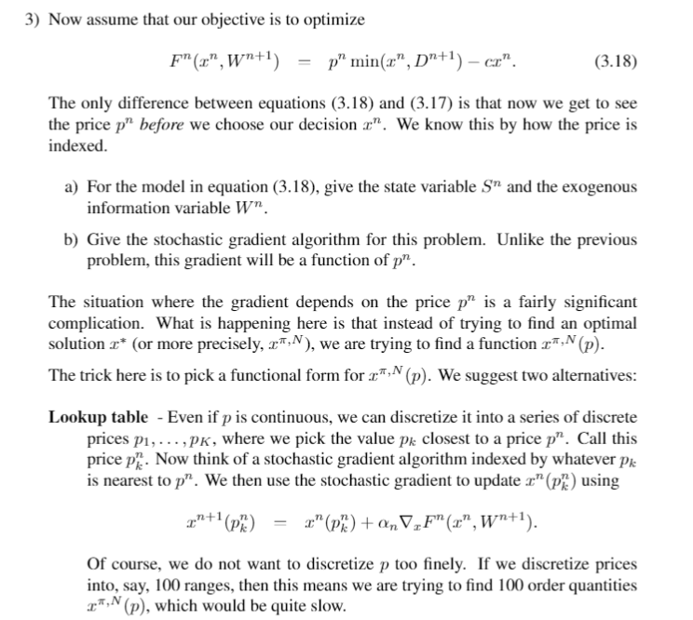
Extensions

Slide 36
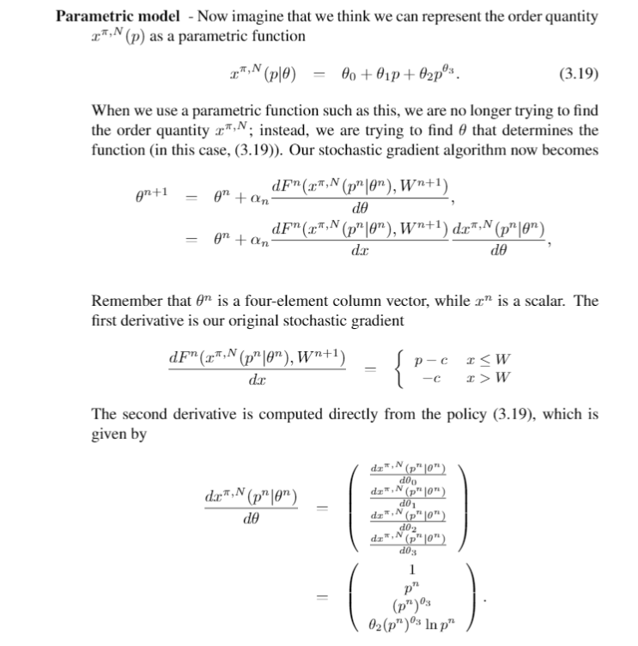
Extensions

