Slide 1
.
Sequential decision analytics and modeling
ORF 411
Fall, 2018
Warren Powell
Princeton University
http://www.castlelab.princeton.edu
© 2017 Warren B. Powell, Princeton University

Slide 2

Week 11 – Wednesday
Clinical trials

Slide 3

Narrative

Slide 4
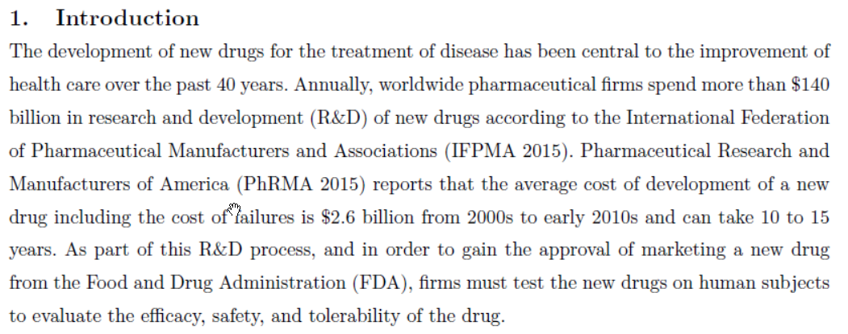

Slide 5
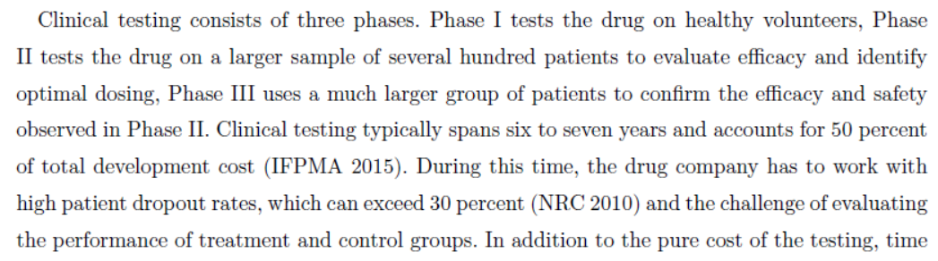
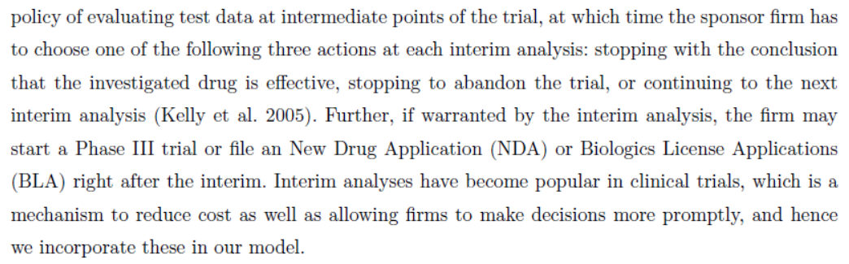

Slide 6
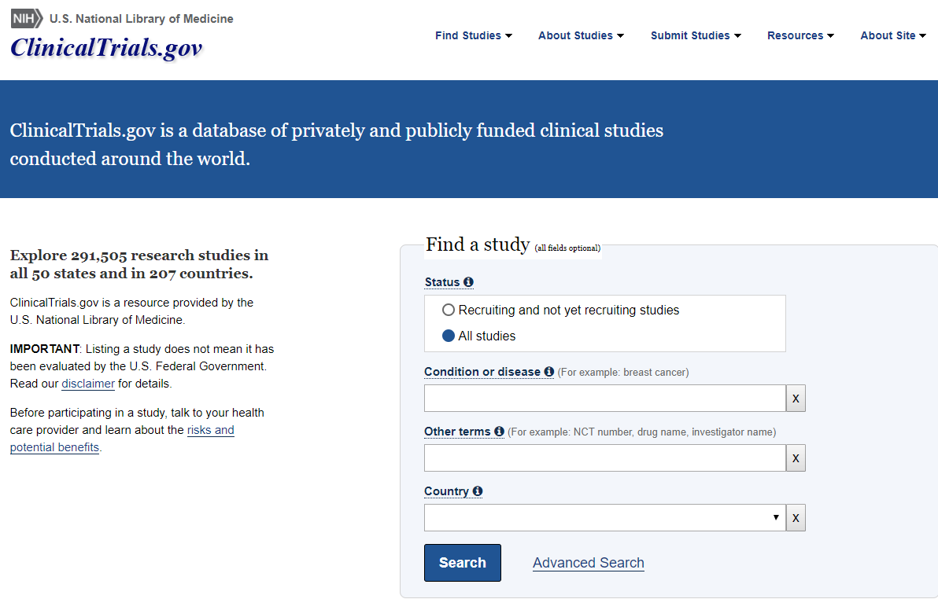

Slide 7
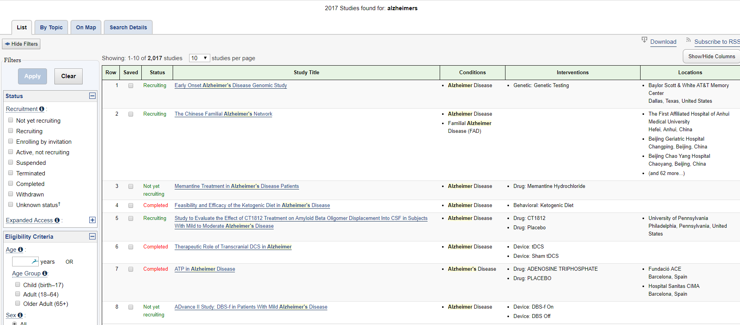

Slide 8
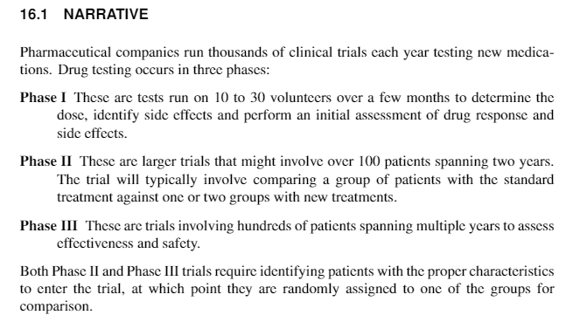
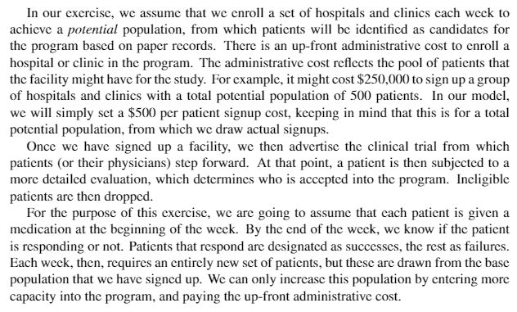

Slide 9
In this lecture, we are going to explore three versions of “reality”:
The real world – this is what we experience when we implement our policies in practice.
The base model – This is going to be our representation of the real world. We would like to make this model as realistic as possible, but simplifications are inevitable.
The lookahead model – We will be using a lookahead policy, where we introduce additional approximations to make it easier to solve.

Slide 10
Notes:
The lookahead model is by far the most subtle in terms of modeling.
When the lookahead model is deterministic (but being used in a stochastic setting), then it is clear that this is an approximation.
But when the lookahead model is stochastic, it can be hard to know if you are solving a lookahead approximation, or the base model.
There are many instances where people will solve a problem using a stochastic lookahead model, without recognizing that it is just a lookahead model.

Slide 11
Basic model

Slide 12
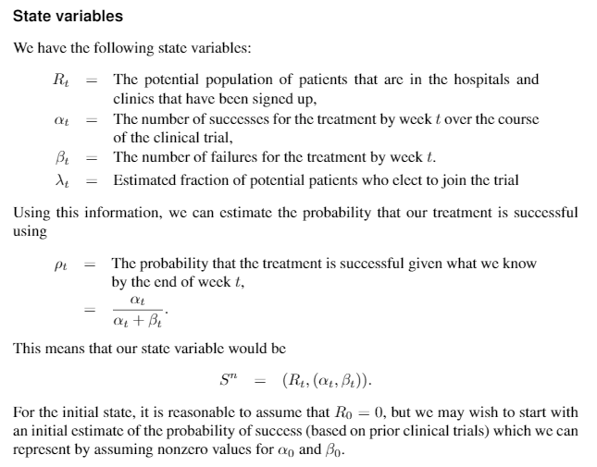

Slide 13
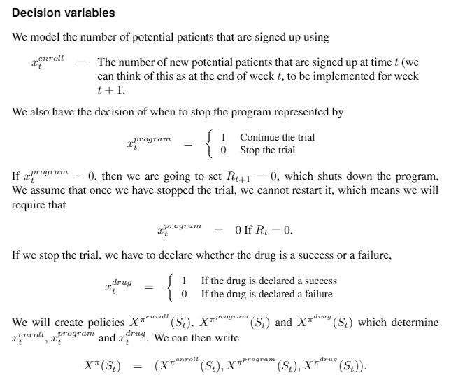

Slide 14
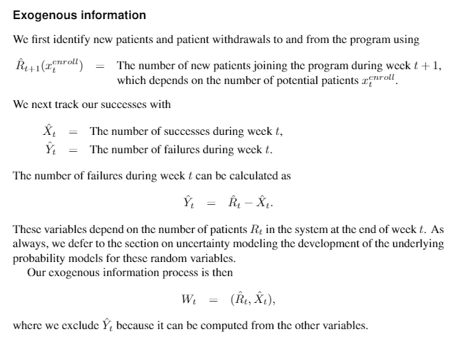

Slide 15
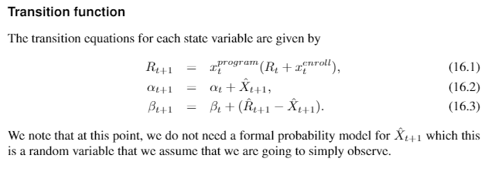

Slide 16
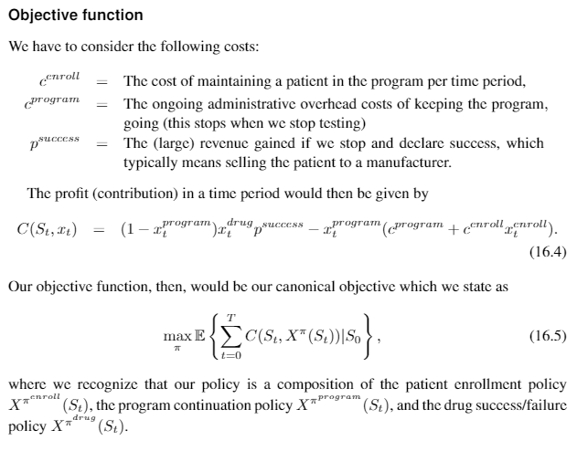

Slide 17
Uncertainty modeling

Slide 18
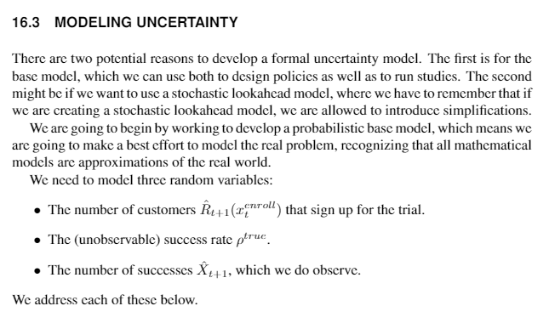

Slide 19
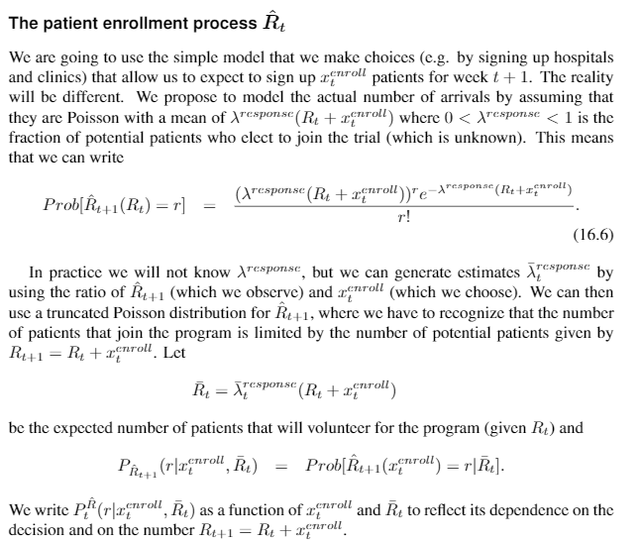

Slide 20
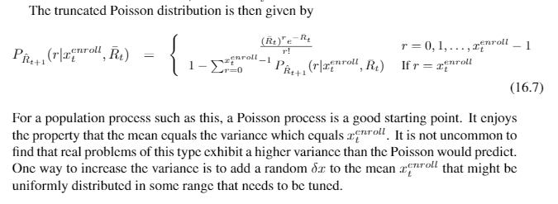

Slide 21
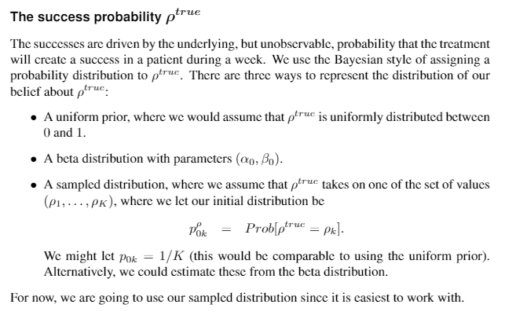

Slide 22
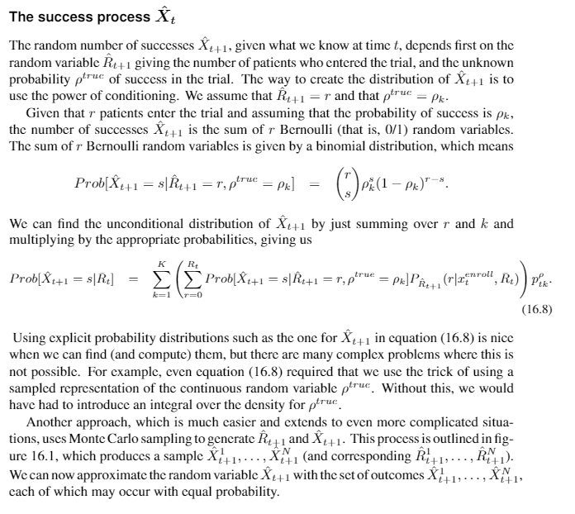

Slide 23
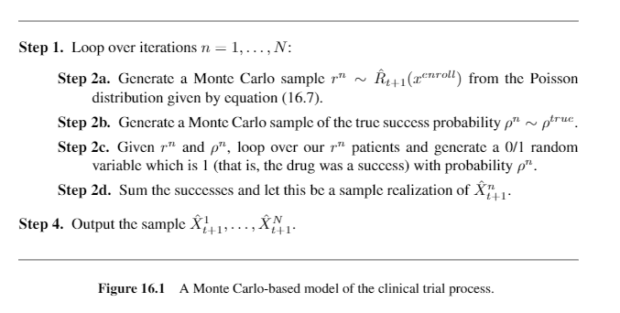

Slide 24
Designing policies
Clinical trials

Slide 25
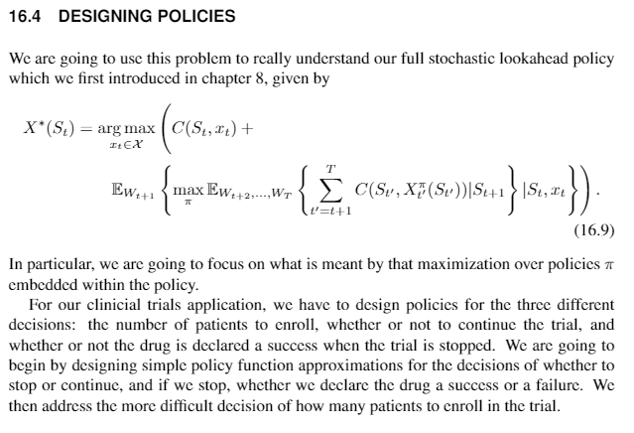

Slide 26
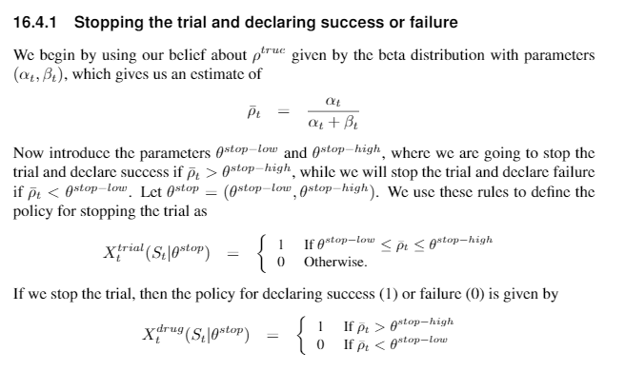

Slide 27
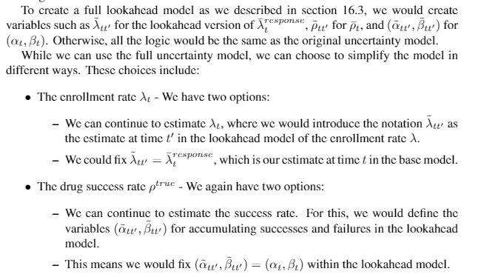

Slide 28
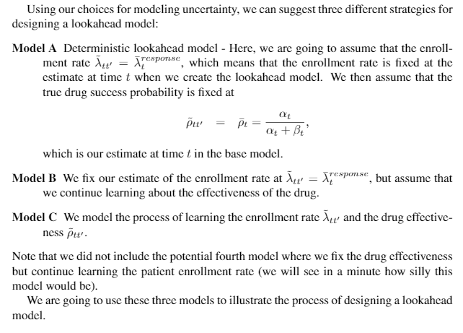

Slide 29
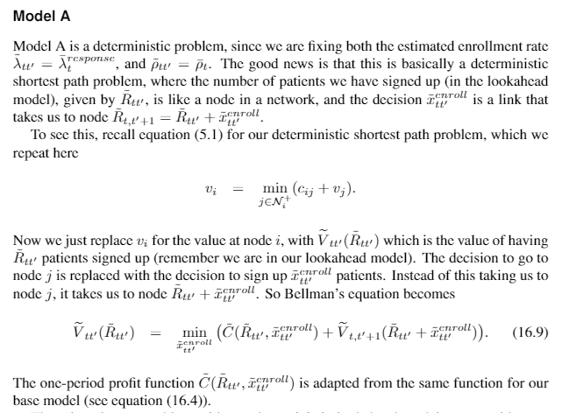

Slide 30
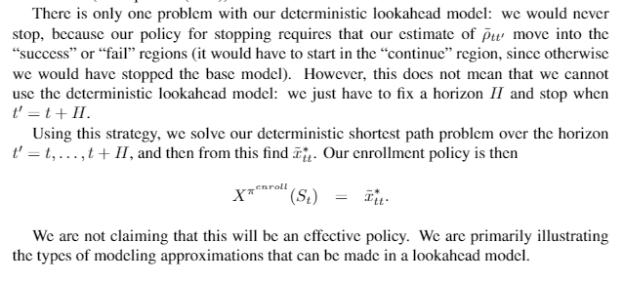

Slide 31
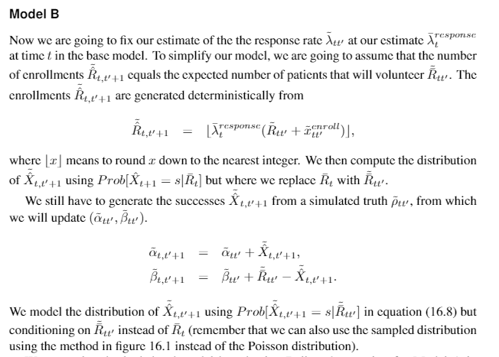
Remember that lambda is the estimate from the base model, so it has a bar, not a tilde.

Slide 32
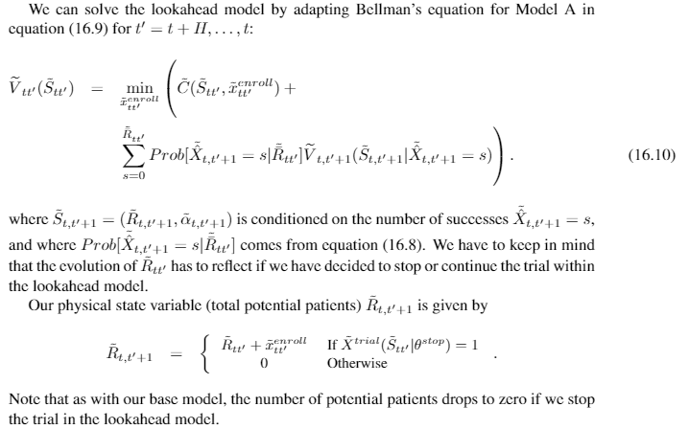

Slide 33
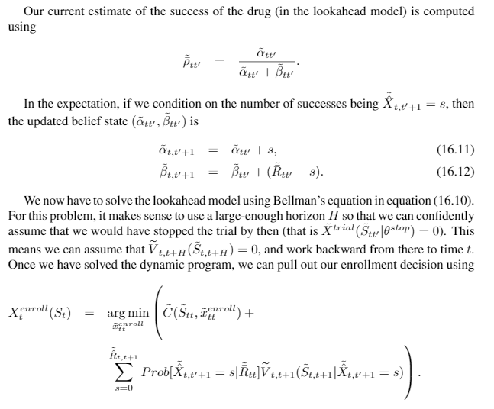

Slide 34
Model C
Here we have modeled the dynamics (including uncertainty) the same as the base model.
The only approximation is that we are using the PFAs that we introduced for the decision of when to stop, and the decision of whether to declare the drug a success. So, we may not be searching over the entire class of policies.
If we could show that the PFAs for these decisions include the optimal policy, then Model C would produce an optimal policy for the base model.

