Slide 1
.
Sequential decision analytics and modeling
ORF 411
Fall, 2018
Warren Powell
Princeton University
http://www.castlelab.princeton.edu
© 2017 Warren B. Powell, Princeton University

Slide 2

Week 12 – Monday
Student decision problems:
Rowing strategies
Twitter trading

Slide 3

Student decision problem
Rowing strategy
Sadie McGirr

Slide 4
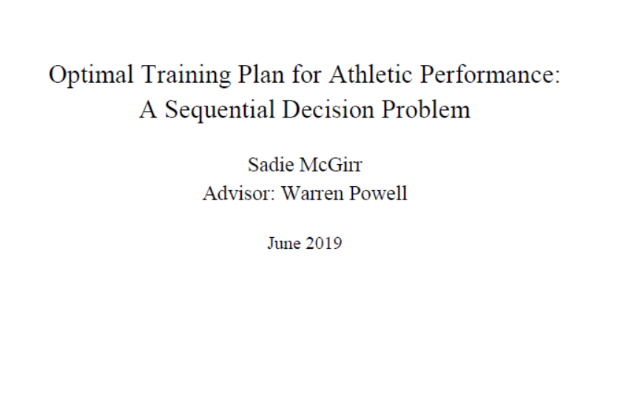

Slide 5
Narrative
Provided by Sadie…
The problem is to optimize the timing of different segments of a rowing race. The race is divided into four 500-yard segments, but the first and last segment are then divided into two, creating an initial “sprint” segment and a final closing segment (both are usually spring segments). Rowers work in terms of “splits” which is the time required to finish each segment.

Slide 6
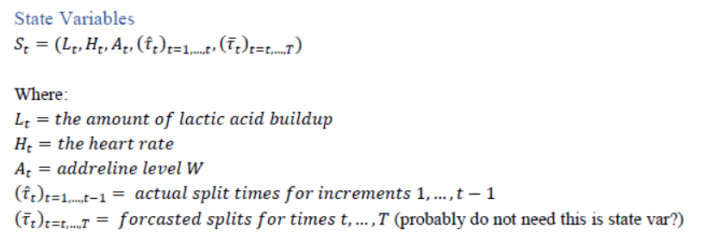
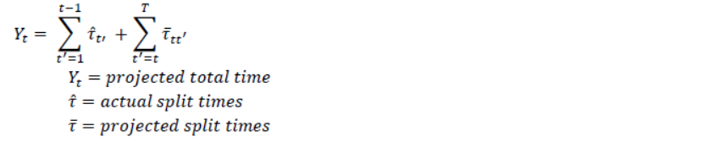
State variables

Slide 7

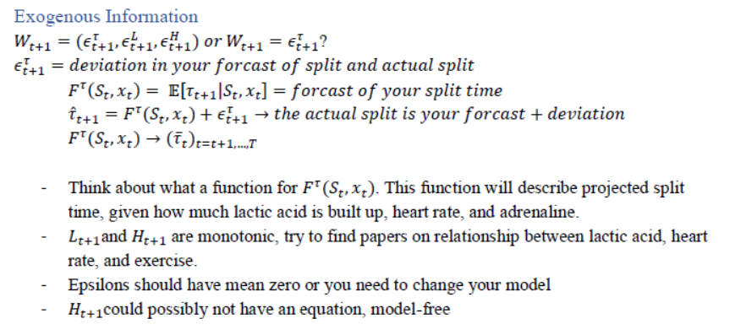
Decision variables
Exogenous information

Slide 8
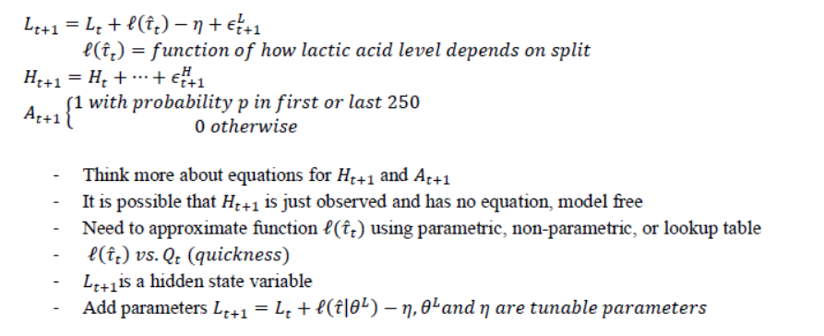
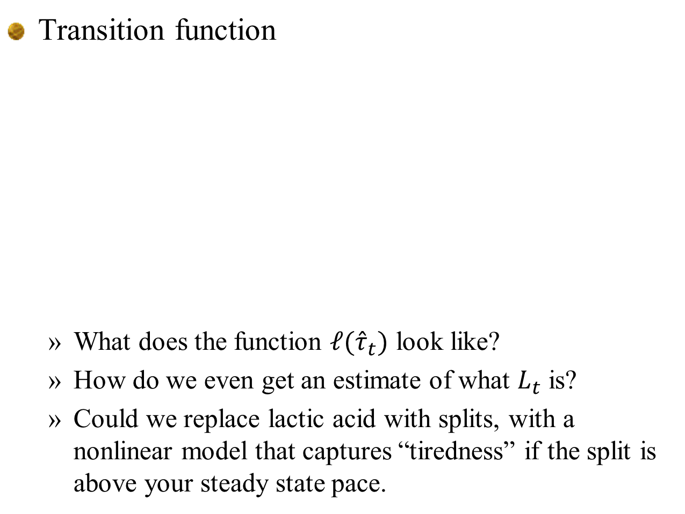
Transition function
What does the function $ℓ({\hat{τ}}_{t})$ look like?
How do we even get an estimate of what $L_{t}$ is?
Could we replace lactic acid with splits, with a nonlinear model that captures “tiredness” if the split is above your steady state pace.
?

Slide 9
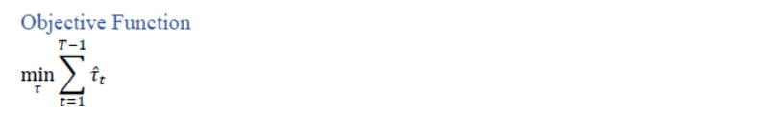
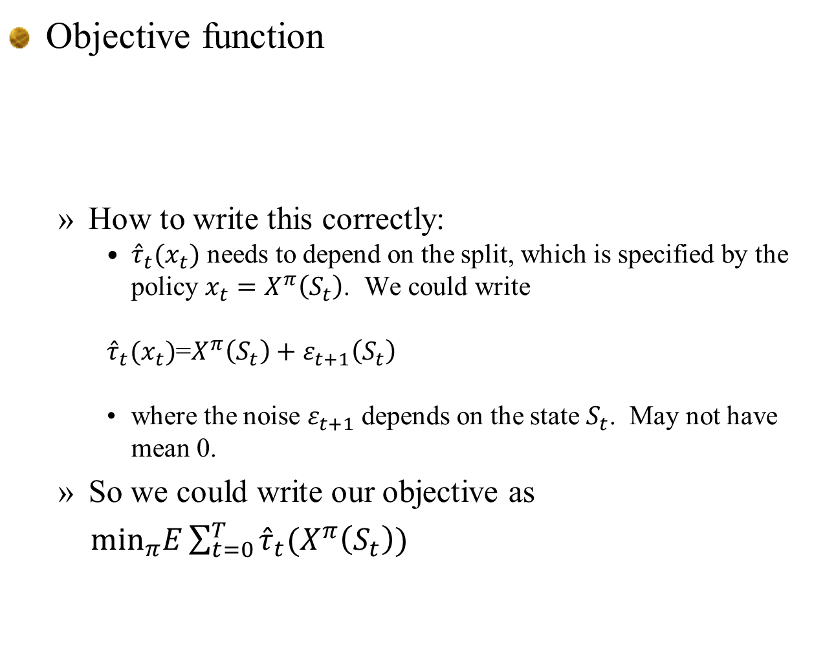
Objective function
How to write this correctly:
${\hat{τ}}_{t}(x_{t})$ needs to depend on the split, which is specified by the policy $x_{t}=X^{π}\left(S_{t}\right)$. We could write
${\hat{τ}}_{t}(x_{t})$=$X^{π}\left(S_{t}\right)+ε_{t+1}\left(S_{t}\right)$
where the noise $ε_{t+1}$ depends on the state $S_{t}$. May not have mean 0.
So we could write our objective as
$\min_{π}E{\sum_{t=0}^{T}{{\hat{τ}}_{t}(X^{π}\left(S_{t}\right))}}$

Slide 10
Uncertainty model

Slide 11
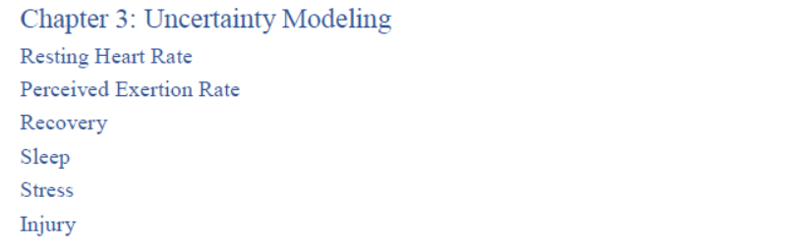
Uncertainty model
Race uncertainties:
Wind, choppiness of the water
Introduce randomness in speeds
Performance of the competition – does this have a psychological effect? How to model?
State variable indicating: behind, tied/close, ahead

Slide 12
Designing policies

Slide 13
Designing policies
Deterministic policy
Choose all the splits in advance regardless of within-race performance.
Discuss – is this realistic? What types of adjustments are made within the race.
Policy function approximation
Split = initial plan + adjustment
Adjustments:
If behind, adjust remaining splits to finish at target time.
If ahead, no adjustment (assumes we cannot keep beating the splits).

Slide 14
Designing policies
Direct lookahead
Optimize over rest of race using nonlinear lactic acid function.
Can describe this as a graph if you discretize the splits. Show as decision tree where each time you set a split, you then realize what actually happens over the segment.
This can be solved as a decision tree, which is really a dynamic program where you use value functions.

Slide 15
Extensions
A nonlinear model for lactic acid should discourage sprinting at the beginning.
If we really believe that sprints work, what are we missing?
We often have an intuitive idea of what we should be doing, without knowing a reason why.
This intuitive behavior can be handled with PFAs, but it does not mean it is right!

Slide 16
Student decision problem
Hiring interns

Slide 17
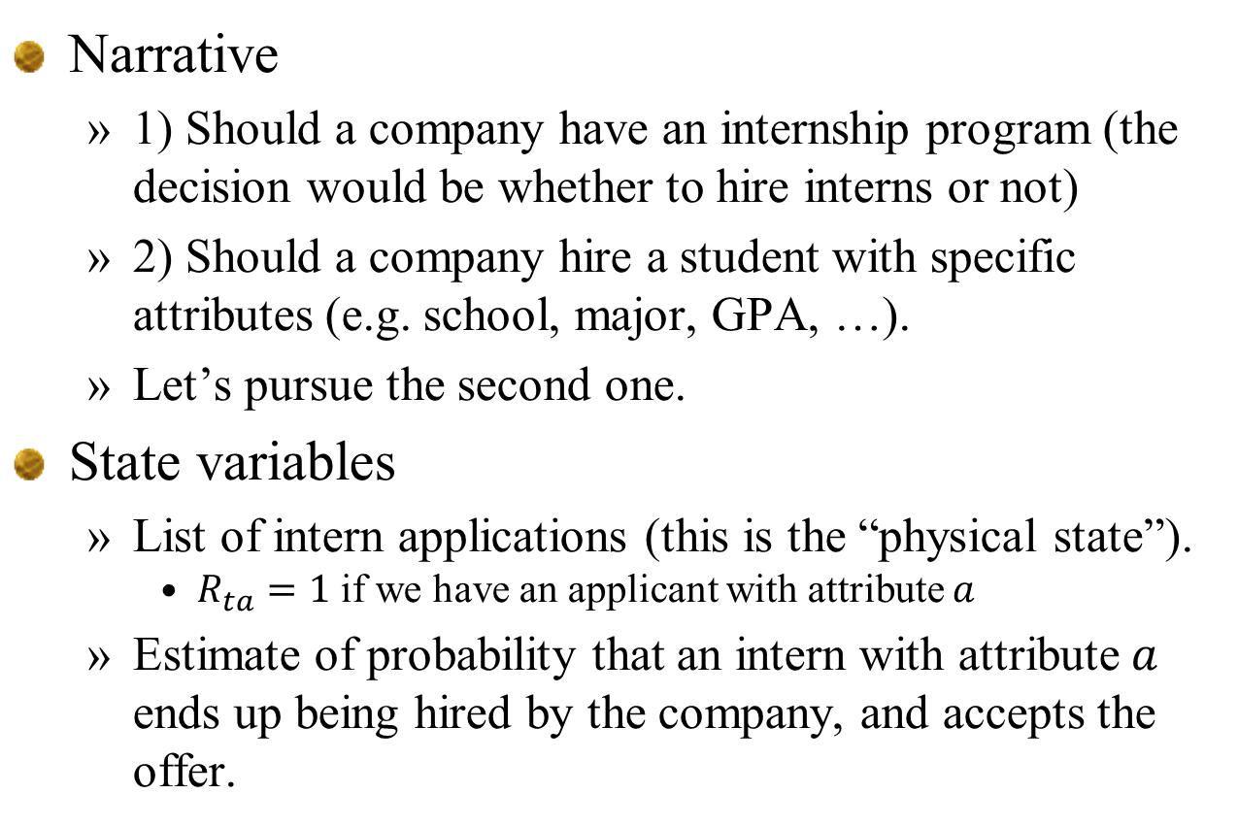
Narrative
1) Should a company have an internship program (the decision would be whether to hire interns or not)
2) Should a company hire a student with specific attributes (e.g. school, major, GPA, …).
Let’s pursue the second one.
State variables
List of intern applications (this is the “physical state”).
$R_{ta}=1$ if we have an applicant with attribute $a$
Estimate of probability that an intern with attribute $a$ ends up being hired by the company, and accepts the offer.

Slide 18
Decision variables
Whether to hire an intern.
Whether to offer an intern a full time job at the end of the summer.
Specify policies (to be designed)
Exogenous information
Intern applications
Performance of the intern.
Whether the intern accepts the offer.

Slide 19
Transition function
Updating of beliefs of probabilities
Objective function
Metric: acceptance of the offer by the intern

Slide 20
Uncertainty model
Probability model of applications from different schools
Probability model of performance by school
Probability model of acceptance of offer

Slide 21
Designing policies
If we ignore learning, we are simply going to hire an intern if the probability of extending an offer, and then the offer being accepted, is high enough.
May also want to include the probability that the employee is viewed as a successful hire after one year, versus hiring someone from a standard interviewing process.
This will be an active learning problem. Need to capture the uncertainty in an estimate, and the value of information to guide future decisions.

Slide 22
Designing policies
PFA policies:
Hire any intern with success probability over some amount.
(1) plus randomization on probability.
CFA policies:
Hire interns with highest probability of eventual success.
Same as (1), but add some randomization (this is Thompson sampling).
Interval estimation – maximize probability plus tunable parameter times standard deviation of estimated probability.
VFA policies ??
Unlikely.
DLA policies:
One-period lookahead – value of information
Multiperiod extension

Slide 23
Extensions
??

Slide 24
Student decision problem
Twitter trading – Senior thesis of Raj Patel

Slide 25
Narrative
Hunter Johnson asked:
How to invest effectively to profit off of Trump’s twitter posts
This is a decision problem on when to buy/sell stocks using the information in twitter feeds.
This is in the same problem class as the original asset selling problem (chapter 2) or when to purchase a seat on a flight. The challenge is designing the stochastic model of prices using twitter data.

Slide 26
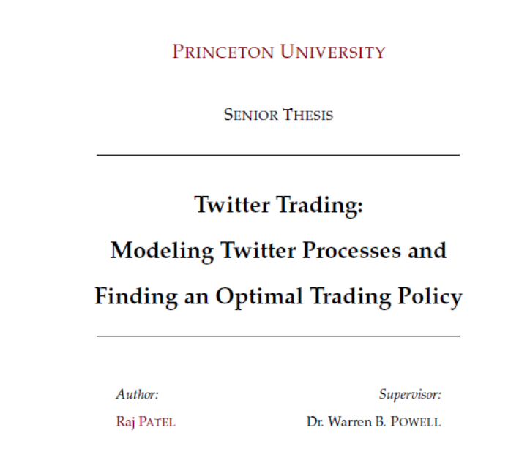

Slide 27
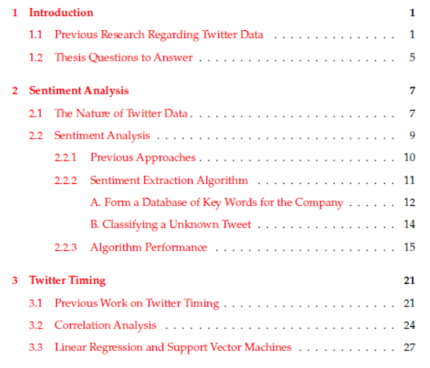
Twitter Trading
Table of contents

Slide 28
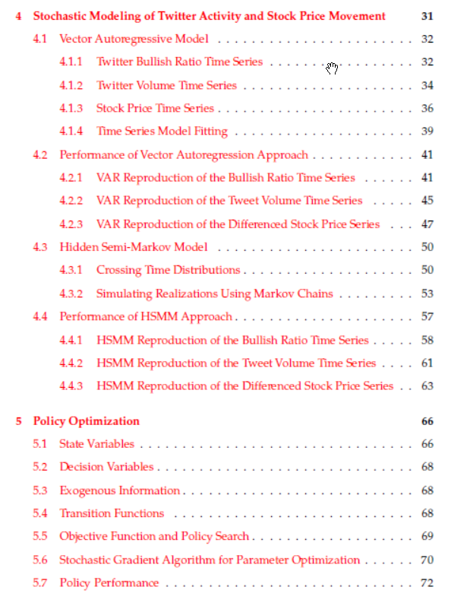
Twitter Trading
Table of contents

Slide 29
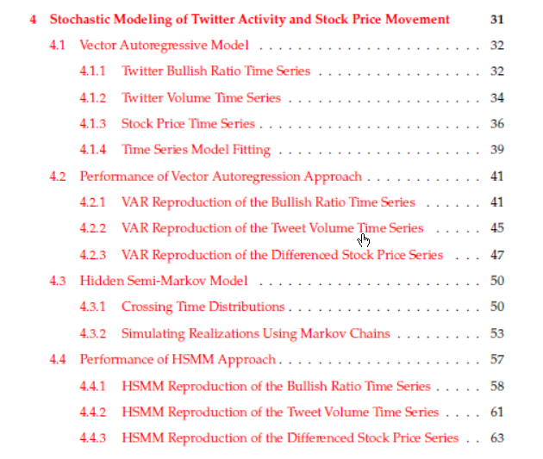
Twitter Trading
Uncertainty model

Slide 30
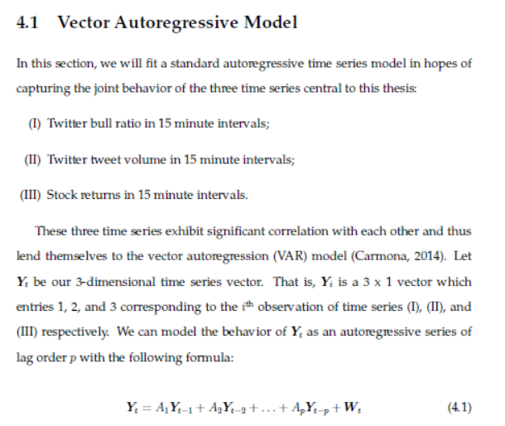
Twitter Trading

Slide 31
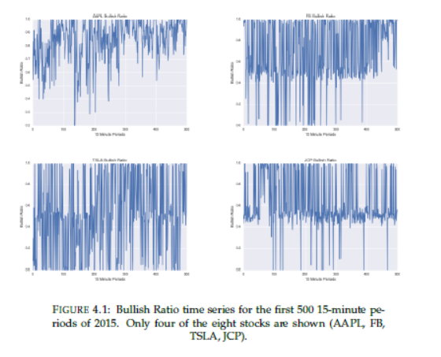
Twitter Trading
Twitter bullish ratio time series

Slide 32
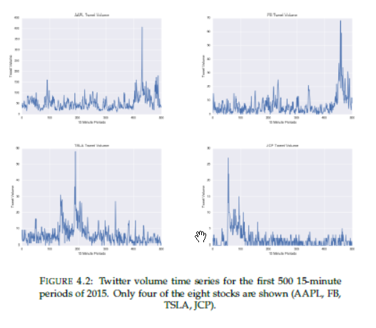
Twitter Trading
Twitter volume time series

Slide 33
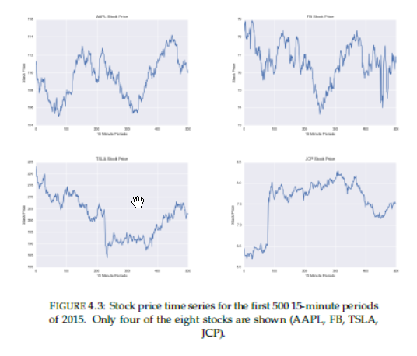
Twitter Trading
Stock price time series

Slide 34
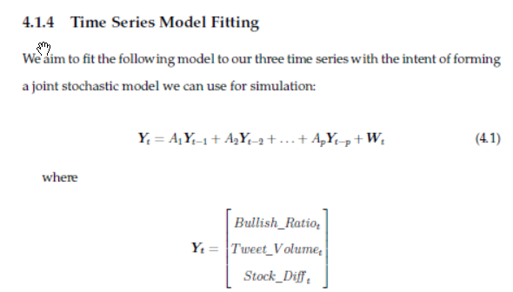
Twitter Trading
Fitting vector-auto regressive model

Slide 35
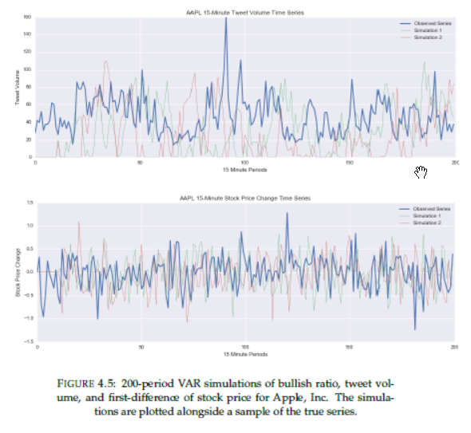
Twitter Trading

Slide 36
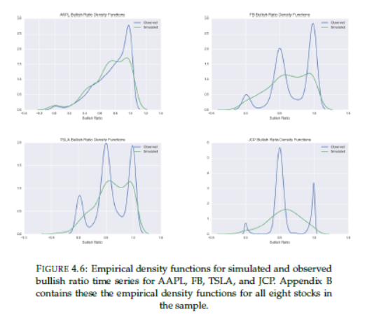
Twitter Trading
Error distribution:

Slide 37
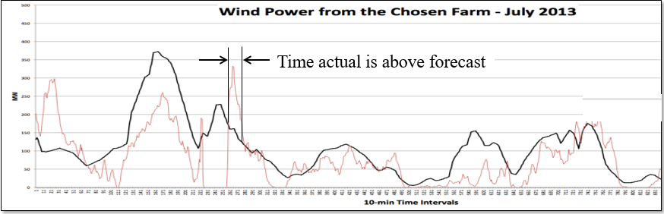
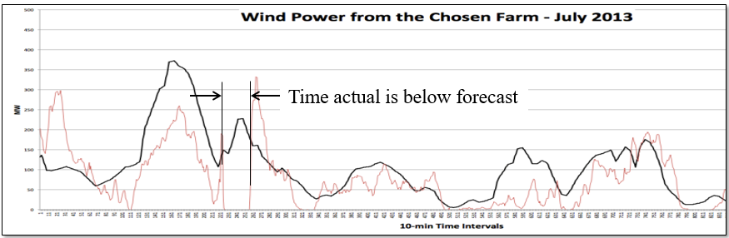
Twitter Trading
Crossing times:

Slide 38
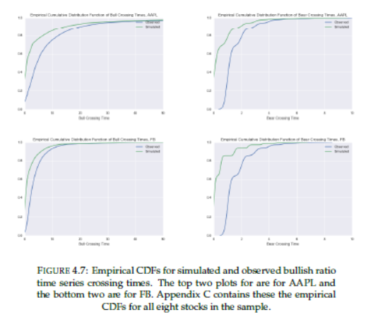
Twitter Trading
The vector autoregressive model did not reproduce the crossing times:

Slide 39
Twitter Trading
We use a hybrid Markov chain model with two stage variables:
The crossing state :
A/B means above or below
S/M/L means a short, medium or long crossing distribution
The wind speed given the crossing state:

Slide 40
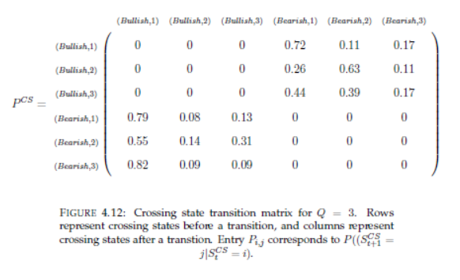
Twitter Trading
Hidden-state Markov chain

Slide 41
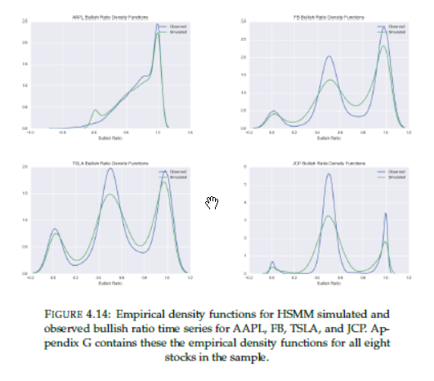
Twitter Trading
Error distribution:

Slide 42
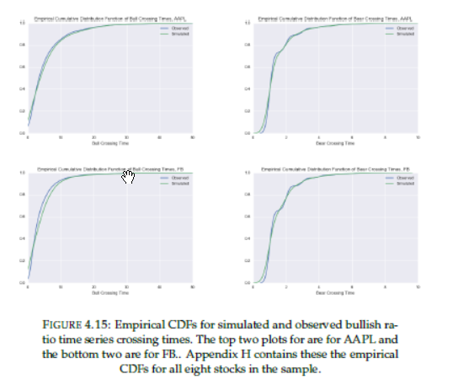
Twitter Trading
Crossing time distribution

Slide 43
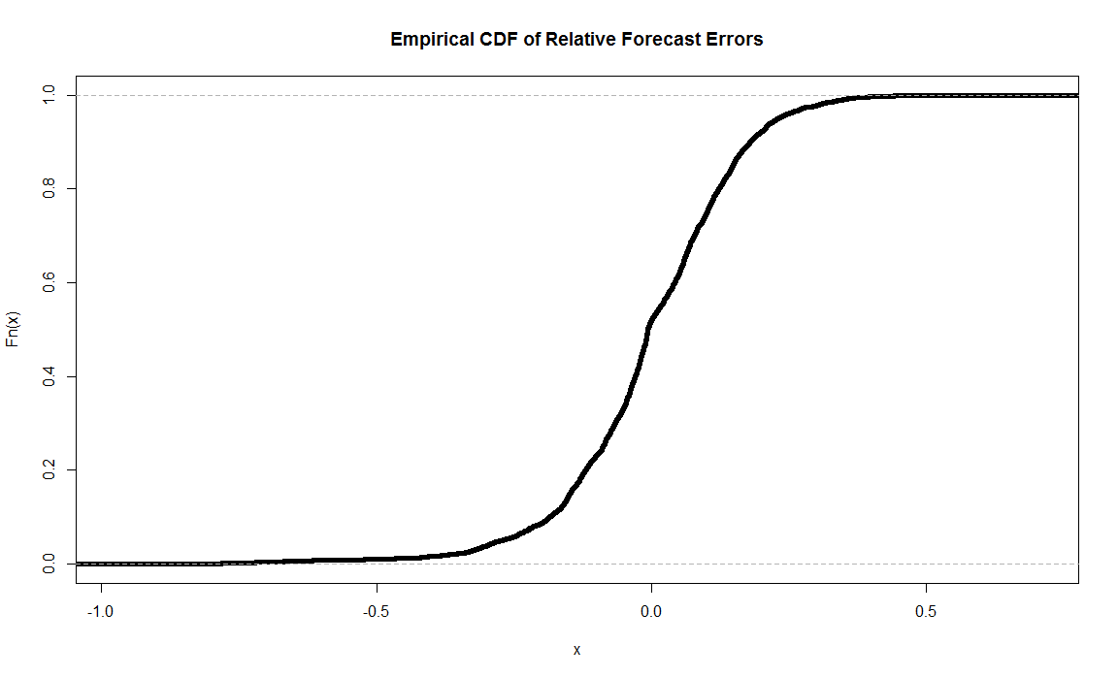
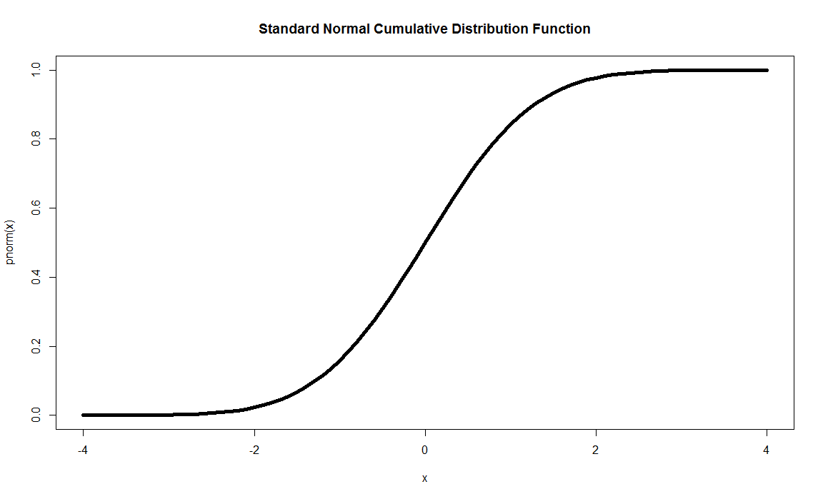
Twitter Trading
Note:
The error distribution is accomplished by using the transformation from actual observations (e.g. prices, feeds) to uniform to normal, doing statistical modeling on the normal deviates, and then transforming back from normal through the empirical distribution to get actuals.
Historical cumulative distn
Standard normal distn
1.0
1.0
0.0
0.0
Observed forecast error
Standard normal deviate Z

Slide 44
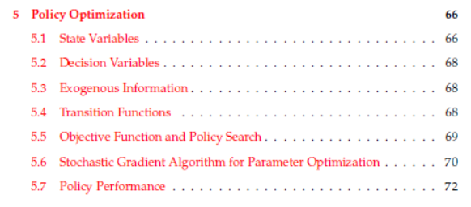
Twitter Trading

Slide 45
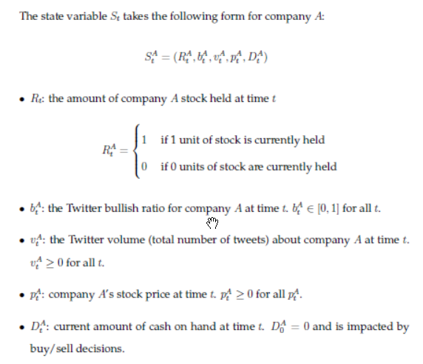
Twitter Trading
State variables

Slide 46
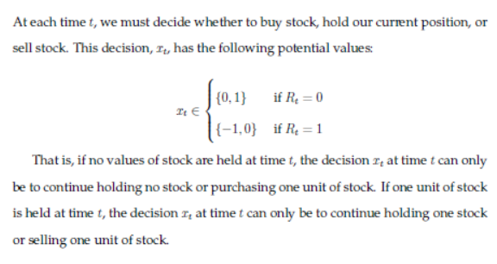
Twitter Trading
Decision variables

Slide 47
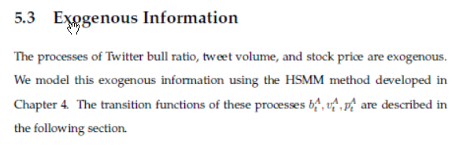
Twitter Trading
Exogenous information
Data from twitter feed

Slide 48
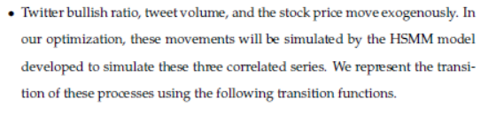
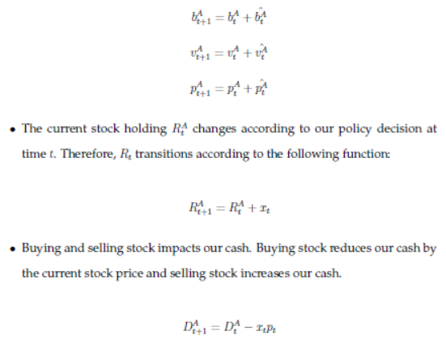
Twitter Trading
Transition function

Slide 49
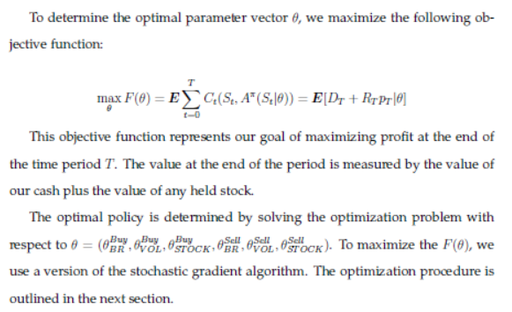
Twitter Trading
Objective function

Slide 50
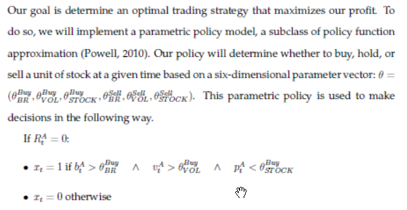
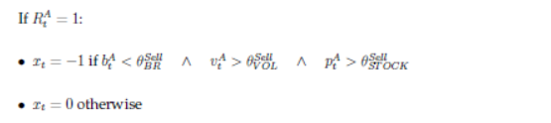
Twitter Trading
Designing policies

Slide 51
Twitter Trading
Evaluating policies
In a simulator:
Using data from history
Limited to what we observe
Need to be careful to keep training and testing data separate
Using samples from a mathematical model
This requires using our stochastic model to generate samples.
In the real world
Similar to running simulations from history

