Slide 1
.
Sequential decision analytics and modeling
ORF 411
Fall, 2018
Warren Powell
Princeton University
http://www.castlelab.princeton.edu
© 2017 Warren B. Powell, Princeton University

Slide 2

Week 2 - Monday
Chapter 4
Learning diabetes medication

Slide 3

Narrative

Slide 4
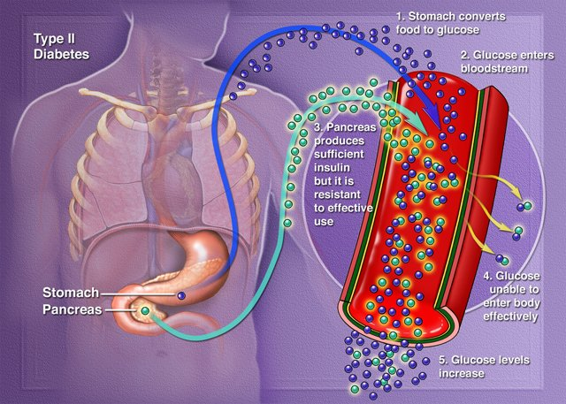
Narrative
Type 2 diabetes: Insulin resistance

Slide 5
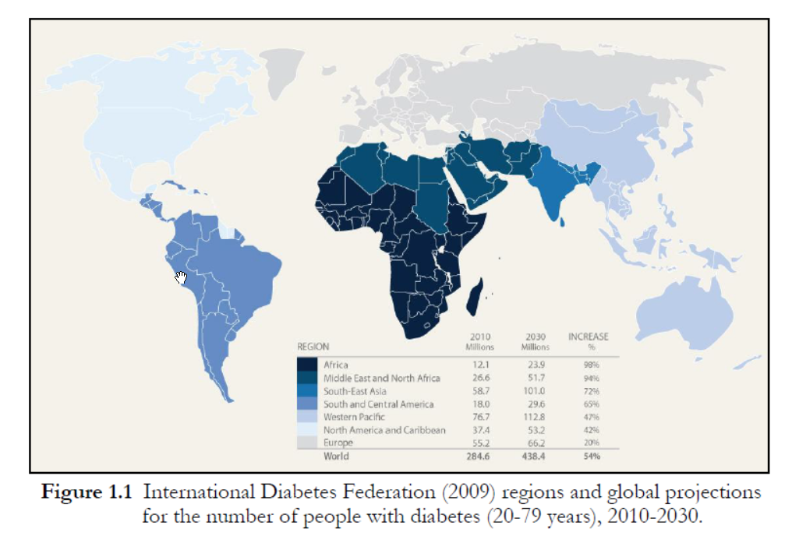

Slide 6
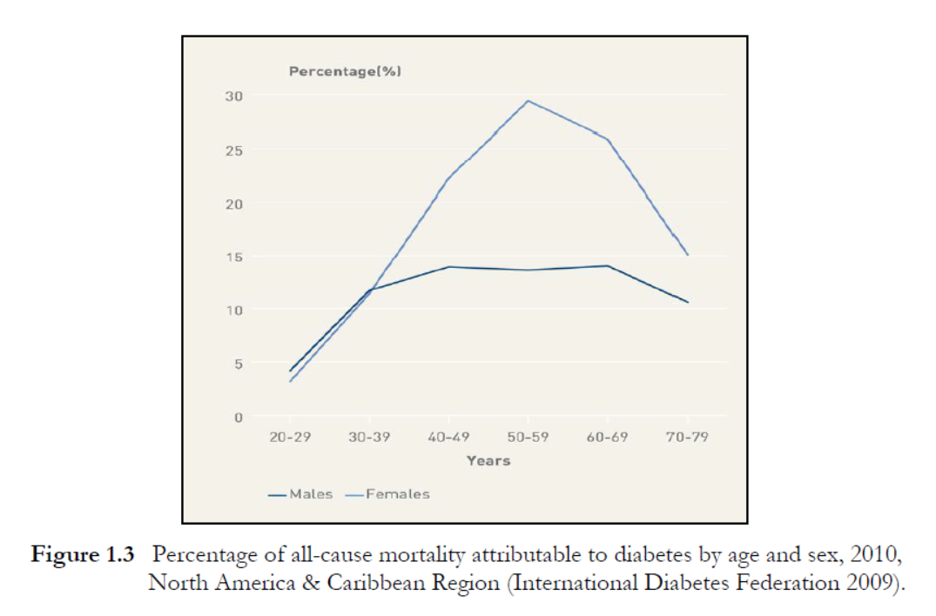

Slide 7
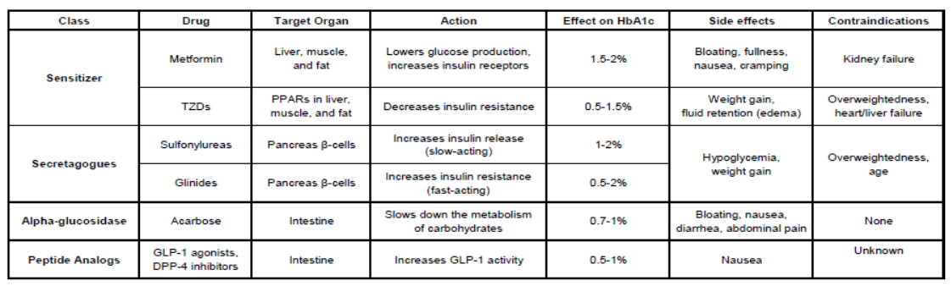
Diabetes medications

Slide 8
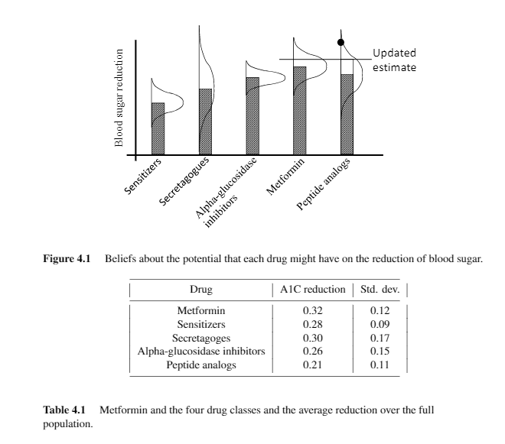

Slide 9
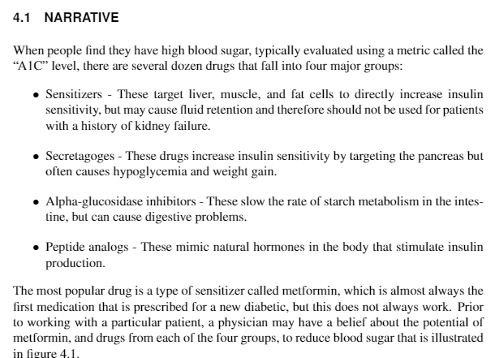

Slide 10
Basic model

Slide 11
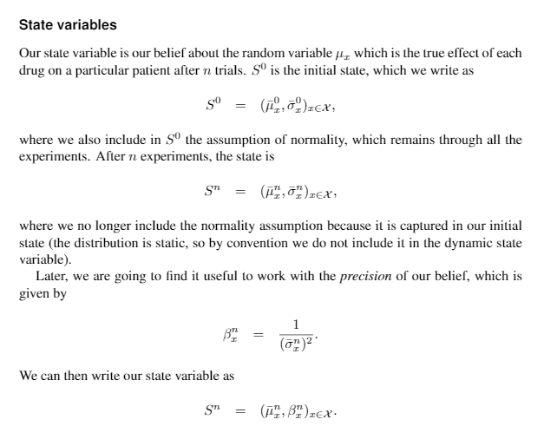

Slide 12
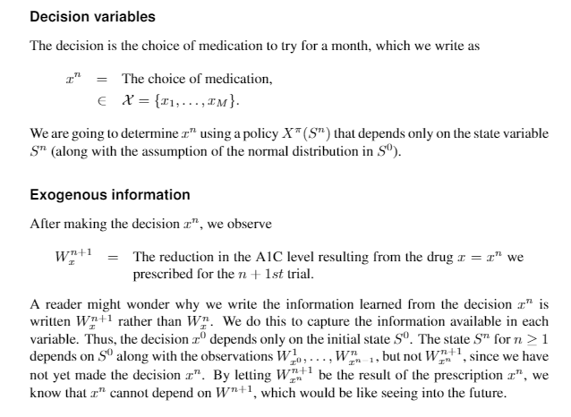

Slide 13
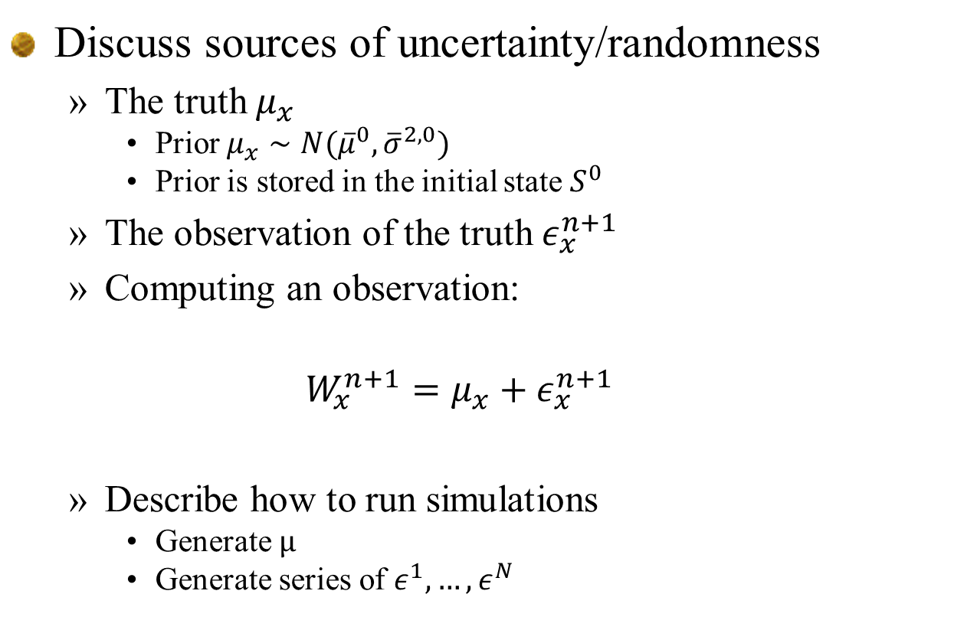
Discuss sources of uncertainty/randomness
The truth $μ_{x}$
Prior $μ_{x}∼N({\overline{μ}}^{0},{\overline{σ}}^{2,0})$
Prior is stored in the initial state $S^{0}$
The observation of the truth $ε_{x}^{n+1}$
Computing an observation:
$$W_{x}^{n+1}=μ_{x}+ε_{x}^{n+1}$$
Describe how to run simulations
Generate $μ$
Generate series of $ε^{1},…,ε^{N}$

Slide 14
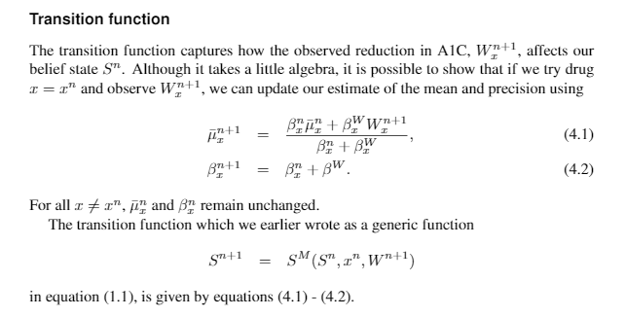

Slide 15
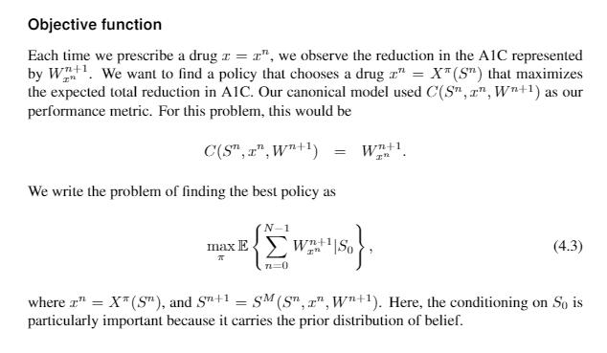

Slide 16
Uncertainty modeling

Slide 17
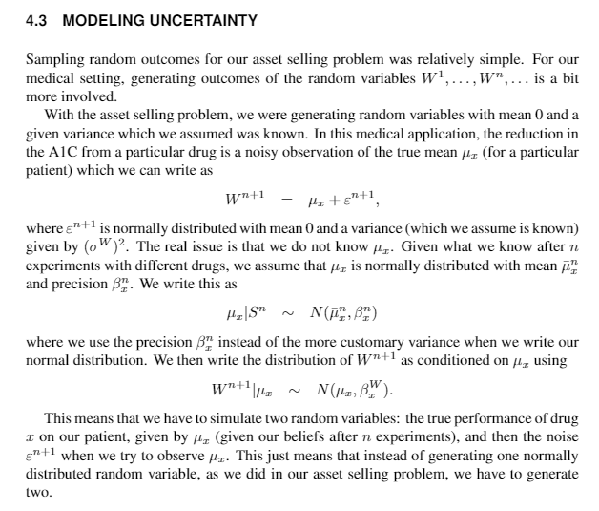

Slide 18
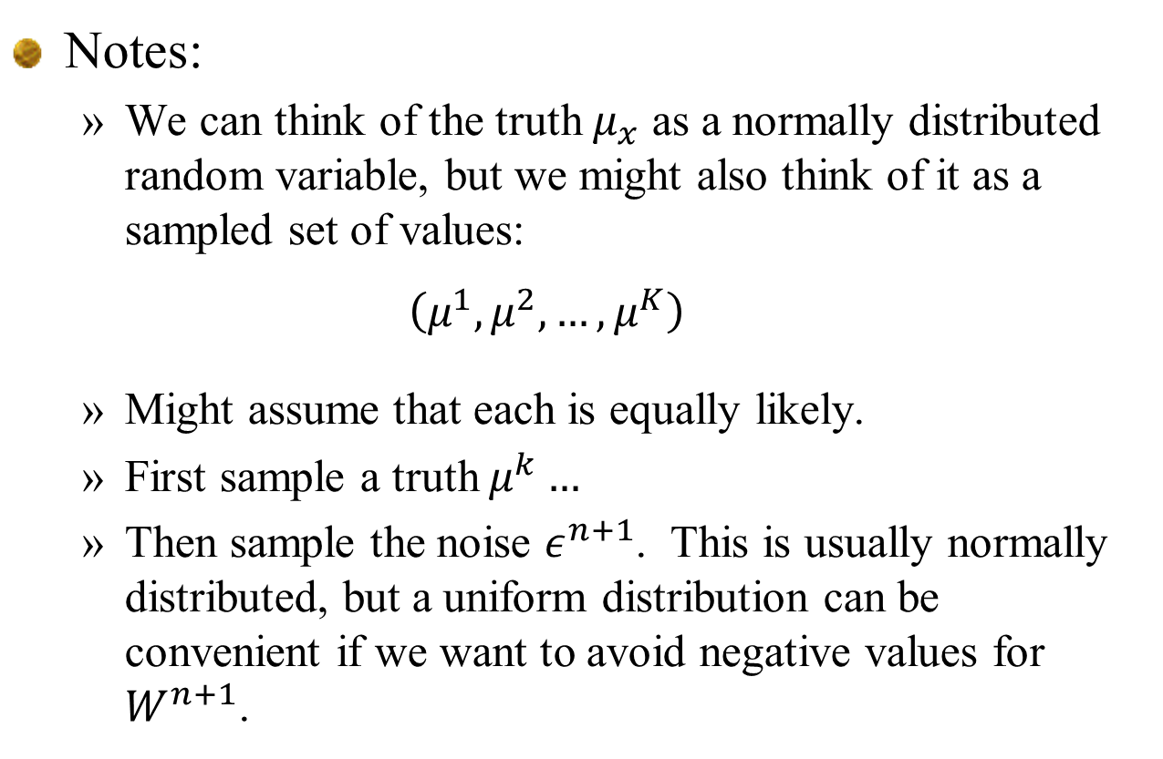
Notes:
We can think of the truth $μ_{x}$ as a normally distributed random variable, but we might also think of it as a sampled set of values:
$$\left(μ^{1},μ^{2},…,μ^{K}\right)$$
Might assume that each is equally likely.
First sample a truth $μ^{k}…$
Then sample the noise $ε^{n+1}$. This is usually normally distributed, but a uniform distribution can be convenient if we want to avoid negative values for $W^{n+1}$.

Slide 19
Designing policies

Slide 20
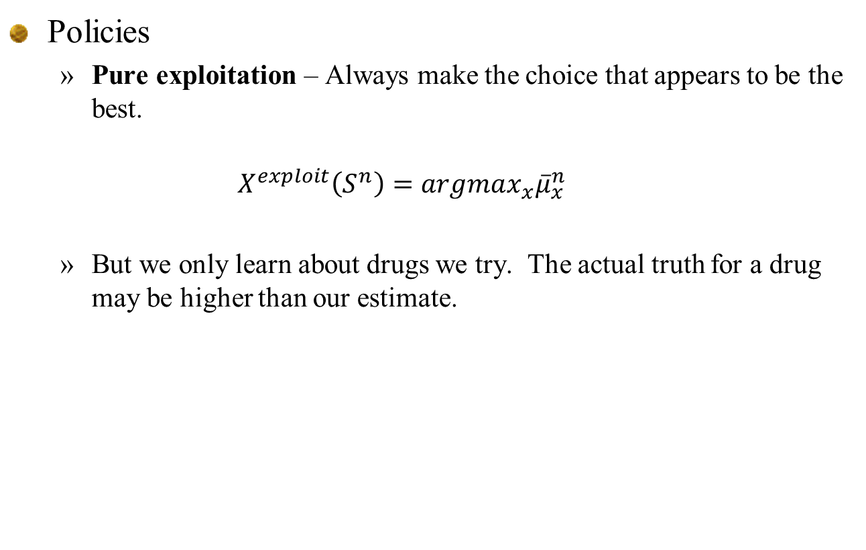
Learning policies
20
Policies
Pure exploitation – Always make the choice that appears to be the best.
$$X^{exploit}\left(S^{n}\right)=argmax_{x}{\overline{μ}}_{x}^{n}$$
But we only learn about drugs we try. The actual truth for a drug may be higher than our estimate.
Notes:
20

Slide 21
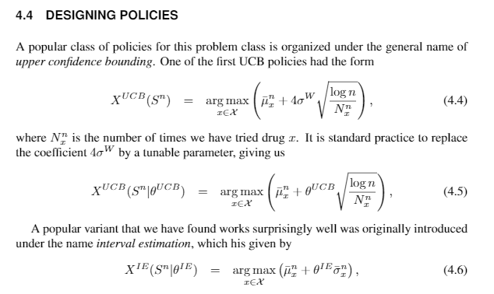

Slide 22
Evaluating policies

Slide 23
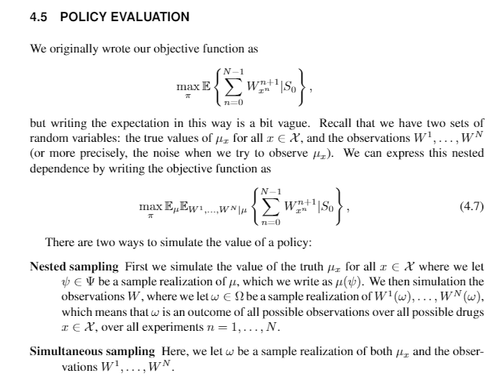

Slide 24
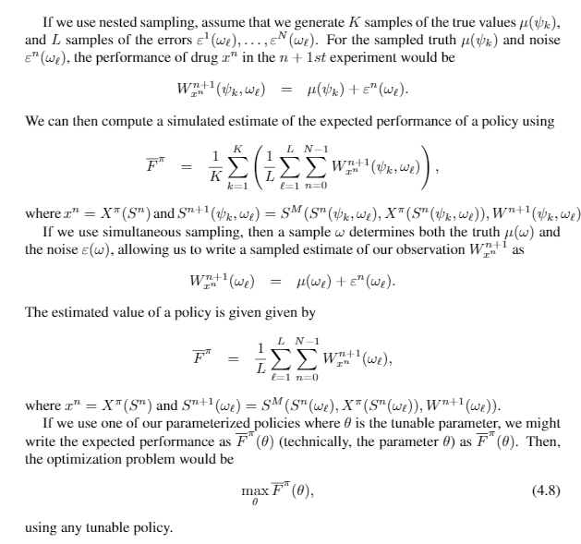
Nested sampling

Slide 25
Simultaneous sampling

Slide 26
Extensions

Slide 27
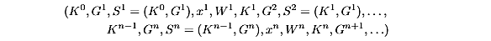
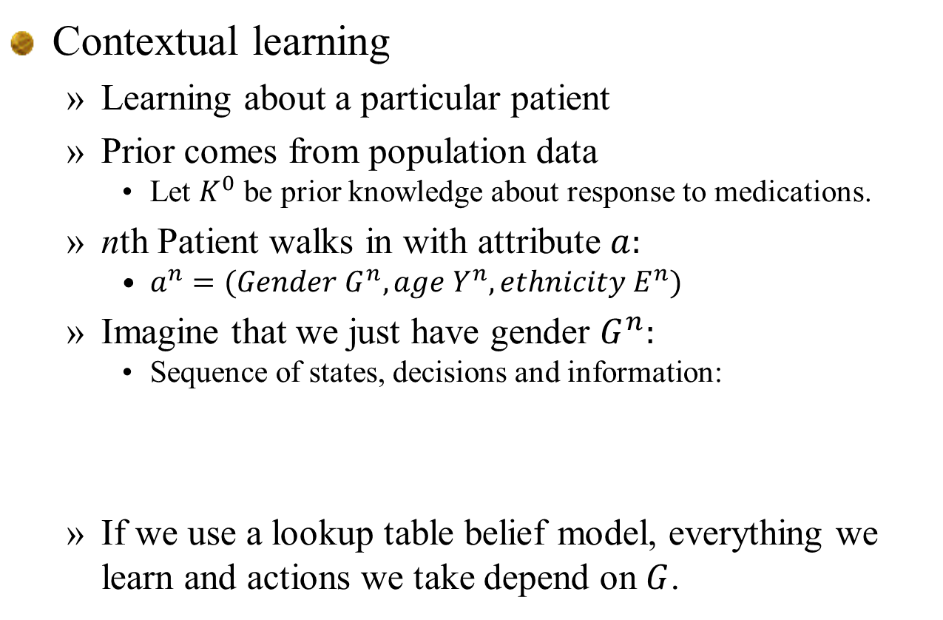
Extensions
Contextual learning
Learning about a particular patient
Prior comes from population data
Let $K^{0}$ be prior knowledge about response to medications.
nth Patient walks in with attribute $a:$
$a^{n}=(Gender G^{n}, age Y^{n}, ethnicity E^{n})$
Imagine that we just have gender $G^{n}:$
Sequence of states, decisions and information:
If we use a lookup table belief model, everything we learn and actions we take depend on $G$.

Slide 28
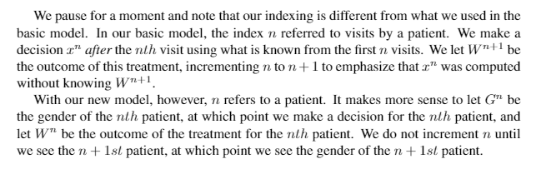
Extensions
Notational note:

Slide 29
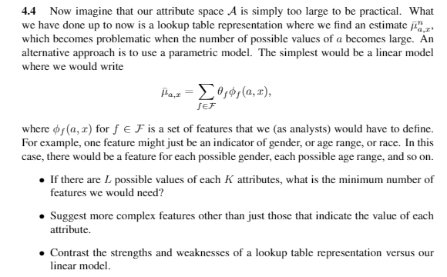
Extensions
Other extensions:
Discuss what happens when we use a vector of patient attributes rather than just gender.
What if we use a linear model:

