Slide 1
.
Sequential decision analytics and modeling
ORF 411
Fall, 2018
Warren Powell
Princeton University
http://www.castlelab.princeton.edu
© 2017 Warren B. Powell, Princeton University

Slide 2

Week 3 - Monday
KG for online learning
Bernoulli belief model
Stochastic shortest paths - I

Slide 3

Knowledge gradient
Online learning/cumulative reward

Slide 4
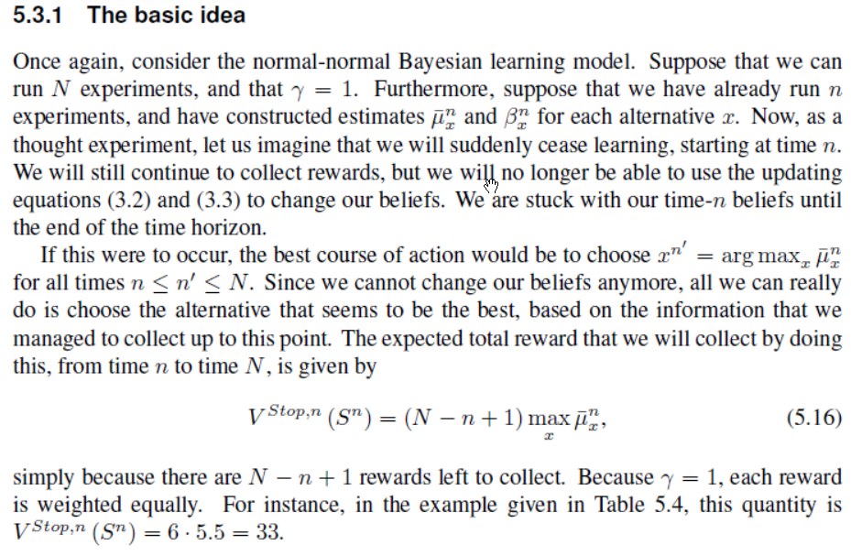
Knowledge gradient

Slide 5
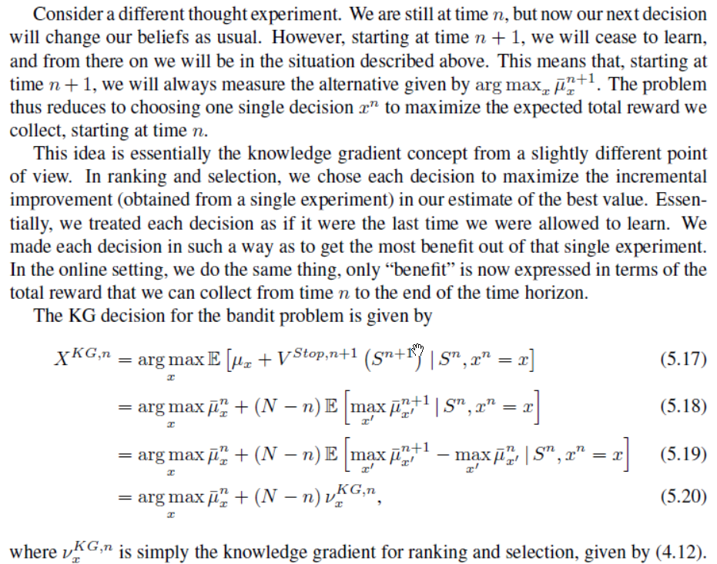
Knowledge gradient

Slide 6
Knowledge gradient
Notes:
Asymptotically finds optimal arm as
Knowledge gradient seems to be the only policy with distinct forms for offline (final reward) and online (cumulative reward):
Offline learning
Online learning

Slide 7



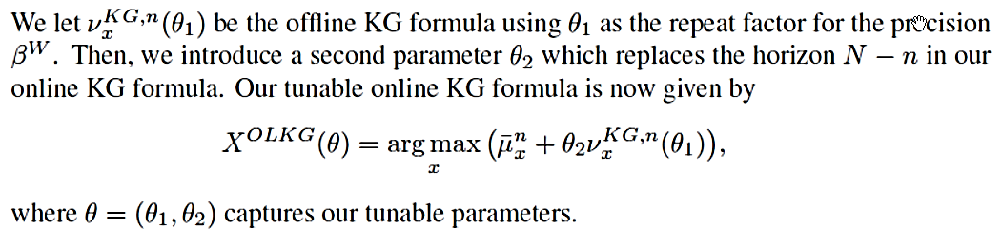
Knowledge gradient
Discounted finite horizon
Discounted infinite horizon
Tunable versions:

Slide 8
Knowledge gradient
Knowledge gradient policy
For finite-horizon on-line problems:
For infinite-horizon discounted problems:
Compare to Gittins indices for bandit problems
…interval estimation
… and UCB
Notes:
8

Slide 9
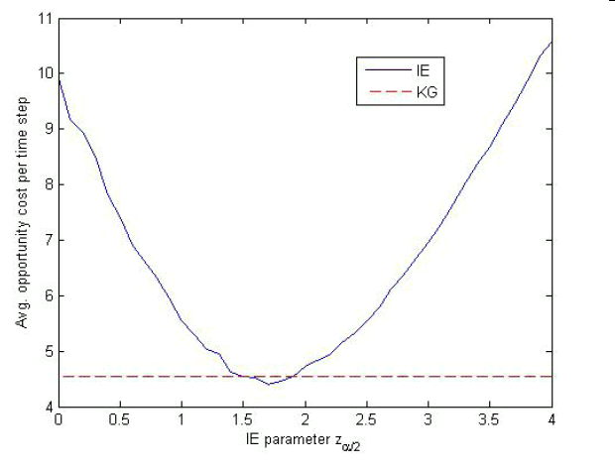
Knowledge gradient
KG versus interval estimation
Recall that with IE, you choose the alternative with the highest:
Tunable parameter
IE
Opportunity cost
IE beats KG
KG

Slide 10
Lookahead learning model
Beta-Bernoulli belief

Slide 11
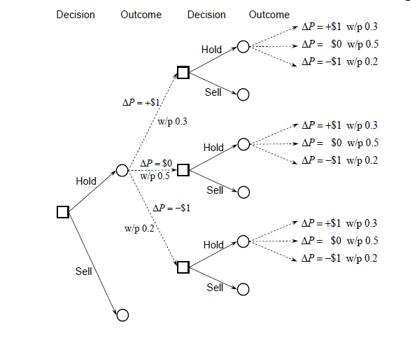
Learning using decision trees
Decision tree without learning

Slide 12
Learning using decision trees
Some vocabulary:
Square nodes are:
Decision nodes – Links emanating from the squares are decisions
Also represents the state of our system (it implicitly captures all the information we need to make a decision).
Also known as the “pre-decision state.”
Circle nodes are:
Outcome nodes – Links emanating from circles represent random events.
Represents the state after a decision is made.
Also known as the “post-decision state.”
Nodes in a decision tree always imply the information in the entire path leading up to the node.
We receive a reward whenever we sell.

Slide 13
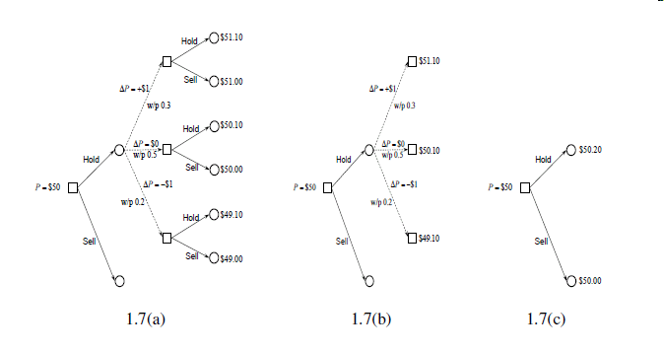
Learning using decision trees
Rolling back the tree

Slide 14
Choose hitter
Hit?
Choose hitter
Hit?
.366
Hidden in each node is the updated belief state after new observations are made.
We could assume that we do not learn, but here we are learning, and new observations produce updated estimates of probabilities.
.333
1
.318
.360
.356
0
.640
.333
.318
A
.360
.500
1
.318
B
.333
0
.360
.667
.250
.318
C
.360
.333
1
.348
.318
0
.360
.682
.333
.304

Slide 15
.366
.333
1
.360
.318
0
.356
.640
.333
A
.318
.360
1
.500
B
.333
.318
0
.360
.667
.250
C
.318
.360
1
.333
.318
.348
0
.360
.682
.333
.304

Slide 16
.366
1
.360
0
.640
.356
A
1
.500
B
.333
0
.667
.360
C
1
.360
.318
0
.682
.360

Slide 17
Notes:
We choose player B, who does not have the highest average.
Discuss the impact of the uncertainty about player B.
What if all the players had 100’s of at bats?
.720 =
.360(1+.366)+
.640(0+.356)
A
B
.740
C
.678

Slide 18
0/1 outcomes
Does an internet customer click on a link or buy a product.
Did the baseball player get a hit?
Did the drug work for the patient?
Did the student accept our offer of admission?

Slide 19
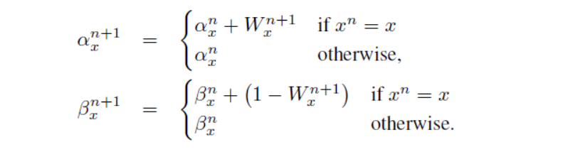
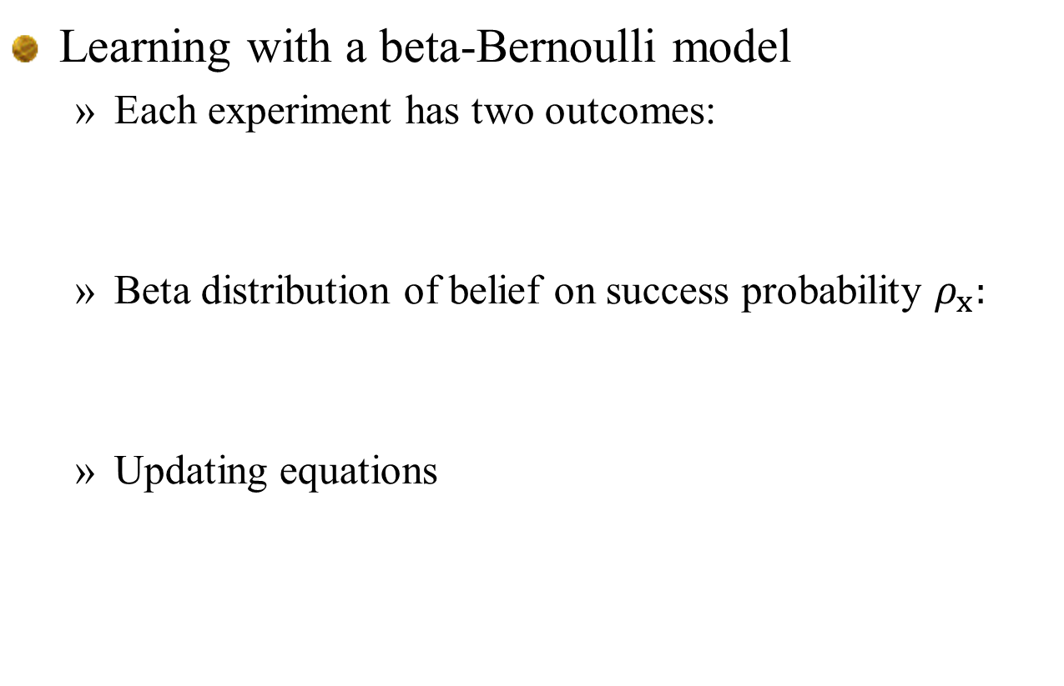
Multi-step lookahead policies
Learning with a beta-Bernoulli model
Each experiment has two outcomes:
Beta distribution of belief on success probability $ρ_{x}:$
Updating equations

Slide 20
Decision Outcome Decision Outcome
Continue
Continue
Stop
Stop
Continue
Continue
Stop
Continue
Stop
Stop
As a decision tree (some states are duplicated)

Slide 21
Decision Outcome Decision Outcome
Continue
Continue
Stop
Stop
Continue
Continue
Stop
Continue
Stop
Stop
As a dynamic program (duplicate states removed)

Slide 22
Decision Outcome Decision Outcome Decision

Slide 23
Discrete MDPs
Decision trees:
Discuss the concept of a “state” in a decision tree.
Implicit in a decision node is the entire history leading up to the decision, which is unique.
We may not need the entire history, but we do not need to articulate this.
The complexity of a decision tree is independent of the complexity of the state variable. Instead, it depends on the number of possible decisions (actions) and outcomes.

Slide 24
Decision Outcome Decision Outcome Decision Outcome
Decision node
Outcome node

Slide 25
Stochastic shortest paths I

Slide 26
Narrative

Slide 27
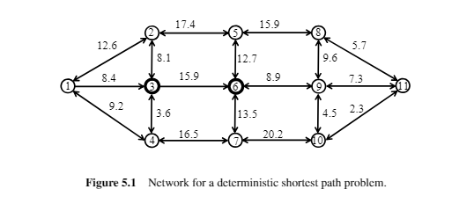
A deterministic shortest path problem

Slide 28
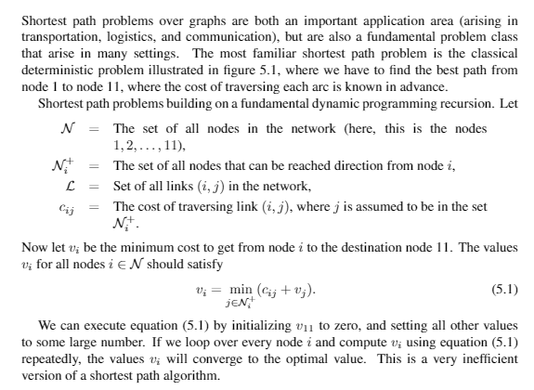

Slide 29
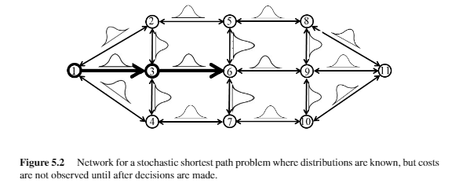
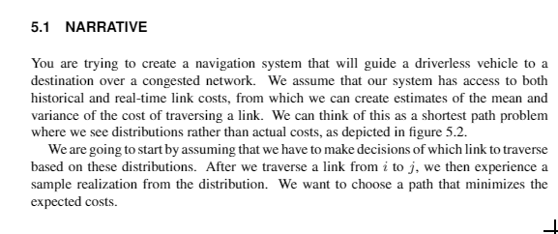

Slide 30
Basic model
Stochastic network – costs revealed after decisions are made

Slide 31
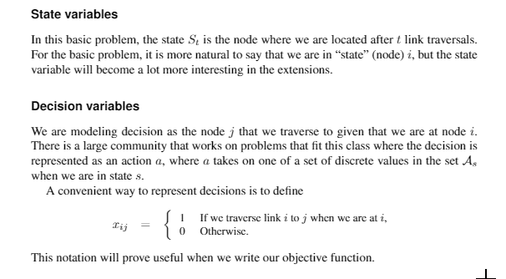

Slide 32
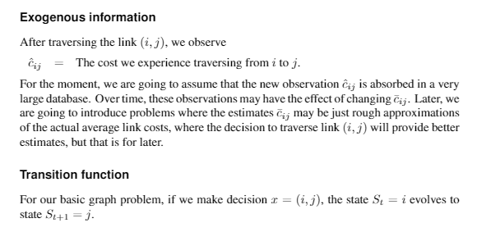

Slide 33
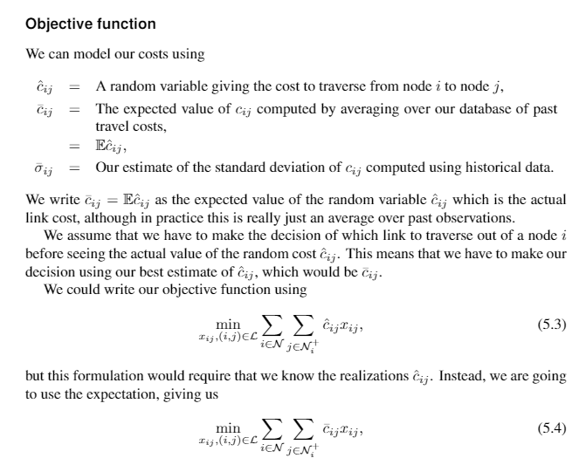

Slide 34
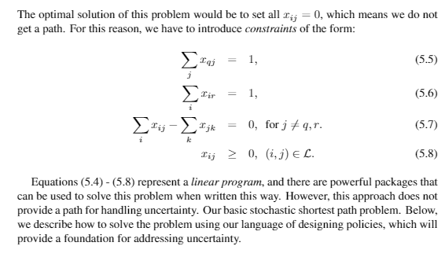
The objective function
In other words, we can think of this as a well defined problem where we call a black box solver. This could be a linear programming solver, or a shortest path algorithm.

Slide 35
Modeling uncertainty

Slide 36
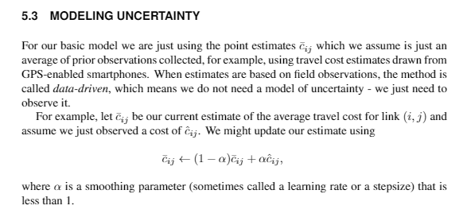
Modeling uncertainty
Discuss modeling the uncertainty of the realizations:
Data driven modeling
Empirical distributions
Moment fitting for parametrics (e.g. normal)

Slide 37
Designing policies

Slide 38
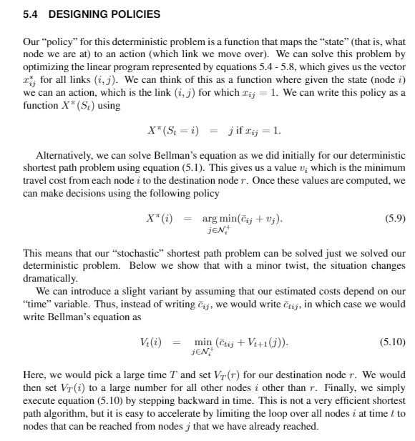

Slide 39
Notes:
This basic problem is just a deterministic shortest path problem, which we can solve using the generic backward DP method we introduced at the beginning.
The policy is optimal, since we are solving the original problem. This means we do not have to do tuning or policy evaluation.

