Slide 1
.
Sequential decision analytics and modeling
ORF 411
Fall, 2018
Warren Powell
Princeton University
http://www.castlelab.princeton.edu
© 2017 Warren B. Powell, Princeton University

Slide 2

Week 3 - Wednesday
Stochastic shortest paths

Slide 3

Stochastic shortest paths II
Adaptive routing

Slide 4
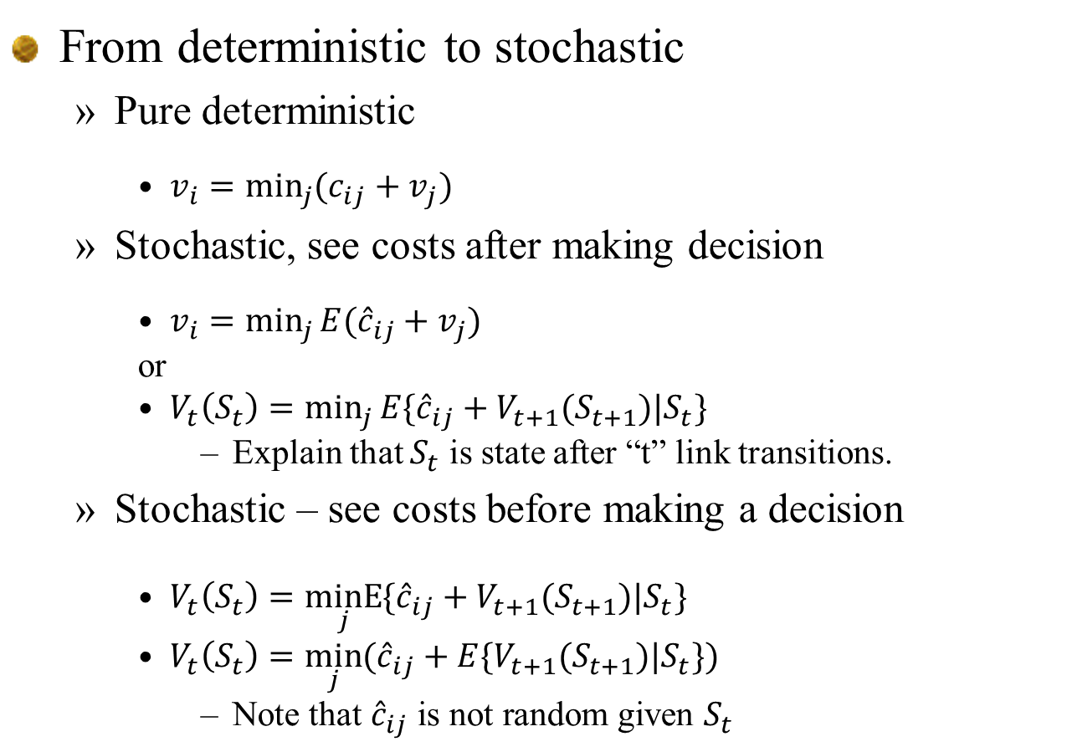
From last time - deterministic
From deterministic to stochastic
Pure deterministic
$v_{i}=\min_{j}{(c_{ij}+v_{j})}$
Stochastic, see costs after making decision
$v_{i}=\min_{j}{E({\hat{c}}_{ij}+v_{j})}$
or
$V_{t}\left(S_{t}\right)=\min_{j}{E\{{\hat{c}}_{ij}+V_{t+1}(S_{t+1})|S_{t}\}}$
Explain that $S_{t}$ is state after “t” link transitions.
Stochastic – see costs before making a decision
$V_{t}\left(S_{t}\right)=\underset{j}{minE}{\{{\hat{c}}_{ij}+V_{t+1}(S_{t+1})|S_{t}\}}$
$V_{t}\left(S_{t}\right)=\min_{j}{({\hat{c}}_{ij}+{E\{V}_{t+1}(S_{t+1})|S_{t}\})}$
$\text{Note} \text{that} {\hat{c}}_{ij} \text{is} \text{not} \text{random} \text{given} S_{t}$

Slide 5
The state variable
Illustrating state variables
A deterministic graph

Slide 6


The state variable
Illustrating state variables
A stochastic graph

Slide 7
The state variable
Illustrating state variables
A stochastic graph

Slide 8
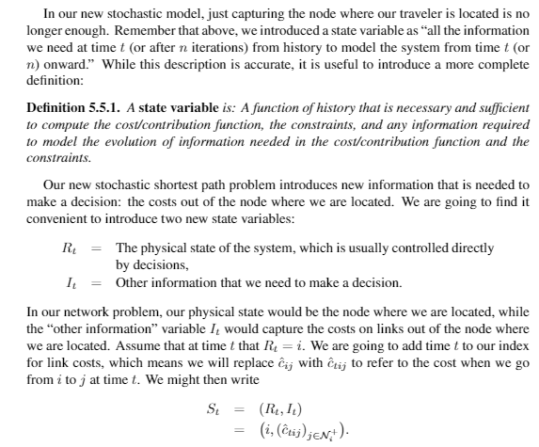

Slide 9
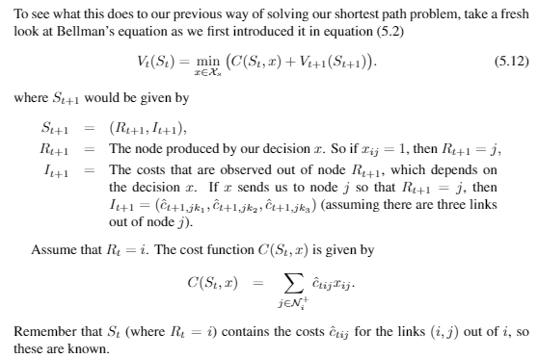
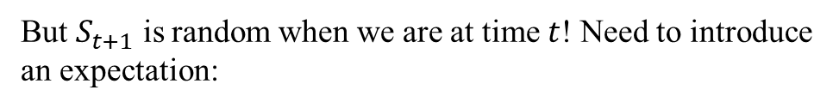
But $S_{t+1}$ is random when we are at time $t$! Need to introduce
an expectation:

Slide 10
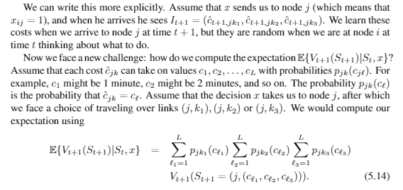

Finding a policy
We could try using Bellman’s equation, but now the transition from $S_{t}$ to $S_{t+1}$ is stochastic because of revealing the new link times, so we have to write Bellman’s equation as:

Slide 11
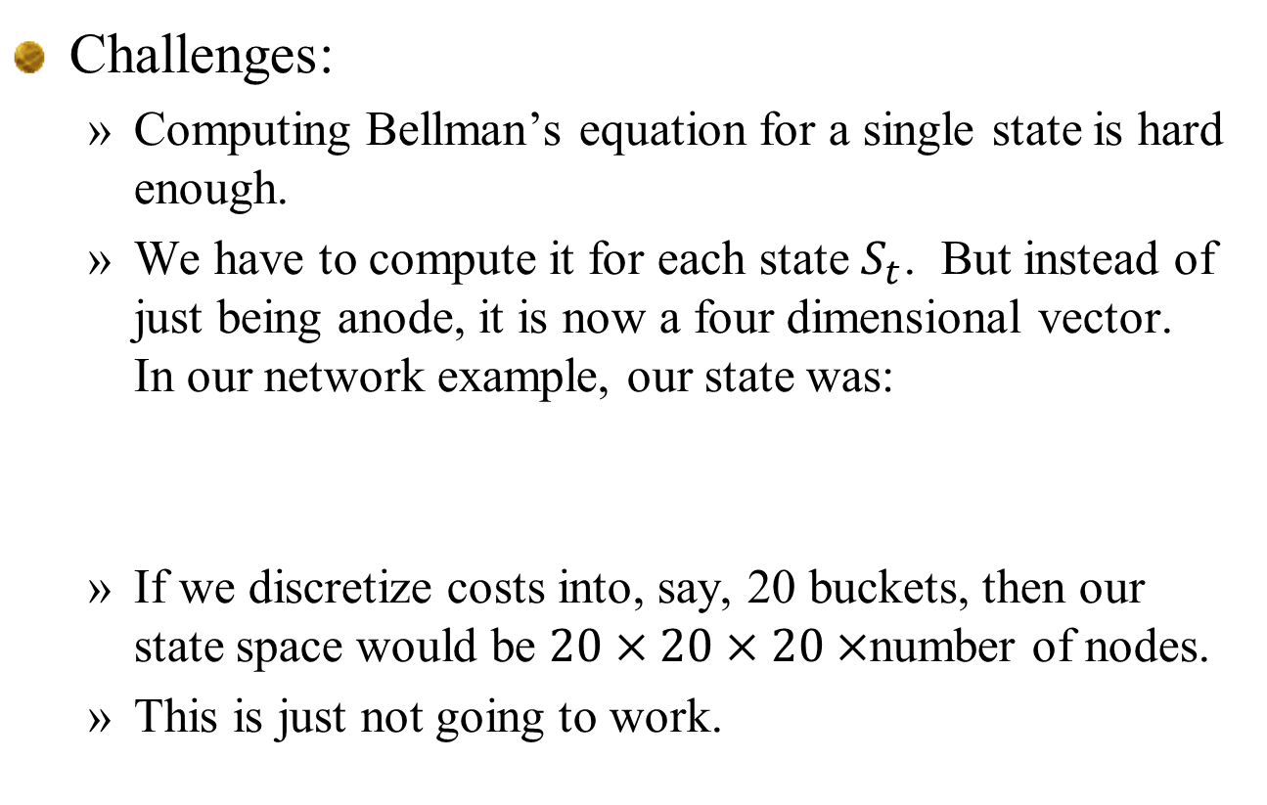
Challenges:
Computing Bellman’s equation for a single state is hard enough.
We have to compute it for each state $S_{t}$. But instead of just being anode, it is now a four dimensional vector. In our network example, our state was:
If we discretize costs into, say, 20 buckets, then our state space would be $20×20×20×$number of nodes.
This is just not going to work.

Slide 12
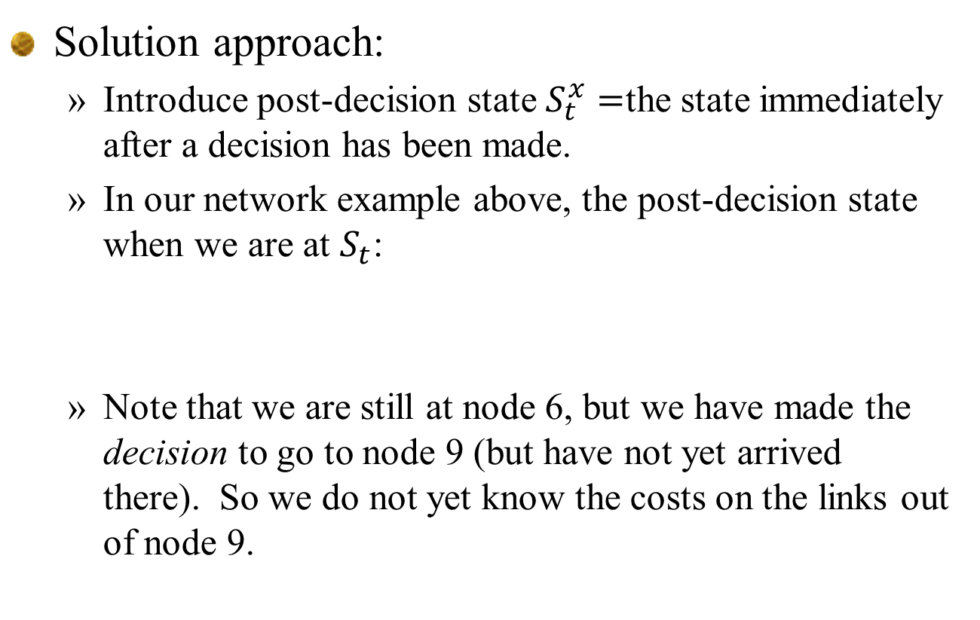
Solution approach:
Introduce post-decision state $S_{t}^{x}=$the state immediately after a decision has been made.
In our network example above, the post-decision state when we are at $S_{t}$:
Note that we are still at node 6, but we have made the decision to go to node 9 (but have not yet arrived there). So we do not yet know the costs on the links out of node 9.

Slide 13


Bellman’s original equation:
From pre- to post-decision state:
From post- to pre-decision state:
This expectation is still hard to compute, but we have tricks…

Slide 14
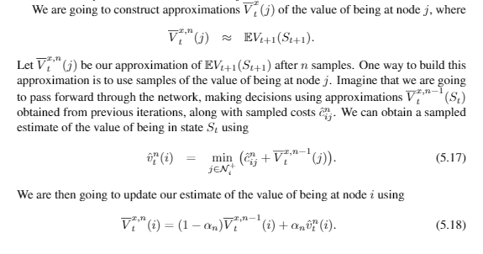
We are going to use an approach called “approximate dynamic programming”

Slide 15
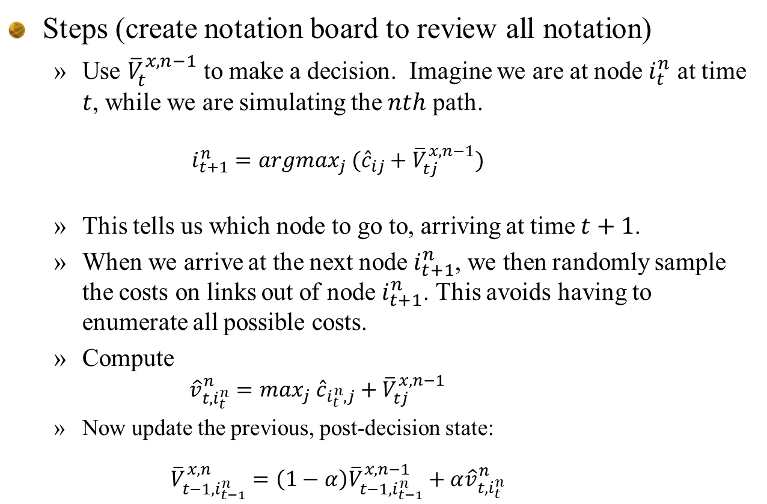
Steps (create notation board to review all notation)
Use ${\overline{V}}_{t}^{x,n−1}$ to make a decision. Imagine we are at node $i_{t}^{n}$ at time $t$, while we are simulating the $nth$ path.
$$i_{t+1}^{n}=argmax_{j} ({\hat{c}}_{ij}+{\overline{V}}_{tj}^{x,n−1})$$
This tells us which node to go to, arriving at time $t+1$.
When we arrive at the next node $i_{t+1}^{n}$, we then randomly sample the costs on links out of node $i_{t+1}^{n}$. This avoids having to enumerate all possible costs.
Compute
${\hat{v}}_{t,i_{t}^{n}}^{n}=max_{j} {\hat{c}}_{i_{t}^{n},j}+{\overline{V}}_{tj}^{x,n−1}$
Now update the previous, post-decision state:
$${\overline{V}}_{t−1,i_{t−1}^{n}}^{x,n}=\left(1−α\right){\overline{V}}_{t−1,i_{t−1}^{n}}^{x,n−1}+α{\hat{v}}_{t,i_{t}^{n}}^{n}$$

Slide 16
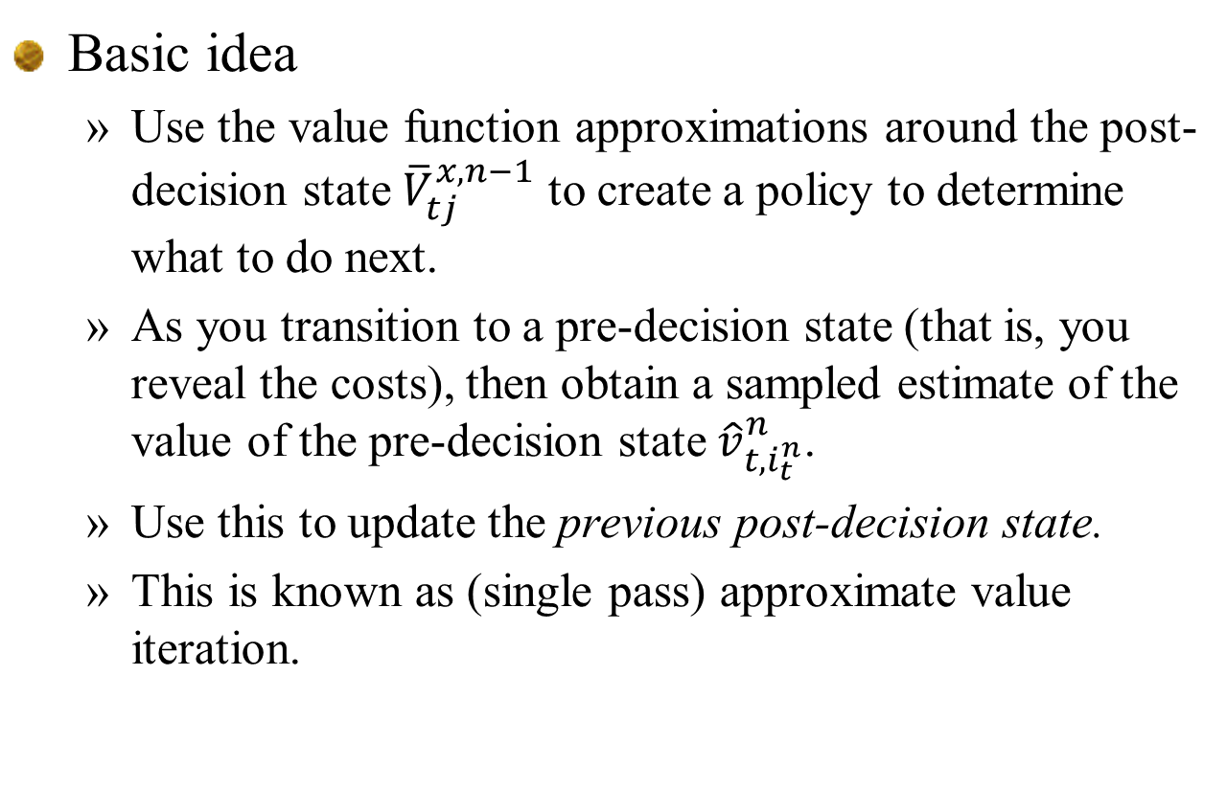
Basic idea
Use the value function approximations around the post-decision state ${\overline{V}}_{tj}^{x,n−1}$ to create a policy to determine what to do next.
As you transition to a pre-decision state (that is, you reveal the costs), then obtain a sampled estimate of the value of the pre-decision state ${\hat{v}}_{t,i_{t}^{n}}^{n}$.
Use this to update the previous post-decision state.
This is known as (single pass) approximate value iteration.

Slide 17
Stepsizes
Updated estimate
Old estimate
New observation
The stepsize
“Learning rate”
“Smoothing factor”
Stepsizes:
Approximate value iteration requires updates of the form:

Slide 18
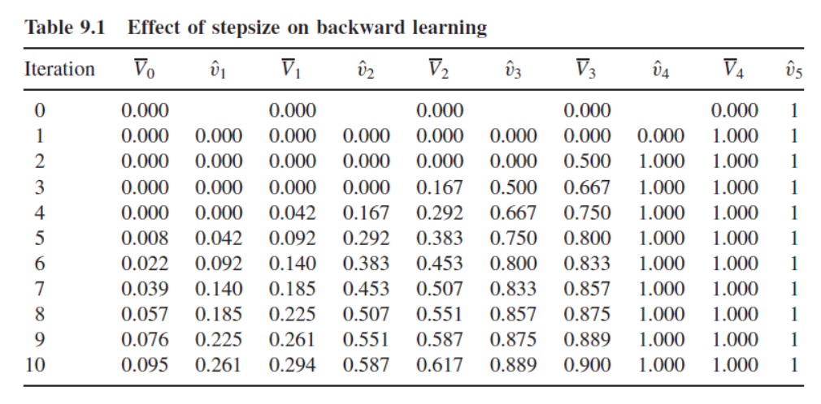
Stepsizes
Single state, single action Markov chain
Updating – receives reward=1 at last node. All other rewards = 0.
Same as adding up random rewards with mean of 1. Noise may be zero, or quite high.
0
0
0
0
0
1
0
1
2
3
4
5

Slide 19
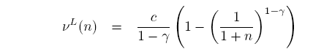
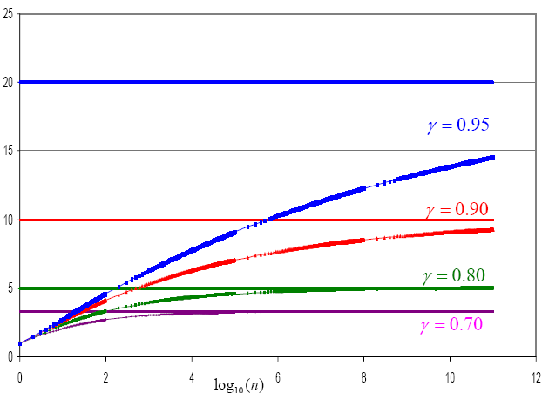
Stepsizes
Single state, single action
Bound on performance using 1/n:

Slide 20
Stepsizes
Some basic tricks:
Use a constant stepsize, but you have to tune.
Harmonic stepsize, but again – careful tuning.
Use a stepsize = 1 for T iterations (T = horizon), then switch to harmonic.

Slide 21
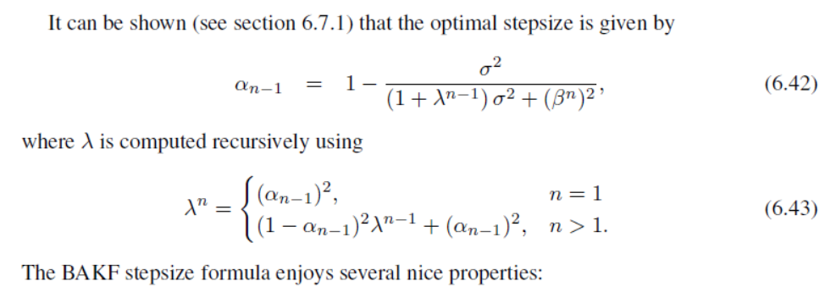

Stepsize policies
BAKF stepsize rule (from chapter 6)
Properties:
With static mean, $α_{n}=\frac{1}{n}$
With no noise, $α_{n}=1$
At all times, $α_{n}≥\frac{1}{n}$

Slide 22
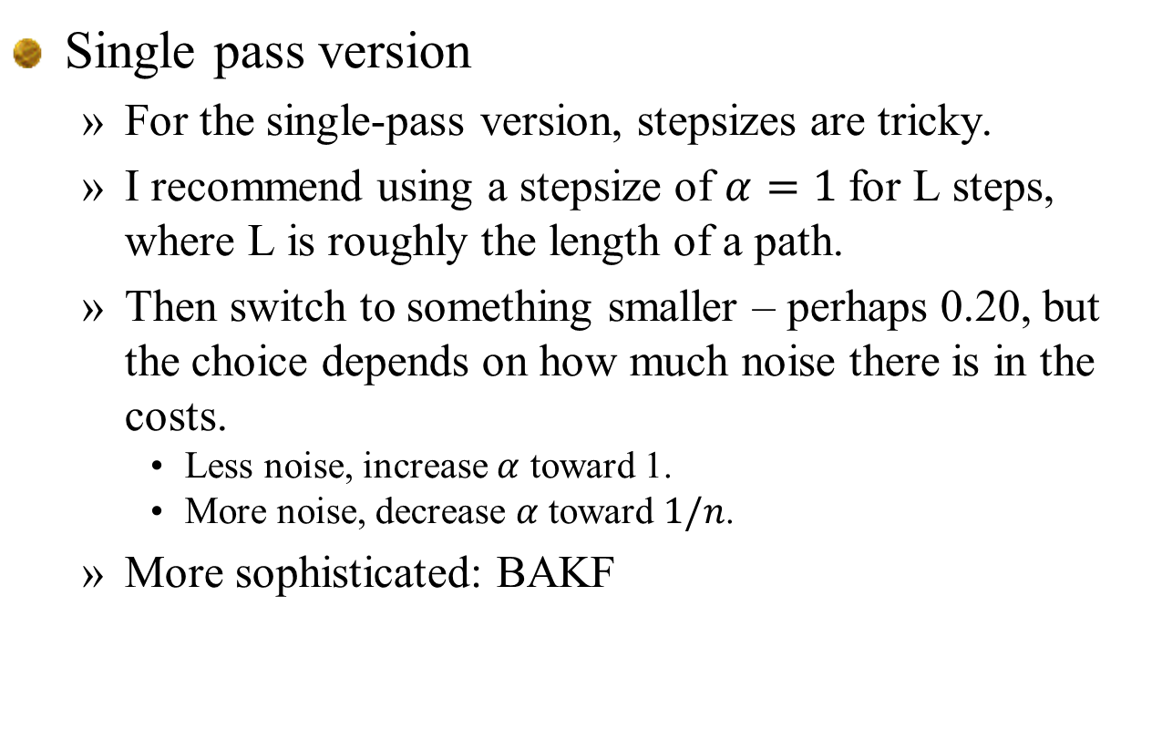
Stepsizes
Single pass version
For the single-pass version, stepsizes are tricky.
I recommend using a stepsize of $α=1$ for L steps, where L is roughly the length of a path.
Then switch to something smaller – perhaps 0.20, but the choice depends on how much noise there is in the costs.
Less noise, increase $α$ toward 1.
More noise, decrease $α$ toward $1/n$.
More sophisticated: BAKF

Slide 23
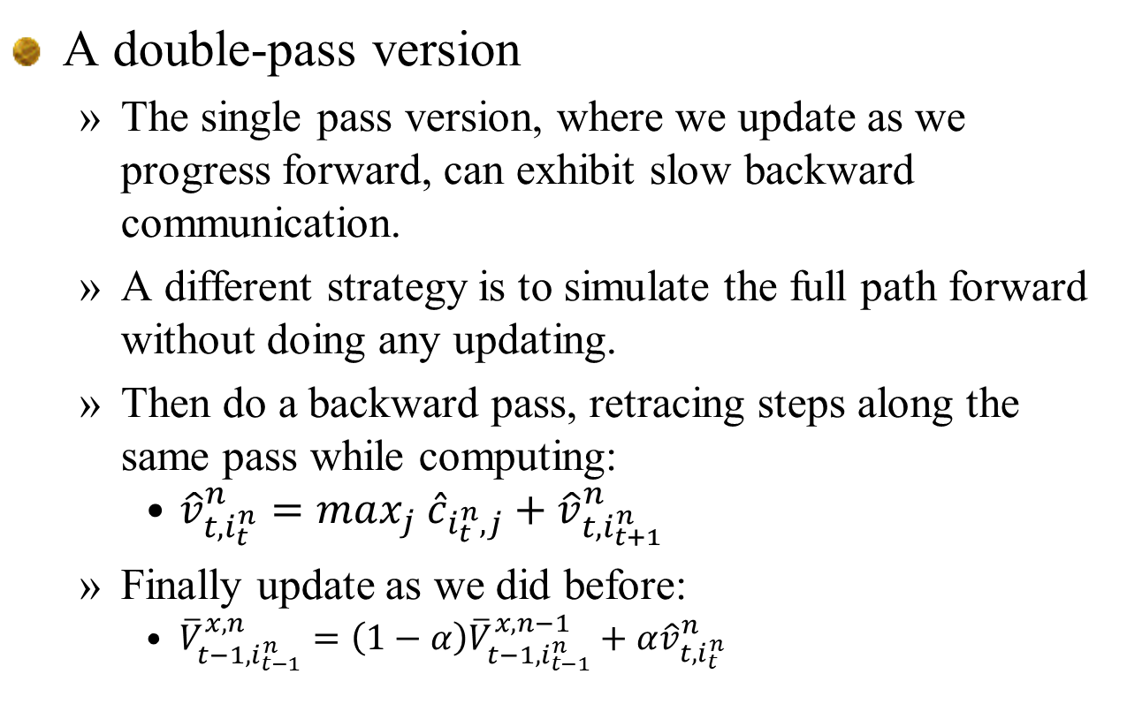
A double-pass version
The single pass version, where we update as we progress forward, can exhibit slow backward communication.
A different strategy is to simulate the full path forward without doing any updating.
Then do a backward pass, retracing steps along the same pass while computing:
${\hat{v}}_{t,i_{t}^{n}}^{n}=max_{j} {\hat{c}}_{i_{t}^{n},j}+{\hat{v}}_{t,i_{t+1}^{n}}^{n}$
Finally update as we did before:
${\overline{V}}_{t−1,i_{t−1}^{n}}^{x,n}=\left(1−α\right){\overline{V}}_{t−1,i_{t−1}^{n}}^{x,n−1}+α{\hat{v}}_{t,i_{t}^{n}}^{n}$

Slide 24
Stepsizes
Double pass version
Harmonic stepsize rule likely to be best.

Slide 25
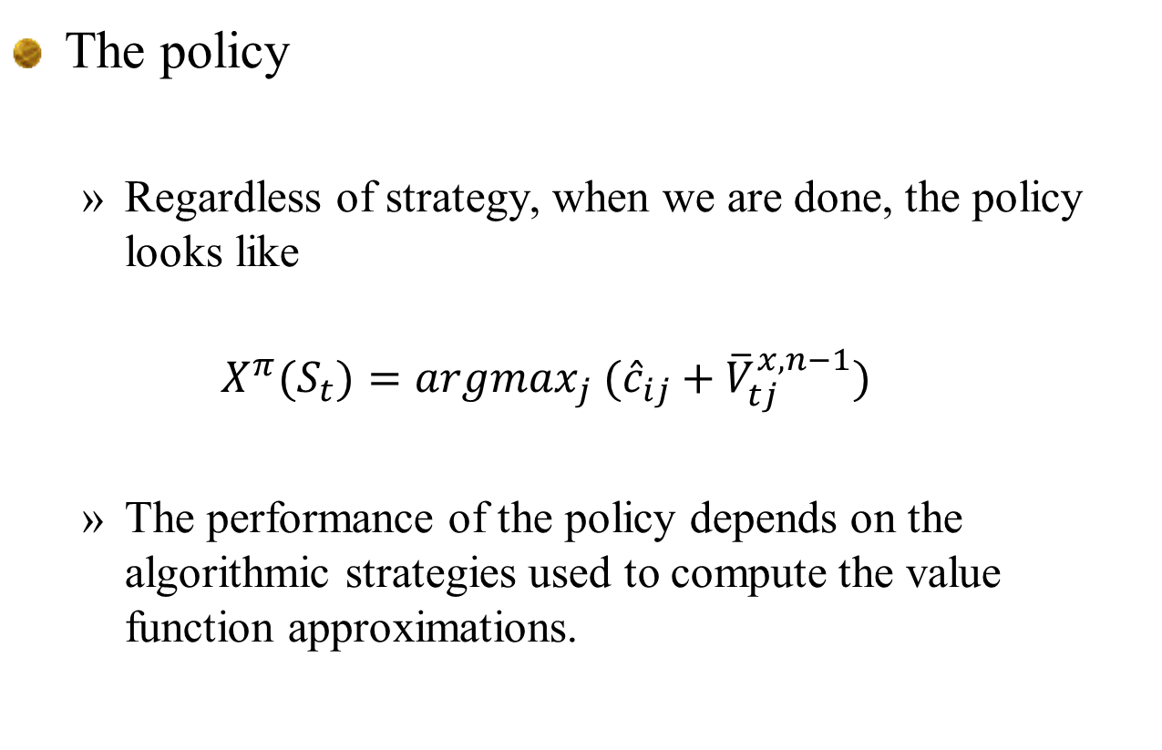
The policy
Regardless of strategy, when we are done, the policy looks like
$$X^{π}(S_{t})=argmax_{j} ({\hat{c}}_{ij}+{\overline{V}}_{tj}^{x,n−1})$$
The performance of the policy depends on the algorithmic strategies used to compute the value function approximations.

Slide 26
Q-learning

Slide 27
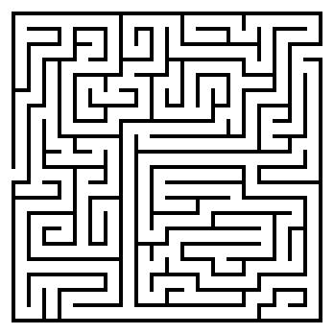
Q-learning
Mouse in a maze problem

Slide 28
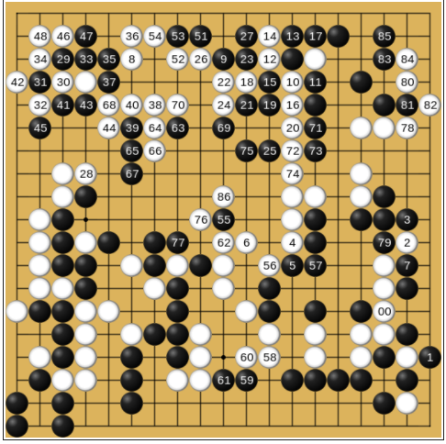
Q-learning
AlphaGo
Much more complex state space.
Uses hybrid of policies:
PFA
VFA
Lookahead (DLA)

Slide 29
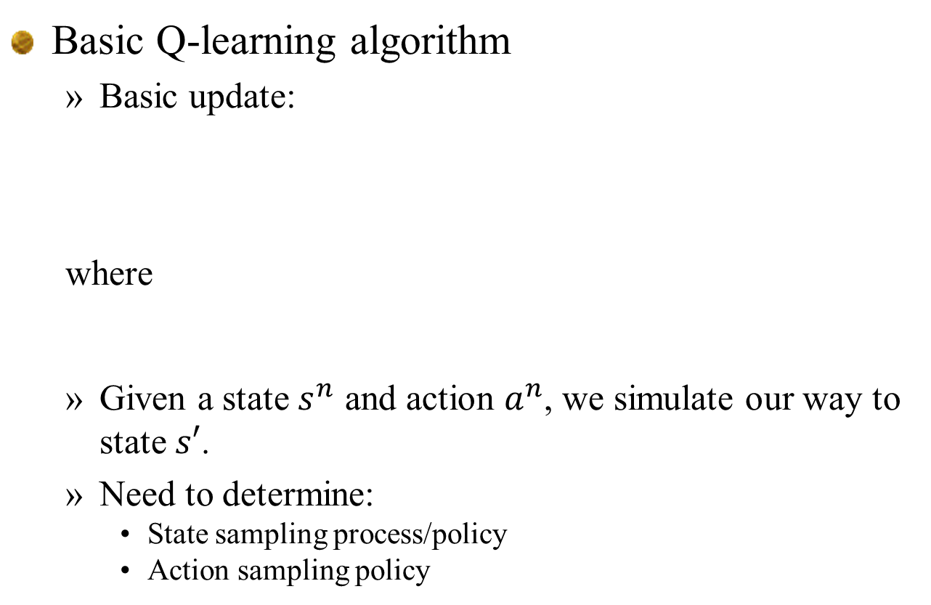
Q-learning
Basic Q-learning algorithm
Basic update:
where
Given a state $s^{n}$ and action $a^{n}$, we simulate our way to state $s′$.
Need to determine:
State sampling process/policy
Action sampling policy

Slide 30
Q-learning
Some terms from reinforcement learning:
“Behavior policy” is the policy used to choose actions
E.g. these are actions observed by a real system
“Target policy” is the policy that we are trying to learn, which is to say the policy we want to implement.
When the target policy is different from the behavior policy, then this is termed “off policy learning”
In this course
The “learning policy” is the policy (often called an algorithm) that learns the value functions (or Q-factors)
The “implementation policy” is the policy determined by the value functions (or Q-factors).

Slide 31
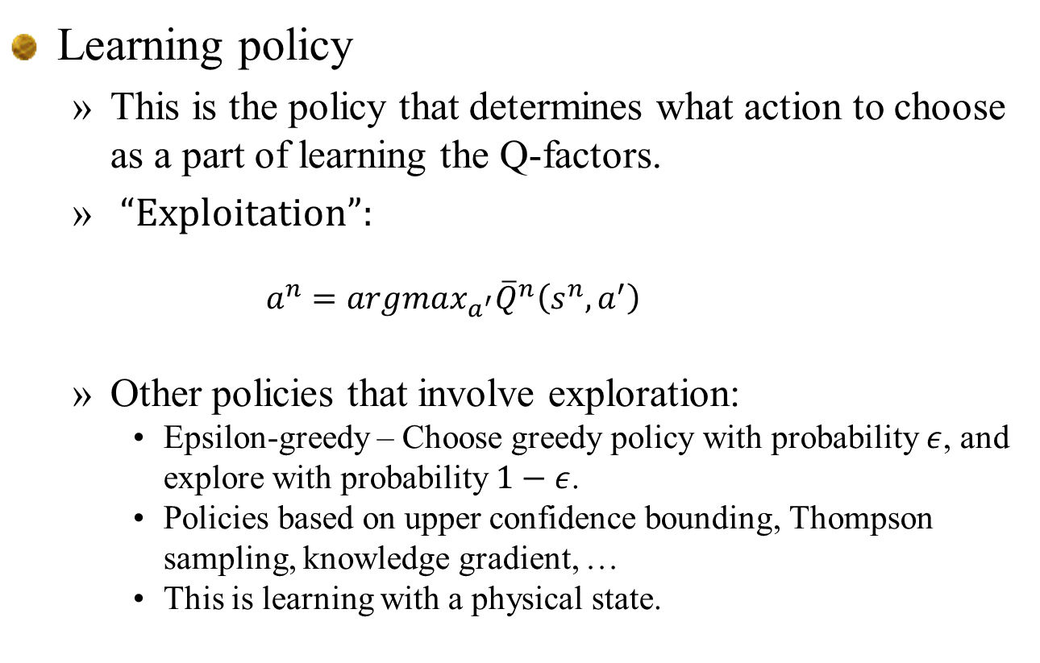
Q-learning
Learning policy
This is the policy that determines what action to choose as a part of learning the Q-factors.
“Exploitation”:
$$a^{n}=argmax_{a^{′}}{\overline{Q}}^{n}\left(s^{n},a^{′}\right)$$
Other policies that involve exploration:
Epsilon-greedy – Choose greedy policy with probability $ε$, and explore with probability $1−ε$.
Policies based on upper confidence bounding, Thompson sampling, knowledge gradient, …
This is learning with a physical state.

Slide 32
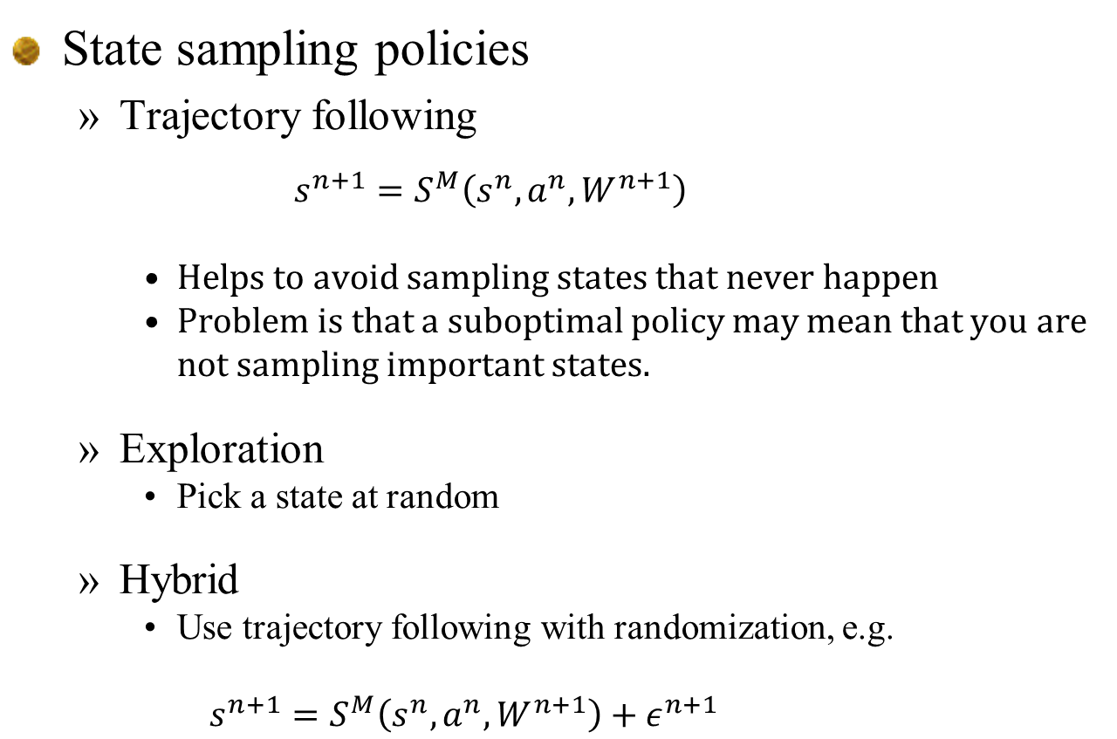
Q-learning
State sampling policies
Trajectory following
$$s^{n+1}=S^{M}\left(s^{n},a^{n},W^{n+1}\right)$$
Helps to avoid sampling states that never happen
Problem is that a suboptimal policy may mean that you are not sampling important states.
Exploration
Pick a state at random
Hybrid
Use trajectory following with randomization, e.g.
$$s^{n+1}=S^{M}\left(s^{n},a^{n},W^{n+1}\right)+ε^{n+1}$$

Slide 33
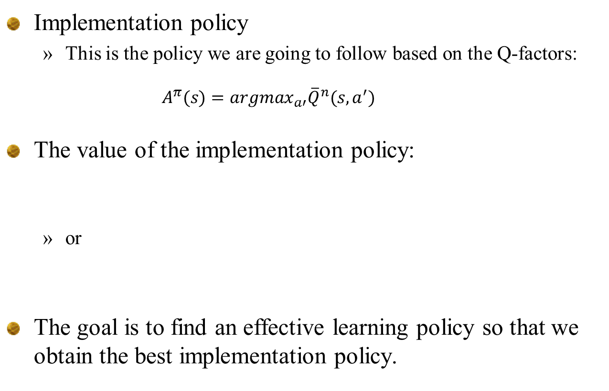
Q-learning
Implementation policy
This is the policy we are going to follow based on the Q-factors:
$$A^{π}(s)=argmax_{a′}{\overline{Q}}^{n}(s,a^{′})$$
The value of the implementation policy:
or
The goal is to find an effective learning policy so that we obtain the best implementation policy.

Slide 34
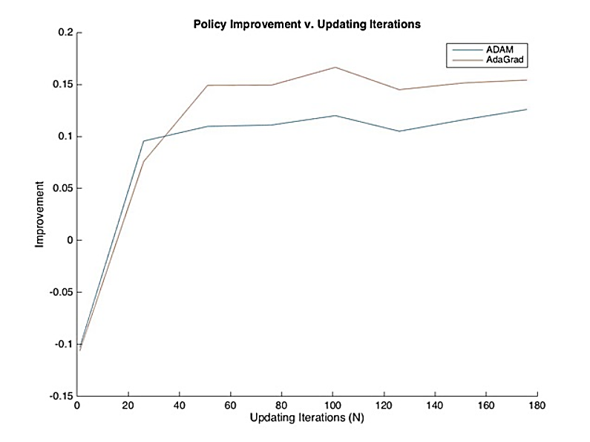
Q-learning
Convergence rates:

Slide 35
Q-learning
On vs off-policy learning:
On-policy learning – Behavior according to the policy dictated by the Q-factors::
Off-policy learning:
Sample actions according to a learning policy (called “behavior policy” in the RL literature). This is the policy used for learning the implementation policy (called the “target policy” in the RL literature).
Needs to be combined with a state sampling policy.

Slide 36
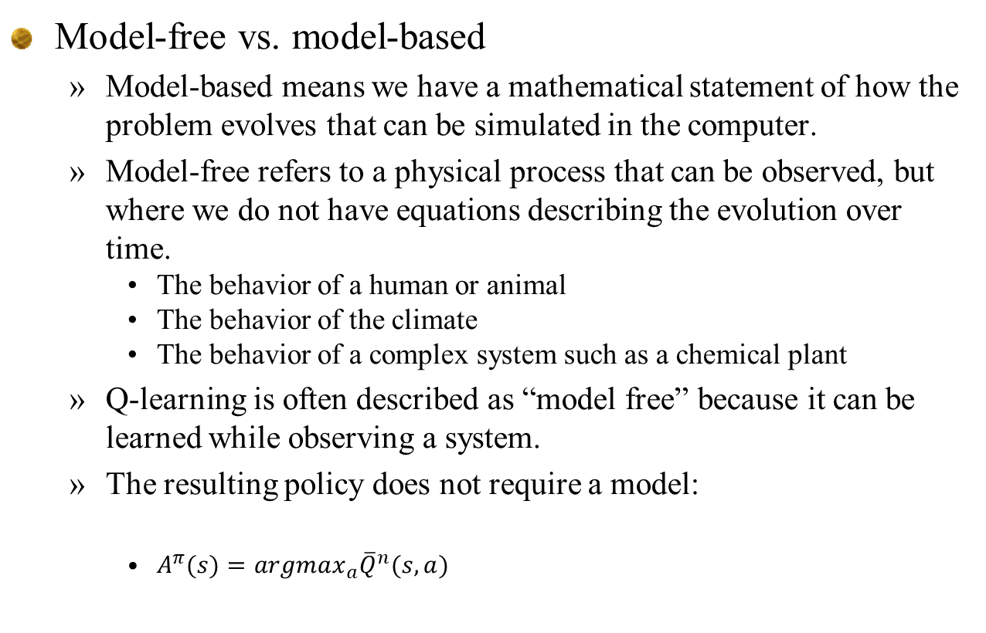
Q-learning
Model-free vs. model-based
Model-based means we have a mathematical statement of how the problem evolves that can be simulated in the computer.
Model-free refers to a physical process that can be observed, but where we do not have equations describing the evolution over time.
The behavior of a human or animal
The behavior of the climate
The behavior of a complex system such as a chemical plant
Q-learning is often described as “model free” because it can be learned while observing a system.
The resulting policy does not require a model:
$A^{π}(s)=argmax_{a}{\overline{Q}}^{n}(s,a)$

Slide 37
Q-learning
Notes
Lookup table belief models are most popular, but do not scale (limit of 3 dimensions).
Various smoothing strategies have been suggested (basically nonparametric statistics), but still limited to 3 dimensions.
Need to be very careful with stepsizes. Q-learning is a form of approximate value iteration where the backward learning is slowed by the use of stepsizes.

Slide 38
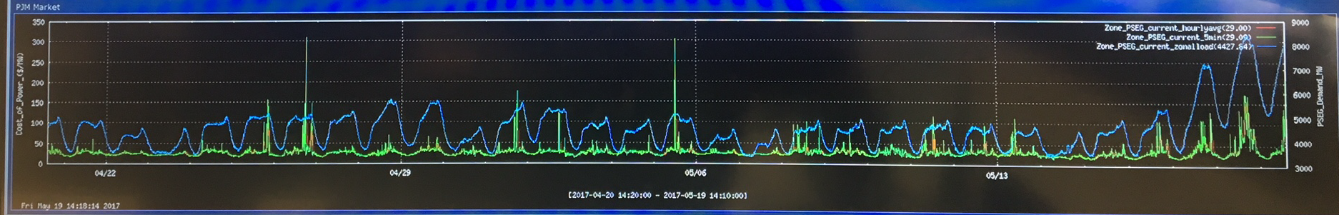

Q-learning
Max operator bias:
Second issue arises when there is randomness in the reward.
Imagine that we are purchasing energy at a price $p_{t}$ which evolves randomly from one time period to the next.
Imagine buying and selling energy using real time prices:

Slide 39
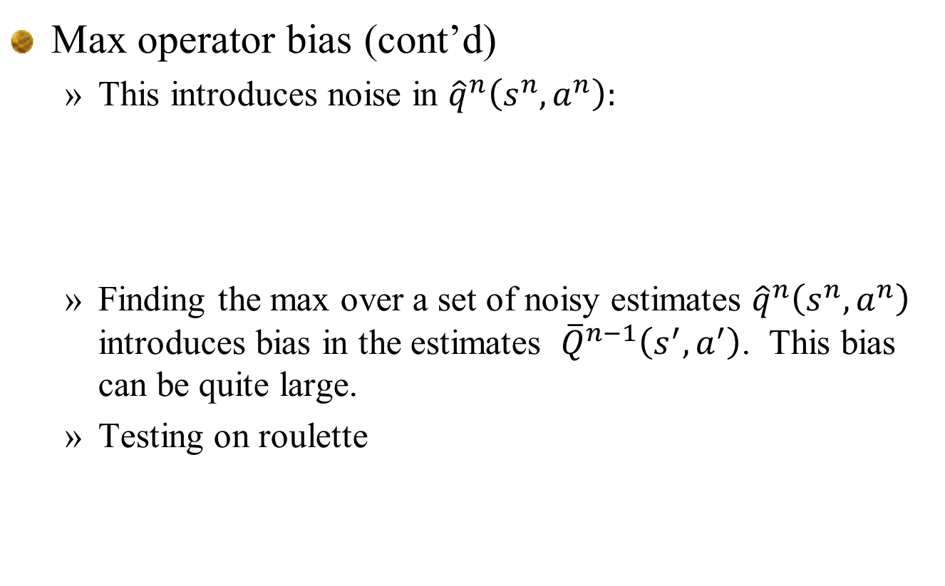
Q-learning
Max operator bias (cont’d)
This introduces noise in ${\hat{q}}^{n}\left(s^{n},a^{n}\right):$
Finding the max over a set of noisy estimates ${\hat{q}}^{n}\left(s^{n},a^{n}\right)$ introduces bias in the estimates ${\overline{Q}}^{n−1}\left(s^{′},a^{′}\right)$. This bias can be quite large.
Testing on roulette

Slide 40
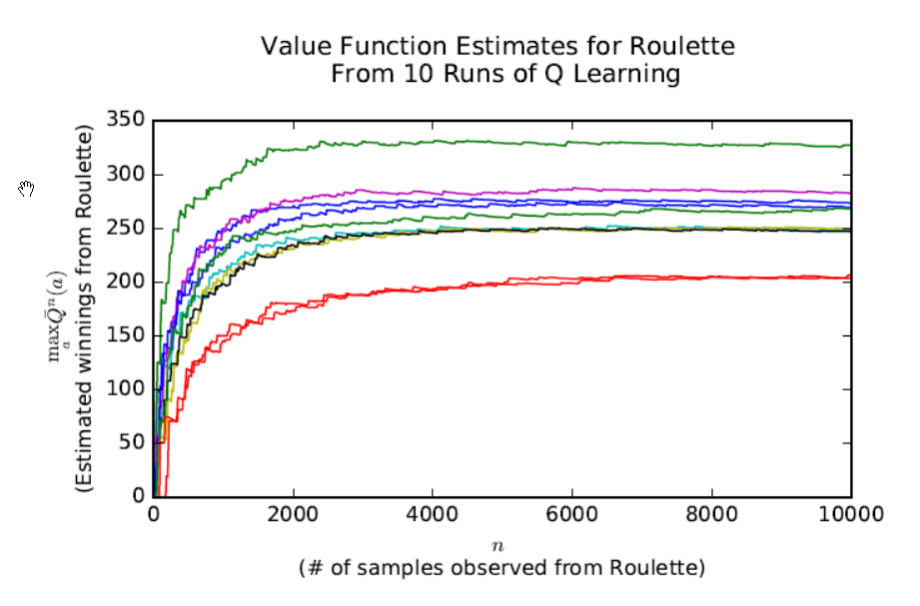
Q-learning
Roulette
Optimal solution is not to play – optimal value of game is zero
Q-learning over 10,000 iterations

Slide 41
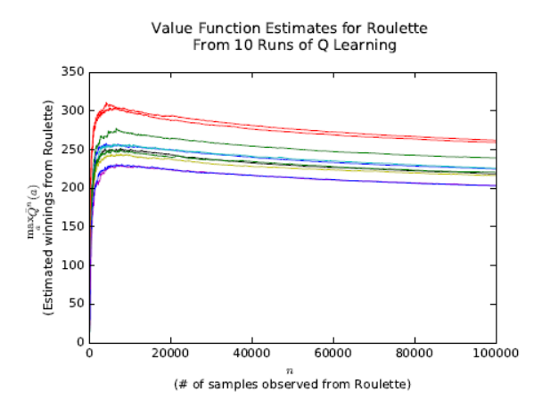
Q-learning
Roulette
Optimal solution is not to play – optimal value of game is zero
Q-learning over 10,000 iterations

Slide 42
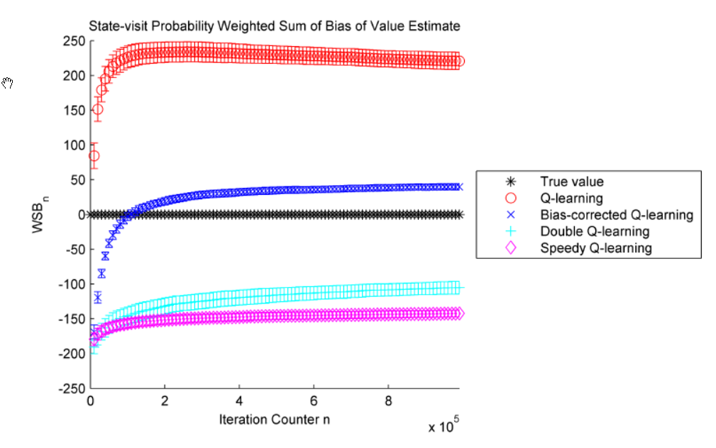
Roulette
Optimal solution is not to play – optimal value of game is zero

Slide 43
Policy evaluation

Slide 44
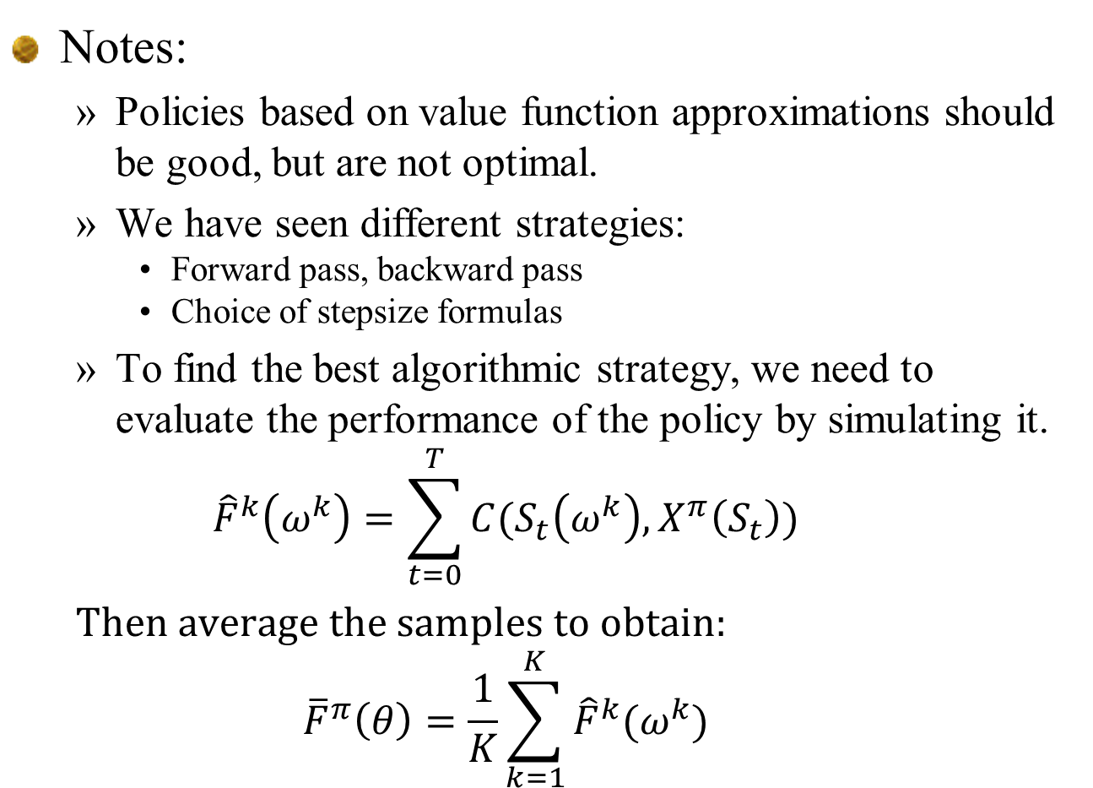
Notes:
Policies based on value function approximations should be good, but are not optimal.
We have seen different strategies:
Forward pass, backward pass
Choice of stepsize formulas
To find the best algorithmic strategy, we need to evaluate the performance of the policy by simulating it.
$${\hat{F}}^{k}\left(ω^{k}\right)=\sum_{t=0}^{T}{C(S_{t}\left(ω^{k}\right),X^{π}\left(S_{t}\right))}$$
Then average the samples to obtain:
$${\overline{F}}^{π}\left(θ\right)=\frac{1}{K}\sum_{k=1}^{K}{{\hat{F}}^{k}(ω^{k})}$$

