Slide 1
.
Sequential decision analytics and modeling
ORF 411
Fall, 2018
Warren Powell
Princeton University
http://www.castlelab.princeton.edu
© 2017 Warren B. Powell, Princeton University

Slide 2

Week 4 - Monday
Dynamic shortest paths

Slide 3

Narrative

Slide 4
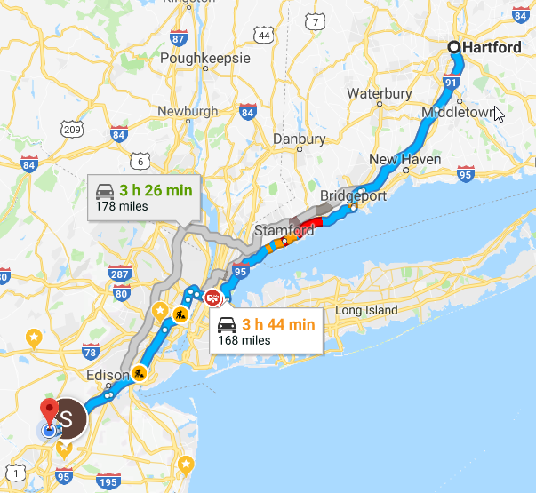
The google maps story:
Use current estimates of travel times on links to find the best path at a time t.
As time passes, google gets updated information on travel times.
The shortest path may change over time since costs are dynamic (and of course stochastic).
We want to model this process.

Slide 5
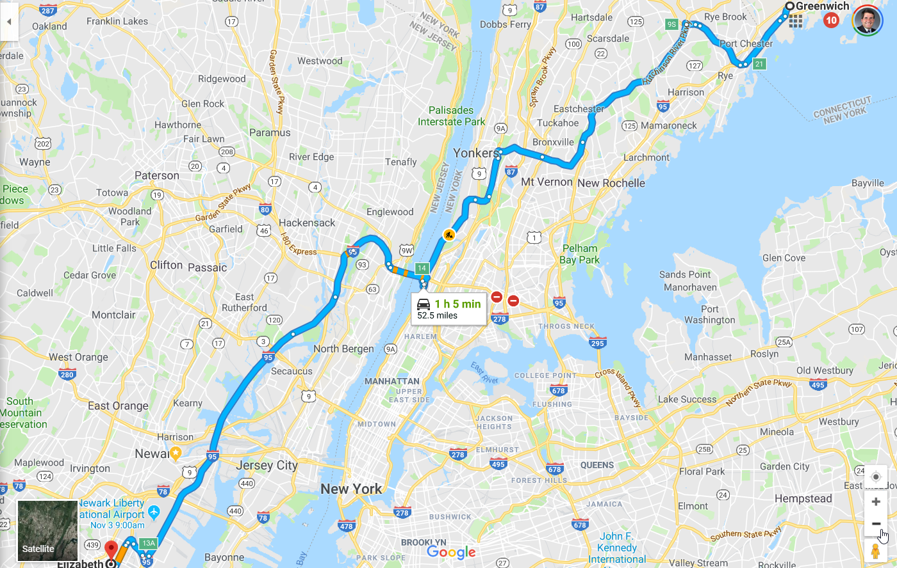

Slide 6
Basic model

Slide 7
Problem variations
Deterministic base model
We assume the real problem does not change over time.
Stochastic base model
Use static point estimates of costs that do not change over time, but we experience actual costs as we traverse links.
Use estimates of costs that are updated as we traverse links. Estimates of costs evolve over time, but are not time dependent.
Use time-dependent estimates of costs that evolve as time passes.

Slide 8
Stochastic, dynamic lookahead
We could use a stochastic lookahead model. This comes in two flavors:
Arc costs are known after we make a decision – This is a deterministic shortest path problem that we can solve as a linear program or a classical deterministic shortest path problem.
Arc costs are known before we make a decision – Now we would have to use approximate dynamic programming to solve the lookahead model. This then has to be re-optimized as the mean arc costs are updated.
We are going to design a policy where we traverse the network repeatedly, sampling arc costs as we proceed.

Slide 9


The state variable
A stochastic network, costs revealed as we arrive to a node:

Slide 10
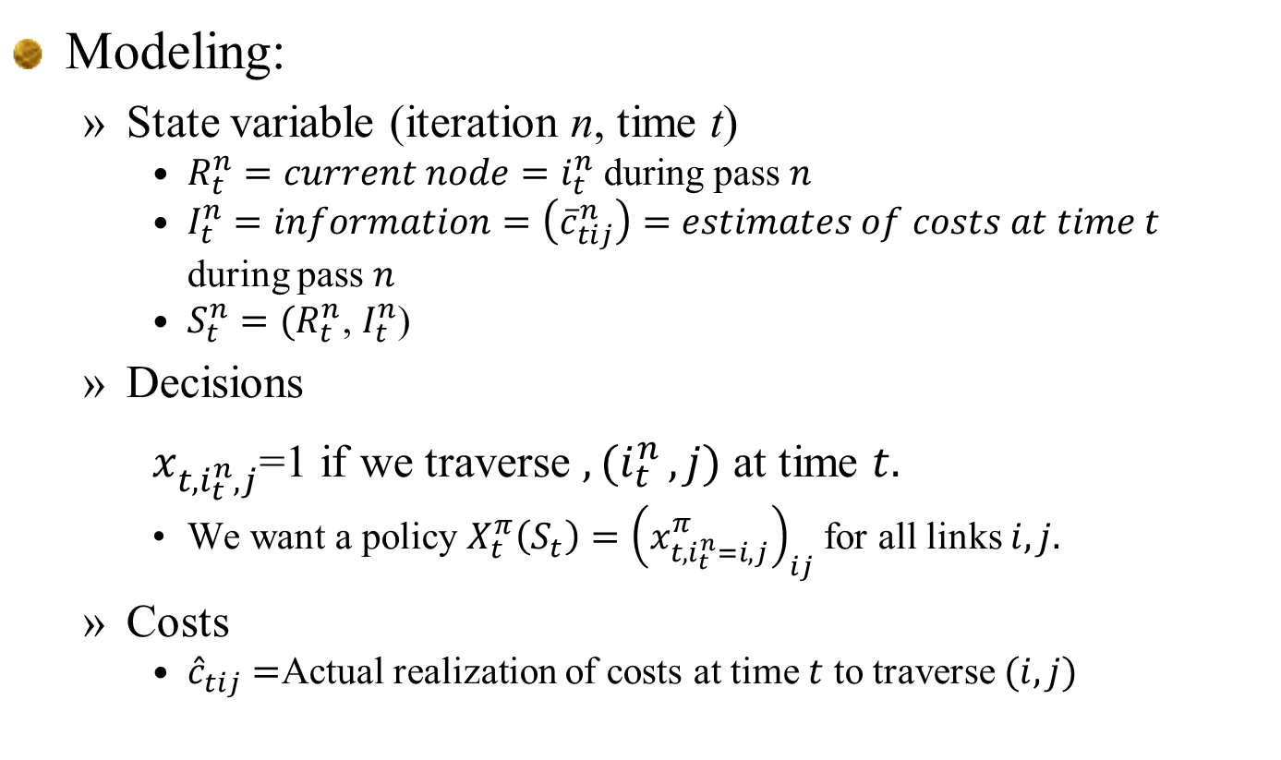
Modeling:
State variable (iteration n, time t)
$R_{t}^{n}=current node=i_{t}^{n} \text{during} \text{pass} n$
$I_{t}^{n}=information=\left({\overline{c}}_{tij}^{n}\right)=estimates of costs at time t$ during pass $n$
$S_{t}^{n}=(R_{t}^{n}$, $I_{t}^{n}$)
Decisions
$x_{t{,i}_{t}^{n},j}^{}$=1 if we traverse ${,(i}_{t}^{n},j)$ at time $t.$
We want a policy $X_{t}^{π}\left(S_{t}\right)={\left(x_{t{,i}_{t}^{n}=i,j}^{π}\right)}_{ij}$ for all links $i,j.$
Costs
${\hat{c}}_{tij}=$Actual realization of costs at time $t$ to traverse $(i,j)$

Slide 11
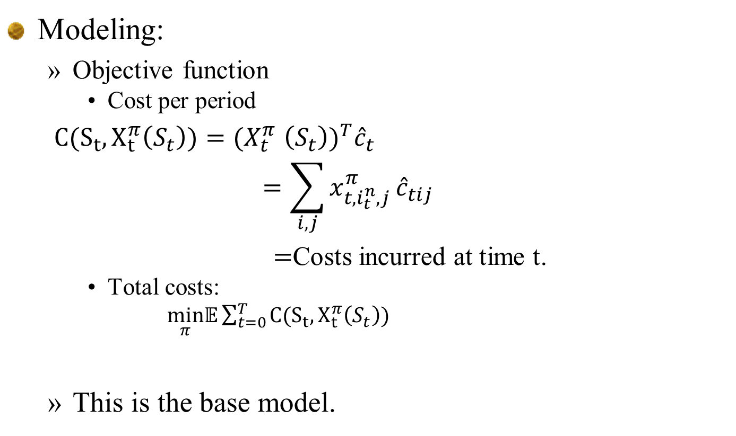
Modeling:
Objective function
Cost per period
$C(S_{t},X_{t}^{π}\left(S_{t}\right)){=(X}_{t}^{π}{\left(S_{t}\right))}^{T}{\hat{c}}_{t}$
$$=\sum_{i,j}{x_{t{,i}_{t}^{n},j}^{π}}{\hat{c}}_{tij}$$
$=$Costs incurred at time t.
Total costs:
$\min_{π}𝔼\sum_{t=0}^{T}{C(S_{t},X_{t}^{π}\left(S_{t}\right))}$
This is the base model.

Slide 12
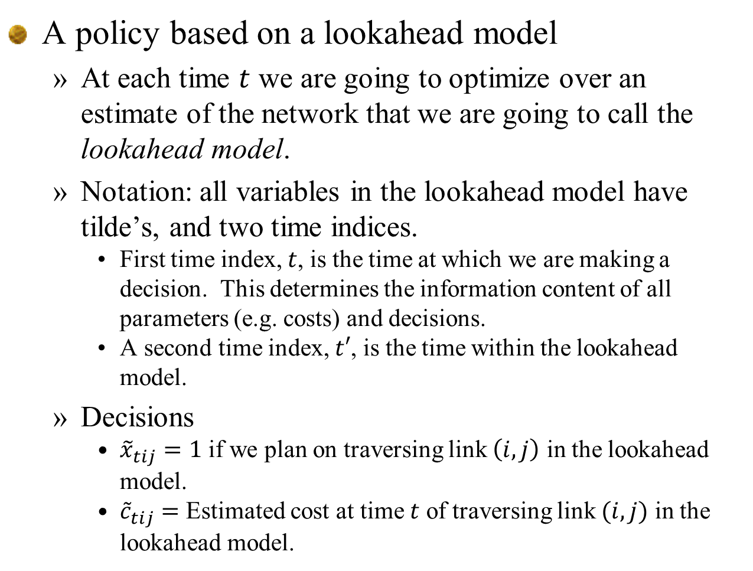
A policy based on a lookahead model
At each time $t$ we are going to optimize over an estimate of the network that we are going to call the lookahead model.
Notation: all variables in the lookahead model have tilde’s, and two time indices.
First time index, $t$, is the time at which we are making a decision. This determines the information content of all parameters (e.g. costs) and decisions.
A second time index, $t′$, is the time within the lookahead model.
Decisions
${\tilde{x}}_{tij}=1$ if we plan on traversing link $\left(i,j\right)$ in the lookahead model.
${\tilde{c}}_{tij}=$ Estimated cost at time $t$ of traversing link $(i,j)$ in the lookahead model.

Slide 13
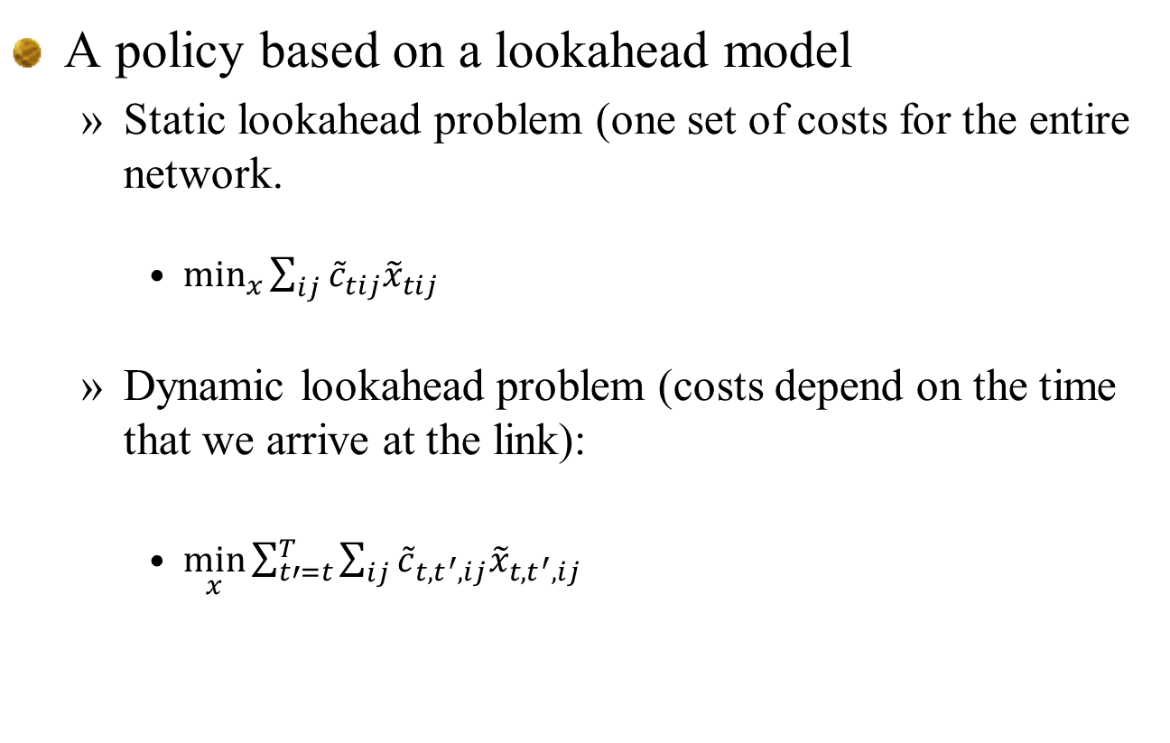
A policy based on a lookahead model
Static lookahead problem (one set of costs for the entire network.
$\min_{x}{\sum_{ij}{{\tilde{c}}_{tij}{\tilde{x}}_{tij}}}$
Dynamic lookahead problem (costs depend on the time that we arrive at the link):
$\min_{x}{\sum_{t′=t}^{T}{\sum_{ij}{{\tilde{c}}_{{t,t}^{′},ij}{\tilde{x}}_{t,t^{′},ij}}}}$

Slide 14
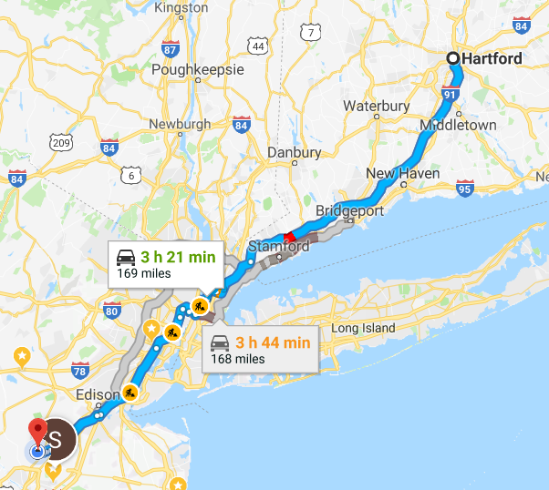

Slide 15
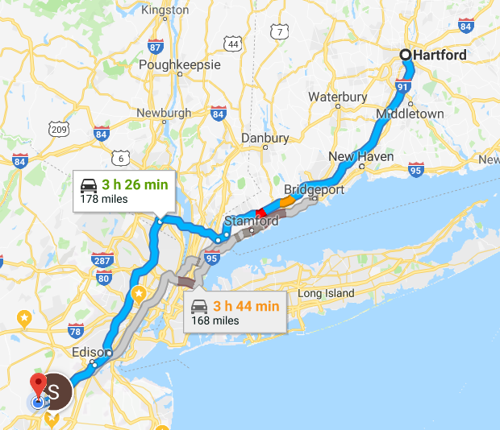

Slide 16
The state variable
A static, deterministic network

Slide 17
Time dependent representation
A time-dependent, deterministic network
t + 3
t + 2
t + 1
t

Slide 18
Time dependent representation
A time-dependent, deterministic lookahead network
The lookahead model
. . . .
The base model

Slide 19
Time dependent representation
A time-dependent, deterministic lookahead network
The lookahead model
. . . .
The base model

Slide 20
Time dependent representation
A time-dependent, deterministic lookahead network
The lookahead model
. . . .
The base model

Slide 21
Notes:
I suspect that google maps uses a static lookahead, since these can be solved much more quickly.
This means if you are traveling from Connecticut to Princeton, passing New York City, leaving at 3pm, the algorithm will use estimates of going through New York at 3pm, rather than at 5pm.
Deterministic, dynamic networks are much larger, since you have a cost for every link, for every point in time.
Stochastic, dynamic networks are even harder than deterministic, dynamic networks.

Slide 22
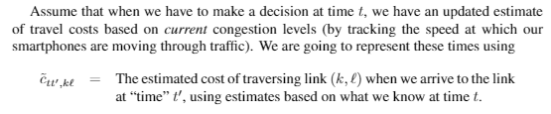
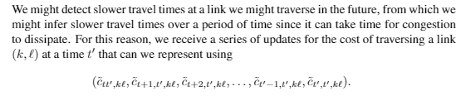
Forecasts of travel times
Evolution of costs:

Slide 23
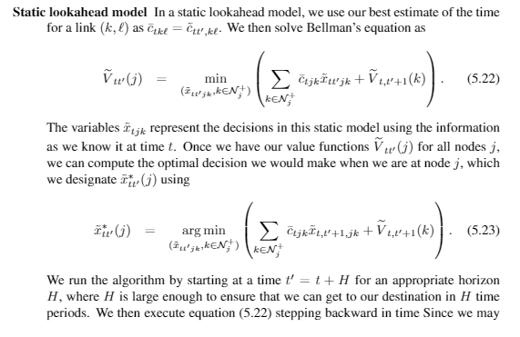
Can also think of this as a linear program.

Slide 24
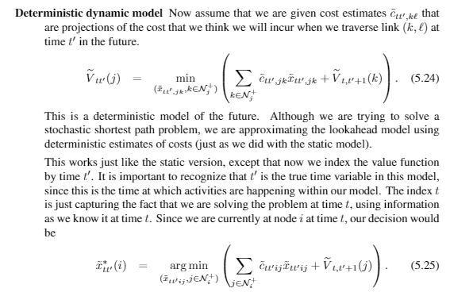

Slide 25
Imagine that the lookahead is just a black box:
Solve the optimization problem
subject to
This is a deterministic shortest path problem that we could solve using Bellman’s equation, but for now we will just view it as a black box optimization problem.

Slide 26
Simulating a lookahead policy
Talk through how this works.

Slide 27

Discuss:
Make distinction between sampled costs ${\hat{c}}_{tij}$ and forecasted costs ${\overline{c}}_{tij}$
Both are updated with time and from one iteration to another.

Slide 28
Policy for stochastic lookahead

Slide 29
Solving a stochastic lookahead
Assume that the travel gets to see the costs out of a node once she arrives at the node.
Further assume that we have a forecast, but model the uncertainty around the forecast.
We would have to us approximate dynamic programming to solve the stochastic shortest path problem.
This is computationally very cumbersome – unlikely to ever be used in practice!

Slide 30
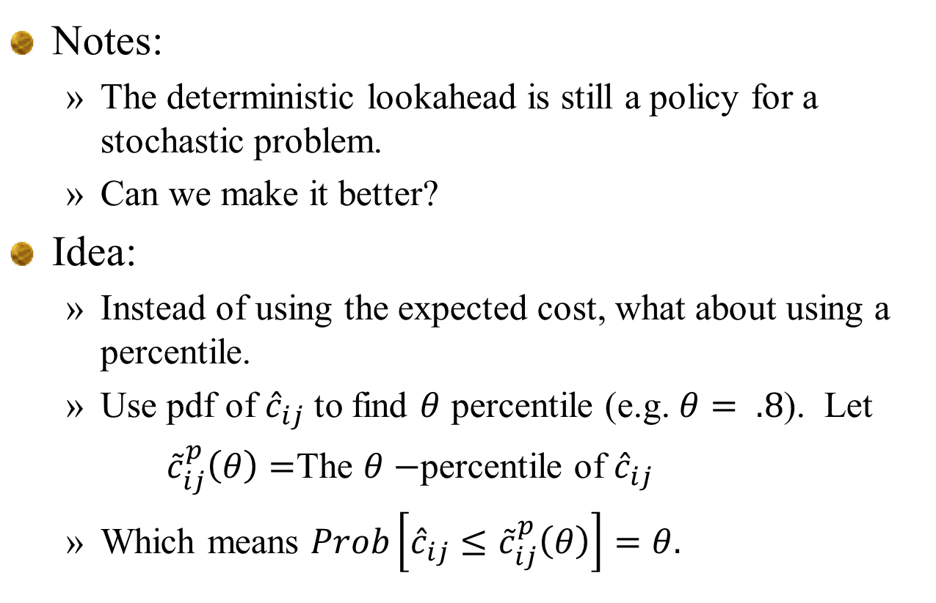
Notes:
The deterministic lookahead is still a policy for a stochastic problem.
Can we make it better?
Idea:
Instead of using the expected cost, what about using a percentile.
Use pdf of ${\hat{c}}_{ij}$ to find $θ$ percentile (e.g. $θ= .8$). Let
${\tilde{c}}_{ij}^{p}\left(θ\right)=$The $θ−$percentile of ${\hat{c}}_{ij}$
Which means $Prob\left[{\hat{c}}_{ij}≤{\tilde{c}}_{ij}^{p}\left(θ\right)\right]=θ.$

Slide 31
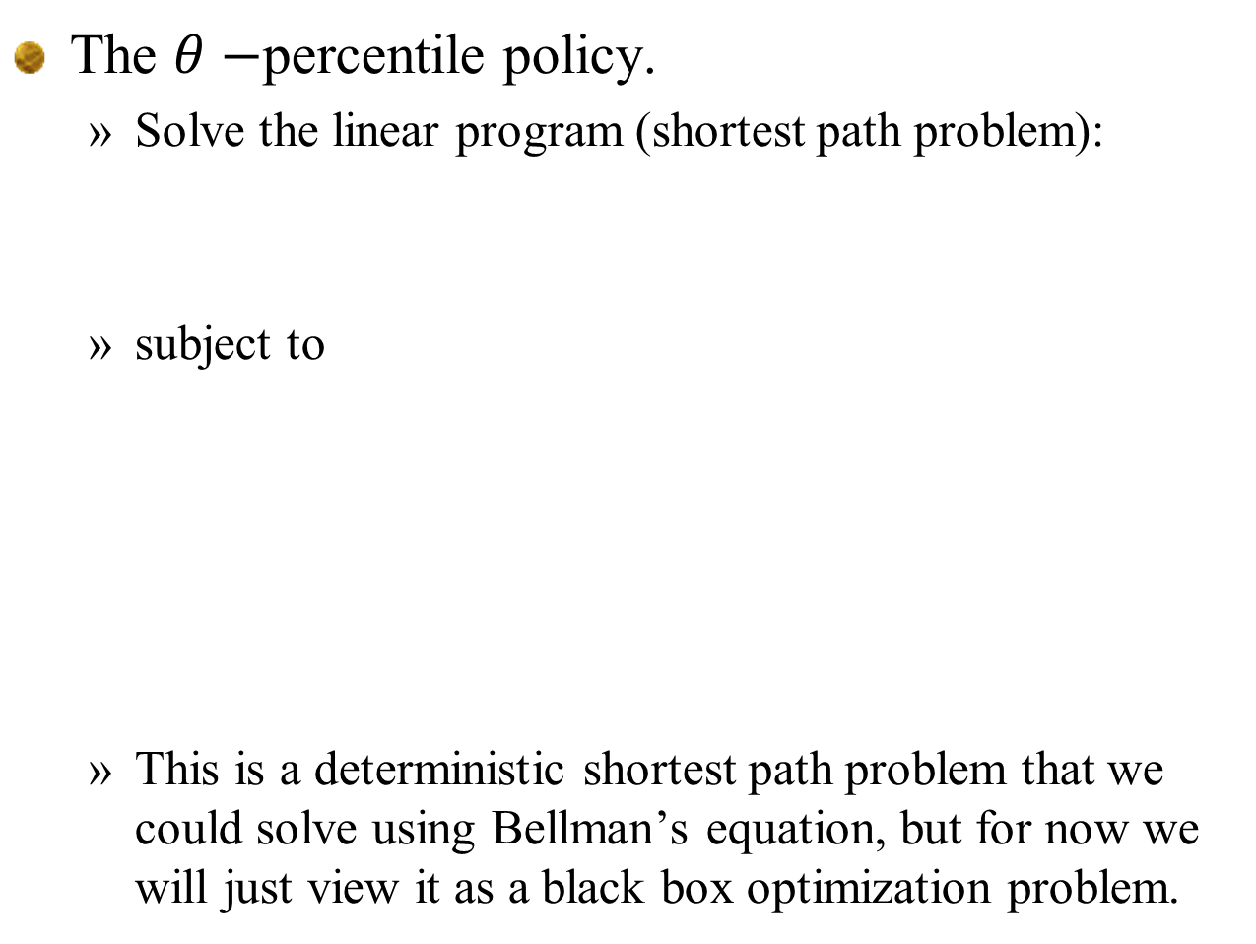
The $θ−$percentile policy.
Solve the linear program (shortest path problem):
subject to
This is a deterministic shortest path problem that we could solve using Bellman’s equation, but for now we will just view it as a black box optimization problem.

Slide 32
Simulating a lookahead policy

Slide 33
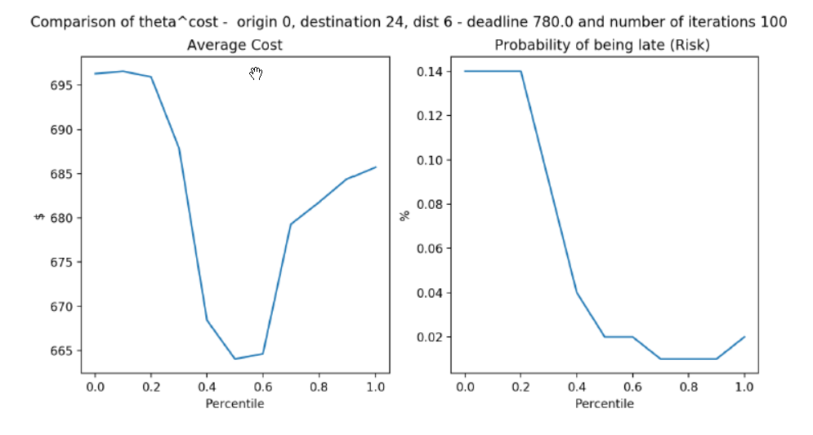
Policy tuning
Cost vs. lateness (risk)

