Slide 1

Modeling sequential decision problems
Before we can solve complex problems, we have to know how to think about them.
The biggest challenge when making decisions under uncertainty is modeling.
Min E {Σ cx}
Ax = b
x > 0
Organize class
libraries, and set up
communications and
databases
Mathematician
Software

Slide 2
Modeling sequential decision problems
For deterministic problems, we speak the language of mathematical programming
Linear programming:
For time-staged problems
Arguably Dantzig’s biggest contribution, more so than the simplex algorithm, was his articulation of optimization problems in a standard format, which has given algorithmic researchers a common language.

Slide 3
Modeling sequential decision problems
Notes:
There are standard, widely used frameworks in deterministic optimization, divided between two core communities:
Math programming, beginning famously with the work of Dantzig on the simplex algorithm for linear programs)
Deterministic optimal control.
Both of these frameworks are used in papers around the world.
… but if you introduce random variables and uncertainty, you enter what I like to call the “jungle of stochastic optimization.”

Slide 4

Stochastic
programming
Approximate
dynamic
programming
Robust
optimization
Decision
analysis
Simulation
optimization
Optimal
learning
Bandit
problems
Dynamic
Programming
and
control
Model
predictive
control
Stochastic
search
Optimal
control
Active
learning
Reinforcement
learning
Online
computation
Markov
decision
processes
Stochastic
control
Simulation
optimization
© Warren Powell 2019
Notes:
Clearing the Jungle of Stochastic optimization – Professor Warren Powell in the Department of Operations Research and Financial Engineering has developed a unified framework for modeling virtually every problem involving optimization under uncertainty. More than just a purely theoretical characterization, he has identified four (meta)classes of policies which provide a clear path to computation (although there is still a lot of work to do for most problems). The framework has identified new problem classes, as well as novel computational strategies. For example, modeling and algorithmic strategies that have long been viewed as competitive (for example, dynamic programming versus stochastic programming) are actually complementary. By building on this integrated framework, we can spend less time focusing on optimizing (making decisions), and more time on an overlooked dimension of stochastic optimization, which is modeling uncertainty.

Slide 5
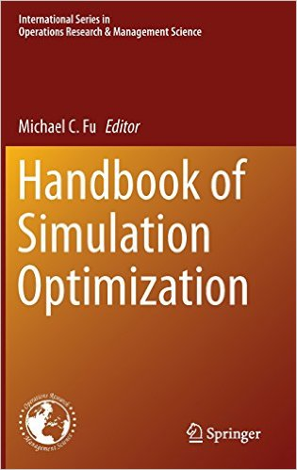
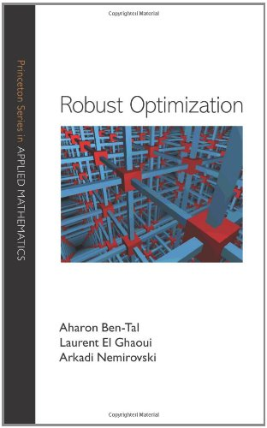
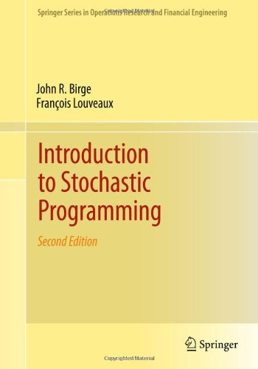
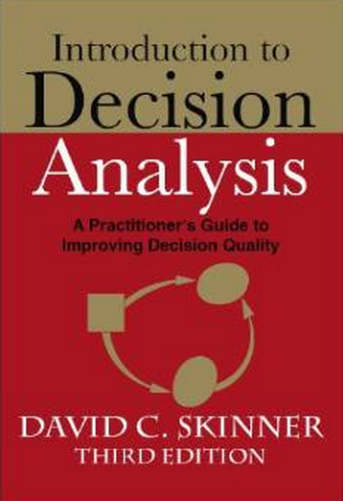
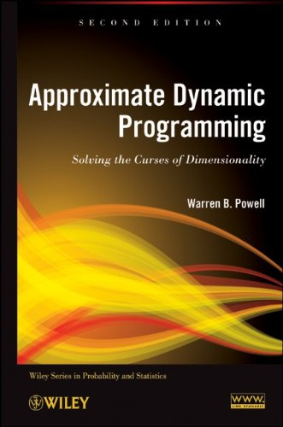
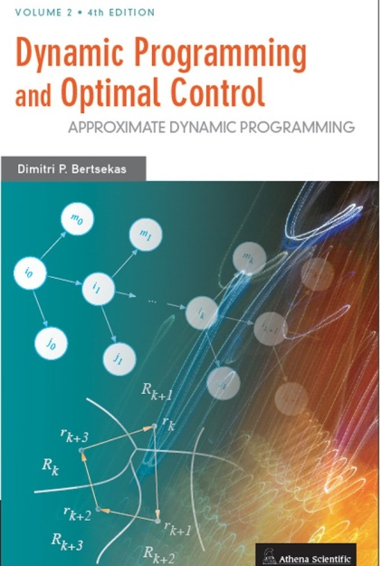
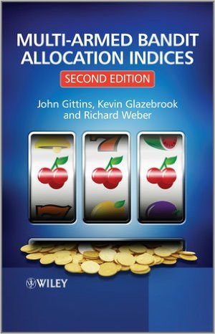
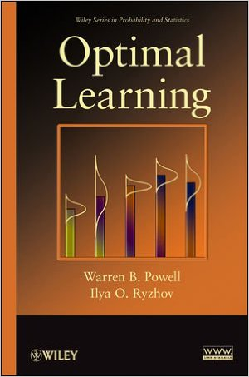
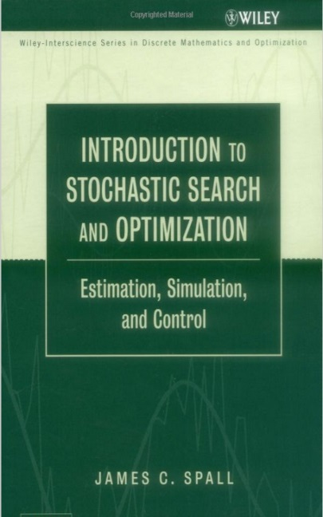
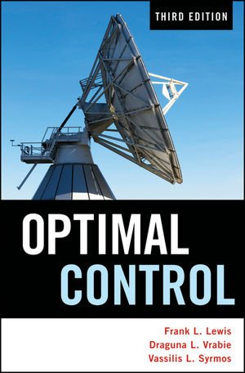
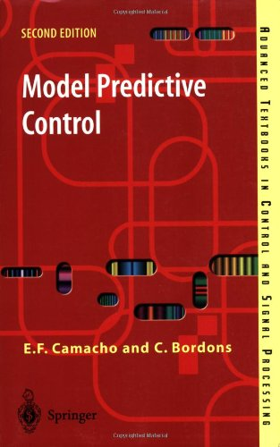
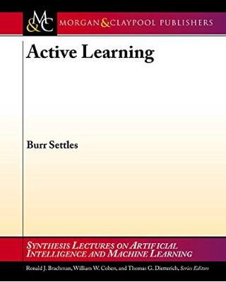
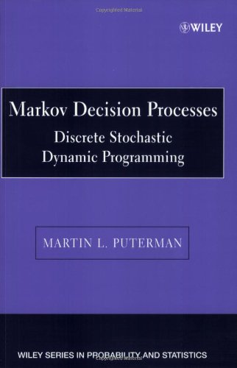
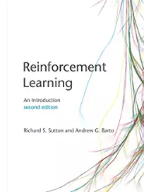

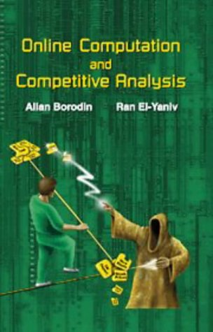
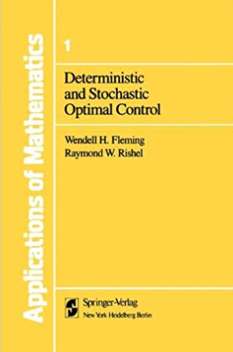
Stochastic
programming
Approximate
dynamic
programming
Robust
optimization
Decision
analysis
Simulation
optimization
Optimal
learning
Bandit
problems
Dynamic
Programming
and
control
Model
predictive
control
Stochastic
search
Optimal
control
Active
learning
Reinforcement
learning
Online
computation
Markov
decision
processes
Stochastic
control
Simulation
optimization
© Warren Powell 2019
Notes:
Clearing the Jungle of Stochastic optimization – Professor Warren Powell in the Department of Operations Research and Financial Engineering has developed a unified framework for modeling virtually every problem involving optimization under uncertainty. More than just a purely theoretical characterization, he has identified four (meta)classes of policies which provide a clear path to computation (although there is still a lot of work to do for most problems). The framework has identified new problem classes, as well as novel computational strategies. For example, modeling and algorithmic strategies that have long been viewed as competitive (for example, dynamic programming versus stochastic programming) are actually complementary. By building on this integrated framework, we can spend less time focusing on optimizing (making decisions), and more time on an overlooked dimension of stochastic optimization, which is modeling uncertainty.

Slide 6
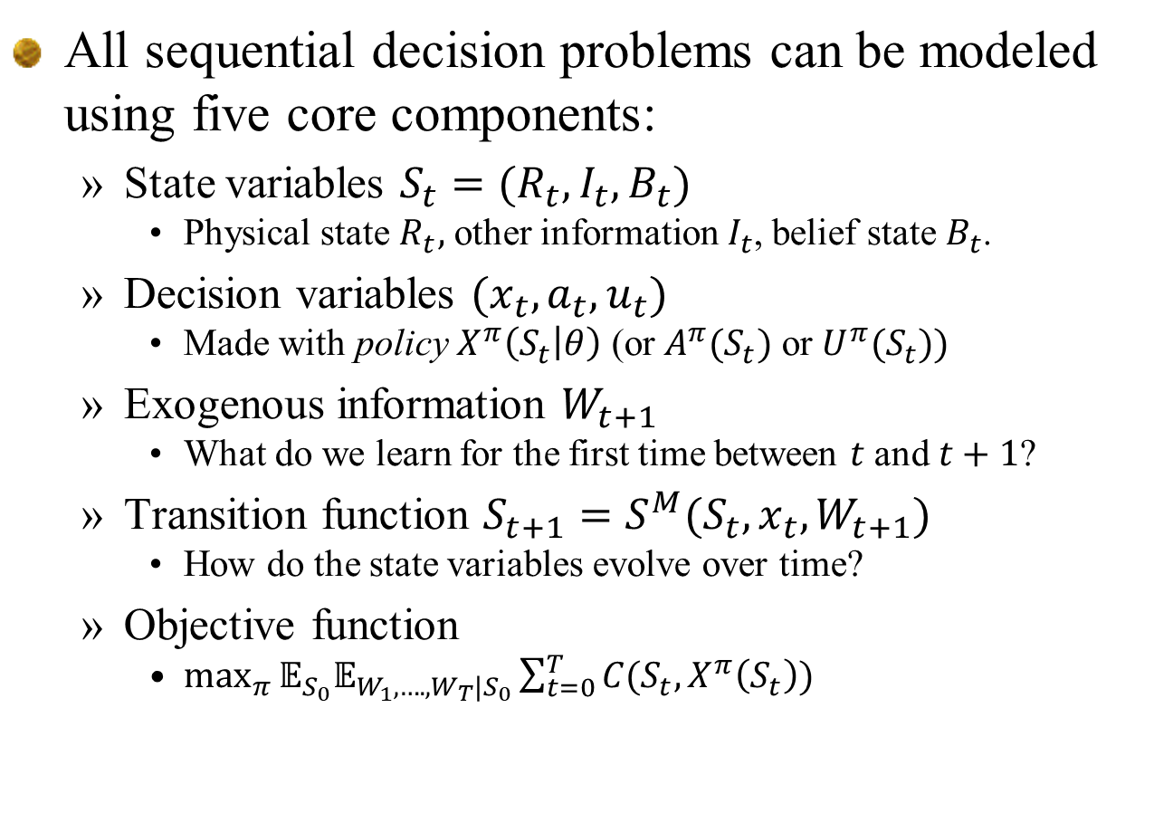
Elements of a dynamic model
All sequential decision problems can be modeled using five core components:
State variables $S_{t}=(R_{t},I_{t},B_{t})$
Physical state $R_{t},$ other information $I_{t}$, belief state $B_{t}$.
Decision variables $(x_{t},a_{t},u_{t})$
Made with policy $X^{π}\left(S_{t} | θ\right)$ (or $A^{π}(S_{t})$ or $U^{π}(S_{t}))$
Exogenous information $W_{t+1}$
What do we learn for the first time between $t$ and $t+1$?
Transition function $S_{t+1}=S^{M}(S_{t},x_{t},W_{t+1})$
How do the state variables evolve over time?
Objective function
$\max_{π}{𝔼_{S_{0}}𝔼_{W_{1},….,W_{T}|S_{0}}\sum_{t=0}^{T}{C(S_{t},X^{π}\left(S_{t}\right))}}$

Slide 7
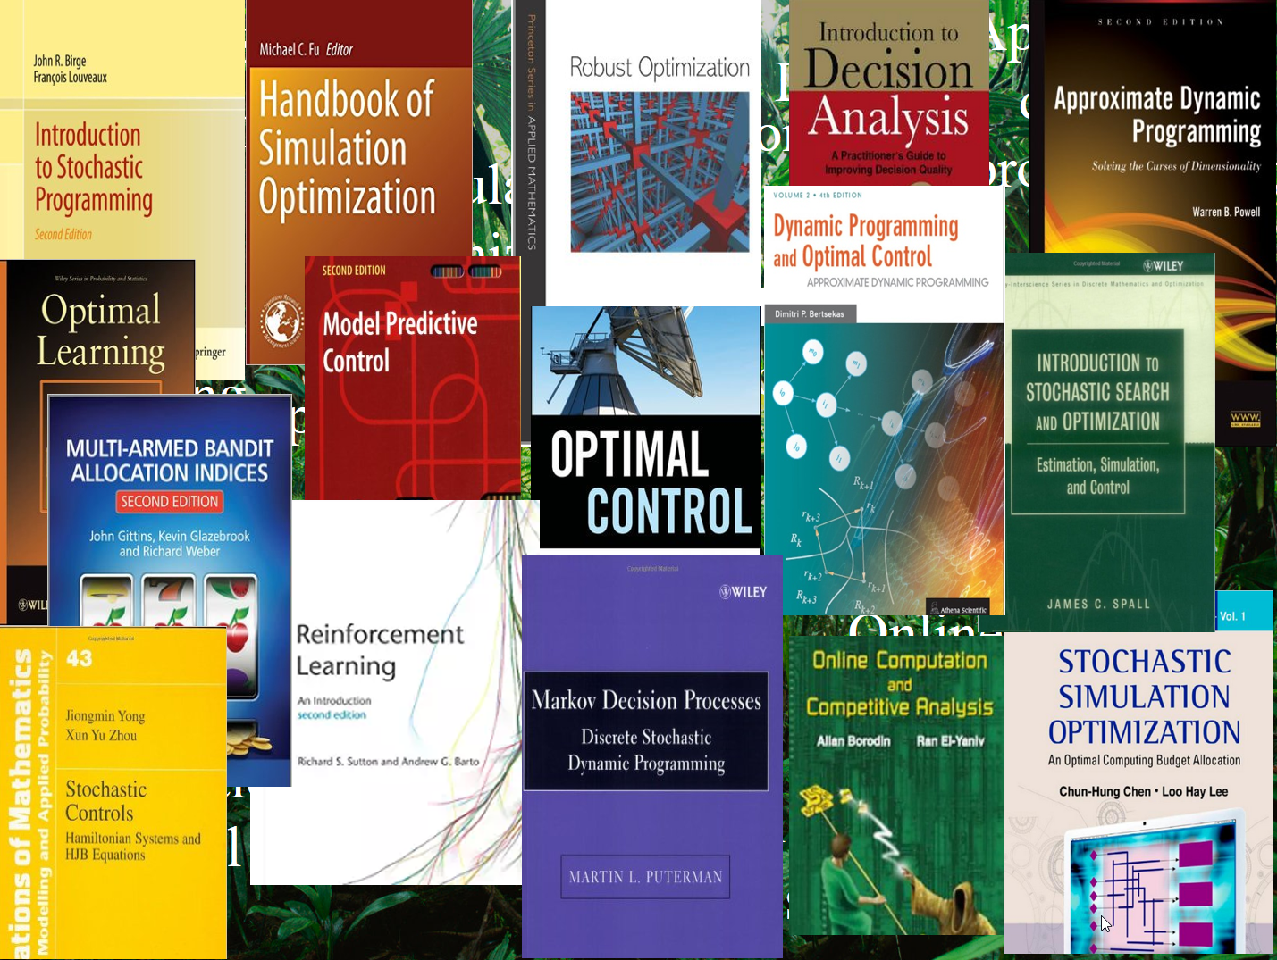
Elements of a dynamic model
The complete model:
Objective function
Cumulative reward (“online learning”)
Final reward (“offline learning”)
Risk:
Transition function:
Exogenous information:

Slide 8
The universal framework
All of the books are describing different classes of policies, which can be organized in the following groups:
Policy search – These involve searching over functions to find the ones that work best over time, including
Policy function approximations (PFAs) – These are analytical functions that map states to actions (lookup tables, linear decision rules, neural nets).
Cost function approximations (CFAs) – These are parameterized cost/reward functions (or constraints) that, when optimized, determine an action.
Lookahead approximations – These policies make decisions by approximating the impact of decisions now on the future:
Value function approximations (VFAs) – Here we approximate the impact of being in a downstream state with a value function.
Direct lookahead approximations (DLAs) – These are policies that optimize over some horizon to make a decision now (think Google maps, rolling horizon procedures, Monte Carlo tree search.

Slide 9
The universal framework
The different communities typically start with one class of policy, but over time, learn that it does not always work.
The next slide depicts the evolution of seven major communities from an initial class of policy, to other classes (sometimes all four, but not always).
I start with “stochastic search” which I divide between derivative-based (the “granddaddy of stochastic optimization) and the much harder derivative-free.
Be sure to step through the animations slowly.

Slide 10
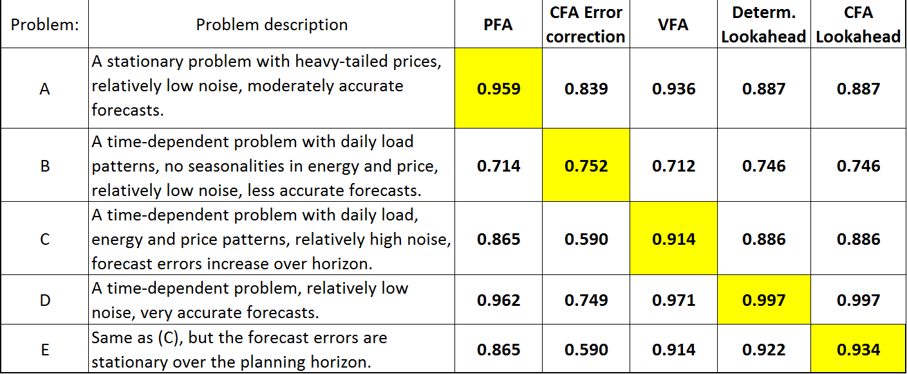
An energy storage problem
Each policy is best on certain problems
Results are percent of posterior optimal solution
… any policy might be best depending on the data.
Joint research with Prof. Stephan Meisel, University of Muenster, Germany.

Slide 11

Stochastic search
Stochastic
programming
Derivative-
based
Derivative-
free
Simulation
optimization
Policy search
(PFAs)
Cost function
approx. (CFAs)
Value function
approx. (VFAs)
Multi-armed bandits
/optimal learning
Reinforcement
learning/ADP
Lookahead policies
(DLAs)
Markov decision
processes
Optimal control
© Warren Powell 2017

Slide 12
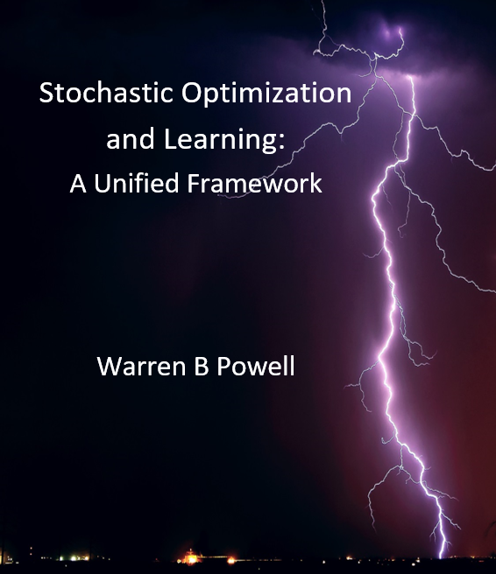
jungle.princeton.edu Look under “Educational materials"

