Slide 1



A Fresh Approach to Teaching Optimization:
From Deterministic Optimization to the Jungle of Stochastic Optimization
Department of Operations Research and Information Engineering Cornell University
April 29, 2025
Warren B Powell
Chief Innovation Officer, Optimal Dynamics
Professor Emeritus, Princeton University
Executive-in-Residence, Rutgers University

Slide 2


OUTLINE
Optimizing decisions
From static to sequential optimization
Sequential decision problems
Designing policies
A new educational field: sequential decision analytics

Slide 3
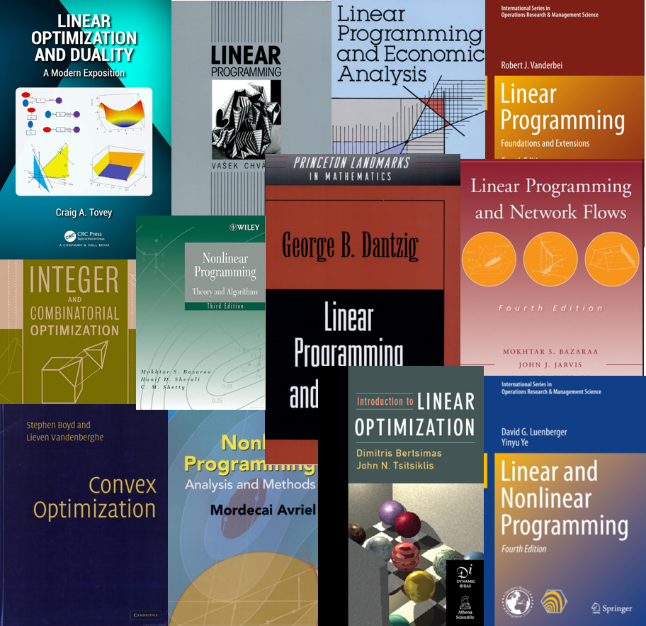
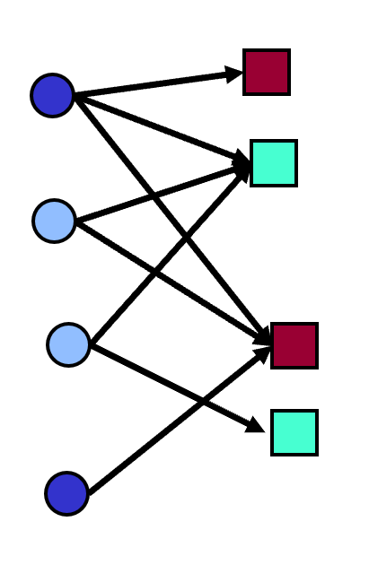
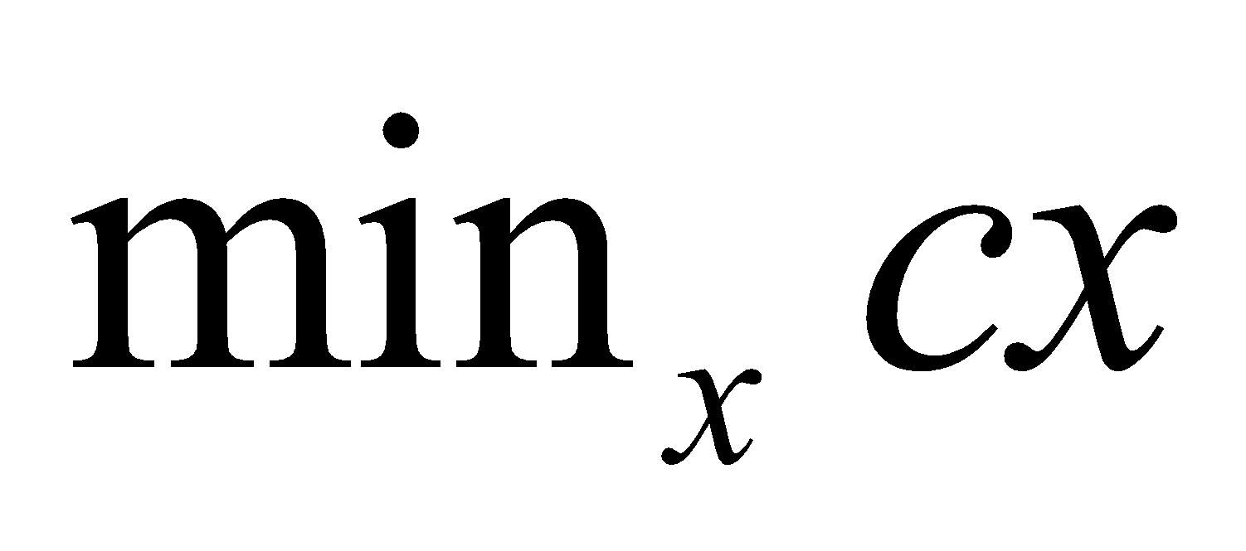
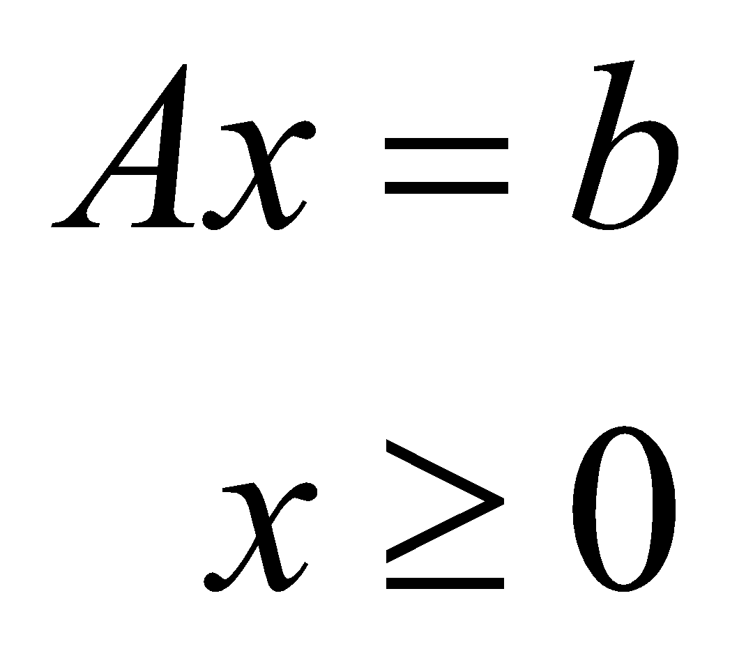
From static to sequential problems
Standard modeling strategy is to pose the optimization problem at a point in time.
The next step is to design some algorithm (e.g. simplex) to solve the decision problem.
We then declare that the solution is optimal!
The language of classical optimization does not capture anything related to the evolution of the system over time.

Slide 4
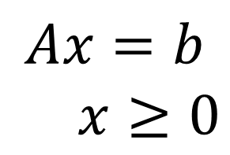
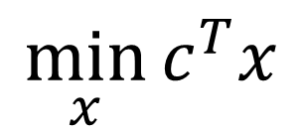
From static to sequential problems
We start with a static, deterministic optimization problem:
$$\min_{x}{c^{T}x}$$
Subject to:
$$Ax=b$$
$x≥0$

Slide 5
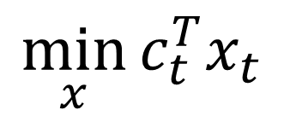
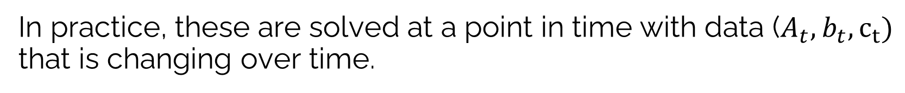
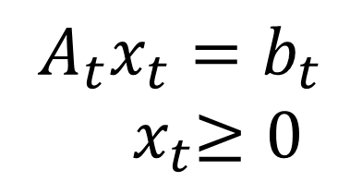
From static to sequential problems
In practice, these are solved at a point in time with data ($A_{t},b_{t},c_{t})$ that is changing over time.
$$\min_{x}{c_{t}^{T}x_{t}}$$
Subject to:
$$A_{t}x_{t}=b_{t}$$
${ x}_{t}≥0$

Slide 6
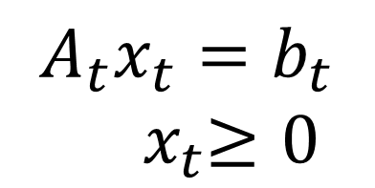

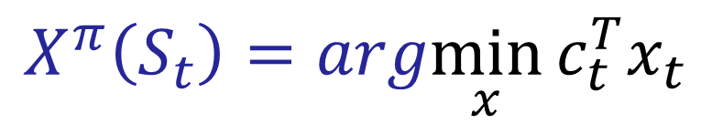
From static to sequential problems
Any method for making a decision at time $t$ can be called a policy that depends on the state $S_{t}=\left(A_{t},b_{t},c_{t}\right):$
$$X^{π}\left(S_{t}\right)=arg\min_{x}{c_{t}^{T}x_{t}}$$
Subject to:
$$A_{t}x_{t}=b_{t}$$
${ x}_{t}≥0$
where “argmin $f(x)$” is the value of $x$ that minimizes $f(x)$. $X^{π}(S_{t})$ is a policy that represents how we make a decision at time t.

Slide 7
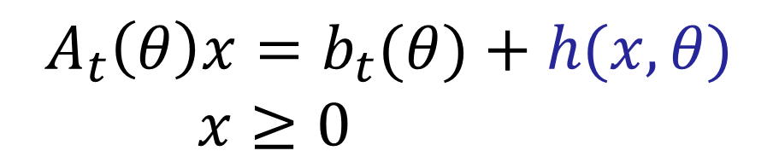
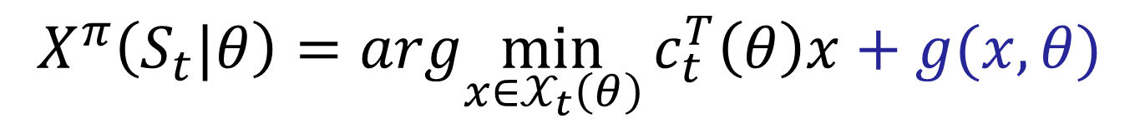
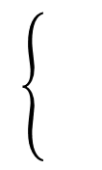

From static to sequential problems
We can modify the behavior of our linear program by introducing tunable parameters in the objective function or constraints.
$$X^{π}\left(S_{t}|θ\right)=arg\min_{x∈𝒳_{t}\left(θ\right)}{c_{t}^{T}\left(θ\right)x+g(x,θ)}$$
Subject to:
$$A_{t}\left(θ\right)x=b_{t}(θ)+h(x,θ)$$
$x≥0$
$$𝒳_{t}\left(θ\right)=$$
The policy “$π$” captures the design of the adjustments to the objective function and constraints, along with the tunable parameters $θ$.

Slide 8
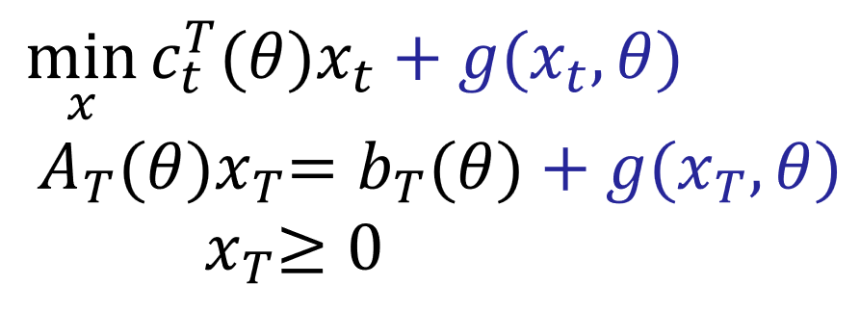
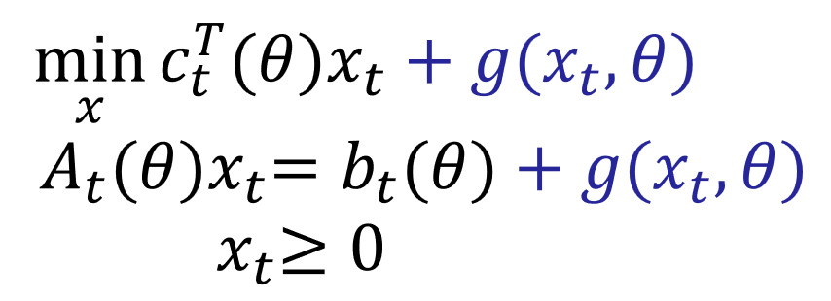
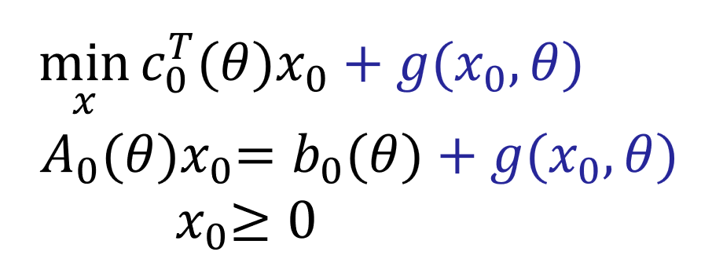


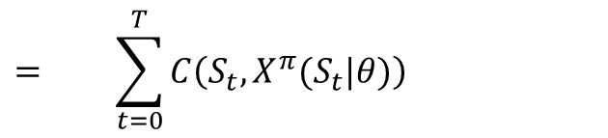













From static to sequential problems
We next simulate to evaluate the performance of our policy:
$$S_{0}$$
$$S_{t}$$
$$S_{T}$$
$$x_{0}=X^{π}(S_{0}|θ)$$
$$x_{t}=X^{π}(S_{t}|θ)$$
$$x_{T}=X^{π}(S_{T}|θ)$$
$$W_{1}$$
$$W_{t+1}$$
$$⋯$$
$$⋯$$
Time
$$C(S_{0},x_{0})$$
$$C(S_{t},x_{t})$$
$$C(S_{T},x_{T})$$
$$F^{π}\left(θ\right)= + ⋯ + + ⋯ +$$
$$= \sum_{t=0}^{T}{C\left(S_{t},X^{π}(S_{t}|θ)\right)}$$
$=$performance of policy $π$ over time, in the field.

Slide 9
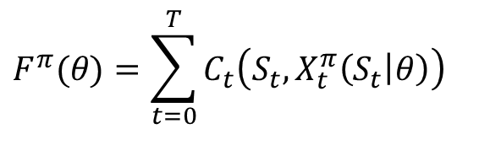



From static to sequential problems
If our policy involves solving an optimization problem, we need to recognize two optimization problems:
An optimal solution to the surrogate optimization model is almost never an optimal policy, and may perform quite poorly.
The surrogate optimization
model – used for making decisions
The objective function, used for
evaluating policies.
$$X^{π}\left(S_{t}|θ\right)=arg\min_{x∈𝒳_{t}\left(θ\right)}{c_{t}^{T}\left(θ\right)x+g(x,θ)}$$
$$F^{π}(θ)=\sum_{t=0}^{T}{C_{t}\left(S_{t},X_{t}^{π}\left(S_{t} | θ\right)\right)}$$
$$A_{t}\left(θ\right)x=b_{t}(θ)+h(x,θ)$$
$x≥0$
$$x_{t}=X^{π}(S_{t}|θ)$$
This evaluation may be done in a simulator or in the field.

Slide 10
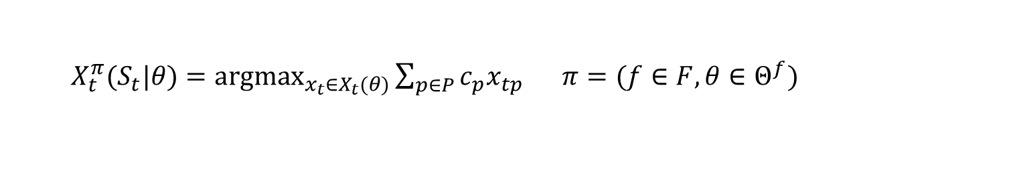

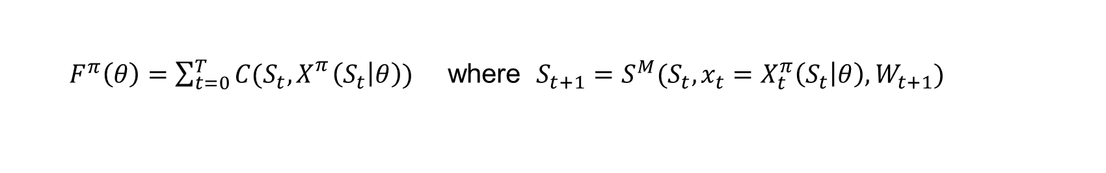
From static to sequential problems
The policy (deterministic linear program)
The objective function (simulates the policy)
The stochastic optimization problem
Parameterizations
$X_{t}^{π}(S_{t}|θ)={argmax}_{x_{t}∈X_{t}(θ)}{\sum_{p∈P}{c_{p}x_{tp}}}$ $π=(f∈F,θ∈Θ^{f})$
$$X^{π}\left(S_{t}|θ\right)=arg\min_{x∈𝒳_{t}\left(θ\right)}{c_{t}^{T}\left(θ\right)x+g(x,θ)}$$
Tunable parameters
$F^{π}\left(θ\right)=\sum_{t=0}^{T}{C(S_{t},{X_{}^{π}\left(S_{t} | θ\right))}_{}}$ where $S_{t+1}=S^{M}(S_{t},x_{t}=X_{t}^{π}\left(S_{t} | θ\right),W_{t+1})$
$$F^{∗}(S_{0})=\min_{f∈F}{\min_{θ}{{𝔼\left\{F^{π}\left(θ\right)|S_{0}\right\}}^{}}}$$
Tuning parameters
Testing parameterizations

