Slide 1
Web Data Integration Introduction to MapForce

Slide 2
Agenda
Project Phase Overview
Altova MapForce
Altova MapForce Introduction
Creating an Integrated Target Schema
Loading your data into MapForce
CSV
Excel
JSON
Creating Correspondences
Get the Translated Data Out
Hands-on: Schema Mapping with Altova MapForce

Slide 3
1. Project Phase Overview
Data Collection
Phase I: Data Collection and Data Translation
Duration: now till October 16th
Tasks:
Find a partner (groups of five)
Decide on a use case
Collect data from the Web
Profile your data and write outline about profile
Generate integrated schema (target schema)
Convert all your data into the integrated schema using MapForce
Result: All data is represented using a single unified schema
one XML file per data source
Schema Mapping Data Translation
Identity Resolution
Data Quality Assessment Data Fusion

Slide 4
Project Phase Overview: Requirements
You should integrate:
3 different data sets
at least 2,500 entities described in total (in joint dataset)
but more are better, good: >10,000 but <100,000
at least 1,000 entities should be contained in at least two datasets
please estimate based on small sample
at least 8 attributes in joint dataset
entities should be identifiable by attribute combinations of at least two attributes, e.g. name+birthdate
at least 5 attributes should be contained in at least two datasets
some attributes (other than name) should be contained in three datasets (for fusion by voting)
ideally, at least one of your attributes is a list attribute
actors of a movie, directors of a company, songs on a CD

Slide 5
2. Altova MapForce
Visual Schema Mapping Tool
Supports many data formats such as CSV, XML, JSON, EXCEL, …
Build-in mapping functions which can be used by drag & drop
How to get and run MapForce
Download & Install: https://www.altova.com/mapforce/download
Version: Altova MapForce 2024 Enterprise Edition
Run MapForce for the first time and use the free 30-day version for now
Documentation: http://manual.altova.com/Mapforce/mapforceenterprise/
Most tools of Altova can be tested for 30-days for free

Slide 6
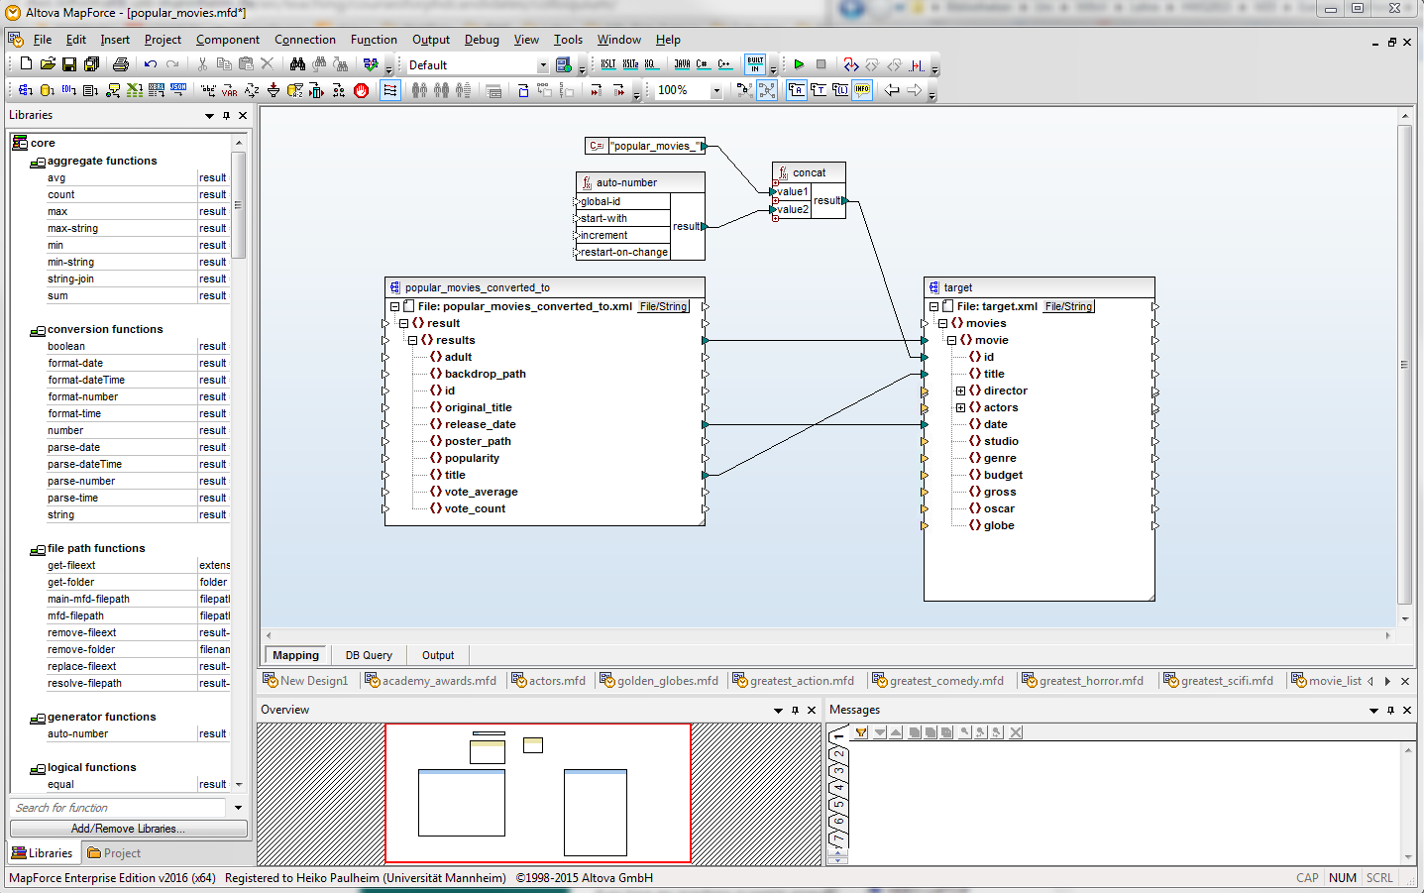
Altova MapForce Interface
Insert
Built-In Functions
Visual Mapping Working Area
Mapping & Output View
Messages/Log
Project Overview

Slide 7
Creating an Integrated Target Schema
Options:
Create XML schema by hand
Retrieve the XML schema from a XML file (example)
The latter is encouraged...
Example file:
<movies> <movie id=”m1”> <title>The Shining</title> <director>Stanley Kubrick</director> </movie> <movie id=”m2”> <title>Pi</title> <director>Darren Aronofsky</director> </movie> </movies>

Slide 8
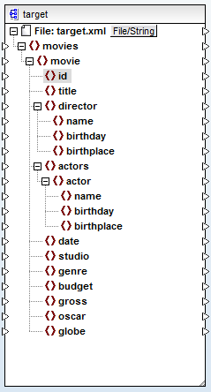
Creating an Integrated Target Schema
Open MapForce
Choose Insert → XML Schema/File…
Let MapForce create a schema for you
Edit the schema, if necessary, e.g.
Adjust cardinalities
Change component name
…

Slide 9
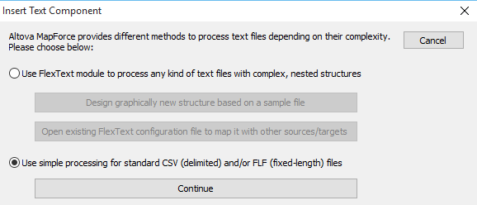
Loading Your Data into MapForce: CSV
To import your csv, choose Insert → Text File..,
Select use simple processing for standard csv
Continue to configure the file importer

Slide 10
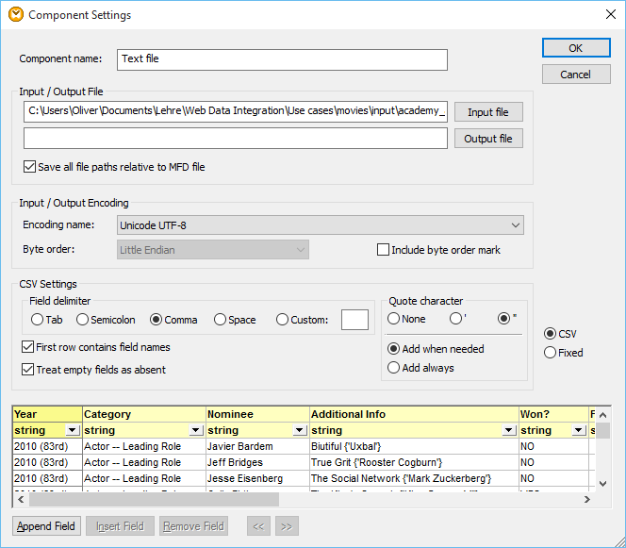
Loading Your Data into MapForce: CSV
Name
select file
select encoding
select CSV layout
are there headlines?
adjust datatypes
control output

Slide 11
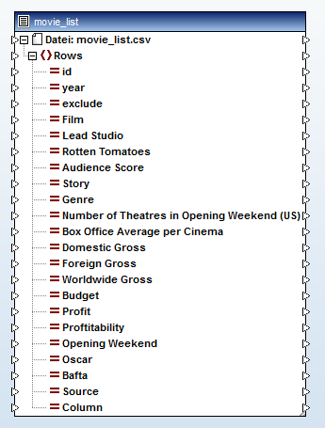
Loading Your Data into MapForce: CSV
Review the final output
Check for missing attributes or not correctly imported fields

Slide 12
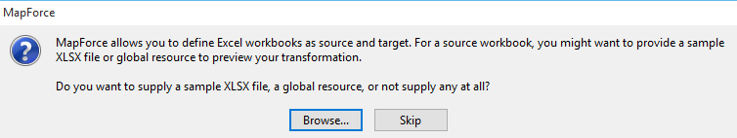
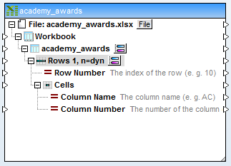
Loading Your Data into MapForce: Excel
To import Excel files, choose Insert → Excel 2007+ File…
Select Skip (if you want an Excel file as output)
Select Browse (if you want to specify an Excel file as input)

Slide 13
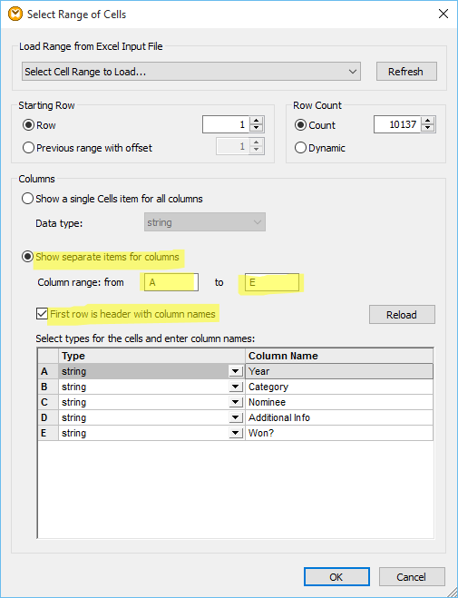
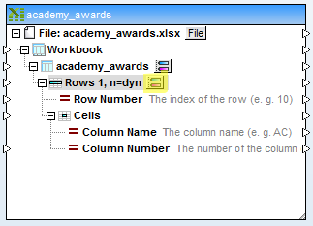
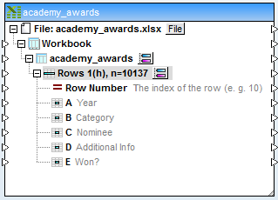
Loading Your Data into MapForce: Excel
Configure the Import

Slide 14
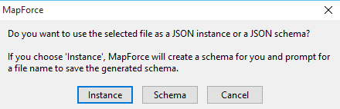
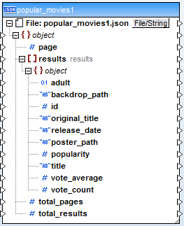
Loading Your Data into MapForce: JSON
To import a JSON file, choose Insert → JSON Schema/File…
Choose Instance

Slide 15
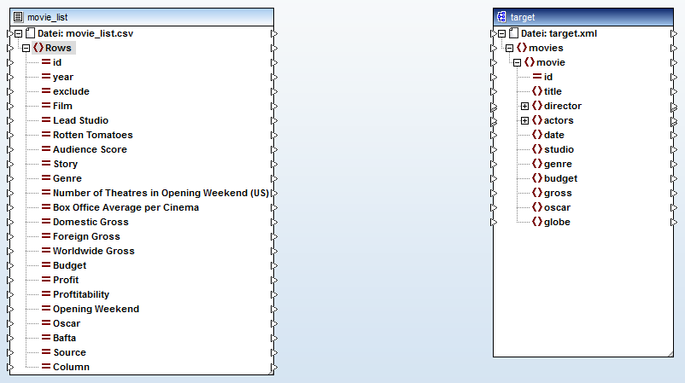
Creating Correspondences
Now, you have two schemata (source: left, target: right) in your MapForce view

Slide 16
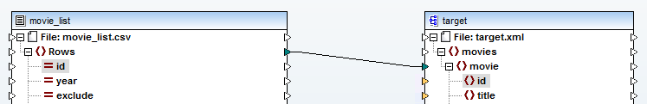
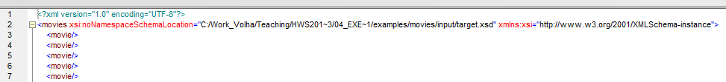
Creating Correspondences
Map the top level elements
each movie instance (row in CSV file) in the input becomes a movie instance in the output
Output View
a list of (still empty) movie elements

Slide 17
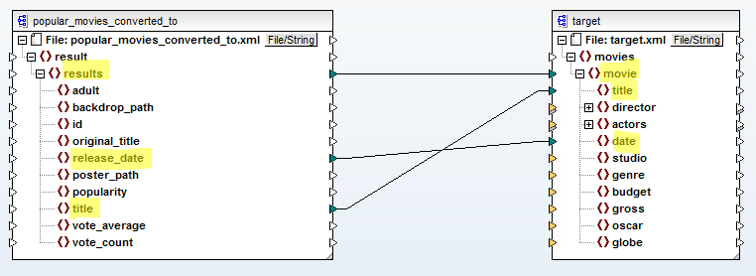
Creating Correspondences
Simple 1:1 correspondences are created by drawing arrows from left to right

Slide 18
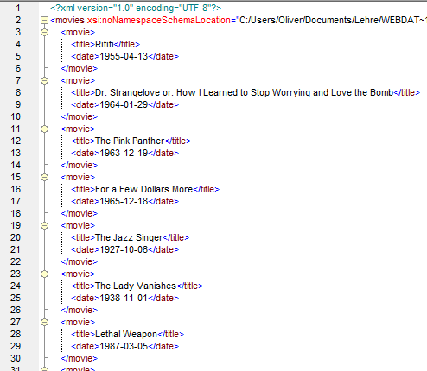
Creating Correspondences
Simple 1:1 correspondences are created by drawing arrows from left to right

Slide 19
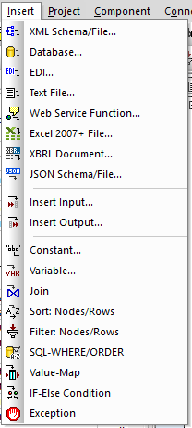




Built-in Functions
Built-in functions allow for the creation of more complex mappings:
Sort: Sort a set of records by the specified key
Filter: Filter a set of records by the Boolean input for each record
Constant: A constant value of type “String”, “Number” or “All other”
Value-Map: Specify values to be replaced by other values
If-Else: Output values is conditional on Boolean input

Slide 20
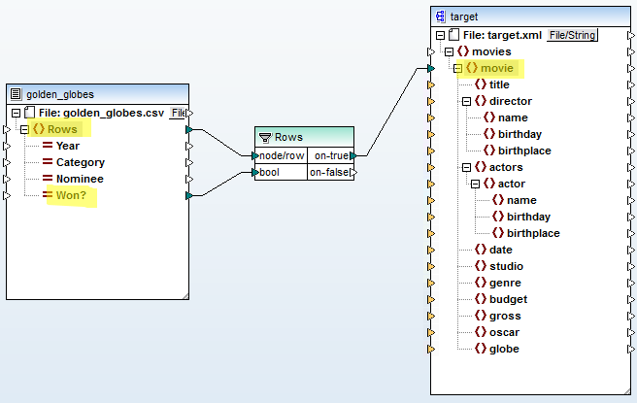
Built-In Functions Example: Filter
Goal: Only use data rows that won a Golden Globe
Insert Filter
Specify which rows to filter as first input
Condition as second input
Output
on-true: All records for which the condition is true
on-false: All records for which the condition is false

Slide 21
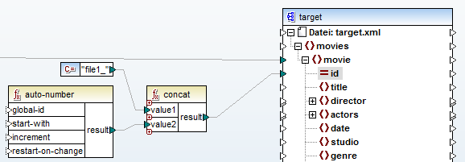
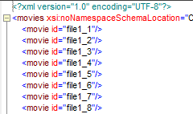
Creating Correspondences
Generating identifiers (ids) (obligatory step)
Using the auto-number function
Caution: your ids should be unique across all generated files
Thus: rather use prefix (e.g. file name) + auto-number
Using the concat function
Insert constant with right click → insert constant

Slide 22
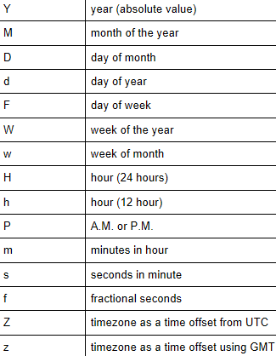

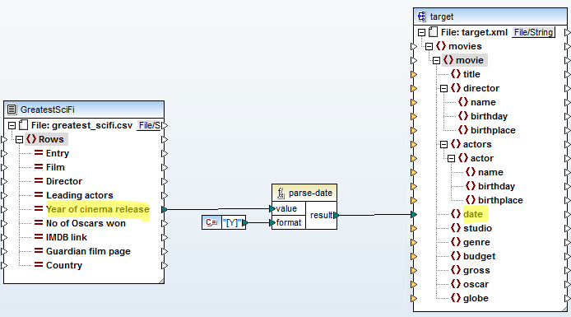
Conversions: parse-date / parse-dateTime
Converts a string into a date / dateTime
See also: format-date / format-dateTime

Slide 23
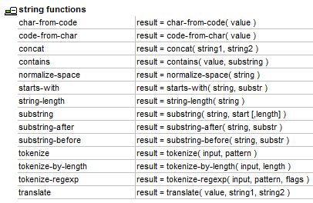

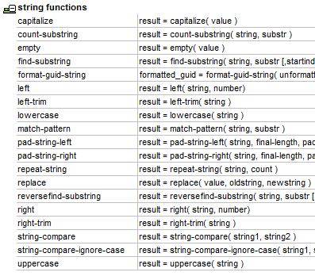
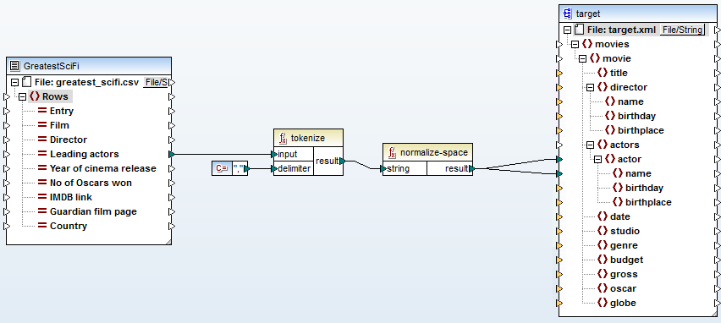
String Functions
Example: list of actors in string with commas
normalize-space removes leading and trailing space

Slide 24
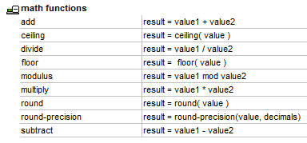
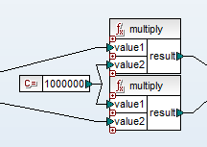
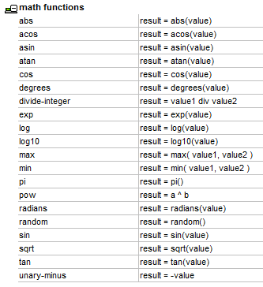
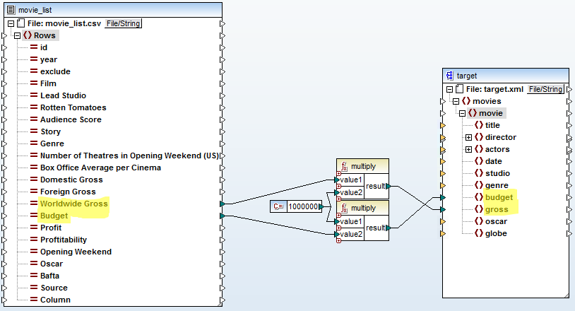
Mathematical Functions
Example: Multiply original values with a constant-value

Slide 25
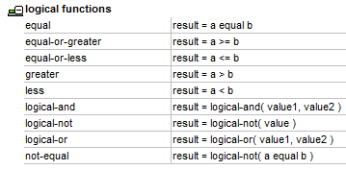
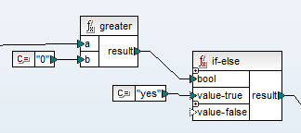

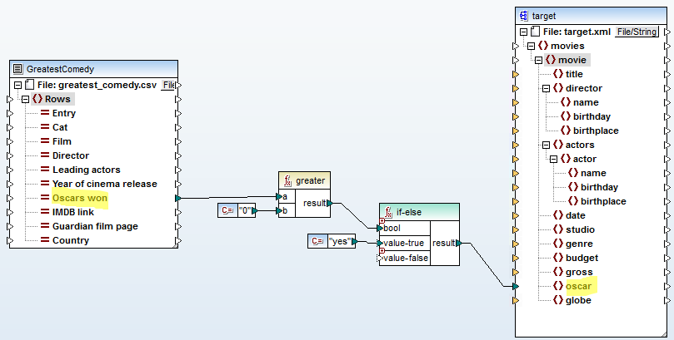
Logical Functions
Example: Transform integer to Boolean value

Slide 26
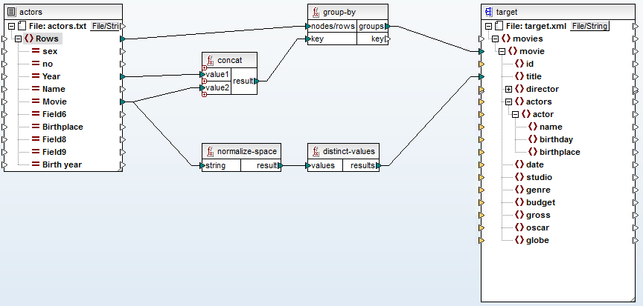
Sequence Functions
Aggregate Actors to Movies
Input: one line per actor/movie combination
Output: one node per movie

Slide 27
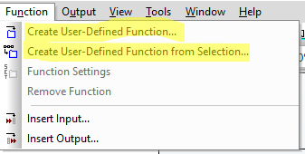
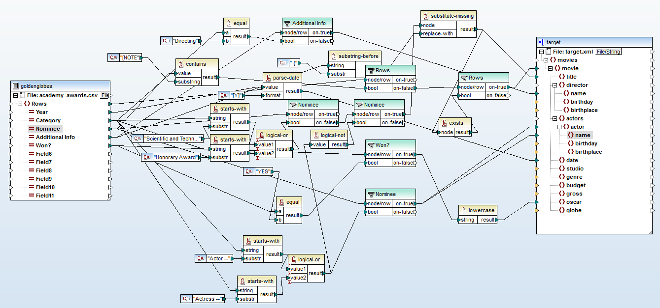
User-Defined Functions
The mapping view quickly becomes confusing

Slide 28
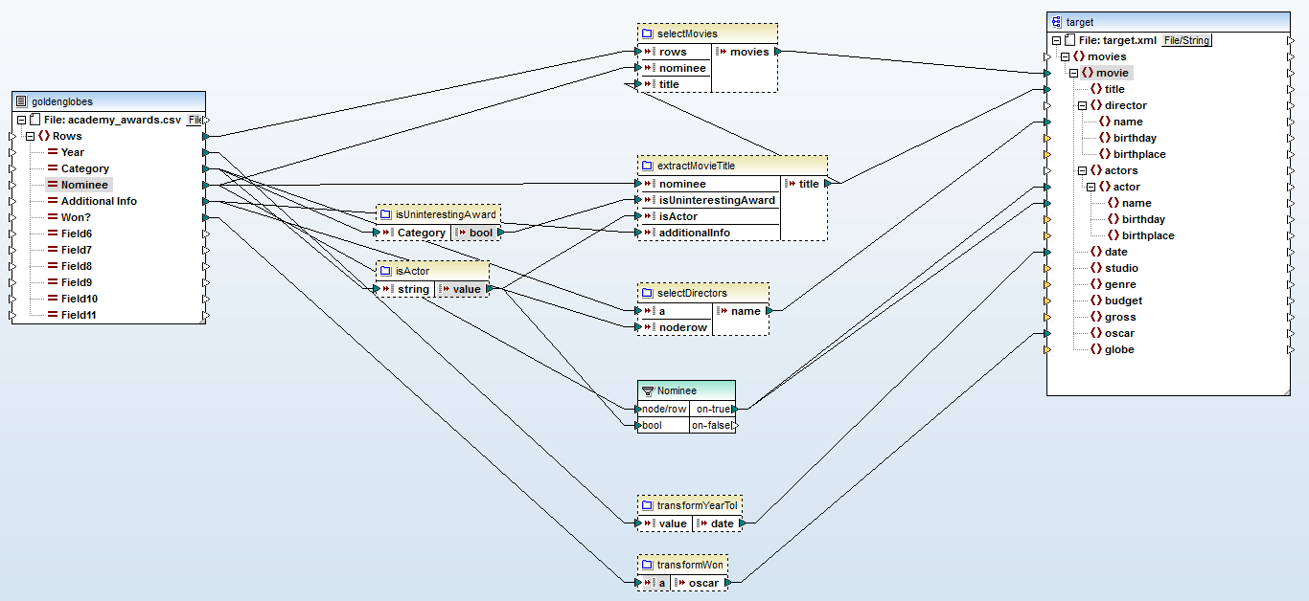
User-Defined Functions
Make use of User-Defined Functions (UDF) to organize your functions

Slide 29
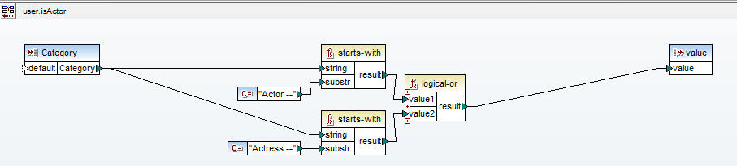

User-Defined Functions
A UDF maps any number of input parameters to output parameters
It is represented by a single function in the mapping view
Click to return to the overall mapping

Slide 30

Get the Translated Data Out
Go to the Output View
Select Save generated output

Slide 31
Hands-on: Schema Mapping with MapForce
Your task: Create mappings between different datasets from the movie domain using MapForce.
Data
target.xsd: An XML schema file providing the target schema
movie_list.csv: Dataset describing movies with 22 features such as year, story and genre stored as csv
actors.csv: Dataset describing actors with 10 different features such as name, movie in which they acted and birthplace stored as a tab separated file

Slide 32
Hands-on: Schema Mapping with MapForce - Movies
1. Load files
movie_list.csv as input
target.xml as target schema
2. Assign IDs
The id should start with the prefix movie_list_id followed by an increasing number which starts at 1000.
3. Create attribute correspondences from source to target
Map Film and Genre to the corresponding attributes of the target schema
Set the gross attribute value as a summation of the Domestic and the Foreign Gross. (hint: You can only perform summation if all the involved values are numeric)
Map year to date and set the day and month to the first of June.
4. Filter
Exclude the movies where the exclude attribute is set to y
Hint : Increment: auto-number function
Add prefix to incrementing number: concat function
Hint: Foreign Gross: if the value is numeric add it else add 0
Date: Add prefix, define the format, parse the concat values as date
Hint: Check if exclude value equals y. On false map the source row to the target movie

Slide 33
Hands-on: Schema Mapping with MapForce - Actors
1. Load files
actors.csv as input
target.xml as target schema
2. Aggregate by Movie
Identify an appropriate mapping key (the name of the movie is not enough as there might be movies with the same title)
Group by the created key. Use the key as id for the target dataset.
Map the aggregated rows to the movies in the target schema
3. Create actor correspondences
Create the missing correspondences for the name, birthplace and the full birthday
In case the values contain spaces, remove them
File Format:
Gender No MovieYear ActorName Title Reviews BirthPlace BirthMonth BirthDay BirthYear
Hint : The input file is tab separated. Define the datatype and names of the attributes.
Hint: A movie can be uniquely defined by its name and its year.
Hint: Use normalize space function to remove the spaces. Concatenate the birthday day, month, year in a parsable format like [D].[M].[Y]
Notes:
Grouping actually works: //actors[count(actor)>1]/../title
Title in original actors file need normalisation (lower-case, encoding, etc.)

Slide 34

...and now
Collect your data
Profile your data
Generate your target schema
Convert all your data into the integrated schema using MapForce

