Slide 1
Web Data Integration Introduction to MapForce

Slide 2
Hands-on: Schema Mapping with MapForce - Movies
1. Load files
movie_list.csv as input
target.xml as target schema
2. Assign IDs
The id should start with the prefix movie_list_id followed by an increasing number which starts at 1000.
3. Create attribute correspondences from source to target
Map Film and Genre to the corresponding attributes of the target schema
Set the gross attribute value as a summation of the Domestic and the Foreign Gross. (hint: You can only perform summation if all the involved values are numeric)
Map year to date and set the day and month to the first of June.
4. Filter
Exclude the movies where the exclude attribute is set to y
Increment: auto-number function
Add prefix to incrementing number: concat function
Foreign Gross: if the value is numeric add it else add 0
Date: Add prefix, define the format, parse the concat values as date
Check if exclude value equals y. On false map the source row to the target movie

Slide 3
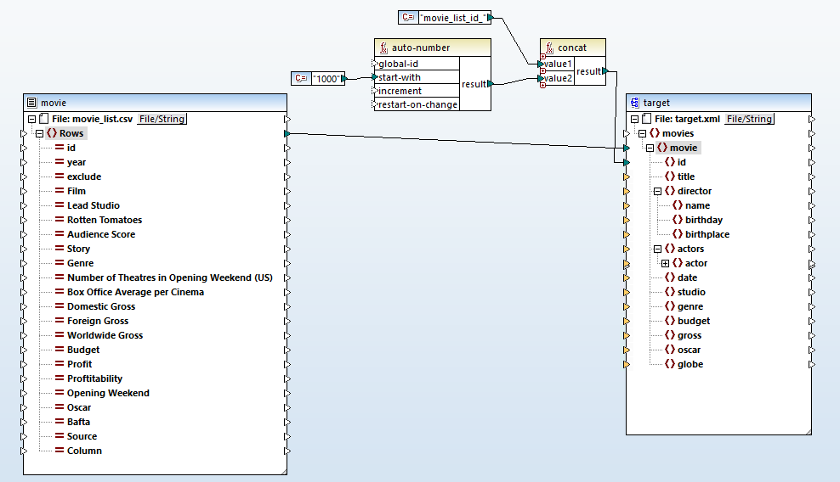
Solution: Schema Mapping with MapForce – Movies
Assign IDs

Slide 4
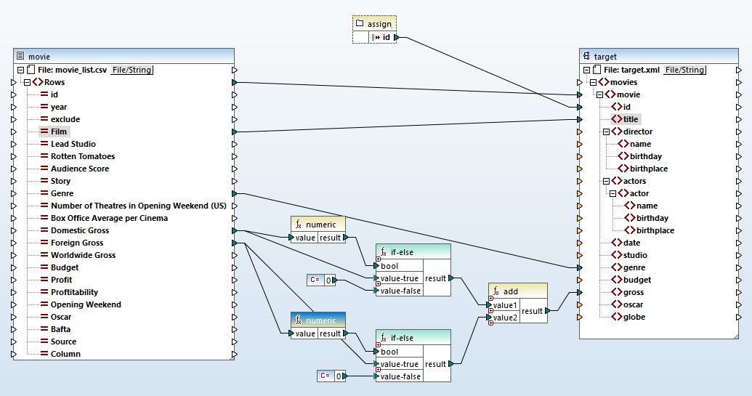
Solution: Schema Mapping with MapForce – Movies
Create attribute correspondences using summation

Slide 5
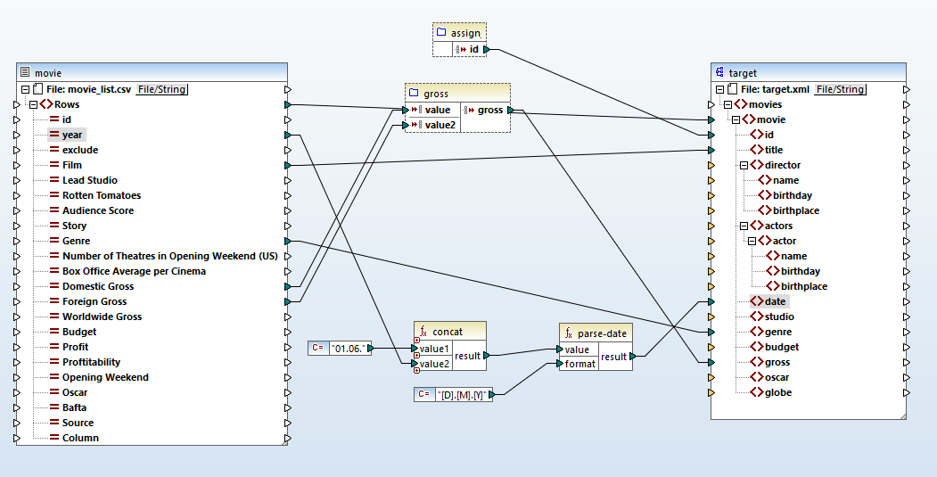
Solution: Schema Mapping with MapForce – Movies
Create attribute correspondences using date functions

Slide 6
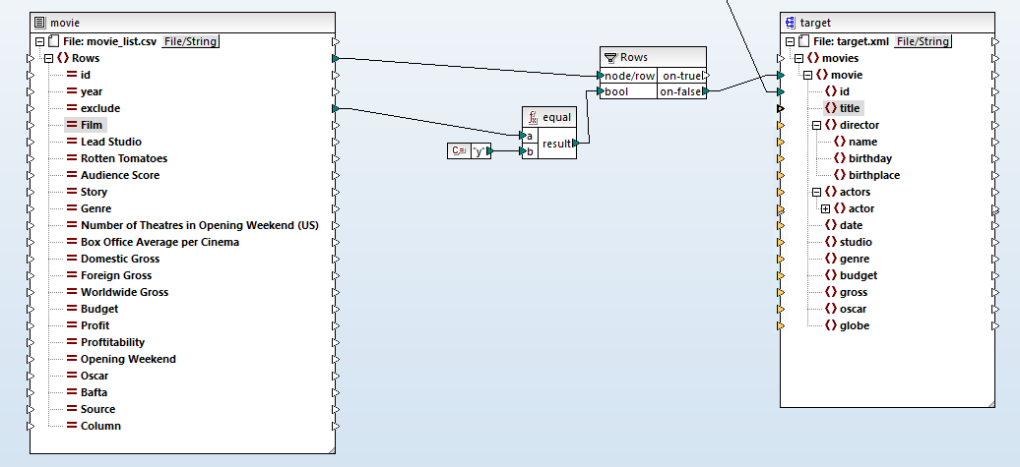
Solution: Schema Mapping with MapForce – Movies
Filter out entities

Slide 7
Hands-on: Schema Mapping with MapForce - Actors
1. Load files
actors.csv as input
target.xml as target schema
2. Aggregate by Movie
Identify an appropriate mapping key (the name of the movie is not enough as there might be movies with the same title)
Group by the created key. Use the key as id for the target dataset.
Map the aggregated rows to the movies in the target schema
3. Create actor correspondences
Create the missing correspondences for the name, birthplace and the full birthday
In case the values contain spaces, remove them
File Format:
Gender No MovieYear ActorName Title Reviews BirthPlace BirthMonth BirthDay BirthYear
The input file is tab separated. Define the datatype and names of the attributes.
A movie can be uniquely defined by its name and its year.
Use normalize space function to remove the spaces. Concatenate the birthday day, month, year in a parsable format like [D].[M].[Y]
Notes:
Grouping actually works: //actors[count(actor)>1]/../title
Title in original actors file need normalisation (lower-case, encoding, etc.)

Slide 8
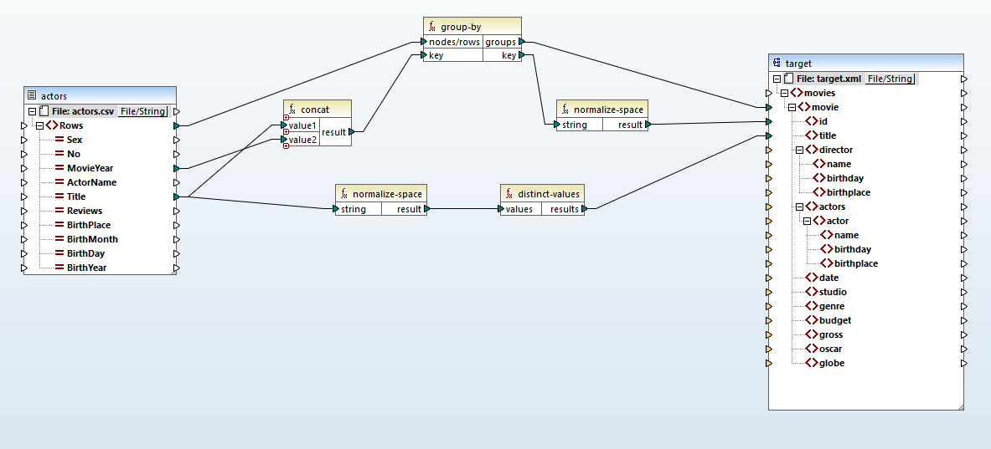
Solution: Schema Mapping with MapForce – Actors
Aggregate by movie

Slide 9
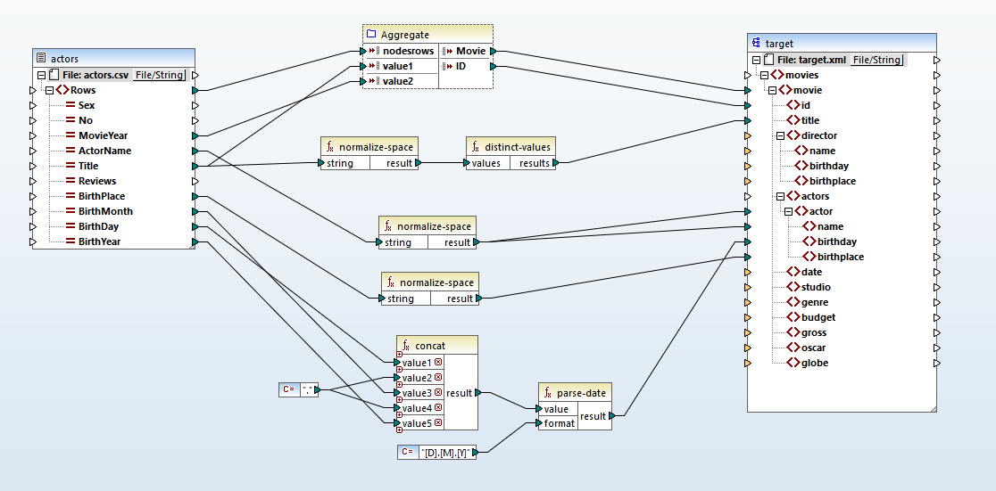
Solution: Schema Mapping with MapForce – Actors
Create actor correspondences

