Slide 1
Exercise: Identity Resolution
Web Data Integration

Slide 2
Agenda
Exercise Overview
Use Case for this Exercise
The WInte.r Framework
Loading Data
Creating a Matching Rule
Running the Identity Resolution
Evaluating the Matching Result
Learning a Matching Rule
Hands-on: Tasks of the Exercise

Slide 3
1. Exercise Overview
Learning goal
Learn how to use the WInte.r Framework in order to:
Identify records in different data sets that describe the same real-world entity
Experiment with different combinations of similarity measures (matching rules)
Use blocking to speed up the comparisons
Evaluate the quality of your approach (F1 / Reduction Ratio)
Result
Correspondences between records in different data sets that describe the same entity
A well-founded idea about the quality of the correspondences
Data Collection
Schema Mapping Data Translation
Identity Resolution
Data Quality Assessment Data Fusion

Slide 4
2. Use Case for this Exercise
Download the .zip of the project from the course page
Unzip it and look at the sample files in \data\input\
.xml input data sets in input folder
.csv gold standard
Open the project in a Java IDE (import as maven project)
The project serves as a quick-start for todays tasks and contains:
Two datasets describing movies
A gold standard for evaluating correspondences between records
Pre-implemented classes and a data model for movies
A fully implemented identity resolution workflow using WInte.r
Several alternative blocking functions and comparators

Slide 5
Explore the Data
We provide you with the following files:
actors.xml: dataset with 149 movies
academy_awards.xml: dataset with 4580 movies
Vocabularies are aligned
Every input file has the same schema
Unique IDs are in place
The IDs are globally unique
Which combination of attributes might be suitable to detect duplicates?
movie title, movie date, list of actors, director name …

Slide 6
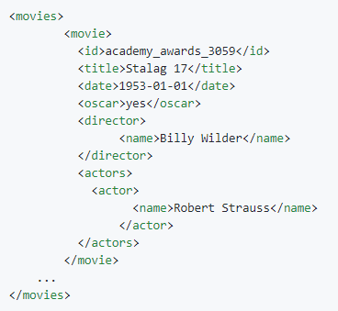
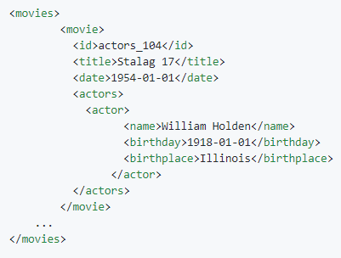
Example
Example of a movie in both datasets
(i) actors dataset
(ii) academy_awards dataset

Slide 7
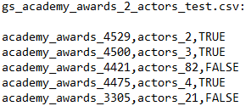
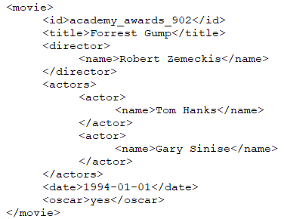
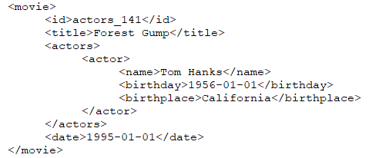
The Gold Standard
To evaluate identity resolution algorithms, you need a manually verified gold standard
.csv file containing pairs of (comma-separated) IDs of entities that match and do not match
The file includes non-trivial cases

Slide 8
The Gold Standard
You need ground truth (gold standard) for the evaluation
To create a gold standard, manually label a set of record pairs as matches or non-matches including corner cases
Rule of thumb for creating a suitable gold standard with acceptable manual effort:
match records using several simple matching techniques (goal: avoid selection bias) and sort record pairs according to their similarity
if available, use information about likely matches (e.g. ISBN or GTIN numbers that exist in multiple sources)
manually verify a fair amount of the resulting pairs (e.g. >500 pairs) including
matching record pairs (randomly chosen, 20% of GS)
corner case matches and non-matches (40% of GS)
non-matching record pairs (randomly chosen, 40% of GS)
Rather similar records that are not a match
Decision boundary
Rather different records that are a match
Record similarity

Slide 9
3. The WInte.r Framework
The Web Data Integration Framework (WInte.r) provides methods for end-to-end data integration
Implements methods for
Data Pre-Processing
Schema Matching
Identity Resolution
Data Fusion
Evaluation
Open Source under Apache 2.0 License
https://github.com/wbsg-uni-mannheim/winter

Slide 10
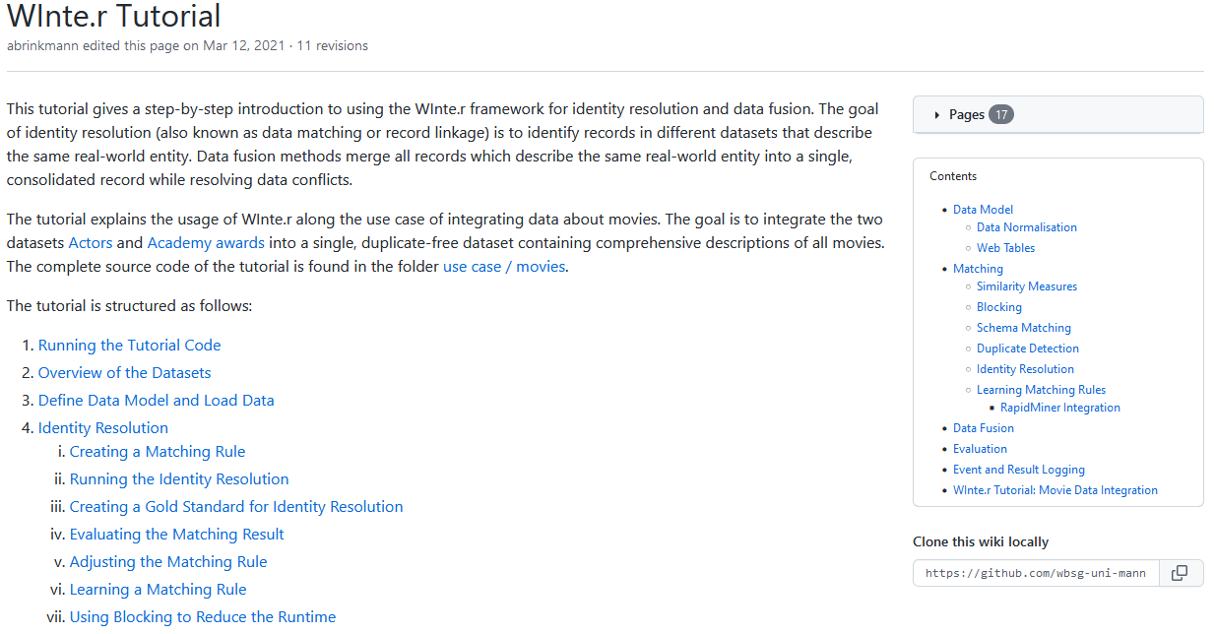
WInte.r Tutorial
https://github.com/wbsg-uni-mannheim/winter/wiki/WInte.r-Tutorial

Slide 11
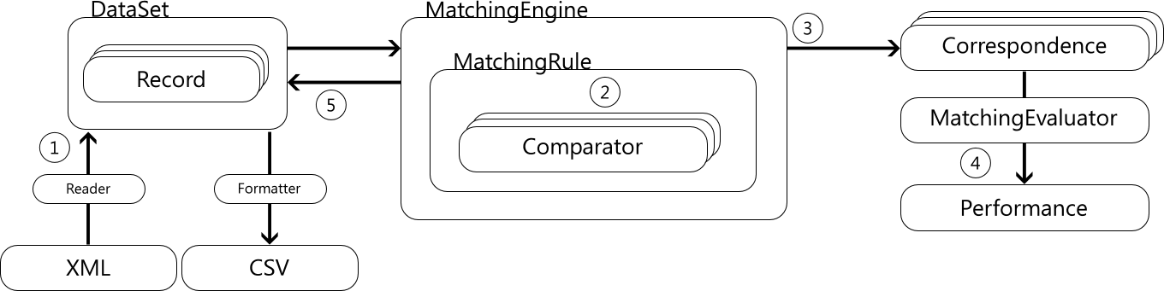
Identity Resolution Walkthrough: Movie Use Case
Loading Data
Creating a Matching Rule
Running the Identity Resolution
Evaluating the Matching Result
Learning a Matching Rule

Slide 12
3.1 Loading Data: Define the Data Model
First Step: Define your data model!
Create Java classes for your entities
Implement the Matchable interface
The data models for this exercise are already implemented in Movie.java and Actor.java in the package:
public class Movie implements Matchable {
public Movie(String identifier, String provenance) {
id = identifier;
this.provenance = provenance;
actors = new LinkedList<>();
}
private String title;
private String director;
private LocalDateTime date;
private List<Actor> actors;
public String getTitle() {
return title;
}
public void setTitle(String title) {
this.title = title;
}
...
}
de.uni_mannheim.informatik.dws.wdi.ExerciseIdentityResolution.model

Slide 13
Loading Data: Create an XML File Reader
Second Step: Define how to load your model from XML files
Extend the XMLMatchableReader class
Override the createModelFromElement method
Creates a new movie instance
public class MovieXMLReader extends XMLMatchableReader<Movie,Attribute> {
@Override
public Movie createModelFromElement(Node node, String provenanceInfo) {
// get the ID value
String id = getValueFromChildElement(node, "id");
// create a new object with id and provenance information
Movie movie = new Movie(id, provenanceInfo);
// fill the attributes
movie.setTitle(getValueFromChildElement(node, "title"));
...
// return the new object
return movie;
}
}

Slide 14
Loading Data: XMLMatchableReader
Methods provided by XMLMatchableReader
getValueFromChildElement(node, "title");
<movie>
<id>academy_awards_2</id>
<title>True Grit</title>
<director>
<name>Joel Coen</name>
<name>Ethan Coen</name>
</director>
<actors>
<actor>
<name>Jeff Bridges</name>
</actor>
<actor>
<name>Hailee Steinfeld</name>
</actor>
</actors>
</movie>
getListFromChildElement(node,"director");
getObjectListFromChildElement(
node,
"actors",
"actor",
new ActorXMLReader(),
provenanceInfo);

Slide 15
Loading Data: Load an XML file
Third Step: Load the provided data sets
Create a new HashedDataSet object
Specify
The file that contains your data
The XPath to the XML elements that represent your records
// create a new data set
HashedDataSet<Movie, Attribute> ds = new HashedDataSet<>();
// load an XML file
new MovieXMLReader().loadFromXML(
new File("data/input/academy_awards.xml"), // the file to load
"/movies/movie", // XPath to elements
ds); // data set to fill

Slide 16
ALTERNATIVE Loading Data: The Default Model
Alternative to creating customized data models:
Use the Default Model for a simple schema
de.uni_mannheim.informatik.dws.winter.model.defaultmodel.*
A key/value map supporting atomic values and lists
Data is modelled using the Record and Attribute classes
More info about data management in the WInte.r tutorial at:
https://github.com/wbsg-uni-mannheim/winter/wiki/Data-Model
HashedDataSet<Record, Attribute> ds = new HashedDataSet<>();
// Map the XML Element names to attribute names in the data set
Map<String, Attribute> nodeMapping = new HashMap<>();
nodeMapping.put("title", new Attribute("title"));
nodeMapping.put("date", new Attribute("date"));
new XMLRecordReader("id", nodeMapping).loadFromXML(sourceFile, "/movies/movie", ds);

Slide 17
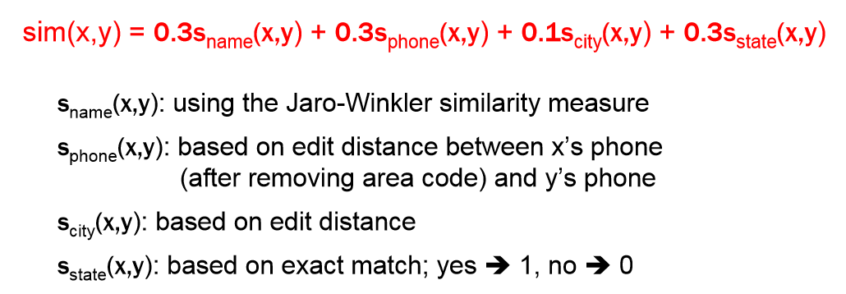
3.2 Creating a Matching Rule
A matching rule specifies which attributes to compare and how to calculate an overall similarity value
SimilarityMeasures specify the similarity of two values
Comparators specify how to compare the values of attributes
MatchingRules specify how to combine the different similarity values

Slide 18
Creating a Matching Rule: Similarity Measures
A similarity measure calculates a similarity between two values
WInte.r provides different similarity measures for string, numeric, date and list attribute
More Info at: https://github.com/wbsg-uni-mannheim/winter/wiki/SimilarityMeasures
Extends the SimilarityMeasure class
Accepts two values and returns their similarity
public class TokenizingJaccardSimilarity extends SimilarityMeasure<String> {
@Override
public double calculate(String first, String second) {
if(StringUtils.isEmpty(first) || StringUtils.isEmpty(second))
return 0.0;
} else {
// use the SecondString library to calculate the similarity value
Jaccard j = new Jaccard(new SimpleTokenizer(true, true));
return j.score(first, second);
}
}
}

Slide 19
Creating a Matching Rule: Comparators
import de.uni_mannheim.informatik.dws.winter
.matching.rules.Comparator;
public class MovieDirectorComparatorJaccard
implements Comparator<Movie, Attribute> {
TokenizingJaccardSimilarity sim
= new TokenizingJaccardSimilarity();
@Override
public double compare(
Movie entity1, Movie entity2, Correspondence<Attribute, Matchable> schemaCor) {
// preprocessing
String s1 = entity1.getDirector().toLowerCase();
String s2 = entity2.getDirector().toLowerCase();
// calculate similarity value
double similarity = sim.calculate(s1, s2);
// postprocessing
similarity *= similarity;
return similarity;
}
}
Example: Calculate Jaccard similarity between movie‘s directors
Creating attribute comparators:
apply specific preprocessing
lower-case the values
calculate similarity value
Use Jaccard Similarity
re-scale the similarity value
square similarity

Slide 20
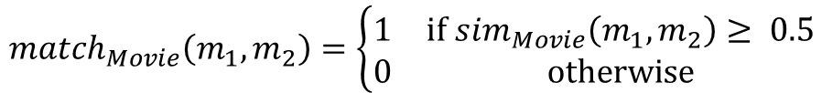
Creating a Matching Rule: Combine Comparators
Defining a Matching Rule:
Use the LinearCombinationMatchingRule class
Specify final threshold
Add comparators and their weights
LinearCombinationMatchingRule<Movie, Attribute> rule =
new LinearCombinationMatchingRule<>(0.5); // final threshold
rule.addComparator(new MovieTitleComparator(), 0.6); // comparator & weight
rule.addComparator(new MovieDateComparator(), 0.4); // comparator & weight
$$sim_{Movie}\left(m_{1},m_{2}\right)=0.6 sim_{title}\left(m_{1},m_{2}\right)+0.4 sim_{date}\left(m_{1},m_{2}\right)$$
$$match_{Movie}\left(m_{1},m_{2}\right)=\left\{\begin{matrix}1 & \text{if} sim_{Movie}\left(m_{1},m_{2}\right)≥ 0.5 \\ 0 & \text{otherwise}\end{matrix}\right.$$

Slide 21
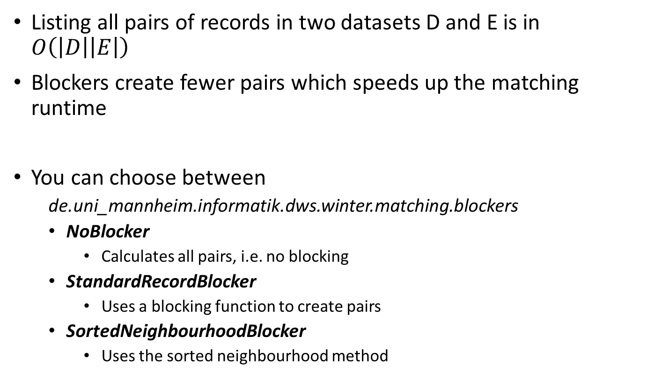
Define a Blocker
Listing all pairs of records in two datasets D and E is in $O\left(\left|D\right|\left|E\right|\right)$
Blockers create fewer pairs which speeds up the matching runtime
You can choose between
de.uni_mannheim.informatik.dws.winter.matching.blockers
NoBlocker
Calculates all pairs, i.e. no blocking
StandardRecordBlocker
Uses a blocking function to create pairs
SortedNeighbourhoodBlocker
Uses the sorted neighbourhood method

Slide 22
Define a Blocking Function
A blocker creates pairs based on a blocking function
Records for which the blocking function returns the same value will be evaluated by the matching rule
Example: use the decade of a movie‘s release as blocking key
Extend RecordBlockingKeyGenerator
Override generateBlockingKeys(…)
public class MovieBlockingFunction extends RecordBlockingKeyGenerator<Movie, Attribute> {
@Override
public void generateBlockingKeys(Movie instance, Processable<Correspondence<Attribute, Matchable>> correspondences, DataIterator<Pair<String, Movie>> resultCollector) {
resultCollector.next(
new Pair<>(
Integer.toString(instance.getDate().getYear() / 10),
instance)
);
}
}

Slide 23
3.3 Running the Identity Resolution
Create a MatchingEngine instance and run the identity resolution
// create & configure the blocker
Blocker<Movie, Attribute> blocker = new StandardRecordBlocker<>(new MovieBlockingFunction());
// create a matching engine
MatchingEngine<Movie, Attribute> engine = new MatchingEngine<>();
// run the matching
Processable<Correspondence<Movie, Attribute>> correspondences
= engine.runIdentityResolution(ds1, ds2, null, rule, blocker);
data set 1
blocker
data set 2
matching rule
Write the resulting correspondences into a file
new CSVCorrespondenceFormatter().writeCSV(new File("usecase/movie/output/academy_awards_2_actors_correspondences.csv"), correspondences);

Slide 24
3.4 Evaluating the Result
First Step: Load the gold standard
Use the MatchingGoldStandard class
Second step: evaluate the result
Use the MatchingEvaluator class
// load the gold standard
MatchingGoldStandard gs = new MatchingGoldStandard();
gs.loadFromCSVFile(new File("gold.csv"));
// evaluate the result
MatchingEvaluator<Movie, Attribute> evaluator = new MatchingEvaluator<>();
Performance perf = evaluator.evaluateMatching(correspondences, gs);
// print the performance
System.out.println(String.format(
"Precision: %.4f\nRecall: %.4f\nF1: %.4f", perf.getPrecision(),
perf.getRecall(), perf.getF1()));

Slide 25
Inspect and Improve the Results – Event Logging
Winte.r supports detailed event logging which can help you find what went wrong and improve your results
Default logging level: info on input data, gold standard, # blocks, results
Trace (tracefile) logging level: default + blocking keys and frequency, missing, wrong and correct correspondences
public class Logger logger = WinterLogManager.activateLogger("trace");
[correct] academy_awards_1272,actors_135,0.85
[ wrong] academy_awards_1115,actors_101,0.7
[missing] academy_awards_4270,actors_9
...
Blocking key values:
BlockingKeyValueFrequency
MA,MO 24
CA 21
...

Slide 26
Inspect and Improve your Results – Result Logging
Get more detailed logging by activating the debug reports for:
Blocking: overview of key values and their frequencies
Matching: input values, pre-processed values, similarity scores, post-processed similarity scores
Activate the Blocking report before running blocking:
// create & configure the blocker
Blocker<Movie, Attribute> blocker = new StandardRecordBlocker<>(new MovieBlockingFunction());
blocker.collectBlockSizeData("data/output/debugResultsBlocking.csv", 100);
Activate the Matching report after loading your gold standard and before adding comparators to your matching rule:
// create & configure the blocker
LinearCombinationMatchingRule<Movie, Attribute> rule = new LinearCombinationMatchingRule<>(0.5);
rule.activateDebugReport("data/output/debugResultsMatchingRule.csv", 1000, gs);

Slide 27


Inspect and Improve your Results - Example
LinearCombinationMatchingRule<Movie, Attribute> rule =
new LinearCombinationMatchingRule<>(0.7);
rule.addComparator(new MovieTitleComparator(), 0.2);
rule.addComparator(new MovieDateComparator(), 0.8);
Matching Rules Debug Report
Total Similarity | Is Match | MovieDateComparator 2Yearsrecord1 PreprocessedValue | MovieDateComparator 2Yearsrecord2 PreprocessedValue | MovieDateComparator 2Years postproccesed Similarity | MovieTitleComparator Jaccardrecord1 PreprocessedValue | MovieTitleComparator Jaccardrecord2 PreprocessedValue | MovieTitleComparator Jaccard postproccesed Similarity
0.6 | 1 | 1978-01-01T00:00 | 1979-01-01T00:00 | 0.5 | Coming Home | Coming Home | 1
0.6 | 1 | 1952-01-01T00:00 | 1953-01-01T00:00 | 0.5 | High Noon | High Noon | 1
0.6 | 1 | 1955-01-01T00:00 | 1956-01-01T00:00 | 0.5 | Marty | Marty | 1
0.6 | 1 | 1948-01-01T00:00 | 1949-01-01T00:00 | 0.5 | Johnny Belinda | Johnny Belinda | 1
We inspect the debug report. The MovieDate attribute is noisy while MovieName is cleaner and should stronger affect the matching decision.
LinearCombinationMatchingRule<Movie, Attribute> rule =
new LinearCombinationMatchingRule<>(0.7);
rule.addComparator(new MovieTitleComparator(), 0.8);
rule.addComparator(new MovieDateComparator(), 0.2);

Slide 28
Learning a Matching Rule
Use the WekaMatchingRule class
Configure it with the model & parameters you want to use
Train it on a labelled training set
Then you can run it on your data
And evaluate it on a *separate* test set
// create the matching rule
String options[] = new String[] { “-S" };
String modelType = "SimpleLogistic"; // use a logistic regression
WekaMatchingRule<Movie, Attribute> matchingRule
= new WekaMatchingRule<>(0.5, modelType, options);
// add comparators
matchingRule.addComparator(new MovieDirectorComparatorLevenshtein());
matchingRule.addComparator(new MovieTitleComparatorLevenshtein());
// load the training set
MatchingGoldStandard gsTraining = new MatchingGoldStandard();
gsTraining.loadFromCSVFile(new File("training.csv"));
// train the matching rule's model
RuleLearner<Movie, Attribute> learner = new RuleLearner<>();
learner.learnMatchingRule(dataAcademyAwards, dataActors, null, matchingRule, gsTraining);
Notes:
-S: don‘t cross validate internally (we already cross-validate for learning the rule)

Slide 29
Learning a Matching Rule
The WekaMatchingRule class can be parametrized with linear (logistic regression) and non-linear models (decision tree).
// create the matching rule
String options[] = new String[1];
options[0] = “-U”;
String modelType = “J48"; // use a tree classifier
WekaMatchingRule<Movie, Attribute> matchingRule
= new WekaMatchingRule<>(0.5, tree, options);
Documentation on Weka classifiers:
http://weka.sourceforge.net/doc.dev/weka/classifiers/Classifier.html

Slide 30
Project Phase 2
Data Collection
Project Phase 2: Identity Resolution
Duration: October 16th – November 13th
Tasks: Use WInte.r to
Identify records in different data sets that describe the same real-world entity
Experiment with different combinations of similarity measures (matching rules)
Use blocking to speed up the comparisons
Evaluate the quality of your approach (F1 / Reduction Ratio)
Result: Correspondences between records in different data sets that describe the same entity
Schema Mapping Data Translation
Identity Resolution
Data Quality Assessment Data Fusion

Slide 31
Prepare the Inputs: Check Your Data
Your input is the output of Exercise 1
Vocabularies are aligned
Unique IDs are in place
Are there duplicates in your data?
At least 1000 entities should be contained in at least two datasets.
Is there enough attribute overlap?
At least 5 attributes should be contained in at least two datasets.
Which combination of attributes can you use to detect duplicates?
name/title, creation/founding date, location/ address, height, colour, …

Slide 32
Prepare the Inputs: Create Gold Standard
Make gold standard big enough
At least 1% (or 500 pairs, if your datasets are huge) of entities
You need a gold standard for all data sets that you want to use in the fusion part
Only makes sense if you have overlapping attributes that you can use
Proceed iteratively
Create a smaller gold standard, go through the whole exercise, then come back to improve the gold standard by adding corner cases (and fixing errors)

Slide 33
Identity Resolution in the Final Project Report
Results of Phase 2 will be part of your final report
Make sure you know/make notes on
Content and size of your gold standard
Which classes/data sets are included?
What „corner cases“ did you include?
Which matching rules did you try?
What happens with P/R/F1?
Which attribute comparators / similarity measures did you use?
What blockers have you tried?
What happened with runtime and number of matches?
What blockers / blocking functions have you used?
How do P/R/F1 change, and why?
Note also that Phase 2 output is Exercise 3 (Data Fusion) input

Slide 34
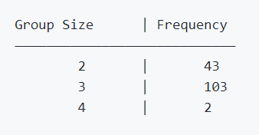
Final Report: Tables describing your Experiments
1. Please add the following table to your final report and presentation slides:
2. Please also report the group size distribution:
# | Matching Rule | Blocker | P | R | F1 | # Corr | Time
1 | Rule1:Title&Year | No Blocking | 0.71 | 0.95 | 0.82 | 10.230 | 90 min
2 | Rule1:Title&Year | StandardYear | 0.71 | 0.73 | 0.72 | 9.609 | 18 sec
3 | Rule1:Title&Year | SNBYear | 0.71 | 0.89 | 0.79 | 10.215 | 50 sec
4 | Rule2:Title&Actors | SNBYear | 0.81 | 0.89 | 0.83 | 9.919 | 19 sec
CorrespondenceSet<Movie, Attribute> correspondences = …
correspondences.printGroupSizeDistribution();
More details in the lecture on data fusion!

Slide 35
Task for this Exercise
Open and run the provided IR_using_linear_combination.java in de.uni_mannheim.informatik.dws.wdi.ExerciseIdentityResolution
Which performance does the linear combination rule achieve?
Understand your results:
Inspect the log files in data\output to see which errors were made
Try different combinations of comparators or weights in your matching rule
Can you improve the performance?
Can you improve the performance using global matching?
Experiment with different Blockers
First, use the NoBlocker to see the maximum runtime
Then, try different blocking keys with the StandardRecordBlocker
Finally, try the SortedNeighbourhoodBlocker
Use machine learning (IR_using_machine_learning.java)
Which performance does the machine learning rule achieve?
Create a comparator that uses the actors
Notes:
Provided project: actors.xml has undergone a manual data cleaning step to remove duplicates! (144 merged into 71, 49 merged into 126)

Slide 36

...and now
Prepare the gold standard
Use WInte.r and
Define your inputs
Define blocking functions
Define your matching rules
Run the evaluation
(extra) Learn matching rules

