Slide 1
Exercise: Data Fusion
Web Data Integration

Slide 2
Agenda
Exercise Overview
Use Case for this Exercise
The WInte.r Framework
Load Data for Fusion
Profile Correspondences
Define a Fusion Strategy
Specify Tolerance Ranges
Run Fusion
Evaluate Fusion Result
Adjust Data Fusion Strategy
Hands-on: Tasks of the Exercise

Slide 3
1. Exercise Overview
Learning goal
Learn how to use the WInte.r Framework to:
Fuse data and resolve data conflicts
Experiment with different conflict resolution functions
Measure the density and accuracy of the resulting fused dataset
Result
Fused data set in which each real-world entity is described by only a single record and these records contain no data conflicts
A well-founded idea about the quality and profile of the fused data
Data Collection
Schema Mapping Data Translation
Identity Resolution
Data Quality Assessment Data Fusion

Slide 4
2. Use Case for this Exercise
Download the .zip of the project from the course page
Unzip it and look at the files in \data\ folder
.xml input datasets in input folder
.csv output of Exercise 2 in correspondences folder
gold.xml in goldstandard folder
Open the project in a Java IDE (import as maven project)
The project serves as a quick-start for todays tasks and contains implementations for:
loading and profiling datasets and correspondences
various conflict resolution functions
comparing fusion results to a gold standard (ground truth)
computing the evaluation metrics density, consistency, and accuracy

Slide 5
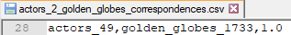
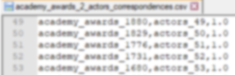
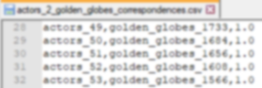
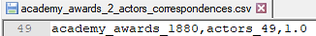
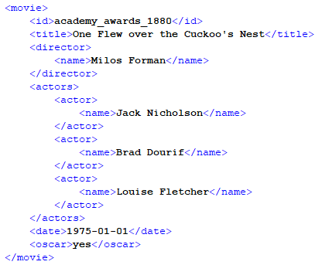
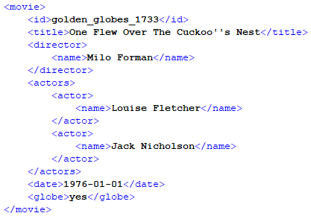
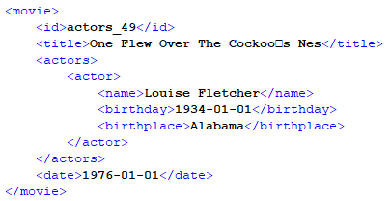
Provided Datasets and Correspondences
(i) academy awards – actors correspondences
(ii) actors – golden globes correspondences
(i) academy awards dataset
(ii) golden globes dataset
(iii) actors dataset
metadata:
dataset_score: 0.4
dataset_date: 2015
metadata:
dataset_score: 0.5
dataset_date: 2018
metadata:
dataset_score: 0.6
dataset_date: 2018

Slide 6
3. The WInte.r Framework
The Web Data Integration Framework (WInte.r) provides methods for end-to-end data integration
Implements methods for
Data Pre-Processing
Schema Matching
Identity Resolution
Data Fusion
Evaluation
Open Source under Apache 2.0 License
https://github.com/wbsg-uni-mannheim/winter/

Slide 7
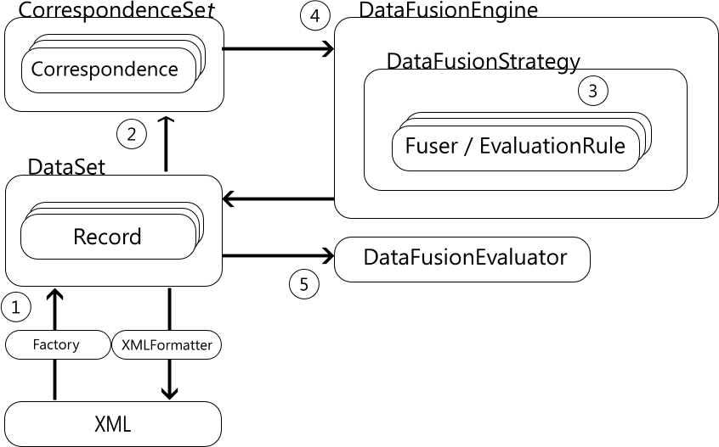
Data Fusion Walkthrough: Movie Use Case
1. Data Sets
2. Correspondences
3. Fusion Strategy
4. Fusion Engine
5. Evaluation

Slide 8
3.1 Load Data for Fusion: Data Model
We need to load:
The individual movie data sets
The correspondences files
Data model for fusion needs to
Extend the AbstractRecord class which implements both Matchable and Fusible
public class Movie
extends AbstractRecord<Attribute> {
public Movie(
String identifier,
String provenance) {
super(identifier, provenance);
actors = new LinkedList<>();
}
private String title;
private String director;
private LocalDateTime date;
private List<Actor> actors;
public String getTitle() {
return title;
}
public void setTitle(String title) {
this.title = title;
}
...
}

Slide 9
Load Data for Fusion: Data Model
Custom XMLReader which implements the FusibleFactory and will create the fused objects
It
public class MovieXMLReader extends XMLMatchableReader<Movie, Attribute> implements
FusibleFactory<Movie, Attribute> {
@Override
public Movie createInstanceForFusion(RecordGroup<Movie, Attribute> cluster) {
List<String> ids = new LinkedList<>();
// collect the ids of all records that are fused in this group
for (Movie m : cluster.getRecords()) {
ids.add(m.getIdentifier());
}
// sort and merge the ids to create an id for the fused record
Collections.sort(ids);
String mergedId = StringUtils.join(ids, '+');
// create the fused record
return new Movie(mergedId, "fused");
}
}

Slide 10
Load Data for Fusion: Create Fusible Data sets
Load data using the FusibleDataSet class
Extends the DataSet class
Allows you to add data set meta data
Calculates density report
// Load the Data into FusibleDataSet
FusibleDataSet<Movie, Attribute> ds1 = new FusibleHashedDataSet<>();
new MovieXMLReader().loadFromXML(new File(“data/input/academy_awards.xml"), "/movies/movie", ds1);
ds1.setScore(3.0);
ds1.setDate(LocalDateTime.parse("2012-01-01", formatter));
DataSet density: 0,58
Attributes densities:
Actors: 0,23
Date: 1,00
Title: 1,00
Director: 0,09
ds1.printDataSetDensityReport();

Slide 11
Load Data for Fusion: Load Correspondences
Use the CorrespondenceSet class to load all correspondences found in data/correspondences
Call loadCorrespondences multiple times!
The order of the data sets (2nd and 3rd parameter) must match the order of Ids in the correpondence file!
// load the correspondences
CorrespondenceSet<FusableMovie> correspondences = new CorrespondenceSet<>();
correspondences.loadCorrespondences( new File("correspondences.csv"),
ds1,
ds2);

Slide 12
3.2 Profile Correspondences: Group Size Distribution
Check group size distribution
All correspondences from the identity resolution are combined
All records that are believed to describe the same real-world entity end up in a group (transitive!)
// write group size distribution
correspondences.printGroupSizeDistribution();
Group Size Distribution of 148 groups:
Group Size | Frequency
————————————————————————————
2 | 43
3 | 103
4 | 2
Due to matching errors or duplicates in sources

Slide 13
3.3 Define Data Fusion Strategy
Use the DataFusionStrategy class to define how each attribute is fused
For each attribute, you have to add a Fuser and an EvaluationRule
Fusers use a conflict resolution function to fuse the values for an attribute
EvaluationRules define tolerance range for considering two values as equal
// define the fusion strategy
DataFusionStrategy<Movie,Attribute> strategy =
new DataFusionStrategy<>(new MovieXMLReader ());
// add attribute fusers
// Note: The attribute name is only used for printing the reports
strategy.addAttributeFuser( "Title",
new TitleFuser(),
new TitleEvaluationRule());

Slide 14
Define Fusion Strategy: Fuser
A fuser defines a conflict resolution function
That decides which of many values to choose
And three additional functions
If a record has a value that can be fused
How to get the value for a record
How to assign the fused value to the fused record
public class TitleFuser extends AttributeValueFuser<String, Movie, Attribute> {
public TitleFuser() {
super(new LongestString<Movie>());
}
@Override
public boolean hasValue(Movie record) {
return record.hasValue(Movie.TITLE);
}
@Override
public String getValue(Movie record) {
return record.getTitle();
}
Define the conflict resolution function
Does record have a value for this fuser?
Get record’s value for this fuser?

Slide 15
Define Fusion Strategy: Fuser
A fuser defines a conflict resolution function
That decides which of many values to choose
And three additional functions
If a record has a value that can be fused
How to get the value for a record
How to assign the fused value to the fused record
@Override
public void fuse(RecordCluster<Movie> group,
Movie fusedRecord) {
FusedValue<String, Movie> fused = getFusedValue(group);
fusedRecord.setTitle(fused.getValue());
fusedRecord.setAttributeProvenance(Movie.TITLE, fused.getOriginalIds());
}
Get the fused value
Assign the fused value to the fused record
Add provenance info to the fused record

Slide 16
Implemented Conflict Resolution Functions
Numeric Functions
 | Average | Calculates the average of all values
 | Median | Calculates the median of all values
String Functions
 | Longest String | Chooses the longest string
 | Shortest String | Chooses the shortest string
List Functions
 | Union | Creates the union of all values of the lists
 | Intersection | Creates the intersection of all values of the lists
Functions that use Provenance Metadata
 | FavourSources | Chooses the value from the data source with the highest score
 | MostRecent | Chooses the most up-to-date value
Data Type Independent Functions
 | Voting | Chooses the most frequent value
 | ClusteredVote | Chooses the centroid of the largest value cluster

Slide 17
3.4 Specify Tolerance Range
Evaluation rules are used to calculate consistency and accuracy
Implement one class per attribute specific evaluation rule which
extends the EvaluationRule class
defines which values should be considered as equal
It might be OK to tolerate
+/- 2% for numeric data like temperature, population
edit distance 1 for people names but likely not for movie names
Ideal case: Complete equality, no tolerance needed
public class TitleEvaluationRule extends EvaluationRule<Movie, Attribute> {
SimilarityMeasure<String> sim = new TokenizingJaccardSimilarity();
@Override
public boolean isEqual(Movie record1, Movie record2) {
// the title is correct if all tokens are there, but the order does not matter
return sim.calculate(record1.getTitle(), record2.getTitle()) == 1.0;
}
}

Slide 18
3.5 Run Fusion
Use the DataFusionEngine class to
calculate value consistency
and fuse the data sets
// create the fusion engine
DataFusionEngine<Movie,Attribute> engine = new DataFusionEngine<>(strategy);
// calculate attribute consistency
engine.printClusterConsistencyReport(correspondences, null);
Attribute Consistencies:
Actors: 0,43
Date: 0,00
Title: 0,94
Director: 1,00
// run the fusion
FusableDataSet<Movie,Attribute> fusedDataSet = engine.run(correspondences, null);

Slide 19
Writing the Fused Dataset to an XML File
Use XMLFormatter to write your dataset to an XML file
public class MovieXMLFormatter extends XMLFormatter<Movie> {
@Override
public Element createRootElement(Document doc) {
return doc.createElement("movies");
}
@Override
public Element createElementFromRecord(FusableMovie record, Document doc) {
Element movie = doc.createElement("movie");
movie.appendChild(createTextElement("id",
record.getIdentifier(), doc));
movie.appendChild(createTextElementWithProvenance("title",
record.getTitle(),
record.getMergedAttributeProvenance(Movie.TITLE), doc));
…
return movie;
}
}

Slide 20
Example Record in the Fused Dataset
<?xml version="1.0" encoding="UTF-8"?>
<movies>
<movie>
<id>academy_awards_2334+actors_39+golden_globes_2000</id>
<title provenance="golden_globes_2000">Who's Afraid Of Virginia Woolf</title>
<director provenance="academy_awards_2334">Mike Nichols</director>
<date provenance="golden_globes_2000+actors_39">1967-01-01T00:00</date>
<actors provenance="academy_awards_2334+golden_globes_2000+actors_39">
<actor>
<name>George Segal</name>
</actor>
<actor>
<name>Richard Burton</name>
</actor>
<actor>
<name>Elizabeth Taylor</name>
</actor>
<actor>
<name>Sandy Dennis</name>
</actor>
</actors>
</movie>

Slide 21
3.6 Evaluate Fusion Result
Use the DataFusionEvaluator class
needs your fusion strategy!
accepts a DataSet as gold standard (ground truth)
returns the accuracy of the dataset compared to the gold standard
// load the gold standard
DataSet<Movie, Attribute> gs = new FusibleHashedDataSet<>();
new MovieXMLReader().loadFromXML( new File("data/goldstandard/fused.xml"), "/movies/movie", gs);
// evaluate
DataFusionEvaluator<Movie, Attribute> evaluator = new DataFusionEvaluator<>(strategy);
double accuracy = evaluator.evaluate(fusedDataSet, gs, null);

Slide 22
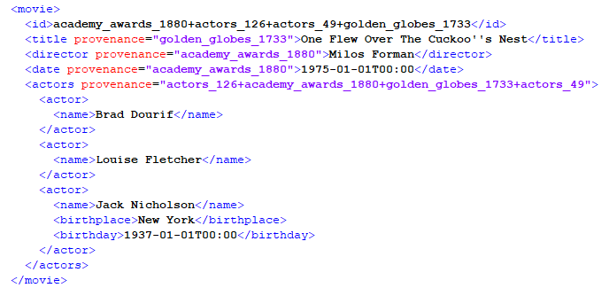
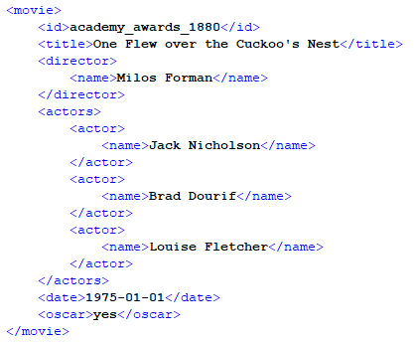
Evaluate Fusion: an example
Record generated by data fusion
title with the longest string
director from most trusted source
actors list from union
Gold standard record
Compare the fused values with the ones in the gold standard:
Did your conflict resolution functions work?
Should the value comparison be strict or more relaxed?
„Cuckoo‘‘s Nest“ vs „Cuckoo‘s Nest“

Slide 23
3.7 Adjust the Data Fusion Strategy
Winte.r supports detailed event logging which can help you adjust your fusion strategy and improve your results
Default logging level: dataset densities, group size distributions, gold standard elements, attributes consistencies, fusion accuracy
Trace (tracefile): default + fusion errors and corresponding correct values from the gold standard, attribute specific accuracy
Activate the fusion debug report after initializing the DataFusionStrategy object
private static final Logger logger = WinterLogManager.activateLogger(“trace");
// define the fusion strategy
DataFusionStrategy<Movie, Attribute> strategy = new DataFusionStrategy<>(new MovieXMLReader());
// write debug results to file
strategy.activateDebugReport("data/output/debugResultsDatafusion.csv", -1, gs);

Slide 24
Adjust the Data Fusion Strategy: an example
Inspect the debug report
Possible implication if this is the case for many values
AttributeName | Consistency | ValueIDS | Values | FusedValue | IsCorrect | CorrectValue
Date | 0 | Date-{actors_97| academy_awards_3480} | {1947-01-01T00:00|1946-01-01T00:00} | 1947-01-01T00:00 | FALSE | 1946-01-01T00:00
Date | 0 | Date-{actors_104| academy_awards_3059} | {1954-01-01T00:00|1953-01-01T00:00} | 1954-01-01T00:00 | FALSE | 1953-01-01T00:00
Date | 0 | Date-{actors_91| academy_awards_4015} | {1941-01-01T00:00|1940-01-01T00:00} | 1941-01-01T00:00 | FALSE | 1940-01-01T00:00
the fused value comes from the actors dataset
as a result of the FavourSource fusion strategy
the fused value is wrong
the correct date agrees with the academy_awards date value
academy awards dataset
academy awards dataset
Change dataset scores from
metadata:
dataset_score: 0.4
to
metadata:
dataset_score: 0.6
actors dataset
actors dataset
metadata:
dataset_score: 0.6
metadata:
dataset_score: 0.4

Slide 25
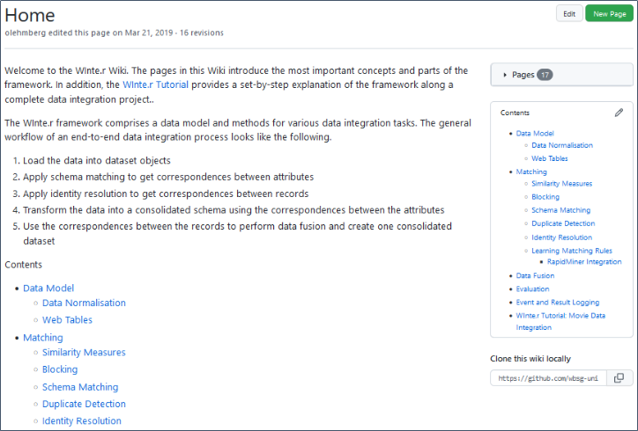
WInte.r Tutorial also covers Data Fusion
https://github.com/wbsg-uni-mannheim/winter/wiki

Slide 26
Project Related Information

Slide 27
Select Data for Fusion Experiments
Your input is the output of Exercises 1 and 2
schema is aligned, unique IDs are in place, identity resolution is done
What to look out for during fusion experiments?
Make sure again that attribute intersection is big enough
you should be able to fuse data for >= 5 attributes
Make sure that the quality of identity resolution is good enough
it makes sense to apply different fusion functions to the attributes
compare different functions
experiment with using provenance data vs. no provenance data

Slide 28
Prepare Your Gold Standard
Your gold standard should contain
>= 15 entities
>= 4 attributes per entity
Manually look up the correct values (in an external data source)!
The Gold Standard uses your target schema
Use IDs from one of your data sets, so the evaluator can find the correct records!
Don’t create ambiguities!
If records a, b, c are the same according to the identity resolution
Only one corresponding record can appear in the gold standard
Choose a, b or c as ID in the gold standard

Slide 29
Requirements for the Final Project Report
12 pages (sharp!) – counted without title page, table of content, literature list
Every extra page (including appendix pages) will reduce your mark by 0.33
Due to Sunday, 1st December 2024, 23:59
Send by email to Chris, Ralph and Alex
You must use the DWS master thesis layout (without Chapters)
https://www.uni-mannheim.de/dws/teaching/thesis-guidelines/
Also submit
your code and
(a subset) of your data
Please cite sources properly if you use any
Preferred citation style [Author, year]

Slide 30
Final Report: Content
Your final report should contain
Results of Phase 1: Data Translation
Results of Phase 2: Identity Resolution
Results of Phase 3: Data Fusion
Summary of the overall result

Slide 31
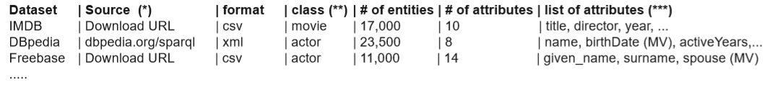
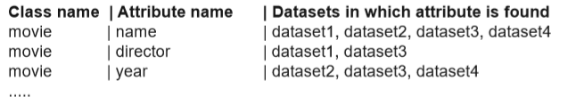
Data Translation in the Final Report
Your report should contain
Profiling results describing your input data sets
e.g. updated versions of the tables that you created for your project proposal
Your consolidated schema and how you created it
Which transformations you used and why
if there was any information you could not transform

Slide 32
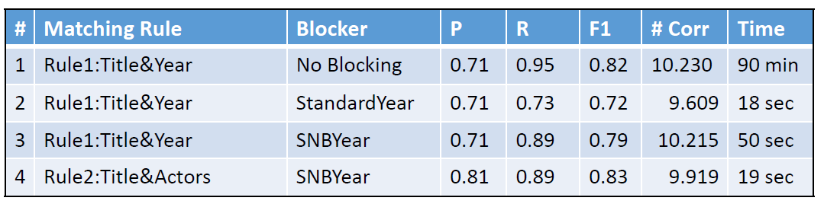
Identity Resolution in the Final Report
Your report should contain
Content and size of your gold standard and procedure used to create it
Which matching rules did you try?
Discuss what happened with P/R and F1?
Please include a table comparing the results of the different matching rules
Which blocking methods did you try?
Report and discuss the change in runtime, number of matches, and reduction ratio. How do P/R/F1 change?
Please include a table comparing the results of the different blocking methods that you tested
What’s the group size distribution of your result?
An analysis of the errors that remain when applying your best matching rule.

Slide 33
Data Fusion in the Final Report
Your report should contain
Which datasets your selected for fusion?
What kind of provenance data you added?
What was the density of your input and the merged datasets?
How consistent were your datasets?
Size and content of your gold standard and how you created it
Which conflict resolution functions you tried for each attribute
Whether your define your own conflict resolution functions
Which accuracy did the different conflict resolution functions deliver? What was the best function for each attribute?
Please include a table comparing the accuracies reached by the different resolution functions.
An analysis of the errors that remain after applying your best resolution function.

Slide 34
Summary of Overall Results in Final Report
Please conclude your report with a summary answering the following three questions:
How many additional entities did you add compared to the largest of your input datasets?
How much did you increase the density of your data compared to the largest of your input datasets?
What is the overall accuracy of your final dataset according to your gold standard?

Slide 35
Final Report: Important
Balance your content between the 3 exercises
not 10 pages on identity resolution and 2 pages on the rest
If you have done something cool – write about it!
it is highly unlikely we dig it out of your code ourselves
We are strict about the 12 pages limit. Thus,
include lots of tables to show us what you have tried
briefly discuss the results of each of your experiments
do not repeat theoretical stuff from the slides (e.g. definition of X)
we will reduce your mark by 0.33 for each extra page no matter how interesting it is!

Slide 36
Task
Open and run the provided Java project
Inspect the profiling results
What is the potential of every dataset to fill missing values within the other datasets?
How many real-world entities are presented by more than one dataset?
How is it possible to have 4 conflicting values given that we have only 3 datasets?
Which attributes do you expect to be more conflicting?
Create your own value-based fusion strategy that selects the longest title value
Inspect the debug report to find which source is the most trustworthy for the date attribute. Change the dataset metadata so that this source is preferred.

Slide 37



Solutions
Interpreting profiling results
Dataset | Number of Elements | Overall Density | Attribute Density
 |  |  | Actors | Date | Title | Director
academy_awards.xml | 4580 | 0.58 | 0.23 | 1.00 | 1.00 | 0.09
actors.xml | 151 | 0.75 | 1.00 | 1.00 | 1.00 | 0.00
golden_globes.xml | 2279 | 0.78 | 0.98 | 1.00 | 1.00 | 0.14
Good for missing values
High overlap: More potential for conflicts
D1
Merged
D2

Slide 38
Solutions
Create your own value-based fusion strategy that selects the longest title value
public class TitleFuserLongestString extends AttributeValueFuser<String, Movie, Attribute> {
public TitleFuserLongestString() {
super(new LongestString<Movie, Attribute>());
}
public void fuse(RecordGroup<Movie, Attribute> group, Movie fusedRecord, Processable<Correspondence<Attribute, Matchable>> schemaCorrespondences, Attribute schemaElement) {
...
}
public boolean hasValue(Movie record, Correspondence<Attribute, Matchable> correspondence) {
...
}
protected String getValue(Movie record, Correspondence<Attribute, Matchable> correspondence) {
...
}

Slide 39
Solutions
Which source is the most trustworthy as far as the date attribute is concerned?
Inspect the log messages → change log level to trace
The current strategy selects the date value from the actors dataset (ds2)
ds1.setScore(1.0);
ds2.setScore(2.0);
ds3.setScore(3.0);

Slide 40
Solutions
Which source is the most trustworthy as far as the date attribute is concerned?
Adjust the dataset scores
Use a conflict resolution function that uses these scores
Check how the accuracy changes
strategy.addAttributeFuser(
Movie.DATE,
new DateFuserFavourSource(),
new DateEvaluationRule());
ds1.setScore(1.0);
ds2.setScore(2.0);
ds3.setScore(3.0);
Attribute-specific accuracy: 0.00
ds1.setScore(3.0);
ds2.setScore(1.0);
ds3.setScore(2.0);
Attribute-specific accuracy: 0.95

Slide 41
Final Presentation and Exam
Presentation Dates
04.12.2024
Date and Time of WDI offline Exam
12.12.2024 at 8:30
Format
5-6 open questions that show that you have understood the theory part of the lecture
all lecture slide sets including structured data on the Web and data exchange formats + query languages
XPath and SPARQL
Duration: 60 minutes

Slide 42

...and now
Get the template project and
Define your inputs
Experiment with creating the merged dataset, and density and consistency evaluation metrics
Define your conflict resolution functions
Define your gold standard
Experiment with data fusion and accuracy evaluation metrics
Write your final report
Repeat the theory parts in order to be ready for the final exam
The video recordings of all lectures are online

