Slide 1
CuisineSync
By: Welela Burayu, Arnab Das, Jean Bikorimana, Nedine Abdulahi

Slide 2
CuisineSync
Core Functionality
Users can create a group within the app and invite their friends to join.
Each member of the group ranks their favorite cuisines(this can be a score users give) and sets their budget.
CuisineSync using an algorithm and machine learning principles will recommend restaurants for the group to try.
Where Taste Meets Harmony
CuisineSync: Simplifies restaurant selection for group dining
Solves the problem of indecision when dining out with friends
Enhances the dining experience for groups by making it seamless and enjoyable

Slide 3


Technical Analysis
App Development: We'll be using Java for native Android app development.
Backend: Our backend will be powered by either Django or MongoDB, and we'll connect it to an SQL database, NoSQL.
APIs: We'll be integrating third-party APIs for restaurant data and location services to provide up-to-date information to our users.

Slide 4
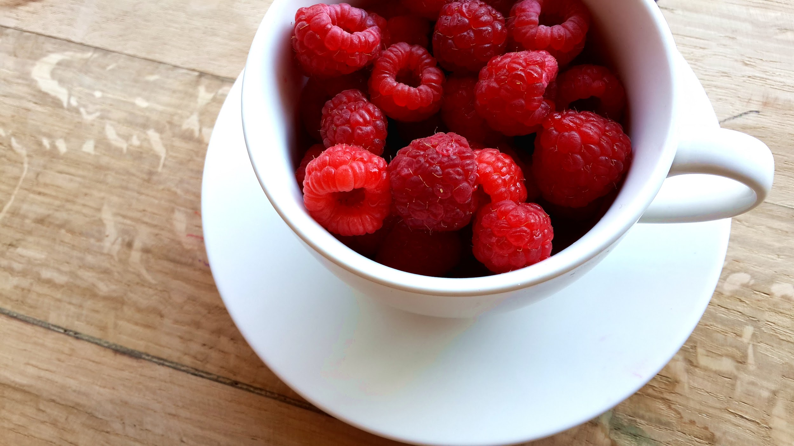
System Documents
Next Slide

Slide 5
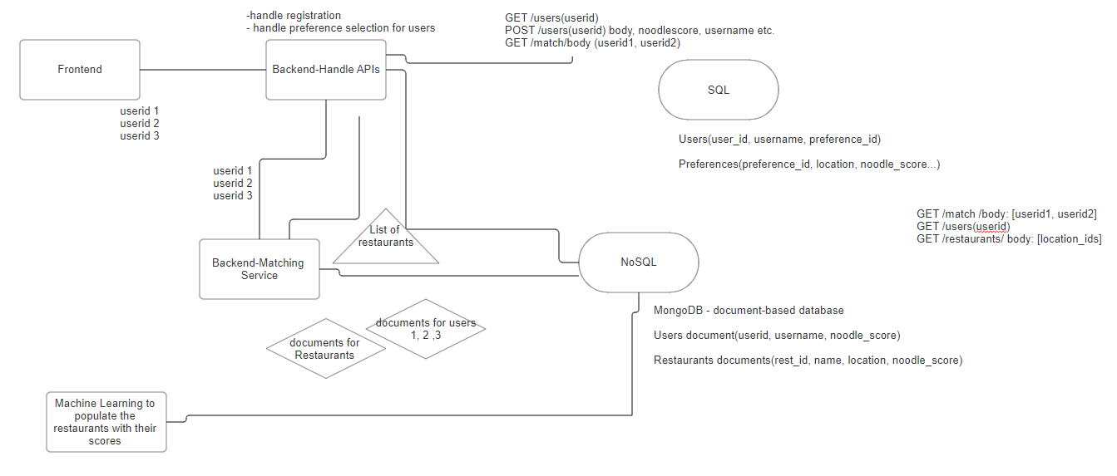

Slide 6
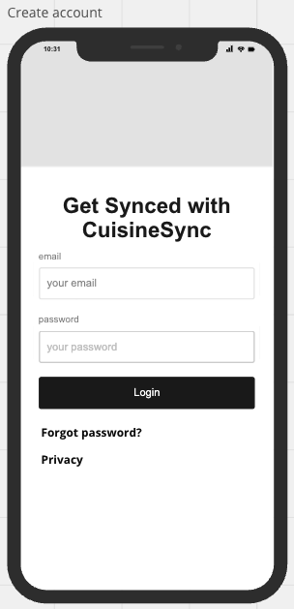
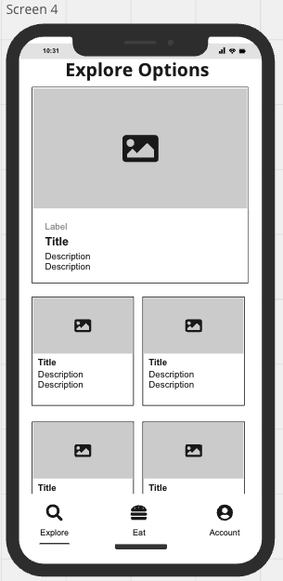
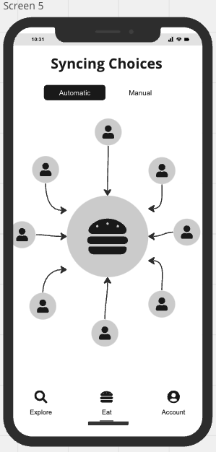
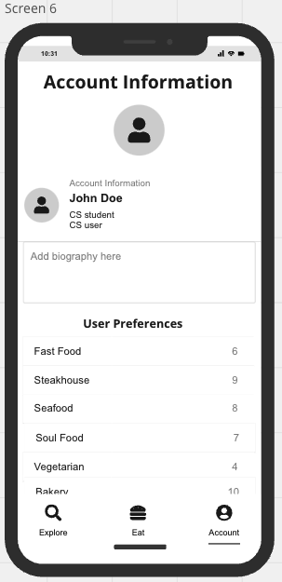
Wireframes

Slide 7
Minimum Viable Product
MVP Focus: Core functionality prioritized.
Integration of machine learning or poll-based system for user cuisine preferences.
Data storage in a database with real-time communication.
Advanced features excluded to streamline future releases.

Slide 8
RoadMap
Milestones
Develop database
Implement groups and friends lists
Basic UI Interface
ML Algorithm
MVP Developed at this stage
Put in map functionality
First few weeks will focus primarily on designing the database for users to preferences and developing the ML Algorithm

Slide 9
https://trello.com/b/j31pF20l/cuisinesync

