Slide 1
Openshift
The basics of deployments

Slide 2
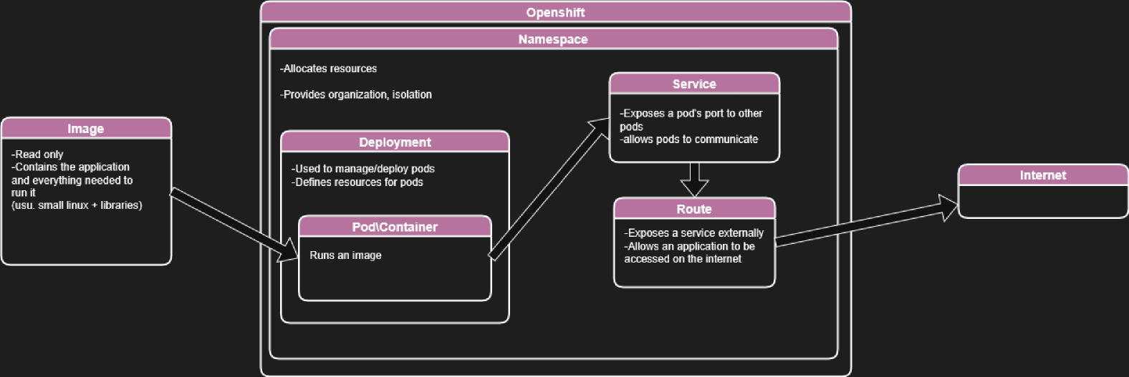
Notes:
This is more or less everything we will be going over today.
We will be leaving a lot out min order to keep things simple and streamlined. You may come across other things as you work in openshift.

Slide 3
What is it?
A distributed computing service that abstracts away hardware and provides containerization
Different Clusters
Openshift
Different clusters offer varying redundancies and security
Silver (We are here)
Gold (Offsite redundancy)
Emerald (Enhanced privacy, Protected C)
How to access
Most people use a combo of the web gui and oc commandline
Web: console.apps.silver.devops.gov.bc.ca
OC: Install via WSL: instructions
Notes:
Define containerization
Most people use web gui and OC to access and view things. Controlling and configuration can be done

Slide 4
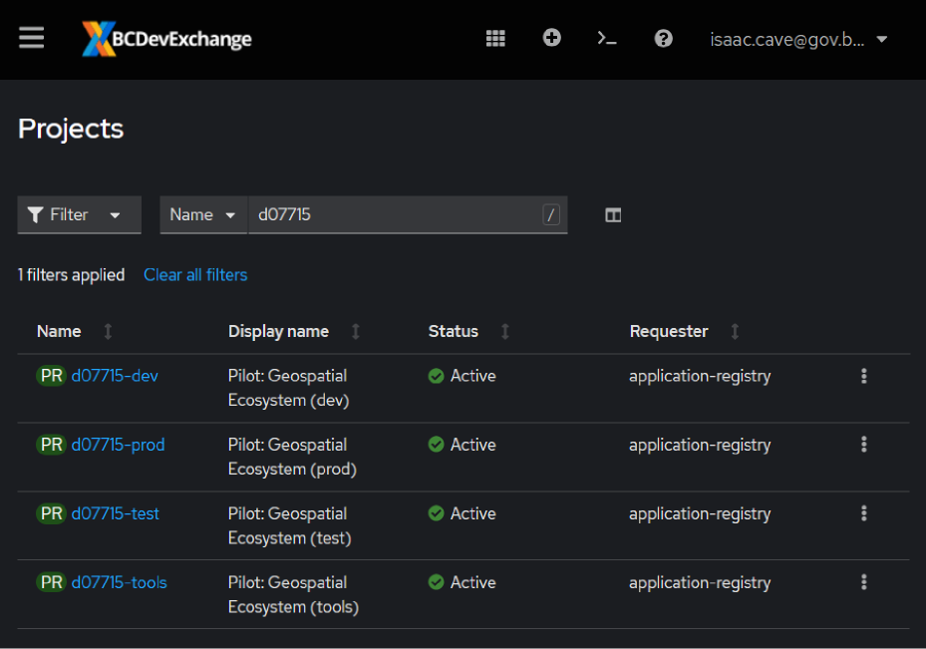
Namespace
What is it?
Divides up and allocates resources Within an openshift cluster. Provides organization, isolation, and grouping.
BC Gov will typically group a number of namespaces together under a ‘licenseplate’
Licenseplate
Will include different namespaces to facilitate development:
dev
test
prod
tools
Examples: d07715-dev, d07715-prod
Notes:
Define containerization

Slide 5
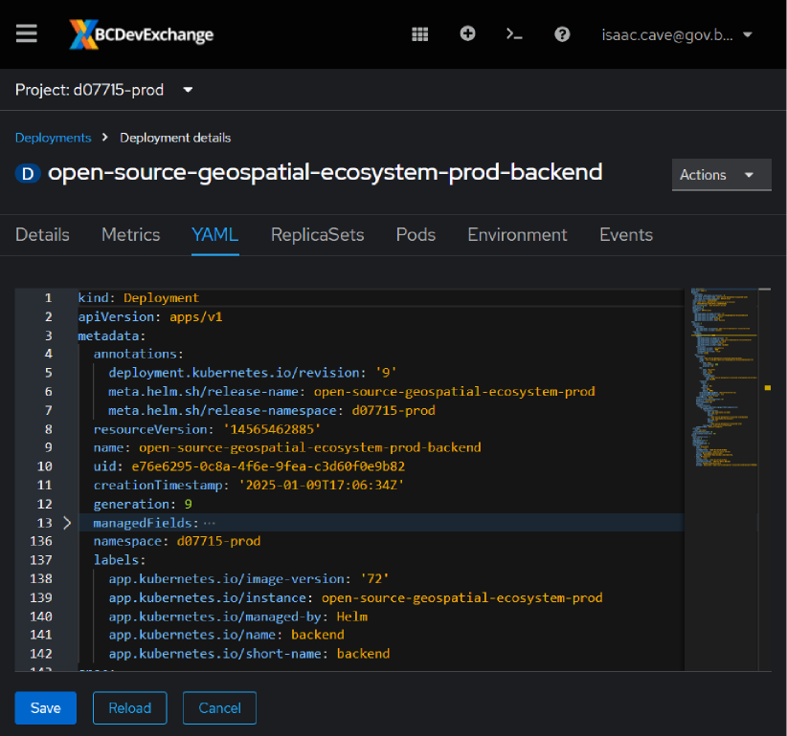
Deployment
What is it?
Within a namespace, deployments are used to manage and deploy pods.
Controls
Deployments control the creation of pods, including resource allocation (cpu, mem, storage, etc), number of pods, and the tags used to identify them.
YAML
Deployments parameters are defined via a yaml file.
Notes:
Define containerization.
Everything is defined by yaml in Openshift and Helm.
YAML is: (Not real).....
Put in second slide, with yaml example, highlight components

Slide 6
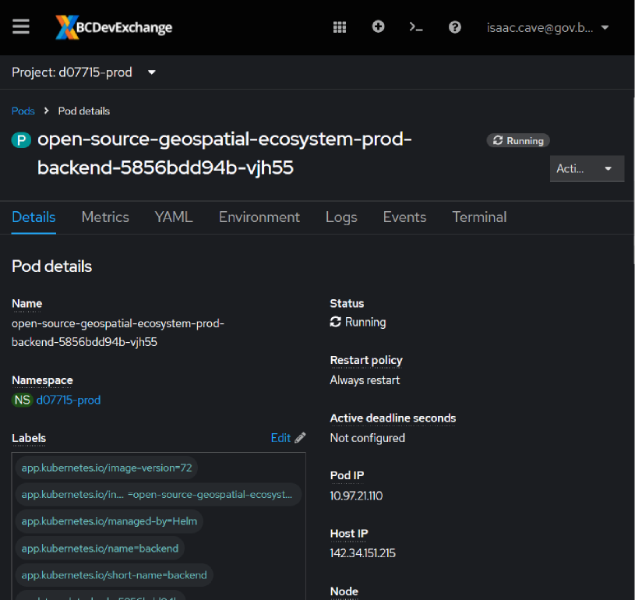
Pod/Container
What is it?
Pods enclose one or more containers, which run your pre-made image in an isolated environment.
In most cases, it’s 1 pod: 1 container, so some people will use the terms interchangeably
Notes:
Define containerization

Slide 7
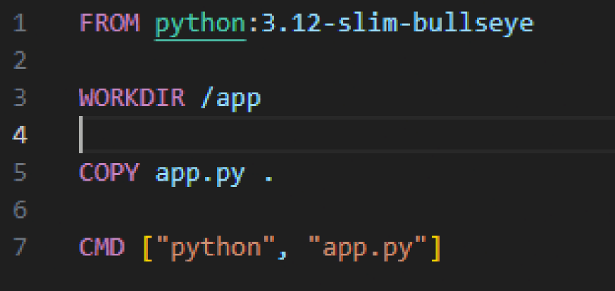
Image
What is it?
A read-only template that contains your application and the dependencies required to run it.
Typically built on a small linux base with dependencies
Where is it?
We typically built and store ours in github.
Other locations include Docker Hub and third party repositories.
Dockerfile
Images are built based on a dockerfile.
Notes:
Define containerization

Slide 8
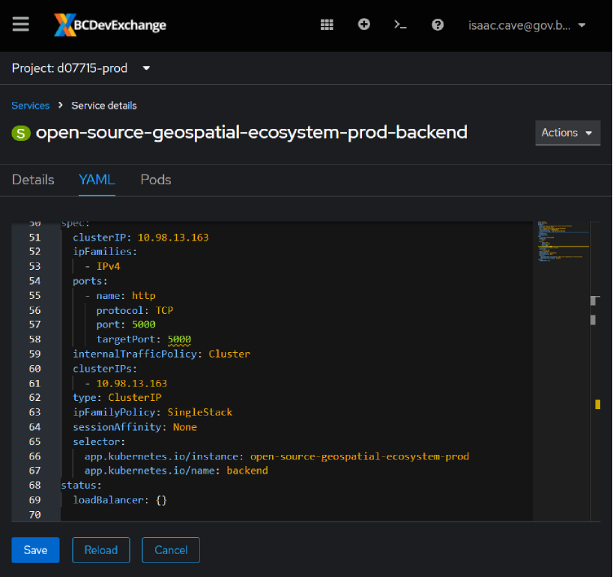
Services
What is it?
Service allows specific routes into/out of pods
This allows pods to communicate with each other within a namespace.
How it works
The Service specifies the port and protocol the application uses.
The pod is selected using selector tags to match to the pod and instance.
Notes:
Services are important when cross-pod communication within a namespace is required. Examples include a frontend/backend relationship, talking to a database, etc.
In this example, we are only selecting a specific prod backend for service

Slide 9
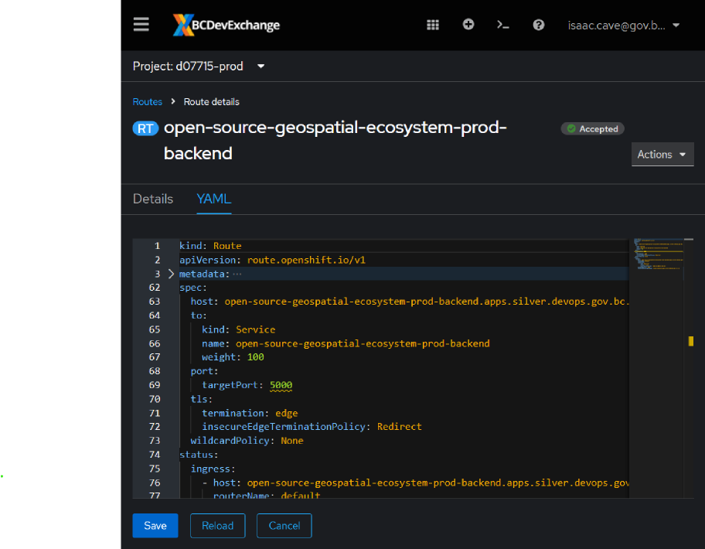
Routes
What is it?
Routes work to expose Services outside of Openshift
How it works
The Route specifies a service, a port, and an ingress host.
Requirements
The Route requires an ingress policy on the namespace, otherwise the route will not be accessible.
Notes:
Services are important when cross-pod communication within a namespace is required. Examples include a frontend/backend relationship, talking to a database, etc.
In this example, we are only selecting a specific prod backend for service

Slide 10
Questions? Comments?

Slide 11
Interactive Lesson
github.com/wburt/demo-app

