Slide 1
Helm
It’s YAML all the way down

Slide 2
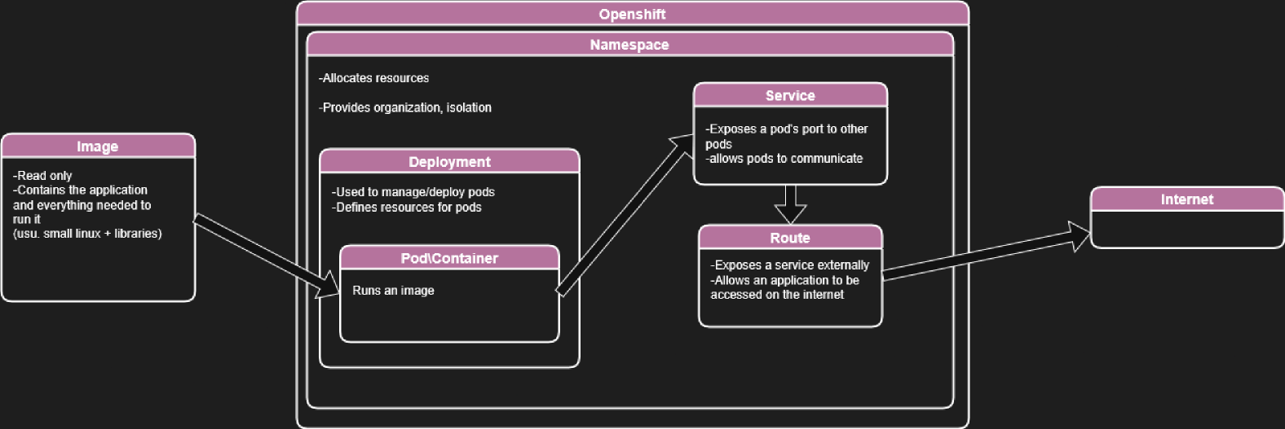
Section title
Notes:
We saw this diagram previously.
Today we are going to learn how components like Deployments, Services, and Routes are defined using Helm

Slide 3
What is Helm?
What is it?
Helm is used to manage kubernetes (and OpenShift) applications
It manages charts, which define all the parameters required for a deployment
Create, install, uninstall applications using charts
Easy to integrate into automated CI/CD processes
Notes:
<as in slides>
The charts

Slide 4
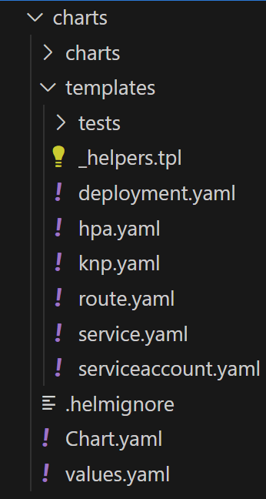
Charts.yaml | Basic info. Name, version, description, dependencies
values.yaml | Defines values used by all the other templates
_helpers.tpl | Stores functions to define complex values
deployment.yaml | Contains pod, container, image, environment variables information
hpa.yaml | HorizontalPodAutoscaler Used to automatically scale pods based on demand
knp.yaml | Kubernetes NetworkPolicy Defines a network policy Used to allow/disallow ingress into a pod eg: Expose a pod to the internet
route.yaml | Create a route with domain name
service.yaml | Expose a pod internally
serviceaccount.yaml | Define a service account for your pods Optional
Structure
Notes:
<as in slides>
Helm charts will reside in a chart folder
There are charts for deployment, service, and route
Additional charts include:
knp (kubernetes network policy)
hpa (horizontal pod autoscaling)
Chart.yaml will provide basic information about your application (name, version, etc)
values.yaml is one of the most important

Slide 5
Template files
What is it?
All template files are in YAML format
They are templates used to generate the YAML files used in openshift
They will look very similar, but the value in the key:value pair is defined differently
Values are defined in values.yaml and then refenced in all the other yamls.
Notes:
<as in slides>
It is very important for values to be defined and referenced. Many objects in openshift will require consistent tags and selectors, for example to work together
-If you forget to change something, then things can easily stop working

Slide 6
Deployment.yaml
We will use deployment.yaml as a specific example to see how a helm chart is built.
Notes:
<as in slides>
We will use deployment.yaml as a specific example to see how a helm chart is built.
The other charts will have different stuff in them, but they will follow a very similar pattern.

Slide 7
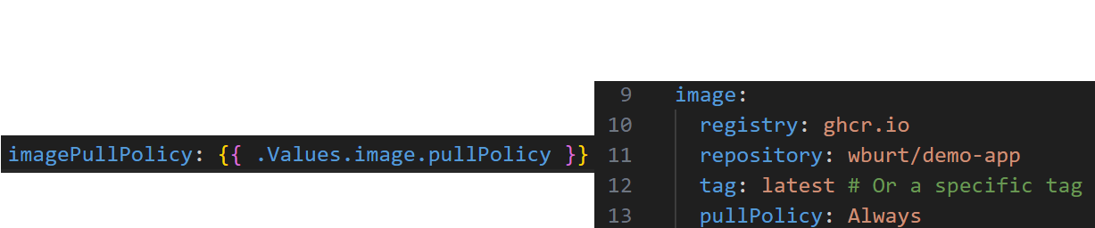
Basic references
When referencing a value in the values.yml, You use a dot notation like this:
imagePullPolicy: {{ .Values.image.pullPolicy }}
Notes:
<as in slides>
This is the most basic way to reference

Slide 8
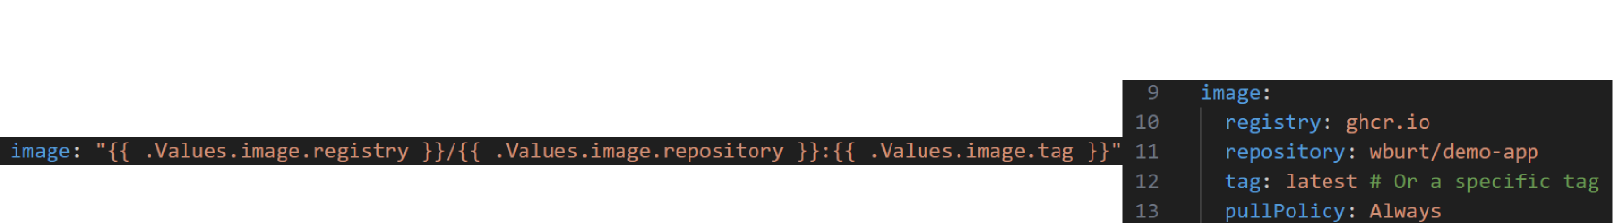
Concatenation
You can also concatenate values to build things like URLs
Notes:
<as in slides>
We will use deployment.yaml as a specific example to see how a helm chart is built.
The other charts will have different stuff in them, but they will follow a very similar pattern.

Slide 9
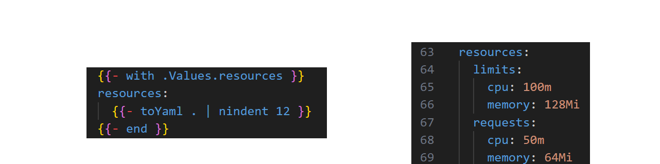
Conditional Blocks
Conditional blocks allow deployment.yaml to populate optional sections only if they are present in the values.yaml
Notes:
<as in slides>
Conditional blocks allow deployment.yaml to populate optional sections only if they are present in the values.yaml
There are two types of conditional block. This is the first
In this example, resources is an optional section in a deployment. Your cluster will have defaults that get put in if these aren't specified.
The format uses a single dash to strip white space and 'with', means we are grabbing this value to check
You have to convert the object back to yaml, and set the indentation. This is important because in many cases, you're grabbing a block of values, and you must maintain the indentation in your deployment.yaml
This is useful for development. Because some values are optional, you can focus on the required ones before looking at the optional ones

Slide 10
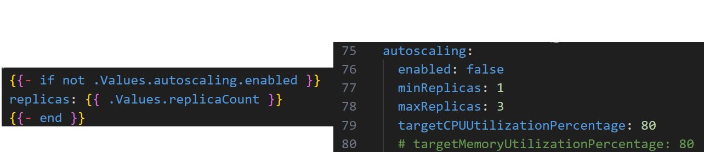
Conditional Blocks
Another conditional evaluates the content of the value to populate a section.
Notes:
<as in slides>
Conditional blocks allow deployment.yaml to populate optional sections only if they are present in the values.yaml
There are two types of conditional block. This is the second
In this example, This evaluates whether autoscaling is turned on
The format is a simple if statement.
Most if statements I have seen only evaluate the truthiness of a value. I haven't seen more complex instances
This is useful for development. Because some values are optional, you can focus on the required ones before looking at the optional ones

Slide 11
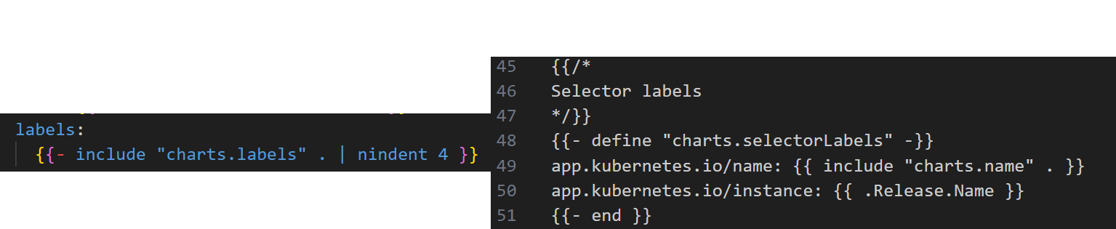
Helper functions
Values can also be derived from functions defined in _helpers.tpl.
Helps to abstract away more complex variable setting
Notes:
<as in slides>
Conditional blocks allow deployment.yaml to populate optional sections only if they are present in the values.yaml
There are two types of conditional block. This is the first
In this example, This evaluates whether autoscaling is turned on
The format is a simple if statement.
Most if statements I have seen only evaluate the truthiness of a value. I haven't seen more complex instances
This is useful for development. Because some values are optional, you can focus on the required ones before looking at the optional ones

Slide 12
Important sections
Notes:
Now that we have the basics of how to read the yamls, we can look at what some of the sections mean.
We won't go over all the sections, but we will hit some of the critical ones for a deployment.yaml
Other files, such as service.yaml will follow a similar structure, with their own values.

Slide 13
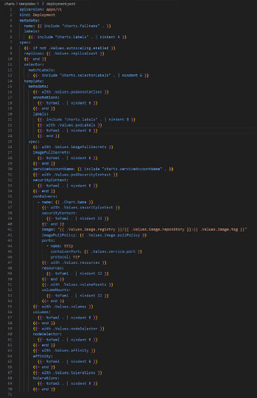
Important sections
Notes:
First is defining what type of configuration this is. This changes depending on whether its a deployment, service, route, etc

Slide 14
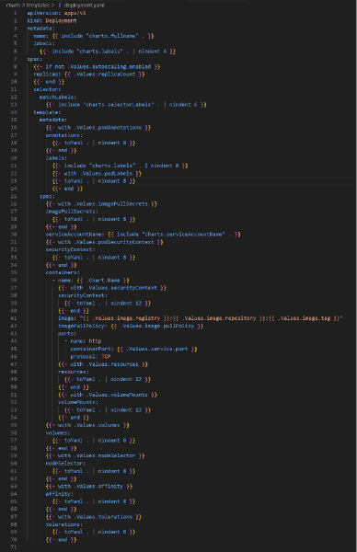
Important sections
Notes:
The metadata labels will be important for selectors

Slide 15
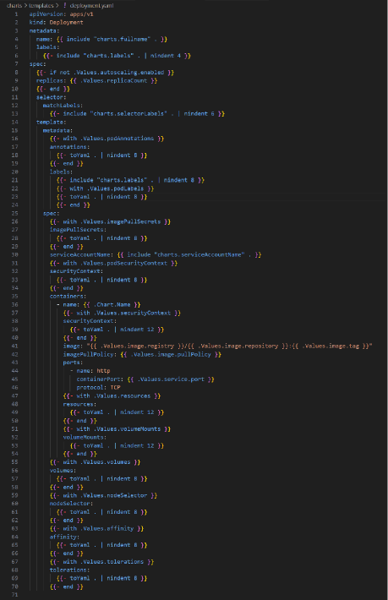
Important sections
Notes:
spec will be the majority of your configuration. It sets pod configuration

Slide 16
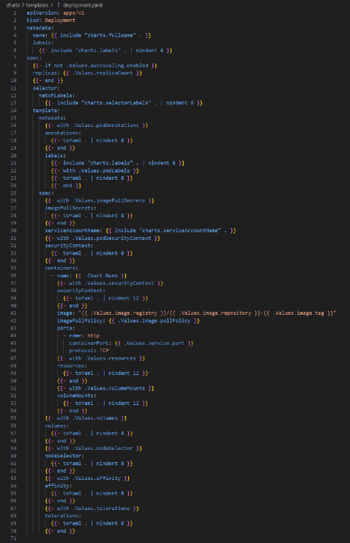
Important sections
Notes:
You will have your autoscaling settings and your matchlabels, again for matching deployment to pod

Slide 17
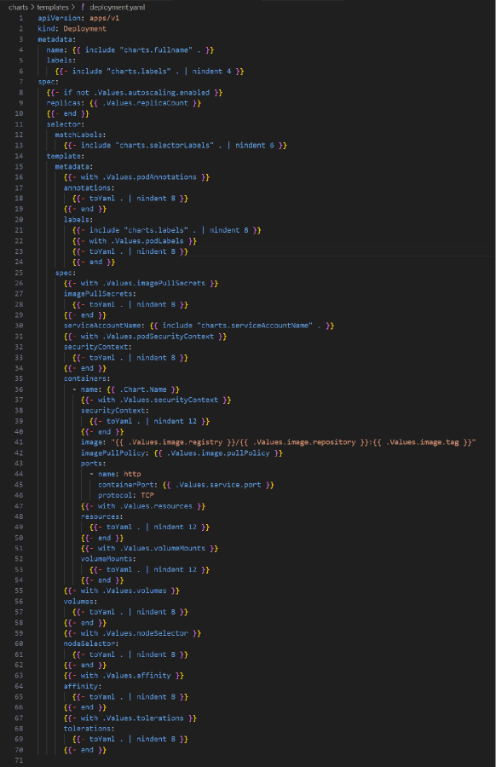
Important sections
Notes:
The template section will set annotations and labels again.

Slide 18
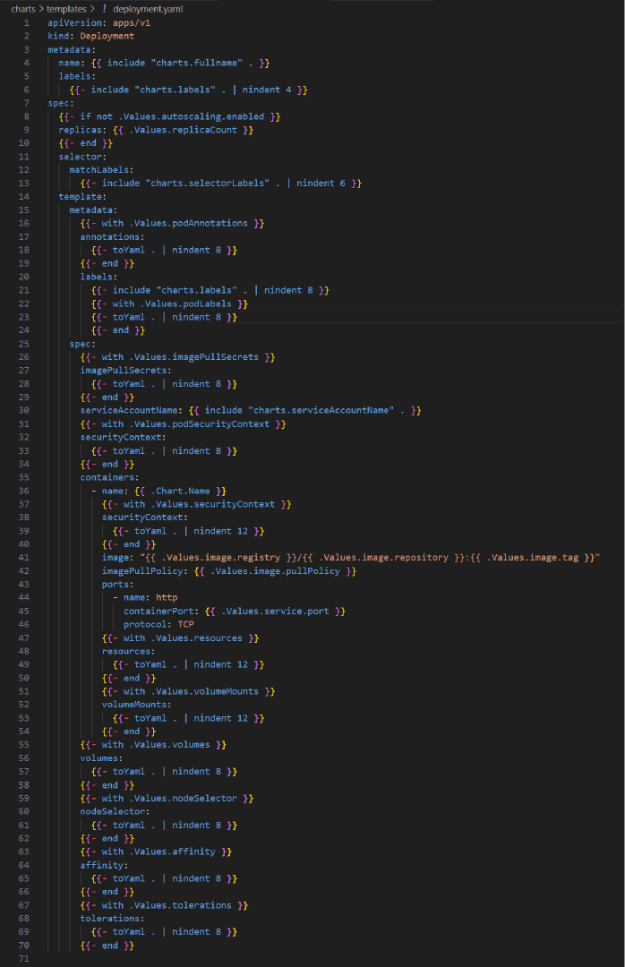
Important sections
Notes:
This template.spec sets some metadata before diving into containers

Slide 19
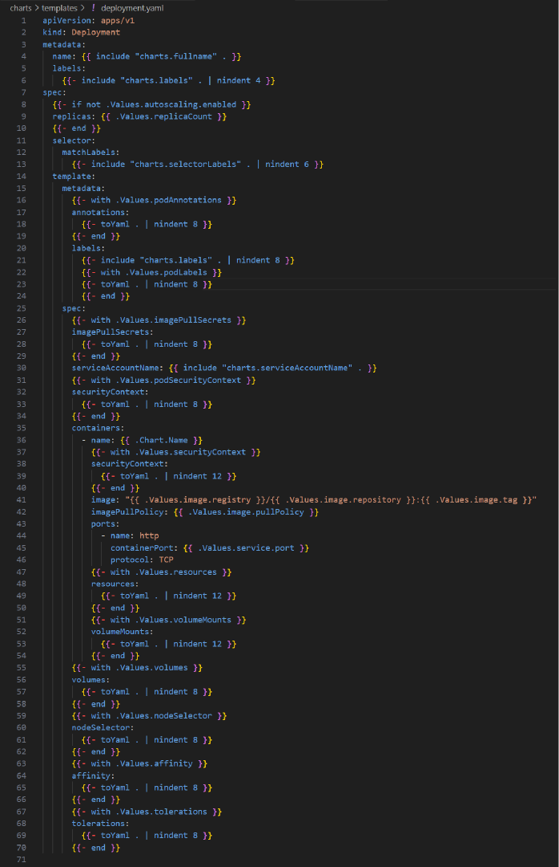
Important sections
Notes:
Now we are on to spec.template.spec.containers. This will contain a lot of the high impact values.
We will have things like name and security context

Slide 20
Important sections
Notes:
But this is also where the image and pull policy is defined.
This is the string concatenation from earlier

Slide 21
Important sections
Notes:
There is also port definitions

Slide 22
Important sections
Notes:
The resource definition from last time.
This will help some of the issues we had last week with namespace resources

Slide 23
Important sections
Notes:
The resource definition from last time.
This will help some of the issues we had last week with namespace resources

Slide 24
Questions? Comments?
Notes:
Does anyone want a quick recap of the value formatting section?

Slide 25
Assignment
github.com/wburt/demo-app/tree/main/learning_resources/tutorials/Openshift_Tutorial.md

