Slide 1
Probability Distributions & Uncertainty
Wednesday Bushong
Summer ‘22 Stats Group

Slide 2
Outline
Probability Distributions
What is a probability distribution?
3 major distributions: Normal, Log-normal, Binomial
Parameter Estimation & Inference
Measures of central tendency & variability
Estimating uncertainty
Linking parameter estimation to classic statistics: deriving a t-test
Statistical Models
What is regression? (terminology & basic formula)
Problems in regression: collinearity, inference from small sample sizes
Methods we will learn about in this ‘class’

Slide 3
Probability Distributions

Slide 4
Normal
Some terminology/notation
Mean = μ
Standard Deviation = σ or SD
Single observation from a normal distribution = X

Slide 5
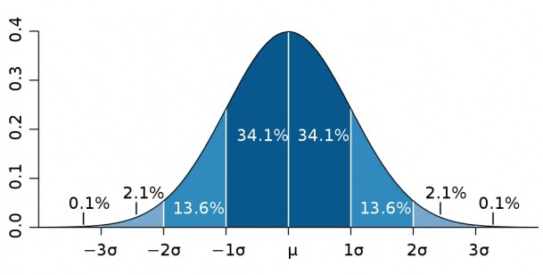
Standard Deviation & the normal distribution
μ ± 1σ = 68.2% of all data
μ ± 2σ = 95.4%
μ ± 3σ = 99.6%
μ ± 1.96σ = 95%

Slide 6
Log-Normal
Skewed to the right
Commonly observed in measures that get close to but can’t go below 0
E.g., reaction time
Mean is not center
Mean > median > mode

Slide 7
Binomial
any response with two categorical possibilities
multinomial distribution extends this to multiple choices
Related: ordinal measures (e.g., surveys)

Slide 8
Parameter Estimation & Inference

Slide 9
Simplest Case: Comparing Means of 2 Groups
General process:
Estimate mean of each group
Estimate how confident we are about that mean estimate (uncertainty)
Compute a value representing a comparison of mean & uncertainty estimates between groups
Compare this value to some desired statistical significance threshold
For this example, we’ll assume we are dealing with data that is normally distributed

Slide 10

Estimating our Sample Mean
This is easy!
$$μ=\frac{\sum{X}}{n}$$
where X = a single observation & n = sample size

Slide 11
Estimating Uncertainty in our Mean Estimate
We can never know the true mean of our population
So how do we know if our sample mean is close to the “right” answer?
Let’s reverse-engineer & pretend we know the true mean and standard deviation

Slide 12

Ground Truth
$$μ=5$$
$$σ=2$$

Slide 13
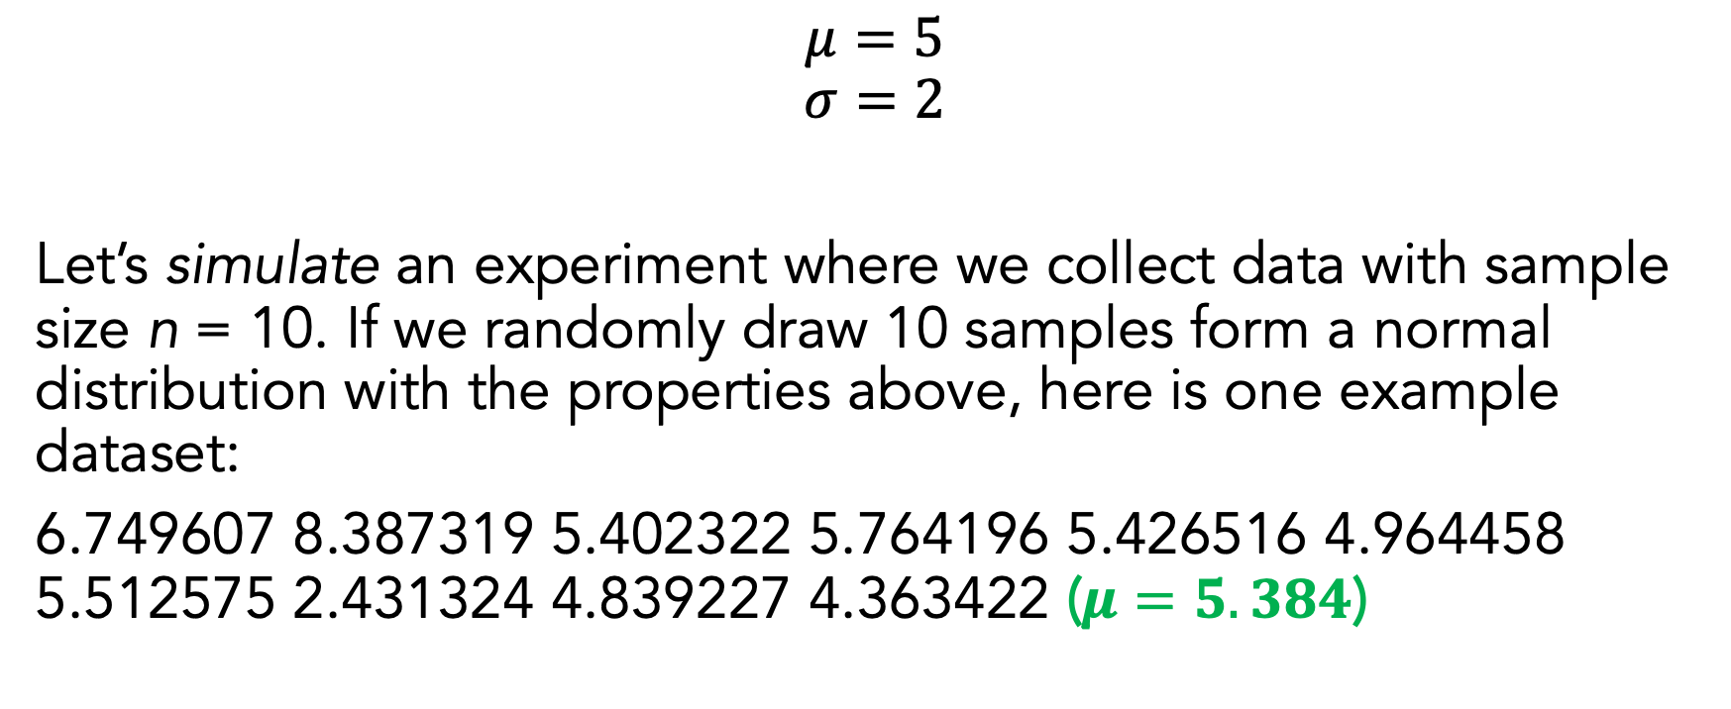
Ground Truth
$$μ=5$$
$$σ=2$$
Let’s simulate an experiment where we collect data with sample size n = 10. If we randomly draw 10 samples form a normal distribution with the properties above, here is one example dataset:
6.749607 8.387319 5.402322 5.764196 5.426516 4.964458 5.512575 2.431324 4.839227 4.363422 ($μ=5.384$)

Slide 14
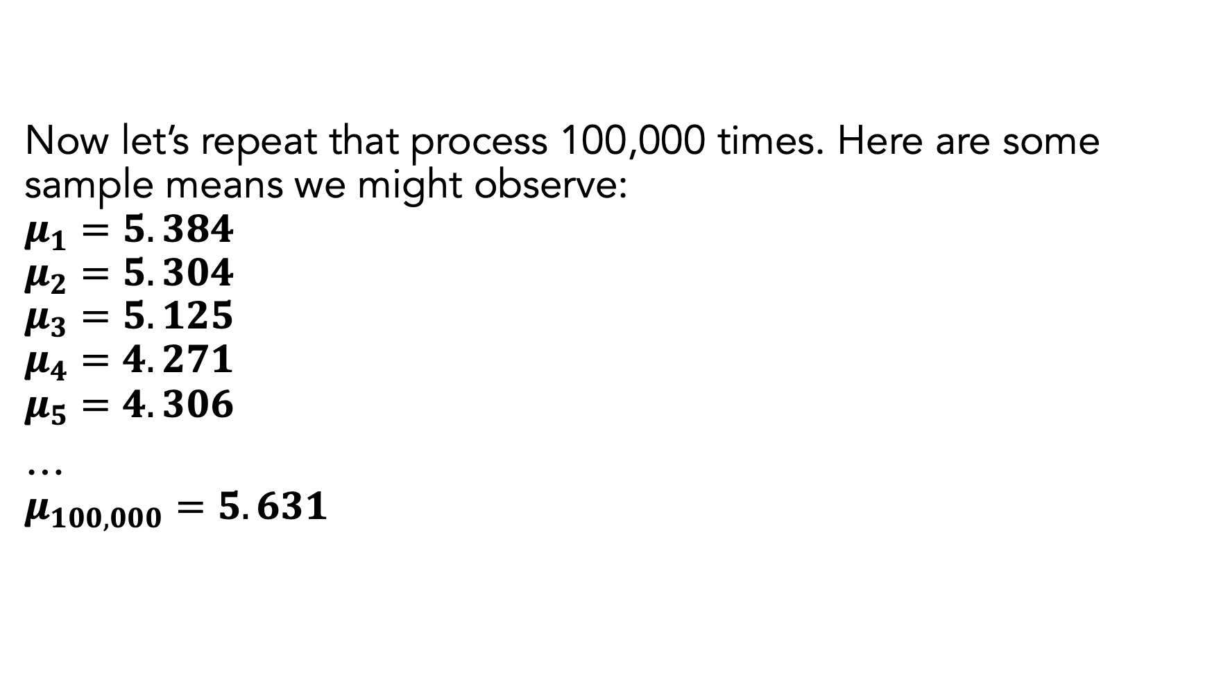
Now let’s repeat that process 100,000 times. Here are some sample means we might observe:
$$μ_{1}=5.384$$
$$μ_{2}=5.304$$
$$μ_{3}=5.125$$
$$μ_{4}=4.271$$
$$μ_{5}=4.306$$
…
$$μ_{100,000}=5.631$$

Slide 15
If we repeat this process infinite times, it turns out that these individual means themselves form a normal distribution:
(this is from 100,000 samples so it won’t look perfectly normal)

Slide 16
This is what’s known as a sampling distribution: when you know the true parameters of your distribution, you can estimate the probability of observing different mean estimates for a given sample size!

Slide 17
The sampling distribution can help us estimate our uncertainty. Let’s take the 95% middle interval of the sampling distribution (by cutting off the top 2.5% and bottom 2.5% of values):
Most common 95% of observations: [3.76, 6.23]

Slide 18
Sampling Distribution & Uncertainty
If the true mean is 5, we should frequently expect individual experiments to find means all over the place!
95% of experiments will return something between [3.76, 6.23]

Slide 19
The larger our sample size is, the smaller this 95% interval will be for the same ground-truth parameters:
sample ns = 10
sd of sampling dist. = 0.63
middle 95% = [3.76, 6.23]
sample ns = 100
sd of sampling dist. = 0.2
middle 95% = [4.61, 5.39]

Slide 20
Sampling Distribution & Uncertainty
We can use the sampling distribution to estimate our uncertainty about the estimate of our mean from a single experiment
We can’t know the true sampling distribution since we don’t know the ground truth
But, it turns out that there is a systematic relationship between the standard deviation estimated from a single experiment & the standard deviation of the sampling distribution!

Slide 21

Relationship between a single experiment’s SD & sampling distribution
Assuming normality:
$$\frac{σ_{{sample}_{i}}}{\sqrt{n}}≈σ_{sampling distribution}$$
Some of you may recognize this as the formula for standard error of the mean (SEM)!

Slide 22
SEM and “confidence intervals”
μ ± multiplier*SEM = 95% confidence interval (CI)
We will come back to this multiplier
If we collected infinite samples, 95% of the estimated 95% confidence intervals would contain the true mean (does your brain hurt yet?)
Examples from our simulation. Remember that we know the true mean is 5
Sample 42: mean = 5.11, SEM = 0.66, 95% CI = [3.63, 6.58]
Sample 96,000: mean = 5.85, SEM = 0.82, 95% CI = [4.03, 7.67]
Sample 5,228: mean = 7.43, SEM = 0.53, 95% CI = [6.25, 8.61]

Slide 23
What does this mean for we who do not know the ground truth?
We can’t know how close our estimated mean is to the ‘true’ mean of the population we are measuring
But we can be reasonably certain that the area defined by our 95% confidence intervals contains the true mean!

Slide 24
Back to our “Simplest Case”: Comparing Means of 2 Groups
General process:
Estimate mean of each group
Estimate how confident we are about that mean estimate (uncertainty)
Compute a value representing a comparison of mean & uncertainty estimates between groups
Compare this value to some desired statistical significance threshold
For this example, we’ll assume we are dealing with data that is normally distributed

Slide 25
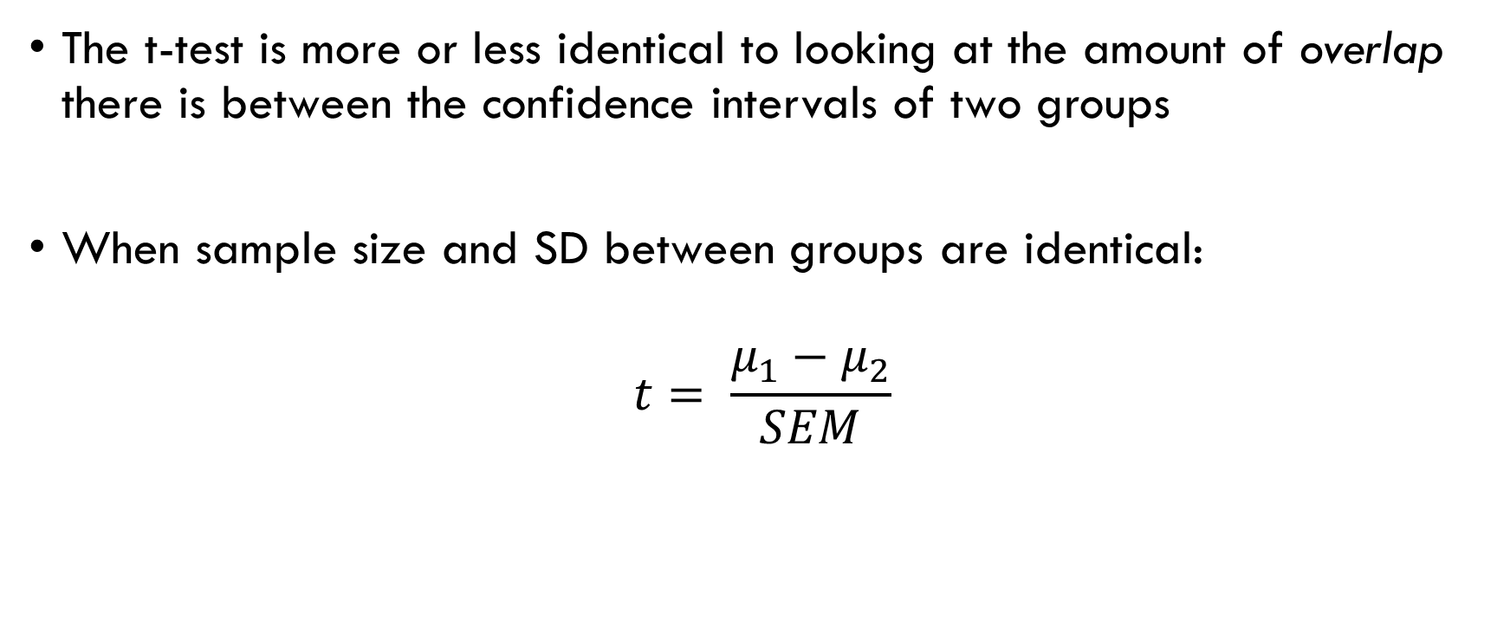
The T-Test
The t-test is more or less identical to looking at the amount of overlap there is between the confidence intervals of two groups
When sample size and SD between groups are identical:
$$t= \frac{μ_{1}−μ_{2}}{SEM}$$

Slide 26
The T-Test
Now, we need some way to compute ‘statistical significance’
With a threshold of .05, we essentially want to see if our t value is outside the 95% confidence interval of the mean difference
We do this by finding the probability of our t value on the t distribution with n-1 degrees of freedom

Slide 27
What is the t distribution?... It’s just a sampling distribution over an expected mean difference of 0 (null hypothesis), with sample size n-1
Now, we just find out whether our t value falls outside of the middle 95% of the data → if so, it’s very unlikely we would observe our results given H0

Slide 28
T Distribution and CIs
Confidence intervals are also based on the t distribution
μ ± multiplier*SEM = 95% confidence interval (CI)
Multiplier = t value corresponding to the p = .05 threshold
This is why plotting 95% CIs is important in publications – you can do a “quick and dirty” t-test by just looking at CI overlap

Slide 29
Statistical Models

Slide 30
What is linear regression?
Generalization of a t-test!
Instead of estimating a mean difference between two groups, we’re estimating the slope of how a mean changes across many possible values of a variable
But, the model is still the same:
Obtain estimate of relationship
Estimate uncertainty about that relationship
Compare to statistical significance threshold (we will even do this using the t distribution still!)

Slide 31

Linear regression
y = mx + b
Format used in Gelman & Hill (and typical elsewhere):
$$y= α+βx$$

Slide 32
Simple case: t-test
Let’s say I am comparing two groups, A and B. Think of A being a value of “0” and B being a value of “1”:
0 1

Slide 33
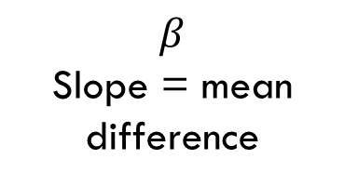
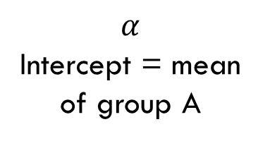
Simple case: t-test
Let’s say I am comparing two groups, A and B. Think of A being a value of “0” and B being a value of “1”:
$$β$$
Slope = mean difference
$$α$$
Intercept = mean of group A
0 1

Slide 34
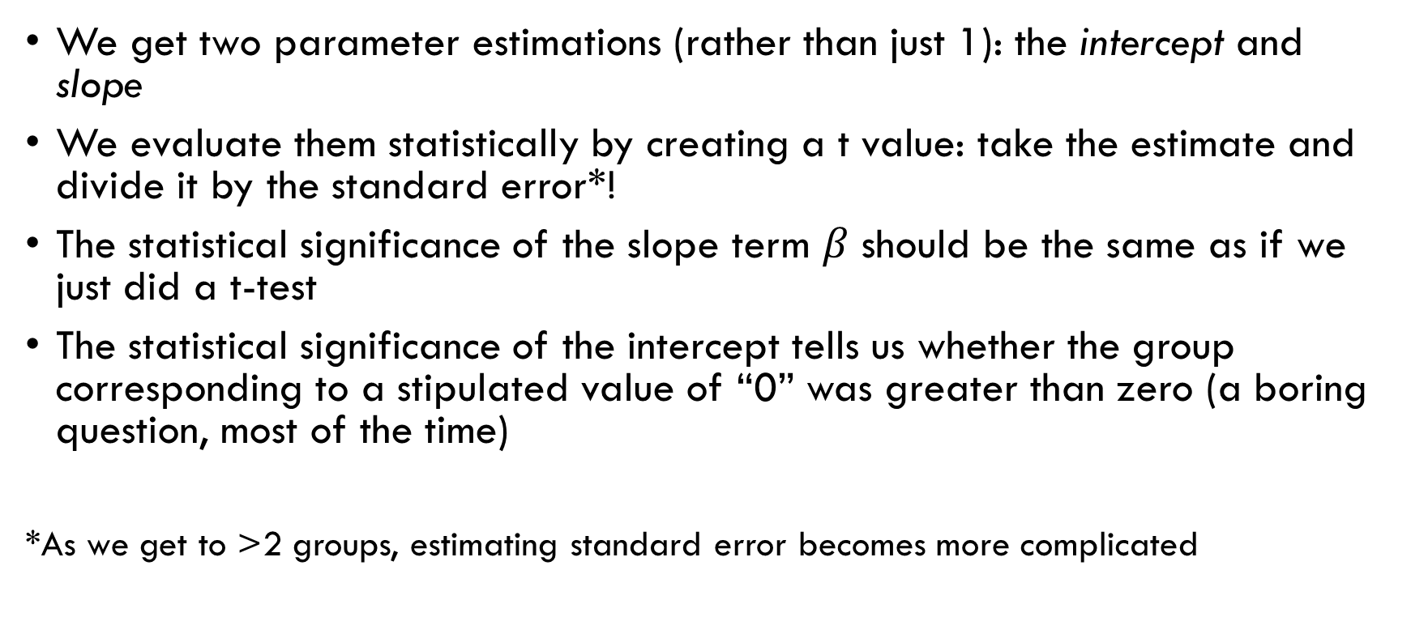
T-test in linear regression
We get two parameter estimations (rather than just 1): the intercept and slope
We evaluate them statistically by creating a t value: take the estimate and divide it by the standard error*!
The statistical significance of the slope term $β$ should be the same as if we just did a t-test
The statistical significance of the intercept tells us whether the group corresponding to a stipulated value of “0” was greater than zero (a boring question, most of the time)
*As we get to >2 groups, estimating standard error becomes more complicated

Slide 35

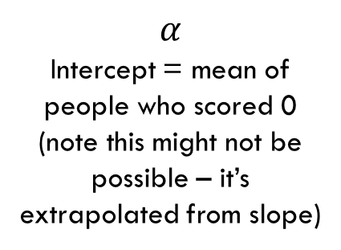
Linear regression w/ continuous IV
Exact same idea – the only difference here is that our standard error estimation is somewhat more complicated since we have many (potentially unbalanced) groups
$$α$$
Intercept = mean of people who scored 0 (note this might not be possible – it’s extrapolated from slope)
$$β$$
Slope
0 5 10 15 20 25
extroversion survey score

Slide 36
Major Issue with Regression (and t-tests/ANOVAs)
Difficult to account for sources of systematic variance
Subjects
Experimental items
…
Multi-level models can help by making ‘sub-level’ slope estimates for each of these grouping factors that affect the overall estimate of the slope

Slide 37
What will we learn in this “class”?
Linear regression
Incl. special topics like variable coding (scaling & centering IVs, how to numerically code categorical IVs for interpretable intercepts/slopes, etc.)
Logistic regression (for binary dependent variables)
Multi-level/mixed-effects regression
Structural Equation Modeling
Relationship between mixed-effects models and more familiar techniques like repeated-measures ANOVA
Plus, how to do all this stuff in R!

