Slide 1
Programming Languages 101

Slide 2
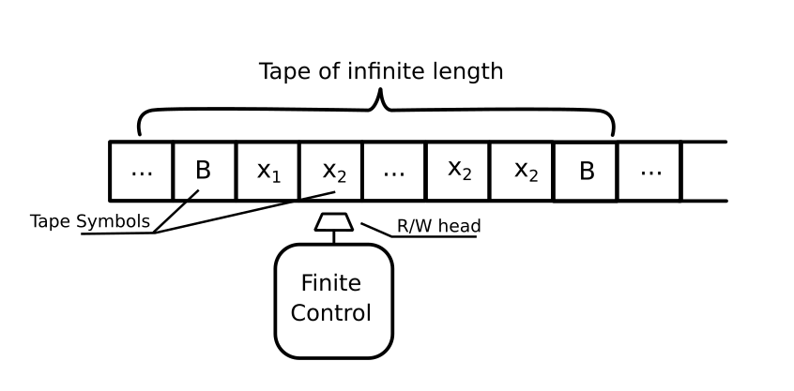
Turing Machine

Slide 3
Turing-completeness
If a system can complete any possible computation, is is Turing-complete
Most programming languages are Turing-complete
Many GUI-style (graphical user interface) statistical packages are NOT Turing-complete, including SPSS & SAS → less flexibility & power

Slide 4

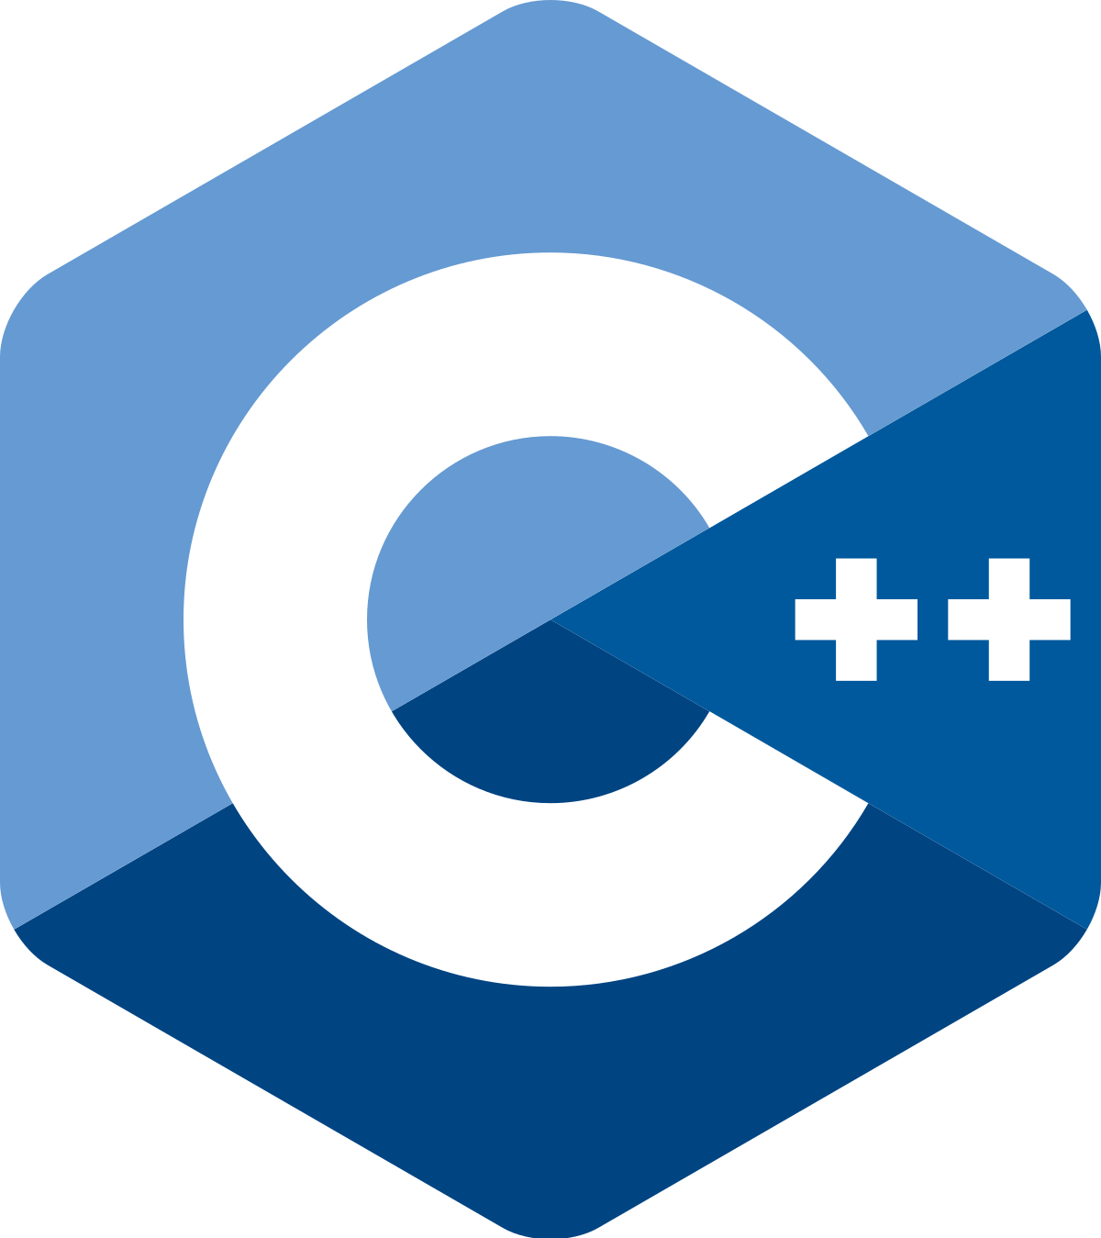



Commonly used statistical programming languages
C, C++, C#
harder to learn

Slide 5
Types of Programming Languages
Compilation style
Compiled languages are converted directly into machine code that can be run by the computer
Pros: Fast, efficient, high level of control by end user
Cons: Every time you make a change you need to re-compile
Interpreted languages are ‘translated’ on the fly
Pros: Easier & faster to change the code
Cons: Doesn’t run as fast

Slide 6
Types of Programming Languages
Programming paradigm (there are many)
Object-oriented
Classes rule all
Variables are instances of classes, which determine what kinds of functions can be done to them
Each line of code is an “imperative” statement updating the running state of the program
Functional
Functions rule all
Each line of code is a “declarative” statement using functions to map values to other values
Generally easier to learn than OO, but some are really hardcore

Slide 7
Types of Programming Languages
Sourcing
Open-source: Source code is freely available to all
Closed-source: Source code is privately held by an owner
Open source also has the advantage that end users can create and share their own add-ons in the form of packages and libraries

Slide 8
Compiled
Object-oriented
Functional
Interpreted

