Slide 1

DESIGN OF NEXT GENERATION eVTOL BATTERIES Monthly meeting No 4 Matthew Mench, Tom Zowadzinski (mmench@utk.edu) July 20, 2022 Gabriel Goenaga, Ramez Elgammal, Shane Foister, Brian Washington, Colt Griffith, Yuanshun Li, Doug Aaron, Bapi Bera, Manikandan Palanisamy, Kaycee Gass, Anirban Roy, Albina Jetybayeva Sponsor: AFC/DEVCOM Army Research Laboratory Program Manager: Mike Kweon 8/17/22

Slide 2
Overall Project Objectives
Develop comprehensive battery development, manufacturing, testing and evaluation ecosystem within UTK and ORNL focused on eVTOL applications.
Develop BOL and degradation performance metrics and T&E protocol specific to eVTOL applications.
Develop and evaluate Li-ion batteries designed for eVTOL applications and manufactured at ORNL battery manufacturing facility (BMF).
Design and evaluate Al-air and all solid-state battery systems for eVTOL applications.
Use knowledge gained from characterization, modeling and T&E to develop high-rate, energy dense batteries that can meet or exceed requirements for eVTOL applications.
Still awaiting major equipment including ARC, e-SEM, and coin cell testing devices expected to be in house by October. Equipment setup/movement and calibration is underway as they come in.

Slide 3
Overall Project Objectives
Develop comprehensive battery development, manufacturing, testing and evaluation ecosystem within UTK and ORNL focused on eVTOL applications.
Develop BOL and degradation performance metrics and T&E protocol specific to eVTOL applications.
Develop and evaluate Li-ion batteries designed for eVTOL applications and manufactured at ORNL battery manufacturing facility (BMF).
Design and evaluate Al-air and all solid-state battery systems for eVTOL applications.
Use knowledge gained from characterization, modeling and T&E to develop high-rate, energy dense batteries that can meet or exceed requirements for eVTOL applications.
Collaborate with ARL and other partners throughout to transition results and publish fundamental results
1st Direct meeting will Bell last week, great exchange
UTK/ORNL team meeting next week
Will be including ARL in internal team technical meetings.

Slide 4
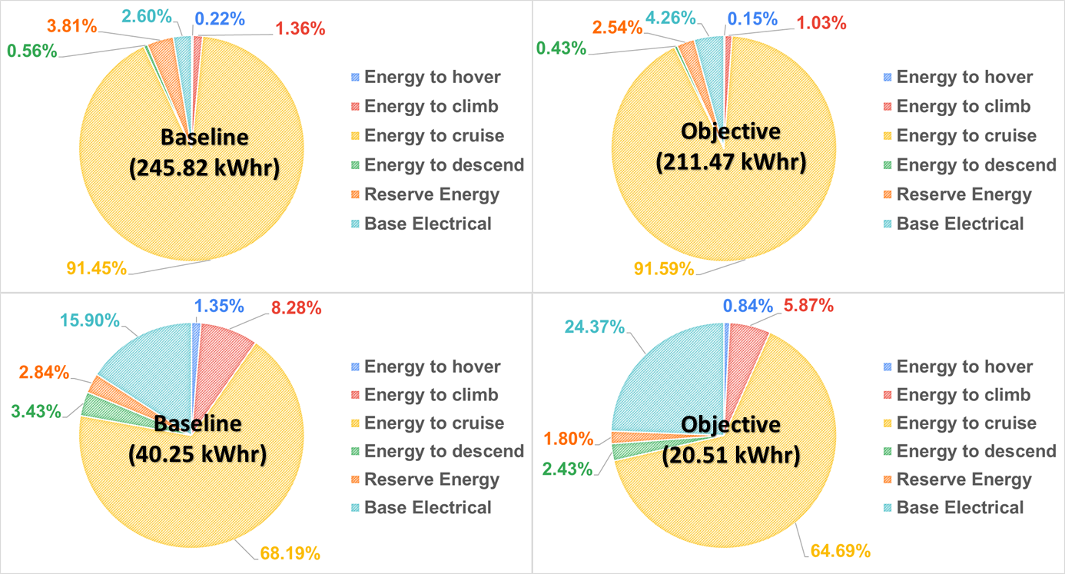
Updated Battery Requirements from Bell
Battery system used for assisted take-off to winged flight and hover only (60 second bursts at high power). Combustion engine always on, providing “cruise power” at all times.
400 V motor systems (in design stage), requires in-series design. Lower voltage motors could allow parallelization of configuration for more robust design.
High power battery systems with long cycle life needed for this application.
From last time for winged aircraft:
Total energy required for TO-hover is very low

Slide 5
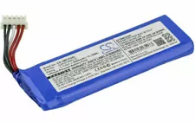
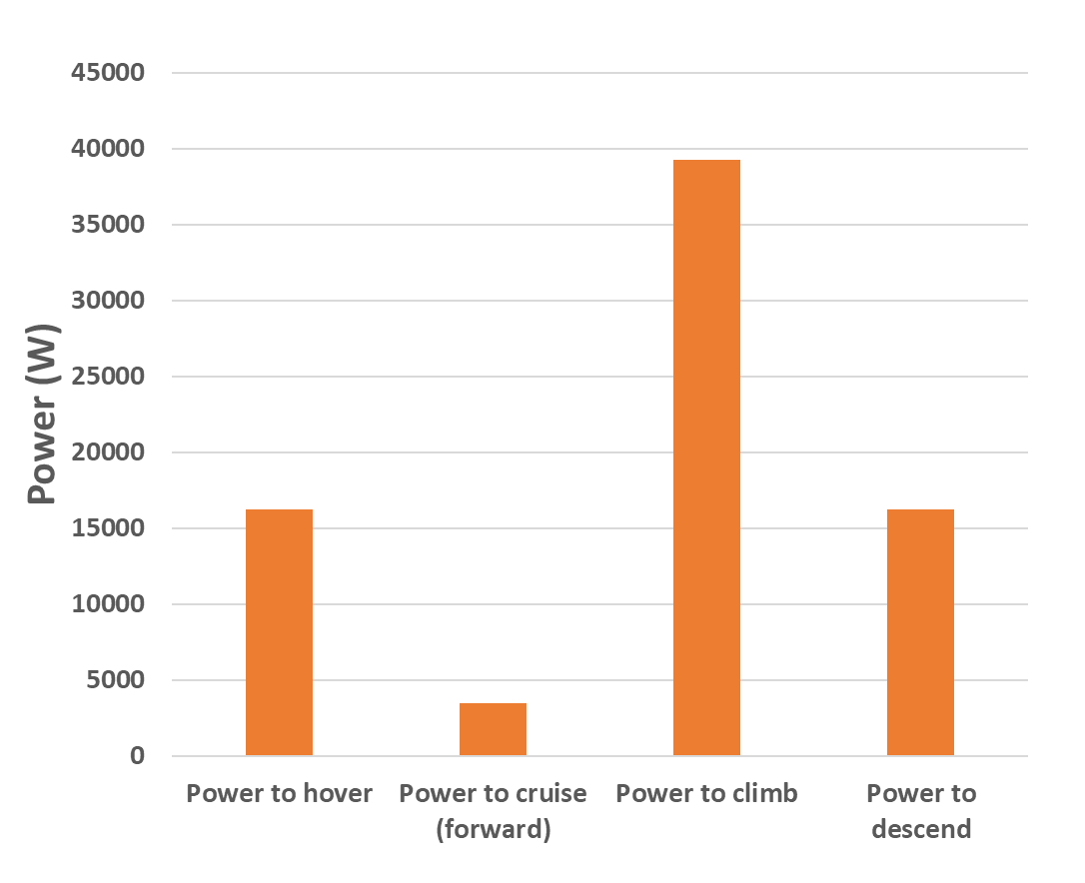
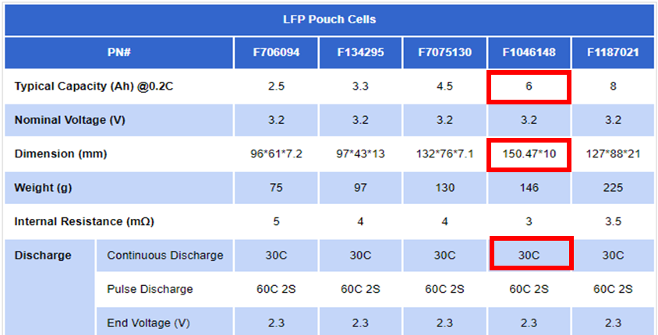
Using Updated Battery Requirements from Bell
 | Baseline |  | Objective
Mission profile | Value | Units | Value | Units
Hover Time | 1.00 | [min] | 1.00 | [min]
Climb time | 8.83 | [min] | 8.83 | [min]
Cruise Time | 480 | [min] | 720 | [min]
Descent Time | 8.83 | [min] | 8.83 | [min]
Hover Time | 1.00 | [min] | 1.00 | [min]
Reserve | 20.0 | [min] | 20.0 | [min]
Total Battery capacity required: 35.81kW x (2/60)hr = 1.19 kWh
Assuming a nominal voltage of 3.6V, total Li-ion battery capacity = 331.6 Ah
Commercial Li-ion energy density = ~250 Wh/kg
Minimum estimated weight of battery pack = 4.7 kg (not incl. BMS/TMS)
Available battery mass (10% of MTOM via Bell) = 11.3kg
Assume System voltage = 400V # of cells in series = 400/3.6 = 112
Minimum cell capacity = 331.6/112 = 3Ah
(~35.81kW)
Power to be supplied by Battery pack
Total current supplied by Battery pack = 35.81kW/400V= 89.53 A
If each cell is 3Ahr, C-Rate would be = ~30C
This off-the-shelf battery combination has too much total energy and low C rate, so would be >16kg

Slide 6
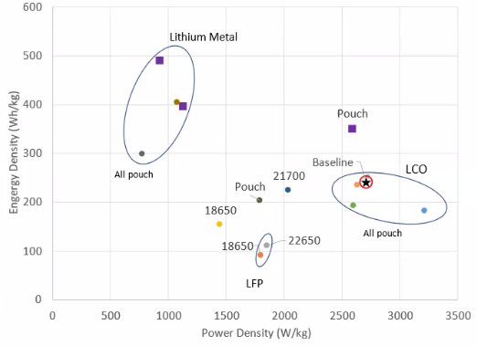
Design Options: Via Bell – for hybrid design we need the power density most.
Hybrid design with batteries or engine
3kW/kg batteries in design.
Hybrid electric now: High power needed for takeoff/hover/land from power batteries, with conventional engine and fuel for cruise/recharge.
All-electric hybrid future: Higher power batteries for take-off/land, higher energy density batteries for cruise.
Current Li-ion or LiPo batteries can meet energy and power requirements for Bell, but not enough cycle life.
Ideal battery for this application has 60C discharge capability and just enough total energy for take-off/hover to winged flight.
Future use of all-electric for mission requires enhanced energy density.
High power class for takeoff/hover/land

Slide 7
August 2022 Summary
LiPo battery of power lithium batteries can be used in Bell application but will not have desired cycle life, and off-the-shelf variety will include extra weight. Ideal battery for this application can discharge at 60C and has just enough energy required for hover to winged flight with long cycle life.
Solid state lithium battery research summary and path forward was presented.
Approach to create high voltage lithium-ion batteries with high discharge rate capability and enhanced cycle life with cobalt free cathode was presented.
Next month we will present summary of path forward on metal-air batteries.

