Slide 1
Program
Electrolyzer
Goal
Investigations into mass transport characteristics of cells
Milestone
Last week | This week | Next week
Moved work to ISAAC Account | Learned ISAAC batch submissions using SLURM Began running LBM Palabos simulations with ISAAC Paraview to process .vti files | More Simulations and Data Processing
Achievements
and Learning
(current week)
Learning SLURM batch submissions and lightening up the repository with .gitignore due to disc space quotas Learned Paraview image processing
Plan
Next Week
Run more Palabos models on ISAAC with differing parameters Process .vti files for Anirban/Frida with Paraview
Issues and
New Ideas
ISAAC accounts come with disc space quotas per account. To avoid reaching these quotas we will have to manage our output file generation

Slide 2
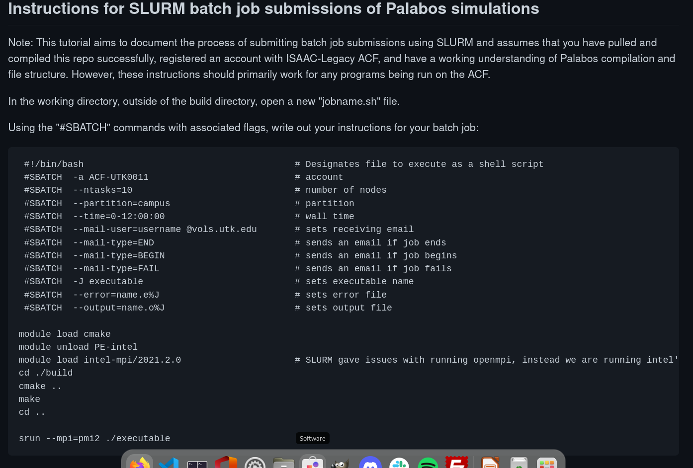
ISAAC and SLURM
Previously, ISAAC used PBS to manage batch submissions, but has recently transitioned to SLURM

Slide 3
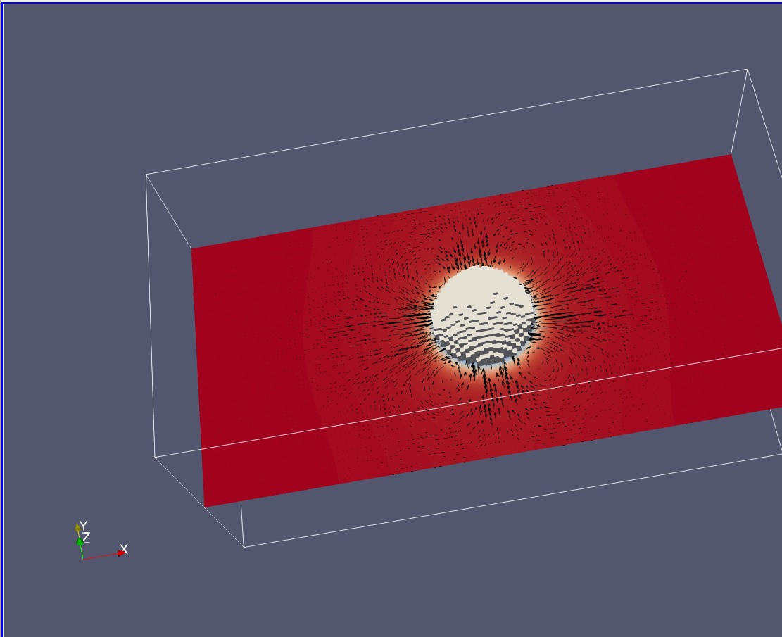
Paraview .vti analysis

Slide 4
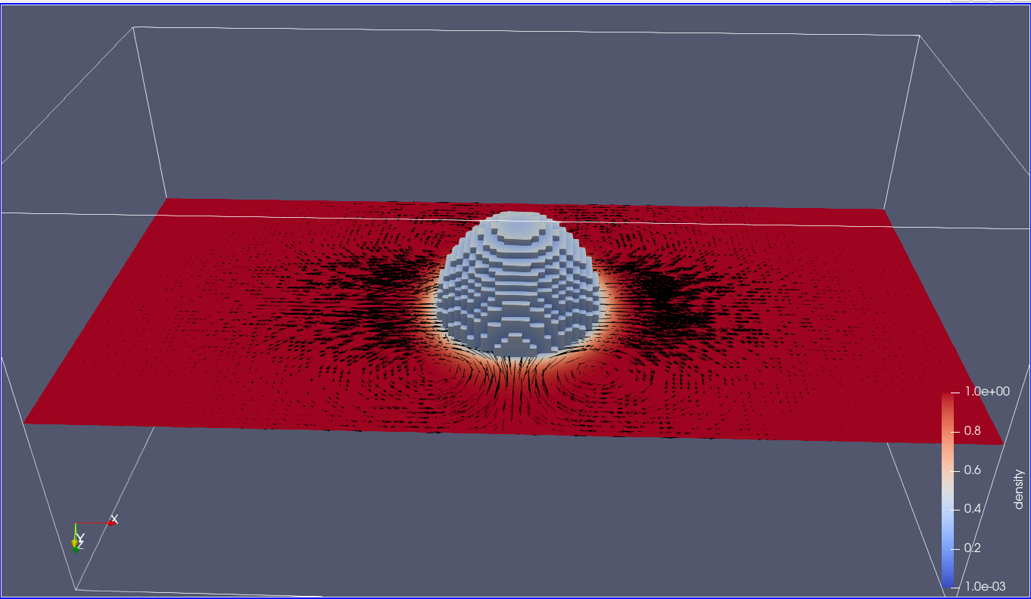
Paraview .vti analysis

