Slide 1
Program
Electrolyzer
Goal
Investigations into mass transport characteristics of cells
Milestone
Last week | This week | Next week
Ran low resolution colliding bubble simulations on ISAAC | Running high resolution colliding bubble simulations Processed finished batch jobs | More simulations and data processing of high resolution simulations for colliding bubble Hopefully begin on Anirban’s moving bubble code
Achievements
and Learning
(current week)
Ran low resolution colliding bubble simulations: - Low res has constant volume throughout runtime Began high resolution simulations: - High resolution simulations come with more limitations to memory, runtime and node privileges - High resolution does not hold constant volume throughout runtime Continue High resolution simulations and process with Paraview For dense simulations, it takes many days to process many jobs due to the limitations to nodes and wall time with ISAAC, with a dedicated condo we could process simulations faster with higher resolutions and longer walltime.
Plan
Next Week
Issues and
New Ideas

Slide 2
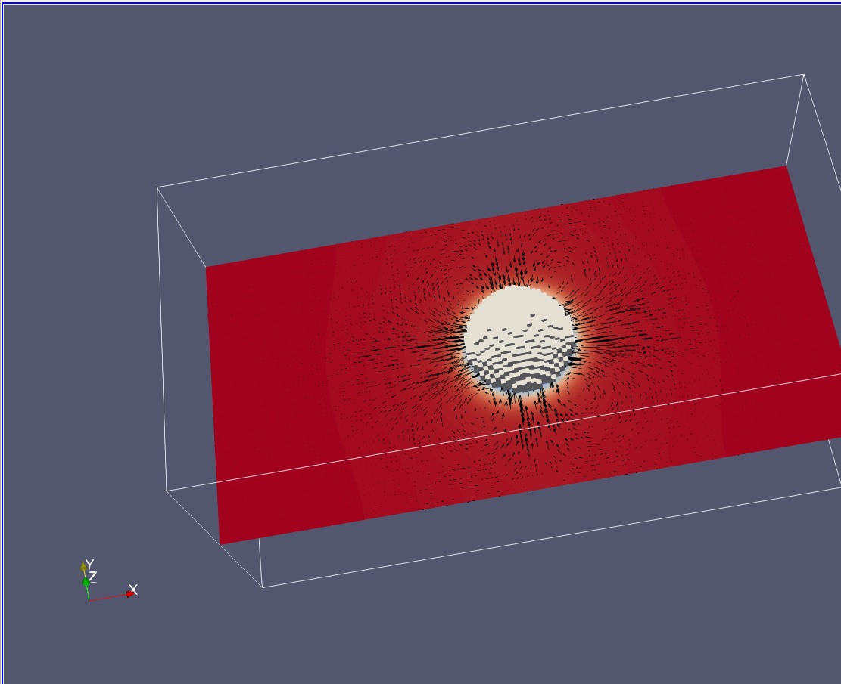
Low resolution simulations have constant volume throughout runtime
Results:
Res: | Radius: | 1e-5 | 1e-3
64 | 16 | .246-.246 | .246-.246
 | 8 | failed | .246-.246
256 | 64 | .24902
 | 32 | .00067-.000665 | .24902

Slide 3
High resolution simulations have limitations
High resolution simulations must be run individually:
- SLURM job submissions have limits to individual node designations and tasks.
- High resolution simulations have a difficult job finishing all timesteps within 24 hours. To mitigate these issues try:
Only running one simulation at a time
Limiting output files
Decreasing time steps

