Slide 1
iPET: Privacy Enhancing Traffic Perturbations for Secure IoT Communications By: Akshaye Shenoi, Prasanna Karthik Vairam, Kanav Sabharwal, et. al.
Presentation By:
Will Buziak Department of Computer Science Colorado School of Mines
CSCI 598-B November 7, 2024

Slide 2
Background
Number of IoT devices projected to be over 41 billion worldwide by 2027
Tracking and sharing personal data in all aspects of life:
Health & Wellness
Sports/Hobbies
Smart Home automation
As such, the opportunity for network attacks on user privacy has also seen exponential growth

Slide 3





Device Fingerprinting
An attacker can use Machine Learning to identify devices based on communication patterns, even when encrypted
Begging the question: How can we protect against such attacks?
clipartbest.com
macrumors.com supplychainbeyond.com
vecteezy.com
clipart-library.com

Slide 4

Device Fingerprinting
An attacker can use Machine Learning to identify devices based on communication patterns, even when encrypted
Begging the question: How can we protect against such attacks?
clipartbest.com
macrumors.com supplychainbeyond.com
vecteezy.com
clipart-library.com

Slide 5
Device Fingerprinting Protection
The natural inclination is to pad the network traffic to make it unrecognizable to ML models, such methods are either:
Ineffective at obscuring the device fingerprint
or
Require a high network bandwidth
Researchers have shown that adversarial perturbations can effectively deceive trained identification models, but similarly susceptible to challenges

Slide 6
Device Fingerprinting Protection
The natural inclination is to pad the network traffic to make it unrecognizable to ML models, such methods are either:
Ineffective at obscuring the device fingerprint
or
Require a high network bandwidth
Researchers have shown that adversarial perturbations can effectively deceive trained identification models, but similarly susceptible to challenges
small

Slide 7
Fight Fire with Fire
clipartbest.com
macrumors.com supplychainbeyond.com
vecteezy.com
clipart-library.com

Slide 8
Adversarial Training
iPET employs an adversarial ML model to provide network perturbations while addressing previous networking concerns
Independent of network traffic of communicating devices, effectively lowering the network latency
Allows users to choose the maximum acceptable bandwidth
Goal: Conceal device fingerprints against a group of trained ML models

Slide 9
Adversarial Training
Stochasticity
iPET employs an adversarial ML model to provide network perturbations while addressing previous networking concerns
Independent of network traffic of communicating devices, effectively lowering the network latency
Allows users to choose the maximum acceptable bandwidth
defensive
Goal: Conceal device fingerprints against a group of trained ML models

Slide 10
Attacker: Goals & Capabilities
We assume the attacker can control of any device inbetween the user gateway and the servers
As such, the attacker can see any incoming or outgoing traffic
“Passive Attacker” trying to breach user privacy
Knowledge of any device the user has access to
supplychainbeyond.com
vecteezy.com

Slide 11

Attacker: Goals & Capabilities
We assume the attacker can control any device inbetween the user gateway and the servers
As such, the attacker can see any incoming or outgoing traffic
“Passive Attacker” trying to breach user privacy
Knowledge of any device the user has access to
clipartbest.com
macrumors.com supplychainbeyond.com
vecteezy.com windowsreport.com

Slide 12
Attacker: Generating the model
An attacker can train an ML model to classify devices easily, one must simply:
Purchase an IoT Device
Generate network traffic
Label the data for feature training
Train a device fingerprinting model

Slide 13
Classifier Models
This paper defines two classes of fingerprinting models:
Magg - Model Based of Feature Aggregates
Mseq – Sequence Based Device Classifier

Slide 14
Classifier Models
This paper defines two classes of fingerprinting models:
Magg
Number of Packets (mean, min, max & sum)
Packet Lengths
Header Metadata
Mseq
Length of Packets
Time in-between

Slide 15
Classifier Models
This paper defines two classes of fingerprinting models:
Magg – Size-Based Classification
Number of Packets (mean, min, max & sum)
Packet Lengths
Header Metadata
Mseq – Time-Based Classification
Length of Packets
Time in-between sessions

Slide 16
The iPET Method
Consists of a Perturber & an Extractor:
Perturber creates noise in the traffic:
Dummy packets
Extra bytes to the packet
Small delays
Extractor removes the noise

Slide 17
Defense Against iPET
Progressive models defend against retraining, or employing iPET as an attack
iPET-Basic: Causes misclassification
iPET-Advanced: Utilizes stochasticity & enhances between sessions
Resilient against an attacker that has knowledge of the defense parameters & architecture

Slide 18
Performance Evaluation
Experiment on UNSW Smart Home Traffic Dataset
30 devices over 20 days
Objective is to minimize the accuracy of several device fingerprinting models
Effectiveness against attacker
Comparison with other traffic obfuscation techniques
How does iPET performance compare for different IoT devices

Slide 19
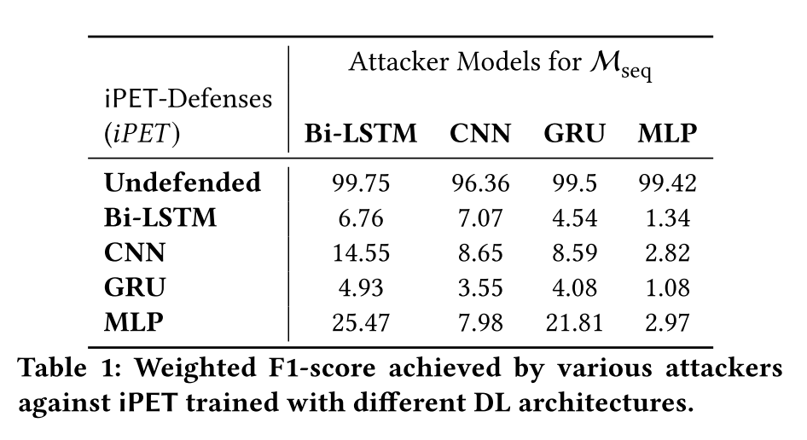
iPET vs. Attacker
iPET demonstrates it’s effectiveness of the defensive strategy against different deep-learning based fingerprinting methods

Slide 20
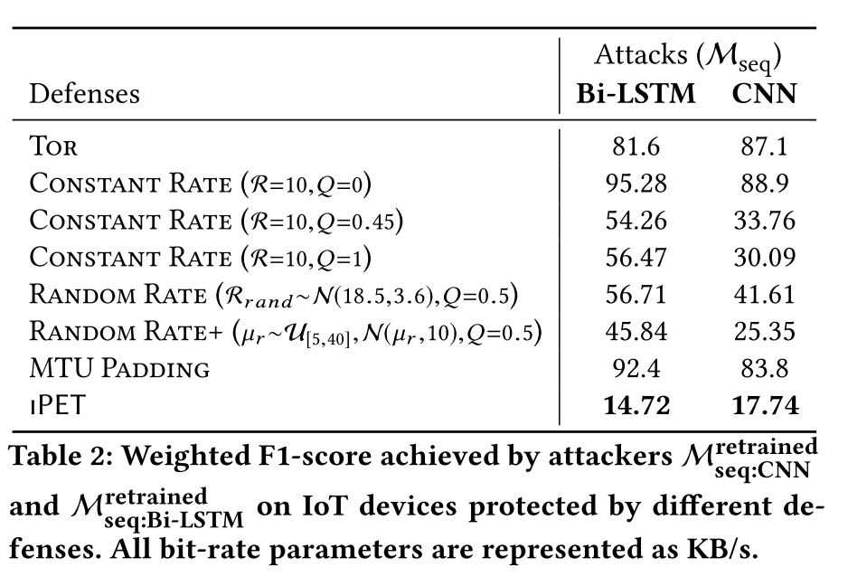
iPET vs. The Competition
Constant Rate: Dummy Packets inserted to maintain a constant bit rate
Random Rate: Randomized bit rate that is constantly resampled
Rate+ introduces a random mean to the distribution
MTU Padding: Pads every packet to the maximum transmission size

Slide 21
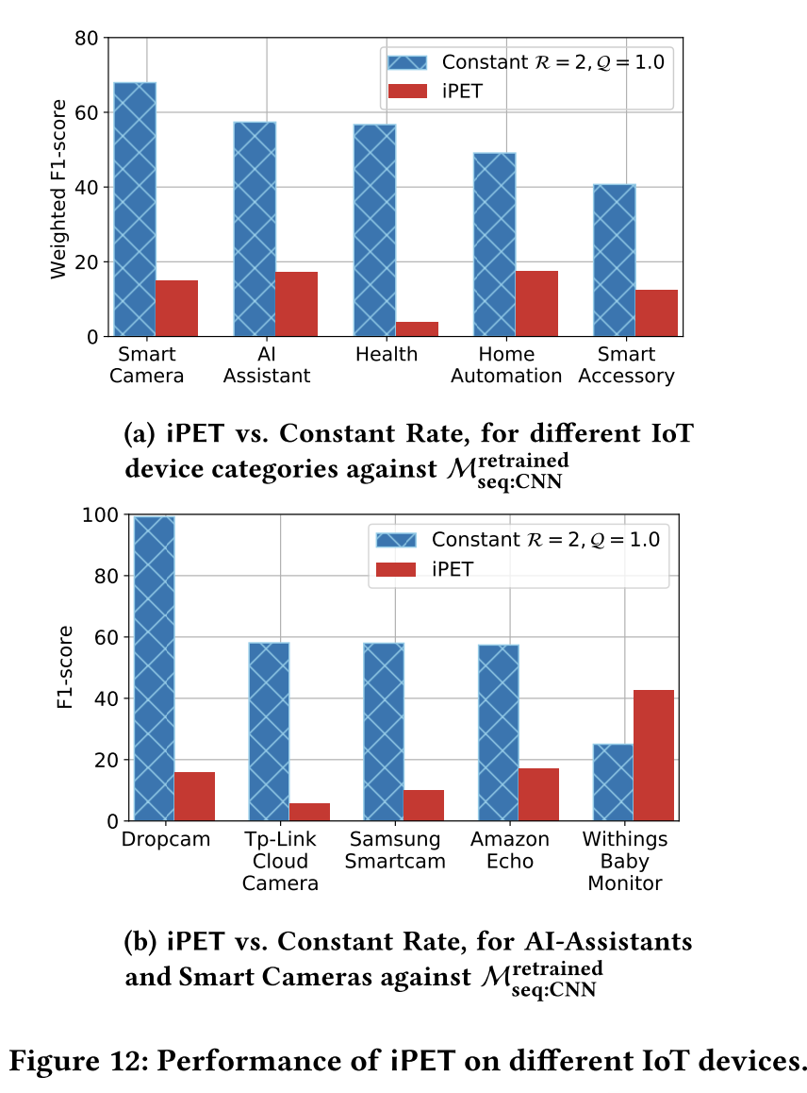
iPET Comparison for Different IoT Devices
Figure A demonstrates the effectiveness for different categories of IoT devices
Figure B investigates devices among the worst performing categories

Slide 22
iPET-Basic vs. iPET-Advanced
In addition to the real world dataset, a synthetic dataset was tested:
50 different devices with 50,000 samples
Sourced from a Gaussian Mixture Model composed of five different Gaussian distributions
Even against the most powerful attack model, iPET achieves a low identification rate

Slide 23
Deployment Options
Implementing iPET in the real world requires implementation on both the gateway and server-side
Options for users are, effectively:
Rely on third-party vendors such as the ISP to implement iPET
or
Use iPET as a Tor plug-in
clipartbest.com
windowsreport.com

Slide 24
Limitations
Constraints on IoT devices make running ML models infeasible
iPET defends against device fingerprinting, but not web traffic or other activity
This work does not consider packet delays

Slide 25
Conclusions
iPET demonstrates it’s effectiveness in hiding device traffic from fingerprinting attacks by training an ML model to randomly insert traffic as:
Dummy packets
Injected bytes
Drastically reduces the accuracy of fingerprinting attacks, including an attack model in which the adversary has complete knowledge of the defense model

Slide 26

Thoughts
Is this method really that different from standard traffic padding?
Machine Learning

Slide 27
Sources
[1] Akshaye Senoi, Prasanna Karthik Vairam, Kanav Sabharwal, Jialin Li and Dinil Mon Divakaran (2023) iPET: Privacy Enhancing Traffic Perturbations for Secure IoT Communications. In: Proceedings on Privacy Enhancing Technologies.

