Slide 1
Phantom: Exploiting Decoder-detectable Mispredictions By: Johannes Wikner, Daniël Trujillo and Kaveh Razavi
Presentation By:
Will Buziak Department of Computer Science Colorado School of Mines
January 31, 2025

Slide 2
Background
The Branch Prediction Unit (BPU) provides a prediction of the upcoming control flow by:
Storing recent control-flows in Branch History Buffers (BHBs)
Holding predictions, indexed by BHBs, in Branch Target Buffers (BTBs)
BPU
IF
ID
EX
Retire
Time

Slide 3
Branch Prediction
Mispredicted instructions are processed in the pipeline until a resteer signal is provided – known as the speculation window
This is the mechanism exploited by Spectre
BPU
IF
ID
EX
Retire
Mispredicted Target
Resteer
Speculation Window

Slide 4
Spectre
Abuses speculative execution to perform mispredicted operations and leak victim’s information via side-channels
Circumvents numerous security countermeasures
Phantom proposes a new Spectre class that considers shorter speculation windows
Resteer is issued before instruction reaches execute stage

Slide 5
Phantom
Cases where training and victim branch sources are different are commonly considered non-exploitable
Instruction mismatches can be discovered at decode and resteered before execution
Previously believed to result in too short of a speculation window
Asymmetric cases have been proven to also lead to long speculation windows
Phantom provides a methodology for user-to-kernel exploitation on shorter speculation windows

Slide 6
Phantom Contributions
Provides tools for measuring transient fetch and decode of mispredicted targets
Analysis of mispredictions and how far instructions get in the pipeline
Presents the Phantom class of attacks
Proves ability to break KASLR and leak arbitrary kernel memory

Slide 7
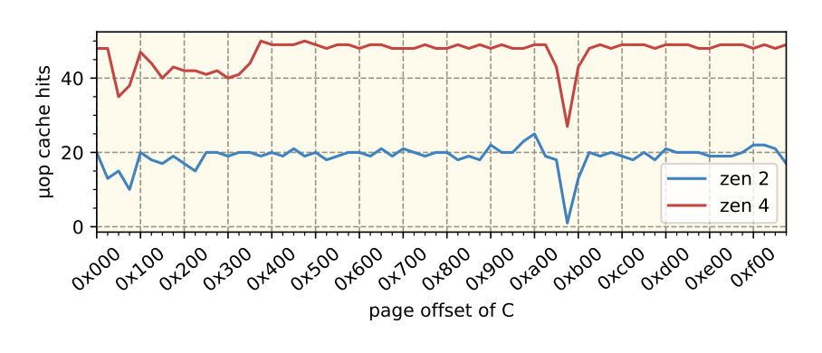
Observing Mispredictions
Instruction Fetch (IF): Measure the I-cache state using a timing side-channel
Not effective for distinguishing IF from BPU-assisted I-cache prefetching
Instruction Decode (ID): Samples performance counters indicating µop-cache use
Less reliable on Intel architectures than on AMD
Execute (EX): Detects execution by using a single memory fetch in the mispredicted path
Due to shorter speculation, resteer is issued before memory operations can be performed
Table 2, Pg. 6

Slide 8
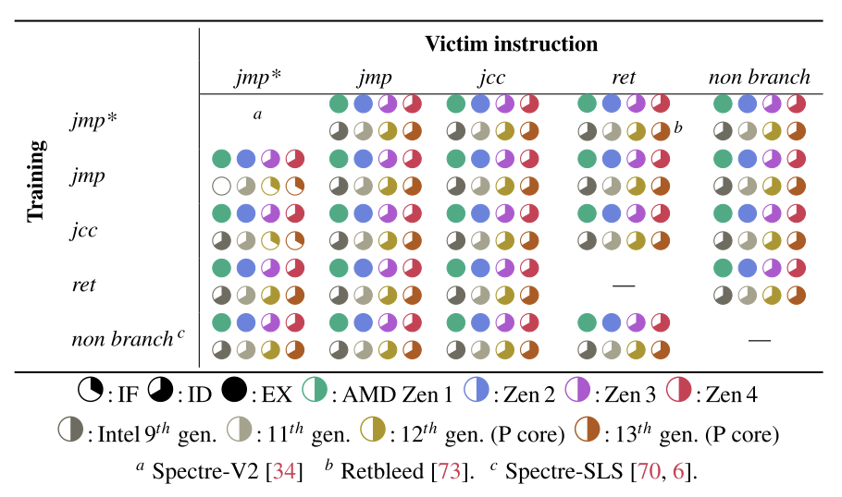
Branch Mispredictions
Phantom uses a training and victim branch to cause mispredictions
Study of instruction combinations causing mispredictions
How far in the pipeline mispredictions get before a resteer
Table 1, Pg. 6

Slide 9
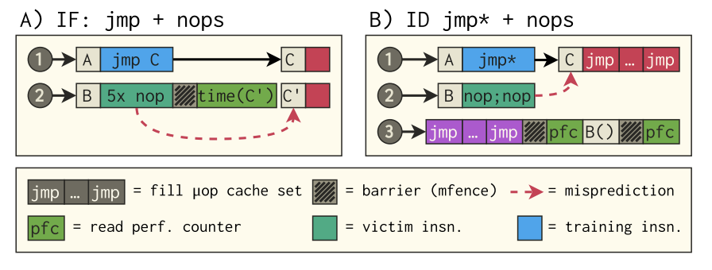
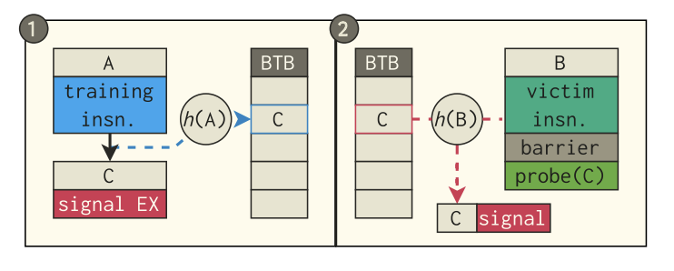
Phantom
Phantom speculation attacks are broken down into three steps:
Train the BTB to a target
Execute the victim
Infer whether the target was loaded from memory (can use Prime+Probe)
Figure 4, Pg. 5
Figure 5, Pg. 5

Slide 10
Phantom Attack Primitives
Detecting mapped executable memory
Fetch only populated I-cache if executable and backed by physical memory
Non-mapped executable memory
Failed fetch leaves I-cache unaffected
Adversary can trigger a data load
Requires a disclosure gadget
Leaking register values
Filters a single byte from the register and aligns with the cache-line
Creates an offset into victim’s address space and loads resulting address
(AMD Zen 1 & 2 only)

Slide 11
Kernel Address Collision
text

Slide 12
Breaking KASLR
text

Slide 13
Mitigation
text

Slide 14
Conclusions
text

Slide 15
Strengths
Digestible
Relevant (affects billions of users)
Methodology is affective

Slide 16
Weaknesses
Very little proposed solution
Could provide more well-rounded information on how some structures work or their impact
Presentation of results is somewhat confusing (time to decode)

Slide 17
Thoughts
text?

Slide 18
Sources
[1] Akshaye Senoi, Prasanna Karthik Vairam, Kanav Sabharwal, Jialin Li and Dinil Mon Divakaran (2023) iPET: Privacy Enhancing Traffic Perturbations for Secure IoT Communications. In: Proceedings on Privacy Enhancing Technologies.

