Slide 1
Secure Extensions for RISC-V Trusted Execution Environments
Presentation By:
Will Buziak Department of Computer Science Colorado School of Mines
March 30, 2025

Slide 2
Background
Motivated attackers can employ many tactics to corrupt or steal data, this work focuses on preventing:
A malicious OS, application or thread from accessing protected memory
Replay or side-channel attacks targeting off-chip peripherals
Trusted Execution Environments (TEEs) provide hardware guarantees that secure the integrity of the processor
Secure Memory methods protect against off-chip tampering by encrypting and verifying the integrity of memory accesses

Slide 3
Motivation
RISC-V TEEs (e. g. Keystone^{[1]}) provide an open-source, configurable platform for developing TEEs to specific applications
Researching TEEs is non-trivial, in part due to a required baseline expertise in the development medium, primarily:
FPGA
Simulation
Goal: Provide Secure Memory Extensions for TEEs and a methodology for developing TEEs in simulation

Slide 4
Progress To-Date
text

Slide 5
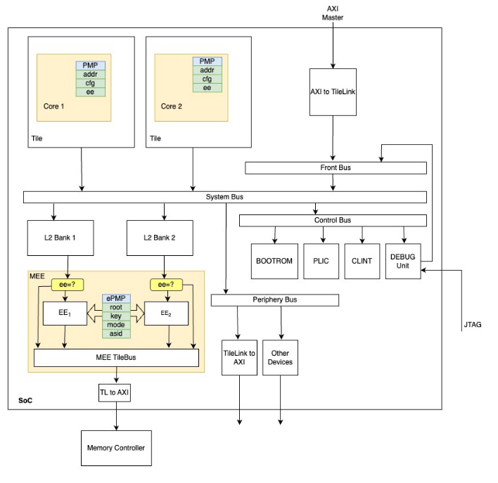
Direction / Future Work
Extending Keystone in gem5:
Simulating
Moolman, Z. & Lehman T.

Slide 6
Sources
[1] Dayeol Lee (2022) Building Trusted Execution Environments. In: A dissertation submitted in partial satisfaction of the requirements for the degree of Doctor of Philosophy in Computer Science in the Graduate Division of the University of California, Berkeley.
[2] Chenyu Yan, Brian Rogers, Daniel Englender, et. al. (2006) Improving Cost, Performance, and Security of Memory Encryption and Authentication. In: Proceedings of the 33rd International Symposium on Computer Architecture (ISCA’06)
[3] Brian Rogers & Milos Prvulovic (2007) Using address independent seed encryption and bonsai merkle trees to make secure processors OS-and performance-friendly. In: 40th IEEE/ACM International Symposium on Microarchitecture (MICRO’07)
[3] Zach Moolman & Tamara Silbergleit Lehman (2024) Extending RISC-V Keystone to Include Efficient Secure Memory

