Slide 1
Secure Extensions for RISC-V Trusted Execution Environments
Presentation By:
Will Buziak Department of Computer Science Colorado School of Mines
April 24, 2025

Slide 2
Motivation
State-of-the-art Trusted Execution Environments support secure memory protocols, but often do not use these methods due to lots of overhead
Researching TEEs requires baseline expertise in the development medium, typically:
FPGA
or
Simulation
Goal: Provide efficient secure memory extensions for TEEs and a methodology for developing TEEs in simulation

Slide 3
Brief Introduction to Trusted Execution
Trusted Execution Environments (TEEs) protect memory through hardware guarantees:
Memory isolation
Permission assignment
Root of trust & remote attestation
There are numerous “flavors” of TEE, produced both in academia and industry
TEEs
Proprietary
Open-Source
SGX
Keystone
TrustZone
Phantom
...
...

Slide 4
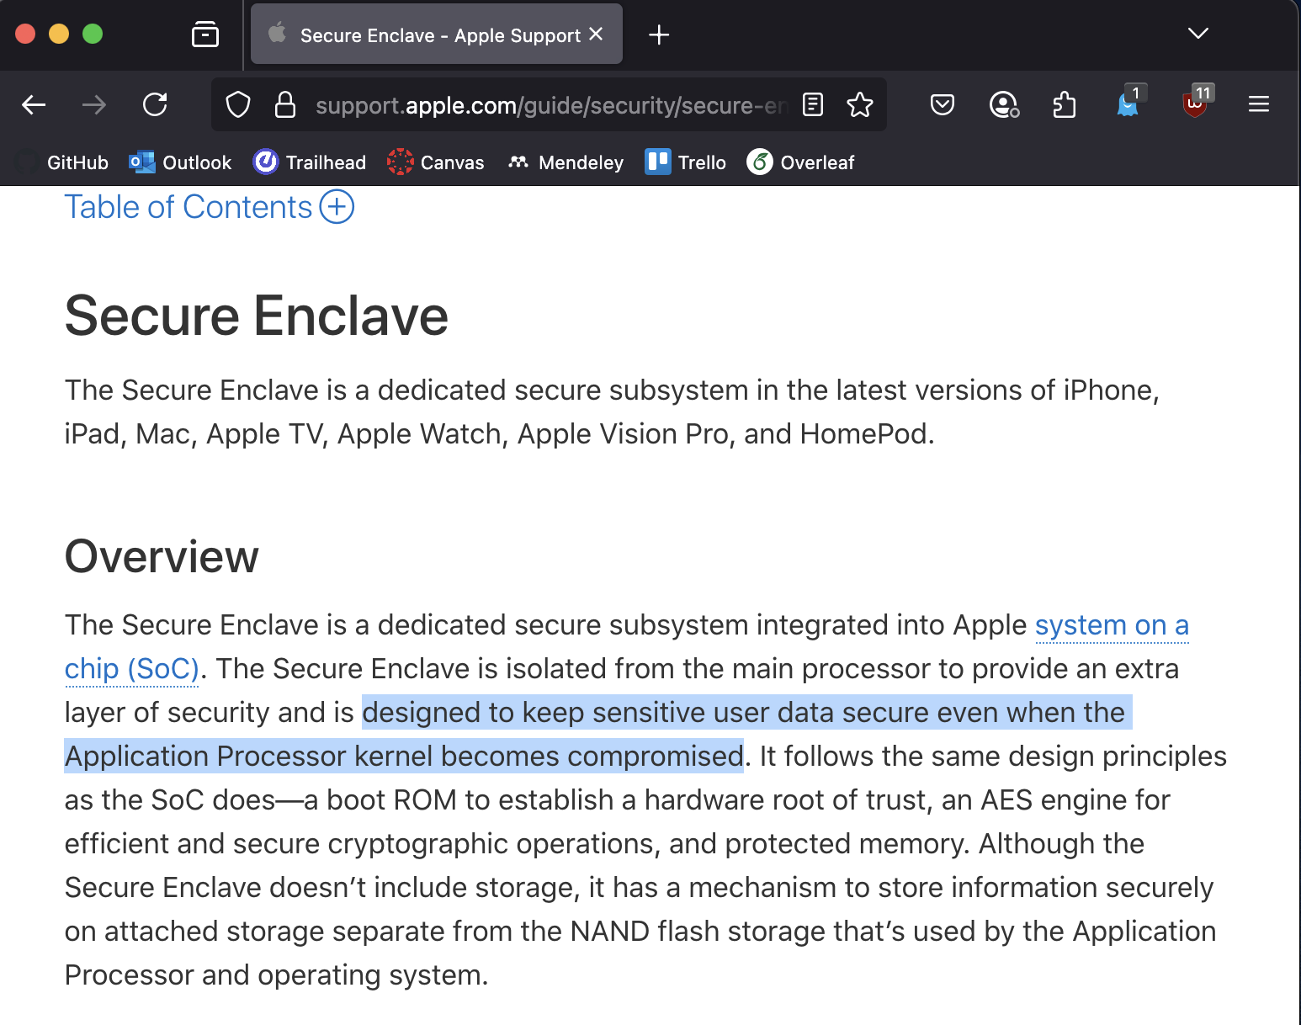
Brief Introduction to Trusted Execution
Trusted Execution Environments (TEEs) protect memory through hardware guarantees:
Memory isolation
Permission assignment
Root of trust & remote attestation
There are numerous “flavors” of TEE, produced both in academia and industry
TEEs
Proprietary
Open-Source
SGX
Keystone
TrustZone
Phantom
...
...

Slide 5
RISC-V Keystone
Keystone is a popular, open-source TEE, protecting against a malicious:
Operating system
User thread
Cloud or remote user
This is achieved by breaking down memory regions into three permissions, or modes
Untrusted
Enclave 1
Enclave 2
User
(U-Mode)
App
App
App
Eapp 1
Eapp 2
Supervisor
(S-Mode)
OS
Runtime
RT 2
Machine (M-Mode)
Security Monitor
Trusted Hardware
RISC-V Cores
Optional H/W Features
Root of Trust
Extension Targets
Untrusted
Enclave 1
Enclave 2
Dayeol Lee, David Kohlbrenner, Shweta Shinde, Krste Asanovic, and Dawn Song, Keystone: An Open Framework for Architecting Trusted Execution Environments, EuroSys 2020.
User
(U-Mode)
App
App
Enclave App 1 (Eapp)
Eapp 2
OS
Runtime (RT) 1
RT 2
Supervisor
(S-Mode)
Machine (M-Mode)
Security Monitor
Trusted Hardware
RISC-V Cores
Optional H/W Features
Root of Trust
Extension Framework

Slide 6
Keystone Limitations
Currently, Keystone only protects storage due to latency and memory overhead, our work focuses on addressing these concerns by:
Fortification of Keystone hardware with efficient secure memory methods to protect against off-chip corruption:
Implementing a hardware / software co-design, providing:
Modified / Extended Keystone hardware components
Performance improvements on Keystone security processes

Slide 7
Where does Secure Memory fit in?
Secure memory methods protect SoCs against off-chip memory corruption by additionally:
Encrypting / Decrypting protected memory
Storing and checking an integrity tree to verify data
These checks result in latencies both in encryption and memory
Potentially Malicious
Application Thread
Operating System
Remote or Cloud User
RISC-V Keystone
Secure Memory
Storage
Chenyu Yan, Brian Rogers, Daniel Englender, et al. (2006) Improving Cost, Performance, and Security of Memory Encryption and Authentication. (ISCA’06)

Slide 8
Secure Memory Incurs Latency
An integrity tree, or Merkle tree, is simply a hash tree
Each parent is the hash of its children
Root is kept on-chip
On a memory fetch, the core must additionally:
Check that the data hash matches a leaf and the parent has not been tampered with
Recursively check each node up to the root
RISC-V Keystone
Secure Memory
hash
hash
hash
hash
hash
data
data
data
data
data
Chenyu Yan, Brian Rogers, Daniel Englender, et al. (2006) Improving Cost, Performance, and Security of Memory Encryption and Authentication. (ISCA’06)

Slide 9
Secure Memory Incurs Latency
An integrity tree, or Merkle tree, is simply a hash tree
Each parent is the hash of its children
Root is kept on-chip
On a memory fetch, the core must additionally:
Check that the data hash matches a leaf and the parent has not been tampered with
Recursively check each node up to the root
RISC-V Keystone
Secure Memory
hash
hash
hash
hash
hash
data
data
data
data
data
Chenyu Yan, Brian Rogers, Daniel Englender, et al. (2006) Improving Cost, Performance, and Security of Memory Encryption and Authentication. (ISCA’06)

Slide 10
Secure Memory Incurs Latency
An integrity tree, or Merkle tree, is simply a hash tree
Each parent is the hash of its children
Root is kept on-chip
On a memory fetch, the core must additionally:
Check that the data hash matches a leaf and the parent has not been tampered with
Recursively check each node up to the root
RISC-V Keystone
Secure Memory
hash
hash
hash
hash
hash
data
data
data
data
data
Chenyu Yan, Brian Rogers, Daniel Englender, et al. (2006) Improving Cost, Performance, and Security of Memory Encryption and Authentication. (ISCA’06)

Slide 11
Keystone Memory Isolation
On boot, the Security Monitor (SM) sets up a component called the Physical Memory Protections (PMP) Table:
Divides memory and assigns to modes
Resides in each core
If a memory request from an application does not have access, it is denied
Potentially Malicious
Application Thread
Operating System
Remote or Cloud User
RISC-V Keystone
PMP
DRAM
Dayeol Lee, David Kohlbrenner, Shweta Shinde, Krste Asanovic, and Dawn Song, Keystone: An Open Framework for Architecting Trusted Execution Environments, EuroSys 2020.

Slide 12
Extending Keystone to include Efficient Secure Memory
To mitigate latency concerns, our work proposes to store metadata on-chip, greatly reducing memory access overhead
This structure is called the Aggregated Extended PMP (ePMP) table:
Tracks requests through the Memory Encryption Engine (MEE)
Updates metadata entries corresponding to their PMP status
RISC-V Keystone
Memory Encryption Engine
ePMP
DRAM
Zach Moolman & Tamara Silbergleit Lehman, Extending RISC-V Keystone to Include Efficient Secure Memory CARRV 2024

Slide 13
Extending Keystone to include Efficient Secure Memory
To mitigate latency concerns, our work proposes to store metadata on-chip, greatly reducing memory access overhead
This structure is called the Aggregated Extended PMP (ePMP) table:
Tracks requests through the Memory Encryption Engine (MEE)
Updates metadata entries corresponding to their PMP status
SoC
CPU
RISC-V Keystone
Memory Encryption Engine
ePMP
DRAM
Zach Moolman & Tamara Silbergleit Lehman, Extending RISC-V Keystone to Include Efficient Secure Memory CARRV 2024

Slide 14
The gem5 Simulation Suite
gem5 is an open-source, cycle-accurate architecture emulation platform
Allows end-to-end development including full-system simulation & benchmarks
Breaks hardware description into different layers, enabling researchers to edit any aspect of an implementation
This is helpful, but also results in a colossal codebase
User Space
Config Files
Program Binary
Hardware Description
Python Wrapper
cpp Implementation
Jason Lowe-Power, Abdul Mutaal Ahmad, Ayaz Akram, Mohammad Alian, et al. (2007), The gem5 Simulator: Version 20.0+ (arXiv)

Slide 15
Challenges with gem5
This work requires the use of gem5 full-system emulation, while many aspects of gem5 enable research, some also hinder progress
Scattered source files
Lots of detail, making high-level understanding non-trivial
FS requires gem5 resources and pre-compiled binaries
gem5 Pre-compiled Resources
Boot-loader
Linux Kernel
Disk Image

Slide 16
Direction / Future Work
Further extending Keystone in gem5, emphasizing:
User Configurability
Performance-Security tradeoff
Simulation Tools:
How can we improve the learning curve to enable new researchers to contribute to TEEs?
Design Idea
Learn gem5
Learn Keystone
&
Implement
Test

Slide 17
Direction / Future Work
Further extending Keystone in gem5, emphasizing:
User Configurability
Performance-Security tradeoff
Simulation Tools:
How can we improve the learning curve to enable new researchers to contribute to TEEs?
Design Idea
Learn gem5
Learn Keystone
Implement
Test

Slide 18
Additional Sources
Brian Rogers & Milos Prvulovic (2007) Using address independent seed encryption and bonsai merkle trees to make secure processors OS-and performance-friendly. In: 40th IEEE/ACM International Symposium on Microarchitecture (MICRO’07)
Ayaz Akram et al. darchr/Keystone-experiments. 2021. url: https://github.com/
darchr/Keystone-experiments.
Gueron, S. (n.d.). A Memory Encryption Engine Suitable for General Purpose Processors.
Thomas, S., Workneh, K., McCarty, J., Izraelevitz, J., Lehman, T., & Bahar, R. I. (2024). A Midsummer Night’s Tree: Efficient and High Performance Secure SCM. International Conference on Architectural Support for Programming Languages and Operating Systems – ASPLOS

Slide 19
Collaborators
Dr. Iris Bahar
Department of Computer Science
Colorado School of Mines
Dr. Samuel Thomas
Department of Computer Science
Brown University
Pomona College
Dr. Tamara Silbergleit Lehman
Department of Electrical, Computer & Energy Engineering
University of Colorado, Boulder
Zach Moolman
Department of Electrical, Computer & Energy Engineering
University of Colorado, Boulder

