Slide 1
Phantom: Exploiting Decoder-detectable Mispredictions By: Johannes Wikner, Daniël Trujillo and Kaveh Razavi
Presentation By:
Will Buziak Department of Computer Science Colorado School of Mines
January 31, 2025

Slide 2
Background
Almost all modern processors employ out-of-order execution with deep pipelines and speculative branch prediction
Branch mispredictions can be exploited by executing malicious code snippets (gadgets) in order to leak information
Time
BPU
IF
ID
EX
Mispredicted Target

Slide 3
Branch Prediction
The Branch Prediction Unit (BPU) provides the prediction of the upcoming control flow and can be trained to follow patterns
Mispredicted instructions are processed in the pipeline until a resteer signal is provided – this set of instructions is known as the speculation window
Mechanism exploited by Spectre
BPU
IF
ID
EX
Mispredicted Target
Speculation Window

Slide 4
Spectre
Abuses speculative execution to perform mispredicted operations and leak victim’s information via side-channels
Circumvents numerous security countermeasures
Spectre attacks rely on execute-dependent branch sources with speculation windows wide enough to trigger multiple memory fetches
BPU
BPU
IF
IF
ID
ID
EX
EX
Mispredicted Target
Mispredicted Target
Speculation Window

Slide 5
Phantom
Cases where training and victim branch sources are different are commonly considered non-exploitable
Instruction mismatches can be discovered at decode and resteered before execution
Previously believed to result in too short of a speculation window
Asymmetric cases have been proven to also lead to long speculation windows
Phantom provides a methodology for user-to-kernel exploitation on shorter speculation windows

Slide 6
Phantom Contributions
Provides tools for measuring transient fetch and decode of mispredicted targets
Analysis of mispredictions and how far instructions get in the pipeline
Presents the Phantom class of attacks
Proves ability to break kernel address space layout randomization (KASLR) and leak arbitrary kernel memory
Randomly assigns address positions of important data

Slide 7
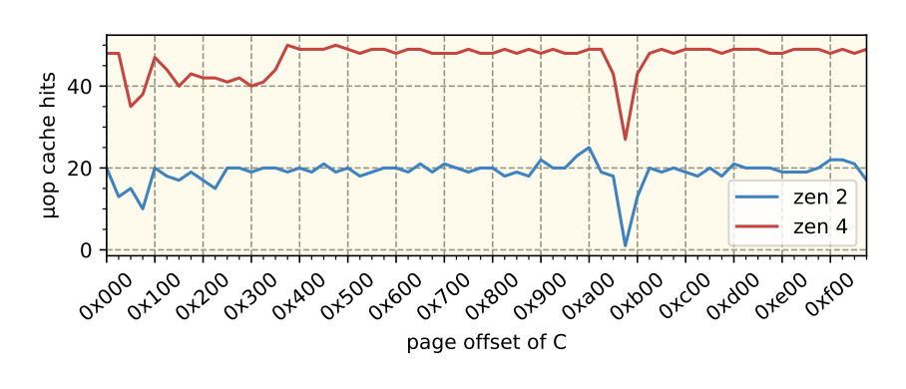
Observing Mispredictions
Instruction Fetch (IF): Measure the I-cache state using a timing side-channel
Not effective for distinguishing instruction fetch from I-cache prefetching
Instruction Decode (ID): Samples performance counters indicating µop-cache use
Less reliable on Intel architectures than on AMD
Execute (EX): Detects execution by using a single memory fetch on a data side channel
Due to shorter speculation windows, resteer is issued before memory operations can be executed
Table 2, Pg. 6

Slide 8
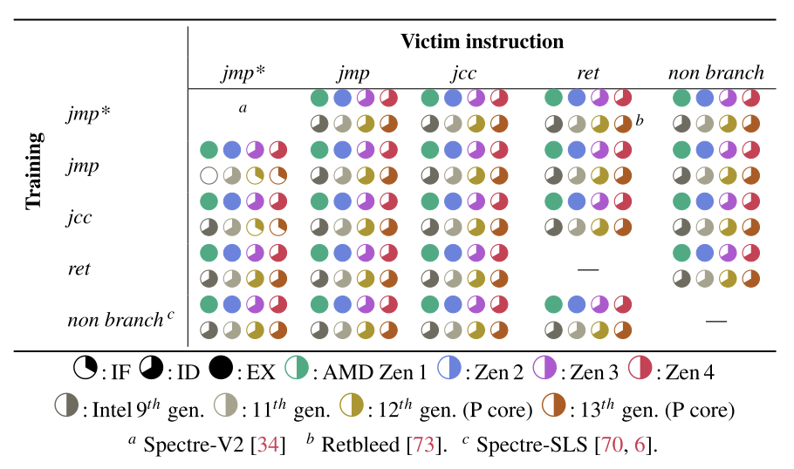
Branch Mispredictions
Study of misprediction causing instruction combinations
How far in the pipeline mispredictions get before a resteer
Almost* no variation in different instruction combinations
Architecture is more important
No explanation for a, b & c variables in the paper
Table 1, Pg. 6

Slide 9
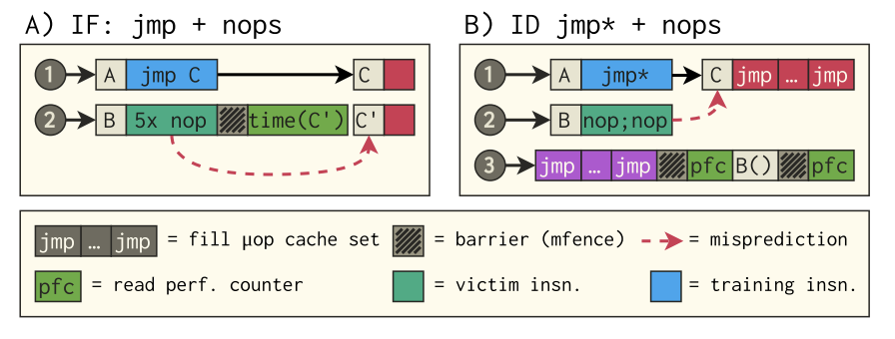
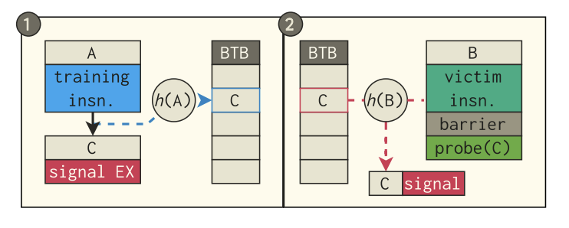
Phantom
Phantom speculation attacks are broken down into three steps:
Train the Branch Table Buffer (BTB) to a target
Execute the victim
Infer whether the target was loaded from memory (can use Prime+Probe)
Intel architectures do not re-use user-inject predictions in kernal mode (eIBRS 9th gen+)
- Exploitations are only performed on AMD architectures
Figure 4, Pg. 5
Figure 5, Pg. 5

Slide 10
Phantom Attack Primitives
Detecting mapped executable memory
Uses the I-cache to detect if a virtual address is mapped and executable
Mapped non-executable memory
Adversary can trigger a data load
Requires a disclosure gadget
Failed fetch leaves I-cache unaffected
Leaking register values
Creates an offset into victim’s address space and loads resulting address
(AMD Zen 1 & 2 only)

Slide 11
Kernel Address Collision
Cross-privilege BTB indexing functions can be manipulated to cause collisions with kernel addresses from user space
Brute forcing a pattern that collides with a user-space address ( < 6 bits )
Random patterns are generated and then collisions are observed using an SMT solver

Slide 12
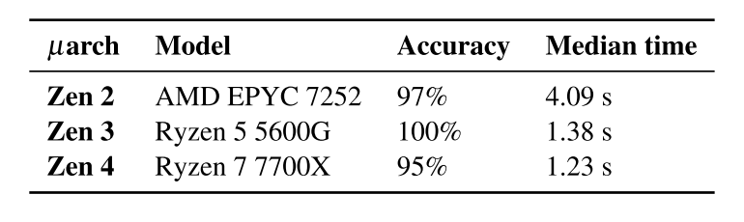
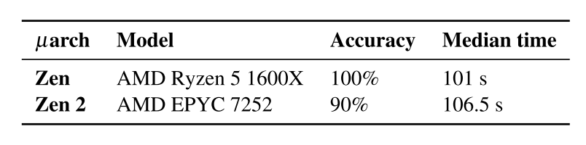
Breaking Physmap KASLR
Injecting a prediction and observing if the branch target was mapped in memory can indicate the correct location of the kernel image
Can be randomly placed in 1 of 488 possible locations
Observe cache signal with Prime+Probe
After finding the kernel image location, the direct mapping of the kernel in physical memory can be de-randomized
physmap is non-executable, requiring the P2 attack primitive
Table 3, Pg. 9
Table 4, Pg. 9

Slide 13
Leaking Kernel Memory
Extending the method for breaking KASLR, it is possible to also leak kernel memory
Find the location of a Flush+Reload buffer in physmap
Create a guess of the physical address of a virtual address in the user program
Pass the pair to a system call and verify if the guess was correct using Flush+Reload
Use a gadget to read and leak data under the guise of kernel privilege

Slide 14
Mitigation
SuppressBPOnNonBranch: (Zen 2)
Bit that, when set, prevents branch prediction from advancing in the pipeline
Incurrs an overhead of 0.69% for multi-core and 0.42% for single core
Not supported in AMD Zen 3+
Does not effectively prevent all cases on any architectures
AutoIBRS: (Zen 4)
Restrict branch predictions based on privilege mode
Still vulnerable to attack primitive 1

Slide 15
Conclusion
Phantom provides methods for evaluating misprediction likelihood and vulnerability to exploitation
Defined how to measure instruction fetch, decode and execution
and
Proved effectiveness of Phantom attacks by breaking KASLR and leaking kernel memory through the use of MDS gadgets

Slide 16
Strengths
Digestible & interesting
Relevant (affects millions of users)
Real-world threat model, victim includes all state-of-the-art Spectre security protocols
Methodology achieves attack goals with high accuracy

Slide 17
Weaknesses
Very little proposed solution – mitigations are infeasible or ineffective
Often repeats filler sentences in paragraphs that otherwise could use more explanation
Did not attempt on Intel architectures, even for comparison
Vague explanation of how attack primitives are performed

Slide 18
Sources
[1] Johannes Wikner, Daniël Trujillo and Kaveh Razavi, Phantom: Exploiting Decoder-detectable Mispredictions, In: 56th Annual IEEE/ACM International Symposium on Microarchitecture (MICRO ‘23), October 28-November 1, 2023.
[2] Paul Kocher, Jann Horn, Anders Fogh, Daniel Genkin, Daniel Gruss, Werner Haas and et. Al, Spectre Attacks: Exploiting Speculative Execution, in: 2019 IEEE Symposium on Security and Privacy (SP), 19-23 May 2019.

