Slide 1
Toleo: Scaling Freshness to Tera-scale Memory using CXL and PIM Written by: Juechu Dong, Jonah Rosenblum and Satish Narayanasamy
Presentation By:
Will Buziak Department of Computer Science Colorado School of Mines
May 9, 2025

Slide 2
Motivation
Trusted Execution Environments support secure memory methods, but often do not employ them due to costly memory overhead:
Merkle tree memory accesses increase with protected memory size
Many enclaves that do provide integrity either only support small amounts of memory, or completely abandon ‘freshness’
No support for large-scale memory storage
Scalable solutions are still open to replay attacks
Goal: Provide security to tera-scale memory storage

Slide 3
Secure Memory Incurs Latency
Monotonically incrementing counters are stored in a merkle tree to prevent replay attacks
Integrity checks trigger otherwise unnecessary memory fetches
Counters are incremented on every write
On a memory fetch, the core must do an additional:
7 memory accesses per read/write for a 128 MB Cache & 8-ary tree
Cache hit rate suffers as the tree grows
TEE
Secure Memory
hash
hash
hash
hash
hash
Main Memory
data
data
data
data
data
Brian Rogers, Siddhartha Chhabra, Yan Solihin, Milos Prvulovic. Using Address Independent Seed Encryption and Bonsai Merkle Trees to Make Secure Processors Os- and Performance-Friendly . (MICRO ‘07)

Slide 4
CXL and Smart Memory
CXL Integrity Data Encryption provides secure connections between trusted components
Ensure confidentiality, integrity and replay protection
Uses non-deterministic AES stream ciphers and MAC checks
Enables low latency and bandwidth overhead
Does not wait for integrity checks before processing data

Slide 5
Trusted Smart Memory
Stacked DRAM sits on a logic layer
Connected by Through-silicon-vias
Can offer up to 168GB of space
Can be utilized to expand trusted computing base
Builds a secure channel between processor and smart memory
16 layers of 32 GB DRAM
Trusted Compute Layer

Slide 6
Trusted Smart Memory
Compute-capable memory
Mitigates side-channels
More expensive
Ensures that any tampering or observation will destroy the functionality of the device
Eliminates need for ‘freshness’
Negates the need for a merkle tree
Not feasible to replace an entire memory rack (up to 28TB)
16 layers of 32 GB DRAM
Trusted Compute Layer

Slide 7
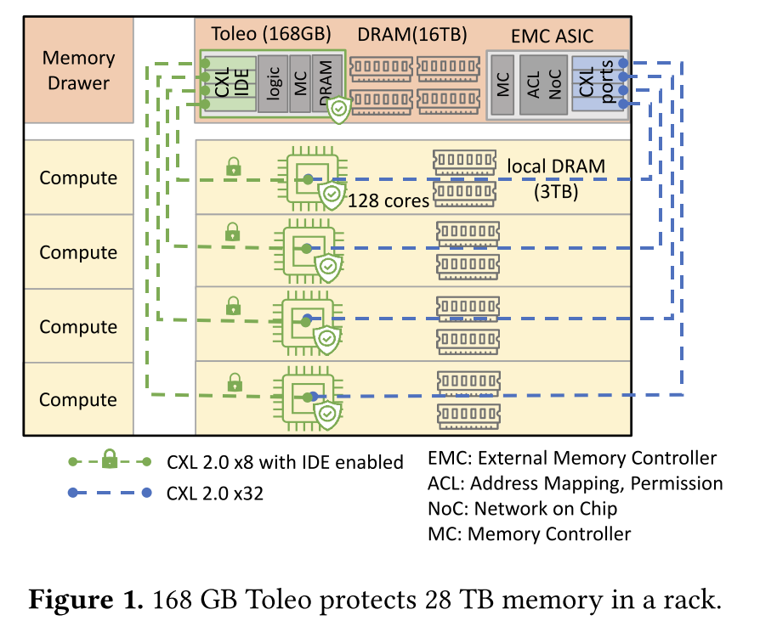
Toleo
To avoid the costs of storing everything in smart memory
Only stores ‘versions’ (counters)
Still utilizes a scheme to increment counters
Negates the need for a merkle tree
Splits the counter between trusted smart memory and conventional memory
Employs a compression format that limits metadata storage while maintaining coverage at scale

Slide 8
Version storage
CXL uses a non-deterministic stream cipher, so identical communication is represented as unique ciphers
Allows for secure transmission of versions to processor
Low latency and bandwidth
Employs a compression format that limits metadata storage while maintaining coverage at scale
Only keeps lower 27-bits (“stealth version”), rest goes to conventional memory
Compresses the stealth version
Stores upper bits, data and MAC tags in conventional memory
Presents stealth version cache
Boasts a 98% hit rate, reducing memory bandwidth and latency

Slide 9
Refresh
Versions are confidential from end-to-end
Replay attacks are reduced to random guessing
Adversaries only have one chance, otherwise the system will enact a “kill-switch”
Toleo initializes versions to a random value between 0 - 2²⁷
If initialized to a known value and increases monotonically, an attacker can infer its value by the addresses
Monotonically increases with rollover
Must be reset before the “lapping” to the initial value
On each counter increment, there is a 1 in 2²⁰ chance for a refresh
Incredibly unlikely to loop back without a reset (1.7 x 10⁻¹⁹)

Slide 10
Refresh
On a reset, the upper version (portion sent to main memory) is incremented
Therefore, even though the “stealth version” may repeat at some point, the combined version will remain unique
Guaranteed to be non-repeating and therefore protected against memory traffic analysis attacks
Additional compression is done to the versions to reduce spatial overhead
Identifies high spatial and temporal locality
Pages with high locality share version numbers
Page granularity (flat, uneven & full)

Slide 11
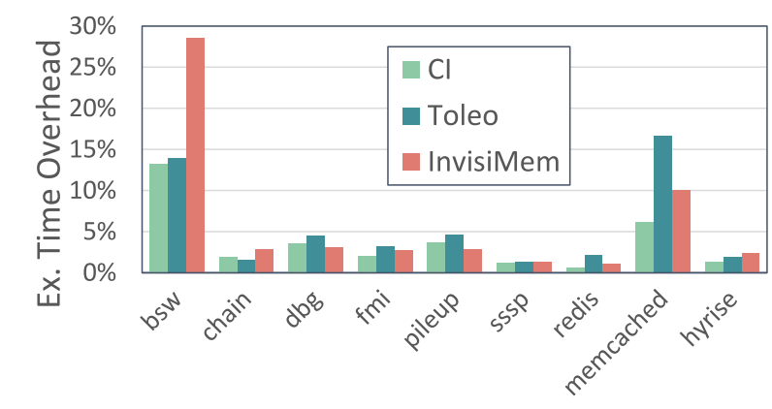
Results
Experimental analysis performed with SniperSim
Integrated DRAM simulator, DRAMSim3
GAPBS, llama2.c, BFS and many more
Modeled four configurations:
No memory protection (baseline)
Confidentiality & Integrity (CI) ~ Scalable SGX
Toleo
InvisiMem

Slide 12
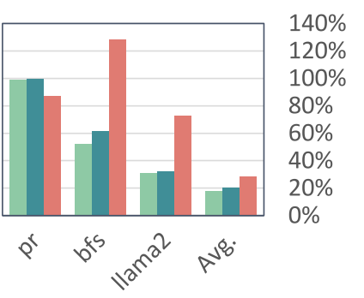
Runtime
Experimental analysis performed with SniperSim
Integrated DRAM simulator, DRAMSim3
GAPBS, llama2.c, BFS and many more
Modeled four configurations:
No memory protection (baseline)
Confidentiality & Integrity (CI) ~ Scalable SGX
Toleo
InvisiMem

Slide 13
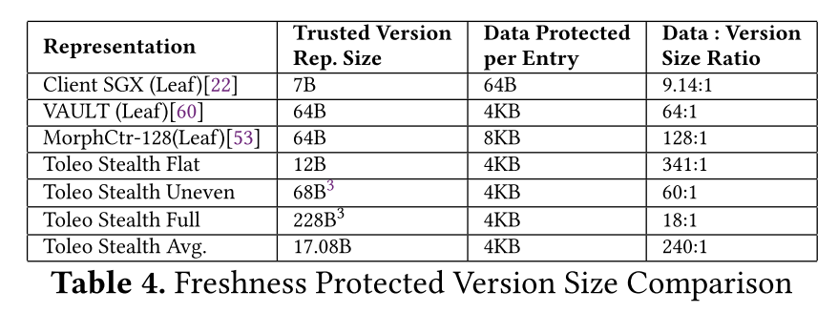
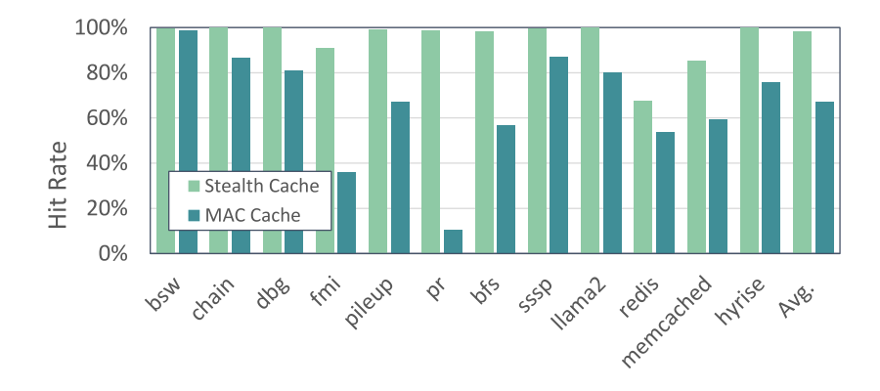
Cache Hit Rate
Toleo protects memory magnitudes larger than SGX with far less bytes
Attributes much of the reduced latency to the version cache
Incredibly high hit rate
Toleo compression strategy allows for most of the protected area to fit in the cache

Slide 14
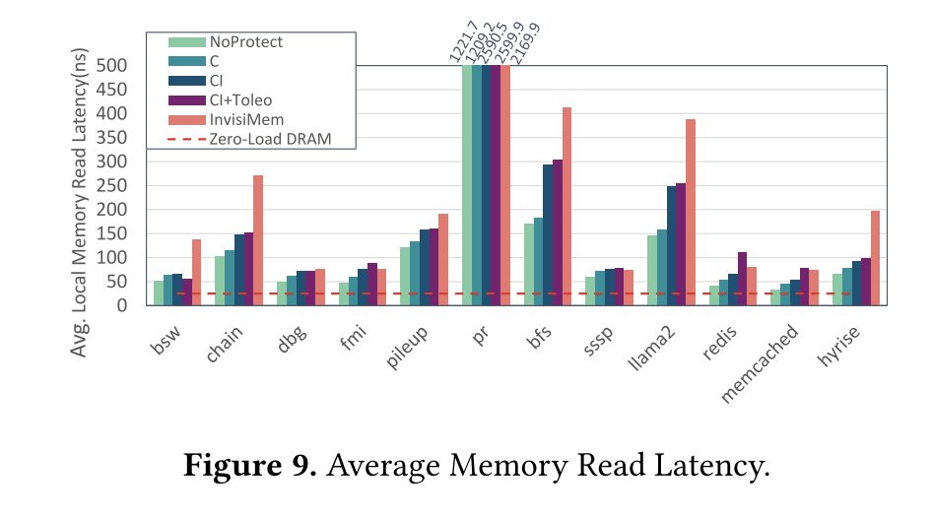
Memory Access Latency
Toleo adds less than 5% overhead
Why is this additional overhead on top of CI?
I thought the whole point was to negate the need for confidentiality & integrity

Slide 15
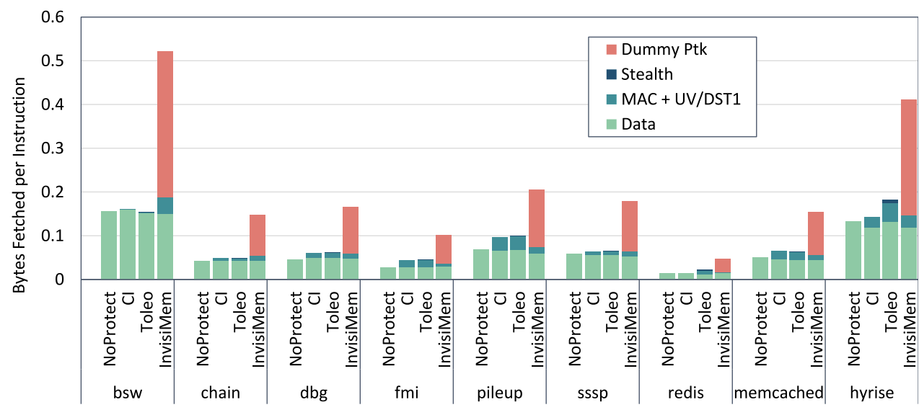
Memory Bandwidth
Toleo adds negligible overhead
Attributes low bandwidth to CXL opposed to DDR
Additional improvements over InvisiMem are due to version cache hits
Dummy packets are used by InvisiMem to maintain constant communication rates

Slide 16
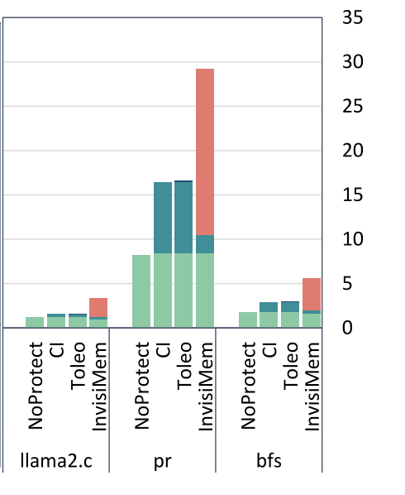
Memory Bandwidth
Toleo adds negligible overhead
Attributes low bandwidth to CXL opposed to DDR
Additional improvements over InvisiMem are due to version cache hits
Dummy packets are used by InvisiMem to maintain constant communication rates

Slide 17
Strengths
Dwarfs competition in size of protected coverage at very little added latency
Version cache has incredibly high hit rate
Enables Large-scale storage without performance hit
Compression strategy allows a much greater area of protected memory

Slide 18
Weaknesses
If an integrity check fails, it triggers a kill-switch that destroys the enclaves and all the sensitive data before shutting down
Little to no explanation as to why version cache has such a high hit rate
Figures are poorly explained (some cases there is no mention of any behavior in the figure)
Might not be any benefit for small-scale application

