Slide 1

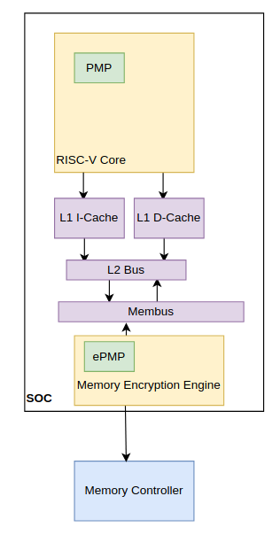
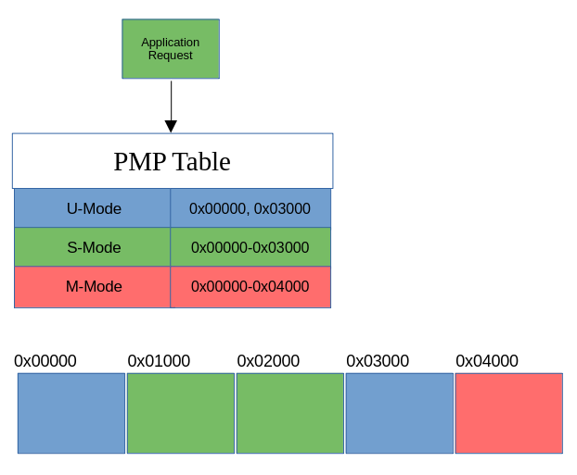
Extending Trusted Execution Environments in Architectural Simulators
Will Buziak Iris Bahar
Department of Computer Science Department of Computer Science
Abstract
Keystone
gem5
Workflow
Trusted Execution Environments (TEEs) provide hardware guarantees that seek to protect the security and isolation of application data.
Many proprietary TEEs exist, each with its own implementation and respective way of providing security.
Open-source TEEs like Keystone grant users the ability to contribute to their standard for security
In order to extend TEEs, developers need to either implement their designs on FPGAs, or turn to architectural simulators.
Lack of effective tools for development and thorough testing on real-world benchmarks make pre-fabrication development difficult.
This work outlines the methods for implementing and evaluating contributions to Keystone within the gem5 architecture simulator.
Enclaves like Keystone provide hardware guarantees that data is safe from a malicious:
Application thread
Operating System
Remote User
Keystone segments memory & defines rules for different threads
Contributions have been proposed to extend the security of Keystone by providing secure memory protocols
gem5 presents architectural design as typical class structures with attributes based on the behavior of the real world component
For example, to properly connect the PMP to the proposed ePMP, it is either necessary to write a new:
- Packet type, bypassing the cache hierarchy
Or
- Port type directly connecting the core(s) to the Memory Encryption Engine
Developers wishing to extend Keystone components can create their own version of the desired component’s class structure, often requiring close attention to:
- Port connections
- Packet handling
In order to further protect state-of-the-art TEEs, Keystone is extended to include secure memory protocols in the gem5 simulation environment
Study Keystone class structures
Potentially Malicious
Application Thread
Operating System
Remote or Cloud User
Keystone
Benchmark
Implement design
Main Memory
Motivation
Insights
Trusted Execution Environments are vulnerable to side-channel & replay attacks
Keystone is a state-of-the-art RISC-V TEE designed for custom modularity, allowing developers to make their own contributions
gem5 allows rapid development and real-world benchmarking and contains Keystone components
Experimentation within gem5 allows a shorter pipeline from design idea to implementation testing, opposed to FPGA or fabrication testing
Keystone components are included, but require configuration by the designer
Extending Keystone in simulation requires some re-configuration of gem5 class structures
For this work, communication between each core and the Memory Encryption Engine requires defining either a new packet type or port
Development in Syscall-Emulation
Full-system Testing
Designs in simulation can be tested on real workloads and state-of-the-art or custom benchmarks.
Real Benchmarks
Tailored Benchmarks
Challenges
Simulation
Fabrication
FPGA
User
(U-Mode)
Untrusted
Enclave 1
Enclave 2
App
App
Enclave App 1 (Eapp)
Eapp 2
Fabrication
Supervisor
(S-Mode)
Operating System
(OS)
Runtime (RT) 1
RT 2
Development Time
FPGA
Machine
(M-Mode)
Security Monitor
Trusted Hardware
RISC-V Cores
Optional H/W Features
Root of Trust
Simulation
Tools for Extension

