Slide 1
Secure Extensions for RISC-V Trusted Execution Environments
Presentation By:
Will Buziak Department of Computer Science Colorado School of Mines
May 9, 2025

Slide 2
Motivation
Trusted Execution Environments support secure memory methods, but often do not employ them due to costly memory overhead:
Merkle tree memory accesses increase with protected memory size’
Many enclaves that do provide integrity either only support small amounts of memory, or completely abandon ‘freshness’
No support for large-scale memory storage
Open to replay attacks
Goal: Provide security to tera-scale memory storage

Slide 3
Secure Memory Incurs Latency
Monotonically incrementing counters are stored in a merkle tree to prevent replay attacks
Integrity checks trigger otherwise unnecessary memory fetches
Counters are incremented on every write
On a memory fetch, the core must do an additional:
7 memory accesses per read/write for a 128 MB Cache & 8-ary tree
Cache hit rate suffers as the tree grows
TEE
Secure Memory
hash
hash
hash
hash
hash
Main Memory
data
data
data
data
data
Chenyu Yan, Brian Rogers, Daniel Englender, et al. (2006) Improving Cost, Performance, and Security of Memory Encryption and Authentication. (ISCA’06)

Slide 4
CXL and Smart Memory
CXL Integrity Data Encryption provides secure connections between trusted components
Ensure confidentiality, integrity and replay protection
Uses non-deterministic AES stream ciphers and MAC checks
Enables low latency and bandwidth overhead
Does not wait for integrity checks before processing data

Slide 5
Trusted Smart Memory
Stacked DRAM sits on a logic layer
Connected by Through-silicon-vias
Can offer up to 168GB of space
Can be utilized to expand trusted computing base
Builds a secure channel between processor and smart memory
Eliminates need for ‘freshness’
16 layers of 32 GB DRAM
Trusted Compute Layer

Slide 6
Trusted Smart Memory
Compute-capable memory
Mitigates side-channels
More expensive
Ensures that any tampering or observation will destroy the functionality of the device
Negates the need for a merkle tree
Not feasible to replace an entire memory rack (up to 28TB)
16 layers of 32 GB DRAM
Trusted Compute Layer

Slide 7
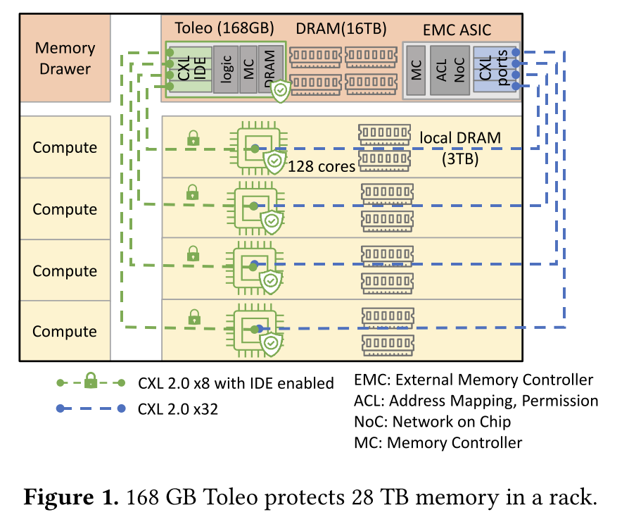
Toleo
To avoid the costs of storing everything in smart memory
Only stores ‘versions’ (counters)
Still utilizes a scheme to increment counters
Negates the need for a merkle tree
Employs a compression format that limits metadata storage while maintaining coverage at scale
Kept in smart memory
Stores data and MAC tags in conventional memory

Slide 8
Version storage
CXL uses a non-deterministic stream cipher, so identical communication is represented as unique ciphers
Allows for secure transmission of versions to processor
Low latency and bandwidth
Employs a compression format that limits metadata storage while maintaining coverage at scale
Only keeps lower 27-bits (“stealth version”), rest goes to conventional memory
Compresses the stealth version
Presents stealth version cache
Boasts a 98% hit rate, reducing memory bandwidth and latency

Slide 9
Refresh
Versions are confidential from end-to-end
Replay attacks are reduced to random guessing
Adversaries only have one chance, otherwise the system will enact a “kill-switch”
Toleo initializes versions to a random value between 0 - 2²⁷
If initialized to a known value and increases monotonically, an attacker can infer its value by the addresses
Monotonically increases with rollover
Must be reset before the “lapping” to the initial value
On each counter increment, there is a 1 in 2²⁰ chance for a refresh
Incredibly unlikely to loop back without a reset (1.7 x 10⁻¹⁹)

Slide 10
Refresh
On a reset, the upper version (portion sent to main memory) is incremented
Therefore, even though the “stealth version” may repeat at some point, the combined version will remain unique
Guaranteed to be non-repeating and therefore protected against memory traffic analysis attacks

Slide 11
Strengths
Dwarfs competition in protected coverage at very little added latency
Employs a compression format that limits metadata storage while maintaining coverage at scale
Stores data and MAC tags in conventional memory

Slide 12
Weaknesses
If an integrity check fails, it triggers a kill-switch that destroys the enclaves and all the sensitive data before shutting down

